Slide 1
AQA A Level Biology
25 - Cardiovascular Disease
Atheromas, Heart Attacks and Risk Factors

Slide 2
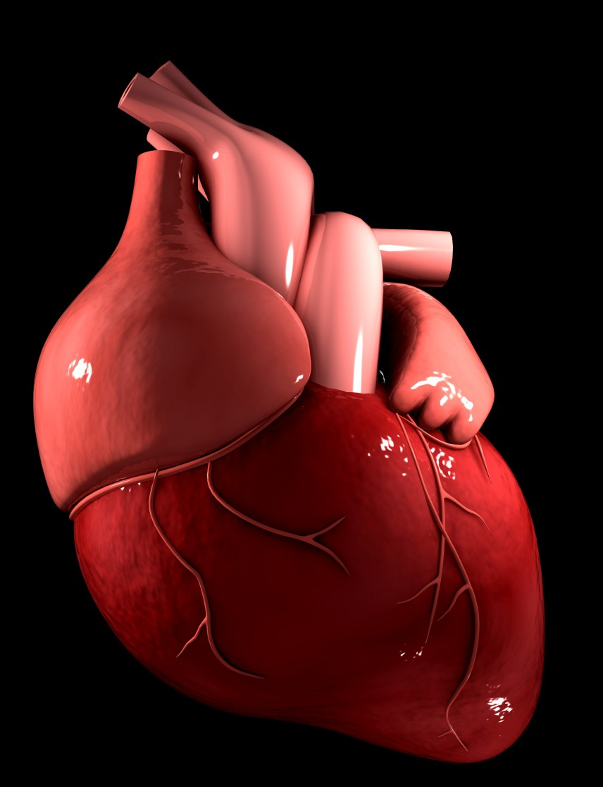
Cardiovascular Disease
Specification Point 3.3.4.1 - Mass transport in animals.
Cardiovascular disease is any affliction associated with the heart or blood vessels.
  Aneurysms, thrombosis and myocardial infarctions (heart attacks) are all examples of cardiovascular disease.
Coronary heart disease (CHD) is a type of cardiovascular disease.
  CHD occurs when atheromas build up in the coronary arteries.
  This restricts blood flow to the heart.
  When blood flow is severely restricted, this can lead to a myocardial infarction.
CHD is a disease that affects the heart.

Slide 3
CHD can restrict flow to heart tissue, starving it of oxygen.
This can lead to a myocardial infarction, more commonly referred to as a heart attack.

Slide 4
Atheroma Formation
Artery walls have several layers to them.
  The inner lining of the artery is called the endothelium.
In healthy arteries, the endothelium is smooth and unbroken.
High blood pressure can cause damage to the endothelium.
  This damage attracts white blood cells and lipids from the blood.
  These clump together to form fatty streaks.
Over time, white blood cells, other lipids and connective tissue build up in the wall of the artery.
  These harden to form a fibrous plaque.
  This is called an atheroma.
The atheroma restricts blood flow to the heart tissue.
  This causes blood pressure to increase further.

Slide 5
White blood cells and cholesterol (LDLs) combine in arteries to form fatty streaks. These then harden to form an atheroma.
FATTY STREAK
LDL
WHITE BLOOD CELL

Slide 6
Aneurysms
Aneurysms occur when the wall of the artery swells.
  Aneurysms begin with the formation of an atheroma.
The plaque in the atheroma causes the wall of the artery to weaken.
  The plaque also causes arteries to narrow.
    This increases blood pressure.
Blood travelling at high pressure through an artery can push the inner layers through the outer, elastic layer.
  This leads to a balloon-like structure called an aneurysm.
Aneurysms may rupture, leading to internal bleeding.
  This is sometimes referred to as a haemorrhage.

Slide 7
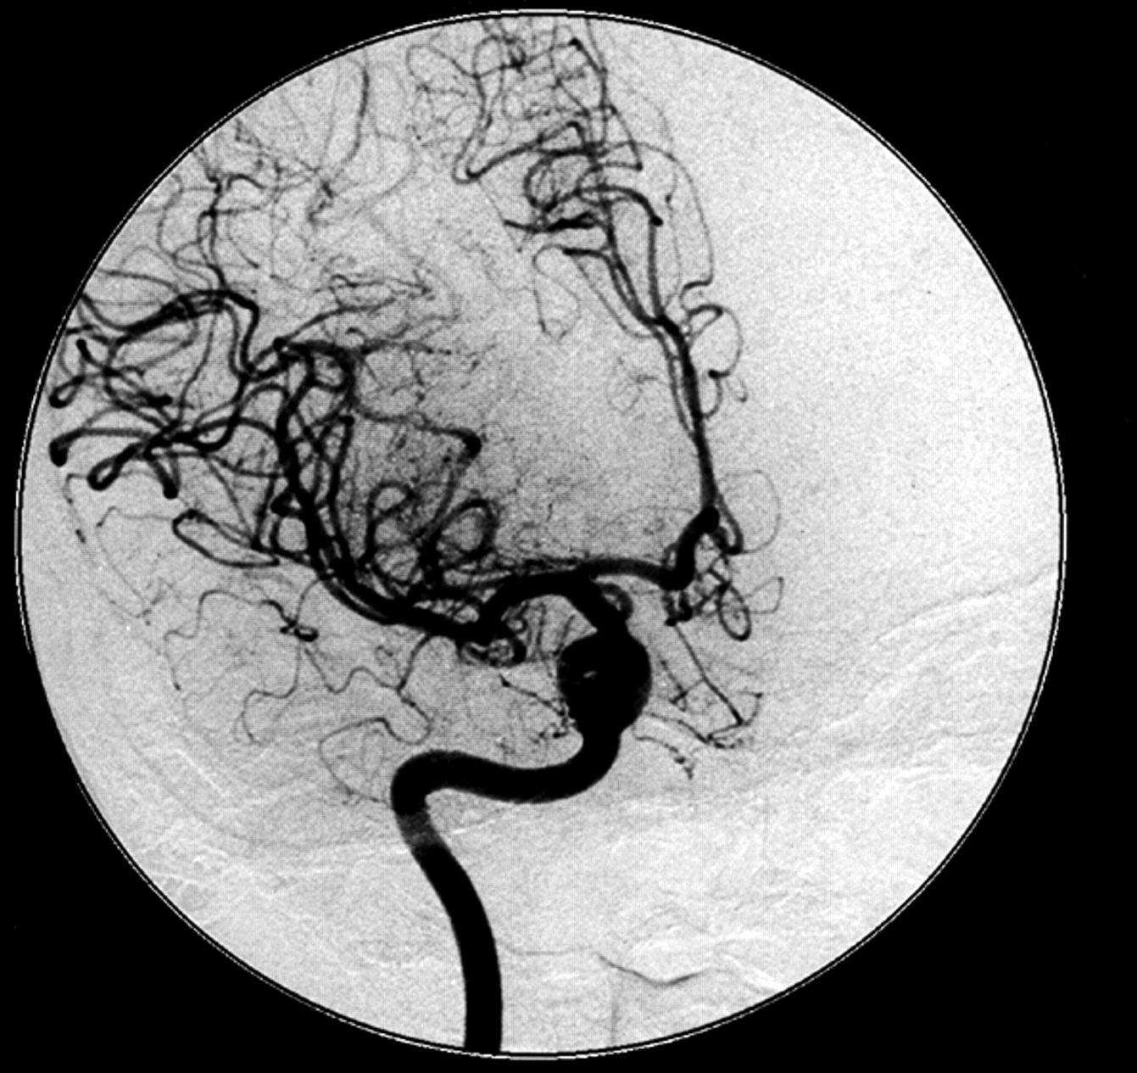
Aneurysms are balloon-like swellings in the walls of arteries. Aneurysms can burst, leading to internal bleeding.

Slide 8
Thrombosis
A thrombosis is the formation of a blood clot.
  Thromboses also begin with the formation of atheromas.
The atheroma plaque can rupture the endothelium of an artery.
  The causes damage to the arterial wall, leaving a damaged, rough surface.
Platelets and fibrin travel to the damaged area, forming a blood clot.
  Fibrin is a structural protein.
  A blood clot is also referred to as a thrombus.
The thrombus can block the artery.
  This can reduce the blood flow to the heart.
The thrombus can also become dislodged and block another artery in a different part of the body.
  A thrombus can lodge in the brain, leading to a stroke.

Slide 9
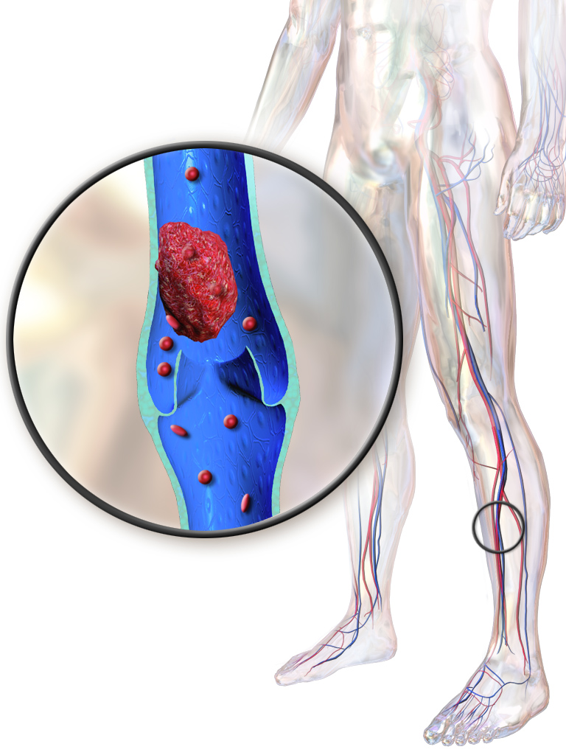
Blood clots can become lodged in the extremities like the legs and feet, leading to a condition known as deep vein thrombosis (DVT).

Slide 10
Heart Attacks
A heart attack is called a myocardial infarction.
A myocardial infarction occurs when the heart muscle does not receive sufficient oxygen (O₂):
  The coronary arteries supply the heart with blood.
  If a coronary artery is completely blocked, the heart muscle will receive no blood.
  A lack of O₂ means that the heart muscle cannot respire aerobically.
  This will cause the heart muscle to die.
There are notable symptoms when a heart attack occurs:
  Pain in the chest and upper body.
  Shortness of breath.
  Excessive sweating.
If large areas of the heart tissue are affected, complete heart failure may occur.

Slide 11
Symptoms of a heart attack include:
1. Chest pain.
2. Pain in the left arm.
3. Feeling lightheaded or dizzy.
4. Sweating.
5. Shortness of breath.
6. Nausea.

Slide 12
Risk Factors for CHD
There are many factors that can increase the risk of developing CHD.
  These are referred to as risk factors.
The risk of CHD can be increased by having high blood pressure.
  High blood pressure can increase the likelihood of atheromas and blood clots. These increase the risk of a heart attack.
  Being overweight, not exercising and drinking lots of alcohol all increase blood pressure.
The risk of CHD can be increased by having high blood cholesterol and a poor diet.
  A diet high in cholesterol and saturated fats increases the likelihood of atheromas.
  A diet high in salt increases the risk of high blood pressure.
Stress can also increase the risk of CHD.
  Stress is known to increase blood pressure.

Slide 13

A diet high in cholesterol and saturated fats has been strongly linked to CHD.

Slide 14
Risk Factors for CHD
The risk of CHD can be increased by smoking cigarettes.
  Carbon monoxide (CO) and nicotine are both present in cigarettes.
  Both of these compounds increase the likelihood of a heart attack.
CO will bind permanently with haemoglobin.
    This reduces the ability of haemoglobin to carry O₂.
    A lack of enough O₂ to heart tissue can lead to a heart attack.
Smoking reduces the amount of antioxidants in the blood.
  Antioxidants help to prevent the cells from damage.
  A lack of antioxidants increases the risk of damage to the artery walls.
  This increases the risk of an atheroma forming.

Slide 15

There is an overwhelmingly strong positive correlation between the number of cigarettes smoked by an individual each year and their mortality rate from CHD.
CIGARETTE CONSUMPTION PER YEAR →
300
200
DEATHS FROM CHD PER 100,000 →
100
0
1,500
2,000
2,500
3,000
3,500
4,000

Slide 16
Reducing the Risk of CHD
Many risk factors are within our control.
  A person can choose not to smoke, drink excess alcohol or eat a diet high in saturated fat.
Other risk factors cannot be controlled.
  Some people are genetically predisposed to CHD.
  Others may have a condition linked to CHD (such as high blood pressure) from another health condition, such as diabetes.
The risk of developing CHD can be reduced by controlling as many risk factors as possible.
Sometimes studies produce conflicting results on the risk of CHD.
  This may be due to the sample size of the study.
  It may also be due to the research methods involved.

