Slide 1
AQA A Level Biology
24 - The Circulatory System
Vessels, the Heart and the Cardiac Cycle

Slide 2
The Circulatory System
Specification Point 3.3.4.1 - Mass transport in animals.
Mammals have a dedicated mass transport system to transport materials around the body.
  Mammals require this due to their low surface area to volume ratio.
  This is referred to as the circulatory system.
The circulatory system consists of the heart and associated blood vessels.
  Arteries, arterioles, veins and capillaries are all examples of blood vessels.
Most mammals have a dedicated double-circuit mass transport system.

Slide 3
Vessel | Origin | Destination
Pulmonary artery | Heart | Lungs
Pulmonary vein | Lungs | Heart
Aorta | Heart | Body
Vena cava | Body | Heart
Renal artery | Body | Kidneys
Renal vein | Kidneys | Vena Cava

Slide 4
The Route of Blood
Various substances are transported in the blood:
  Respiratory gases, like oxygen (O₂) and carbon dioxide (CO₂).
  The products of digestion, such as glucose and amino acids.
  Metabolic waste, such as urea.
  Hormones, such as adrenaline and insulin.
Mammalian circulatory systems are double circuits.
  The pulmonary circuit carries blood from the heart to the lungs and then back to the heart.
  The systemic circuit carries blood around the rest of the body.
The heart has its own blood supply.
  The left and right coronary arteries supply the heart with blood.

Slide 5
Arteries and Arterioles
There are a number of different blood vessels in the body.
  Arteries, arterioles and veins are all examples of blood vessels.
Arteries carry blood away from the heart.
  Arteries have thick elastic walls that recoil when the heart beats.
    This helps to maintain high pressure.
  They have a folded endothelium, which allows the artery to stretch.
Arteries mostly carry oxygenated blood around the body.
  The pulmonary artery carries deoxygenated blood from the heart to the lungs.
Arteries branch into smaller vessels called arterioles.
  Arterioles form a network of vessels around the body.
  Arterioles can constrict or dilate depending on the body’s demand for blood.

Slide 6
FOLDED ENDOTHELIUM
NARROW
LUMEN
THICK LAYER OF MUSCLE
The structure of an artery.
Arteries carry blood away from the heart.
Arteries have thick, muscular walls to tolerate high pressures, as well as a narrow lumen.
ARTERIOLES

Slide 7
Veins
Veins carry blood towards the heart.
  Veins function at a lower pressure than arteries.
  Veins have a wider lumen than arteries.
  They have very little elastic tissue.
Veins contain valves.
  Valves prevent blood from flowing backwards.
Muscles in the body contract to aid blood flow in veins.
Veins mostly carry deoxygenated blood around the body.
  The pulmonary vein carries oxygenated blood from the lungs to the heart.

Slide 8
VALVE
WIDE
LUMEN
THIN LAYER OF MUSCLE
The structure of a vein.
Veins carry blood towards the heart.
Veins do not contain much muscle but have much wider lumens than arteries, as well as valves to prevent the backflow of blood.
VENULES

Slide 9
Capillaries
Arterioles branch into capillaries.
  Capillaries are the smallest blood vessel.
  The walls of capillaries are only one cell thick.
Compounds are exchanged at blood vessels.
  Glucose and O₂ diffuse into cells from capillaries.
There are a huge number of capillaries.
  This increases the surface area for gas exchange.
  Capillary networks that are located in tissues are called capillary beds.
The capillary endothelium is only wide enough for a single red blood cell to squeeze through at a time.

Slide 10
Tissue Fluid
Tissue fluid surrounds cells in tissues.
  Tissue fluid is made from the molecules that leave the blood plasma.
    O₂, water and digested nutrients enter the tissue fluid.
    Red blood cells and larger proteins remain in the bloodstream.
O₂ and nutrients are removed from the tissue fluid by cells.
  Metabolic waste like urea is released into the tissue fluid.
Exchange of materials occurs at capillary beds.

Slide 11
BLOOD FLOW
ARTERIOLE END
High hydrostatic pressure at the arteriole end forces fluid out of the blood into the surrounding tissues.
Some water returns at the venule end due to the differences in water potential. Excess tissue fluid will drain into the lymphatic system.
HYDROSTATIC
PRESSURE
ONCOTIC
PRESSURE
CAPILLARY
VENOUS END

Slide 12
The Heart
The heart is a muscular organ that pumps blood around the body.
  It consists of 4 chambers:
    The left and right atria are found at the top of the heart.
    The left and right ventricles are found at the bottom of the heart.
The heart is adapted for its function:
  The ventricles are thicker than the atria.
    This is because they have to pump blood to the body whereas the atria only have to pump blood to the ventricles.
  The left ventricle has a thick wall of muscle.
    This allows it to contract powerfully to pump blood around the body.
  The heart has valves to prevent the backflow of blood.
    The atrioventricular (AV) valves link the atria to the ventricles.
    The semi-lunar (SL) valves link the ventricles to the pulmonary artery and the aorta.

Slide 13
Number | Name
1 | Vena Cava
2 | Right Atrium
3 | Right Ventricle
4 | Left Atrium
5 | Left Ventricle
6 | Pulmonary Artery
7 | Pulmonary Vein
8 | Aorta
9 | Atrioventricular (AV) Valves
10 | Semi-lunar (SL) Valves
11 | Valve Tendons
8
6
1
7
4
2
9
10
10
11
5
9
11
3

Slide 14
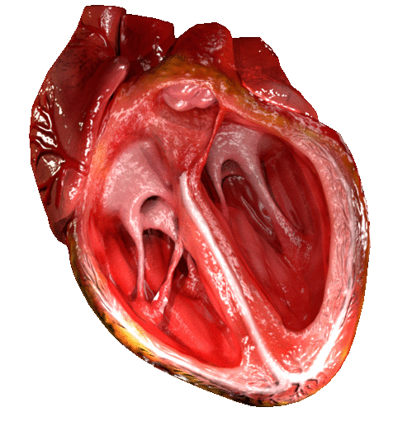
The Role of Valves
Valves only open in 1 direction.
  Whether or not the valve is open depends on the pressure of the heart chambers.
If the pressure is higher behind a valve, it is forced open.
If the pressure is higher in front of a valve, it is closed shut.
This ensures that the flow of blood is unidirectional.
  Using this mechanism ensures blood does not flow the wrong way around the heart.
Valves open or close depending on the pressure in chambers.

Slide 15
Dissecting a Heart
Practical 5: Dissection of animal or plant gas exchange system or mass transport system or of organs within such a system.
As part of the AQA A Level syllabus, students are expected to carry out at least 1 dissection.
There are several ethical issues to consider:
  Some argue it is morally wrong to kill animals for the purpose of dissection.
  However, many dissections that are carried out in schools involve animals that have already been killed for meat.
  If animals are raised in school settings for dissection (insects or fish for example), it is important they are raised in a humane way.
Dissection video.

Slide 16
The Cardiac Cycle
The cardiac cycle is the sequence of contraction and relaxation in the heart.
  It is how blood is continually circulated in the body.
  The cardiac cycle can be described in 3 stages.
Atrial systole:
  During atrial systole, the ventricles are relaxed. The atria contract, increasing the pressure in the atrial chambers.
  The AV valves open and blood is forced into the ventricles.
  As the ventricles receive this blood, their pressure increases slightly.
Ventricular systole:
  The atria now relax and the ventricles contract. This increases the pressure of the ventricular chambers.
  The pressure in the ventricles is higher than the pressure in the atria, so the AV valves close.
  The pressure in the ventricles opens the SL valves and blood is forced out of the pulmonary artery and the aorta.
Diastole:
  Both the atria and ventricles relax. The SL valves close due to the higher pressure in the vessels. Blood returns to the heart and the atria begin to fill with blood again. This increases the pressure of the atria slightly.
  The higher pressure in the atria forces the AV valves open and some blood flows passively from atria to ventricles.

Slide 17
ATRIAL SYSTOLE
THE ATRIA CONTRACT, FORCING BLOOD INTO THE VENTRICLES
The cardiac cycle can be broken down into 3 clear stages:
1. Atrial systole.
2. Ventricular systole.
3. Diastole.
VENTRICULAR SYSTOLE
THE VENTRICLES CONTRACT, FORCING BLOOD THROUGH THE PULMONARY ARTERY AND THE AORTA
DIASTOLE
THE ATRIA AND VENTRICLES BOTH RELAX, BLOOD RETURNS TO THE ATRIA, SOME BLOOD PASSIVELY FLOWS INTO THE VENTRICLES

Slide 18
There are a variety of ways to measure the activity of the heart.

Slide 19
Cardiac Output
2 of the main measures of cardiac activity are heart rate and stroke volume.
  The heart rate is the number of times the heart beats in 1 minute (bpm).
  The stroke volume is the average volume of blood pumped during each heartbeat (cm³).
Heart rate and stroke volume can be combined to calculate cardiac output.
  Cardiac output is the total volume of blood pumped by the heart in 1 minute (cm³ min⁻¹).
CO = cardiac output (cm³ min⁻¹)
HR = heart rate (bpm)
SV = stroke volume (cm³)

Slide 20
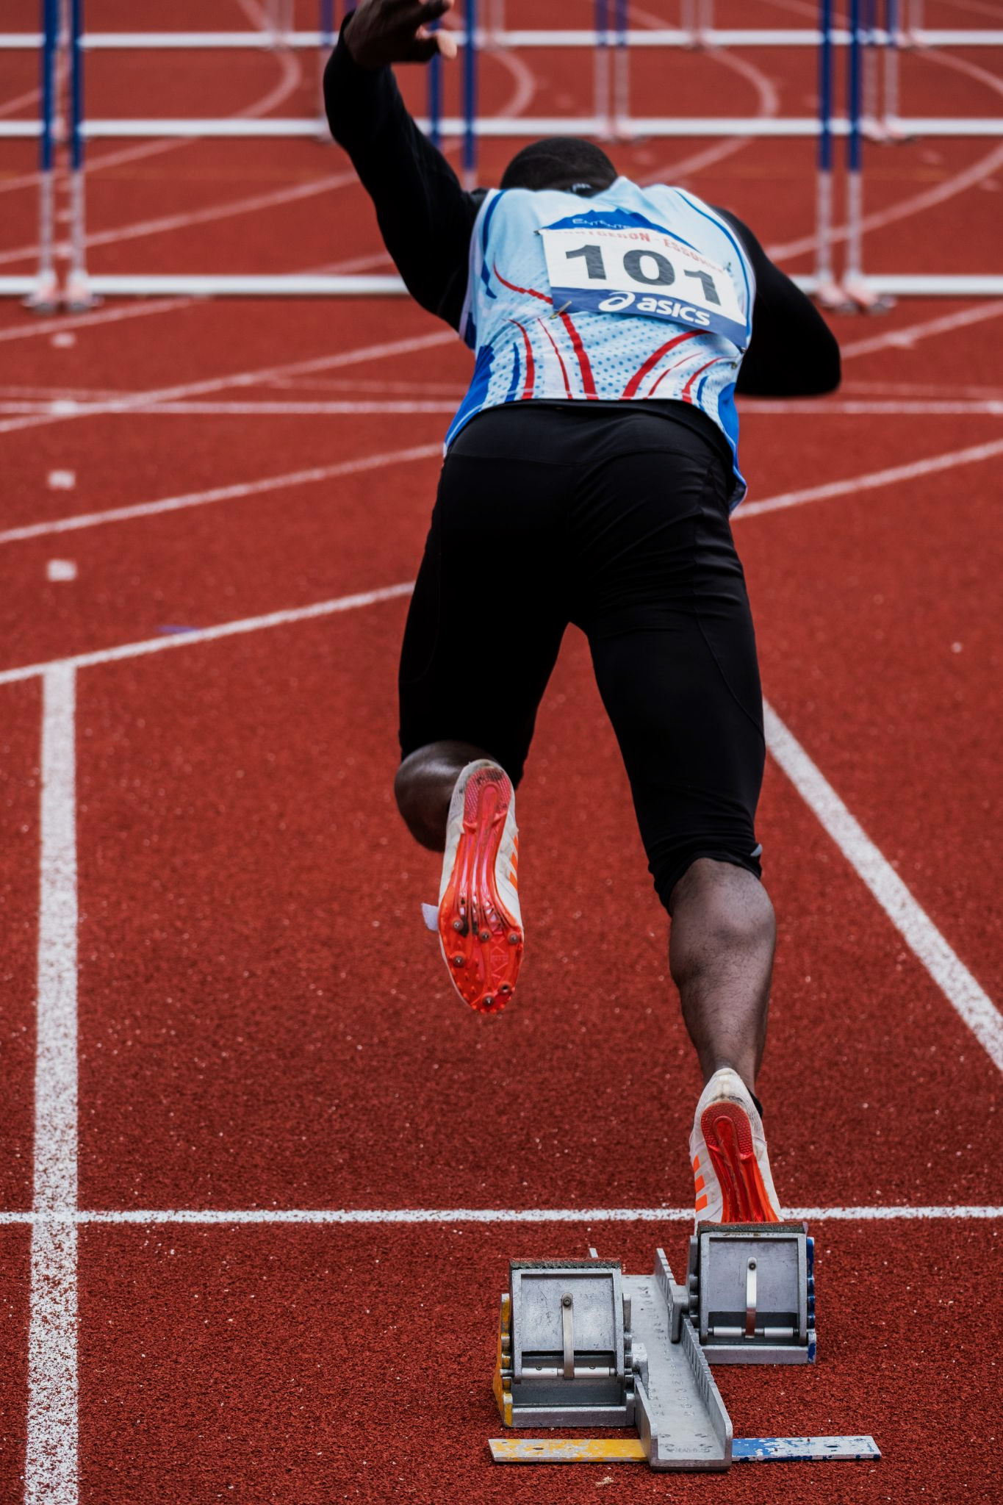
Those who regularly practice exercise are likely to have hearts with a high cardiac output.
Consider an athlete with a heart rate of 150 bpm and a stroke volume of 100 cm³.
This athlete therefore has a cardiac output of 15,000 cm³ min⁻¹.

