Slide 1
AQA A Level Biology
23 - Haemoglobin
Association with Oxygen and the Bohr Effect

Slide 2
Haemoglobin
Specification Point 3.3.4.1 - Mass transport in animals.
Complex multicellular organisms use mass transport systems to transport substances across large distances.
  The circulatory system in animals is an example of a mass transport system.
  Mass transport systems ensure that molecules are exchanged as efficiently as possible.
Haemoglobin helps to transport oxygen (O₂) around the body.
  Most organisms contain molecules similar to haemoglobin.
  All of these molecules carry out the same function.
Haemoglobin is a protein that transports O₂ around the body. Haemoglobin in stored inside red blood cells.

Slide 3
Haemoglobin is a complex protein consisting of 4 distinct chains. The iron (Fe²⁺) ion in the centre gives haemoglobin its characteristic red colour.
Each haemoglobin is able to carry 4 molecules of O₂.

Slide 4
Haemoglobin and Oxyhaemoglobin
Haemoglobin (Hb) joins with O₂ in the lungs to form oxyhaemoglobin (HbO₈).
  This reaction is reversible (⇌).
  O₂ is released from haemoglobin near to body cells.
  The O₂ is then used by these cells for aerobic respiration.
When an O₂ molecule joins with haemoglobin, it is called association.
When an O₂ molecule is released from haemoglobin, it is called dissociation.
Each haemoglobin molecule can associate with up to 4 molecules of O₂.
Hb + 4O₂ ⇌ HbO₈

Slide 5
Affinity for Oxygen
Haemoglobin has an affinity for O₂.
  This means that it has a natural tendency to bind with O₂.
The strength of this affinity depends on the partial pressure of O₂ (pO₂).
  The pO₂ is a measure of O₂ concentration.
  The higher the concentration of O₂, the higher the pO₂.
As the pO₂ increases, so does haemoglobin’s affinity for O₂.
  At a high partial pressure (in the lungs), O₂ will readily associate with haemoglobin.
  At a low partial pressures (in the respiring tissues), O₂ will readily dissociate with haemoglobin.
HAEMOGLOBIN AFFINITY INCREASES WITH O₂ PARTIAL PRESSURE
AFFINITY FOR O₂ →
O₂ PARTIAL PRESSURE →

Slide 6
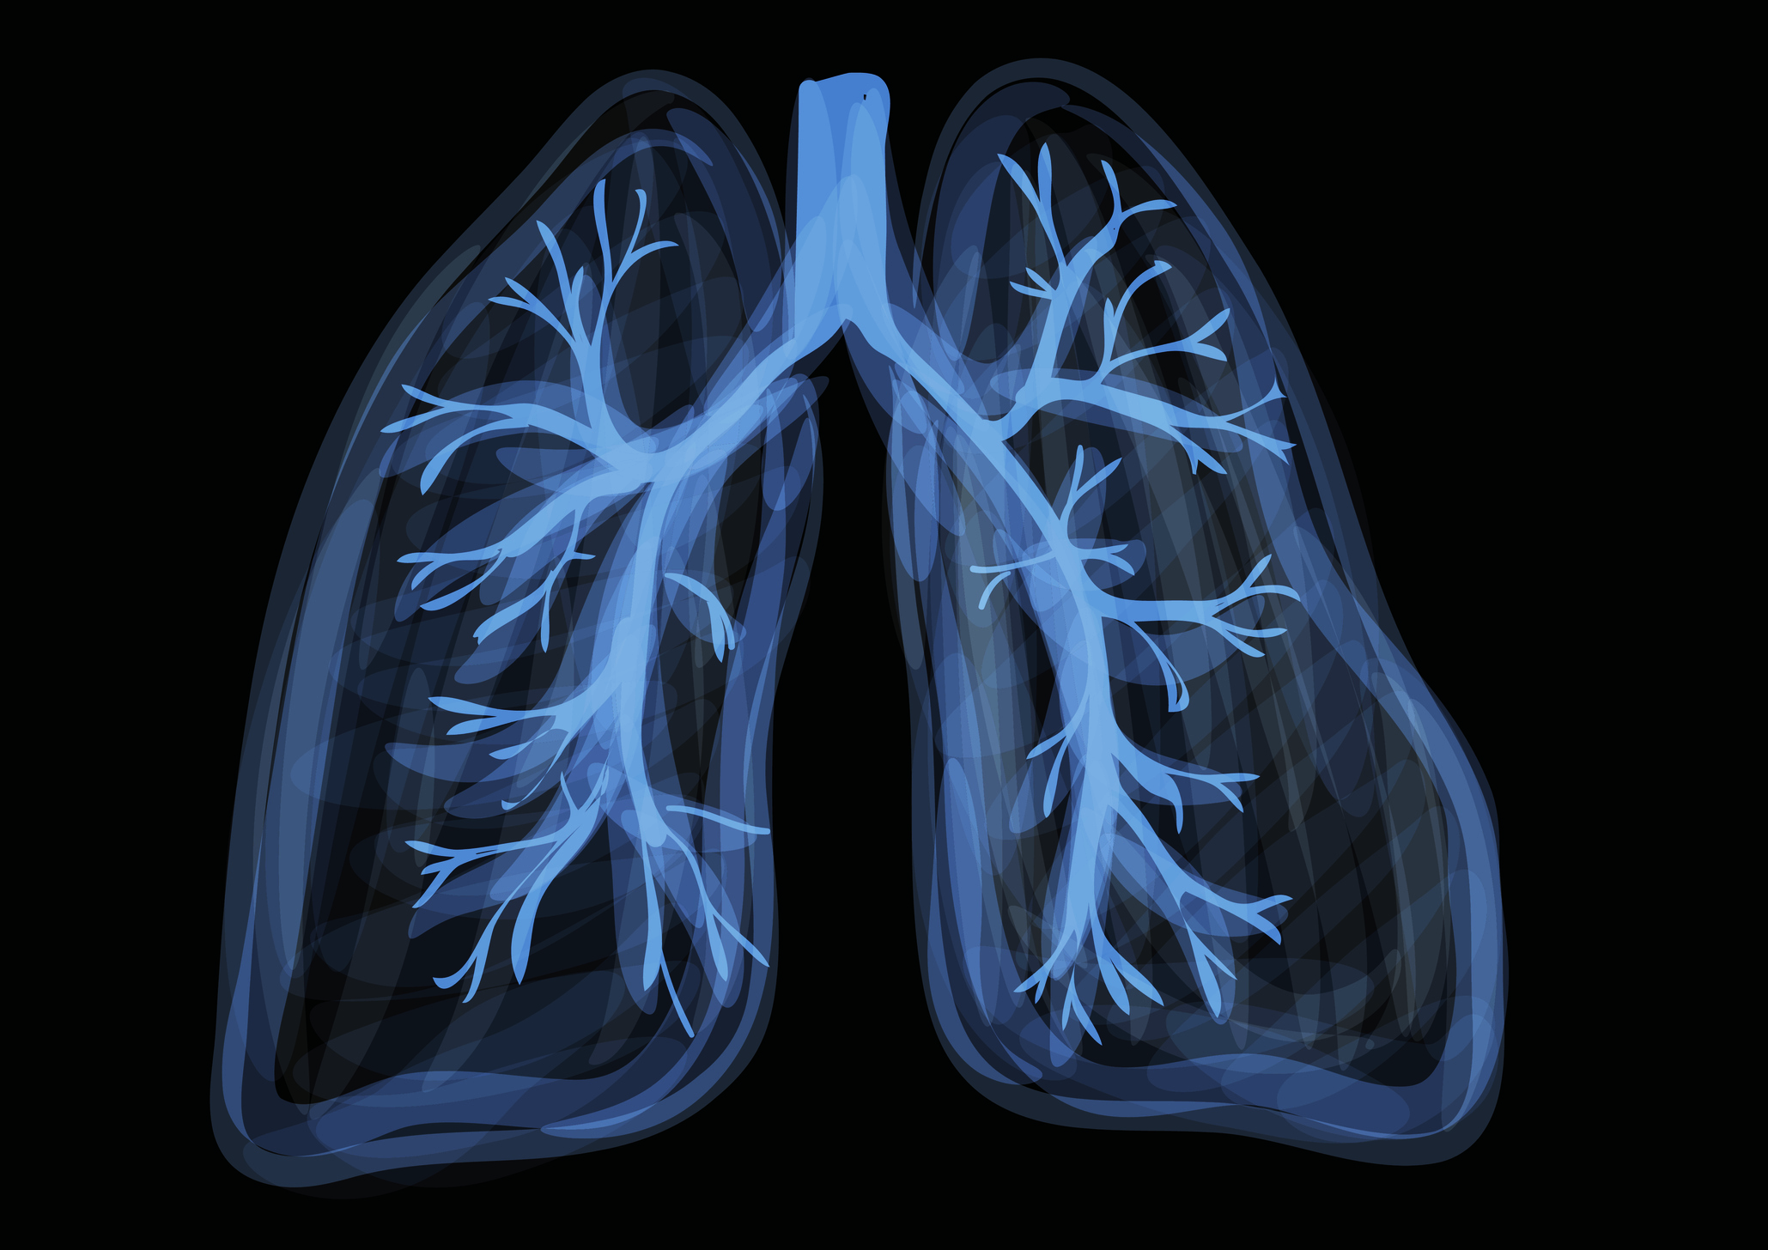
Haemoglobin has a high affinity for O₂ at the lungs, where pO₂ is high.
Oxyhaemoglobin is readily formed in the lungs.

Slide 7
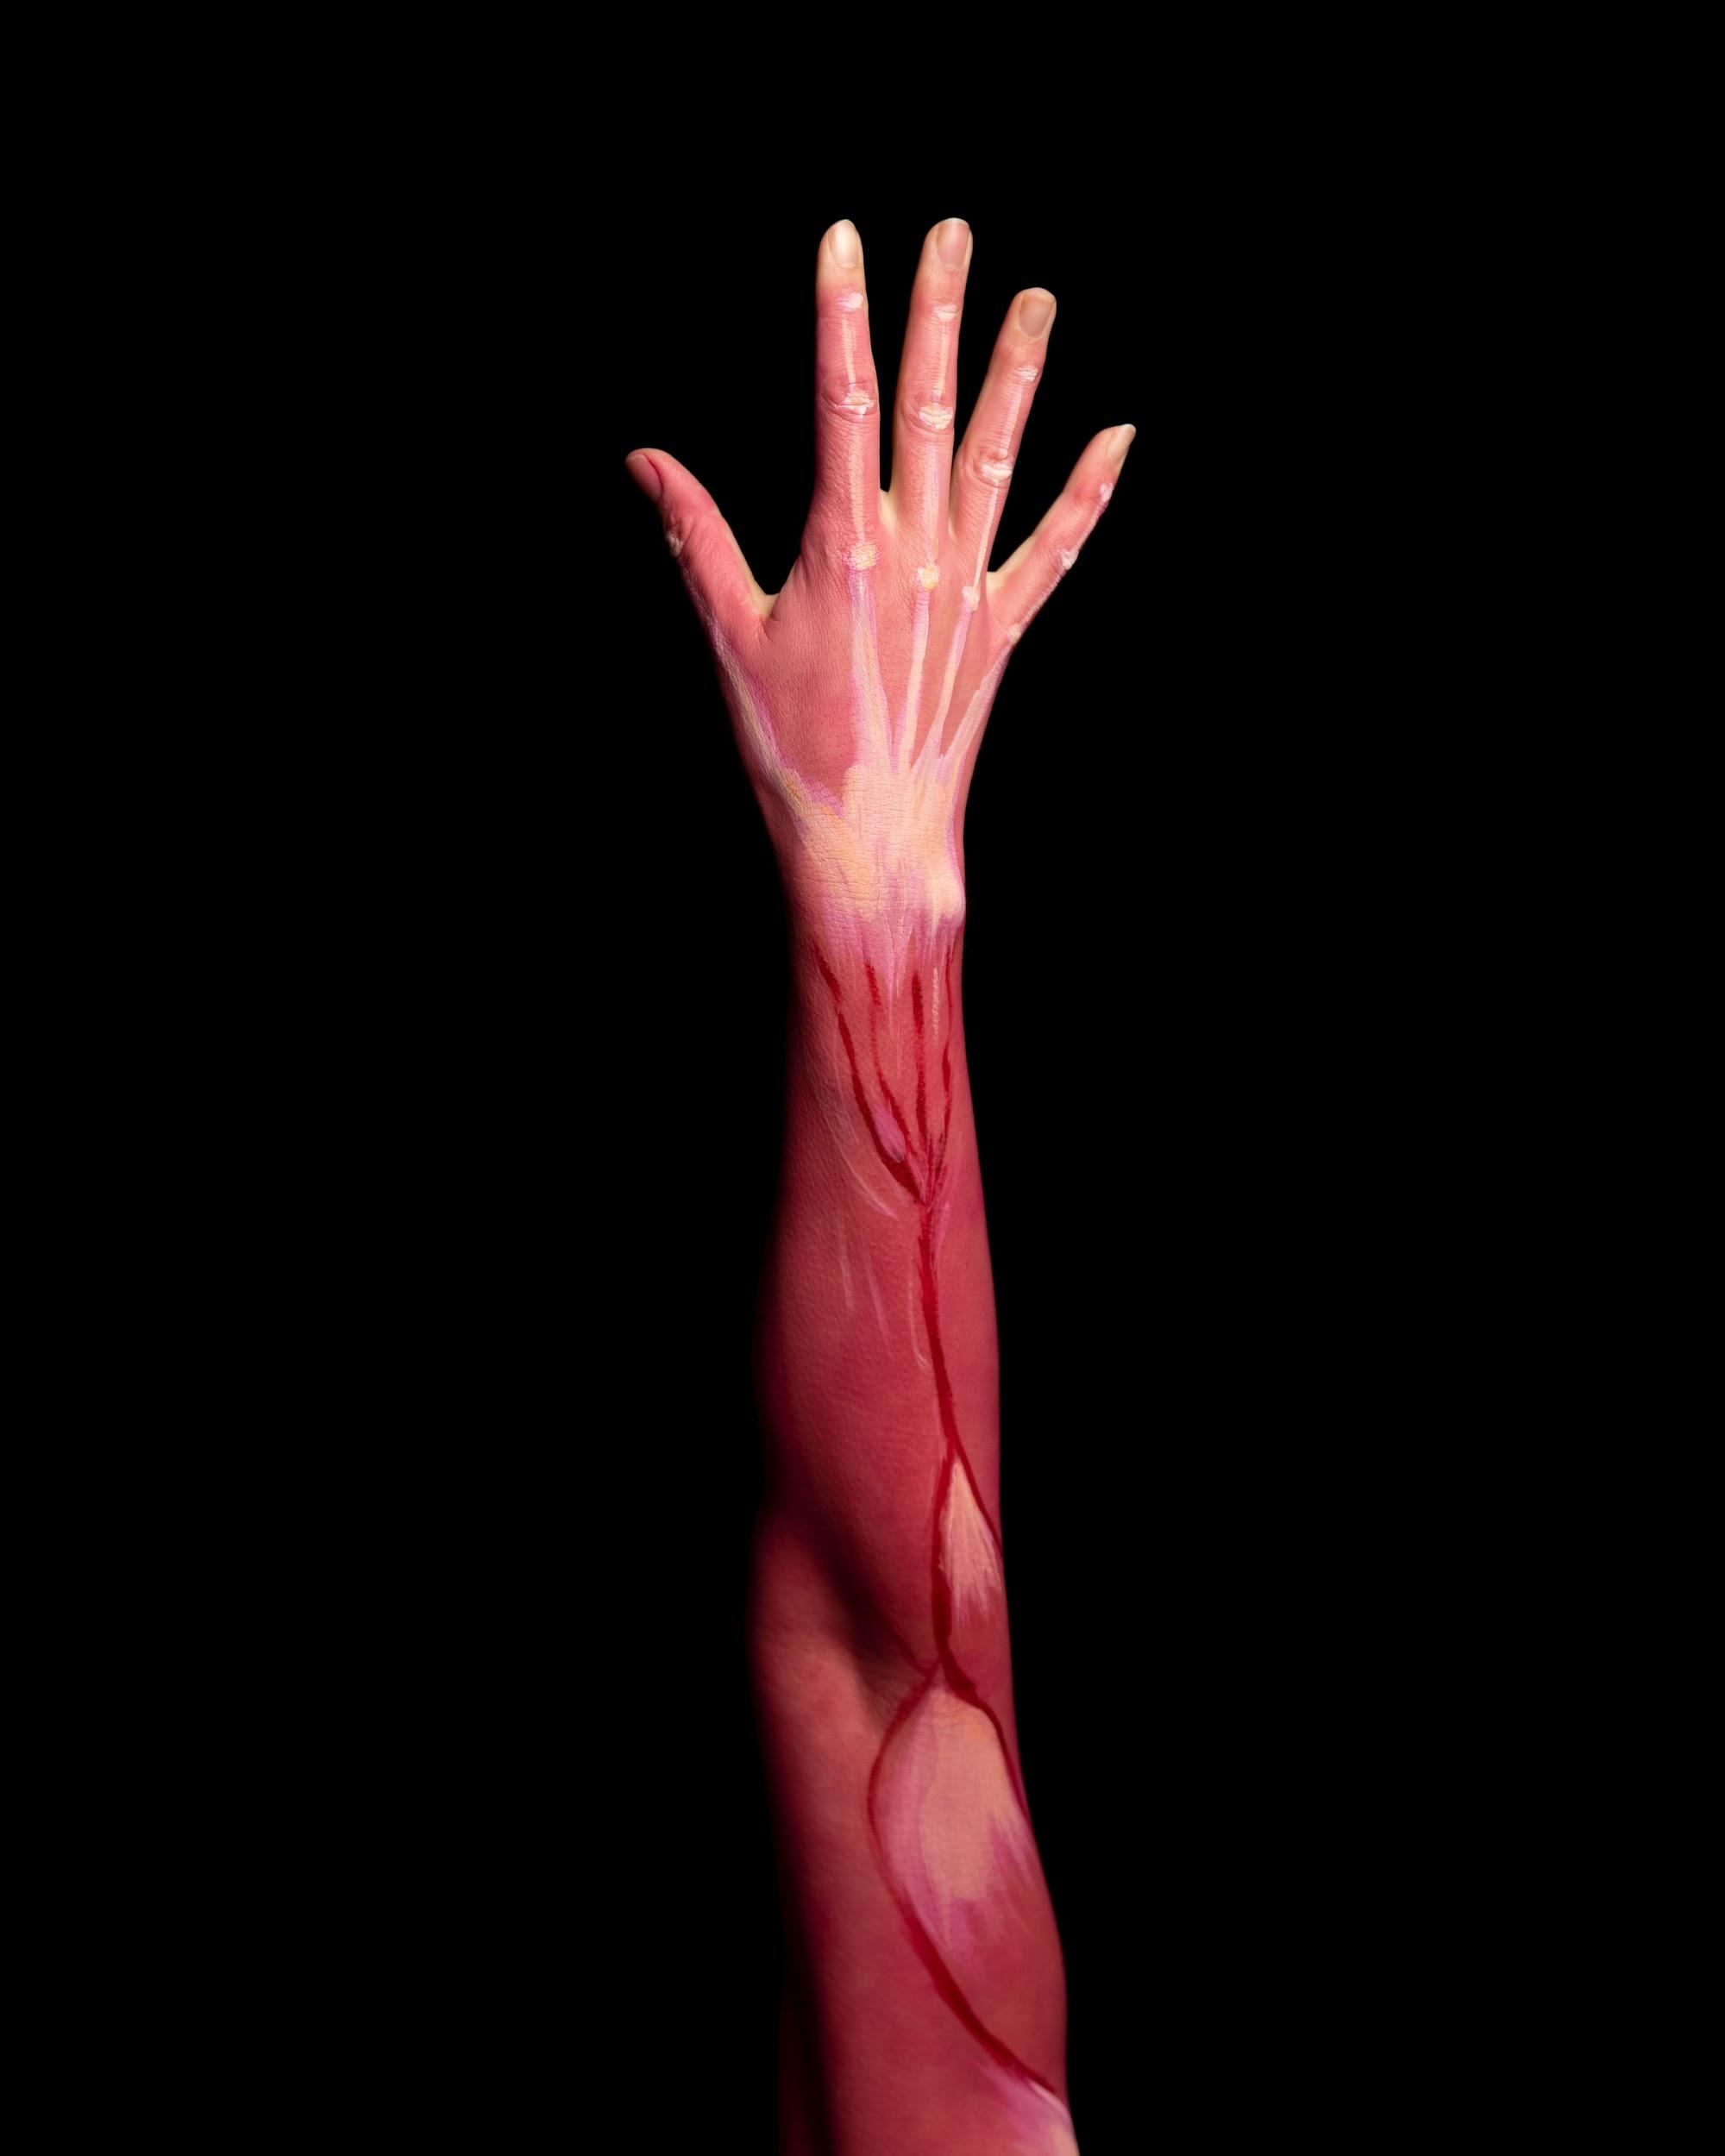
Haemoglobin has a much lower affinity for O₂ in respiring tissues, where pO₂ is low. Oxyhaemoglobin readily unloads its O₂ through dissociation.

Slide 8
Dissociation Curves
The association and dissociation of O₂ with haemoglobin can be illustrated using a dissociation curve.
  A dissociation curve shows how saturated haemoglobin is with O₂ at different partial pressures of O₂.
At a high pO₂ (in the lungs), haemoglobin has a high affinity for O₂.
  This means lots of the haemoglobin molecules will be saturated with O₂.
At a lower pO₂ (in the respiring tissues), haemoglobin has a much lower affinity with O₂.
  This means fewer haemoglobin molecules will be saturated with O₂.

Slide 9
A dissociation curve for adult human haemoglobin.

Slide 10
Shape and Affinity
When O₂ molecules bind to haemoglobin, they alter its shape.
  This also affects the haemoglobin’s affinity for O₂.
The binding of the first O₂ molecule makes subsequent bindings easier.
  This is because the first O₂ molecule changes the shape of the haemoglobin in such a way as to increase its affinity for other O₂ molecules.
As the haemoglobin becomes more saturated with O₂, it becomes harder for more O₂ molecules to join.
  This is what gives the dissociation curve it’s ‘S-shape’.
  When the curve is steep, a small change in pO₂ causes a big change in the amount of O₂ carried by the haemoglobin.

Slide 11
The Bohr Effect
The partial pressure of carbon dioxide (pCO₂) is a measure of CO₂ concentration in a cell.
The pCO₂ has an impact on haemoglobin’s affinity for O₂.
  Haemoglobin has a lower affinity for O₂ at a high pCO₂.
  This means haemoglobin will readily dissociate from O₂ when concentrations of CO₂ are high.
When cells undergo respiration, they release lots of CO₂.
  This raises the pCO₂.
Increased respiration increases the rate of O₂ unloading.
  More O₂ is released into cells that are undergoing lots of respiration.
This is referred to as the Bohr effect.
  The dissociation curve is shifted to the right.

Slide 12
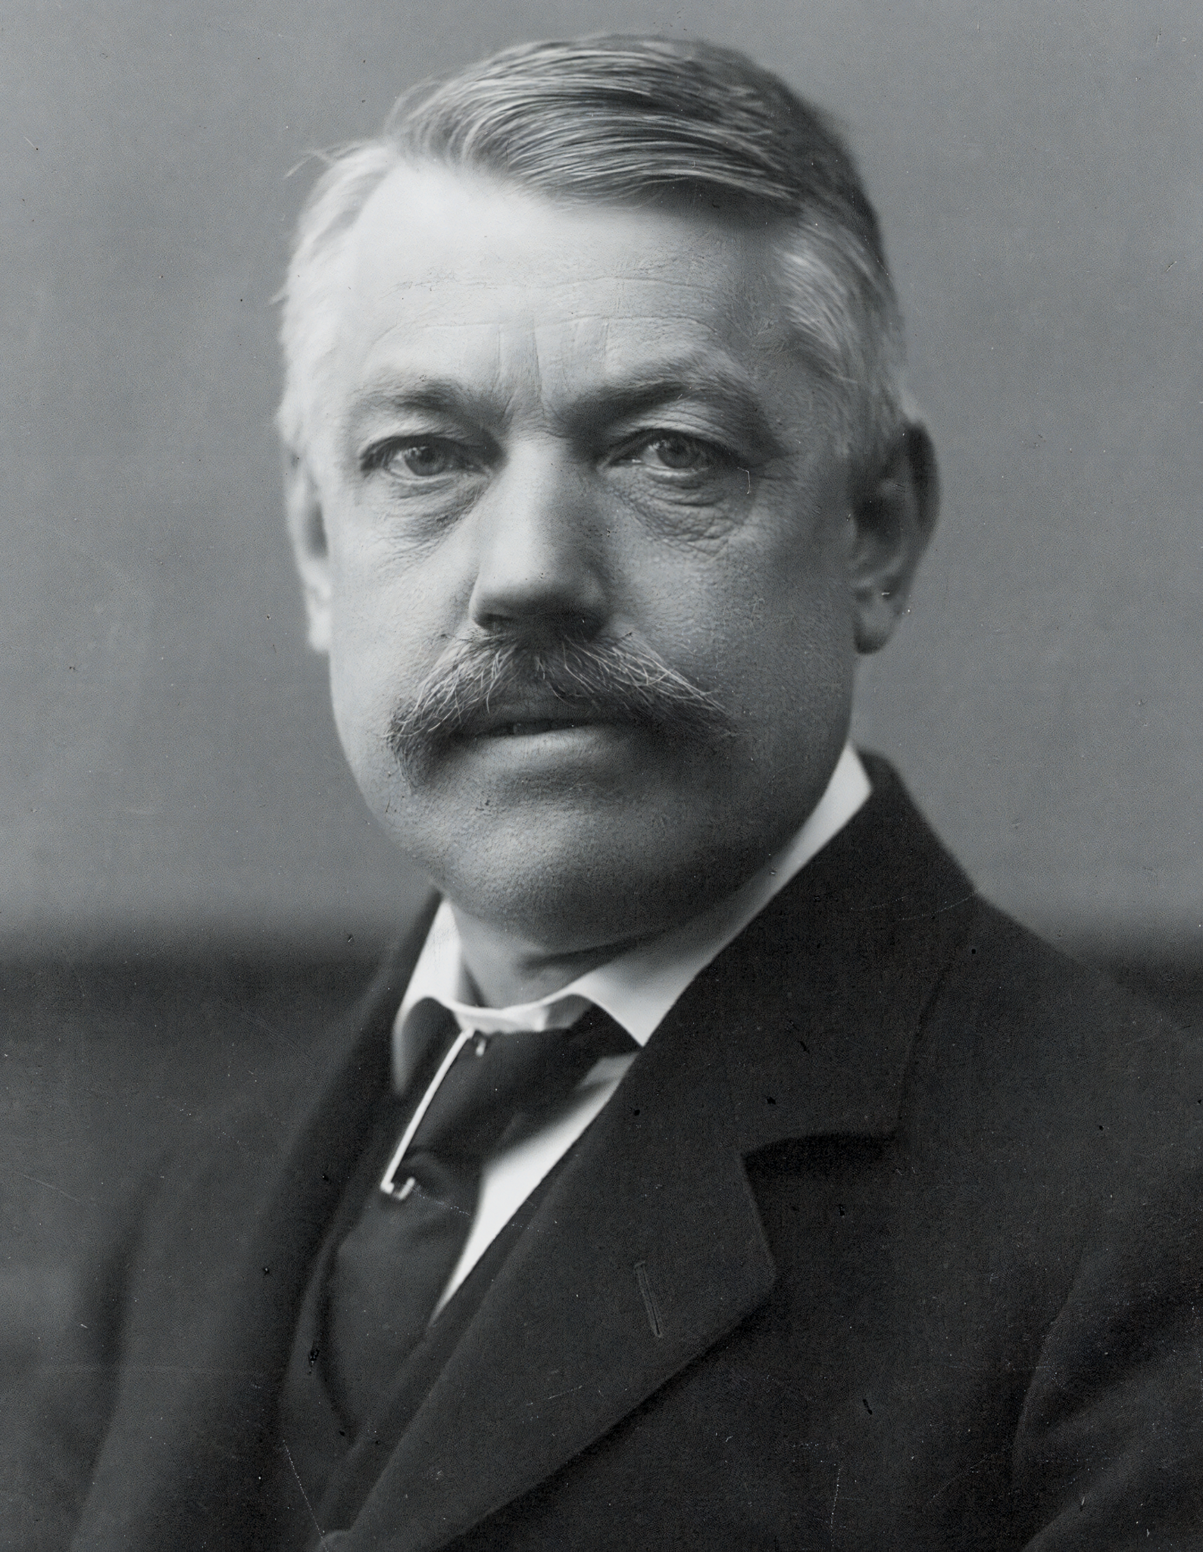
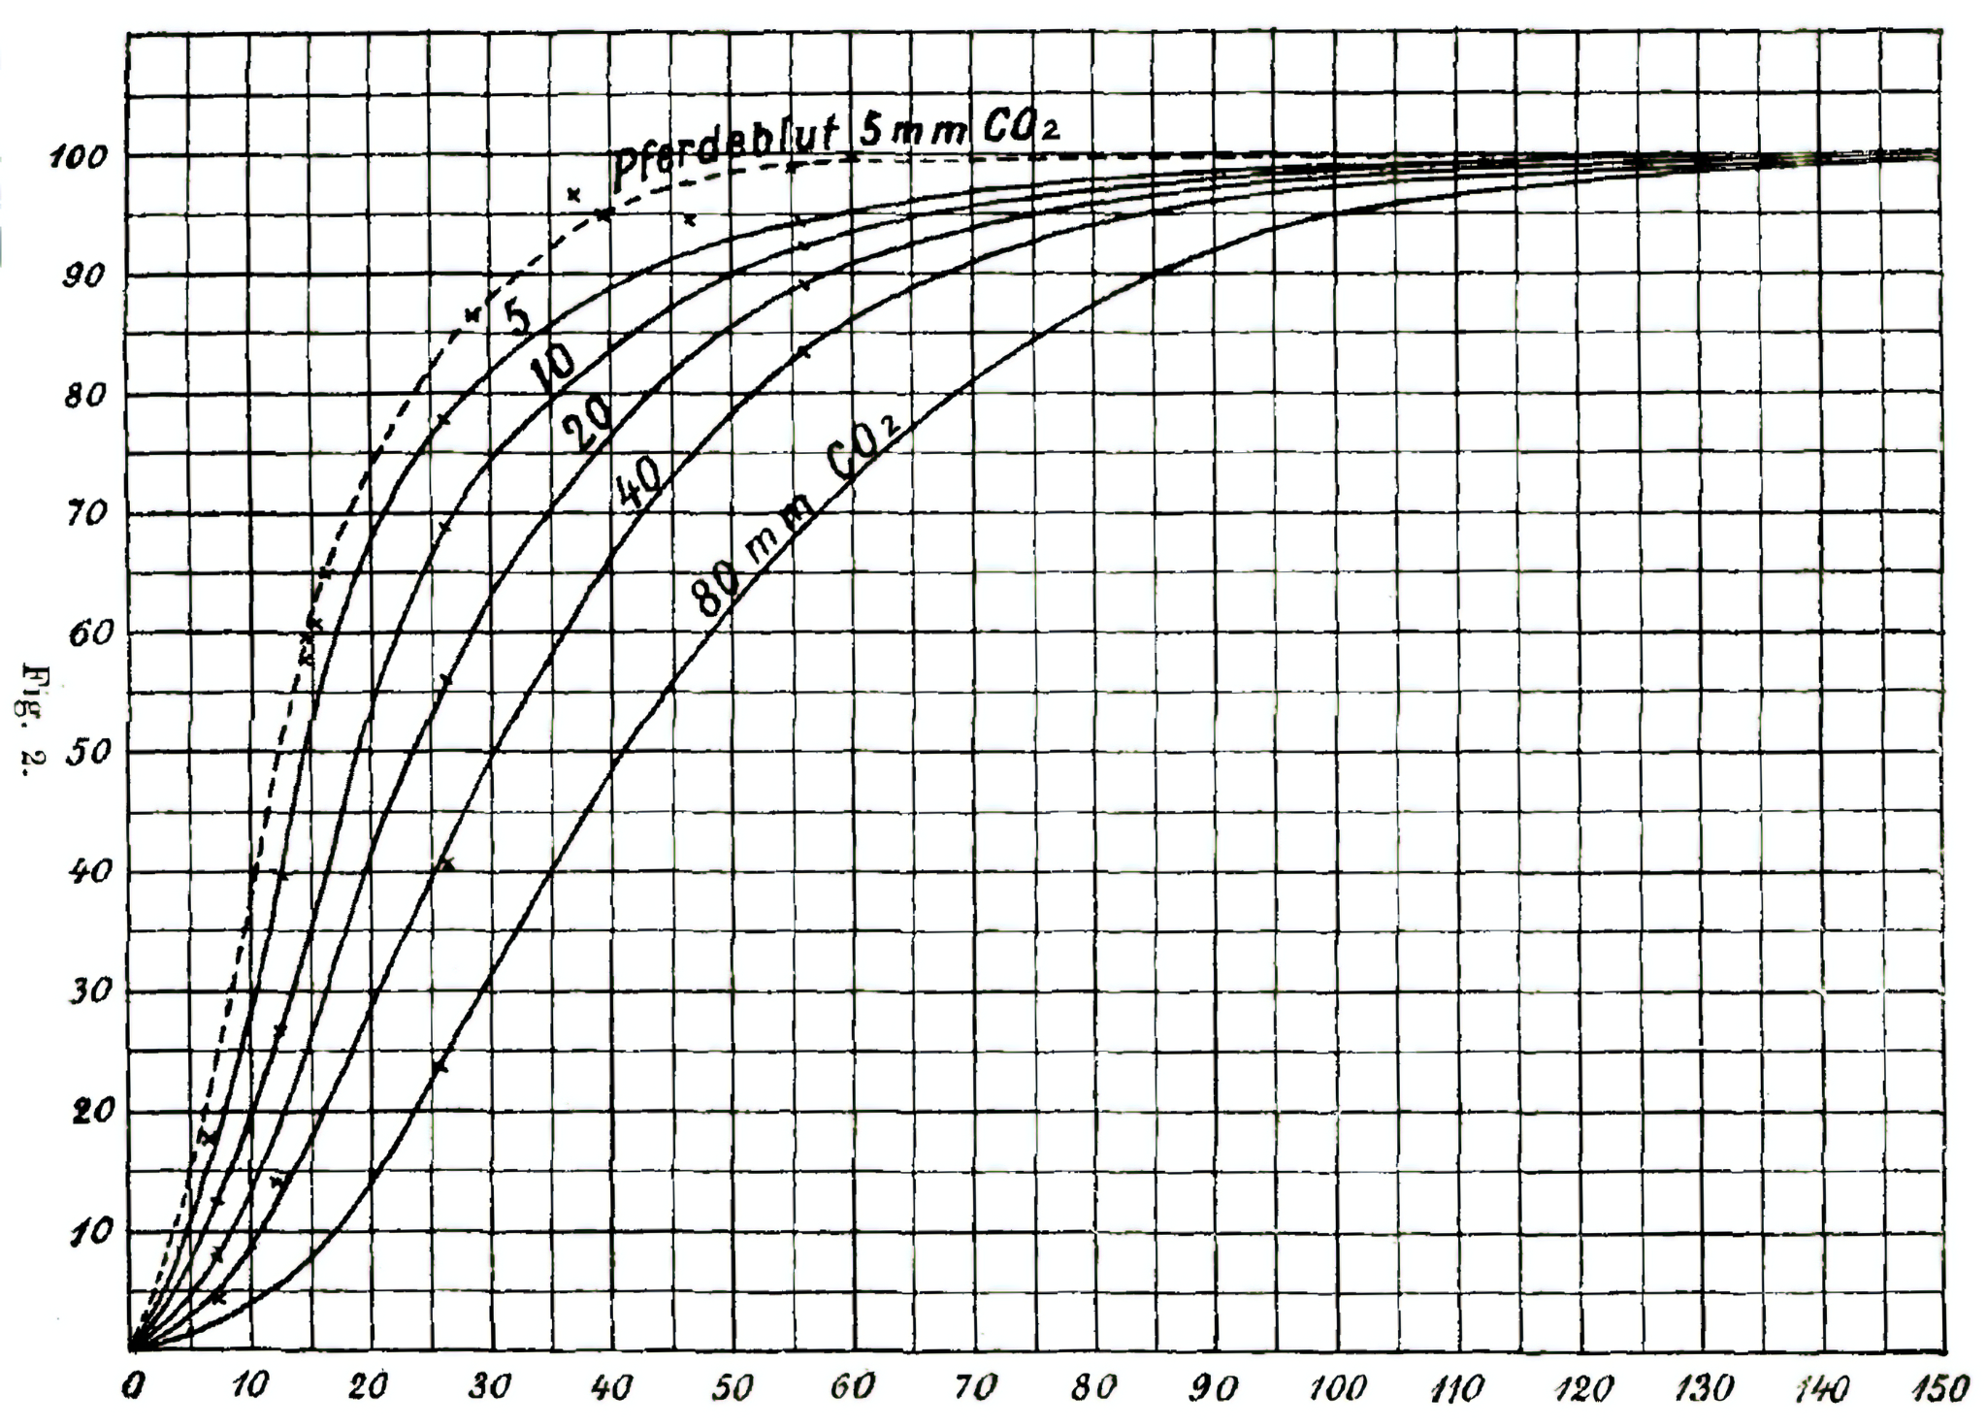
Danish doctor Christian Bohr is credited with discovering the Bohr effect, a phenomenon that causes haemoglobin’s affinity with O₂ to reduce when exposed to high concentration of CO₂.
Below is Bohr’s original research from 1904.

Slide 13
CO₂ concentration can significantly reduce the affinity of haemoglobin for O₂.
This means that O₂ will be more readily unloaded to tissues, allowing for higher and consistent rates of respiration.
LOW pCO₂
MEDIUM pCO₂
HIGH pCO₂

Slide 14
Haemoglobin in Other Organisms
Different organisms have evolved different forms of haemoglobin.
  This is to adapt to their environment.
  The type of haemoglobin may also be dependent on their level of activity.
Organisms that live in low O₂ environments will have haemoglobin with a very high affinity for O₂.
  This is because there isn’t much O₂ available, so the haemoglobin has to be very efficient at binding with it.
  The dissociation curve of their haemoglobin will lie to the left of human haemoglobin.
Organisms that are very metabolically active have a high demand for O₂.
  This means that their haemoglobin needs to unload O₂ readily.
  Their haemoglobin thus has a lower affinity for O₂ than human haemoglobin.
  The dissociation curve of their haemoglobin will lie to the right of human haemoglobin.

Slide 15

Birds of prey like the black kite have a high metabolic demand.
Their haemoglobin easily dissociates with O₂.

Slide 16
LUGWORM Hb
HUMAN Hb
BLACK KITE Hb
Haemoglobin from different species of organism will have different affinities for O₂

Slide 17
Haemoglobin in Other Organisms
The behaviour of haemoglobin is also dependent on the size of the organisms.
  Small mammals have a higher surface area to volume ratio than larger mammals.
  This means they lose heat more quickly.
To keep warm, small mammals must have a high metabolic rate.
  This means that they have a high demand for O₂.
The haemoglobin of small mammals will have a lower affinity for O₂ than human haemoglobin.
  Their haemoglobin must easily dissociate from O₂ to keep up with their metabolic demands.
  The dissociation curve of their haemoglobin will lie to the right of human haemoglobin.

Slide 18
Haemoglobin in different sizes of organism will have different affinities for O₂.
Organisms with a high SA:V will have a high metabolic rate and a need for their haemoglobin to dissociate from O₂ easily.
HUMAN Hb
MOUSE Hb

Slide 19
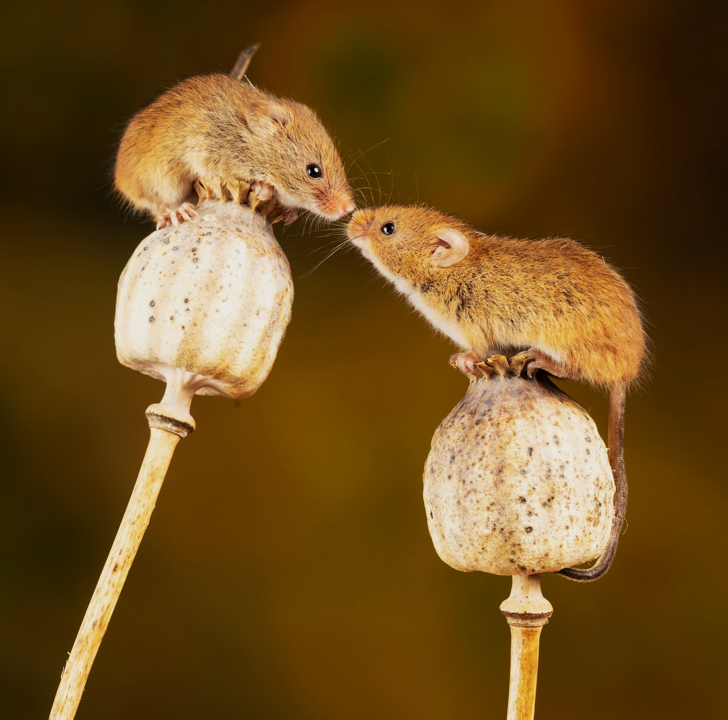
Field mice have a very high SA:V. They lose lots of heat so have a high demand for O₂ for metabolic processes.
Their haemoglobin needs to easily dissociate from O₂ to fulfill these demands.

