Slide 1
AQA A Level Biology
22 - Digestion and Absorption
Enzymes, Bile Salts and the Ileum

Slide 2
Digestion
Specification Point 3.3.3 - Digestion and absorption.
Large molecules from food, such as starch, are too big to cross cell membranes.
  They can therefore not be absorbed into the bloodstream.
These molecules first have to be digested.
  Digestion is the breakdown of large, insoluble molecules into smaller, soluble ones.
Molecules are broken down in hydrolysis reactions.
  Hydrolysis reactions break bonds through the addition of water.
Hydrolysis reactions are involved in a number of digestive processes:
  Carbohydrates are broken down into disaccharides and then monosaccharides.
  Fats are broken down into glycerol and fatty acids.
  Proteins are broken down into amino acids.

Slide 3
Amylase
Amylase is an enzyme that breaks down starch into maltose.
  Starch is a mixture of 2 polysaccharides - amylose and amylopectin.
  These polysaccharides are made from α-glucose.
Amylase catalyses hydrolysis reactions.
  The glycosidic bonds between glucose monomers are broken.
Amylase is produced by the salivary glands.
  These release amylase into the mouth.
It is also produced by the pancreas.
  The pancreas secretes amylase into the small intestine.
Amylase is used to break down the polysaccharide starch into maltose.

Slide 4
The hydrolysis of starch using the enzyme amylase.
One molecule of starch is broken down into two molecules of maltose.

Slide 5
SALIVARY GLANDS
TONGUE
The human digestive system.
One of the main organs responsible for the production and secretion of enzymes is the pancreas.
OESOPHAGUS
PANCREAS
LIVER
GALLBLADDER
DUODENUM
STOMACH
BILE DUCT
COLON
ILEUM
RECTUM
ANUS

Slide 6
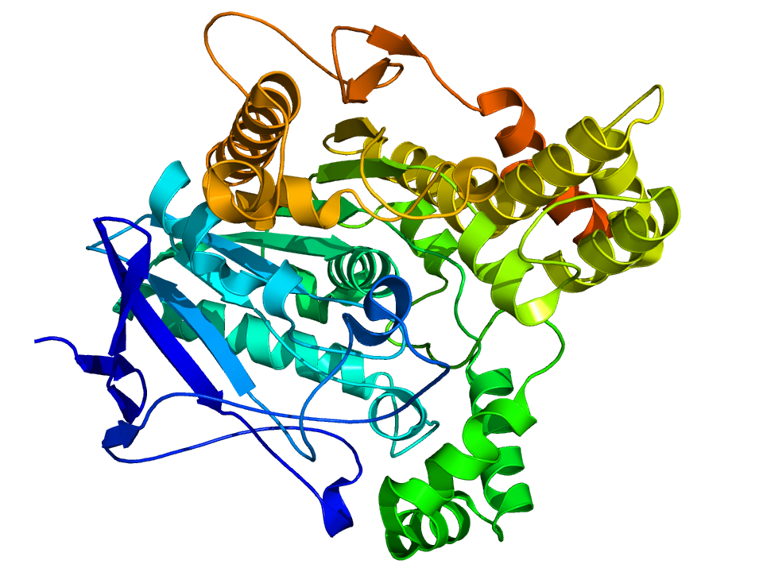
Membrane-Bound Disaccharidases
Membrane-bound disaccharidases are enzymes that are attached to the cell membrane.
  They are often found on the surface of epithelial cells that line the ileum.
    The ileum is the final part of the small intestine.
Membrane-bound disaccharidases help to break down disaccharides into monosaccharides.
The disaccharidase maltase breaks down maltose into 2 glucose monomers.

Slide 7
Membrane-Bound Disaccharidases
Monosaccharides that are broken down by membrane-bound disaccharidases are then transported into the bloodstream.
  They are carried by specific transporter proteins across epithelial cells in the ileum.
Disaccharide | Disaccharidase | Monosaccharide
Sucrose | Sucrase | Glucose and Fructose
Maltose | Maltase | Glucose and Glucose
Lactose | Lactase | Glucose and Galactose

Slide 8
Lipid Digestion and Bile Salts
Lipids are broken down into monoglycerides and fatty acids.
  This reaction is catalysed by lipase enzymes.
Lipases are made in the pancreas.
  They are then secreted into the small intestine.
Bile salts help to emulsify lipids.
  They are produced in the liver and are also secreted into the small intestine.
Emulsification causes lipids to form small droplets.
  This increases the surface area of the lipids, allowing for faster breakdown by enzymes.
Once the lipid is broken down, the monoglycerides and fatty acids combine with bile salts to form micelles.
  These are small structures that aid with the absorption of lipid products.

Slide 9
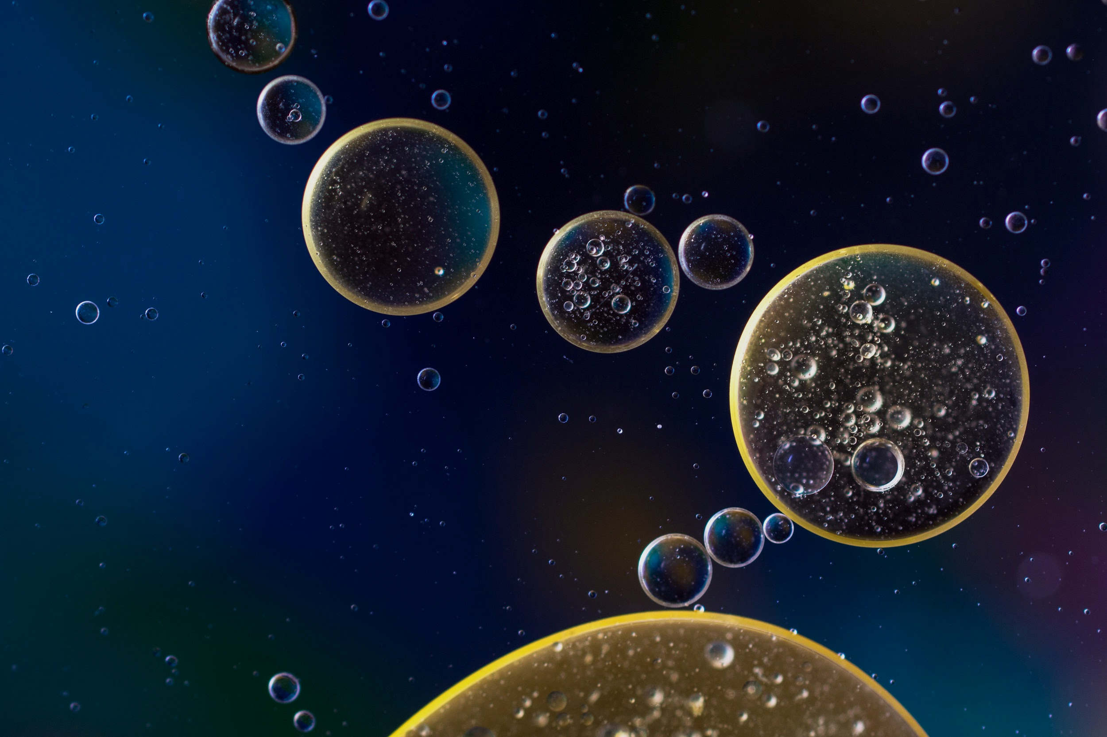
Bile will help to emulsify fats which increase their surface area.
This makes fats easier to digest.

Slide 10
BILE SALT
The formation of a micelle.
Bile salts will surround monoglycerides and fatty acids for easier absorption into the bloodstream.
FATTY ACID
MICELLE

Slide 11
Protein Digestion - Endopeptidases
Proteins are digested by enzymes called peptidases.
  These hydrolyse peptide bonds between amino acids.
Endopeptidases hydrolyse peptide bonds within a protein.
  Trypsin is an endopeptidase that is synthesised in the pancreas and secreted into the small intestine.
  Pepsin is an endopeptidase that is synthesised and released in the stomach.

Slide 12
Protein Digestion - Exopeptidases
Exopeptidases hydrolyse peptide bonds at the ends of a protein.
  They shorten the protein by 1 amino acid each time.

Slide 13
Protein Digestion - Dipeptidases
Dipeptidases are a specific kind of exopeptidase.
  They hydrolyse the peptide bond between dipeptides.
Dipeptidases are often found in the cell membrane.
  Specifically, the membrane of epithelial cells in the small intestine.

Slide 14
Absorbing Products
The products of digestion are then absorbed into the bloodstream.
  Products are transported across the ileum epithelium.
Monosaccharides and amino acids are absorbed by cotransport and facilitated diffusion.
  Glucose and galactose are absorbed using the sodium cotransport mechanism.
  Fructose is absorbed using a different transporter protein via facilitated diffusion.
  Amino acids are absorbed using sodium-dependent transporter proteins.
Monoglycerides and fatty acids are absorbed using micelles.
  Micelles transport monoglycerides and fatty acids to the epithelium.
  When micelles break up, they release these products across the epithelial membrane.

Slide 15
DUODENUM
The small intestine absorbs the products of digestion.
Products are transported across the
ileum epithelium into the bloodstream.
ILEUM

Slide 16
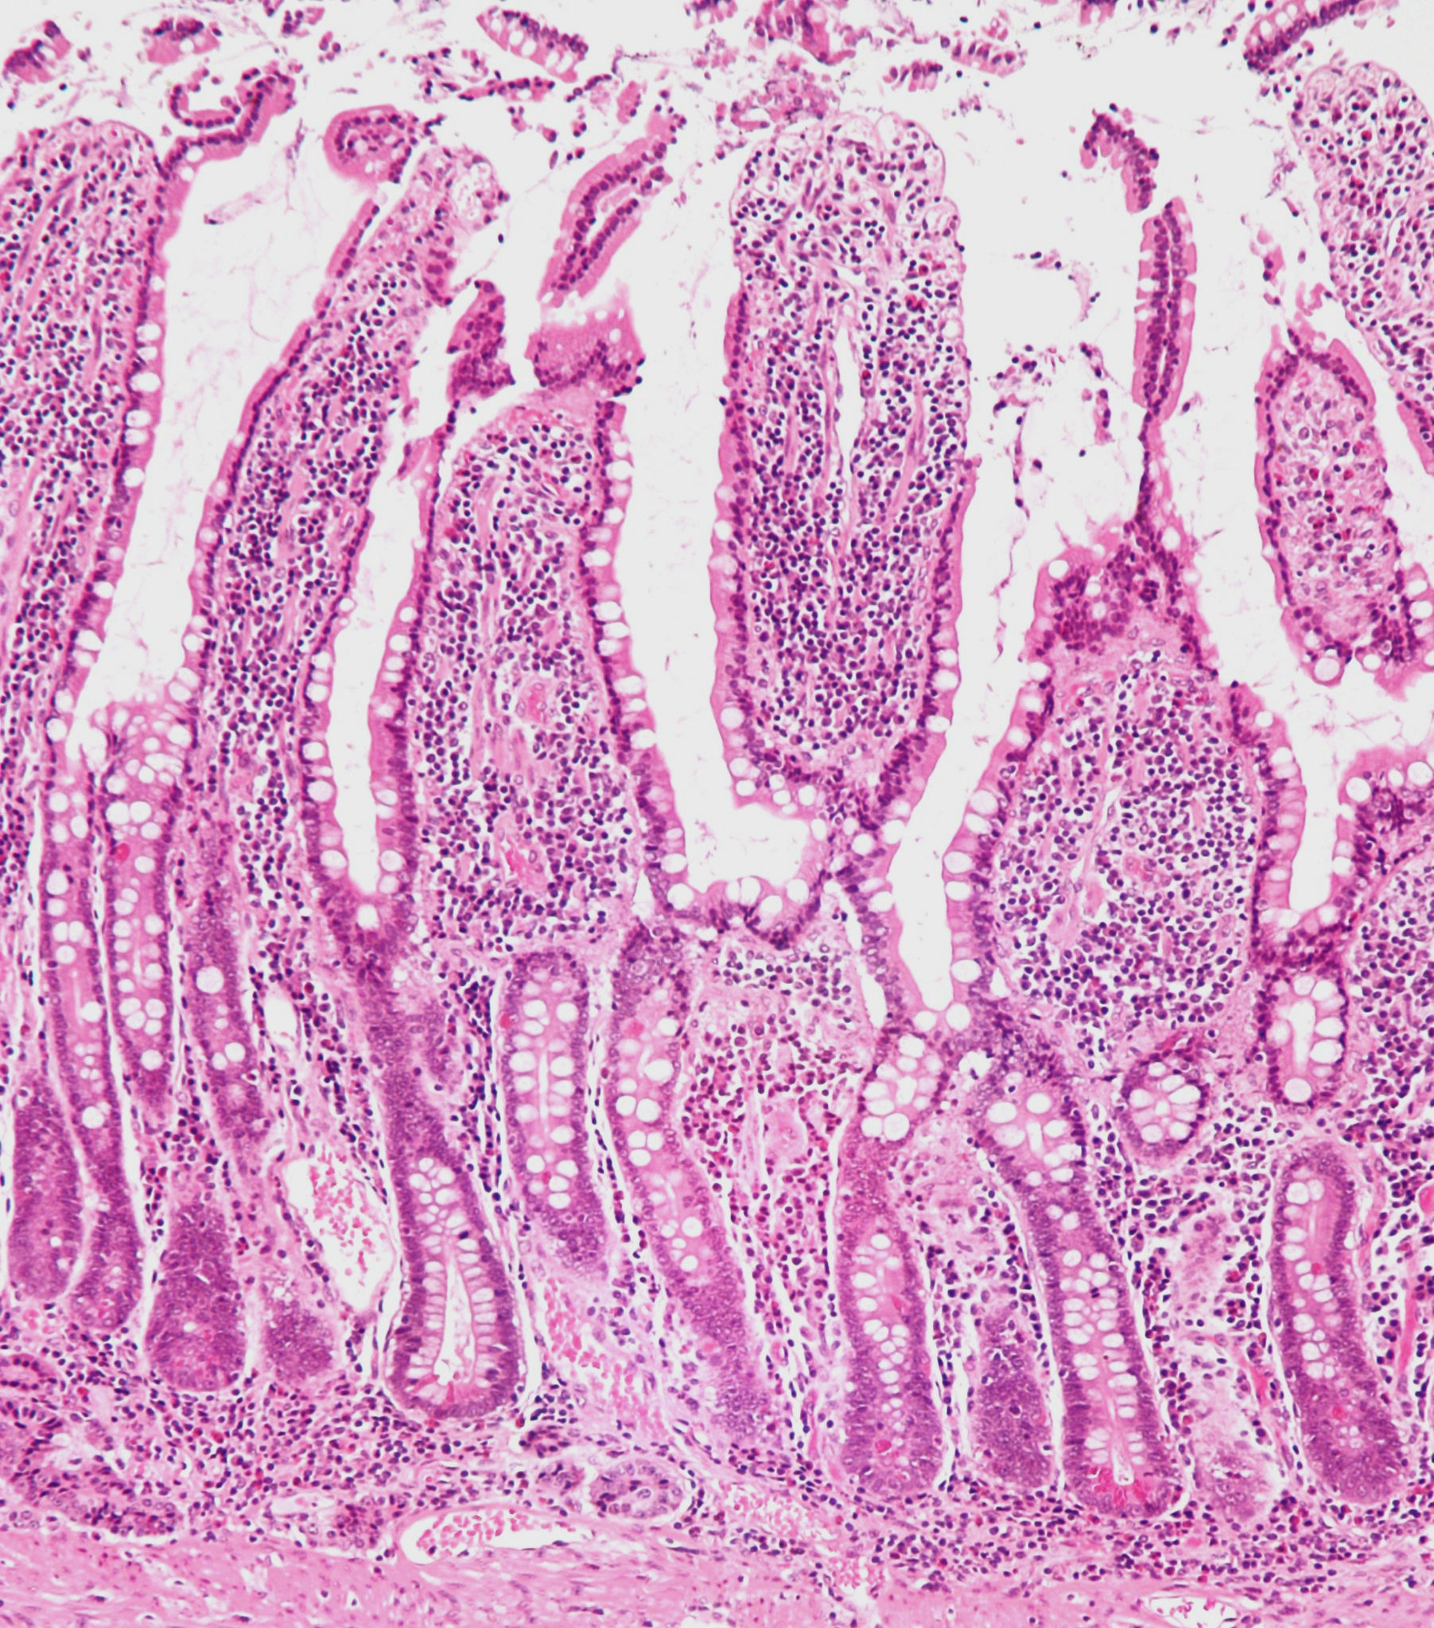
A micrograph of the human ileum with villi present.
Products are absorbed through epithelial cells into the bloodstream.

