Slide 1
AQA A Level Biology
21 - Lung Disease
Effects, Analysis and Dissection

Slide 2
Lung Function
Specification Point 3.3.2 - Gas exchange.
Lung diseases affect how well the lungs function.
  They can affect both breathing and the efficiency of gas exchange.
The health of the lungs can be measured by:
  Tidal volume - this is the volume of air in each breath. It is usually around 0.5 dm³ for a healthy adult.
  Ventilation rate - this is the number of breaths per minute. For a healthy adult at rest it is around 15 breaths per minute.
  Forced expiratory volume (FEV₁) - this is the maximum volume that can be breathed out in 1 second.
  Forced vital capacity (FVC) - This is the maximum volume of air it is possible to breathe out of the lungs forcefully after a deep breath in.

Slide 3
TRACHEA
LEFT AND RIGHT BRONCHUS
RINGS OF
CARTILAGE
BRONCHIOLE
ALVEOLI
The structure of the human lungs.
DIAPHRAGM

Slide 4

A spirometer trace measures various aspects of lung function.

Slide 5
80
INSPIRATORY
RESERVE
VOLUME
(IRV)
VITAL
CAPACITY
37
A spirometer trace measures various aspects of lung function.
TIDAL
VOLUME
TOTAL
LUNG
CAPACITY
VOLUME (ML/KG)
30
EXPIRATORY
RESERVE
VOLUME
(ERV)
15
RESIDUAL
VOLUME
RESIDUAL
VOLUME
0
NORMAL
RESPIRATION
FORCED
RESPIRATION
NORMAL
RESPIRATION

Slide 6
Tuberculosis
Tuberculosis (TB) is a lung disease caused by a bacterial infection.
  Individuals are infected with the Mycobacterium tuberculosis bacteria.
The main symptom of TB is a chronic, persistent cough.
  Other symptoms include coughing up blood, chest pains and a general shortness of breath.
When an individual is infected, the immune system builds a wall around the bacteria.
  This forms small, hard lumps referred to as tubercules.
The infected tissue within the tubercules dies.
  This damages the gas exchange surface, reducing tidal volume.
  It may also lead to scar tissue (fibrosis), which further reduces tidal volume.
Less air can be inhaled with each breath.
  This means the individual has to breathe faster, thus increasing their ventilation rate.

Slide 7
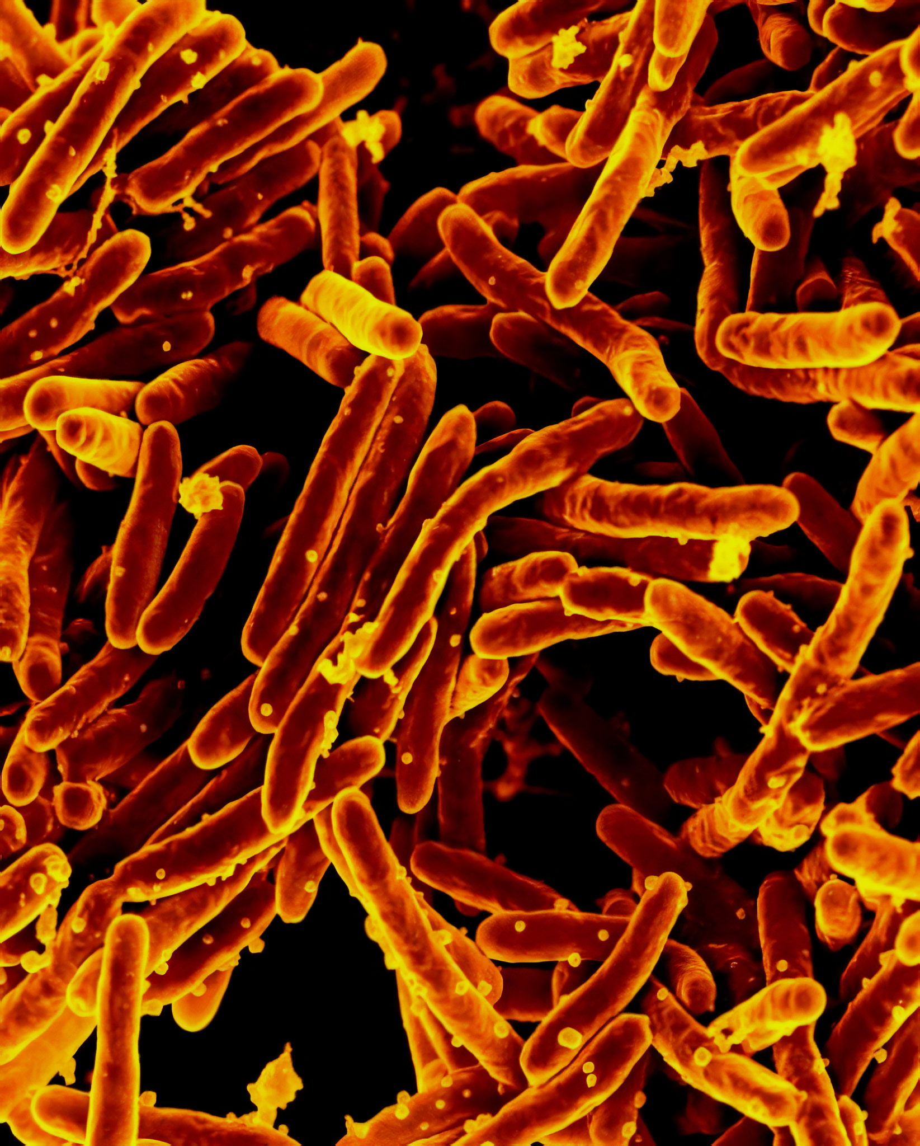
TB is a lung disease caused by the bacteria Mycobacterium tuberculosis.

Slide 8
Tuberculosis can lead to the formation of tubercles.
Tubercles are small hard lumps embedded in lung tissue.
TUBERCULE

Slide 9
Fibrosis
Fibrosis is the formation of scar tissue in the lungs.
  Fibrosis may form in response to an infection like TB.
  It may also form after exposure to irritating substances such as asbestos or dust.
Symptoms of fibrosis include shortness of breath and a dry, hacking cough.
  There may also be chest pain, fatigue and weakness.
Scar tissue is thicker and less elastic than normal lung tissue.
  The lungs can’t expand as easily.
  They also can’t hold as much air as normal.
  Tidal volume and FVC is also reduced.
Diffusion is slower across a thicker membrane.
  Those suffering from fibrosis will have a faster ventilation rate than normal.
  This is needed to sufficiently oxygenate the blood.

Slide 10
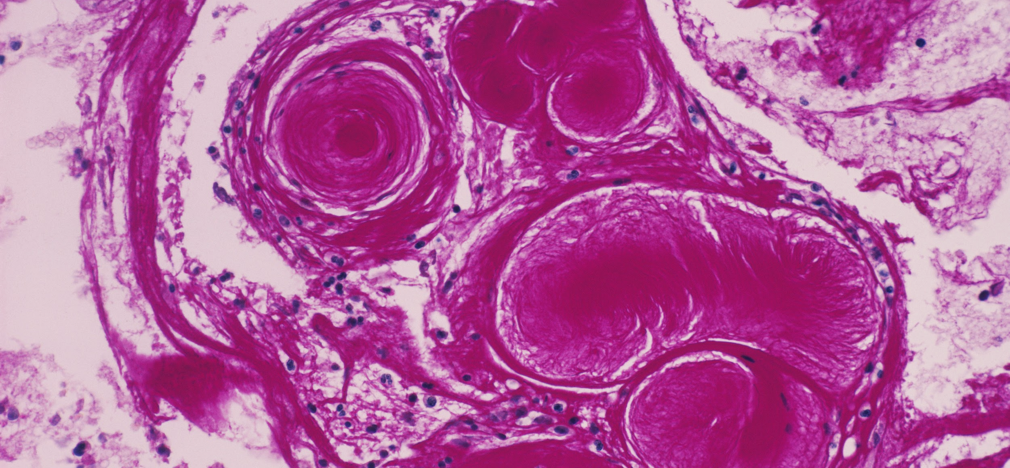
Fibrosis is the formation of scar tissue in the lungs.

Slide 11
Asthma
Asthma is a condition where the airways become inflamed and irritated.
  Most asthma attacks occur due to an allergic reaction to foreign particles, such as dust or pollen.
The symptoms of asthma include wheezing, a tight chest and shortness of breath.
  Asthma attacks are usually rapid in onset.
  The symptoms of asthma are usually relieved with bronchodilators (inhalers).
During an asthma attack, muscles lining the bronchioles contract.
  A large quantity of mucus is produced.
The airways constrict which makes it more difficult to breathe.
  Reduced air flow means FEV₁ is reduced.

Slide 12

Asthma is usually a lifelong condition where the airways become easily irritated.
The symptoms of asthma include wheezing, a tight chest and shortness of breath.

Slide 13
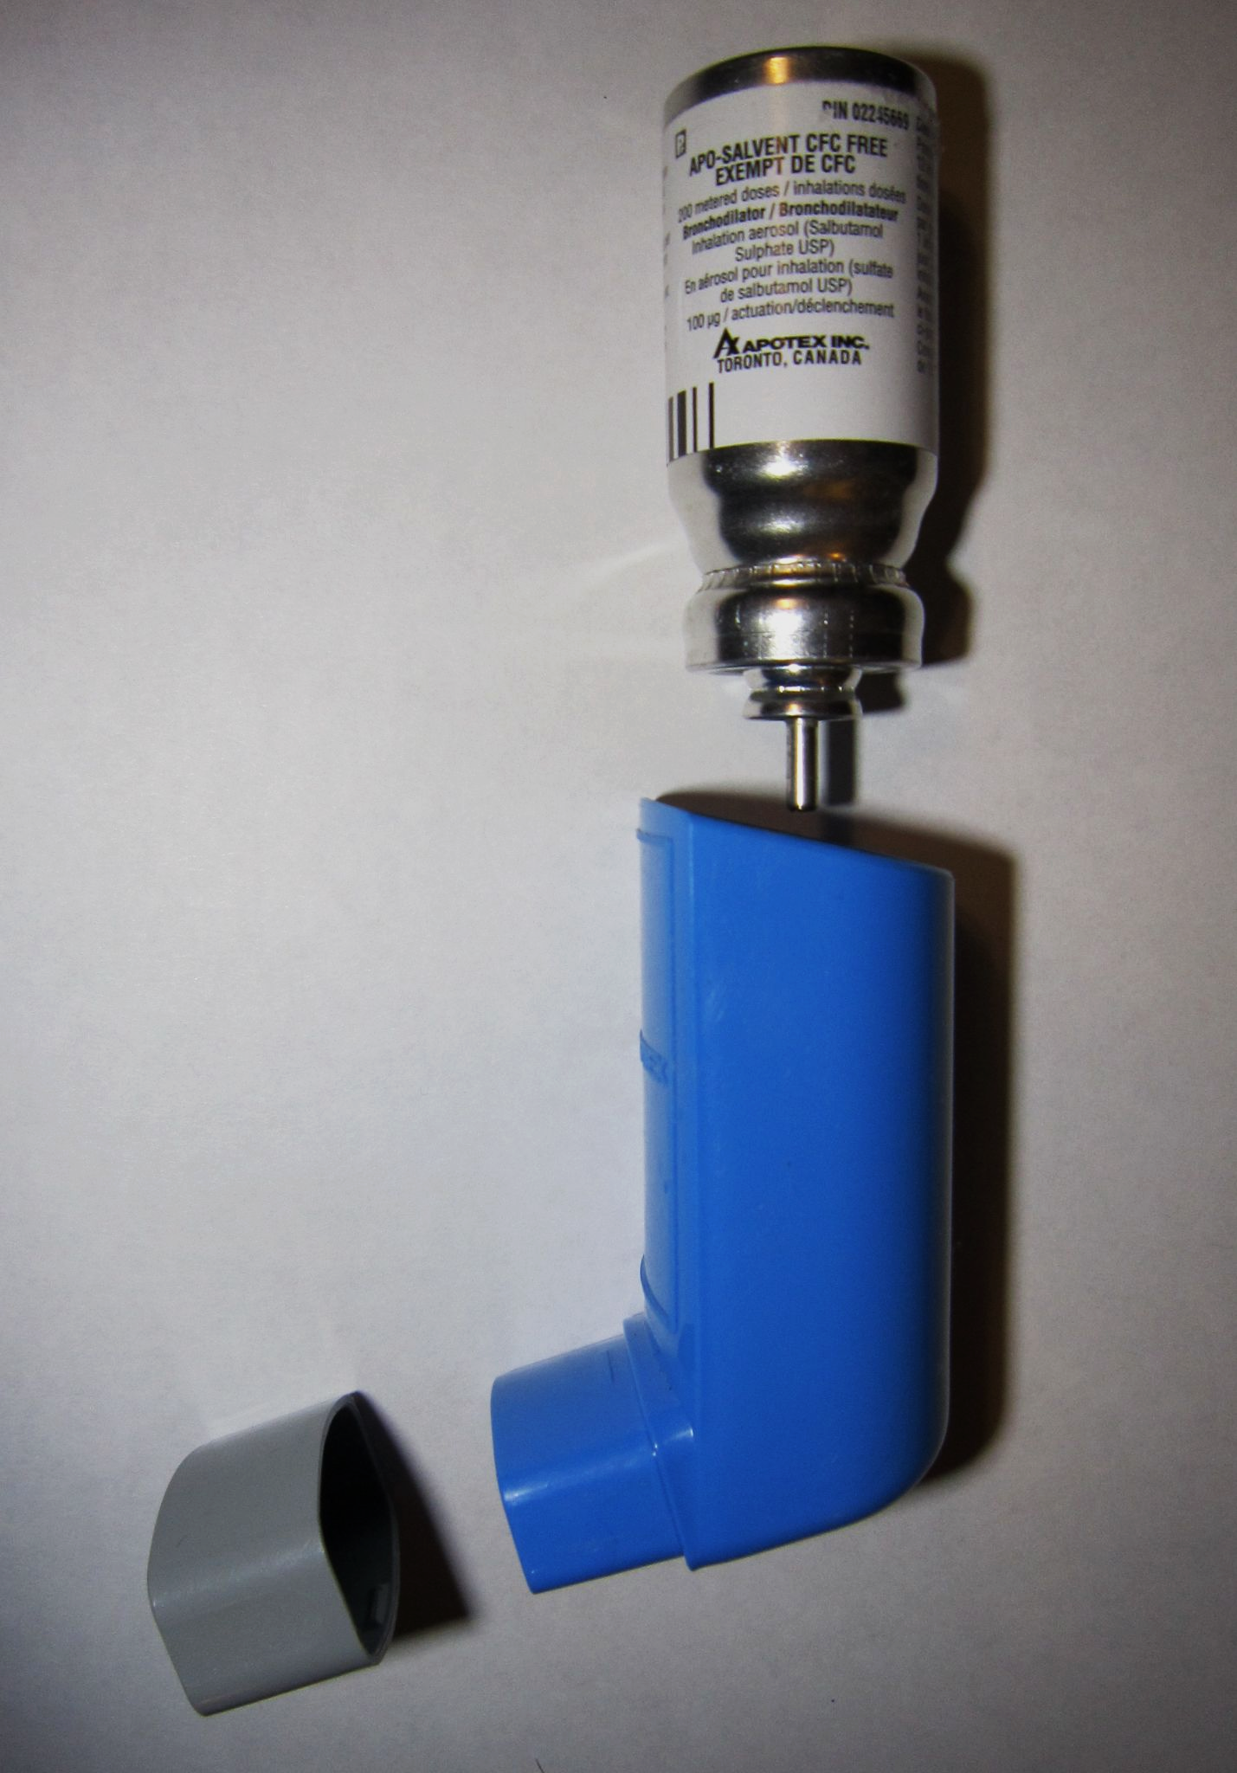
Bronchodilators like salbutamol are often used to relieve the symptoms of asthma.

Slide 14
Emphysema
Emphysema is a disease caused by smoking or long-term exposure to damaging air pollutants.
  Particles in the air become trapped in the alveoli.
  This leads to inflammation which attracts white blood cells to the lungs.
  These white blood cells produce enzymes which break down elastin in the lungs.
    Elastin is a protein that increases elasticity.
Lack of elastin reduces the ability of the alveoli to recoil.
  The alveolar walls can also be damaged, reducing the surface area of the exchange surface.
Symptoms of emphysema include shortness of breath and wheezing.
  Those with emphysema have an increased ventilation rate to increase the amount of O₂ reaching the lungs.

Slide 15
Lung Cancer
Cigarettes contain many carcinogenic compounds:
  A cigarette contains approximately 100 µg of arsenic.
  A cigarette contains approximately 60 µg of benzene.
  A cigarette contains approximately 6 µg of formaldehyde.
  A cigarette contains approximately 2 µg of lead.
Carcinogens are chemicals that cause cells to mutate.
Mutations can lead to the formation of a cancerous tumour.
  Cigarette smoking is linked to around 85% of deaths from lung cancer.
There is an extremely strong correlation between cigarette consumption and lung cancer.

Slide 16
Dissecting Gas Exchange Systems
Practical 5: Dissection of animal or plant gas exchange system or mass transport system or of organs within such a system.
As part of the AQA A Level syllabus, students are expected to carry out at least 1 dissection.
There are several ethical issues to consider:
  Some argue it is morally wrong to kill animals for the purpose of dissection.
  However, many dissections that are carried out in schools involve animals that have already been killed for meat.
  If animals are raised in school settings for dissection (insects or fish for example), it is important they are raised in a humane way.
Dissection of fish gills video.

