Slide 1
AQA A Level Biology
20 - Gas Exchange in Humans
Ventilation and Lung Structure

Slide 2
Gas Exchange in Humans
Specification Point 3.3.2 - Gas exchange.
Humans have a requirement for oxygen (O₂).
  O₂ needs to enter the bloodstream for respiration.
Humans also need to remove carbon dioxide (CO₂).
  A buildup of CO₂ can be toxic for cells.
Gas exchange in humans takes place in the lungs.
  The exchange of gases takes place during ventilation.
    Ventilation is the process of breathing in and breathing out.
The lungs are situated inside a cavity called the thorax.

Slide 3
The Lungs
Air enters through the trachea.
  This is sometimes referred to as the windpipe.
The trachea split into the left and right bronchus.
  Each bronchus feeds directly into a lung.
The bronchi then branch into smaller bronchioles.
  These terminate at air sacs, called alveoli.
Gas is exchanged at alveoli.
  O₂ leaves the alveoli and enters the bloodstream.
  CO₂ enters the alveoli and is released during exhalation.
The lungs are encased in the ribcage.
  Each rib is linked by intercostal muscles.
The thick wall of muscle at the base of the lungs is called the diaphragm.

Slide 4
TRACHEA
LEFT AND RIGHT BRONCHUS
PLEURAL MEMBRANE
BRONCHIOLE
The trachea splits into the left and right bronchus.
Many bronchioles then branch of the bronchi, where they terminate into air-filled sacs called alveoli.
The lungs are surrounded by a pleural membrane which helps to lubricate them during ventilation
ALVEOLI
DIAPHRAGM

Slide 5
The thorax is enclosed by the ribcage; a collection of bones which protect the thorax.
RIB CAGE

Slide 6
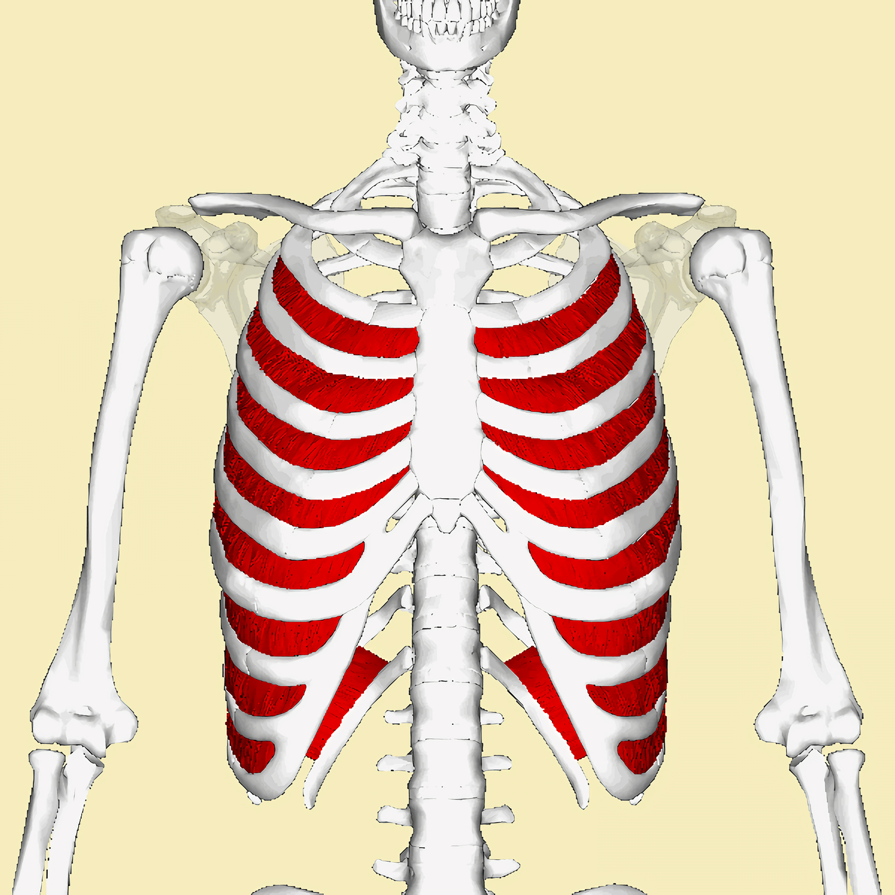
The ribs are held together by muscles called the intercostal muscles.
The internal intercostal muscles are located on the inside of the ribs.
The external intercostal muscles are located on the outside of the ribs.

Slide 7
Inhalation
Ventilation is the process of breathing in and out.
  It consists of 2 stages, inhalation and exhalation.
Air is drawn into the lungs during inhalation.
  The external intercostal and diaphragm muscles contract.
  The ribcage moves upwards and outwards.
  As the diaphragm flattens, the volume of the thoracic cavity increases.
The pressure inside the lungs drops to below that of atmospheric pressure.
  This draws air into the lungs.
Inhalation is an active process.
  It requires energy in the form of ATP.
AIR ENTERS THE LUNGS
THORAX MOVES DOWNWARDS AND OUTWARDS
NEGATIVE
PRESSURE IN THORAX
DIAPHRAGM FLATTENS

Slide 8
Exhalation
Ventilation is the process of breathing in and out.
  It consists of 2 stages, inhalation and exhalation.
Air is forced out of the lungs during exhalation.
  The external intercostal and diaphragm muscles relax.
  The ribcage moves downwards and inwards.
  As the diaphragm curves upward and becomes dome-shaped, the volume of the thoracic cavity decreases.
The pressure inside the lungs increases to above that of atmospheric pressure.
  This forces air out of the lungs.
Exhalation is usually a passive process.
  Forced exhalation is an active process.
  During forced exhalation, the external intercostals relax, the internal intercostals contract and the ribcage is pulled further down.
AIR LEAVES THE LUNGS
THORAX MOVES UPWARDS AND INWARDS
POSITIVE
PRESSURE IN THORAX
DIAPHRAGM BECOMES DOME-SHAPED

Slide 9
Alveoli
The lungs contain millions of alveoli.
  These are air sacs where gas exchange takes place.
  O₂ moves from the alveoli into the bloodstream.
  CO₂ moves from the bloodstream into the alveoli.
Alveoli are surrounded by a network of capillaries.
  This maintains a steep concentration gradient for diffusion.
Alveoli have a large surface area.
  This increases the speed of gas exchange.
Alveoli are very thin.
  This means there is a short diffusion pathway for speedy gas exchange.

Slide 10
CAPILLARY BED
ALVEOLAR SACS
Gas exchange takes place at specialised structures called alveoli.
ALVEOLUS
PULMONARY ARTERY
PULMONARY VEIN

Slide 11
Gas Exchange at Alveoli
O₂ diffuses out of the alveoli.
O₂ crosses the outer layer of the alveoli (the alveolar epithelium).
  O₂ moves through the inner layer of the capillary wall (the capillary endothelium).
O₂ combines with haemoglobin the the bloodstream to form oxyhaemoglobin.
  O₂ is then carried by red blood cells to target tissues.
TRACHEA
BRONCHUS
BRONCHIOLE
ALVEOLUS
ALVEOLAR
EPITHELIUM
CAPILLARY
ENDOTHELIUM
BLOODSTREAM

Slide 12
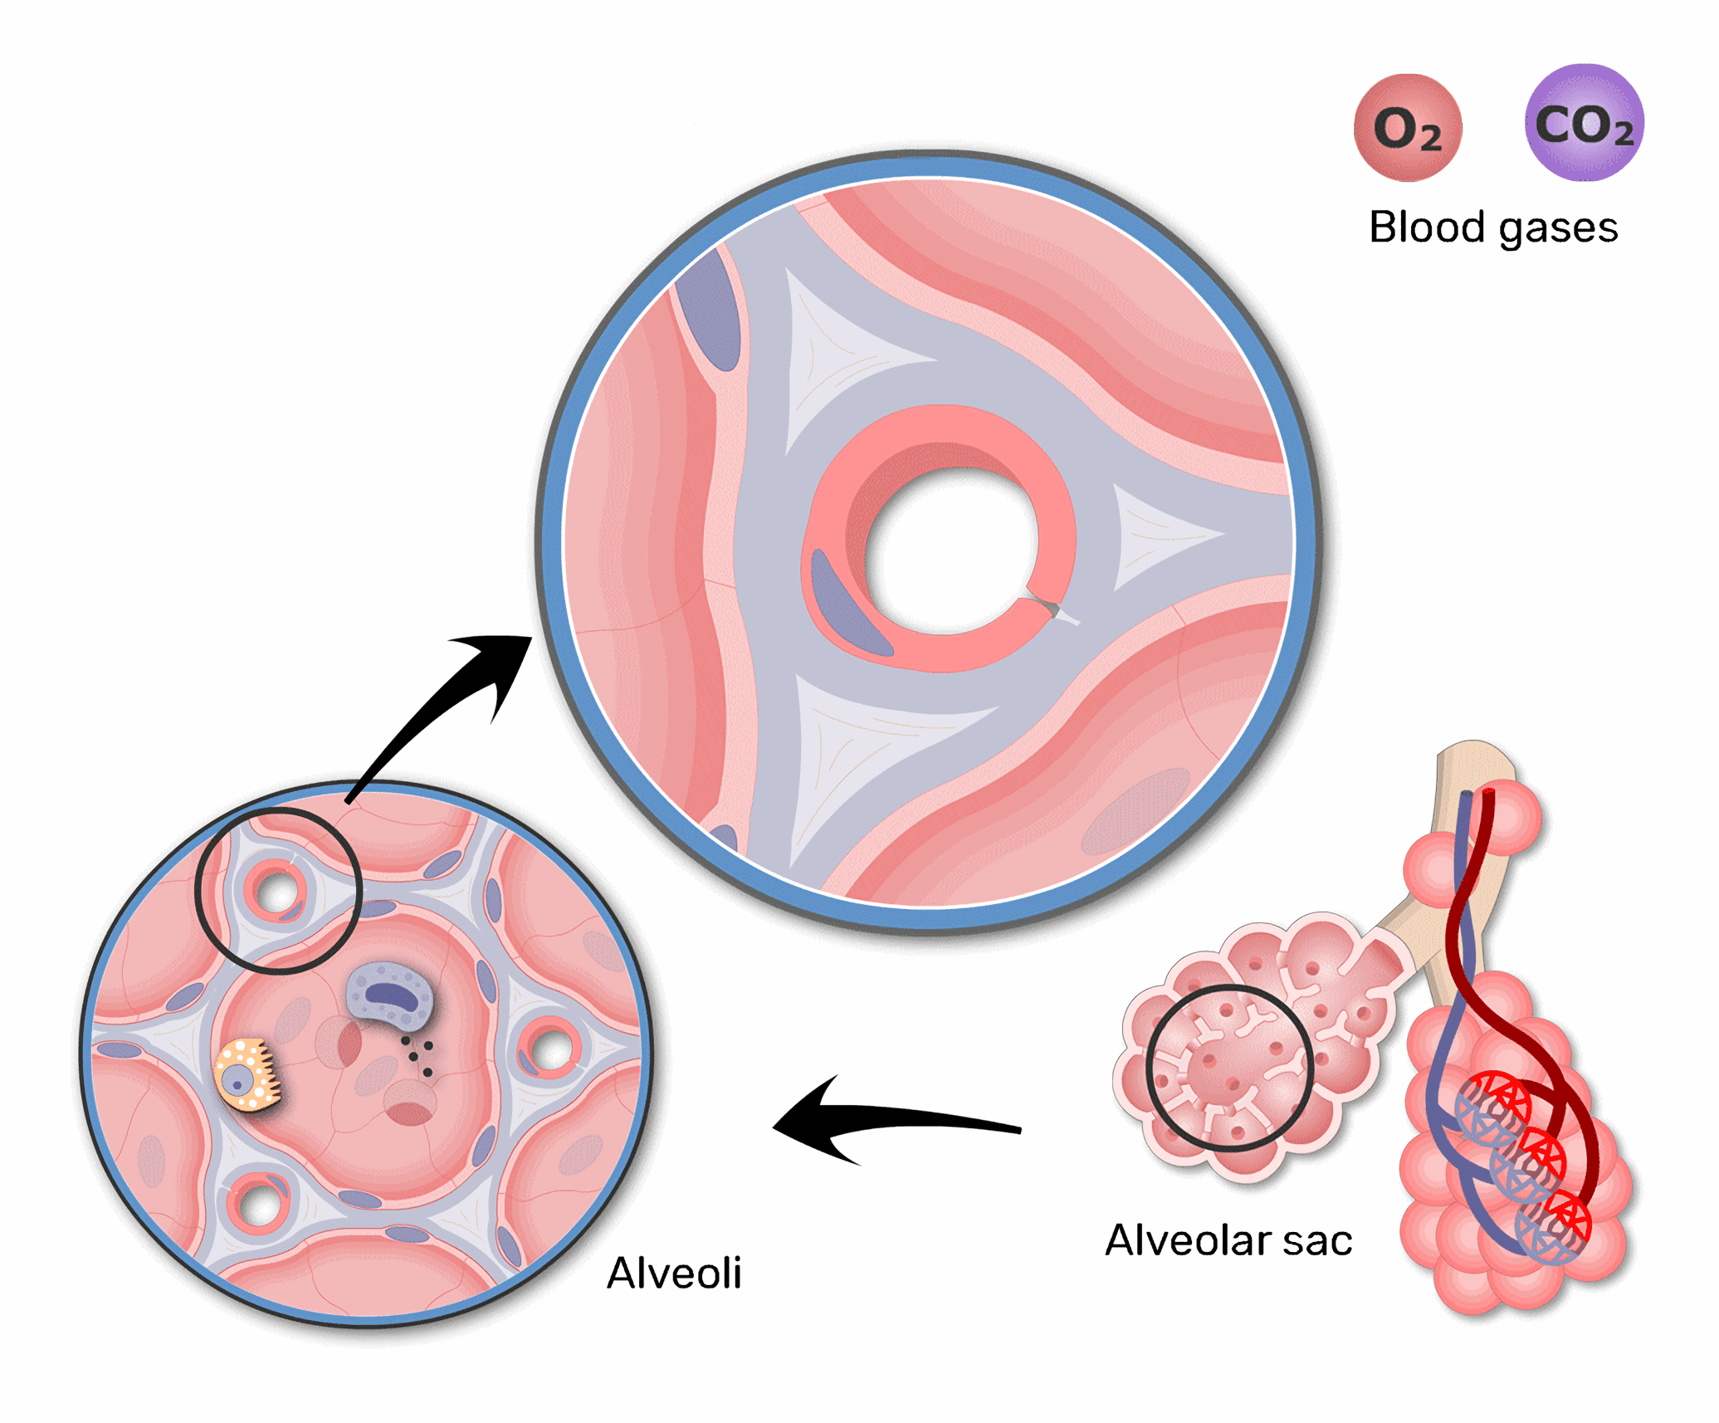
Alveoli are extremely well-adapted for gas exchange.
CO₂ diffuses out of the bloodstream into the alveoli.
O₂ diffuses into the bloodstream out of the alveoli.

