Slide 1
AQA A Level Biology
1 - Monomers and Polymers
Condensation and Hydrolysis Reactions

Slide 2
Evidence for Evolution
Specification Point 3.1.1 - Monomers and polymers.
The variety of life on Earth is extensive.
All living things share a similar biochemistry:
All life uses nucleic acid (DNA or RNA) as genetic material.
All life uses amino acids to build proteins.
These empirical facts supports the theory of evolution.
  The theory of evolution suggests all organisms are descended from a common ancestor.

Slide 3
All forms of life on Earth uses the same twenty amino acids to build proteins.

Slide 4
Darwin’s theory of evolution provides an explanation for the tremendous diversity of life on Earth.

Slide 5
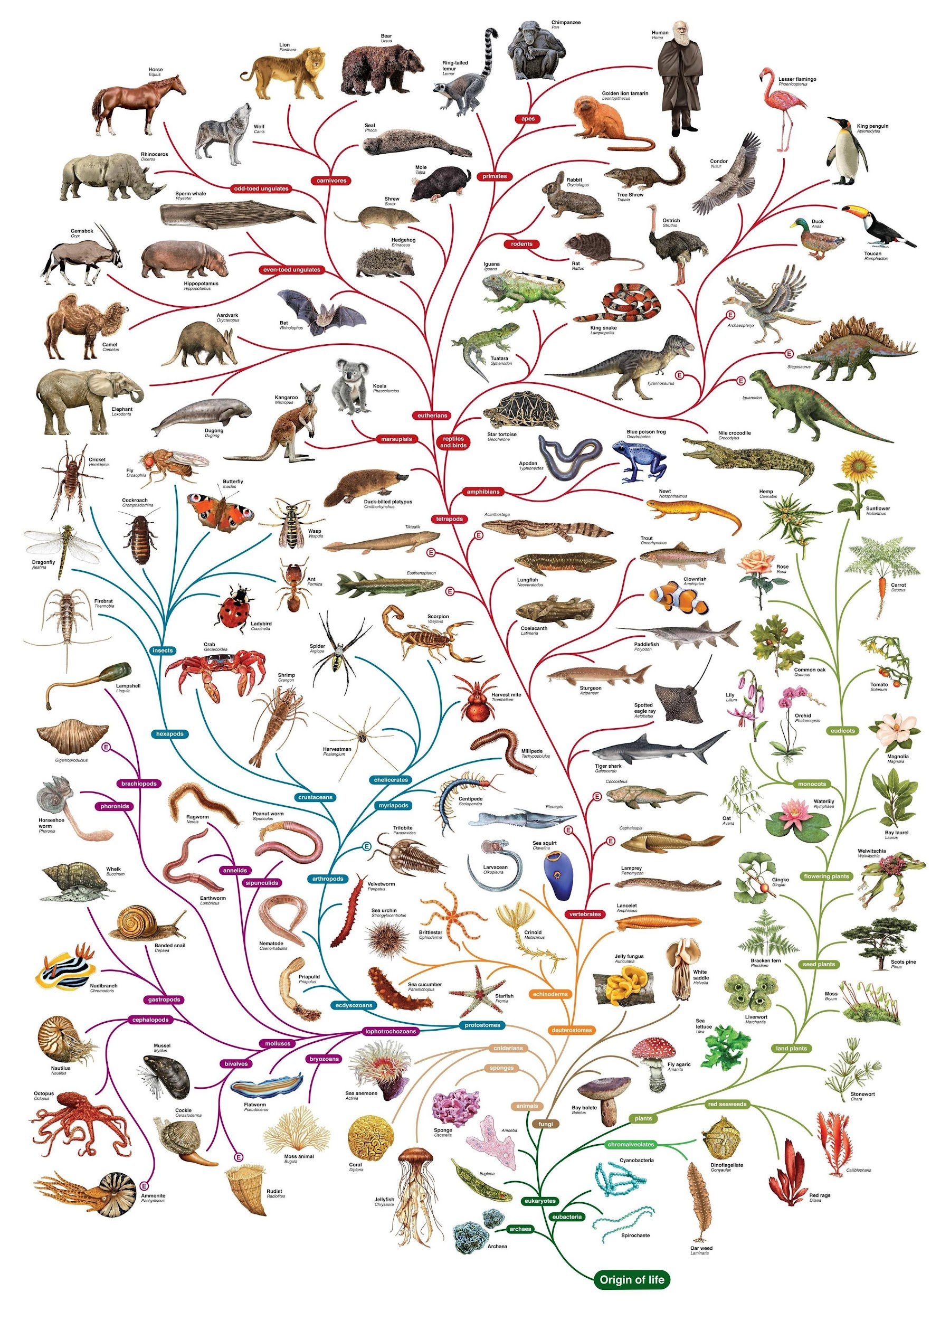
Darwin’s theory of evolution provides an explanation for the tremendous diversity of life on Earth.

Slide 6
Monomers and Polymers
Most carbohydrates, proteins and lipids are polymers.
Polymers are large, complicated molecules composed of long chains of monomers.
  Polymers are formed from their monomers by condensation reactions.
Monomers are small, basic units that form a polymer.
Examples of monomers include:
  Monosaccharides.
  Amino acids.
  Nucleotides.

Slide 7
DNA is a polymer built up from many repeating nucleotides.

Slide 8
Making Polymers - Condensation Reactions
A condensation reaction joins two monomers together.
A chemical bond is formed.
  At the same time a molecule of water is eliminated.

Slide 9
Breaking Down Polymers - Hydrolysis Reactions
A hydrolysis reactions splits a polymer apart into two monomers.
A chemical bond is broken.
  A molecule of water is required.

