Slide 1
AQA A Level Biology
19 - Gas Exchange
Gas Exchange in Fish, Plants and Insects

Slide 2
Gas Exchange Surfaces
Specification Point 3.3.2 - Gas exchange.
Gas exchange occurs at exchange surfaces.
  The is the boundary between internal and external environments with regards to an organism.
  Organisms need oxygen (O₂) and carbon dioxide (CO₂) to diffuse across exchange surfaces.
Gas exchange surfaces usually increase the rate of diffusion by:
  Having a large surface area.
  Being very thin.
    This creates a short diffusion pathway across the exchange surface.
Organisms will also increase the rate of diffusion by maintaining a steep concentration gradient.
  Dedicated mechanisms will quickly move gases away from the exchange surfaces.
  This maintains a concentration gradient.

Slide 3
Gas Exchange in Single-Celled Organisms
Single-celled organisms have a large surface area and a thin exchange surface.
  This means that gases can quickly diffuse into the cell.
As soon as gases diffuse into the cell, they will immediately start to participate in biochemical reactions.
  O₂ for example will take part in respiration.
Single-celled organisms have no need for a specialised gas exchange system.
Bacteria are unicellular and have no specialised systems for gas exchange.

Slide 4
Gas Exchange in Fish
The concentration of O₂ is much lower in water than it is in air.
  Fish have evolved a mechanism to maximise their absorption of O₂.
The specialised gas exchange structure in fish is called the gills.
Water enters the fish through its mouth.
  Water (which contains O₂) will then leave the fish through the gills.
As water passes over the gills, O₂ is absorbed.
  Each gill contains gill filaments. These have a large surface area for diffusion.
  Gill filaments are covered in structures called lamellae. These increase the surface area further.
  Lamellae have many blood capillaries. These increase the concentration gradient.

Slide 5
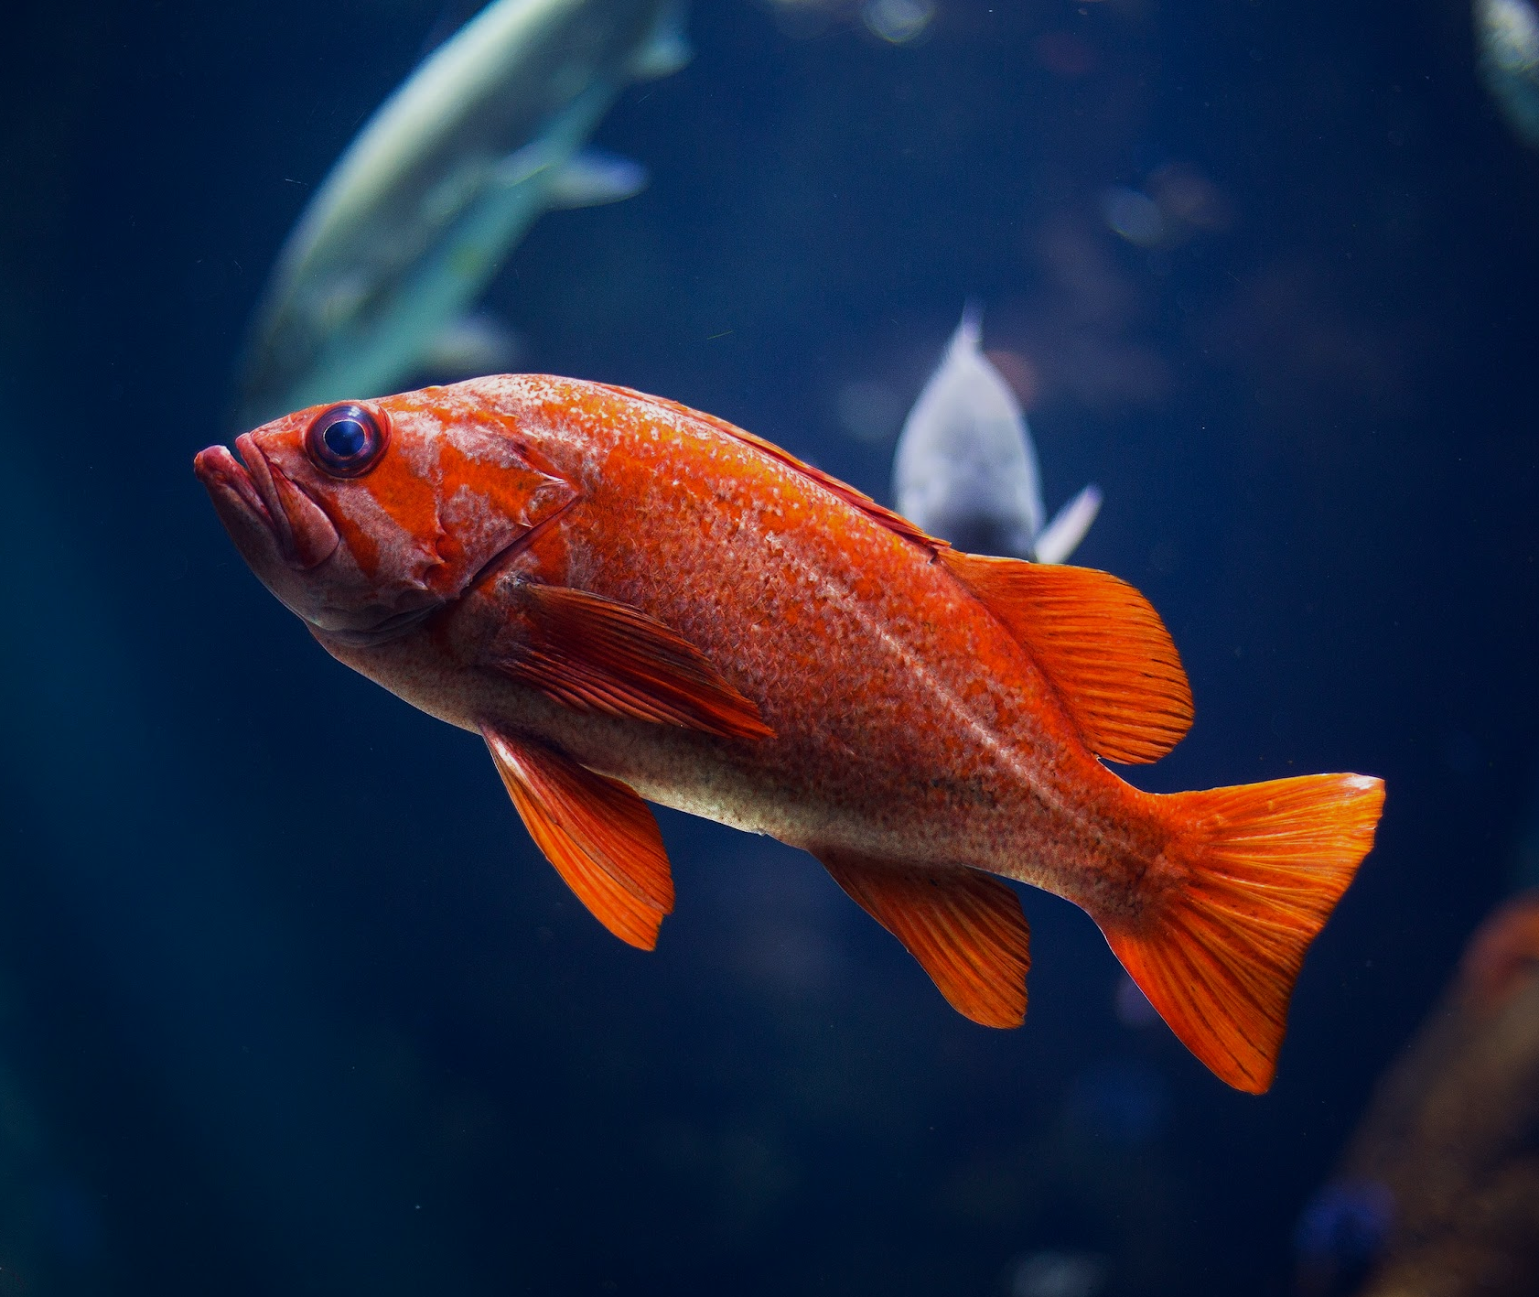
Fish have specialised organs for gas exchange called gills.

Slide 6
As water flows over the surface of the gills, O₂ diffuses into the fish bloodstream.
O₂
H₂O
O₂
O₂
O₂
O₂
O₂
H₂O

Slide 7
Countercurrent Exchange
In the gills of a fish, blood flows in one direction and water flows in the opposite direction.
  This is referred to as countercurrent exchange.
This means that O₂ diffuses over the entire length of the gills.
  Water with a particular concentration of O₂ will always flow next to blood with a lower concentration of O₂.
  A concentration gradient is maintained between water and blood.
This maximises the amount of O₂ that can be released from water.
WATER
In countercurrent exchange, blood flows in one direction and water flows in the opposite direction.
Countercurrent exchange is the most efficient way of releasing O₂ from water.
BLOOD

Slide 8
Gas Exchange in Plants
Plants require CO₂ for photosynthesis.
  Photosynthesis also produces O₂ as a waste product.
Gas exchange in plants mainly takes place on the surface of mesophyll cells.
  Mesophyll cells are highly adapted for their function.
  They have a very high SA:V.
Gases are exchanged through stomata.
  Stomata can open and close to allow gases in and out of the leaf.
Stomata are opened and closed by guard cells.
EXCRETION OF O₂ AND CO₂
Plants excrete waste gases (O₂ and CO₂) through openings called stomata. The stomata are the main route for plants to excrete gases.

Slide 9
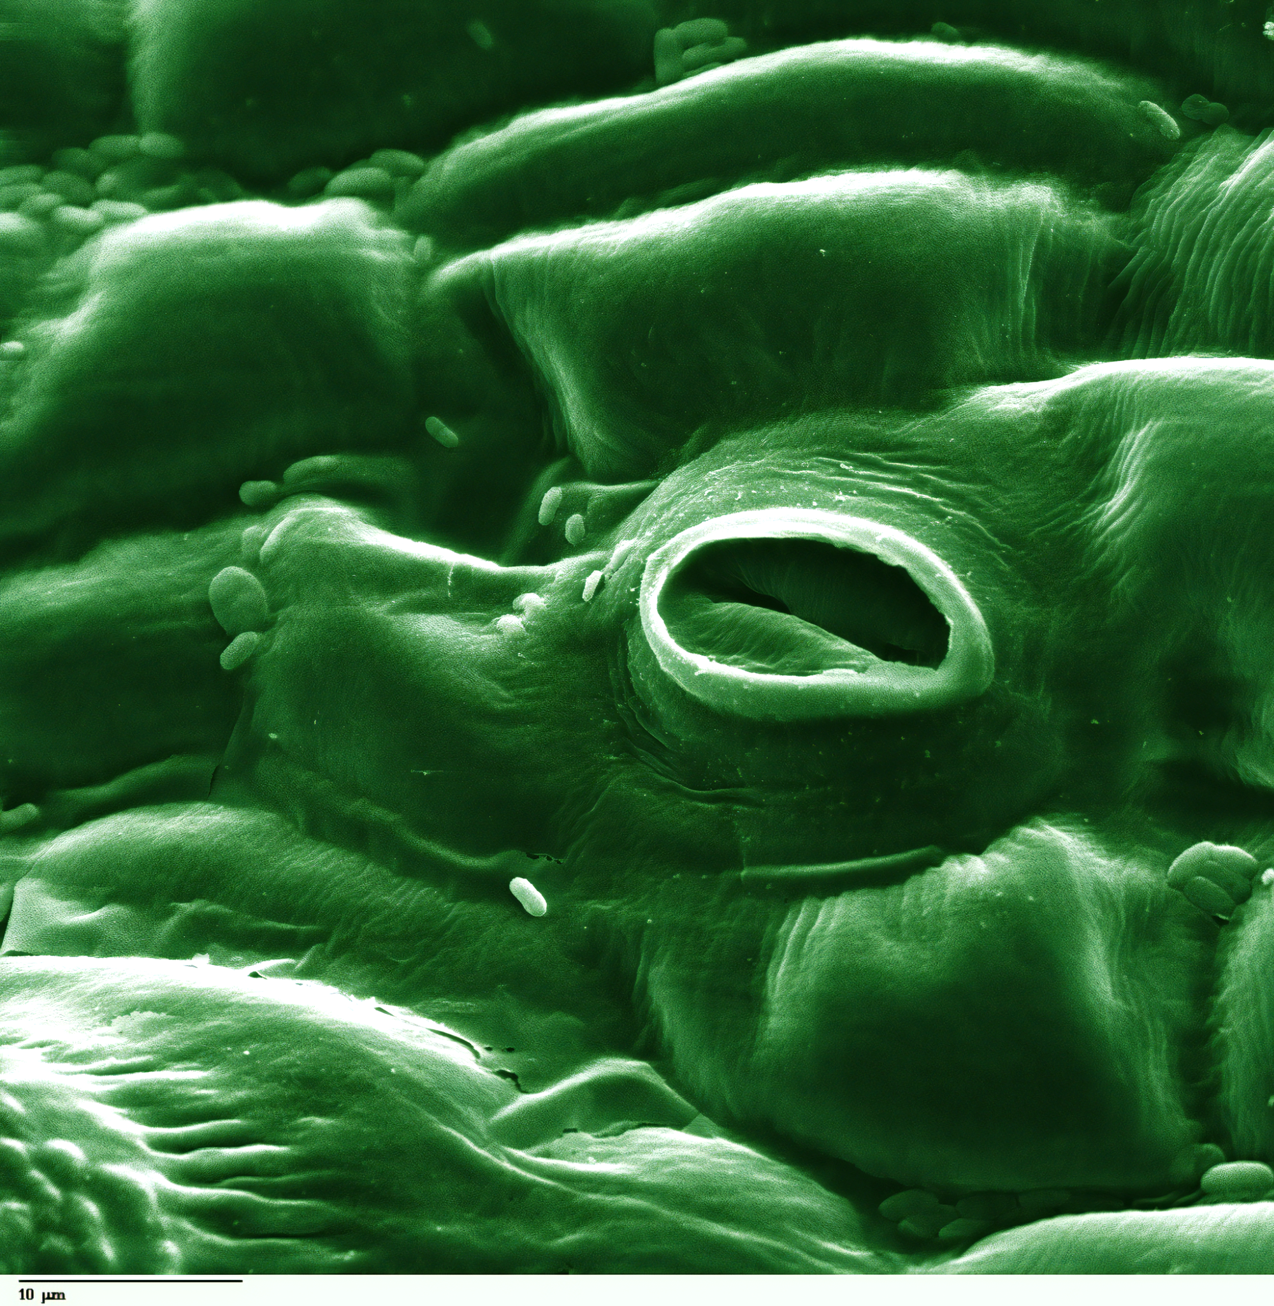
Stomata are small pores that are usually found on the underside of the leaf.
Both O₂ and CO₂ exit through stomatal pores.

Slide 10
Gas Exchange in Insects
Insects exchange gases using their trachea.
  Trachea are small, air-filled pipes.
Air moves down the trachea through spiracles.
  Spiracles are pores on the surface of the insect’s exoskeleton.
Trachea branch into tracheoles.
  Tracheoles have thin, permeable walls that terminate at individual cells.
  O₂ will diffuse directly into respiring cells.
  The circulatory system of the insect does not transport O₂.
CO₂ diffuses from cells to the spiracles.
  CO₂ travels down its own concentration gradient out of the insect.
Some larger insects have muscles in their abdomens.
  These contract rhythmically to move air in and out of the spiracles.

Slide 11
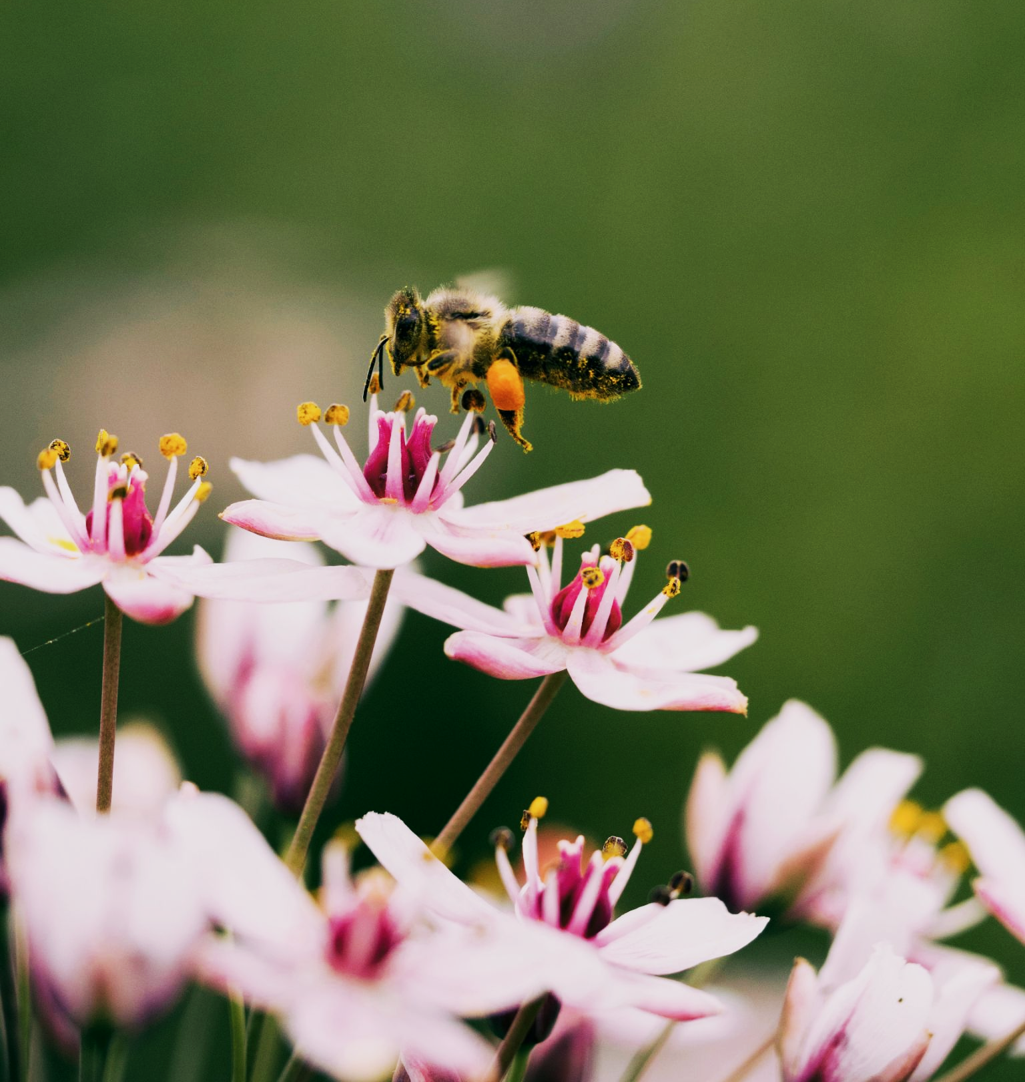
Insects like bees have pores in their exoskeletons called spiracles.
These allow O₂ to diffuse into the insect down trachea.

Slide 12
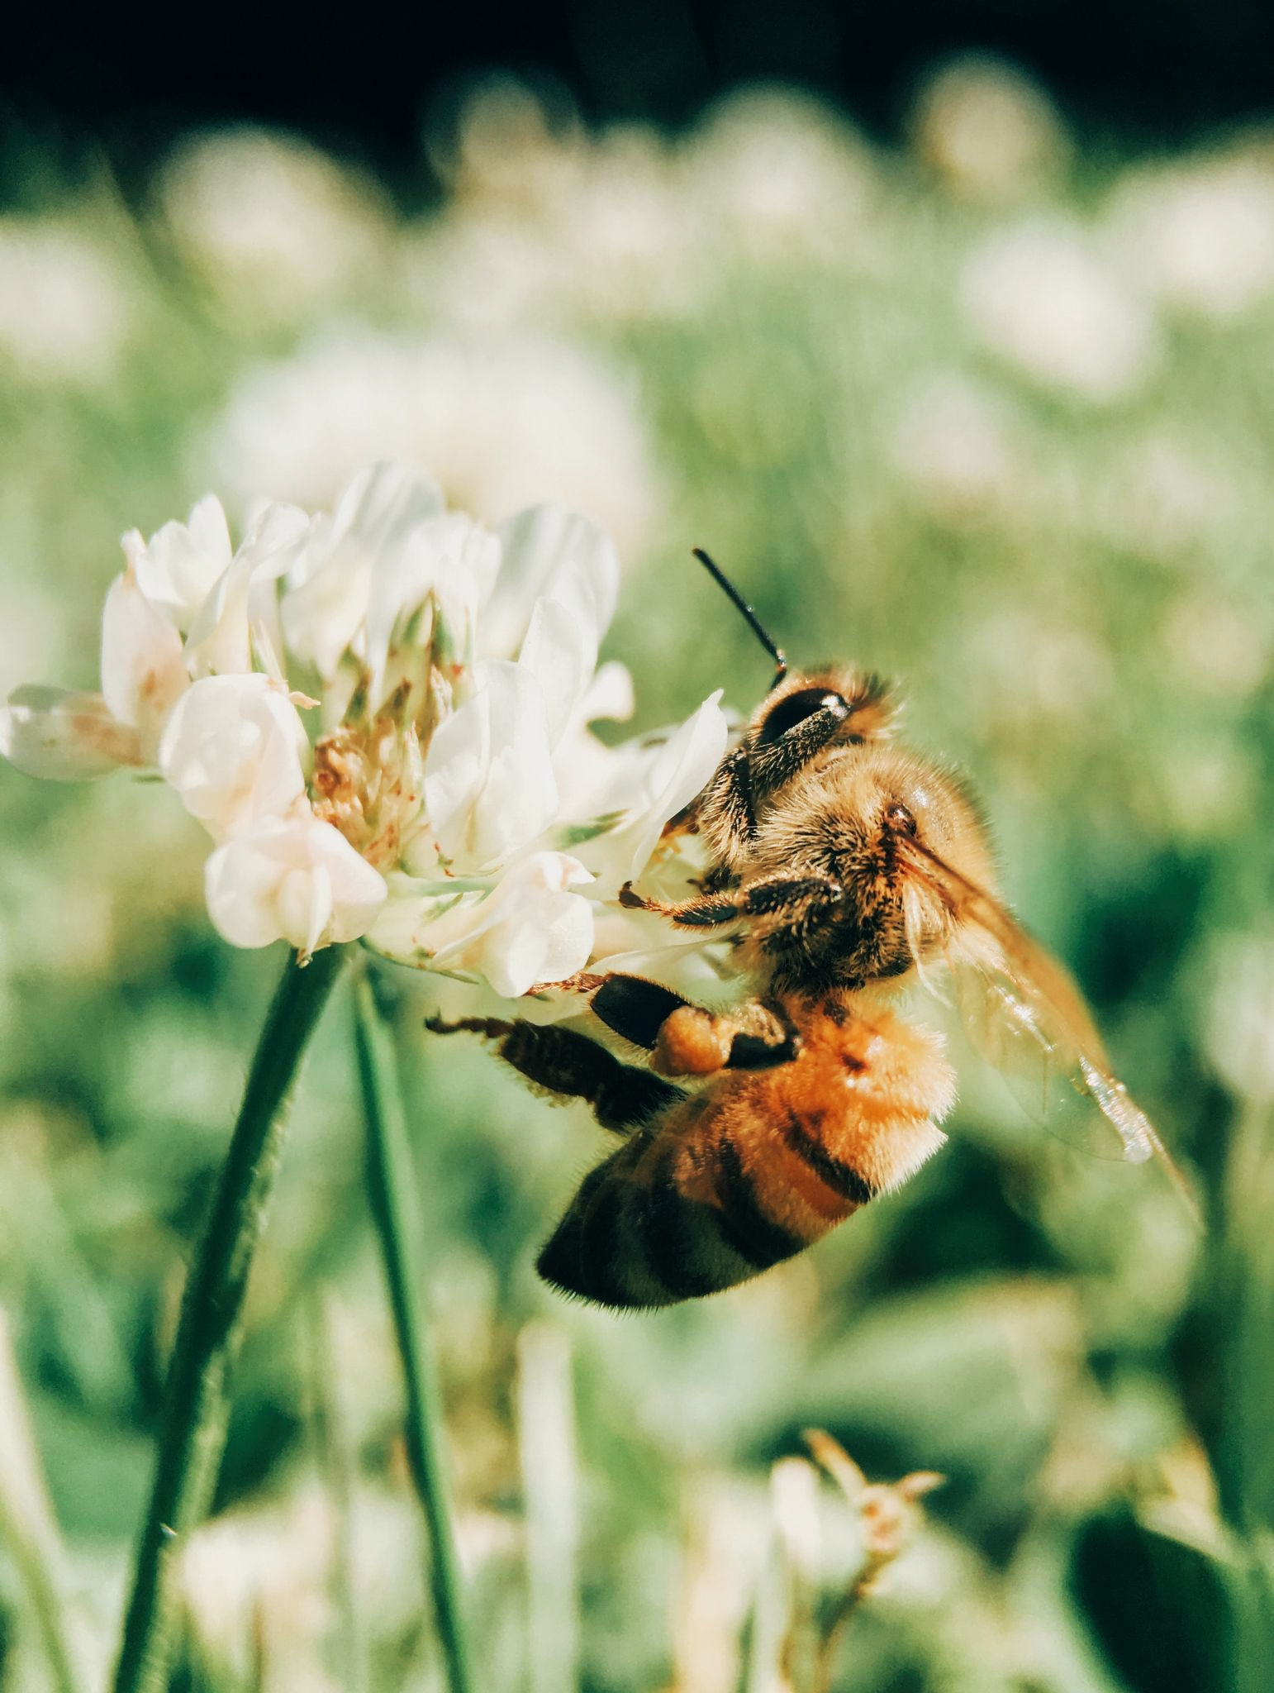
The gas exchange system in an insect.

Slide 13
Controlling Water Loss
Water is often lost during gas exchange.
  Plants and insects have both evolved adaptations to limit water loss.
Insects close their spiracles to mitigate water loss.
  They are also covered in a waxy cuticle and hairs.
  Both of these features help to limit the amount of water lost during gas exchange.
Stomata are opened and closed by guard cells.
  During the day, the stomata are open.
    Water enters the guard cell, causing them to swell. This opens the stomatal pores.
  If the plant loses too much water, guard cells become flaccid.
    This causes stomatal pores to close.

Slide 14
Xerophytes
Some plants are evolved to live in very dry environments.
  These plants are called xerophytes.
Xerophytes have a number of structural adaptations:
Xerophytes have sunken stomata and hairs.
  These collect water vapour, reducing the concentration gradient inside and outside of the leaf.
Xerophytes have curled leaves.
  These protect the plant from windy conditions.
  Wind increases the rate of evapotranspiration.
Xerophytes often have a thicker waxy cuticle.
  This waterproofs the leaves and stems, reducing evapotranspiration.

Slide 15
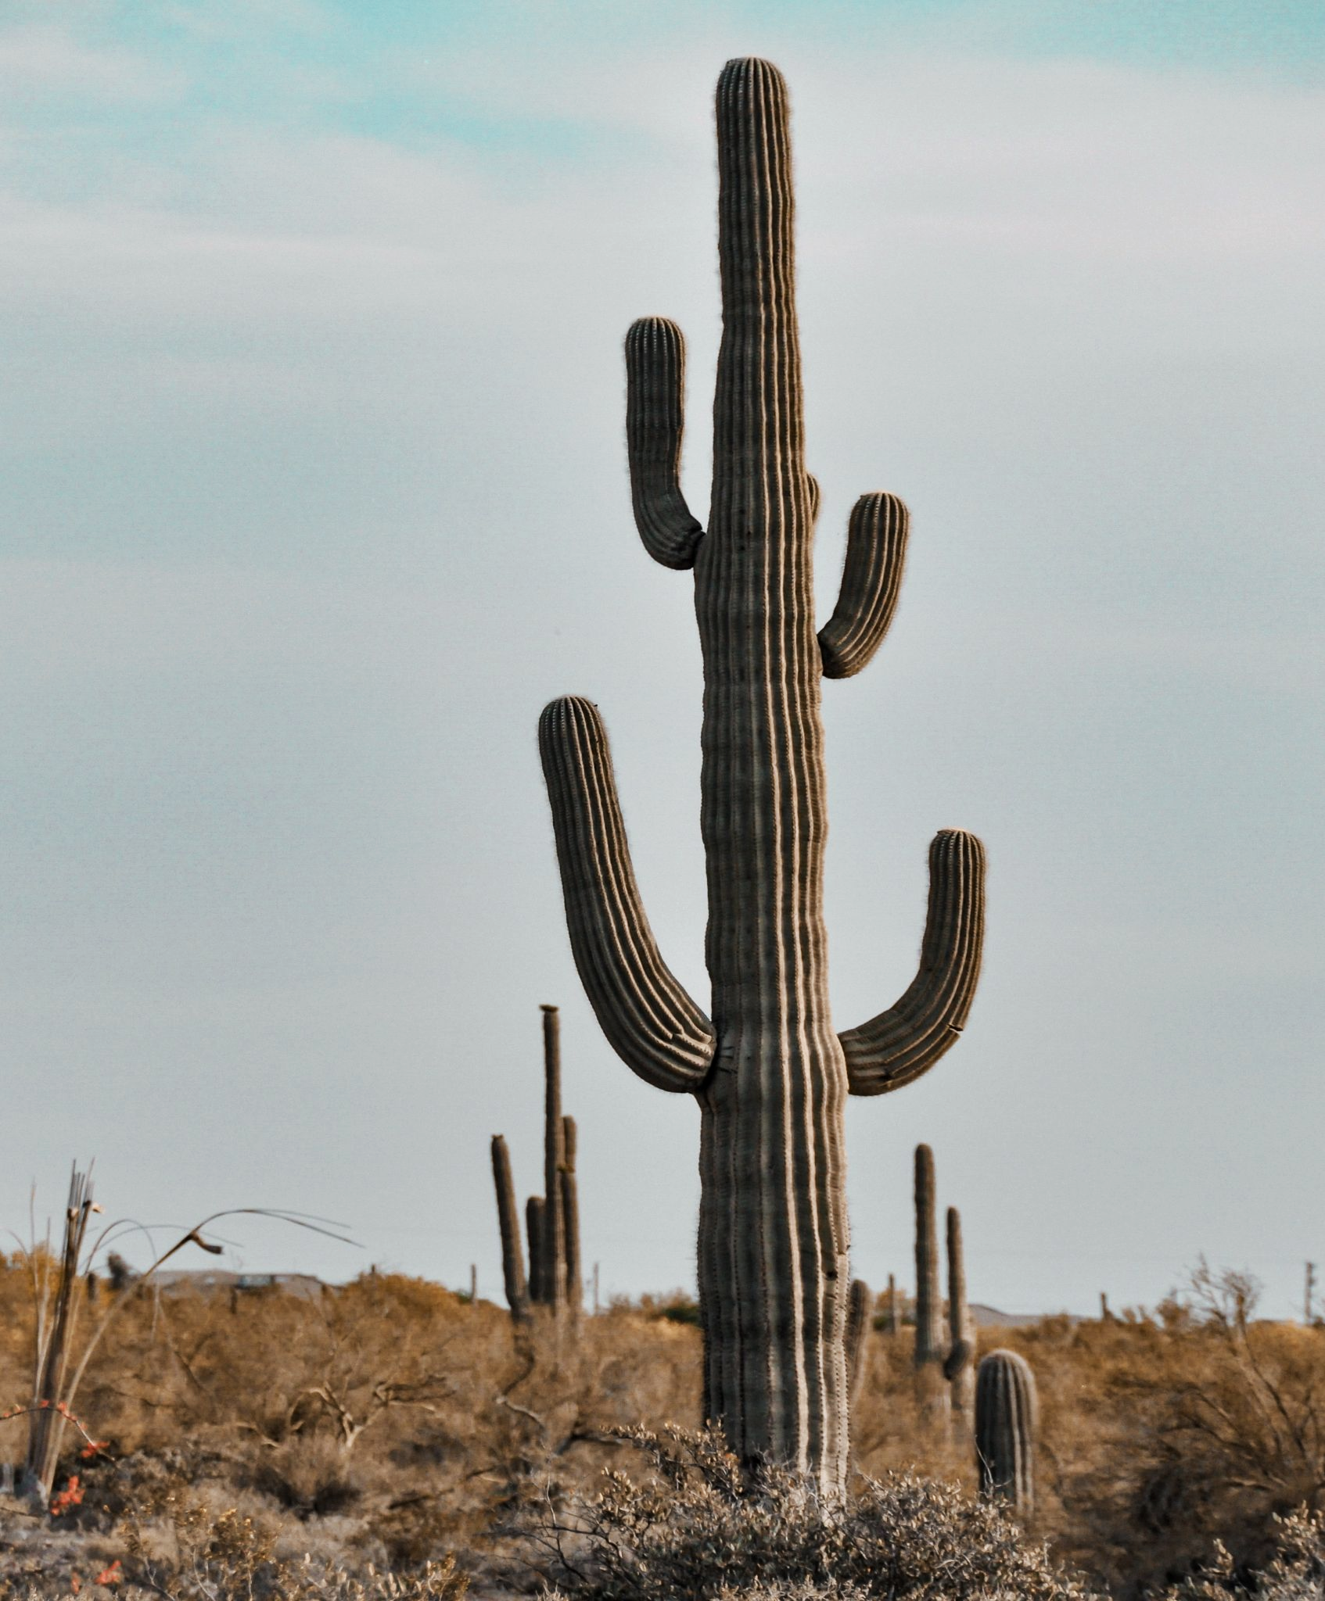
Cacti are probably the most famous family of xerophytic plants.

