Slide 1
AQA A Level Biology
18 - Size and Surface Area
SA:V, Heat Exchange and Physiological Adaptations

Slide 2
Surface Area to Volume Ratio
Specification Point 3.3.1 - Surface area to volume ratio.
Organisms need to exchange substances with their environment.
  Cells require oxygen (O₂) and glucose for aerobic respiration.
  They also need to excrete waste products such as carbon dioxide (CO₂).
Organisms need to maintain a fairly constant temperature.
  Heat needs to be exchange with the environment.
The rate of substance exchange is determined by an organism’s surface area to volume ratio (SA:V).
  Small organisms have a high SA:V.
  Larger organisms have a lower SA:V.

Slide 3
NUMBER OF CUBES = 1
DIMENSIONS (CM) = 2 × 2
SURFACE AREA (CM²) = (2 × 2 × 6) = 24
VOLUME (CM³) = (2 × 2 × 2) = 8
SA:V = 24 ÷ 8 = 3
NUMBER OF CUBES = 8
DIMENSIONS (CM) = 1 × 1
SURFACE AREA (CM²) = 8 (1 × 1 × 6) = 48
VOLUME (CM³) = 8 (1 × 1 × 1) = 8
SA:V = 48 ÷ 8 = 6
Small animals have a much higher SA:V than larger animals. This can be proven mathematically using cubes of various sizes.

Slide 4
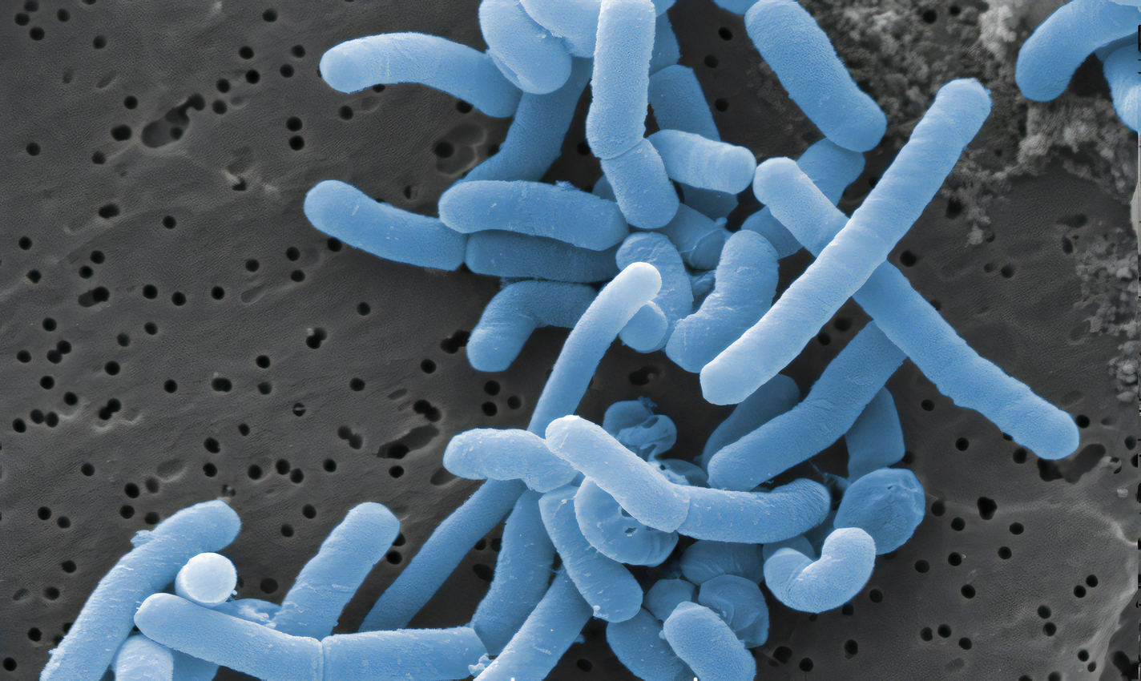
Calculating Volume and Surface Area
Bacteria come in several shapes.
  Coccal bacteria are spherical in shape.
  Bacilli (rod-shaped) bacteria are cylindrical in shape.
The volume of coccal bacteria can be calculated.
  The volume of a sphere is 4/3πr³.
The volume of rod-shaped bacteria can also be calculated:
  By splitting the shape into 2 parts.
    The cylindrical core.
    The semicircular hemispheres on each end of the cell.
Lactobacillus is a rod-shaped bacteria that is used in the production of yoghurt.

Slide 5
LACTOBACILLUS
1. Firstly, the volume of a cylinder is calculated using πr²h. Here r = 3/2 = 1.5 and h = 10 - (1.5 x 2) = 7. Therefore πr²h = 49.48.
2. Then the volume of the 2 hemispheres is calculated. The volume of a sphere is 4/3πr³. The total volume is 14.14.
3. These are added together for the total volume.
This equals 49.48 + 14.14 = 63.62 μm³.
3 μm
10 μm
r
h

Slide 6
Exchange Organs
In single-celled organisms, substances diffuse directly in and out of the cell.
  The diffusion rate is very quick, because of a high SA:V and a short diffusion pathway.
In multicellular organisms, diffusion is too slow to exchange substances quickly enough.
  Some cells are too deep inside the body to interact with the environment.
  There is a much lower SA:V in larger organisms.
Multicellular organisms use specialised organs to exchange substances.
  Mammals use organs such as the lungs to exchange O₂ and CO₂.
  Organisms also have specialised transport systems to exchange substances. This is called mass transport.
Mammals use the circulatory system to transport substances around the body.
  This includes the lungs, the heart and associated vessels.

Slide 7
The lungs are a specialised exchange organ utilised by mammals.

Slide 8
Heat Exchange and Size
It is important for many organisms to maintain a constant temperature.
  The ability to exchange heat is influenced by body size and body shape.
Heat exchange depends on body size.
Large organisms have large internal volume.
  This likely means they have a low SA:V.
  They will find it more difficult to lose heat than a smaller organism (with a higher SA:V).
Smaller organisms will require a higher metabolic rate than larger ones.
  This is because they will lose lots of heat due to their high SA:V.
  A mouse will have a much higher metabolic rate (per gram) than an elephant.

Slide 9
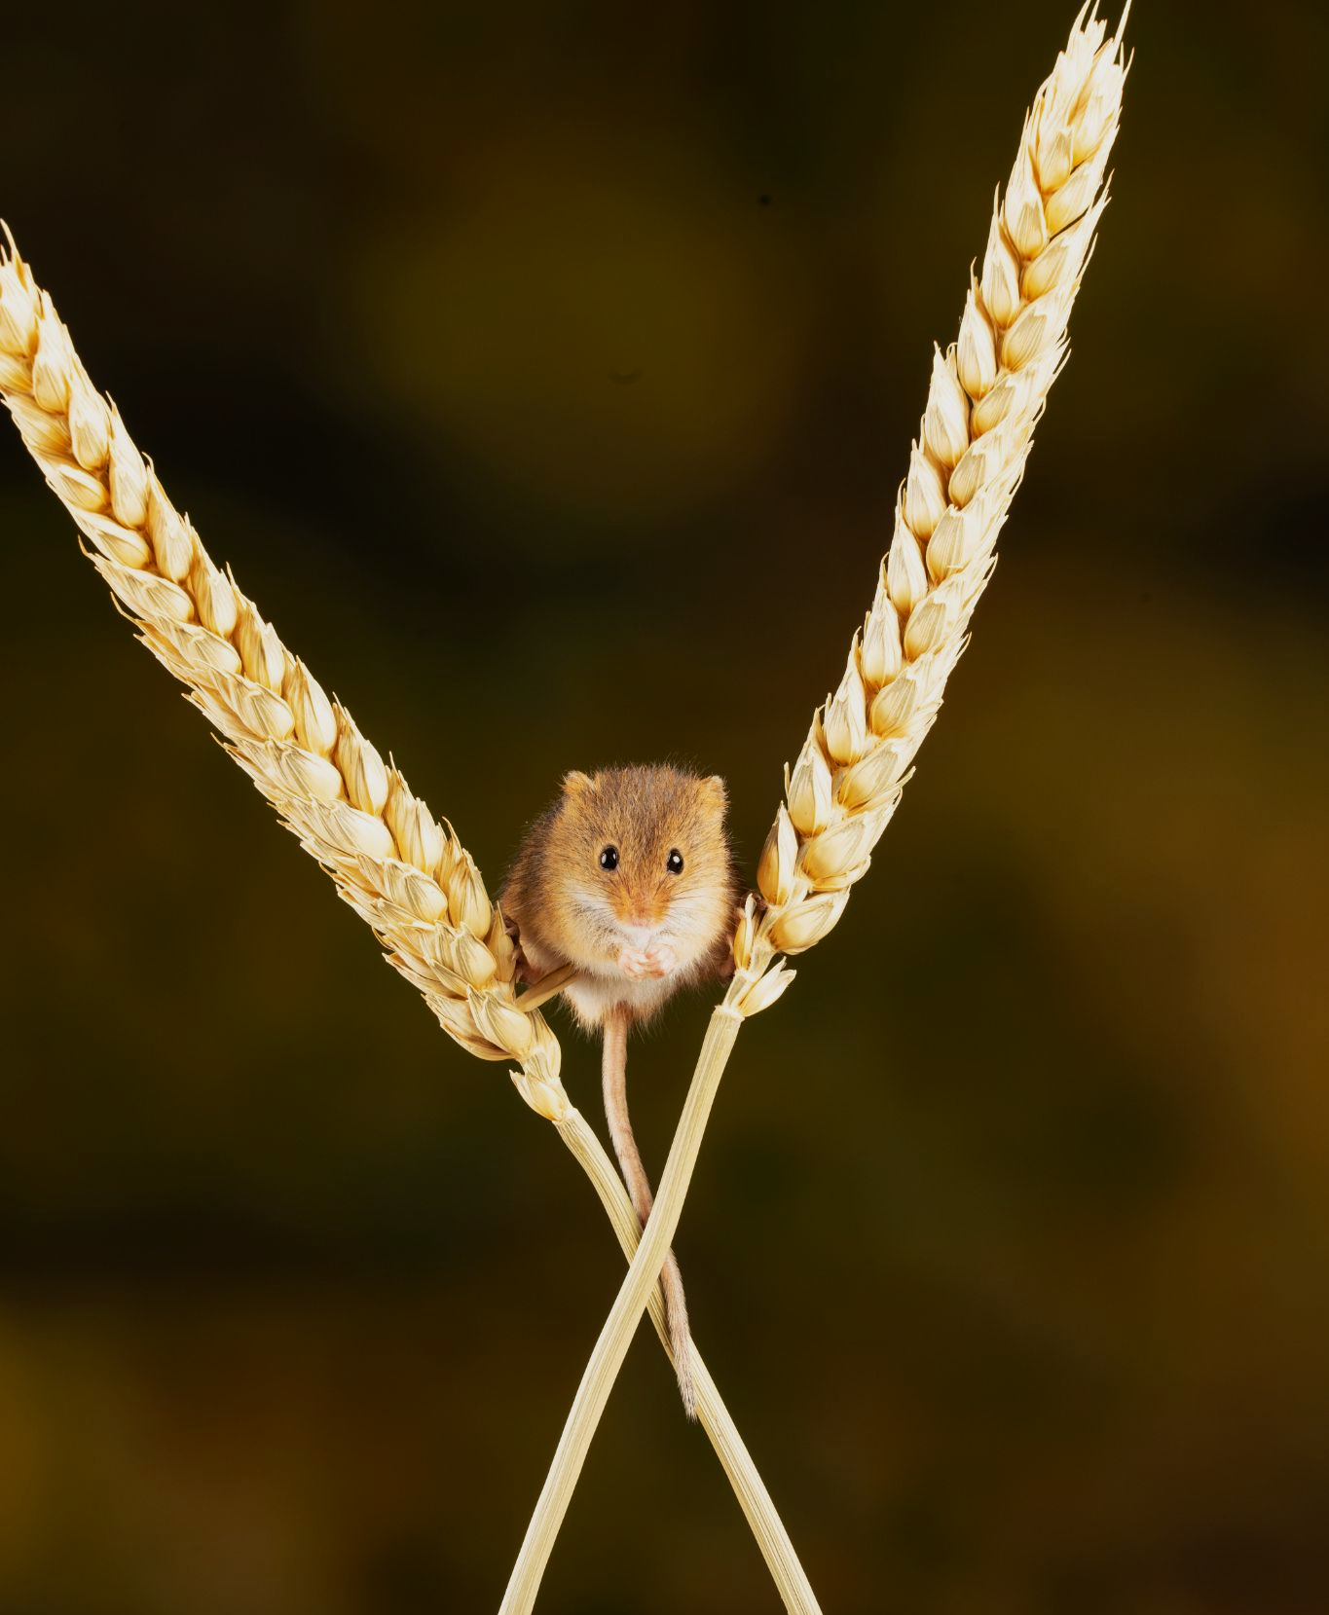
A field mouse loses a lot of heat due to its high SA:V.
It must eat regularly to maintain its high metabolic rate.

Slide 10
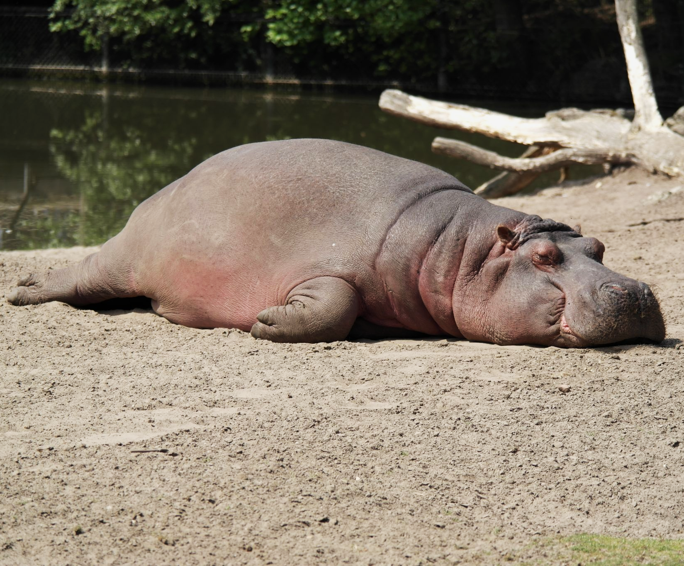
A hippopotamus has a massive internal volume, so has a low SA:V.
It will lose heat much more slowly than the field mouse so has a lower basal metabolic rate.

Slide 11
Heat Exchange and Shape
Heat exchange depends on body shape.
Organisms with a compact shape will have a relatively small SA:V.
  This means they will lost relatively little heat.
Animals with a less compact shape will have a higher SA:V.
  This means they will lose more heat.
Animals have adaptations to suit their environment.
The shape of an organism has often evolved to adapt to the temperature or weather conditions of their habitat.

Slide 12
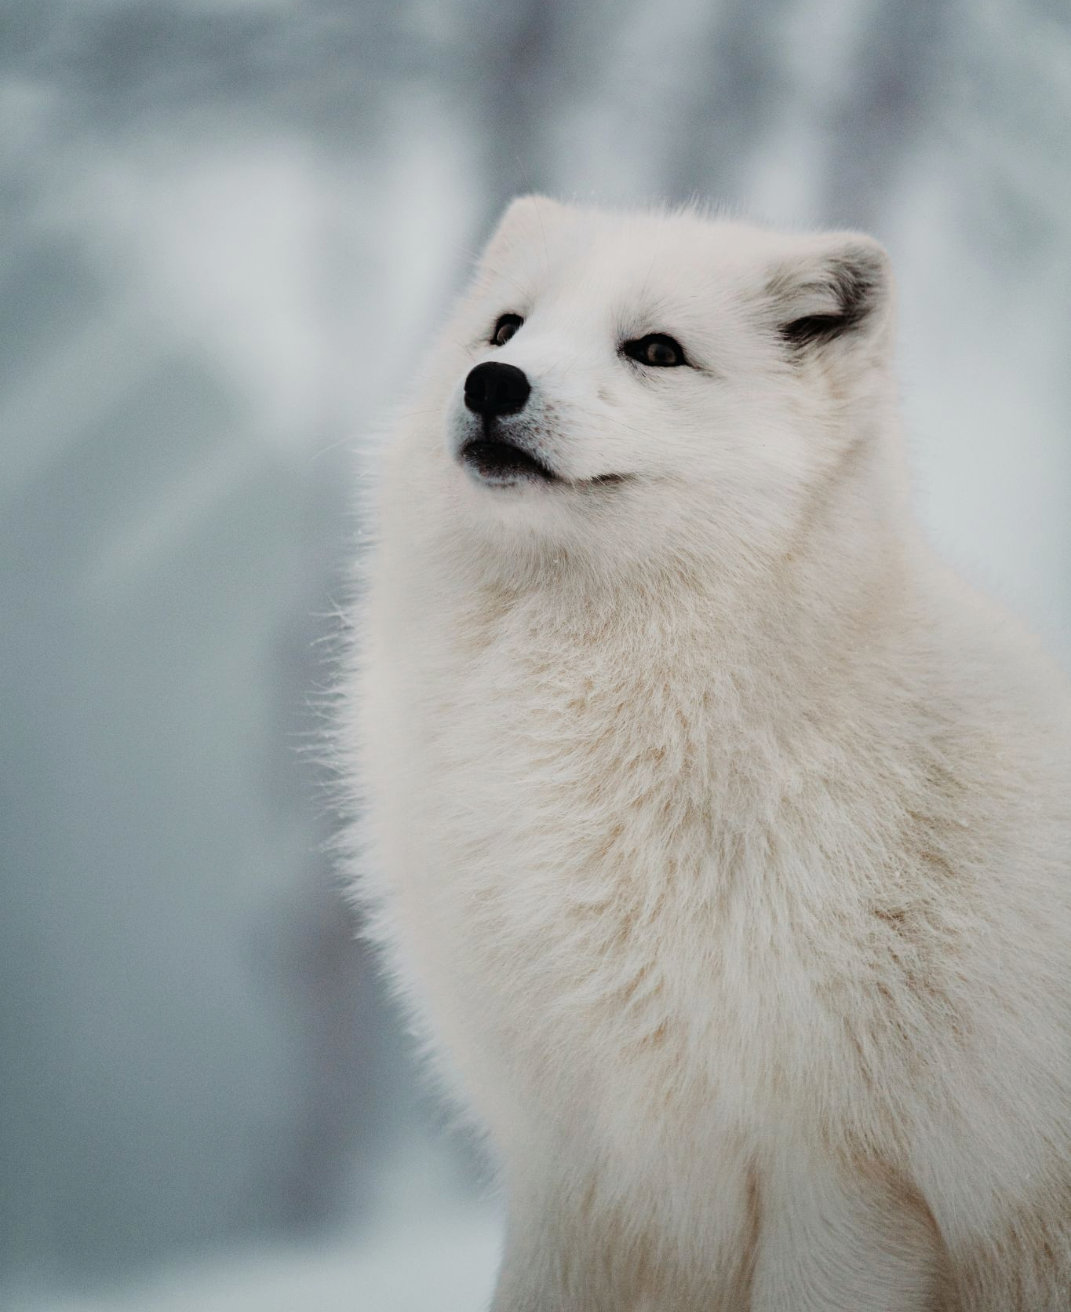
The Arctic fox has very small ears to reduce it’s SA:V.
This helps to reduce heat loss in cold climates.

Slide 13
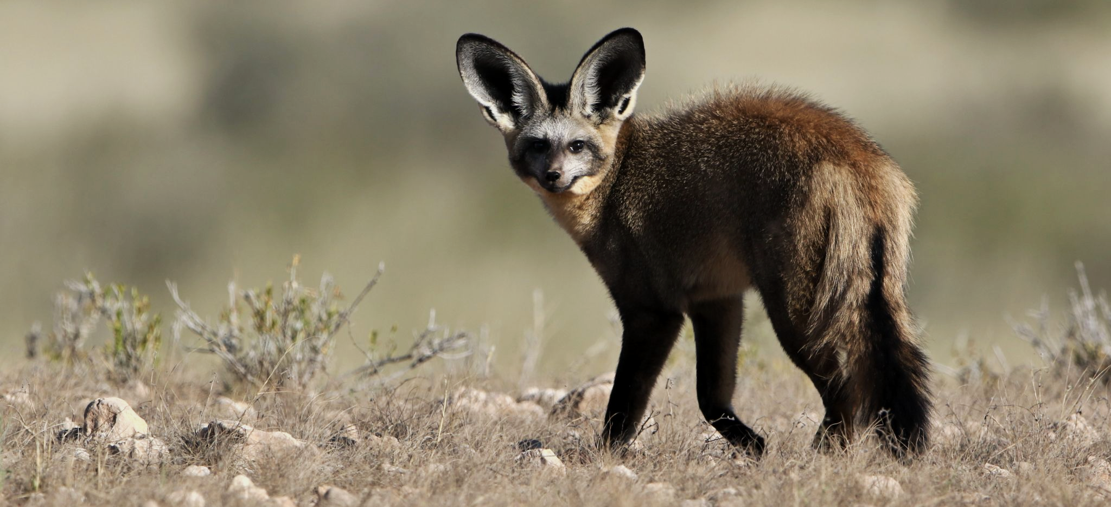
The African bat-eared fox has very large ears to increase its SA:V. This increases its ability to lose heat in hot climates.

Slide 14
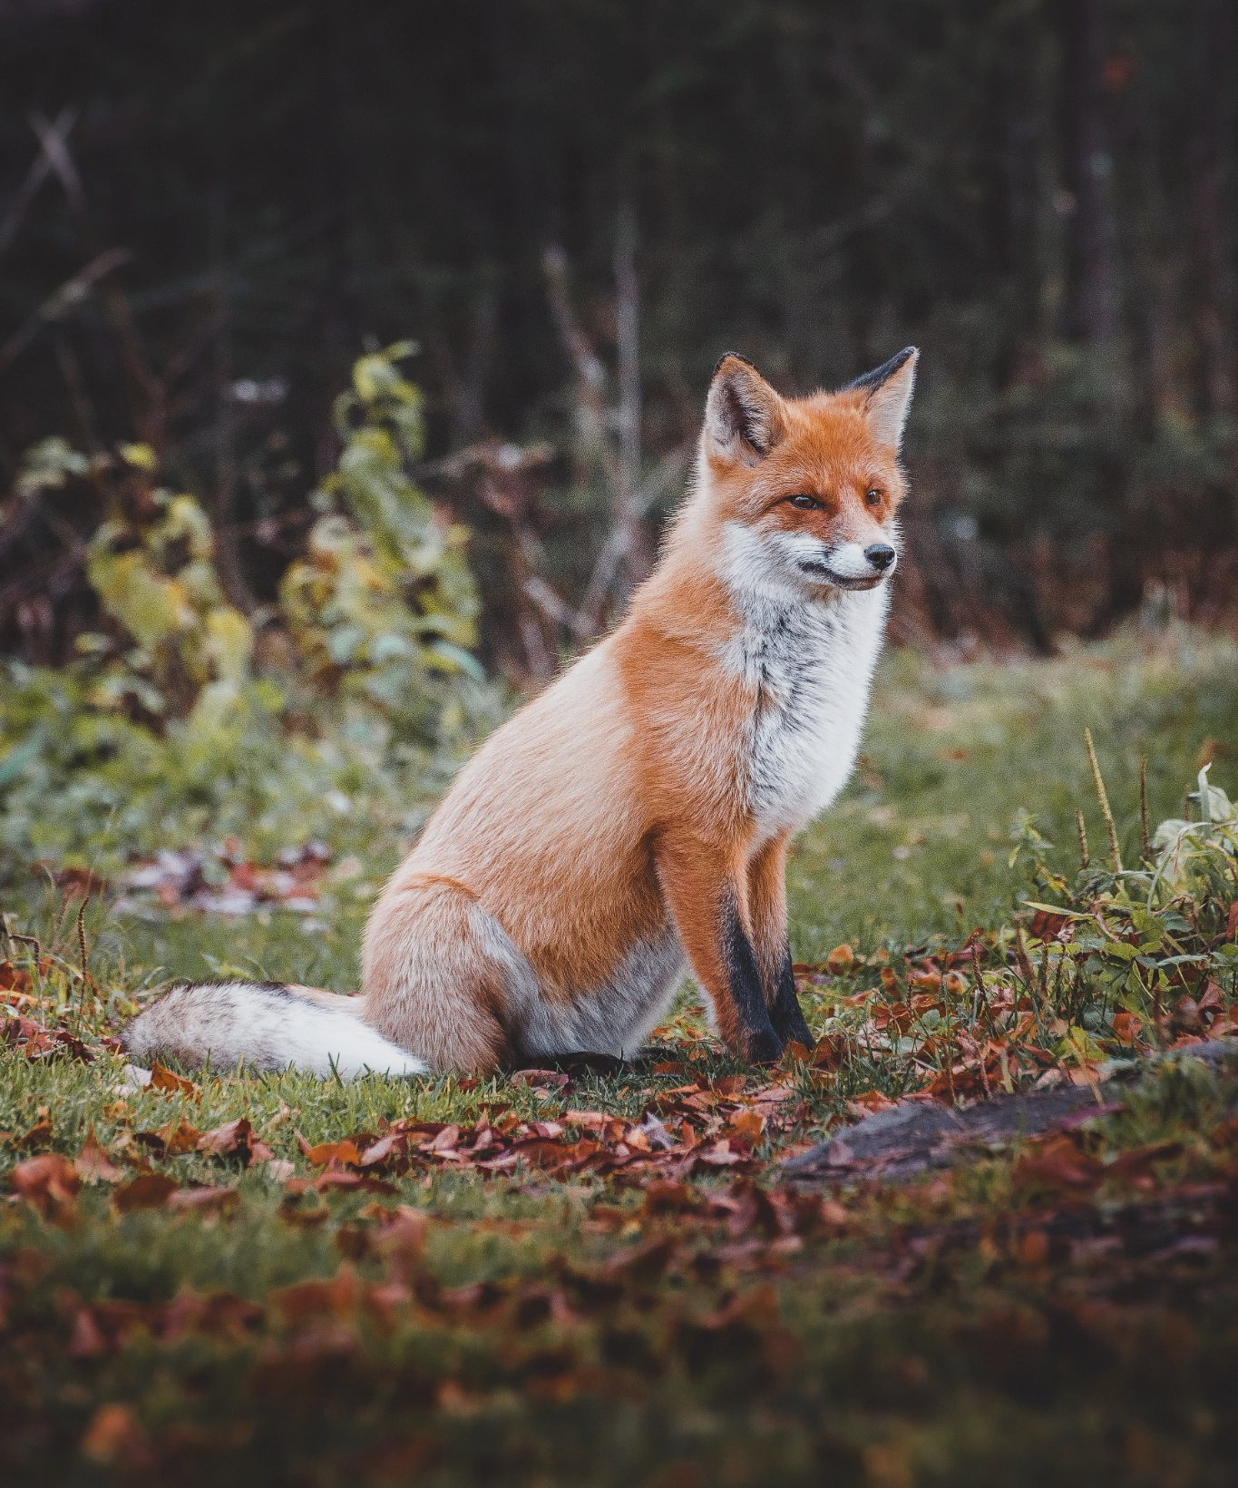
The European fox lives in temperate climes.
It has a moderate SA:V due to its intermediately-sized ears.

Slide 15
Physiological and Behavioral Adaptations
Some animals have internal physiological adaptations for their environment.
  Desert-dwelling animals such as the desert mole rat have specialised structures in the kidney to retain as much water as possible.
Some animals have external anatomical adaptations for their environment.
  Animals that live in cold environments have thick fur or blubber to maintain body temperature.
Other animals have modified their behaviour.
  Some animals with high SA:V will eat constantly to maintain their high metabolic rates.
  Many will seek shelter when weather becomes inhospitable.

Slide 16
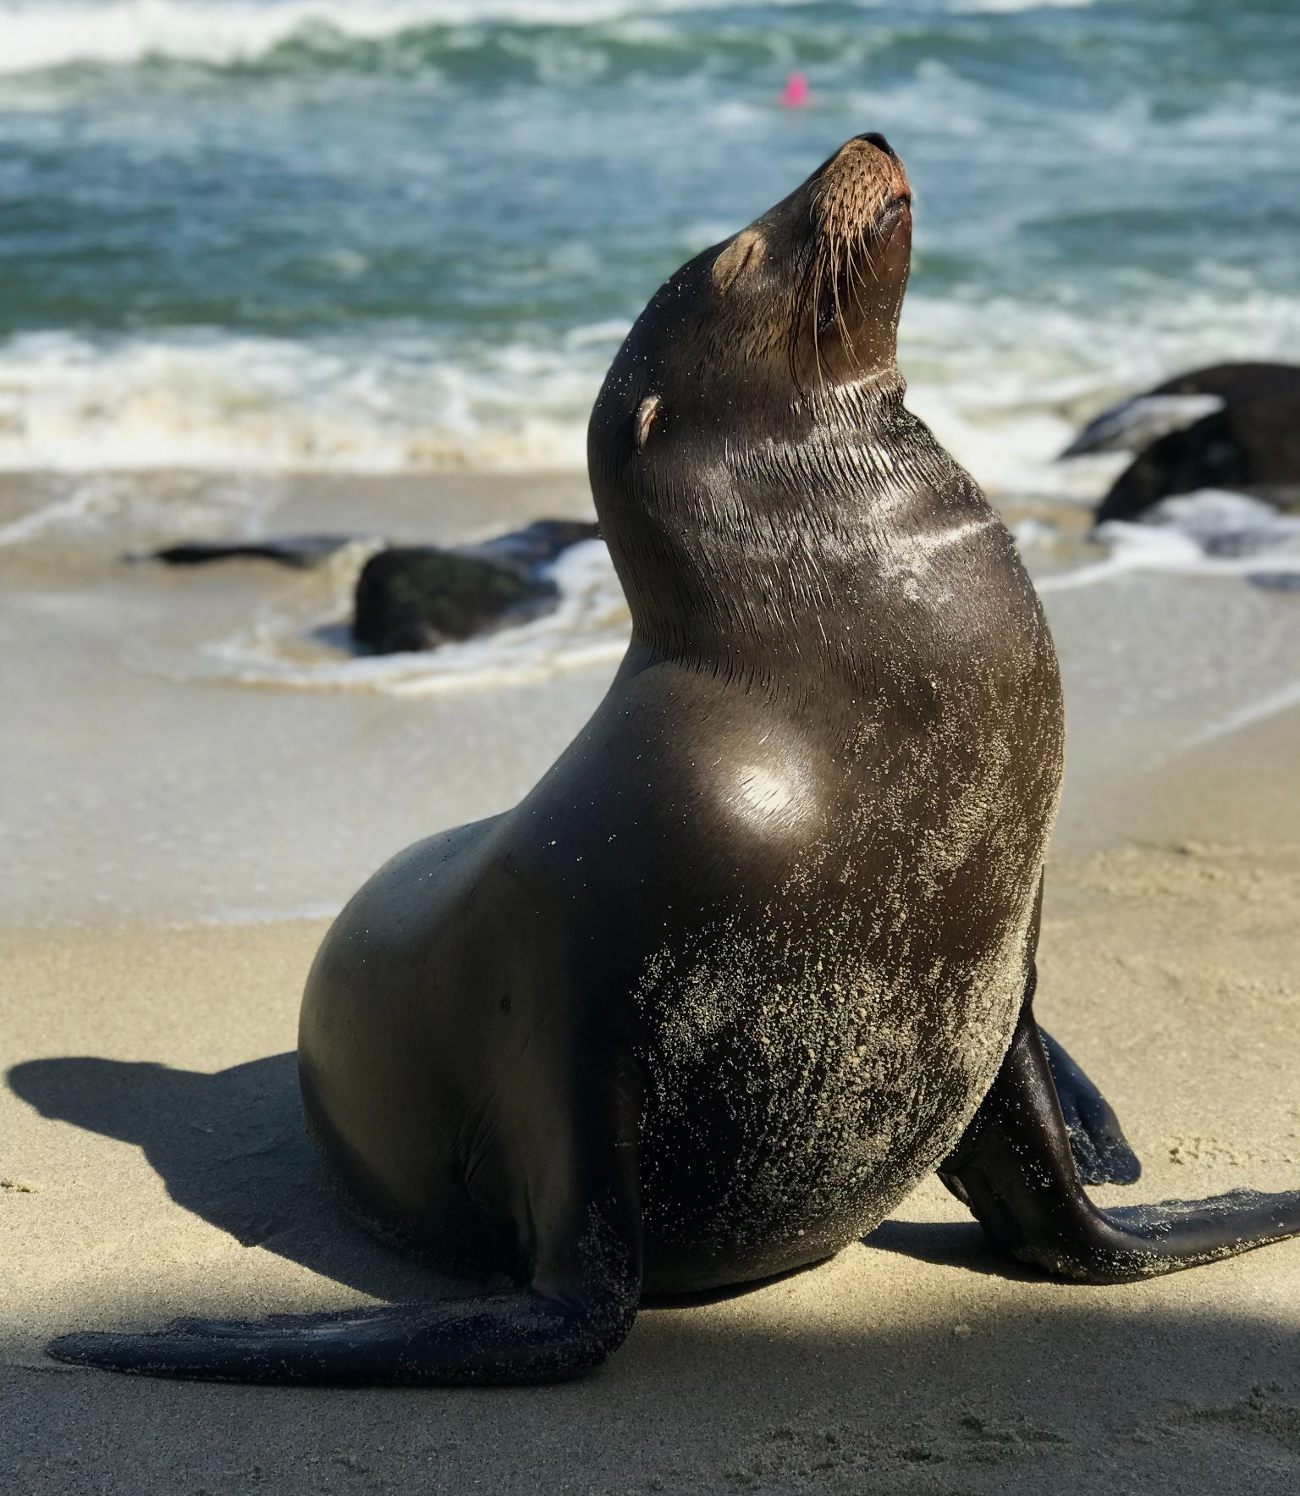
Seals have a thick layer of blubber to help conserve heat in polar waters.

