Slide 1
AQA A Level Biology
17 - HIV and Viruses
Mechanisms, Symptoms and Control

Slide 2
HIV and AIDS
Specification Point 3.2.4 - Cell recognition and the immune system.
The human immunodeficiency virus (HIV) is a virus that affects the human immune system.
HIV will eventually lead to acquired immunodeficiency syndrome (AIDS).
  AIDS results in a compromised immune system that is unable to fight off infectious diseases.
  Those with AIDS are more vulnerable to infections such as tuberculosis and pneumonia.
HIV infects T-helper (T_{H}) cells.
  These act as the host cells for the virus.
  T_{H} cells help run the immune system. They activate cytotoxic T-cells and B-cells.
  When the number of T_{H} cells drops below a certain level, the immune system begins to fail.
  Individuals with critically low numbers of T_{H} cells begin to show the symptoms of AIDS.

Slide 3
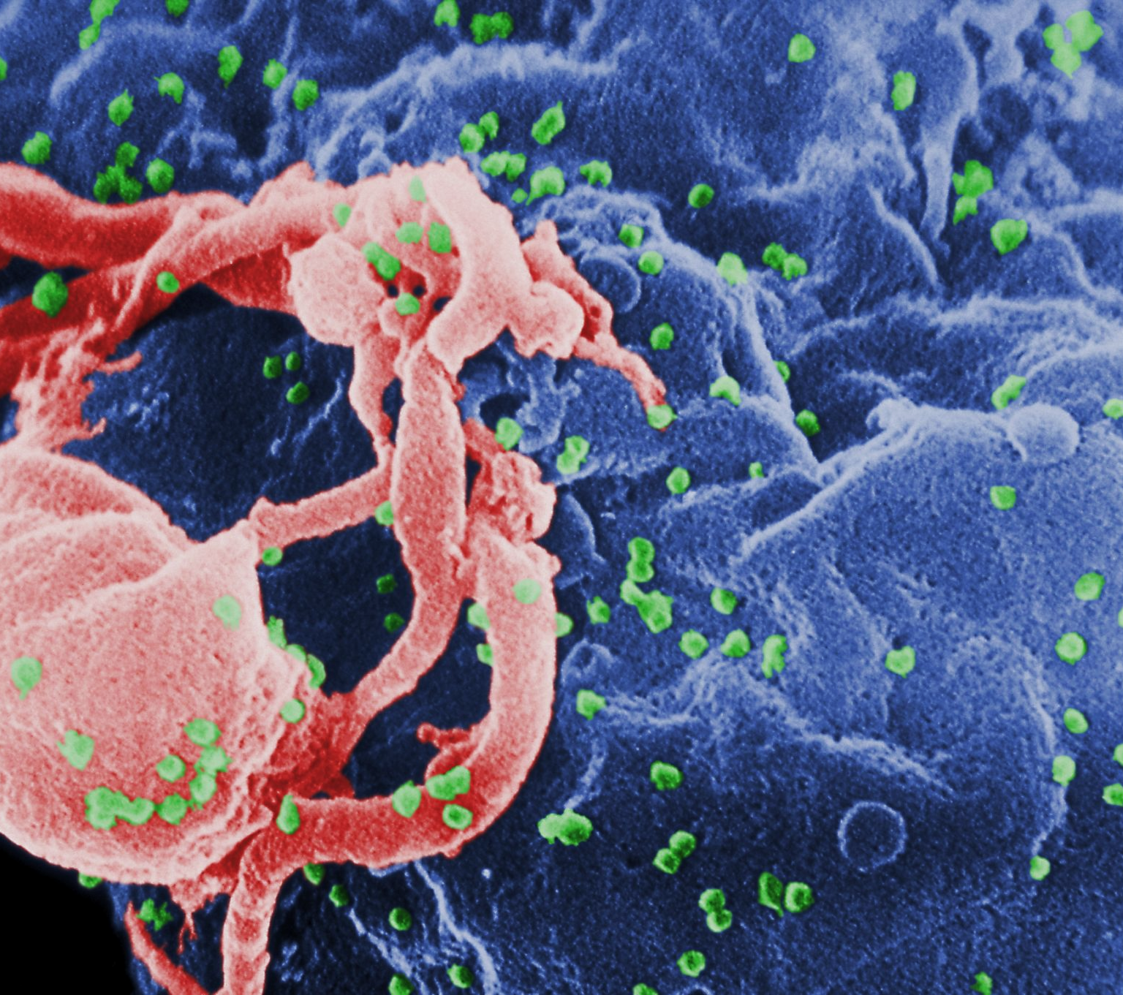
HIV particles attacking a T_{H} cell.

Slide 4
HIV Infection
HIV is primarily a sexually transmitted infection.
During the initial period of infection, HIV particles replicate rapidly.
  In most cases, individuals will experience flu-like symptoms that will persist for several weeks.
After the initial infection, HIV replication will slow.
  This is referred to as the latency period. This may last for a number of years.
  During the latency period, the individual will experience no symptoms whatsoever.
Following primary infection, patients will experience a period of latency, often lasting upwards of ten years. During this time they will experience no symptoms and the viral load will remain low.
AIDS SYMPTOMS
ACUTE HIV
CLINICAL LATENCY
WHITE BLOOD CELL COUNT →
HIV RNA COPIES PER mL →
WEEKS →
YEARS →

Slide 5
HIV Structure
HIV is has a specific structure:
  It contains an RNA core.
  It contains the enzyme reverse transcriptase, which aids with viral replication.
The protein coat of HIV is called the capsid.
  There is often an outer envelope, created from membranes collected from host T_{H} cells.
On the surface of HIV are attachment proteins.
  These help adhere HIV to T_{H} cells.
ATTACHMENT PROTEIN
LIPID ENVELOPE
CAPSID
RNA GENOME
REVERSE
TRANSCRIPTASE

Slide 6
1. ATTACHMENT PROTEINS ATTACH TO A RECEPTOR ON THE CELL MEMBRANE OF THE T_{H} CELL
5. VIRAL PROTEINS ARE CREATED FROM THE VIRAL DNA TEMPLATES
6. VIRAL PROTEINS ARE ASSEMBLED INTO NEW VIRUSES. THESE ARE RELEASED FROM THE CELL AND GO ON TO INFECT OTHER T_{H} CELLS
4. THE DOUBLE STRANDED DNA IS INSERTED INTO THE HUMAN GENOME
2. THE CAPSID DEGRADES, RELEASING RNA INTO THE CYTOPLASM OF THE T_{H} CELL
3. REVERSE TRANSCRIPTASE IS USED TO CONVERT THE SINGLE STRANDED RNA INTO DOUBLE STRANDED DNA

Slide 7
Antibiotics and Viruses
Antibiotics kill bacteria.
  Some antibiotics work by interfering with bacterial enzymes.
  Others work by damaging the bacterial cell wall.
Antibiotics don’t damage human cells.
  The enzymes and structures in a bacteria are very different to eukaryotic cells.
  Human cells are not targeted by antibiotics.
Viruses use the enzymes and ribosomes of human cells to replicate.
  This means that antibiotics do not have any effect on viruses.
Antiviral drugs are used to target viruses.
  Some viruses contain virus-specific enzymes or replication methods.
  These can be inhibited by antivirals.

Slide 8
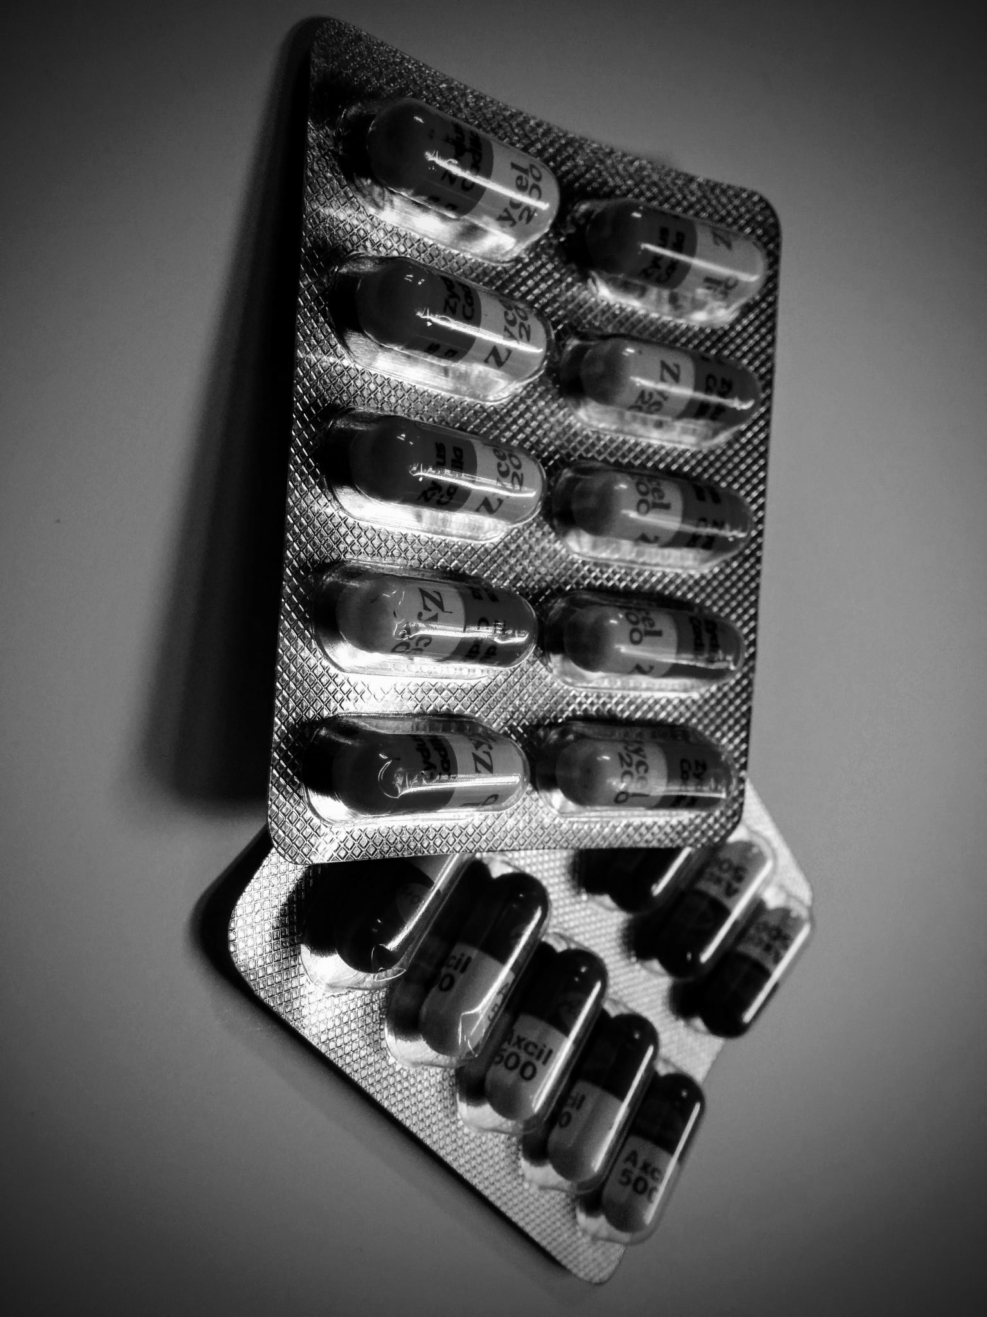
Antibiotics like amoxicillin have no effect on viruses.

Slide 9
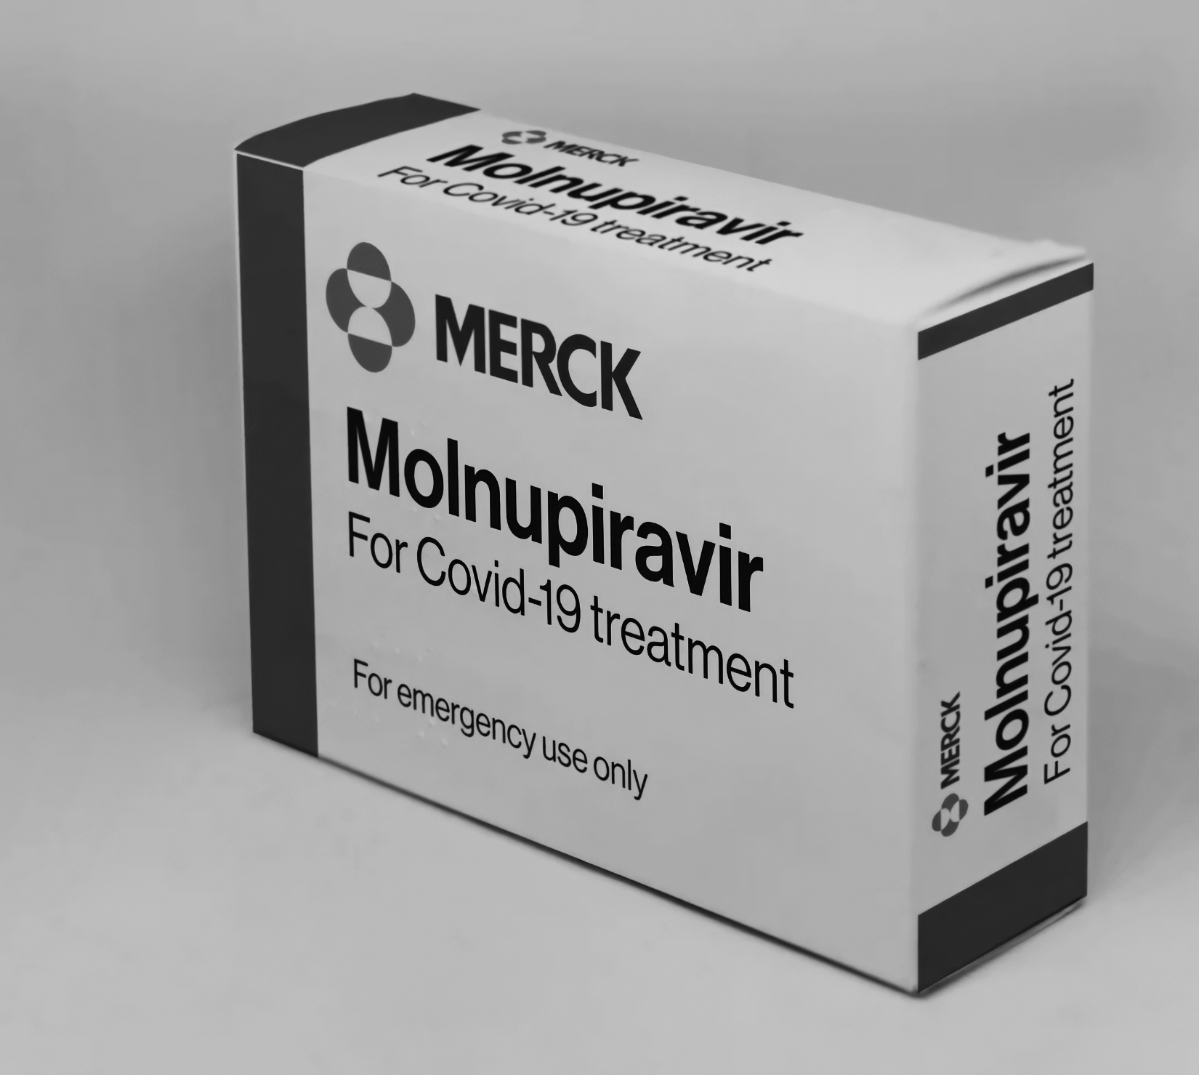
Due to the seriousness of the COVID-19 pandemic, several antiviral medications, including molnupiravir were quickly licensed for use.
Antivirals work by inhibiting viral-specific processes.

Slide 10
Controlling HIV Infection
There is no cure for HIV.
  Antiviral drugs are used to slow the progression of the infection.
  Reverse transcriptase inhibitors are a type of antiviral used for HIV therapy.
The most effective way to control HIV is to prevent its spread.
  HIV is spread through unprotected sexual intercourse.
  HIV can also be contracted through the use of contaminated needles.
    This is most commonly through intravenous drug use.
HIV can be passed from mother to child.
  HIV can pass through the placenta to the fetus.
  Not all babies contract HIV.
  The risk of contracting HIV can be reduced when the mother takes antiviral drugs throughout her pregnancy.

Slide 11
Men who have sex with men are considered at the highest risk of contracting HIV. The most effective way of preventing the spread of HIV is to wear condoms during sex.
INCREASING USE OF CONDOMS →
NO DATA
0%
100%

Slide 12
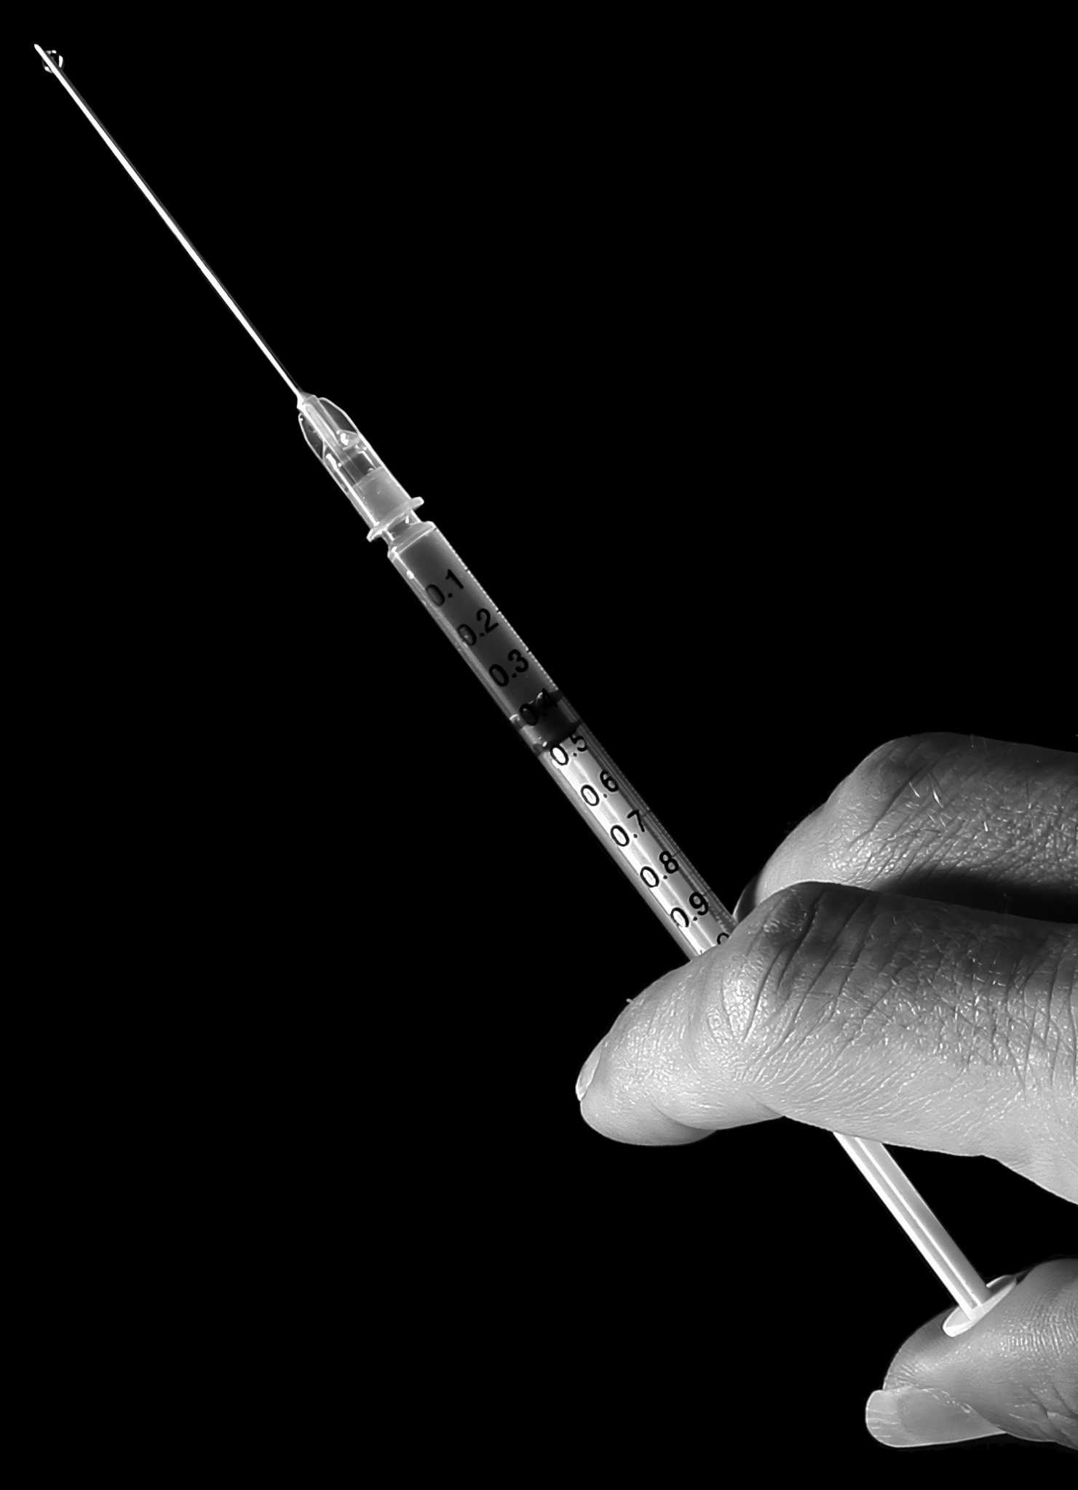
HIV can also be contracted by sharing contaminated needles.
The most likely route of infection is through the misuse of intravenous drugs, such as heroin.

Slide 13
GLOBAL PREVALENCE, NEW CASES AND DEATHS FROM HIV/AIDS
NO. PEOPLE LIVING WITH HIV × 10
3.5 MIL
3 MIL
2.5 MIL
Following a peak of deaths in the early 2000s, mortality has steadily declined.
This due to a combination of new antiviral therapies and increased awareness.
2 MIL
NEW INFECTIONS OF HIV/AIDS
1.5 MIL
1 MIL
DEATHS FROM HIV/AIDS
500,000
0
1990
TIME →
2020

Slide 14
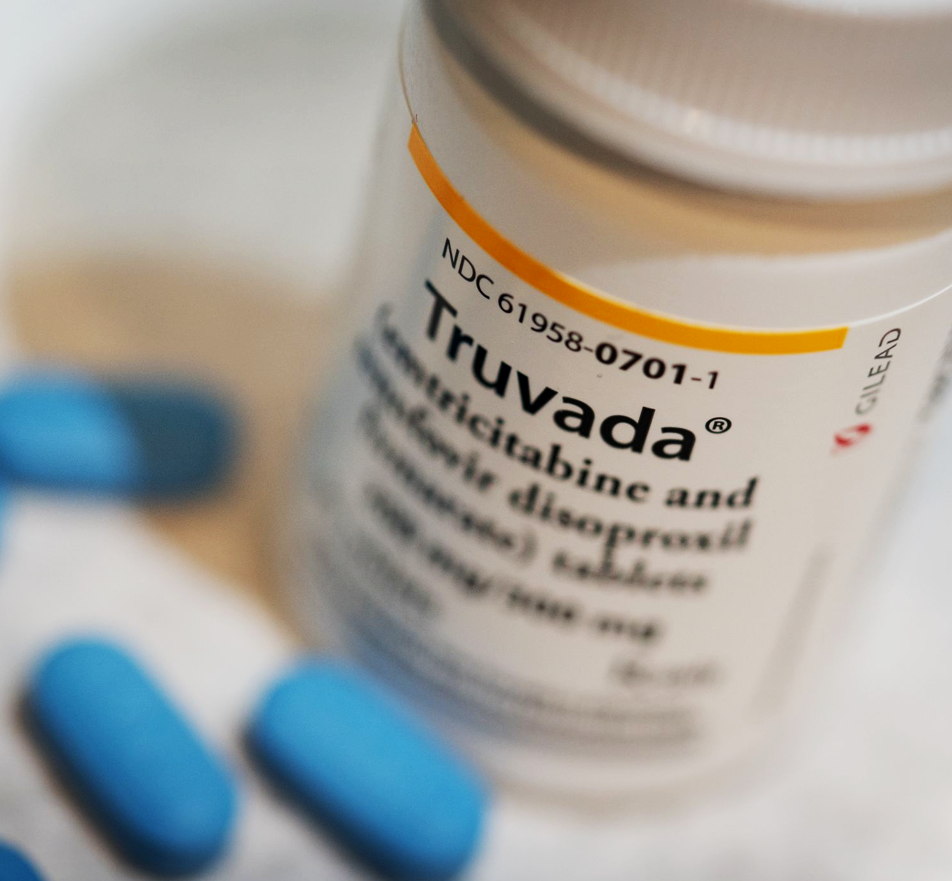
In 2016, the UK licensed a drug called tenofovir, sold under the brand name Truvada.
Truvada is a pre-exposure prophylaxis (PrEP) drug, designed to be taken before sexual intercourse.
Truvada is an antiretroviral and, when taken appropriately, can prevent the replication of HIV inside the body.

