Slide 1
AQA A Level Biology
16 - Immunity, Vaccines and Monoclonal Antibodies
Forms of Immunity, Antigenic Variation, ELISA Testing

Slide 2
Immunity
Specification Point 3.2.4 - Cell recognition and the immune system.
Immunity can be either active or passive:
Active immunity occurs when the immune system creates its own antibodies.
  Natural active immunity occurs when the body becomes immune after catching a disease.
  Artificial active immunity occurs when the body becomes immune after vaccination.
    During vaccination the body is injected with a harmless dose of antigen.
Passive immunity occurs when antibodies are donated from another organism.
  Natural passive immunity occurs when a baby becomes immune through antibodies it receives from its mother.
    This is usually through breast milk.
  Artificial passive immunity occurs after being injected with antibodies from another individual.
    In the case of a tetanus infection, the individual is injected with antibodies that counteract tetanus toxin. These antibodies are collected from blood donations.

Slide 3
Active and Passive Immunity
There are key differences between active and passive immunity.
Active Immunity | Passive Immunity
Active immunity requires direct exposure to an antigen. | Passive immunity does not require exposure to an antigen.
Protection only develops after a period of time. | The protection from antibodies is immediate.
Memory cells are produced by the body. | Memory cells are not produced by the body.
Protection will last for a number of years. Memory cells will persist in the bloodstream which contain complementary antibodies to the pathogenic antigen. | Protection will only last for a number of days or weeks. The antibodies that are delivered to the individual are broken down over time.

Slide 4
Vaccination
During the process of synthesising antibodies to battle a pathogen, the symptoms of a disease are usually felt.
  Vaccination can help to avoid the symptoms of disease.
Vaccines contain antigens.
  These stimulate the production of memory cells.
  Vaccines are comprised of attenuated pathogen.
    This means the pathogen has been rendered harmless.
Vaccines protect individuals and communities.
  The vaccines prevent the individual succumbing to disease.
  Vaccines can also create herd immunity.
    Herd immunity reduces the rate of transmission through populations.

Slide 5
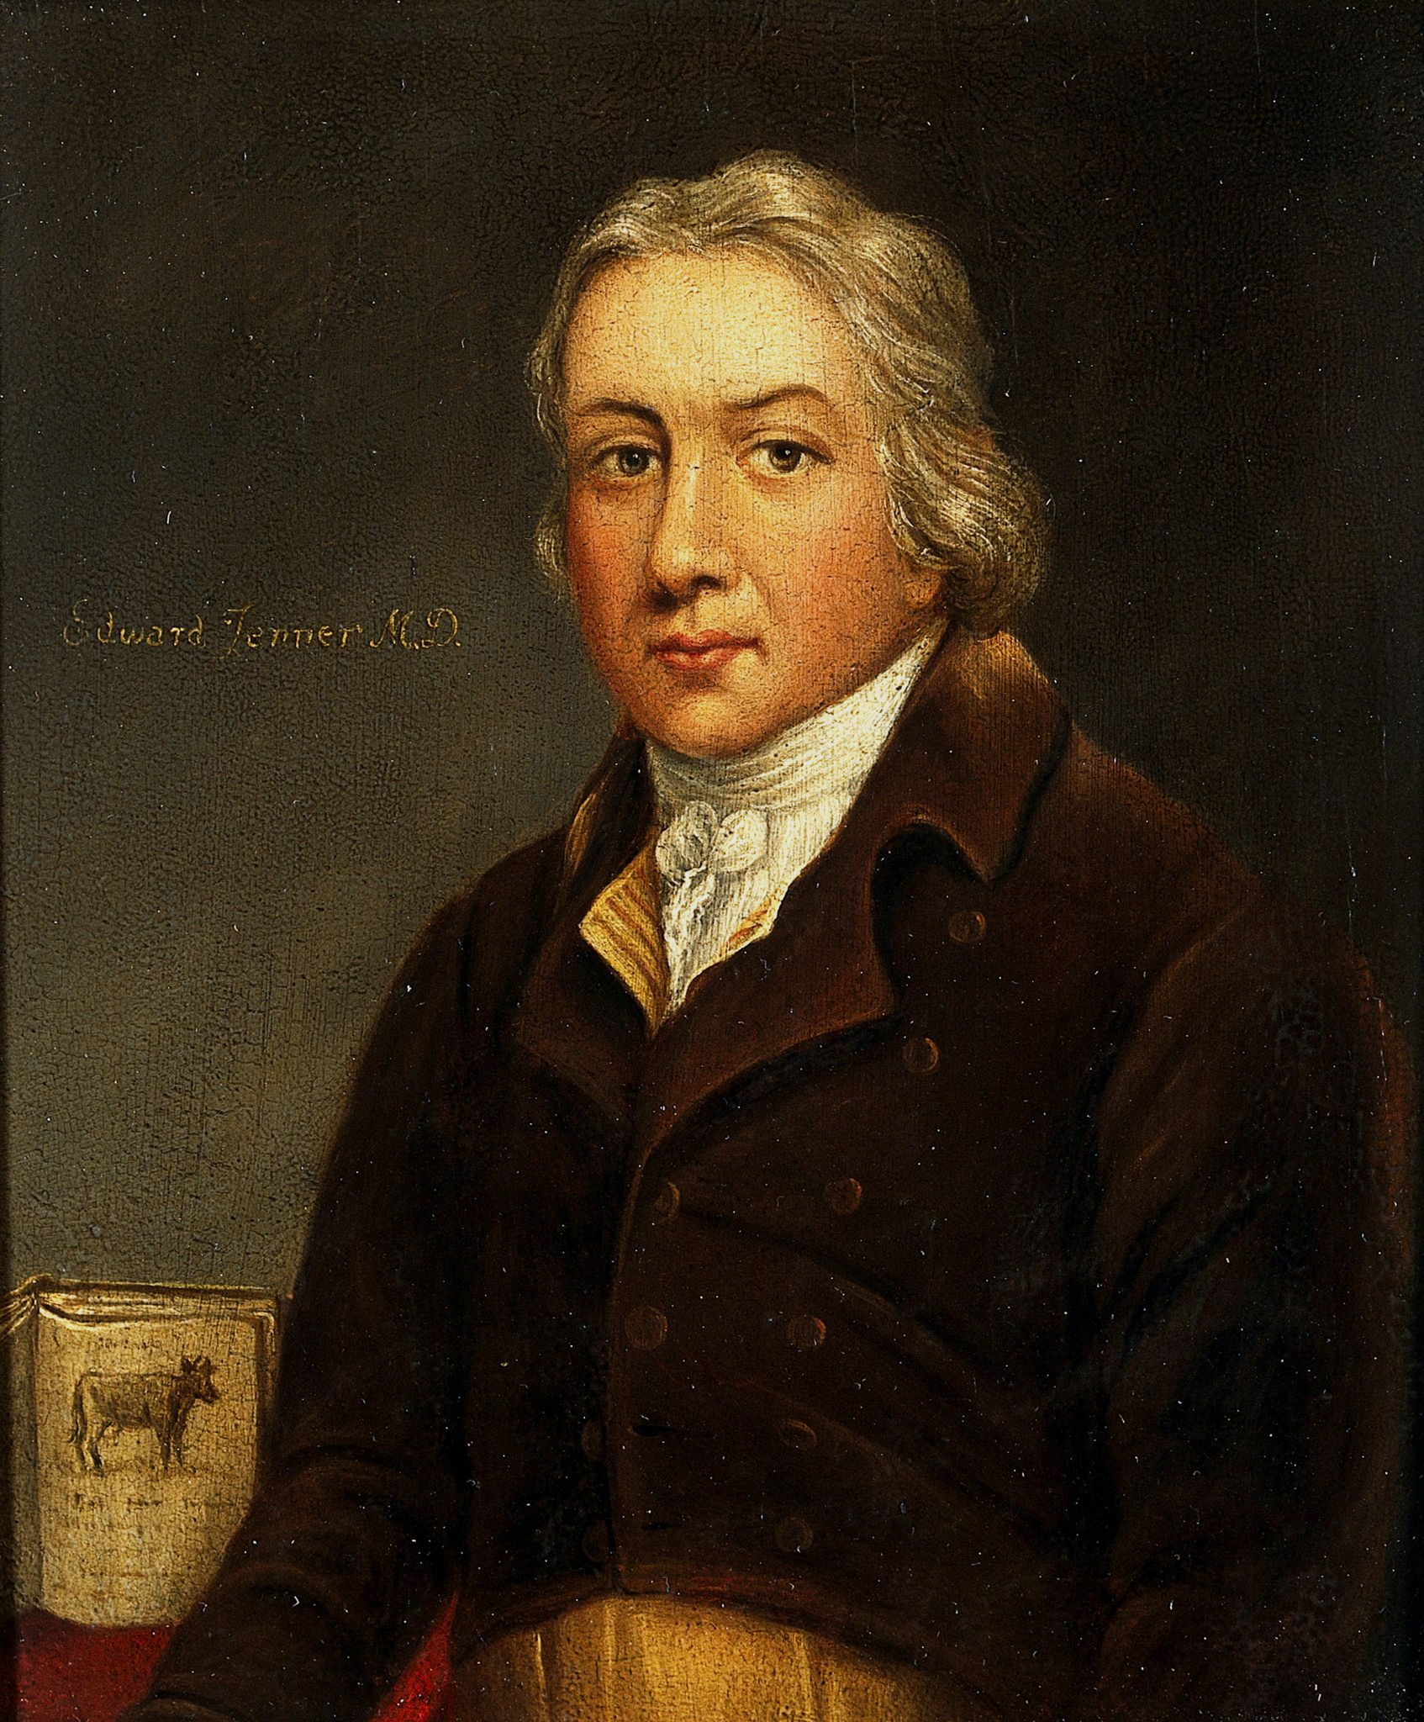
Edward Jenner was an British doctor who pioneered the concept of vaccination.
Jenner used a strain of cowpox to immunize individuals against the lethal smallpox virus.
Jenner performed his first vaccination in 1796.

Slide 6
35
30
SALK VACCINE RELEASED IN 1954
25
In 1954 a polio vaccine, developed by virologist Jonas Salk, became the first widely-distributed vaccine in the United States.
Today polio cases in the US have been all but eradicated.
20
NUMBER OF CASES OF POLIO PER 100,000 IN US →
15
10
5
0
1910
1920
1940
1960
1980
2000
2019

Slide 7
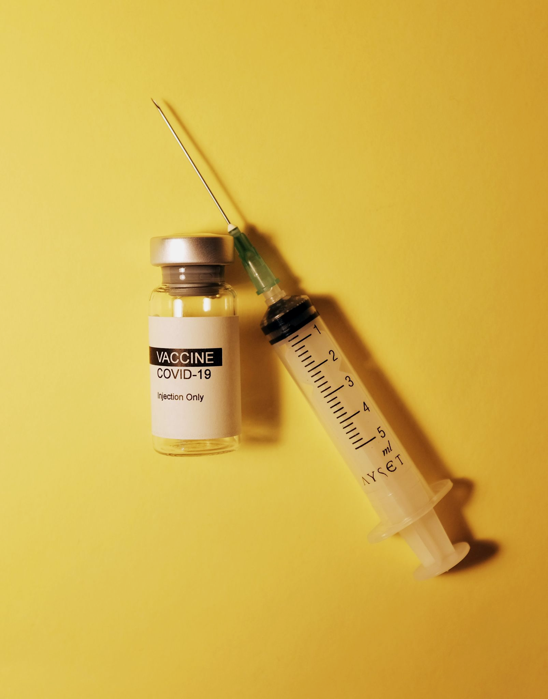
The production, distribution and uptake of COVID-19 vaccines is unprecedented.
The vast majority of vaccines are injected. Oral vaccines are usually broken down by enzymes in the body.

Slide 8
NOT IMMUNIZED, BUT HEALTHY
IMMUNIZED AND HEALTHY
NOT IMMUNIZED, SICK AND CONTAGIOUS
NO ONE IS IMMUNIZED
DISEASE SPREADS THROUGHOUT THE POPULATION
Herd immunity. The entirety of the population does not need to be vaccinated to contain a disease.
Depending on the transmissibility of a disease (the R number) a greater or lesser proportion of the population will have to be vaccinated.
SOME OF THE POPULATION GETS IMMUNIZED
DISEASE SPREADS THROUGH SOME OF THE POPULATION
MOST OF THE POPULATION GETS IMMUNIZED
THE SPREAD OF THE DISEASE IS CONTAINED

Slide 9
The Ethics of Vaccines
All vaccines are tested on animals before they are tested on humans.
  Many people disagree with the notion of animal testing.
  Animal products may also be used (for example gelatin) in the production of a vaccine.
Testing vaccines on humans carries risks.
  There are several case studies of serious side effects that have occurred during human trials.
Some people will refuse to take vaccines due to side effects.
  They may be protected through herd immunity.
  Many believe this to be unfair.
When outbreaks of a disease occur, difficult decisions are made over who should receive the vaccine first.
  This has been the case with COVID-19 vaccines, with the most vulnerable individuals prioritised.

Slide 10

Rabbits and mice are most commonly used for laboratory testing.
Many argue this is ethically objectionable.

Slide 11
■ AFRICA ■ ASIA ■ EUROPE ■ NORTH AMERICA ■ OCEANIA ■ SOUTH AMERICA
SHARE OF WORLD POPULATION IN 2021
0%
20%
40%
60%
80%
100%
A graph showing the share of people who received at least one dose of COVID-19 vaccine.
The pandemic brought into stark focus the topic of vaccine inequity.
As of mid-2022 only 20.2% of people in low-income countries have received at least one dose of vaccine.
% OF POP WITH AT LEAST 1 DOSE →

Slide 12

There is often a small risk associated with the use of vaccines.
In April 2021 the British Government suspended the use of pharmaceutical company AstraZeneca’s vaccine to the under-30s due to the risk of blood clots.

Slide 13
Antigenic Variation
Antigens are found on the surface of pathogens.
  These stimulate the primary response and memory cells are produced.
  When infected with the same antigens the secondary response is stimulated and symptoms are not seen.
Some pathogens can change the shape of their antigens.
  This is called antigenic variation.
Memory cells will not recognise these antigens.
  The primary response will be stimulated again.
  Individuals will once again exhibit signs of illness.
Antigenic variation makes it difficult to create vaccines.
  HIV, influenza and COVID-19 are all viruses that exhibit antigenic variation.

Slide 14
ANTIGEN A
INFLUENZA STRAIN 1
Two strains of influenza may have differently shaped antigens on their surface.
This means that the antibodies complementary to the first strain will not be complementary to the second strain.
As a result, immunity will not be present.
ANTIBODY A
ANTIGEN B
INFLUENZA STRAIN 2

Slide 15
Antibodies in Medicine
Monoclonal antibodies are made from a single group of B-cells.
  These B-cells are all clones of each other.
    They are genetically identical plasma cells.
  This means every monoclonal antibody they produce are identical in structure.
Monoclonal antibodies can be designed to bind to specific substances.
  For example an antigen or a toxin.
Monoclonal antibodies can be used to target cancer cells.
  Cancer cells contain antigens called tumour markers. These are not found on healthy body cells.
  Anti-cancer drugs can be attached to antibodies that are complementary to these markers.
    This can allow for more specific targeting of cancer and fewer side effects from the drugs.
Monoclonal antibodies can be used for molecule detection.
  Pregnancy test rely on monoclonal antibodies to detect the hormone human chorionic gonadotropin (hCG).

Slide 16
MONOCLONAL
ANTIBODY
Monoclonal antibodies will bind to tumour maker antigens on the surface of cancer cells.
This allows for targeted delivery of either radiotherapy or chemotherapy.
CANCER CELL
CHEMOTHERAPY DRUG
RADIOTHERAPY DRUG

Slide 17
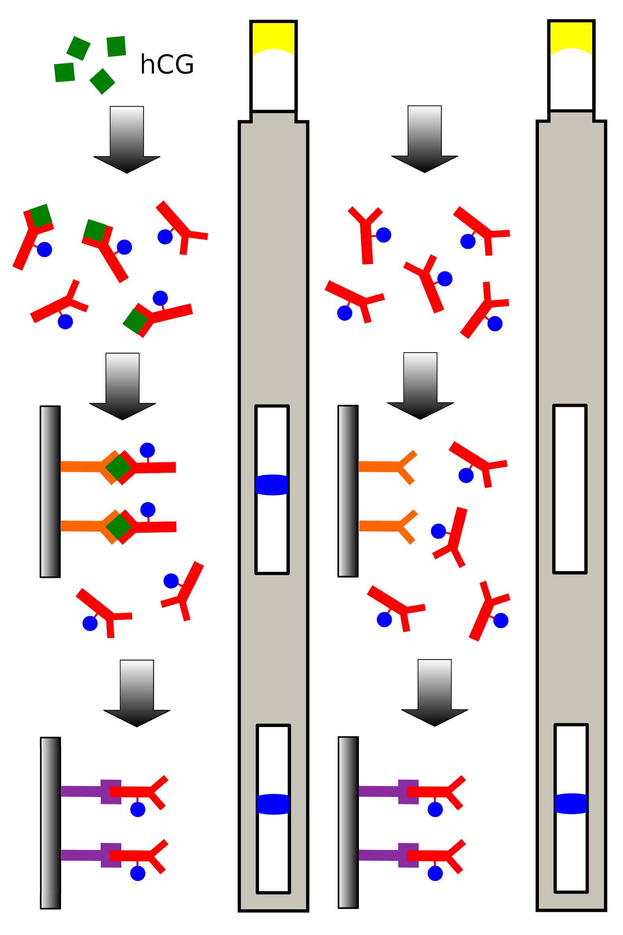
PREGNANT
NOT PREGNANT
1.
HCG
1. The application area will contain antibodies that are complementary to the hCG antigen. When combined, an antigen-antibody complex will form.
2. The antibody is bound to a coloured bead which will then begin to move down the test strip.
3. The antigen-antibody complex will bind to a second, immobilised antibody. This new complex will remain in position, forming a blue line.
4. Some antibodies will not bind to the hCG antigen. They will continue past the immobilized antibody, forming a second, control line. A single control line will also be present if no hCG was present in the sample, indicating the individual was not pregnant.
2.
3.
4.

Slide 18
ELISA Testing
Testing for the presence of antibodies can be done using an enzyme-linked immunosorbent assay (ELISA).
  ELISA testing is used for medical diagnosis.
  It is often used to see if a patient is suffering from a pathogenic infection.
  It can also be used to test for allergies to certain compounds.
In ELISA testing, antibodies are bound to enzymes.
  The enzyme will react with a substrate to produce a colour change.
  This only happens if the antibody associated with the enzyme binds to an antigen.
There are 2 types of ELISA test.
  Direct ELISA.
  Indirect ELISA.

Slide 19
Direct ELISA
Direct ELISA involves the use of a single antibody.
  This antibody will be complementary to the antigen being tested for.
Antigens are isolated from a patient’s sample.
  This is usually blood or urine.
  These antigens are then bound to a plastic well.
Monoclonal antibodies that are complementary to the antigen are added.
  These antibodies are attached to an enzyme.
  If the antigen is present in the sample, these antibodies will bind, forming antigen-antibody complexes.
  The well is then washed to remove any unbound antibody.
A coloured substrate solution is added.
  If the complex is present, the enzyme will break down the substrate, and the colour of the solution will change.

Slide 20
Indirect ELISA - The Case of HIV Testing
Indirect ELISA involves the use of 2 antibodies.
  It is often used for HIV testing.
HIV antigen is attached to a well plate.
  The individual's blood serum is added to the well.
If HIV antibodies (from infection) are present in the individual’s sample, they will bind to the antigen.
  The well is then washed to remove any unbound antibodies.
A second antibody is added to the well.
  This has an enzyme attached to it.
  The secondary antibody can bind to the primary HIV antibody.
  The well is washed again to remove any unbound antibody.
A substrate solution is added to the well.
  The substrate will react with the enzyme carried by the second antibody and a colour change will ensue.

Slide 21
SUBSTRATE
Direct ELISA involves the use of a single antibody.
Monoclonal antibodies that are complementary to the antigen are added.
The antibody has an enzyme attached to it.
A coloured substrate solution is then added. If the complex is present, the enzyme will break down the substrate and the colour of the solution will change.
ENZYME
ANTIBODY
ANTIGEN
DIRECT ELISA
DIRECT ELISA

Slide 22
Indirect ELISA involves the use of 2 antibodies.
An antigen is attached to a well plate.
If complementary, the individual's antibodies will bind to the antigen. The well is then washed to remove any unbound antibodies.
A second antibody is added to the well. This has an enzyme attached to it.
The secondary antibody can bind to the primary antibody.
A substrate solution is added to the well.
The substrate will react with the enzyme carried by the second antibody and a colour change will ensue.
HIV ANTIBODY
INDIRECT ELISA

Slide 23
Ethics of Monoclonal Antibodies
Monoclonal antibodies are often produced using animals.
In order to make a monoclonal antibody a mouse is injected with an antigen.
  The mouse will then create antibodies to counteract this antigen.
The antibodies are then removed from the mouse using surgery.
Many people disagree with this on grounds of animal cruelty.
Laboratory mice are used as bioreactors to culture monoclonal antibodies.

