Slide 1
AQA A Level Biology
15 - The Immune Response
Antigens, Antibodies and Phagocytosis

Slide 2
Antigens
Specification Point 3.2.4 - Cell recognition and the immune system.
Antigens are molecules that generate an immune response.
  They are usually but not exclusively proteins.
Antigens are found on the surface of all cells.
  These include cells in the human body.
Antigens that belong to cells not usually found in the body are called foreign antigens.
  It is these foreign antigens that stimulate the immune system.
Antigens, such as MHC molecules, are found on the surface of all nucleated mammalian cells.

Slide 3
Foreign antigens have specific shapes that stimulate various white blood cells.

Slide 4
Pathogens, Cancer and Toxins
Pathogens are microorganisms that cause disease.
  Bacteria, fungi and viruses all have pathogenic capabilities.
  All pathogens have antigens on their surface.
  These antigens are recognised by the immune system which then destroys the pathogen.
Abnormal body cells can turn cancerous.
  Cancerous cells have abnormal antigens on their surface.
  These also stimulate the immune response.
Some pathogens can produce toxins.
  Toxins are molecules that are poisonous to the body.
  The immune system can respond to toxins, as well as the pathogens responsible for releasing them.

Slide 5

A pathogen is a microorganism that causes disease.
Bacteria, fungi and viruses all have pathogenic capabilities.

Slide 6
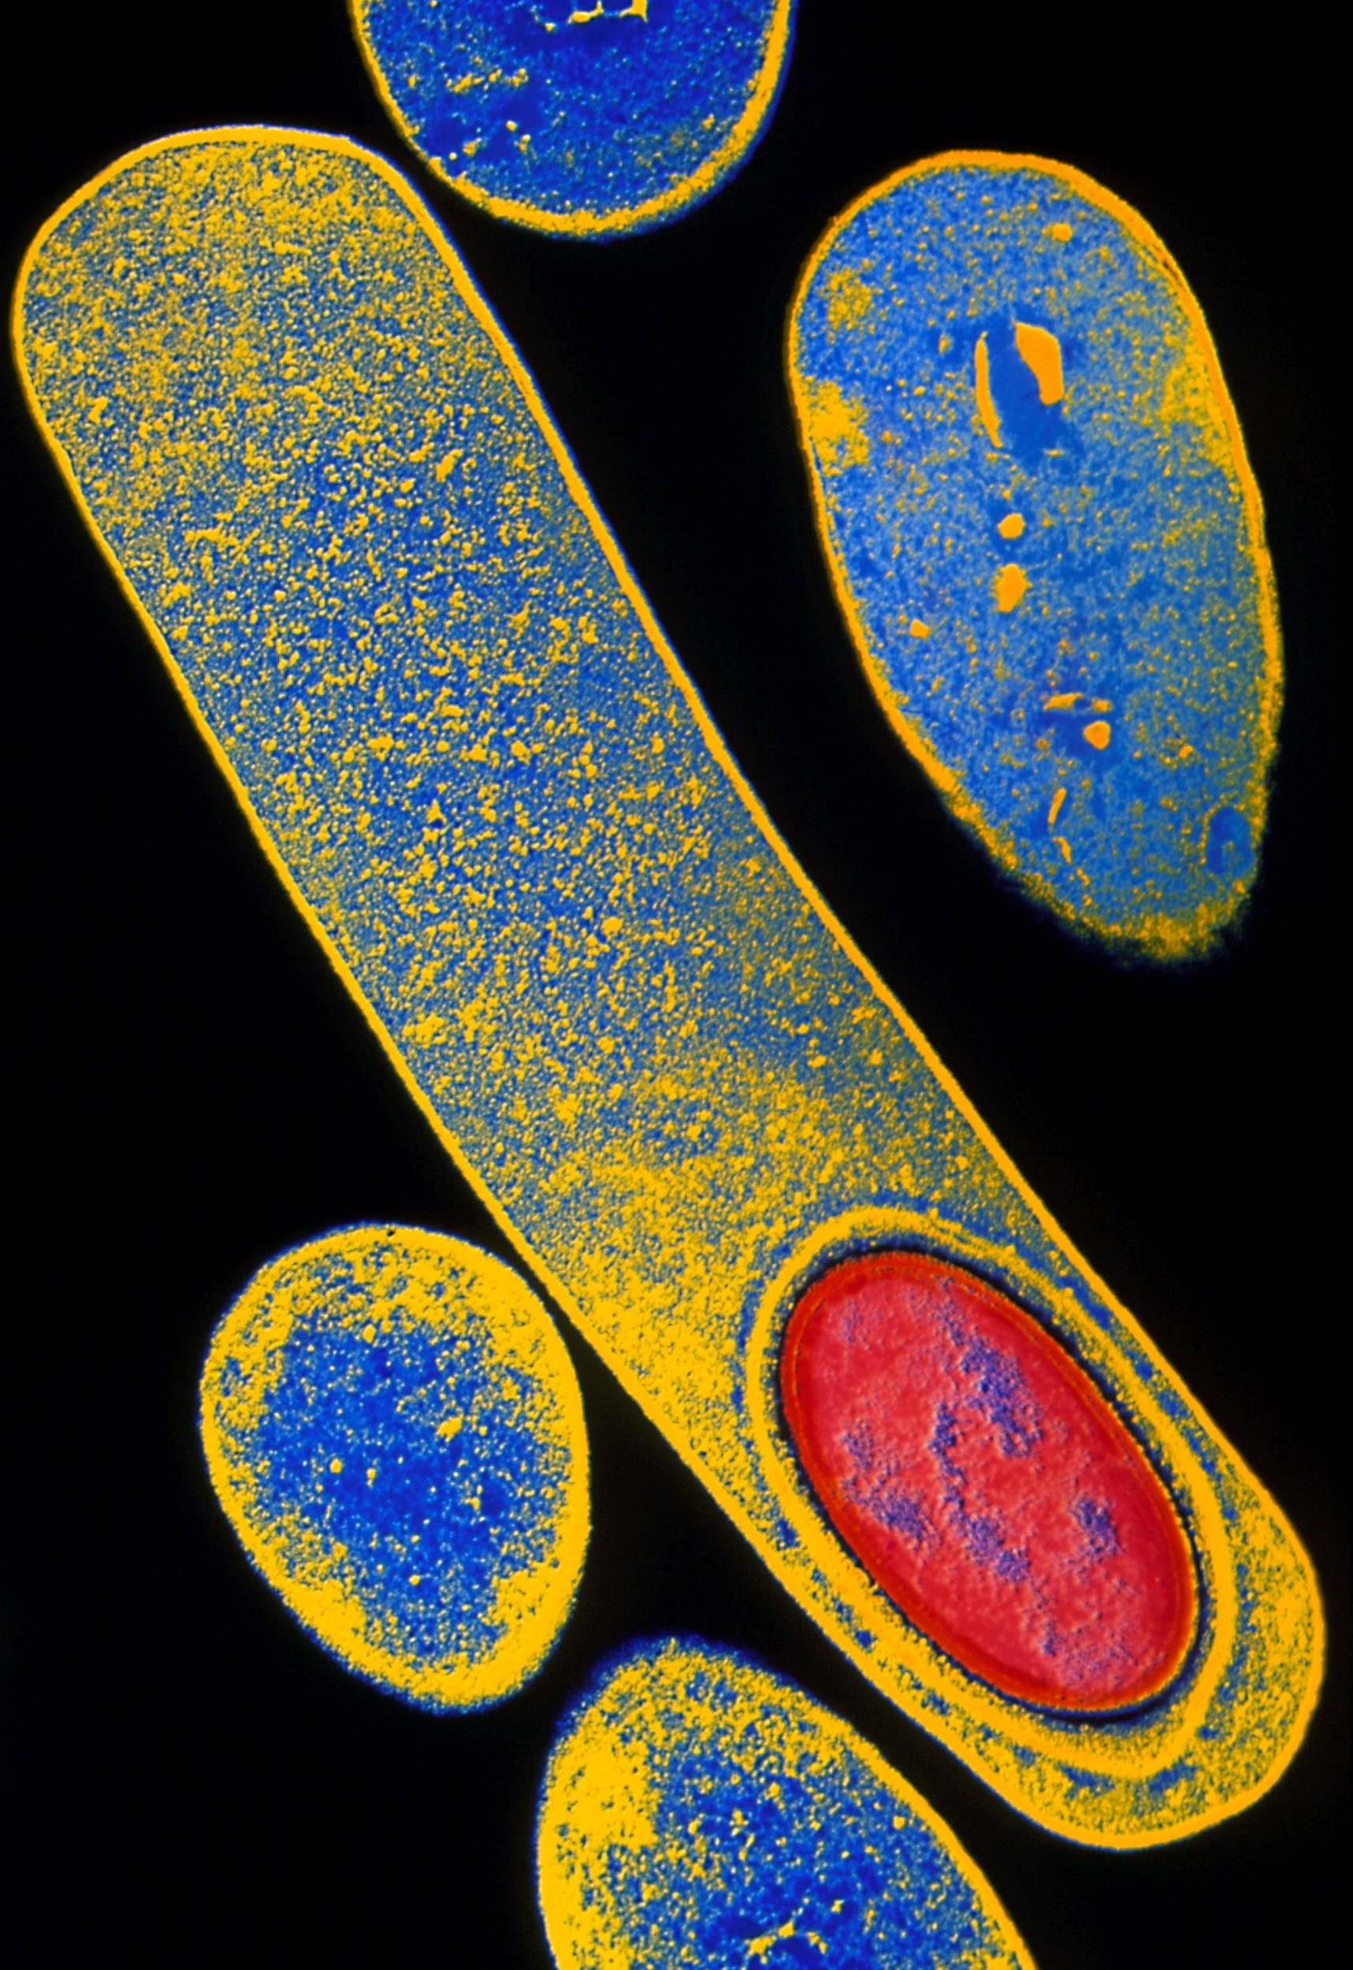
Clostridium botulinum is a bacterium that releases a toxin that affects the nervous system, leading to the symptoms of botulism.

Slide 7
Blood Transfusions
When a recipient receives cells from a donor, such as from a blood transfusion, those cells will contain antigens foreign to the recipient.
  These foreign antigens will trigger the immune response.
If these cells are too different to the recipients, they will be rejected.
  The most important antigens on the surface of red blood cells are the A and B antigens.
  A group O individual has no antigens on the surface of their red blood cells.
It is thus important for blood typing.
  A recipient with group B blood should only receive transfusions from a type B donor.

Slide 8
TYPE A
TYPE B
Red blood cells have 4 major types.
Type A, type B and type AB have different combinations of antigens whereas type O has no antigens at all.
TYPE AB
TYPE O

Slide 9
The Immune Response - Phagocytosis
A phagocyte is a type of white blood cell.
  These cells carry out phagocytosis.
  During phagocytosis, a foreign pathogen is engulfed and destroyed.
Phagocytosis is the first stage of the immune response:
A phagocyte recognises the foreign antigens on a pathogen.
The phagocyte moves towards the pathogen and engulfs it.
The pathogen is packaged into a phagocytic vesicle, referred to as a phagosome.
A lysosome, an organelle containing lysozyme, fuses with the phagosome, forming a phagolysosome.
  Lysozymes digest the pathogen.
The phagocyte may then present the pathogen’s antigens on its own surface.
  The phagocyte is now referred to as an antigen-presenting cell (APC).

Slide 10
1.
1. The phagocyte recognises the antigens of a foreign pathogen. The cytoplasm of the phagocyte engulfs the pathogen.
2. The pathogen is packaged into a phagocytic vacuole (phagosome). Lysosomes fuse with the phagosome and release lysozyme. The pathogen is destroyed.
3. The remnants of the pathogen are incorporated into the cell membrane of the phagocyte. The phagocyte is now an antigen-presenting cell.
2.
3.

Slide 11
The Immune Response - T-Cells
T-cells are another form of white blood cell.
  T-cells are sometimes referred to as T-lymphocytes.
T-cells have receptor proteins on their surface.
  These bind to complementary antigens which are presented to them by APCs.
  When this binding takes place, the T-cell is activated.
There are several types of T-cell:
  Helper T-cells (T_{H} cells) release chemical messengers, called cytokines that activate and stimulate phagocytes.
    They also activate another type of T-cell called cytotoxic T-cells (T_{C} cells).
  T_{C} cells kill pathogens directly.
  T_{H} cells also activate another kind of white blood cells, called B-cells.

Slide 12
The Immune Response - B-Cells
B-cells are another type of white blood cell.
  They are sometimes referred to as B-lymphocytes.
B-cells are covered with proteins called antibodies.
  Every B-cell has a different shaped antibody on their surface.
  Different antibodies will bind to different antigens.
When antigens and antibodies bind with one another, they form antigen-antibody complexes.
  When combined with cytokines released from T_{H} cells, the B-cell is activated.
The activation of the B-cell is referred to as clonal selection.
  The activated B-cells now divide into B plasma cells.

Slide 13
ACTIVATED
T_{H} CELL
B PLASMA CELL
ANTIBODIES
The route of clonal selection.
FOREIGN ANTIGEN
APC
T_{H} CELL
ACTIVATED
T_{H} CELL
PHAGOCYTE
ACTIVATED
T_{H} CELL
T_{C} CELL

Slide 14
Antibodies
All activated plasma cells are clones of one another.
  They are also clones of their B-cell progenitor.
Plasma cells secrete antibodies into the bloodstream that are specific to a particular antigen.
  These antibodies are also clones.
  They are referred to as monoclonal antibodies.
Each antibody has 2 binding sites.
  Every antibody can bind to 2 antigens at once.
  This means that antibodies can clump pathogens together.
  This process is called agglutination.
Phagocytes will then come and destroy the agglutinated pathogens.

Slide 15
ANTIGENS
ANTIGEN
VARIABLE REGIONS
The structure of an antibody. All antibodies are proteins with 2 binding sites for antigens.
Antigen and antibody must be complementary for binding to occur, forming an antigen-antibody complex.
LIGHT CHAIN
DISULPHIDE BRIDGE
HEAVY CHAIN
CONSTANT REGIONS
ANTIBODY

Slide 16
Cellular and Humoral Responses
The immune response split into 2 sections:
  The cellular response.
  The humoral response.
The cellular response includes T-cells and the cells that they interact with.
  For example, phagocytes.
  The cellular response includes the use of cytokines.
The humoral response includes B-cells, clonal selection and the production of antibodies.
  The humoral response included substances secreted into the bloodstream.

Slide 17
The Primary and Secondary Immune Response
The primary response occurs when an individual is infected for the first time.
  The primary response is slow because there aren’t many B-cells to make monoclonal antibodies.
  Eventually enough antibodies will be made to fight the infection.
    During this time the individual will exhibit symptoms associated with the pathogen.
After primary exposure, the body will make memory cells.
  Both T_{M} and B_{M} cells are made.
  These have the ability to respond quickly in the case of a secondary infection.
  The person is considered to be immune.
If the individual is reinfected, the immune system will exhibit the secondary response.
  Memory cells are activated and antibodies are made quickly.
  The individual is likely to be rid of the infection before symptoms show.

Slide 18
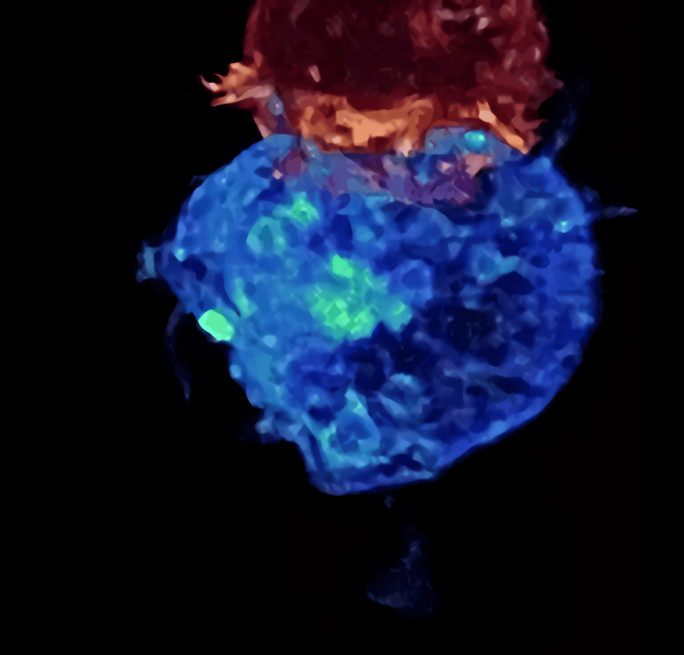
A T-cell is seen here attacking a pathogen.
High levels of memory cells in the bloodstream have been strongly linked to immunity against a particular disease.

Slide 19
SECONDARY
RESPONSE
EXPOSURE
TO SAME
ANTIGEN
When infected with a pathogen, cells called memory cells are created.
This means that if an individual is reinfected with the same pathogen, antibodies are made much more quickly, usually preventing the development of symptoms.
ANTIBODY CONCENTRATION →
EXPOSURE TO
ANTIGEN
PRIMARY
RESPONSE
TIME →

