Slide 1
AQA A Level Biology
14 - Transport Across Membranes
Diffusion, Osmosis and Active Transport

Slide 2
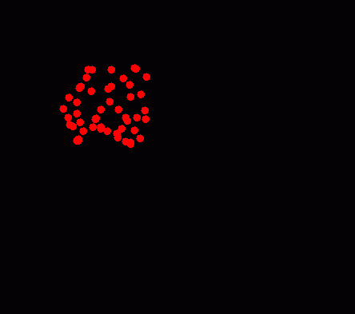
Diffusion
Specification Point 3.2.3 - Transport across cell membranes.
Diffusion is the net movement of particles from an area of higher concentration to an area of lower concentration.
  Particles can be molecules or ions.
  Particles will diffuse in both ways, but the net movement will always be from higher to lower concentrations.
Diffusion is a passive process.
  It does not require energy to take place.
When molecules diffuse directly through the cell membrane, it is referred to as simple diffusion.
During diffusion, a solute distributes itself throughout a solvent, creating a solution.

Slide 3
Diffusion is the movement of particles from an area of higher concentration to an area of lower concentration.
MOVEMENT OF PARTICLES

Slide 4
The Rate of Diffusion
Various factors can affect the rate of diffusion:
Diffusion is affected by the concentration gradient.
  This is the difference between the concentration of a particle in 2 different areas.
  The bigger the difference, the faster the rate of diffusion.
  Over time, the concentrations will equilibrate, slowing the rate of diffusion.
Diffusion is affected by the thickness of the exchange surface.
  A thinner exchange surface will mean a shorter diffusion pathway.
  As the pathway becomes shorter, the rate of diffusion increases.
Diffusion is affected by the surface area of the exchange surface.
  The higher the surface area, the faster the rate of diffusion.

Slide 5
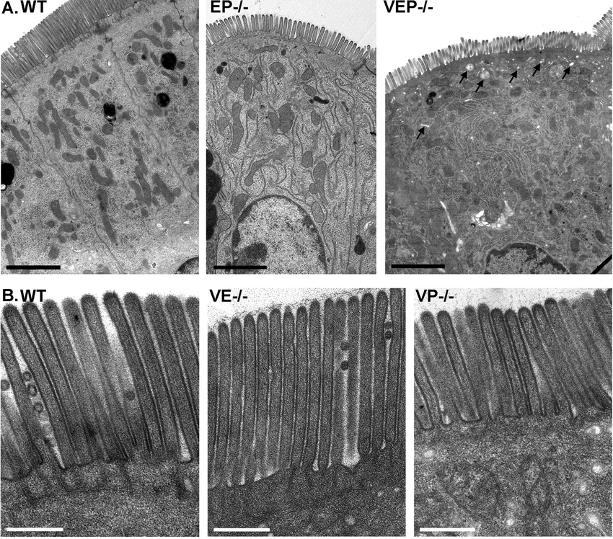
Microvilli are present on the surface of the epithelial cells.
These increase the surface area of the cells, increasing the rate of diffusion.

Slide 6
Facilitated Diffusion
Some molecules cannot diffuse directly through the cell membrane.
  Amino acids and glucose are too large to fit between gaps in the bilayer.
  Some polar molecules and ions can fit through, but the hydrophobic core causes the rate of diffusion to slow drastically.
Large or charged particles diffuse through carrier proteins or channel proteins.
  This is referred to as facilitated diffusion.
Facilitated diffusion also moves down concentration gradients.
  It is also a passive process.

Slide 7
OUTSIDE MEMBRANE
Channel proteins form pores in the membrane. This allows charged particles to diffuse through them and cross the membrane.
INSIDE
MEMBRANE

Slide 8
OUTSIDE MEMBRANE
Carrier proteins move large molecules across the membrane.
A molecule firstly attaches to to the carrier protein on one side of the membrane. This molecule changes the shape of the carrier protein and forces it to release the molecule on the opposite side of the membrane.
`
INSIDE
MEMBRANE

Slide 9
The Rate of Facilitated Diffusion
The rate of facilitated diffusion is affected by the concentration gradient.
  The higher the concentration gradient, the faster the rate of diffusion.
It is also affected by the number of channel or carrier proteins.
  These can both become saturated with molecules.
  Once saturation point is reached, the rate of facilitated diffusion cannot increase, even when more molecules are added.
1 CHANNEL 2 CHANNELS 3 CHANNELS
RATE OF DIFFUSION →
TIME →
The rate of facilitated diffusion of glucose is limited by the number of free GLUT1 carrier proteins.

Slide 10
Osmosis
Osmosis is the diffusion of water from an area of higher water potential (ψ) to an area of lower water potential across a partially permeable membrane.
  Pure water has a ψ of 0 kPa.
  Adding solutes will lower the ψ, so it is often negative.
Water molecules are small so can diffuse easily through the cell membrane.
  Larger, dissolved solutes cannot.
2 solutions with the same ψ are said to be isotonic.
  As the concentrations of water are the same, there will be no net movement of water.
Solutions with a higher ψ than the inside of the cell are said to be hypotonic.
  Water will enter the cell and it will swell.
Solutions with a lower ψ than the inside of the cell are said to be hypertonic.
  Water will leave the cell and it will shrivel.

Slide 11
PARTIALLY PERMEABLE MEMBRANE
Water molecules will move from the area of higher ψ (the hypotonic side) to the area of lower ψ (the hypertonic side) across a partially permeable membrane.
This will increase the water content on the left hand side of the diagram.
HYPERTONIC
HYPOTONIC
SOLUTE
WATER

Slide 12
The Rate of Osmosis
The rate of osmosis is affected by the ψ gradient.
  The higher the gradient, the faster the rate of osmosis.
It is also affected by the thickness of the exchange surface.
  The thinner the exchange surface, the faster the rate of osmosis.
It is also affected by the surface area of the exchange surface.
  The larger the surface area, the faster the rate of osmosis.
THIN MEMBRANE
THICK MEMBRANE
Thin membranes have short diffusion pathways. This means that molecules can move through them more quickly.

Slide 13
Serial Dilutions
Practical 3: Production of a dilution series of a solute to produce a calibration curve which to identify the water potential of plant tissue.
Make a series of dilutions of 1 molar (M) sucrose solution.
  These should be at 0.0, 0.2, 0.4, 0.6, 0.8 and 1.0M sucrose. Dilute using distilled water.
  Osmosis practical video.
Measure 5 cm³ of each dilution into separate test tubes.
Use a cork borer to cut out six potato cores.
  Dry each core using a paper towel to remove excess water.
Weigh each core before the start of the experiment.
Place a potato core in each test tube (one per sucrose concentration).
  Leave for 20 minutes.
Remove each potato core, dry gently using paper towel, and weigh them in turn.
Calculate the percentage change in mass for each sucrose solution.

Slide 14
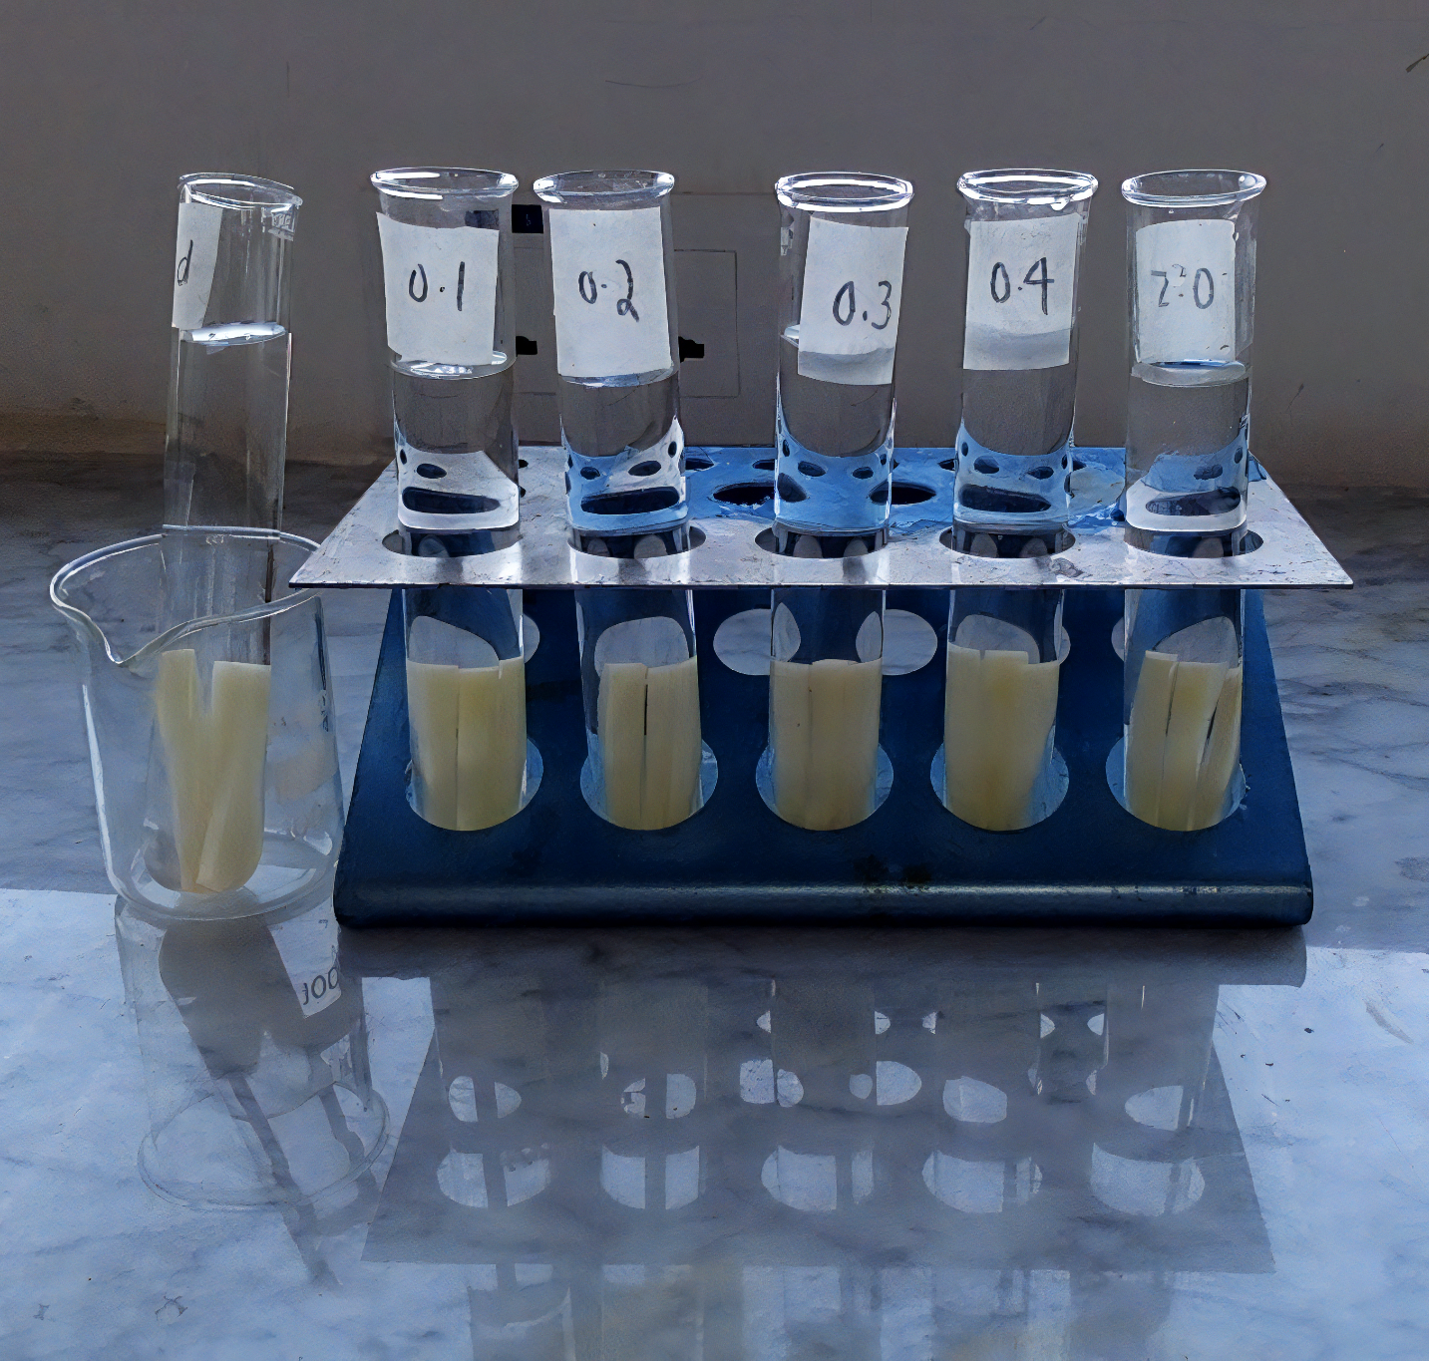
Potato cores are submerged into solutions with different concentrations of sucrose to investigate the process of osmosis.

Slide 15
Potatoes that are submerged in a low sucrose concentration will gain mass (water will move from the solution to the potatoes).
Potatoes that are submerged in a high sucrose concentration will lose mass (water will move from the potatoes to the solution).

Slide 16
Calculating Percentage Change
The mass of the potato will either increase or decrease.
The change in mass can be calculated using percentage change.
Percentage change is more useful than the change in mass.
  This is because two potato cores may have different starting masses.
  Percentage change allows for more accurate comparisons between potato cores.
PC = percentage change
C = change in value
O = original value

Slide 17
Active Transport
Active transport moves particles across cell membranes.
  This usually happens against the concentration gradient.
  Active transport requires energy, usually in the form of ATP.
Carrier proteins are involved in active transport.
  The mechanism is similar to facilitated diffusion.
  A molecule attaches to the carrier protein, causing a change in its shape.
  The molecule is transported across the membrane and released on the opposite side.
Co-transporters are a type of carrier protein.
  Co-transporters bind 2 molecules at once.
  The concentration gradient of 1 molecule is used to move the other molecule across the membrane.
  One example of this is the sodium-glucose co-transport mechanism.

Slide 18
Co-transport in the Ileum
Glucose is absorbed into the bloodstream through the small intestine.
  The last section of the small intestine is called the small intestine.
In the ileum, the concentration of glucose is too low for it to diffuse into the blood.
Glucose is instead absorbed from the inner lining (the lumen) of the small intestine through co-transport.
  Glucose is transported through the small intestine alongside sodium.

