Slide 1
AQA A Level Biology
13 - Cell Membranes
The Phospholipid Bilayer

Slide 2
Cell Membranes
Specification Point 3.2.3 - Transport across cell membranes.
All cells are surrounded by membranes.
  Many of the organelles in eukaryotic cells also contain membranes.
The cell-surface membrane acts as a barrier between the cell and its environment.
  The membrane controls what enters and leaves the cell.
  It is referred to as partially permeable.
  Substances can move into the cell by diffusion, osmosis or active transport.
CELL
MEMBRANE
All cells, including animal cells, are surrounded by a cell membrane.

Slide 3
Membrane Structure
Membranes are usually made up of the following:
  Lipids (primarily phospholipids).
  Proteins.
  Carbohydrates.
Membranes are explained by the fluid mosaic model.
  The fluid mosaic model was proposed in 1972 to describe how molecules are arranged in the membrane.
Phospholipids form a fluid double layer, called a bilayer.
Proteins are found in the bilayer, creating a mosaic structure.

Slide 4
The fluid mosaic model helps to explain the complexity of the bilayer.
TRANSPORT PROTEIN
HYDROPHILIC
HEADS
GLYCOPROTEIN
PHOSPHOLIPID BILAYER
PHOSPHOLIPID MOLECULE
CHOLESTEROL
INTRINSIC PROTEIN
GLYCOLIPID
EXTRINSIC PROTEIN
HYDROPHOBIC TAILS

Slide 5
The Fluid Mosaic Model
There are several types of protein in the bilayer:
  Channel proteins and carrier proteins allow molecules and ions to pass through the membrane.
  Receptor proteins allow the cell to detect chemicals released by other cells.
  Some proteins are combined with sugars to form glycoproteins.
Lipids may be combined with sugars to form glycolipids.
  Glycolipids are involved in cell recognition and the immune response.
  Cholesterol is also found in the cell membrane.
Glycolipids can be found on the surface of the cell membrane and play a role in cell recognition.

Slide 6
Phospholipids
Phospholipids form a barrier to water-soluble compounds.
  The hydrophilic head and hydrophobic tail arrange into a bilayer.
As the centre of the molecule is hydrophobic, water-soluble substances cannot cross the bilayer.
  These include ions and polar molecules.
Small, non-polar substances can still pass through the bilayer.
  Non-polar substances include CO₂ and water.
PHOSPHATE HEAD
The structure of a phospholipid.
The polar nature of the structure means phospholipids will often arrange themselves in bilayers.
FATTY ACID TAILS

Slide 7
Cholesterol
Cholesterol helps to add stability to the membrane.
  Cholesterol is a lipid found in all cell membranes.
Cholesterol fits in the gaps between phospholipids.
  Cholesterol binds to the hydrophobic tails of the phospholipids.
  This forces them to pack more closely together.
  This restricts the movement of the phospholipid, making them more rigid.
Cholesterol is important in maintaining the shape of animal cells.
  This is especially important for free-floating cells, like red blood cells.

Slide 8
Cholesterol (C₂₇H₄₆O) is essential for maintaining the stability of the bilayer.
CHOLESTEROL

Slide 9
The Membrane and Temperature
Cell membranes are sensitive to changes in temperature.
  Temperature affects how much the phospholipids can move in the bilayer.
Temperature affects the permeability of the membrane.
At low temperatures, phospholipids can’t move very much.
  Phospholipids will be packed close together which will increase the rigidity of the membrane.
  Proteins may denature, increasing the permeability of the membrane.
At very low temperatures, ice crystals may form.
  These may pierce holes in the membrane, making it highly permeable when the temperature increases.

Slide 10
MEMBRANE PERMEABILITY VS. TEMPERATURE
POINT OF FREEZING
The permeability of the cell membrane is dependent on temperature.
MEMBRANE PERMEABILITY →
TEMPERATURE (°C) →

Slide 11
The Membrane and Temperature
At higher temperatures, the phospholipids will begin to move around.
  Between 0 and 45°C the membrane is partially permeable.
  As the temperature increases the phospholipids will move more because they have more kinetic energy.
Above 45°C, the bilayer will melt.
  Permeability of the membrane will increase dramatically.
Water inside the cell will expand, putting further pressure on the membrane
Channel and carrier proteins will also denature and control of the cell’s contents will be lost.

Slide 12
Investigating Membrane Permeability
Practical 4: An investigation into the permeability of cell membranes.
Cut a piece of beetroot into 5 identical cubes using a scalpel.
  Rinse off any pigment that may be released as a result.
Add the cubes to 5 different test tubes, each containing 5 cm³ of water.
Place each test tube in a water bath at a range of temperatures.
  Between 10°C and 60°C is appropriate.
  Leave the samples for 20 minutes. This will allow the pigment to leak out of the beetroot.
Set a colorimeter to a blue filter.
  Calibrate the cuvette by filling one and zeroing with distilled water.
Filter each sample into their own cuvette.
Measure the absorbance for each solution.
  The higher the absorbance value, the higher the pigment concentration, suggesting a more permeable membrane.

Slide 13
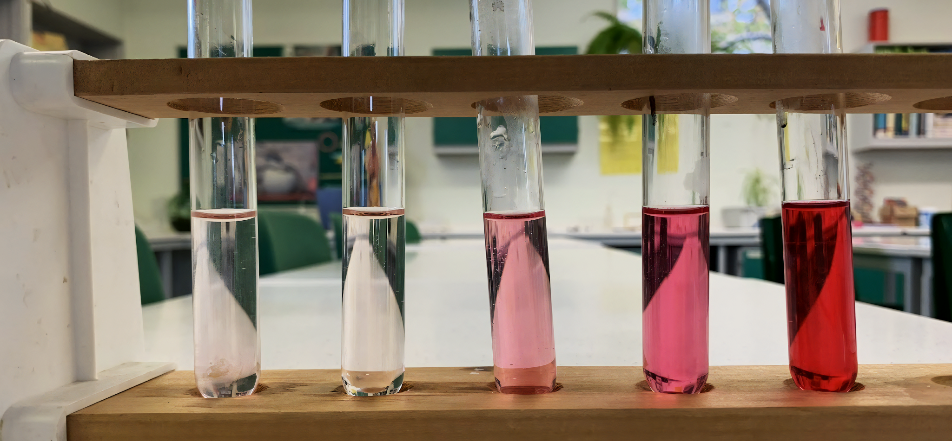
The pigment betalain is released in varying quantities from beetroot depending on temperature.

Slide 14
Investigating Membrane Permeability
Practical 4: An investigation into the permeability of cell membranes.
A similar experiment can be done with beetroot to investigate the effects of solvents on membrane permeability.
  Varying concentrations of ethanol can be used as the solvent.
As the concentration of the solvent increases, so does the permeability of the membrane.
  This is because the solvent will dissolve the lipids in the membrane.
  As a result the bilayer will lose structure.
Membrane permeability experiment video.

