Slide 1
AQA A Level Biology
12 - Cell Division
The Cell Cycle, Mitosis and Cancer

Slide 2
The Cell Cycle
Specification Point 3.2.2 - All cells arise from other cells.
New cells are needed for the growth and repair of tissues.
  Cells constantly need to divide.
  They do this during the cell cycle.
The cell spends most of its time in interphase.
  During interphase the cell is growing and replicating its DNA.
  Interphase can be divided into 3 stages (G₁, S and G₂).
The cell will then divide during mitosis.
The cell cycle can be divided into a number of clear stages: G₁, S and G₂ take place during interphase. The cell then divides during mitosis.

Slide 3
MITOSIS (M)
THE CELL CYCLE STARTS AND ENDS DURING MITOSIS
GAP PHASE 2 (G₂)
THE CELL WILL CONTINUE TO GROW AS WELL AS MAKING THE PROTEINS REQUIRED FOR CELL DIVISION
M
G₂
GAP PHASE 1 (G₁)
THE CELL WILL GROW, SYNTHESISING NEW ORGANELLES AND PROTEINS
G₁
SYNTHESIS (S)
THE CELL WILL REPLICATE ITS DNA HERE, READY TO DIVIDE BY MITOSIS
S
INTERPHASE (I)
INTERPHASE INCLUDES G₁, G₂ AND S
I

Slide 4
Interphase
The cell will continue to carry out its normal functions during interphase.
  For example, respiration, synthesis of enzymes etc.
Towards the end of interphase, the cell will prepare to divide.
  The DNA of the cell is doubled and organelles are replicated.
  The amount of ATP is increased to provide extra energy for cell division.
During interphase, the cell will continue to carry out its normal functions.

Slide 5
An animal cell as it appears during interphase.

Slide 6
Mitosis
During mitosis, a parent cell will divide to produce 2 genetically identical daughter cells.
  Each cell will contain an exact copy of the DNA of their parent cell.
Mitosis is important for growth and repair.
  Organisms need to increase in size to reach adulthood.
  They also need to repair tissues that may sustain damage.
There are 4 main stages to mitosis:
  Prophase (P).
  Metaphase (M).
  Anaphase (A).
  Telophase (T).

Slide 7
Chromosome Structure
DNA is stored in structures called chromosomes.
Chromosomes are made up of 2 strands that are joined by a centromere.
  The centromere is in the middle of the chromosome.
At the end of interphase a chromosome will have 2 strands, called chromatids.
  2 strands on the same chromosome are called sister chromatids.
  These will be identical copies of one another.
Each chromatid will end up as a single-stranded chromosome at the end of mitosis.
  These single-stranded chromosomes will be located in the 2 daughter cells.

Slide 8
CENTROMERE
0.2-20 MICRONS
The structure of a chromosome.
CHROMATID

Slide 9
Prophase
During prophase, chromosomes will condense.
  They will get shorter and fatter and they will become visible under a microscope.
Centrioles will migrate to opposite ends of the cell.
  Centrioles are small proteins that form a connective apparatus called the spindle.
The nuclear envelope will break down.
  As a result the chromosomes will float freely in the cytoplasm.
CYTOPLASM
NUCLEUS

Slide 10
Metaphase
During metaphase, chromosomes will line up along the middle of the cell.
  This is sometimes referred to as the equator.
Chromosomes will attach to the spindle by their centromeres.
  Centromeres attach to the metaphase plate.
CENTROMERE
CHROMOSOME

Slide 11
Anaphase
During anaphase, the centromeres will divide.
  This separates the sister chromatids.
The spindle contracts.
  This pulls the chromatids to opposite ends (poles) of the cell.
Chromatids will now appear v-shaped.
SPINDLE FIBRE

Slide 12
Telophase
During telophase, chromatids uncoil.
  Once they have reached opposite poles, chromatids become long and thin once more.
  They are now referred to as chromosomes again.
A nuclear envelope forms around the chromosomes.
  There are now 2 nuclei.
The cytoplasm divides by cytokinesis.
  2 genetically identical daughter cells are formed.
DUPLICATE
CHROMOSOME

Slide 13
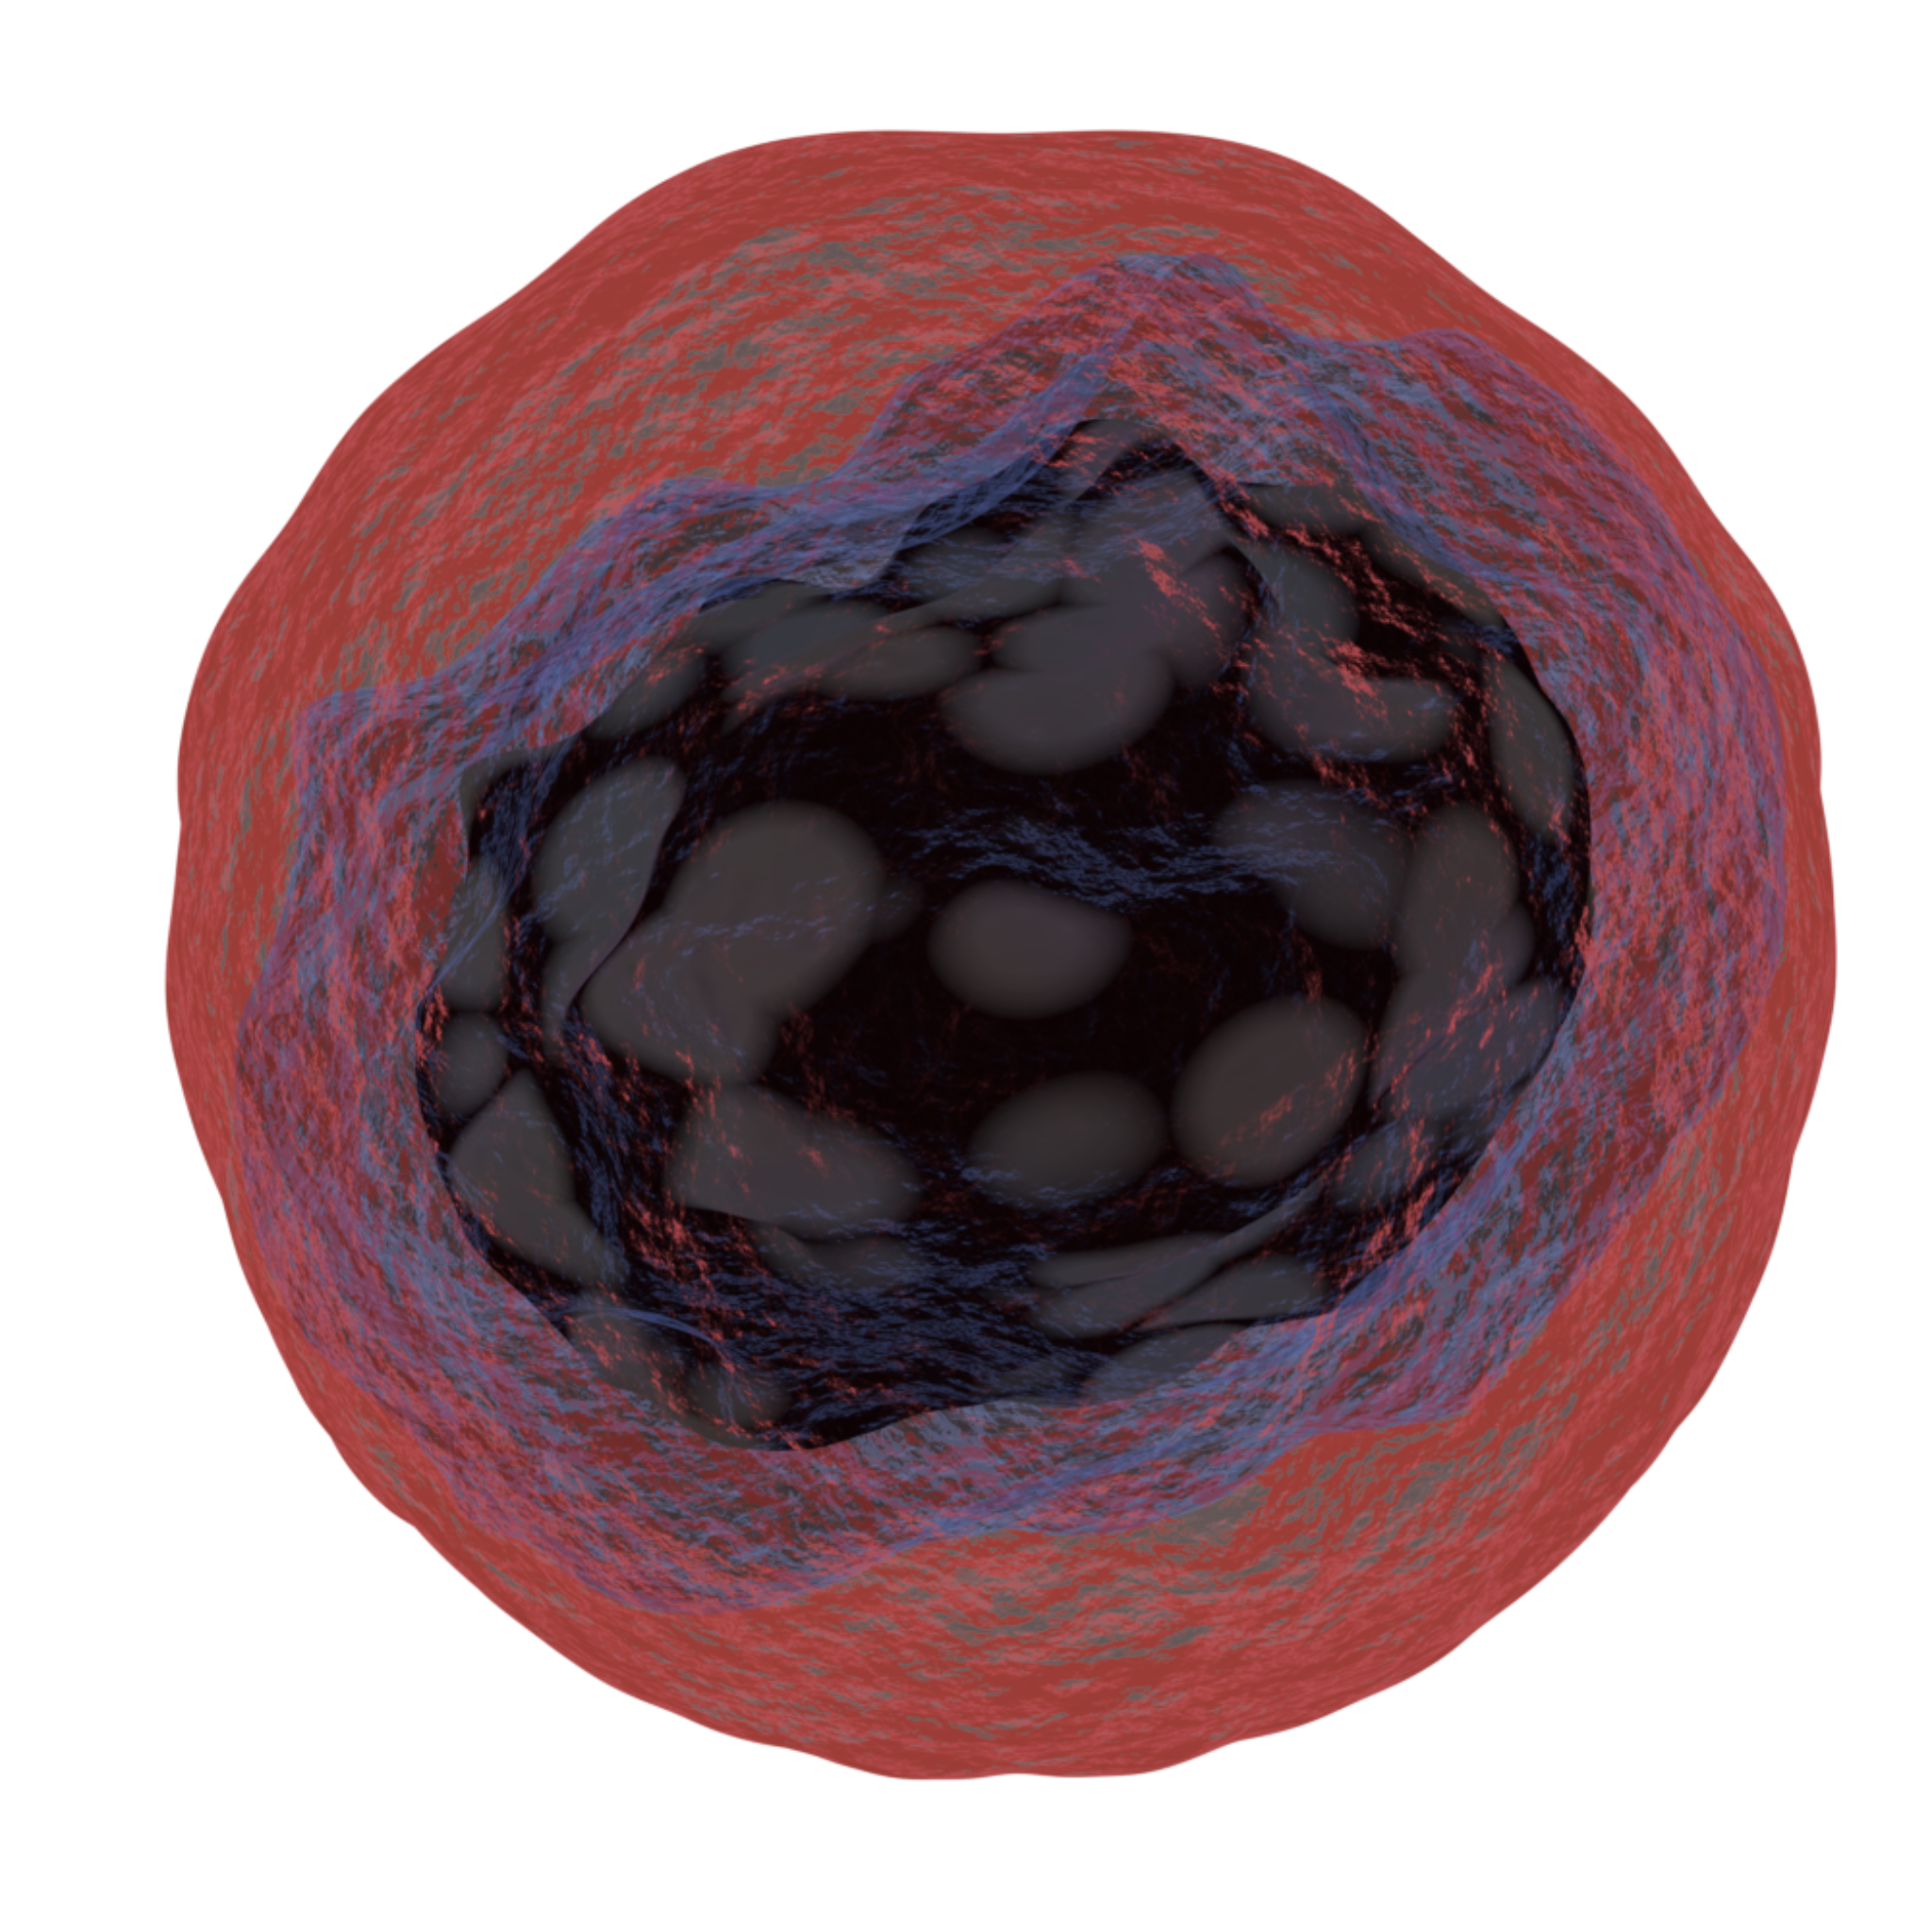
Cancer
The cell cycle is controlled by genes.
  When cells have divided sufficiently for growth and repair, genes usually signal them to stop.
If a mutation occurs in a gene that controls cell division, the cell can divide out of control.
  Cells may divide rapidly to form a tumour.
Cancer is a type of tumour that invades surrounding tissue.
  Cancer forms tumours that are referred to as malignant.
Cancer cells are usually irregularly shaped.

Slide 14
Cancer can invade surrounding tissue, causing damage.
Cancer cells can also break through tissues and travel around the bloodstream.
This can cause the cancer to spread. At this point the cancer is referred to as metastatic.

Slide 15
Cancer Treatments
Some cancer treatments work by disrupting the cell cycle.
  This will kill the tumour cells by limiting their rate of division.
Traditional cancer therapy also impacts healthy cells.
  These treatments will kill normal body cells that are undergoing cell division.
  They will however kill tumour cells more frequently as these cells are dividing continuously.
Chemotherapy disrupts cell growth and protein production.
  Chemical drugs can stop the production of enzymes that are required for cell division.
  The cell is unable to enter the S phase and is forced to kill itself.
Radiotherapy inhibits DNA replication.
  Radiation can damage DNA.
  At several points during the cell cycle, the DNA is checked for damage.
  If damage is detected, the cell is forced to kill itself.

Slide 16
The discipline of oncology (cancer therapy) has two major methods of treatment.
Chemotherapy uses drugs that disrupt the growth and replication of cancer cells.

Slide 17
The discipline of oncology (cancer therapy) has two major methods of treatment.
Radiotherapy uses radiation that disrupts the growth and replication of cancer cells.

Slide 18
Investigating Mitosis
Practical 2: Preparation of root tip cells.
Root tips contain cells that divide rapidly.
  By counting the proportion of cells that are in mitosis, we can work out something called the mitotic index.
  Cells that are dividing rapidly will have a high mitotic index.
Heat 1 mol/dm³ hydrochloric acid (HCl) at 60°C in a water bath.
Transfer a piece of cut root tip into the HCl and leave for 5 minutes.
  Then remove the sample from the HCl and wash in cold, distilled water.
Place the root tip on a microscope slide and stain.
  Toluidine blue or ethano-orcein are appropriate stains.
  Staining will make the chromosomes visible.
Lower a coverslip onto the slide.
  Ensure there are no artefacts or air bubbles.

Slide 19
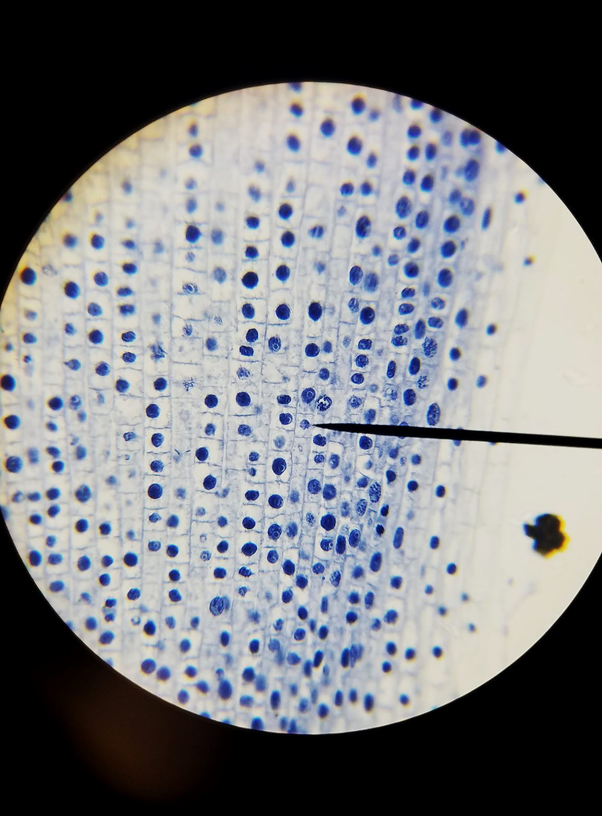
Cells are the fundamental building blocks of life. Pictured are some stained root tip cells with their nuclei visible.

Slide 20
Investigating Mitosis
Place the slide on the microscope.
  Set the objective lens to the lowest value.
Use the coarse adjustment knob to refocus the image until it is clear.
Count the number of cells undergoing mitosis, as well as the total number of cells to calculate the mitotic index.
  Those undergoing mitosis will have visible chromosomes.
Mitosis practical video.
MI = mitotic index
C_{V} = number of cells with visible chromosomes
C_{T} = total number of cells

