Slide 1
AQA A Level Biology
11 - Analysing Cell Components
Microscopes and Cell Fractionation

Slide 2
Microscopes
Specification Point 3.2.1.3 - Methods of studying cells.
Microscopes enlarge images, they allow us to see things we can’t see with the naked eye.
  Galileo perfected the design of the microscope in 1609.
There are two common types of microscopes:
  Light microscopes use light and lenses to form an image of a specimen and magnify it.
  Electron microscopes use a beam of electrons to bounce off organelles. They allow us to see at a much higher magnification and resolution.
Magnification is how much bigger the image you see is in relation to the object.
Resolution is how much detail can be seen in the image.
  A high resolution is defined as the ability to see two objects as distinct images, located close together.

Slide 3
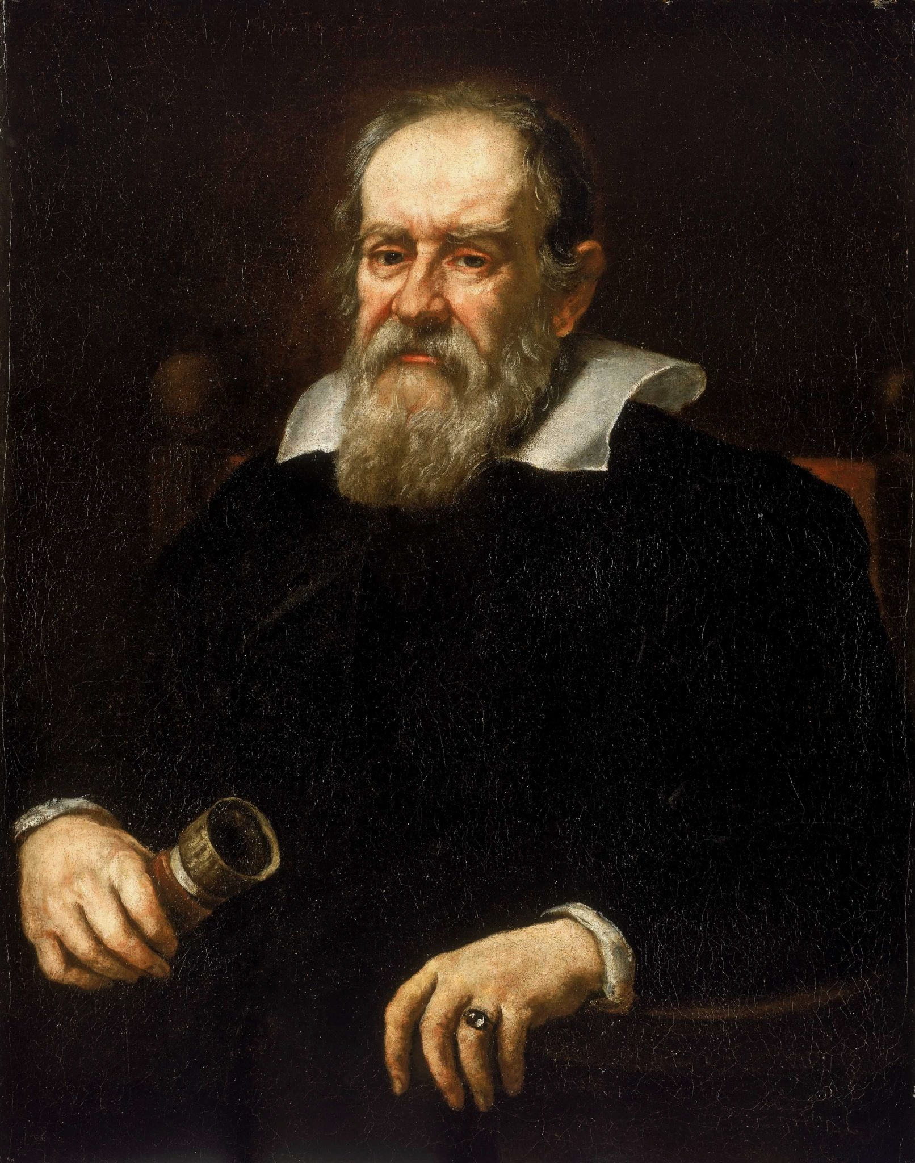
Galileo Galilei is credited with the production of a functional light microscope in 1609.

Slide 4

Magnification is a measure of how much bigger an image is than the real object it represents.

Slide 5
Light Microscopes
Light microscopes use light and lenses to form an image of a specimen and magnify it.
Light microscopes can see individual cells and nuclei.
There is a standard procedure to prepare a slide for a light microscope using onion cells:
Add a drop of water to a clean slide.
Cut up the onion, separate into layers.
  Use tweezers to peel off one of the bottom layers.
Place the onion tissue onto the slide.
Add a drop of iodine solution.
  This is to stain the cells to make them easier to see.
Place a cover slip on top of the slide
  Carefully tilt and lower the cover slip so it covers the specimen.
Microscope preparation video.

Slide 6
Light microscopes have a maximum magnification of around ×1500 and a maximum resolution of about 0.2 μm.

Slide 7
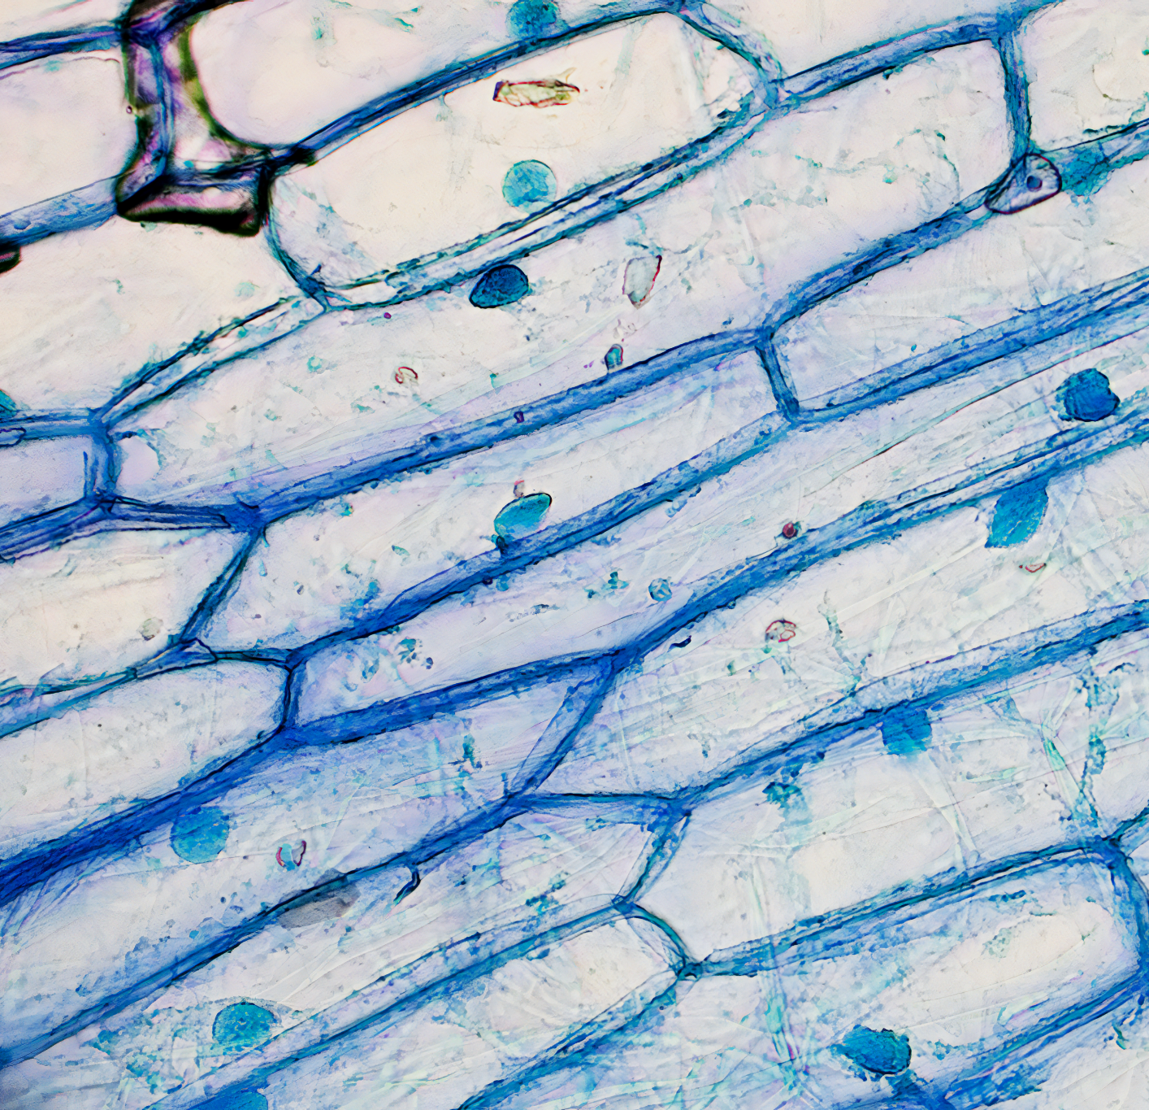
Onion cells are often used for microscopy practicals.

Slide 8
Calculating Magnification
Magnification is how much bigger the image is than the real object that you’re looking at:
Magnification can be calculated using the following formula:
Consider a magnified image that is 10 mm wide. The real size of the specimen is 0.05 mm wide.
Therefore the magnification is 10 ÷ 0.05 = ×200
M = magnification
I = image size
O = object or actual size

Slide 9
Electron Microscopes
There are 2 types of electron microscopes:
  Transmission electron microscopes (TEMs).
  Scanning electron microscopes (SEMs).
TEMs use electromagnets to focus a beam of electrons.
  The beam is then transmitted through the specimen.
  Different parts of the specimen will have different densities.
    Denser regions will absorb more electrons.
SEMs scan a beam of electrons across a specimen.
  The beam knocks electrons off the specimen.
  These electrons are then collected in a cathode ray tube - this forms an image.
  The images formed can be 3 dimensional.

Slide 10
Electron microscopes are much more complex than light microscopes.
Electron microscopes have a maximum magnification of around ×1,500,000 and a maximum resolution of about 0.0002 μm.

Slide 11
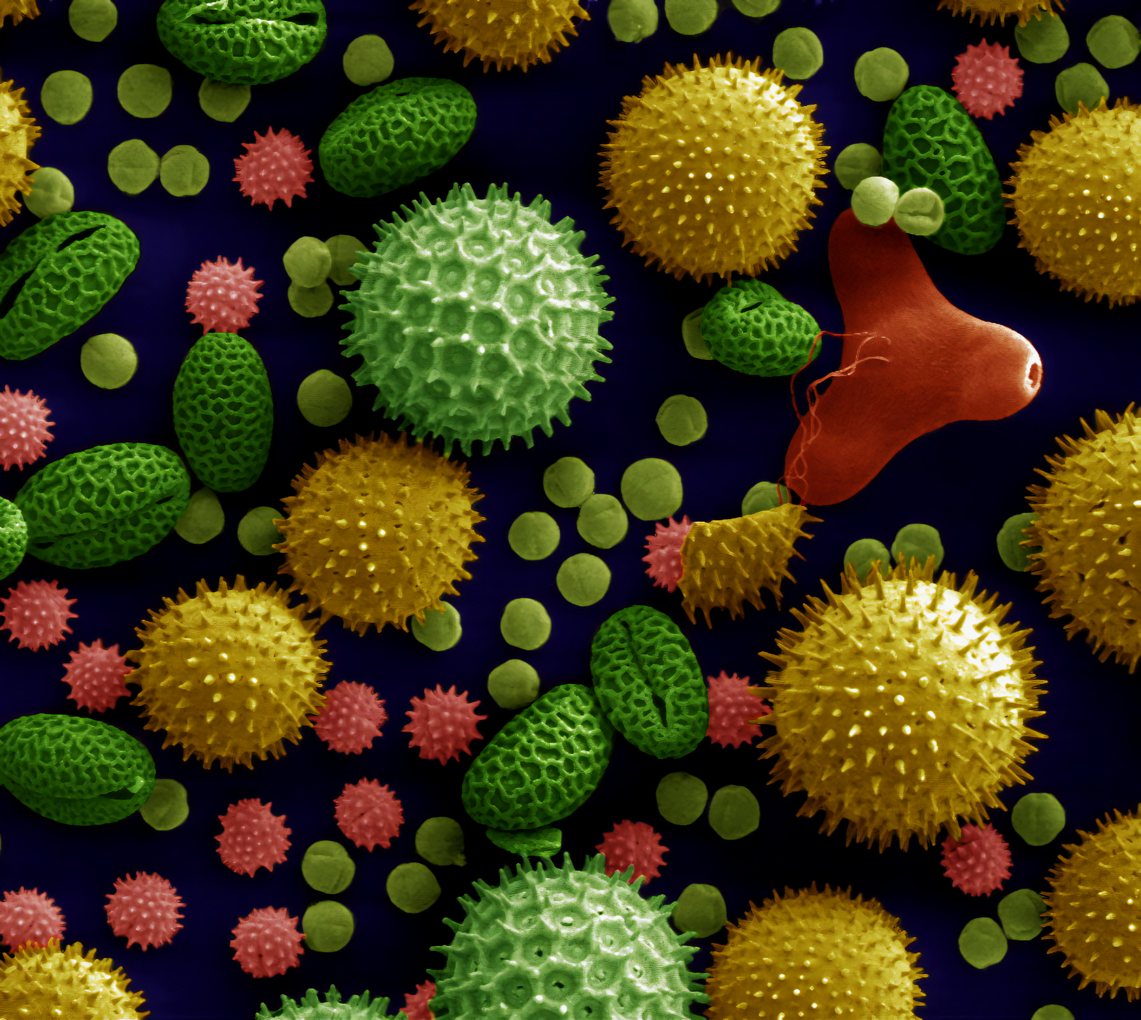
Pollen grains as revealed by a scanning electron microscope.

Slide 12
Comparing Electron Microscopes
TEMs and SEMs both have advantages and disadvantages:
 | TEMs | SEMs
Advantages | TEMs give high resolution images, so smaller organelles can be seen. | SEMs can be used on thick specimens and can also be 3D.
Disadvantages | TEMs can only be used on thin specimens which requires preparation. They can also only be used on non-living specimens. | SEMs give lower resolution images than TEMs. They can also only be used on non-living specimens.

Slide 13
Cell Fractionation
In order to look at specific organelles, they must first be separated from the rest of the cell.
  For example, observing mitochondria or ribosomes.
This is done using cell fractionation:
The cells are first broken up by homogenisation.
  This can be done through grinding the cells up in a blender.
  This breaks the cell-surface membrane apart, releasing the organelles.
  The solution must be kept ice-cold, to reduce enzyme activity.
  The solution must be isotonic, which means it has the same water potential as the organelles. This is to prevent osmosis.
  The solution should be buffered. This will maintain a constant pH to avoid damage to the organelles.

Slide 14
A food blender can be used to homogenise the contents of the cell.
This breaks the cell-surface membrane apart, releasing the organelles.

Slide 15
Cell Fractionation
The cells are the filtered to remove larger debris.
  The homogenised solution is filtered through gauze to remove any tissue debris, such as connective tissue.
  Organelles will pass cleanly through the gauze.
The organelles are separated using ultracentrifugation.
  The cell fragments are decanted to a test tube. The tube is inserted into a centrifuge.
  The centrifuge is spun at a low speed.
    The heaviest organelles sink to the bottom of the tube and form a sedimented pellet. The rest of the organelles are suspended in solution and form the supernatant.
  The supernatant is drained, decanted into another tube and spun at a higher speed.
  This process is repeated until every family of organelle has been separated out by density.

Slide 16
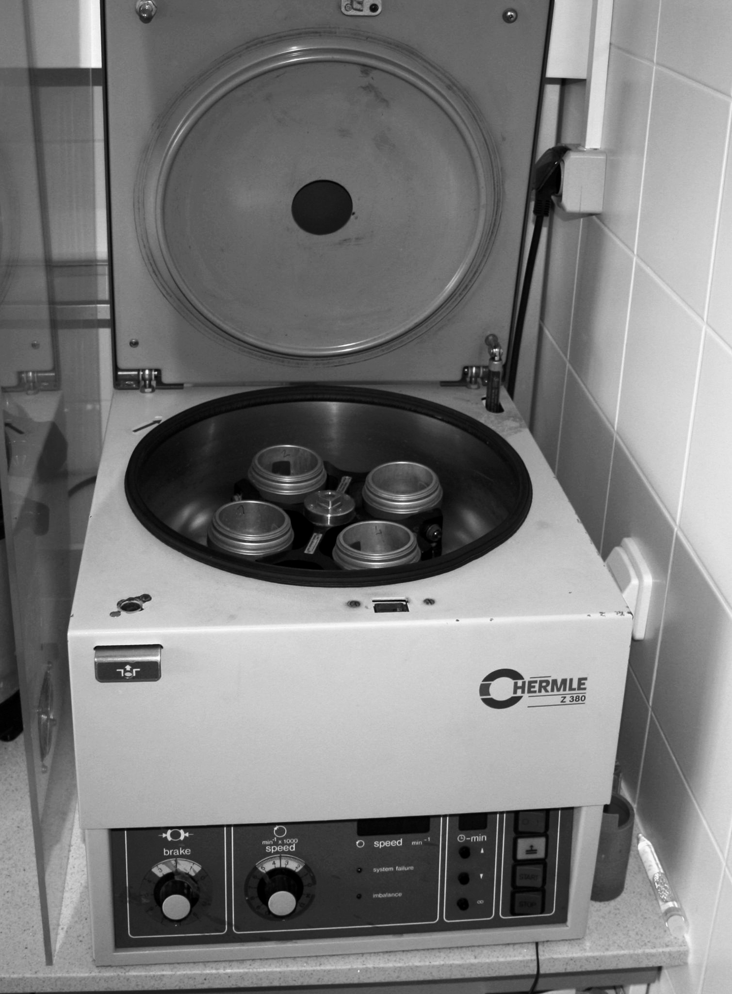
A centrifuge is used to separate organelles based on their density.

Slide 17
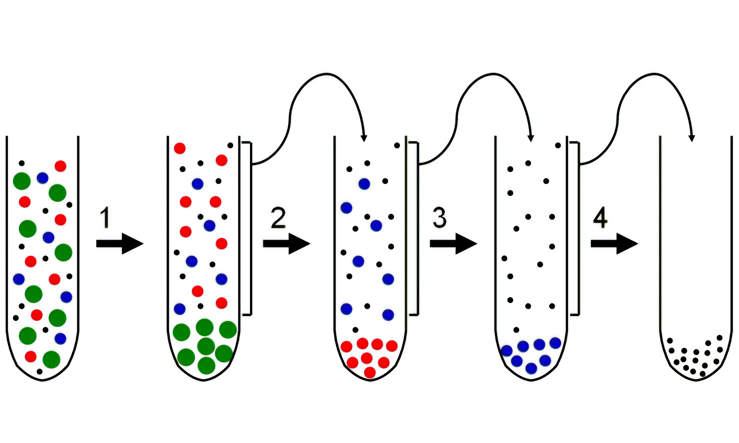
Organelles are separated out by density.
From most dense to least dense the order is usually: nuclei, mitochondria or chloroplasts, lysosomes, endoplasmic reticuli and finally ribosomes.

