Slide 1
AQA A Level Biology
10 - Prokaryotic Cells and Viruses
Structure and Replication

Slide 2
Prokaryotic Cells
Specification Point 3.2.1.2 - Structure of prokaryotic cells and of viruses.
Prokaryotic cells are simpler and smaller than eukaryotic cells.
  A prokaryotic cell can be 50 times smaller than a eukaryotic cell.
Prokaryotes are always single celled.
Prokaryotes do not have a nucleus or any other membrane-bound organelles.
  They do not have mitochondria, chloroplasts or endoplasmic reticula.
  They do however contain ribosomes.
Prokaryotes include bacteria.
  E. coli is an example of a bacteria that causes food poisoning.
Prokaryotes include a large domain of microscopic organisms called bacteria.

Slide 3
A typical prokaryotic bacterial cell.
RIBOSOMES
CYTOPLASM
CELL WALL
FLAGELLUM
SLIME CAPSULE
NUCLEOID
CELL MEMBRANE
PLASMID

Slide 4
There are several species of ‘good’ bacteria present in the small intestine which aid in the process of digestion.

Slide 5
Prokaryotic Cell Structure
The DNA of prokaryotes is free in the cytoplasm.
  Prokaryotes have circular DNA.
  The central nucleoid determines when the cell divides.
  Secondary plasmids contain genes for things like antibiotic resistance.
    Plasmids can be copied across bacteria.
Prokaryotes have a cell wall.
  Bacterial cell walls are usually made out of a form of glycoprotein such as murein.
Most prokaryotes have a flagellum.
  This is a hair-like structure that rotates to give the prokaryote mobility.
Ribosomes in prokaryotes are smaller than in eukaryotes.
  Prokaryotic ribosomes are referred to as 70s ribosomes. This means they are less dense than their larger 80s eukaryotic counterparts.
Some prokaryotes have a protective slime capsule.

Slide 6
Binary Fission
Prokaryotes replicate through binary fission.
  The prokaryotic cell first copies its genetic material.
  It then splits into 2 identical daughter cells.
The nucleoid and plasmids replicate.
  The central nucleoid is only replicated once, but the plasmids can replicate a number of times.
The cell increases in size and DNA moves to the opposite ends of the cell.
  These are referred to as the poles.
The cytoplasm divides and a new cell wall begins to form.
Two daughter cells are produced.
  Each has a single copy of the nucleoid and a variable number of copied plasmids.

Slide 7
A prokaryotic cell undergoing binary fission.
MOTHER CELL
BIPARTITION
DAUGHTER CELLS

Slide 8
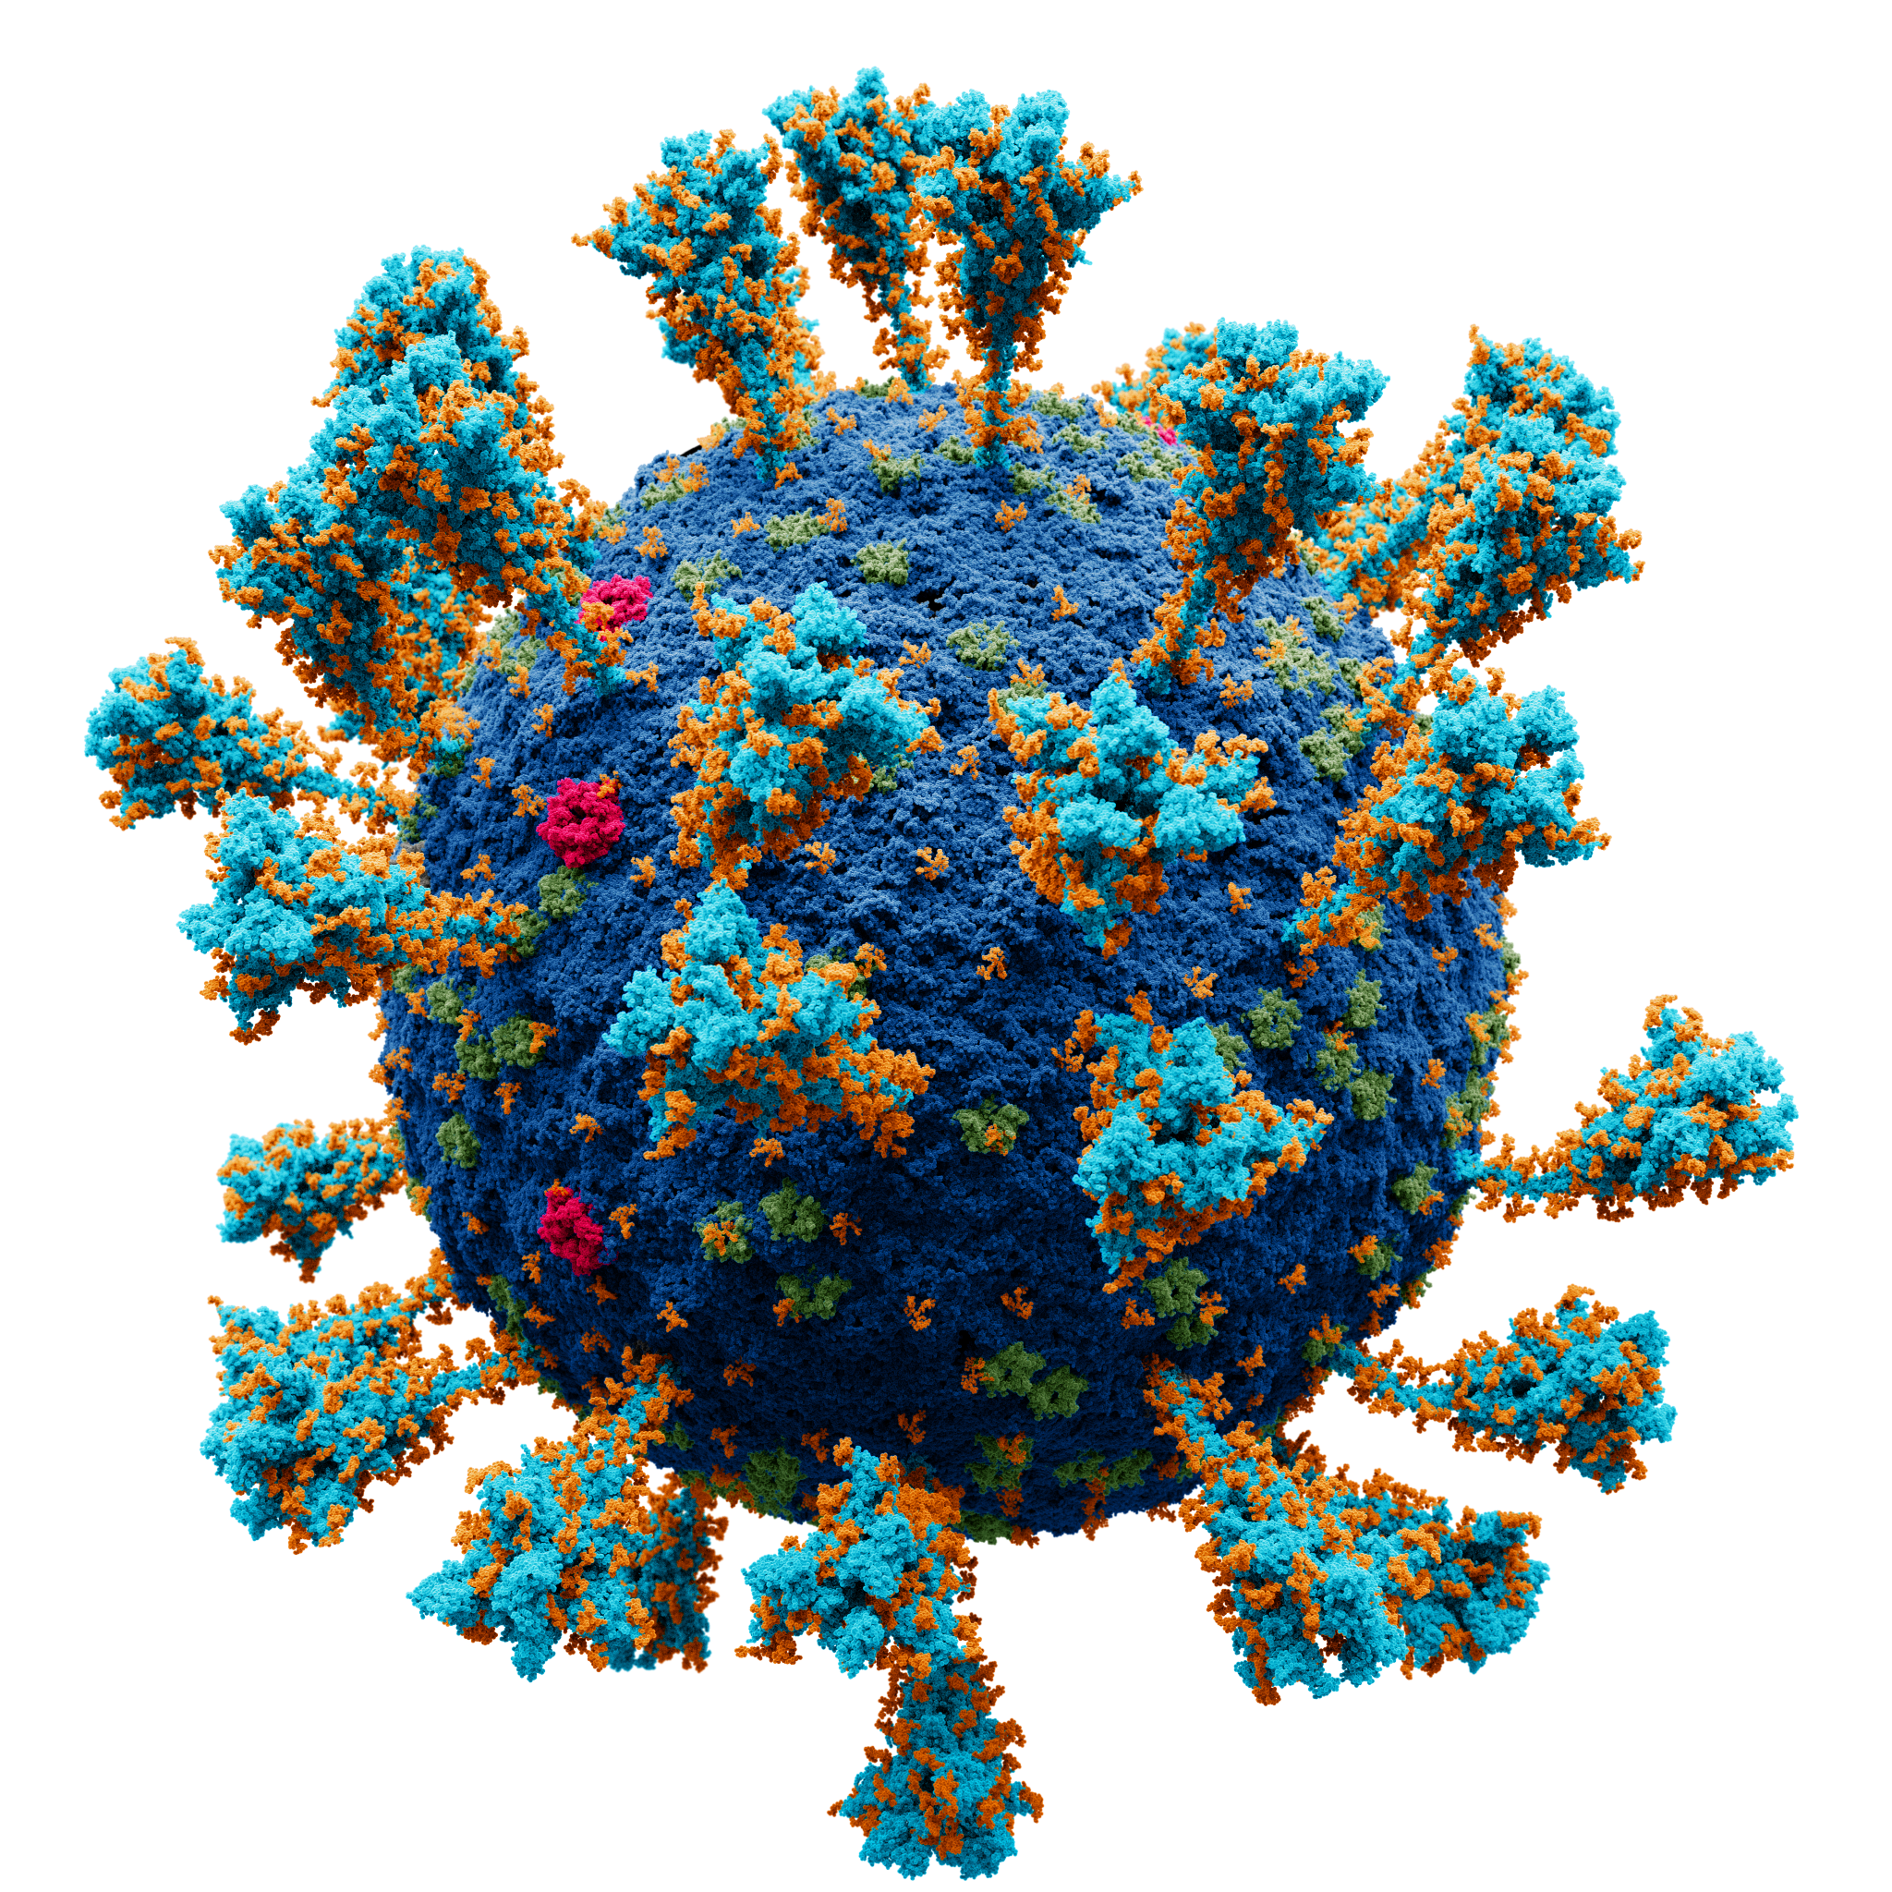
Viruses
Viruses are not cells.
  They are considered to be acellular as they do not contain many cellular components.
Viruses are considered to be particles.
  Viruses contain a length of nucleic acid which is surrounded by protein shell (a capsid).
Viruses invade and reproduce inside cells.
  These cells are referred to as host cells.
Many diseases are caused by viruses.
  Influenza, HIV and COVID-19 are all viral diseases.
Viruses are smaller than cells.
  HIV is some 20 times smaller than E. coli.
A model of the virus SARS‑CoV‑2, responsible for causing COVID-19.

Slide 9
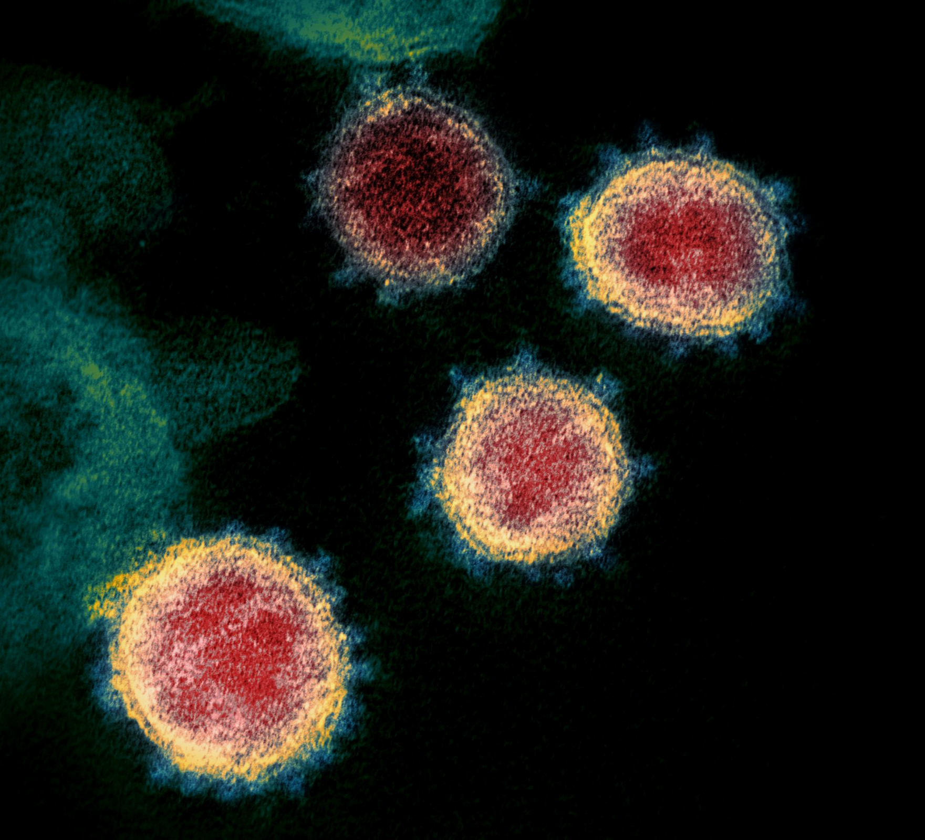
The structure of the SARS-CoV-2 as seen by an electron microscope.
Viruses reproduce by invading host cells and then replicating within them.

Slide 10
ATTACHMENT PROTEIN
VIRAL ENVELOPE
CAPSID
The basic structure of a virus.
Viruses have a simple and elegant design when compared to prokaryotic or eukaryotic cells.
DNA OR RNA
ENZYMES

Slide 11
Viral Replication
Viruses inject their nucleic acid into host cells.
  They do this by binding to cells using their attachment proteins.
  Some viruses can only attach to a single cell type.
  Others can attach to many different types of cell.
These ‘hijacked’ cells then create proteins and other compounds to assemble new viruses.
  Viruses co-opt ribosomes into creating new proteins.
The new viruses burst out of the host cell.
  This causes the cell to lyse and die.
  This is what usually causes viral illness.

Slide 12
Viral replication inside a host cell.

