Slide 1
Cambridge International A Level Computer Science (9618) – Revision Notes
Cryptography and Secure Communication Technologies
This pack is intended for students to who are taking CIE A Level in Computer Science, either in preparation for their A Level exam, or more likely alongside year 2 of the course to improve fluency, recall and pace on AS & A topics. It could be used as lesson starters, or supplied to students for independent use.

Slide 2


Chapter
21
Cryptography and Secure Communication Technologies
AS & A Level Computer Science 9618

Slide 3



21.2
21.1
Ensuring Authenticity with Digital Signatures and Certificates
21.3
Symmetric Encryption: Shared Key Techniques
21.4
Core Concepts of Encryption
Public Key Cryptography: Secure Key Exchange
21.5
SSL/TLS: Secure Communication Protocols
Chapter
Outline
21.6
Quantum Cryptography: The Future of Secure Communication

Slide 4


21.1 Core Concepts of Encryption
Purpose of encryption
Encryption is essential when transmitting data over a network to protect it from unauthorised access or interception by converting it into a secure and unreadable format, ensuring confidentiality and privacy.
“Pezwd* O lk S”
“Hello, I am A”
“Hello, I am A”

Slide 5

21.1 Core Concepts of Encryption
Terminology
Plaintext
Encryption
Ciphertext
Decryption
Plaintext
Key
Key
“Pezwd* O lk S”
“Hello, I am A”
“Hello, I am A”

Slide 6





21.1 Core Concepts of Encryption
Security Concerns
Confidentiality: Protecting data from unauthorised access during transmission to maintain secrecy and privacy.
Authenticity: Verifying the identities of sender and receiver to prevent unauthorised access or alteration.
Integrity: Ensuring data remains unaltered and intact during transmission, free from unauthorised modifications.
Non-repudiation: Preventing denial of involvement in data transmission by providing proof of sender's actions.
Availability: Ensuring data is accessible and usable by authorised parties whenever needed during transmission.

Slide 7
21.1 Core Concepts of Encryption
Security Concerns
Confidentiality: Protecting data from unauthorised access during transmission to maintain secrecy and privacy.
Authenticity: Verifying the identities of sender and receiver to prevent unauthorised access or alteration.
Integrity: Ensuring data remains unaltered and intact during transmission, free from unauthorised modifications.
Non-repudiation: Preventing denial of involvement in data transmission by providing proof of sender's actions.
Availability: Ensuring data is accessible and usable by authorised parties whenever needed during transmission.

Slide 8
21.1 Core Concepts of Encryption
Encryption methods
Symmetric key encryption
Asymmetric key encryption

Slide 9

21.1 Core Concepts of Encryption
Symmetric key encryption
Symmetric encryption uses a single key for both encryption and decryption of data.
Plaintext
Encryption
Ciphertext
Decryption
Plaintext
Key
Key

Slide 10
21.1 Core Concepts of Encryption
Symmetric key encryption
Its main disadvantage lies in securely sharing the key between communicating parties without interception, which poses a challenge for secure key distribution.
Plaintext
Encryption
Ciphertext
Decryption
Plaintext
Key
Key

Slide 11

21.1 Core Concepts of Encryption
Asymmetric encryption
Asymmetric encryption uses two keys (public and private) for encryption and decryption, providing enhanced security. Only the private key is secret.
Plaintext
Encryption
Ciphertext
Decryption
Plaintext
Public Key
Private Key

Slide 12



21.1 Core Concepts of Encryption
How does asymmetric encryption work?
Public Key
Private Key

Slide 13

21.1 Core Concepts of Encryption
How does asymmetric encryption work?
Public Key
Public Key
Private Key
Public Key
Public Key

Slide 14
21.1 Core Concepts of Encryption
How does asymmetric encryption work?
Public Key
Public Key
Private Key
“Pezwd* O lk S”
Public Key
Public Key can be used to encrypt a message
“Hello, I am A”

Slide 15
21.1 Core Concepts of Encryption
How does asymmetric encryption work?
Public Key
Public Key
Only private key can be used to decrypt a message
“Pezwd* O lk S”
“Hello, I am A”
Public Key
Public Key

Slide 16
21.1 Core Concepts of Encryption
How does asymmetric encryption work?
To allow intercommunication among the 5 individuals, they need to have their own private keys and public key for every other individual.

Slide 17
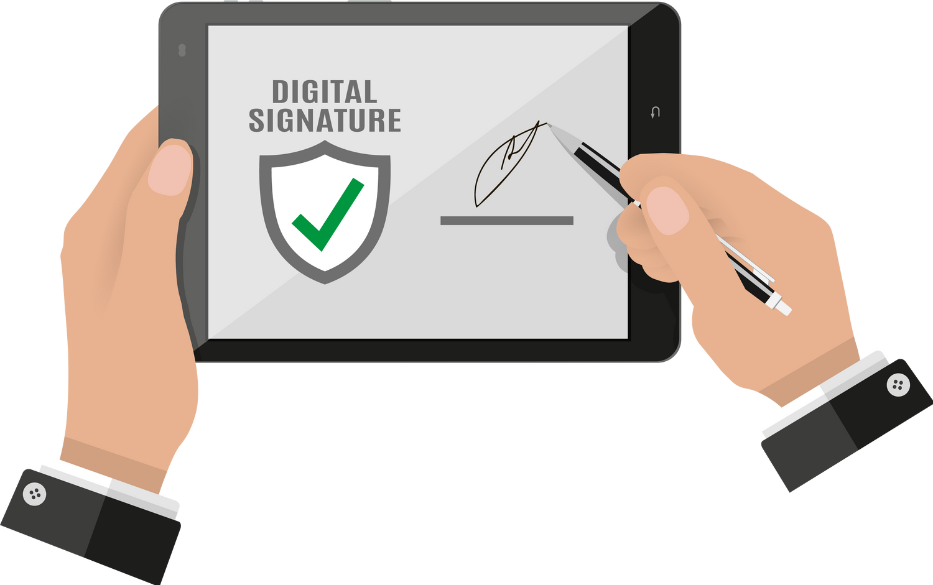
21.2 Ensuring Authenticity with Digital Signatures and Certificates
Subtopic 1
Digital signature
A digital signature is a cryptographic technique used to verify the authenticity and integrity of digital data, crucial for ensuring the validity and non-repudiation of electronic documents or transactions.

Slide 18
21.2 Ensuring Authenticity with Digital Signatures and Certificates
Subtopic 1
Digital signature
How do we verify the identity of the sender?
One solution: Ask the sender to encrypt a message using their private key.
Plaintext
Encryption
Ciphertext
Decryption
Plaintext
Sender’s private key
Receiver’s public key
Disadvantage: It requires the whole message to be encrypted, which could result in slower process.

Slide 19
21.2 Ensuring Authenticity with Digital Signatures and Certificates
Subtopic 1
Digital signature
How do we make the process faster?
Solution: Instead of encrypting the whole message, encrypt only the digest.
What is a digest? A number created using a PUBLIC cryptographic one-way hash function.
Plaintext
Crytographic hash function
Digest
Sender’s private key
Encryption
Digital Signature

Slide 20
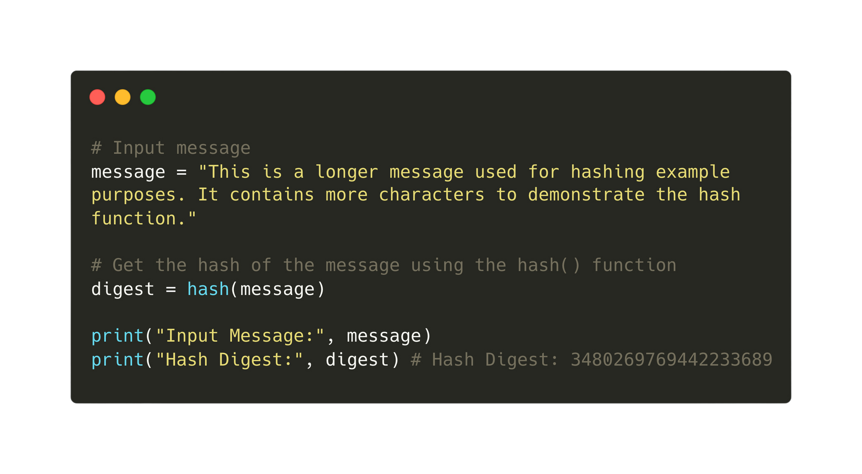
21.2 Ensuring Authenticity with Digital Signatures and Certificates
Subtopic 1
Digital signature
How do we make the process faster?
Solution: Instead of encrypting the whole message, encrypt only the digest.
What is a digest? A number created using a public cryptographic one-way hash function.

Slide 21

21.2 Ensuring Authenticity with Digital Signatures and Certificates
Subtopic 1
Digital signature
With this method, the encrypted digest can be transmitted as a separate file alongside with the plaintext.
This process is faster than if the whole message is encrypted.
Encrypted Digest
Receiver
Plaintext

Slide 22
21.2 Ensuring Authenticity with Digital Signatures and Certificates
Subtopic 1
Digital signature
Receiving End (Step 1):
Crytographic hash function
Plaintext
Digest

Slide 23
21.2 Ensuring Authenticity with Digital Signatures and Certificates
Subtopic 1
Digital signature
Receiving End (Step 2):
Encrypted Digest (Digital Signature)
Decryption
Digest
Sender’s public key

Slide 24
21.2 Ensuring Authenticity with Digital Signatures and Certificates
Subtopic 1
Digital signature
Receiving End (Step 3): Compare the two digests the check whether the message is authentic and has been transmitted unaltered.
Crytographic hash function
Plaintext
Digest
Encrypted Digest (Digital Signature)
Decryption
Digest
Sender’s public key

Slide 25


21.2 Ensuring Authenticity with Digital Signatures and Certificates
Subtopic 1
Digital signature
Problem: The authenticity only confirms to the receiver that the message was sent from the person who had sent them the public key.
Public Key
Person A
Person B

Slide 26

21.2 Ensuring Authenticity with Digital Signatures and Certificates
Subtopic 1
Digital signature
Problem: The authenticity only confirms to the receiver that the message was sent from the person who had sent them the public key. It does not consider the fact that someone might create a public key and pretend to be someone else.
Public Key
Person A
Public Key
Person B
Pretend to be Person A

Slide 27

21.2 Ensuring Authenticity with Digital Signatures and Certificates
Subtopic 1
Digital signature
Solution: Have a third party act as a Certification Authority.
Certification Authority: A Certification Authority (CA) is a trusted entity responsible for issuing digital certificates that verify the authenticity of identities or entities in electronic communications or transactions.
Certification Authority
public key
public key with digital signature
Person A
Person B

Slide 28
21.2 Ensuring Authenticity with Digital Signatures and Certificates
Subtopic 1
How does it work?
Step 1: Person A contacts a local CA.
Person A (would be receiver)
Certification Authority

Slide 29

21.2 Ensuring Authenticity with Digital Signatures and Certificates
Subtopic 1
How does it work?
Step 2: The CA confirms the identity of person A.
You are indeed A.
Person A (would be receiver)
Certification Authority

Slide 30
21.2 Ensuring Authenticity with Digital Signatures and Certificates
Subtopic 1
How does it work?
Step 3: Person A sends the public key to the CA.
Person A (would be receiver)
Public Key
Certification Authority

Slide 31

21.2 Ensuring Authenticity with Digital Signatures and Certificates
Subtopic 1
How does it work?
Step 4: The Certification Authority (CA) generates a public-key certificate containing person A's public key, and it employs encryption using its private key to append a digital signature to this document.
Person A (would be receiver)
Certification Authority
Public Key
(with digital signature)

Slide 32
21.2 Ensuring Authenticity with Digital Signatures and Certificates
Subtopic 1
How does it work?
Step 5: The digital certificate is given to person A. Person A then posts the digital certificate on a website.
Person A (would be receiver)
Public Key
Certification Authority
(with digital signature)

Slide 33
21.2 Ensuring Authenticity with Digital Signatures and Certificates
Subtopic 1
How does it work?
Anyone who wishes to extract the public key from the certificate has to use the CA’s public key (Remember: the digital signature is created using the CA’s private key).
Public Key
(with digital signature)

Slide 34

21.3 Symmetric Encryption: Shared Key Techniques
Simplified Data Encryption Standard (S-DES)
The algorithm is used to encrypt an 8-bit block.
Data:
0 | 1 | 1 | 0 | 1 | 1 | 1 | 0
There are 2 stages of encryption:
Stage 1:
Create 2 8-bit keys
from a 10-bit key
Encrypt the data using the 2 8-bit keys generated
Stage 2:

Slide 35


21.3 Symmetric Encryption: Shared Key Techniques
Simplified Data Encryption Standard (S-DES)
Stage 1: Create 2 8-bit keys from a 10-bit key.
Assuming that a 10-key key is selected.
0 | 1 | 1 | 0 | 1 | 0 | 1 | 0 | 1 | 0
Permutate the key
0 | 1 | 1 | 0 | 1 | 0 | 1 | 0 | 1 | 0
2 | 7 | 9 | 1 | 3 | 10 | 8 | 4 | 6 | 5

Slide 36
21.3 Symmetric Encryption: Shared Key Techniques
Simplified Data Encryption Standard (S-DES)
Stage 1: Create 2 8-bit keys from a 10-bit key.
Assuming that a 10-key key is selected.
0 | 1 | 1 | 0 | 1 | 0 | 1 | 0 | 1 | 0
Permutate the key
Before
0 | 1 | 1 | 0 | 1 | 0 | 1 | 0 | 1 | 0
2 | 7 | 9 | 1 | 3 | 10 | 8 | 4 | 6 | 5
0 | 0 | 1 | 0 | 0 | 1 | 1 | 1 | 1 | 0
After

Slide 37

21.3 Symmetric Encryption: Shared Key Techniques
Simplified Data Encryption Standard (S-DES)
Stage 1: Create 2 8-bit keys from a 10-bit key.
Apply circular shift to the left and right 5 bits.
0 | 0 | 1 | 0 | 0 | 1 | 1 | 1 | 1 | 0

Slide 38
21.3 Symmetric Encryption: Shared Key Techniques
Simplified Data Encryption Standard (S-DES)
Stage 1: Create 2 8-bit keys from a 10-bit key.
Apply circular shift to the left and right 5 bits.
0 | 0 | 1 | 0 | 0 | 1 | 1 | 1 | 1 | 0
0 | 1 | 0 | 0 | 0 | 1 | 1 | 1 | 0 | 1

Slide 39

21.3 Symmetric Encryption: Shared Key Techniques
Simplified Data Encryption Standard (S-DES)
Stage 1: Create 2 8-bit keys from a 10-bit key.
Create the first 8-bit key using permutation.
0 | 1 | 0 | 0 | 0 | 1 | 1 | 1 | 0 | 1
3 | 7 | 10 | 1 | 9 | 5 | 6 | 4

Slide 40
21.3 Symmetric Encryption: Shared Key Techniques
Simplified Data Encryption Standard (S-DES)
Stage 1: Create 2 8-bit keys from a 10-bit key.
Create the first 8-bit key using permutation.
0 | 1 | 0 | 0 | 0 | 1 | 1 | 1 | 0 | 1
3 | 7 | 10 | 1 | 9 | 5 | 6 | 4
0 | 1 | 1 | 0 | 0 | 0 | 1 | 0

Slide 41

21.3 Symmetric Encryption: Shared Key Techniques
Simplified Data Encryption Standard (S-DES)
Stage 1: Create 2 8-bit keys from a 10-bit key.
Create the second 8-bit key using permutation.
0 | 1 | 0 | 0 | 0 | 1 | 1 | 1 | 0 | 1
2 | 5 | 7 | 10 | 9 | 3 | 6 | 4
1 | 0 | 1 | 1 | 0 | 0 | 1 | 0

Slide 42
21.3 Symmetric Encryption: Shared Key Techniques
Simplified Data Encryption Standard (S-DES)
Stage 1: Create 2 8-bit keys from a 10-bit key.
Keys generated are then used for encryption in stage 2.
Key 1
0 | 1 | 1 | 0 | 0 | 0 | 1 | 0
Key 2
1 | 0 | 1 | 1 | 0 | 0 | 1 | 0

Slide 43
21.3 Symmetric Encryption: Shared Key Techniques
Simplified Data Encryption Standard (S-DES)
Stage 2: The encryption process.
Data:
0 | 1 | 1 | 0 | 1 | 1 | 1 | 0
Key 1
0 | 1 | 1 | 0 | 0 | 0 | 1 | 0
Key 2
1 | 0 | 1 | 1 | 0 | 0 | 1 | 0

Slide 44
21.3 Symmetric Encryption: Shared Key Techniques
Simplified Data Encryption Standard (S-DES)
Stage 2: The encryption process.
Permutate the data
Before
0 | 1 | 1 | 0 | 1 | 1 | 1 | 0
2 | 1 | 8 | 3 | 5 | 7 | 4 | 6
1 | 0 | 0 | 1 | 1 | 1 | 0 | 1
After

Slide 45
21.3 Symmetric Encryption: Shared Key Techniques
Simplified Data Encryption Standard (S-DES)
Stage 2: The encryption process.
Apply a function (eg. XOR operation) using the permuted code and key #1.
Permuted code:
1 | 0 | 0 | 1 | 1 | 1 | 0 | 1
Key 1
0 | 1 | 1 | 0 | 0 | 0 | 1 | 0
After:
1 | 1 | 1 | 1 | 1 | 1 | 1 | 1

Slide 46
21.3 Symmetric Encryption: Shared Key Techniques
Simplified Data Encryption Standard (S-DES)
Stage 2: The encryption process.
A switch at the last and first 4 parts.
Before:
1 | 1 | 1 | 1 | 1 | 1 | 1 | 1
After:
1 | 1 | 1 | 1 | 1 | 1 | 1 | 1

Slide 47
21.3 Symmetric Encryption: Shared Key Techniques
Simplified Data Encryption Standard (S-DES)
Stage 2: The encryption process.
Apply a function (eg. XOR operation) using the resultant code and key #2.
Code
1 | 1 | 1 | 1 | 1 | 1 | 1 | 1
Key 2
1 | 0 | 1 | 1 | 0 | 0 | 1 | 0
Code
0 | 1 | 0 | 0 | 1 | 1 | 0 | 1

Slide 48

21.3 Symmetric Encryption: Shared Key Techniques
Simplified Data Encryption Standard (S-DES)
Stage 2: The encryption process.
A final permutation using the reverse of the initial permutation sequence.
Code
0 | 1 | 0 | 0 | 1 | 1 | 0 | 1
6 | 4 | 7 | 5 | 3 | 8 | 1 | 2
1 | 0 | 0 | 1 | 0 | 1 | 0 | 1
Final Code
The decryption by the receiver of a transmission uses the same generated 8-bit keys and follows the reverse of the above process.

Slide 49
21.3 Symmetric Encryption: Shared Key Techniques
Advanced Encryption Standard (AES)
AES (Advanced Encryption Standard) typically uses block lengths of 128 bits, dividing data into 128-bit blocks for encryption and decryption.
The requirement of securely sharing and managing keys between both the sender and receiver in AES encryption raises concerns about key distribution, storage, and potential vulnerabilities if the keys are compromised during transmission or storage.

Slide 50



21.4 Public Key Cryptography: Secure Key Exchange
Rivest-Shamir-Adleman (RSA)
It is the usual method of public key encryption.
Key generation algorithm
Two very large prime numbers p and q are chosen and their product n is calculated. n = p x q.
The product (p-1) x (q-1) is calculated. A number smaller than the product, e, that is not a factor of it, is chosen. 65537 is usually the choice.

Slide 51

21.4 Public Key Cryptography: Secure Key Exchange
Rivest-Shamir-Adleman (RSA)
It is the usual method of public key encryption.
Key generation algorithm
Two very large prime numbers p and q are chosen and their product n is calculated. n = p x q.
The product (p-1) x (q-1) is calculated. A number smaller than the product, e, that is not a factor of it, is chosen. 65537 is usually the choice.
Find d. How?
(p-1) x (q-1)
d x e
must give a remainder of 1.
Public Key = (n,e)
Private key = (n,d)
It is not easy to deduce p and q!

Slide 52
21.4 Public Key Cryptography: Secure Key Exchange
Rivest-Shamir-Adleman (RSA)
It is the usual method of public key encryption.
Public key encryption, although more secure, tends to have slower algorithms. It is a common practice to employ public key encryption for securely transmitting a key that can subsequently be used for faster symmetric key encryption.

Slide 53


21.5 SSL/TLS: Secure Communication Protocols
SSL (Secure Socket Layer)
SSL (Secure Sockets Layer) is essential for ensuring the authenticity of a website and facilitating secure transmission of sensitive data by encrypting the communication between the user's browser and the website's server.
21.2
21.3
Digital signatures and digital certificates
Symmetric key encryption methods
21.4
Public key encryption methods

Slide 54

21.5 SSL/TLS: Secure Communication Protocols
SSL (Secure Socket Layer)
SSL operates at the application layer of the OSI model and is commonly implemented on top of the transport layer protocol, typically TCP (Transmission Control Protocol). It typically uses port number 443 for secure communication. SSL provides a secure channel between a client (e.g., a web browser) and a server, ensuring confidentiality and integrity of data exchanged during communication.

Slide 55

21.5 SSL/TLS: Secure Communication Protocols
SSL (Secure Socket Layer)
When the SSL is in place, the application protocol http becomes https.

Slide 56
21.5 SSL/TLS: Secure Communication Protocols
SSL (Secure Socket Layer)
SSL is a protocol suite that includes:
Record Protocol: Encrypts, authenticates, and fragments data for secure transmission between communicating applications.
Handshake Protocol: Facilitates the negotiation of security parameters and mutual authentication to establish a secure connection between the client and the server.

Slide 57




21.5 SSL/TLS: Secure Communication Protocols
SSL (Secure Socket Layer) Operation
The SSL operation starts when the client wants to establish a connection with the server.
Client
Server

Slide 58


21.5 SSL/TLS: Secure Communication Protocols
SSL (Secure Socket Layer) Operation
The client browser then invokes the Handshake Protocol from the SSP suite.
Client
Server

Slide 59
21.5 SSL/TLS: Secure Communication Protocols
SSL (Secure Socket Layer) Operation
The handshake protocol requests from the server its SSL certificate that can confirm its identity.
Client
Server

Slide 60


21.5 SSL/TLS: Secure Communication Protocols
SSL (Secure Socket Layer) Operation
The server sends its SSL certificate plus its public key.
Client
Server

Slide 61

21.5 SSL/TLS: Secure Communication Protocols
SSL (Secure Socket Layer) Operation
The browser employs the public key to encrypt a key, serving as a temporary session key for symmetric key encryption during the data transfer in that session.
Encrypted data
Client
Server

Slide 62

21.5 SSL/TLS: Secure Communication Protocols
TLS (Transport Layer Security)
TSL is an upgraded version of SSL recommended for use because of some security concerns with the use of SSL.
Compared to SSL, TSL has stronger cryptographic algorithms and improved protocols.

Slide 63

21.6 Quantum Cryptography: The Future of Secure Communication
Subtopic 1
Quantum Mechanics
Quantum mechanics explores the behavior of particles on the smallest scales, challenging classical understanding with phenomena like wave-particle duality.
Photons - particles that transmit light

Slide 64
21.6 Quantum Cryptography: The Future of Secure Communication
Subtopic 1
Photons
Photons exhibit wave-like characteristics, causing each photon to oscillate in a specific direction perpendicular to its travel path; this directional oscillation, termed polarisation, is illustrated in diagrams as a double-ended arrow.
A photon can be created with a specific polarisation to represent a value for a bit.
= 1
= 1
= 0
= 0

Slide 65
21.6 Quantum Cryptography: The Future of Secure Communication
Subtopic 1
Quantum Key Distribution
A secure communication method that leverages quantum mechanical properties to exchange cryptographic keys between parties while detecting any eavesdropping attempts.

Slide 66
21.6 Quantum Cryptography: The Future of Secure Communication
Subtopic 1
How does it work?
First, the sender chooses the bit pattern at random.
1 | 1 | 0 | 0 | 1 | 1 | 1 | 0

Slide 67
21.6 Quantum Cryptography: The Future of Secure Communication
Subtopic 1
How does it work?
Then, the sender chooses the polarisation basis for each value at random (which means how the user decides to send the light photons).
1 | 1 | 0 | 0 | 1 | 1 | 1 | 0
+ | x | x | x | + | + | x | +
= 1
= 0
= 1
= 0

Slide 68
21.6 Quantum Cryptography: The Future of Secure Communication
Subtopic 1
How does it work?
Now, the receiver will also select the polarisation basis at random (meaning the direction they receive the photon).
1 | 1 | 0 | 0 | 1 | 1 | 1 | 0
+ | x | x | x | + | + | x | +
x | + | x | x | x | + | x | +

Slide 69
21.6 Quantum Cryptography: The Future of Secure Communication
Subtopic 1
How does it work?
Following the transfer, the sender informs the receiver about the polarisation basis used for each value. The receiver responds by saying which ones were chosen to match.
1 | 1 | 0 | 0 | 1 | 1 | 1 | 0
+ | x | x | x | + | + | x | +
x | + | x | x | x | + | x | +
 |  | 0 | 0 |  | 1 | 1 | 0
Secret code: 00110

Slide 70
21.6 Quantum Cryptography: The Future of Secure Communication
Subtopic 1
How does it work?
For each bit, only when the polarisation basis of the sender matches the receiver that the bit will be retained.
1 | 1 | 0 | 0 | 1 | 1 | 1 | 0
+ | x | x | x | + | + | x | +
x | + | x | x | x | + | x | +
 |  | 0 | 0 |  | 1 | 1 | 0
Secret code: 00110

Slide 71


21.6 Quantum Cryptography: The Future of Secure Communication
Subtopic 1
Advantage of QKD
The exchange doesn't include specific values, only photons. According to the principles of quantum mechanics, any attempt to intercept and determine the polarisation of these photons will unavoidably disrupt and destroy them; a photon cannot be detected, measured, and then forwarded again.
what polarisation should I use...
Photon
Photon
Interception of message will be detected.

Slide 72
21.6 Quantum Cryptography: The Future of Secure Communication
Subtopic 1
Disadvantage of QKD
The disadvantage of Quantum Key Distribution (QKD) is its incompatibility with standard communication media, necessitating the use of dedicated quantum channels for secure key exchange. This makes routine use unlikely.

