Slide 1
Cambridge International
A Level Computer Science
(9618) – Revision Notes
Networking and Internet Technologies
This pack is intended for students to who are taking CIE AS Level in Computer Science, either in preparation for their AS exam, or more likely alongside year 2 of the course to improve fluency, recall and pace on AS & A topics. It could be used as lesson starters, or supplied to students for independent use.

Slide 2



Chapter
17
Networking and Internet Technologies
AS & A Level Computer Science 9618

Slide 3



17.1
17.2
17.3
17.4
Data Transmission Modes
Layered Protocol Architecture
The TCP/IP Protocol Suite
Networking Protocols
17.5
Ethernet Protocol Stack
Chapter
Outline
17.6
Application Layer Protocols in TCP/IP
17.7
Peer-to-peer file sharing

Slide 4



17.1 Data Transmission Modes
Circuit switching
Circuit switching is a telecommunications method where a dedicated communication path between two nodes is established for the entire duration of a connection, ensuring continuous and exclusive transmission. As long as the call lasts, the circuit cannot be used for anything else.
User 1
User 3
User 2
Switch
Switch
User 4

Slide 5
17.1 Data Transmission Modes
Circuit switching
1. In the initial phase, the Sender identifies the intended recipient.
2. The system verifies if the receiver is prepared to receive data.
3. Upon confirmation of receiver availability, a series of connections are formed throughout the network.
4. Data transmission takes place.
5. Once the data transfer is complete, the connections are dismantled.
User 1
User 3
Node
Node
Node
Node
Node
Node
User 2
Switch
User 4
Switch

Slide 6
17.1 Data Transmission Modes
Packet Switching
Circuit switching was historically employed in telephone systems, establishing dedicated communication paths for calls, while in the present era, packet switching dominates internet data transfer by breaking information into packets for more efficient transmission.

Slide 7
17.1 Data Transmission Modes
Packet Switching
Packet switching involves breaking data into smaller packets, which are individually routed across a network based on the most efficient path, and then reassembled at the destination.
Packet
Data
Header
Contains instructions for delivery
Node
Node
Message
Packet
Node
Node
Node
Node
Data is not sent in a continuous stream, but broken down
Switch
Switch
Packet

Slide 8
17.1 Data Transmission Modes
Comparing connectionless service and connection-oriented service
In connectionless service, acknowledgments are not typically required for each individual packet sent, whereas in connection-oriented service, acknowledgments are commonly utilised to confirm successful delivery of data packets.

Slide 9
Subtopic 1
17.2 Networking Protocols
Protocol
  Set of rules
The importance of a protocol lies in its role as a set of rules and conventions that enable communication and data exchange between devices or systems in a standardised manner.
In a complex network, various protocols with different versions coexist, offering distinct functionalities and addressing specific aspects of communication; these protocols can work synergistically, complementing one another by handling different layers or aspects of data transmission, ensuring compatibility, and enhancing the overall network's efficiency and functionality.
Many rules relate to the structure or layout of a message or its individual parts.

Slide 10
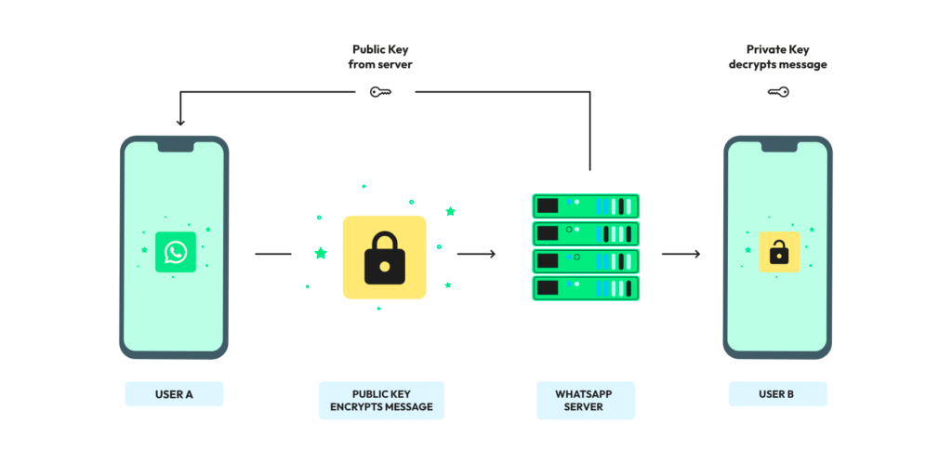
Subtopic 1
17.2 Networking Protocols
Example: Signal Protocol (WhatsApp)

Slide 11










17.3 Layered Protocol Architecture
Aspect of a protocol stack
User Interaction
Users interact with the highest level in the protocol through applications and software interfaces
highest level
protocol
Each layer only interacts with the layer directly above or below it .
protocol
protocol
A layer may comprise sub layers
lowest level
protocol
The adjacent layers have a specific interface that governs their interaction, restricting communication exclusively through this defined interface.
Hardware
Hardware communicates with the lowest level through electrical signals or physical transmission media.

Slide 12



17.4 The TCP/IP Protocol Suite
What is TCP/IP
Application Layer
The TCP/IP protocol suite is a collection of communication protocols used for transmitting data across networks, including the internet, facilitating reliable and standardised data transmission.
To understand it, we need to know how a network model is like:
Transport
Layer
Network
/Internet Layer
Data Link Layer
Physical Layer

Slide 13

17.4 The TCP/IP Protocol Suite
Application Layer
The application layer serves as the topmost layer in the network model, responsible for providing network services directly to end-user applications.
Transport
Layer
Protocols:
HTTP, SMTP, DNS, FTP, POP3, IMAP3
Network
/Internet Layer
Data Link Layer
The application layer passes data to the transport layer by encapsulating the message within a protocol-specific format or header, providing necessary information for reliable transmission.
Physical Layer

Slide 14

17.4 The TCP/IP Protocol Suite
Application Layer
Now, the TCP protocol functioning within the transport layer is tasked with to guarantee the secure transmission of the message to the intended recipient.
Transport
Layer
Protocols:
TCP, UDP, SCTP
Network
/Internet Layer
Data Link Layer
The TCP Protocol generates packets sized appropriately to accommodate all the data, wherein each packet comprises a header along with the user data.
Physical Layer

Slide 15
17.4 The TCP/IP Protocol Suite
Application Layer
Data
Header
The header of the packet contains:
  Port number: Allow the receiving application layer to properly direct the incoming data to the correct application or service on the destination device.
  Sequence number: Allow the receiving end to arrange and reconstruct the data in the correct order at the transport layer
This allows TCP to ensure that any response is directed back to the application protocol.
TCP is connection-oriented because it establishes a logical connection between sender and receiver before transmitting data (by sending just one packet). TCP will only send other packets once it has received acknowledgement.
Transport
Layer
Network
/Internet Layer
Data Link Layer
Physical Layer

Slide 16

17.4 The TCP/IP Protocol Suite
Application Layer
The network layer determines the optimal path and utilises routing protocols to ensure packets are efficiently directed through interconnected networks toward their destinations on the internet.
Transport
Layer
Network
/Internet Layer
Data Link Layer
The IP protocol, receiving packets from the transport layer, appends a header containing sender and receiver IP addresses, obtaining these addresses via DNS (Domain Name System) resolution, ensuring proper addressing and routing of the packet to its intended destination across the internet.
Physical Layer

Slide 17
17.4 The TCP/IP Protocol Suite
Application Layer
The IP packet (also known as datagram) is then sent to the data-link layer.
The data-link layer assembles datagrams into frames.
The IP has no duty after the IP packet has been sent to the data-link layer.
IP is a connectionless service as it lacks confirmation of packet delivery to the destination and does not possess awareness or insight into the content received.
Transport
Layer
Network
/Internet Layer
Data Link Layer
Physical Layer

Slide 18
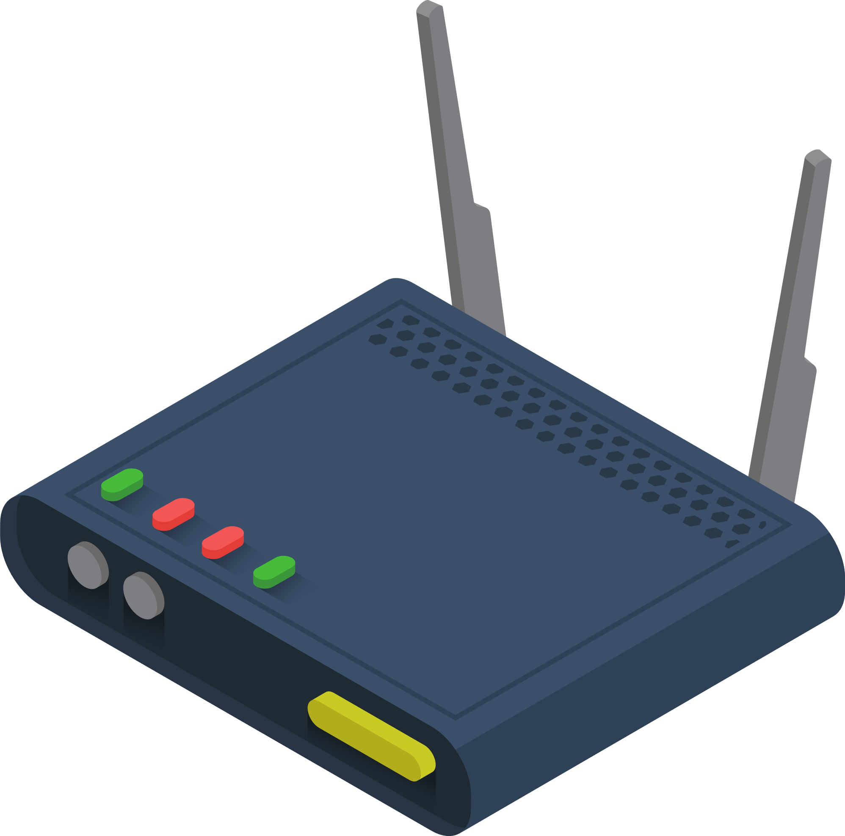
17.4 The TCP/IP Protocol Suite
Application Layer
During transmission, frames sent by the data-link layer will likely reach multiple routers, where the datagram content is relinquished to the IP layer.
Router software, equipped with a specific routing table, determines the subsequent destination host for transmission. Due to the Internet's size and complexity, routers don't maintain global routing tables. After inserting the suitable address into the datagram, IP returns it to the data-link layer of the router.
Transport
Layer
Network
/Internet Layer
Data Link Layer
Physical Layer

Slide 19
17.4 The TCP/IP Protocol Suite
Application Layer
Transport
Layer
Shortest path: The routing table within each router contains information regarding the current status of available transmission routes, allowing packets to be delivered to their destinations via the most efficient and viable path.
Network
/Internet Layer
Data Link Layer
Physical Layer

Slide 20
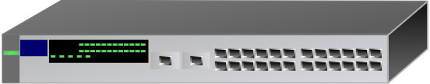
17.4 The TCP/IP Protocol Suite
Application Layer
Transport
Layer
Switch
Router
Network
/Internet Layer
The primary difference between a switch and a router within a network lies in the handling of incoming frames: a switch forwards frames without making routing decisions, operating solely in the data-link layer and lacking access to the network layer.
Data Link Layer
Physical Layer

Slide 21
17.4 The TCP/IP Protocol Suite
Application Layer
The physical layer is the lowest layer of the network model responsible for the actual transmission and reception of raw data bits over a physical medium, defining electrical, mechanical, procedural, and functional specifications for hardware devices and connections.
Transport
Layer
Network
/Internet Layer
Data Link Layer
Physical Layer

Slide 22
17.5 Ethernet Protocol Stack
Application Layer
TCP/IP protocol suite occupies the top three layers of the five-layer stack.
TCP/IP is designed to be capable of being supported by whatever protocols are available. Therefore, it has no concern of the functioning of the lower 2 layers.
Transport
Layer
Network
/Internet Layer
Data Link Layer
Physical Layer

Slide 23

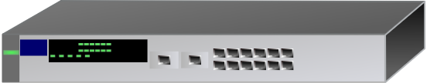


17.5 Ethernet Protocol Stack
Importance of a ethernet protocol stack
An Ethernet protocol stack enables devices in a LAN to communicate internally and connects the LAN to the internet through a router or gateway, enabling data transmission beyond the LAN.
WAN
Local Area Network (LAN)
Local Area Network (LAN)
Local Area Network (LAN)

Slide 24

17.5 Ethernet Protocol Stack
Application Layer
Ethernet is the most likely protocol to be used to provide the functionality required of the two lower layers.
How?
Transport
Layer
Logical Link Control
Network
/Internet Layer
LLC oversees communication with the Network layer, managing data transmission and maintaining data integrity.
Medium Access Control Protocol
MAC assembles Ethernet packets (frames) and includes transmitter and receiver addresses, initiating frame transmission and managing recovery from transmission failures caused by collisions.
Data Link Layer
Physical Coding Sublayer protocol
PCS encodes or decodes data for transmission, receiving frames from the MAC or sending frames to it.
Physical Layer
Physical Medium Attachment protocol
PMA manages the transmission and reception of signals.

Slide 25
17.5 Ethernet Protocol Stack
MAC Address
MAC address, in relation to an Ethernet frame, is a unique 48-bit identifier assigned to network interface hardware, enabling devices to communicate within an Ethernet network by specifying the source and destination of data packets.
Format
NN - NN - NN - DD - DD - DD
Manufacturer Code
Serial Number
Each digit is represented in Hexadecimal
If the NIC card is replaced, the MAC address will also change
Eg. 00 - 1C - B3 - 4F - 25 - FF

Slide 26
17.5 Ethernet Protocol Stack
MAC Address
A 48-bit MAC address has been sufficient so far, but the shift to a 64-bit version has commenced due to the increasing number of connected devices and the need for a larger address space to accommodate the expanding IoT (Internet of Things) ecosystem and emerging technologies.

Slide 27

Subtopic 1
17.6 Application Layer Protocols in TCP/IP
Hypertext Transfer Protocol (HTTP)
Application Layer
Email Protocols
File Transfer Protocol

Slide 28

Subtopic 1
17.6 Application Layer Protocols in TCP/IP
Hypertext Transfer Protocol (HTTP)
HTTP (Hypertext Transfer Protocol) is a transaction-oriented, client-server communication protocol used for transmitting web page data and facilitating requests between web clients and servers.
Format of a HTTP message
<Method> <URL> < Version> CRLF
GET
POST
DELETE
POST
CR LF in HTTP stands for Carriage Return (CR) and Line Feed (LF), which are control characters used to represent the end of a line in text-based protocols like HTTP.
Version of HTTP

Slide 29


Subtopic 1
17.6 Application Layer Protocols in TCP/IP
Email Protocol
Mail Server
Mail Server
Sender
Receiver
Server
Server
Client
Internet
Server
SMTP
Simple Mail Transfer Protocol
POP3
Post Office Protocol Version 3l
SMTP is a push protocol as it actively pushes outgoing emails from the sender's email client to the mail server for delivery.
POP3 is a pull protocol because it requires the email client to initiate a request to the mail server to pull or retrieve incoming emails from the server to the client's device.

Slide 30
Subtopic 1
17.6 Application Layer Protocols in TCP/IP
Email Protocol
Mail Server
Mail Server
Sender
Receiver
Server
Server
Client
Internet
Server
POP3 | IMAP
POP3 allows emails to be downloaded onto the client computer. | With IMAP, emails are not downloaded and are remain stored on the server but remain accessible from the client.
More secure to cyber attack because emails are locally stored. | Server can accessed from any client.

Slide 31
Subtopic 1
17.6 Application Layer Protocols in TCP/IP
Email Protocol
SMTP has been superseded by web-based email services for end-user email interactions, yet it remains the standard protocol used for communication between mail servers for sending and receiving emails.

Slide 32
Subtopic 1
17.6 Application Layer Protocols in TCP/IP
File Transfer Protocol (FTP)
FTP (File Transfer Protocol) is a standard network protocol used for transferring files between a client and a server on a computer network.
Transferring files becomes complex when end-systems use diverse operating systems with distinct file systems; FTP addresses this by segregating the control and data transfer processes.

Slide 33

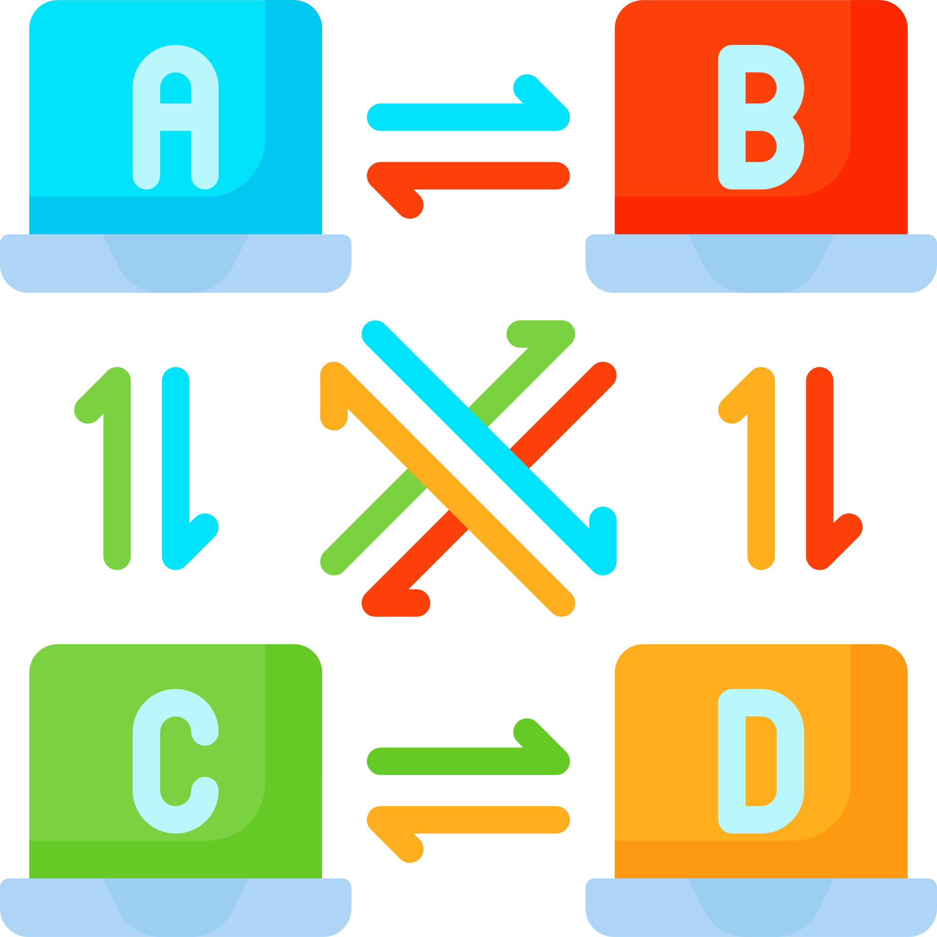
17.7 Peer-to-peer file sharing
Peer-to-peer model
Rather than relying on a single server that multiple clients access, a peer-to-peer network functions by having each peer store some files.
This setup allows every peer to act both as a client , requesting files from other peers, and as a server (seed), providing requested files for download to other peers.

Slide 34

17.7 Peer-to-peer file sharing
BitTorrent protocol
BitTorrent protocol is a peer-to-peer (P2P) communication protocol facilitating efficient and decentralised file sharing over the internet. Some questions to solve:
How does a peer find others that have the wanted content?
Peers in BitTorrent locate others with the desired content by connecting to a tracker or a Distributed Hash Table (DHT), obtaining a list of peers sharing the same file.

Slide 35
17.7 Peer-to-peer file sharing
BitTorrent protocol
BitTorrent protocol is a peer-to-peer (P2P) communication protocol facilitating efficient and decentralised file sharing over the internet. Some questions to solve:
How do peers replicate content to provide high-speed downloads for everyone?
Peers replicate content by sharing the pieces of files they possess with other peers, enabling simultaneous downloading and uploading, enhancing download speeds for everyone.

Slide 36
17.7 Peer-to-peer file sharing
BitTorrent protocol
BitTorrent protocol is a peer-to-peer (P2P) communication protocol facilitating efficient and decentralised file sharing over the internet. Some questions to solve:
How do peers encourage other peers to provide content rather just using the protocol to download for themselves?
Peers in BitTorrent incentivise sharing by implementing a tit-for-tat strategy, prioritising upload capacity to peers who reciprocate by sharing content, thus encouraging a fair exchange and sustaining the network.

