Slide 1
Starter questions to answer:
Name the process of cell division used for growth and repair.
What happens to the organelles at the beginning of this process?
How does this affect the DNA?

Slide 2
DNA Replication
By the end of the lesson you should be able to:
Explain the process of DNA replication
Explain how Meselson and Stahl’s experiment provided data to support the current theory of DNA replication
Justify how data from the Meselson and Stahl experiment supports the semi conservative theory of DNA replication

Slide 3
Homework:
http://www.sumanasinc.com/webcontent/animations/content/meselson.html
http://highered.mheducation.com/olcweb/cgi/pluginpop.cgi?it=swf::535::535::/sites/dl/free/0072437316/120076/bio22.swf::Meselson%20and%20Stahl%20Experiment
1) Watch the two attached tutorials and take the quiz
2)Complete the exam questions, then self assess and correct.
3)(Challenge) Find out the role of DNA ligase in DNA replication and explain why it’s necessary

Slide 4
DNA Replication:
Say what you see …
Helicase
Use your whiteboard to jot down ideas

Slide 6
DNA polymerase
DNA polymerase
Write out the process of DNA replication in 4 steps incorporating as many key terms as you can.
Read someone else's answer, then add to yours if you need to.
1. Gyrase allows sections of DNA to unwind at a time.
2. Helicase catalyses the break down of H bonds between complementary bases.
3. Free nucleotides line up in complementary pairs with both strands of DNA.
4. DNA polymerase catalyses formation of phosphodiester bonds between sugar and phosphate groups.

Slide 7
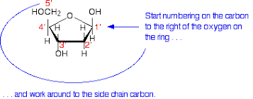
DNA polymerase
DNA polymerase
3 prime – 3' and 5 prime – 5'
This just refers to the direction of the DNA strand.
As the strands are antiparallel the deoxyribose is flipped over.
3 and 5 refer to which carbon the phosphate molecule binds to in the strand (these animations are a bit vague)
The sugar points up to the 5' and down to the 3' end
DNA polymerase can only bind to the 3' end therefore each strand is formed in opposing directions.

Slide 8
A* Thinking questions:
1. This method of replication is known as semi-conservative, why?
2. There are two other methods that DNA could use for replication, suggest what these could these be.
3. Suggest why these methods would not work?

Slide 9
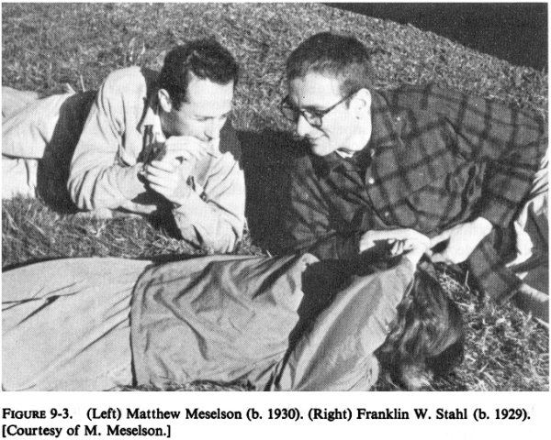
The Meselson & Stahl experiment
Semi – conservative replication

Slide 10
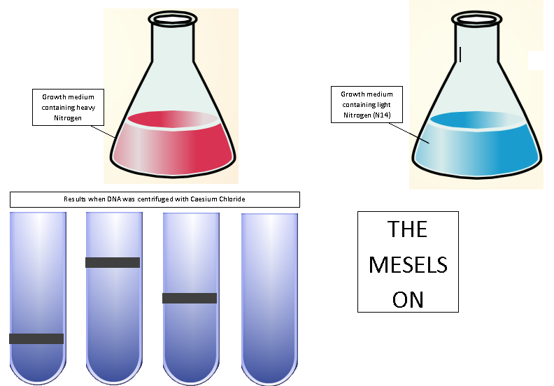
Use your plasticine to model each stage of the investigation as I explain.

Slide 11
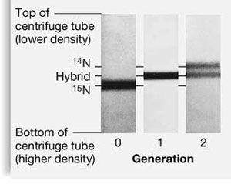
Meselson & Stahl
Using a red line to represent DNA strands made with heavy Nitrogen & a blue line to represent DNA strands made with light Nitrogen, draw out the DNA for each generation shown in the diagram.
Extension:
What could the other 2 possible methods of replication could there be?
Justify how data from the Meselson and Stahl experiment supports the semi conservative theory of DNA replication
Can you move LO3?

Slide 12
Read through your DNA replication explanation again.
Is there anything you would like to add now?
Move around the room to a new place and use the peer assessment grid and a green pen to mark another answer.
Order of events
Tick/cross
DNA Helicase binds to the double stranded DNA
Causing the DNA to unwind and the strands to separate
Each strand acts as a template
Free nucleotides line up against each strand by complementary base pairing
DNA polymerase catalyses the formation of new phosphodiester bonds between nucleotides
Two new DNA molecules are created, each consisting of one new strand and one old strand
This is called semi-conservative replication

