Slide 1









English Language Paper 2 Section A: Q1 and Q2
Choosing evidence
Language analysis
Identifying
Zooming in
Summarising
Inferencing
Explaining
Understanding effects
Comparing
We have already covered these skills and the requirements of Q1 to Q4. Let’s refocus on Q1 now.
What skills are needed for Q1?
How can you ensure you get all four marks in Q1?
Why is it wise to re-read the Q1 task carefully before answering it?

Slide 2
Learning outcomes
To describe how to answer Q1 effectively
To explain how Source A and Source B offer different perspectives
To evaluate how the two sources differ in terms of bias, perspectives and tone

Slide 3
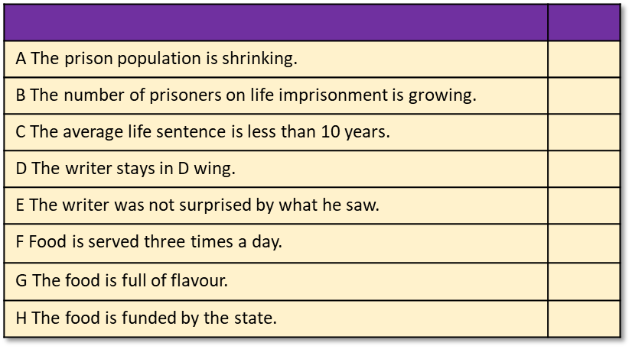
Q1 is about identifying information
You will be given eight statements about the text.
Four of the statements are true, while four are false.
You must shade in which four statements are true.
Do not shade in more than four boxes.
Q1 will normally focus on Source A.
The Q1 task will give you specific lines to focus on. In this question, we are asked to focus on lines 1 to 9 only.
Re-read each statement carefully to make sure you have interpreted it correctly.

Slide 4


Source A
An extract from the diary of Barry Farrell, a journalist who spent two weeks living in a men’s prison and investigating the conditions there in the 1980s. Prisons have historically been used as a deterrent for committing crimes and as a form of punishment for crimes committed.
This is important information to keep in mind when answering the questions.
Give yourself 5-7 minutes to read through the extract.
Timed conditions: 5-7 minutes

Slide 5

Q1) Identifying and interpreting information
Q1) This question asks you to focus on the first nine lines of the extract.
You are then given eight statements: four are true, four are false. You are asked to shade to the four boxes next to the true statements.
Exam tip
In the exam you will need to read the text quickly but carefully and answer these questions as fast as you can.
Read each statement carefully as sometimes they can be worded to try and catch you out!
A The prison population is shrinking.
B The number of prisoners on life imprisonment is growing.
C The average life sentence is less than 10 years.
D The writer stays in D wing.
E The writer was not surprised by what he saw.
F Food is served three times a day.
G The food is full of flavour.
H The food is funded by the state.
Timed conditions: 5 minutes

Slide 6
A The prison population is shrinking.
B The number of prisoners on life imprisonment is growing.
C The average life sentence is less than 10 years.
D The writer stays in D wing.
E The writer was not surprised by what he saw.
F Food is served three times a day.
G The food is full of flavour.
H The food is funded by the state.
A The prison population is shrinking.
B The number of prisoners on life imprisonment is growing.
C The average life sentence is less than 10 years.
D The writer stays in D wing.
E The writer was not surprised by what he saw.
F Food is served three times a day.
G The food is full of flavour.
H The food is funded by the state.
A The prison population is shrinking.
B The number of prisoners on life imprisonment is growing.
C The average life sentence is less than 10 years.
D The writer stays in D wing.
E The writer was not surprised by what he saw.
F Food is served three times a day.
G The food is full of flavour.
H The food is funded by the state.
A The prison population is shrinking.
B The number of prisoners on life imprisonment is growing.
C The average life sentence is less than 10 years.
D The writer stays in D wing.
E The writer was not surprised by what he saw.
F Food is served three times a day.
G The food is full of flavour.
H The food is funded by the state.

Slide 7
Q1) Answers
Q1) This question asks you to focus on the first nine lines of the extract.
You are then given eight statements: four are true, four are false. You are asked to shade to the four boxes next to the true statements.
Exam tip
In the exam you will need to read the text quickly but carefully and answer these questions as fast as you can.
Read each statement carefully as sometimes they can be worded to try and catch you out!
A The prison population is shrinking.
B The number of prisoners on life imprisonment is growing.
C The average life sentence is less than 10 years.
D The writer stays in D wing.
E The writer was not surprised by what he saw.
F Food is served three times a day.
G The food is full of flavour.
H The food is funded by the state.
Timed conditions: 5 minutes

Slide 8
Statement | True or False? | Evidence to show why it is true or false:
A The prison population is shrinking. |  | “The prison population is big and it is getting bigger.”
B The number of prisoners on life imprisonment is growing. |  | “The number of men on life imprisonment was 850 in 1972; by 1982 it has rocketed to 1750.”
C The average life sentence is less than 10 years. |  | “The average life sentence served by a ‘lifer’ is 10.5 years”
D The writer stays in D wing. |  | “I’ve been staying in ‘D wing’”
E The writer was not surprised by what he saw. |  | “It really has been an eye opener for me.”
F Food is served three times a day. |  | “For instance, food served three times daily is basic”
G The food is full of flavour. |  | “focuses on nutritional value rather than taste” “flavourless slop”
H The food is funded by the state. |  | “It is state funded, mass-produced”

Slide 9
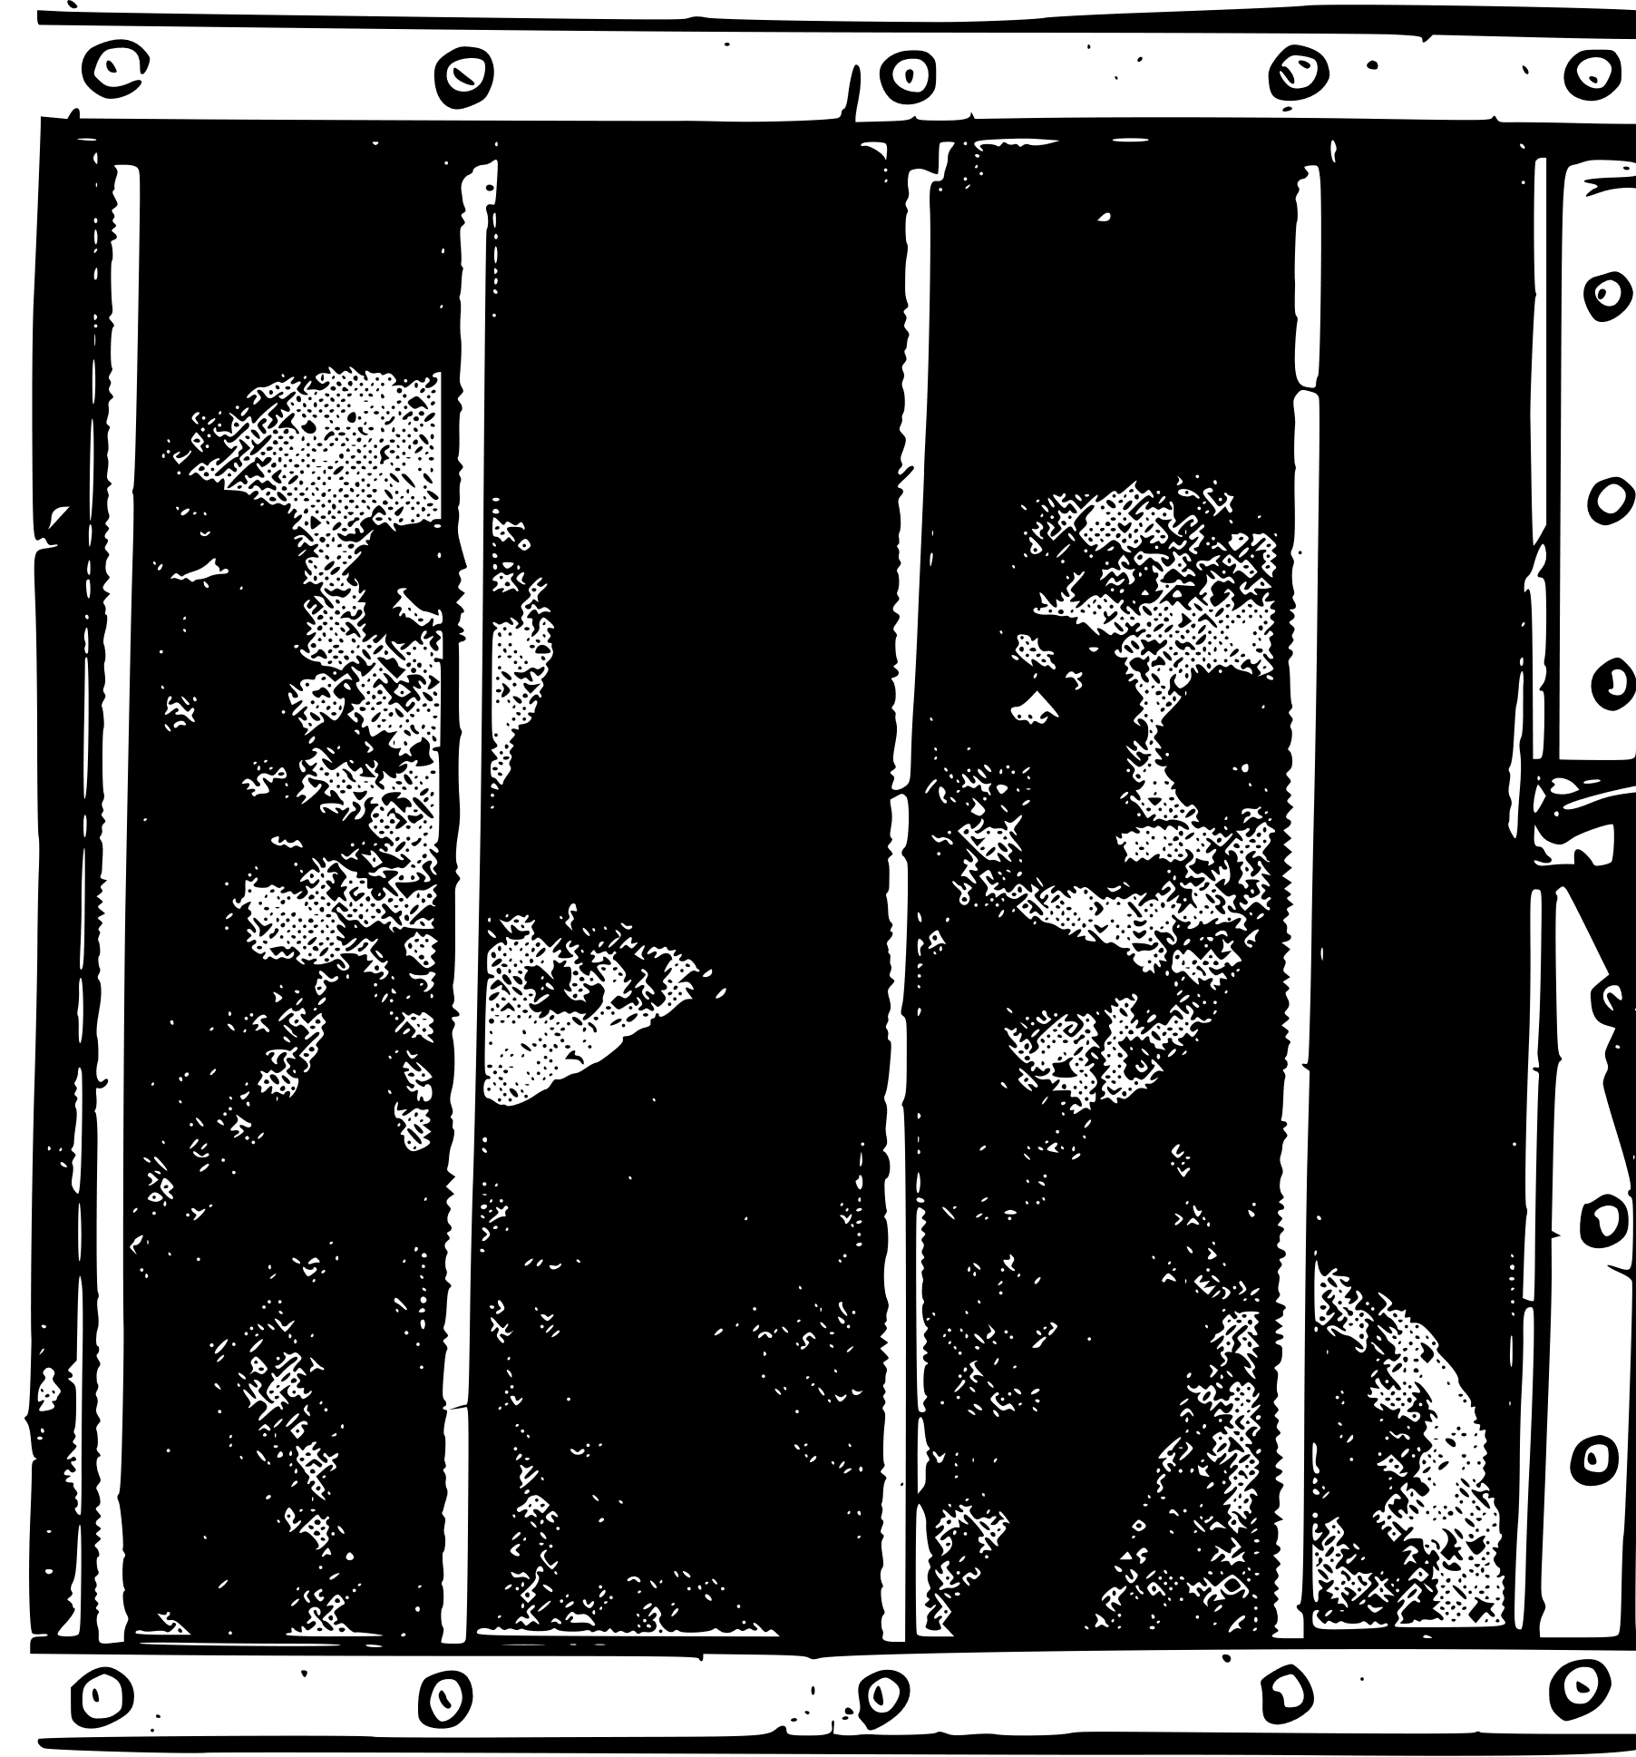
Now, read through Source B.
It was written in 1897 by Oscar Wilde. It is a letter a national newspaper about the treatment of children in prison.
Just like Source A, it is important to consider this information when analysing the source.
Timed conditions: 5-7 minutes

Slide 10

Now, we’ll look at the two texts together
Working in a pair, complete your comparison worksheet.
1) Complete the speedometers above to compare the two texts.
2) Complete the table on the right to compare the use of language in both text.
3) Make notes on how the two texts are different.

Slide 11


Positive
Negative
One-sided
Balanced
Persuasive
Informative
Language techniques | Source A (Farrell) | Source B (Wilde)
Adjectives
Facts
Opinions
Rhetorical questions
Repetition
Emotive language
Statistics
Triplets
Single viewpoint
Multiple perspectives
1) Complete the speedometers above to compare the two texts.
2) Complete the table on the right to compare the use of language in both text.
3) Make notes on how the two texts are different.

Slide 12
A
B
B
A
A
B
Positive
Negative
One-sided
Balanced
Persuasive
Informative
B
A
Language techniques | Source A (Farrell) | Source B (Wilde)
Adjectives
Facts
Opinions
Rhetorical questions
Repetition
Emotive language
Statistics
Triplets
Single viewpoint
Multiple perspectives
Wilde’s tone is predominantly negative; he talks about the terror of the child, how the magistrates ignore the child’s plight, the conditions the child lives in and why all this is wrong. In contrast, Farrell’s tone is mostly neutral, where he offers different perspectives on the positives and negatives of prison life, although he does suggest there are still issues about how the UK uses imprisonment to punish and reform.
Wilde presents mostly his own opinions and ideas, as well as include the views of the child and the magistrates and judges. Farrell offers different perspectives from prisoners with contrasting views but does offer some of his opinions on conditions in the prison.

Slide 13
Q2 involves writing a summary
You need to refer to Source A and Source B for this question.
The writers in Source A and Source B have spent time in different types of prison.
What can you infer about the differences between the prisons?
What is a summary?
What are the key features or parts of a summary?
Why does the exam question mention about what you can “infer”? What does this mean and how can you show it in your summary?
Choosing evidence
Identifying
Summarising
Inferencing

Slide 14

This is what you are marked on in the summary question in Paper 2:
Assessment criteria:
Identify key information
Interpret information both explicitly and implicitly
Select evidence to support interpretations across different texts
This is an exam-style question:
You need to refer to Source A and Source B for this question.
The writers in Source A and Source B have spent time in different types of prison.
What can you infer about the differences between the prisons?
Use the assessment objective and exam question above to complete one of the following activities:
Write down the five most important words from the assessment criteria.
What do you need to include in your summary to achieve a good mark?
How would you plan your answer to achieve a good mark in this exam question?

Slide 15
A summary contains a number of key features
It is written in your own words, not those of the original writers.
You should include lots of small quotes from both texts regularly to show you can provide evidence to support your interpretations.
In the exam, you must look at two texts and summarise key information from both on the same topic or area.
You must only pick out the relevant information and ignore anything not relevant to the topic.
A summary should be well-organised and include a clear structure.
Think of a summary as a bit like making lemonade. You’re squeezing the juice out of a lemon to make the drink. In the same way, you’re squeezing out the key information from a whole text to make a summary.

Slide 16
Next lesson we will explore the two texts in more detail and write out full answers for Q2
Choosing evidence
Identifying
Summarising
Inferencing

Slide 17

Plenary: Mind Storm
Identifying information
On your lightning diagram, write down the different ideas that came to you as you went through the lesson today.
Multiple perspectives
To describe how to answer Q1 effectively
To explain how Source A and Source B offer different perspectives
To evaluate how the two sources differ in terms of bias, perspectives and tone

