Slide 1
Differentiation

Slide 2

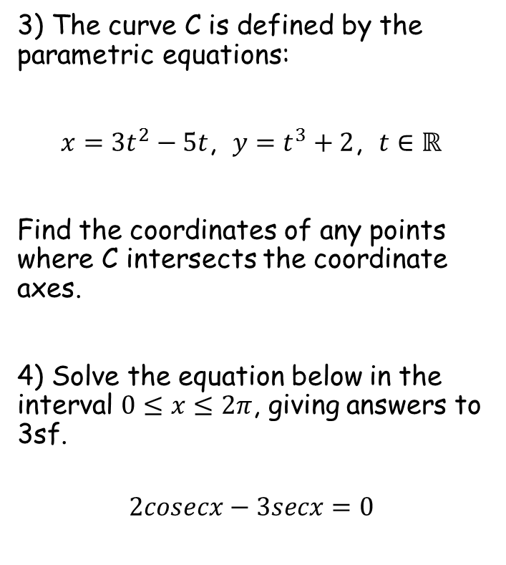

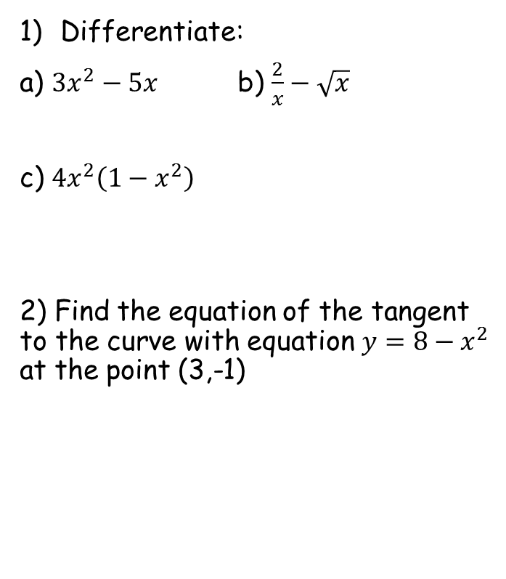




Prior Knowledge Check
Differentiate:
a) ${3x}^{2}−5x$ b) $\frac{2}{x}−\sqrt{x}$
c) ${4x}^{2}\left(1−x^{2}\right)$
2) Find the equation of the tangent to the curve with equation $y=8−x^{2}$ at the point (3,-1)
3) The curve C is defined by the parametric equations:
$x={3t}^{2}−5t$, $y=t^{3}+2$, $t∈ℝ$
Find the coordinates of any points where C intersects the coordinate axes.
4) Solve the equation below in the interval $0≤x≤2π$, giving answers to 3sf.
$$2cosecx−3secx=0$$
$$6x−5$$
$$−\frac{2}{x^{2}}−\frac{1}{2\sqrt{x}}$$
$$8x−16x^{3}$$
$(0,2)$ $\left(0,\frac{179}{27}\right)$ $(11.1,0)$
$$y=−6x−19$$
$$0.588, 3.73$$

Slide 3
Teachings for
Exercise 9A

Slide 4





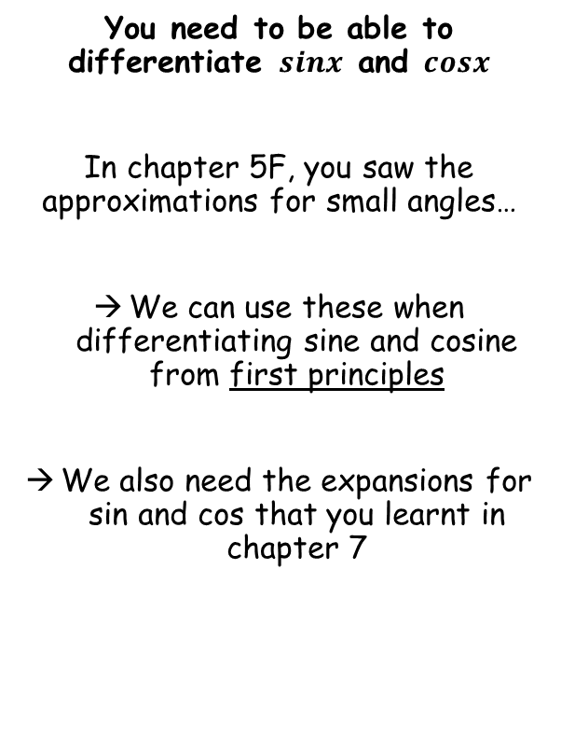








Differentiation
When $θ$ is small and measured in radians
$$sin\left(α+β\right)=sinαcosβ+cosαsinβ$$
$$sinθ≈θ$$
$$cosθ≈1−\frac{θ^{2}}{2}$$
$$tanθ≈θ$$
$$cos\left(α+β\right)=cosαcosβ−sinαsinβ$$
You need to be able to differentiate $sinx$ and $cosx$
In chapter 5F, you saw the approximations for small angles…
We can use these when differentiating sine and cosine from first principles
We also need the expansions for sin and cos that you learnt in chapter 7
Since $sinθ≈θ$ for small values of $θ$…
As $θ→0, sinθ→θ$
$$\frac{sinθ}{θ}$$
As $θ→0, sinθ→θ$
$$=\frac{θ}{θ}$$
This expression therefore tends towards 1
$$=1$$
As $θ→0,\frac{sinθ}{θ}→1$
9A

Slide 5
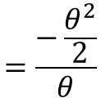

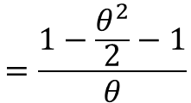







Differentiation
When $θ$ is small and measured in radians
$$sin\left(α+β\right)=sinαcosβ+cosαsinβ$$
$$sinθ≈θ$$
$$cosθ≈1−\frac{θ^{2}}{2}$$
$$tanθ≈θ$$
$$cos\left(α+β\right)=cosαcosβ−sinαsinβ$$
Since $cosθ≈1−\frac{θ^{2}}{2}$ for small values of $θ$…
You need to be able to differentiate $sinx$ and $cosx$
In chapter 5F, you saw the approximations for small angles…
We can use these when differentiating sine and cosine from first principles
We also need the expansions for sin and cos that you learnt in chapter 7
As $θ→0, cosθ→1−\frac{θ^{2}}{2}$
$$\frac{cosθ−1}{θ}$$
As $θ→0, cosθ→1−\frac{θ^{2}}{2}$
$$=\frac{1−\frac{θ^{2}}{2}−1}{θ}$$
$$=\frac{−\frac{θ^{2}}{2}}{θ}$$
Simplify numerator
Simplify
$$=−\frac{θ}{2}$$
As $θ→0,\frac{sinθ}{θ}→1$
As $θ→0,\frac{cosθ−1}{θ}→0$
As $θ→0$, this expression will also $→0$
$$=0$$
9A

Slide 6










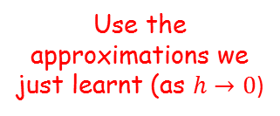
Differentiation
As $θ→0,\frac{sinθ}{θ}→1$
$$sin\left(α+β\right)=sinαcosβ+cosαsinβ$$
$$cos\left(α+β\right)=cosαcosβ−sinαsinβ$$
As $θ→0,\frac{cosθ−1}{θ}→0$
You need to be able to differentiate $sinx$ and $cosx$
In chapter 5F, you saw the approximations for small angles…
We can use these when differentiating sine and cosine from first principles
We also need the expansions for sin and cos that you learnt in chapter 7
$$f^{′}\left(x\right)=\lim_{h→0}{\frac{f\left(x+h\right)−f(x)}{h}}$$
Let $f\left(x\right)=sinx$
$$f^{′}\left(x\right)=\lim_{h→0}{\frac{sin\left(x+h\right)−sinx}{h}}$$
Use the expansion of sin from above
$$f^{′}\left(x\right)=\lim_{h→0}{\frac{sinxcosh+cosxsinh−sinx}{h}}$$
Rearrange
$$f^{′}\left(x\right)=\lim_{h→0}{\frac{sinxcosh−sinx+cosxsinh}{h}}$$
Separate into 2 fractions
$$f^{′}\left(x\right)=\lim_{h→0}\left(\frac{sinxcosh−sinx}{h}+\frac{cosxsinh}{h}\right)$$
Factorise left fraction
$$f^{′}\left(x\right)=\lim_{h→0}\left(\frac{sinx\left(cosh−1\right)}{h}+\frac{cosxsinh}{h}\right)$$
Use the approximations we just learnt (as $h→0$)
$$f^{′}\left(x\right)=cosx$$
9A

Slide 7



Differentiation
As $θ→0,\frac{sinθ}{θ}→1$
$$sin\left(α+β\right)=sinαcosβ+cosαsinβ$$
$$cos\left(α+β\right)=cosαcosβ−sinαsinβ$$
As $θ→0,\frac{cosθ−1}{θ}→0$
You need to be able to differentiate $sinx$ and $cosx$
Gradient = -1
y = Cosθ
If:
$$y=sinx$$
1
$$\frac{dy}{dx}=cosx$$
y = Sinθ
Then:
0
^{π}/₂
π
^{3π}/₂
2π
-1
Gradient = 0
This means that the Cos graph is actually telling you the gradient of the Sin graph at the equivalent point!
At π, Cosθ = -1
The gradient of Sinθ at π is -1
At ^{3π}/₂, Cosθ = 0
The gradient of Sinθ at ^{3π}/₂ is 0!
9A

Slide 8


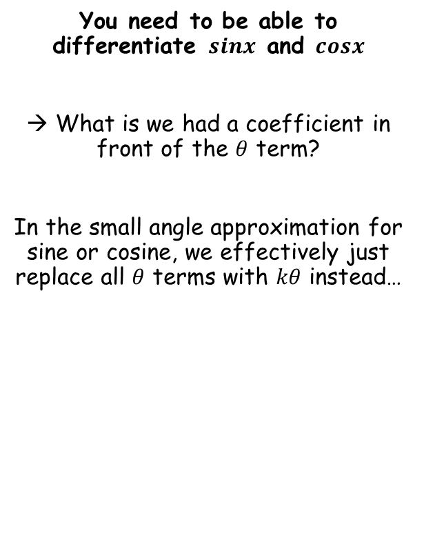






Differentiation
When $θ$ is small and measured in radians
$$sin\left(α+β\right)=sinαcosβ+cosαsinβ$$
$$sinθ≈θ$$
$$cosθ≈1−\frac{θ^{2}}{2}$$
$$tanθ≈θ$$
$$cos\left(α+β\right)=cosαcosβ−sinαsinβ$$
You need to be able to differentiate $sinx$ and $cosx$
→ What is we had a coefficient in front of the $θ$ term?
In the small angle approximation for sine or cosine, we effectively just replace all $θ$ terms with $kθ$ instead…
Since $sinkθ≈kθ$ for small values of $θ$…
As $θ→0, sinkθ→kθ$
$$\frac{sinkθ}{θ}$$
As $θ→0, sinkθ→kθ$
$$=\frac{kθ}{θ}$$
This expression therefore tends towards $k$
$$=k$$
As $θ→0,\frac{sinkθ}{θ}→k$
9A

Slide 9
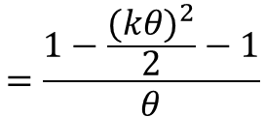








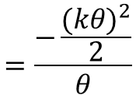
Differentiation
When $θ$ is small and measured in radians
$$sin\left(α+β\right)=sinαcosβ+cosαsinβ$$
$$sinθ≈θ$$
$$cosθ≈1−\frac{θ^{2}}{2}$$
$$tanθ≈θ$$
$$cos\left(α+β\right)=cosαcosβ−sinαsinβ$$
Since $coskθ≈1−\frac{{(kθ)}^{2}}{2}$ for small values of $θ$…
You need to be able to differentiate $sinx$ and $cosx$
→ What is we had a coefficient in front of the $θ$ term?
In the small angle approximation for sine or cosine, we effectively just replace all $θ$ terms with $kθ$ instead…
As $θ→0, coskθ→1−\frac{{\left(kθ\right)}^{2}}{2}$
$$\frac{coskθ−1}{θ}$$
As $θ→0, cosθ→1−\frac{{\left(kθ\right)}^{2}}{2}$
$$=\frac{1−\frac{{(kθ)}^{2}}{2}−1}{θ}$$
$$=\frac{−\frac{{(kθ)}^{2}}{2}}{θ}$$
Simplify numerator
As $θ→0,\frac{sinkθ}{θ}→k$
As $θ→0,\frac{coskθ−1}{θ}→0$
Simplify
$$=−\frac{k^{2}θ}{2}$$
As $θ→0$, this expression will also $→0$
$$=0$$
9A

Slide 10






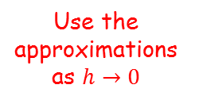






Differentiation
As $θ→0,\frac{sinkθ}{θ}→k$
$$sin\left(α+β\right)=sinαcosβ+cosαsinβ$$
$$cos\left(α+β\right)=cosαcosβ−sinαsinβ$$
As $θ→0,\frac{coskθ−1}{θ}→0$
You need to be able to differentiate $sinx$ and $cosx$
What if instead of differentiating $sinx$, we differentiated $sinkx$
→ So for example, $sin2x$, $sin3x$ etc…
$$f^{′}\left(x\right)=\lim_{h→0}{\frac{f\left(x+h\right)−f(x)}{h}}$$
Let $f\left(x\right)=sinkx$
$$f^{′}\left(x\right)=\lim_{h→0}{\frac{sin\left(k(x+h)\right)−sinkx}{h}}$$
Expand the inner bracket
$$f^{′}\left(x\right)=\lim_{h→0}{\frac{sin\left(kx+kh\right)−sinkx}{h}}$$
Use the expansion of sine
$$f^{′}\left(x\right)=\lim_{h→0}{\frac{sinkxcoskh+coskxsinkh−sinkx}{h}}$$
Rearrange
$$f^{′}\left(x\right)=\lim_{h→0}{\frac{sinkxcoskh−sinkx+coskxsinkh}{h}}$$
Write as 2 separate fractions
$$f^{′}\left(x\right)=\lim_{h→0}\left(\frac{sinkxcoskh−sinkx}{h}+\frac{coskxsinkh}{h}\right)$$
Factorise left fraction
$$f^{′}\left(x\right)=\lim_{h→0}\left(\frac{sinkx(coskh−1)}{h}+\frac{coskxsinkh}{h}\right)$$
Use the approximations as $h→0$
= $k$
$$f^{′}\left(x\right)=kcoskx$$
9A

Slide 11








Differentiation
As $θ→0,\frac{sinkθ}{θ}→k$
$$sin\left(α+β\right)=sinαcosβ+cosαsinβ$$
$$cos\left(α+β\right)=cosαcosβ−sinαsinβ$$
As $θ→0,\frac{coskθ−1}{θ}→0$
You need to be able to differentiate $sinx$ and $cosx$
If: $f\left(x\right)=sinx$
If: $f\left(x\right)=cosx$
Then: $f^{′}\left(x\right)=cosx$
Then: $f^{′}\left(x\right)=−sinx$
If: $f\left(x\right)=sinkx$
If: $f\left(x\right)=coskx$
Then: $f^{′}\left(x\right)=kcoskx$
Then: $f^{′}\left(x\right)=−ksinkx$
You should try to prove these yourself from first principles!
9A

Slide 12



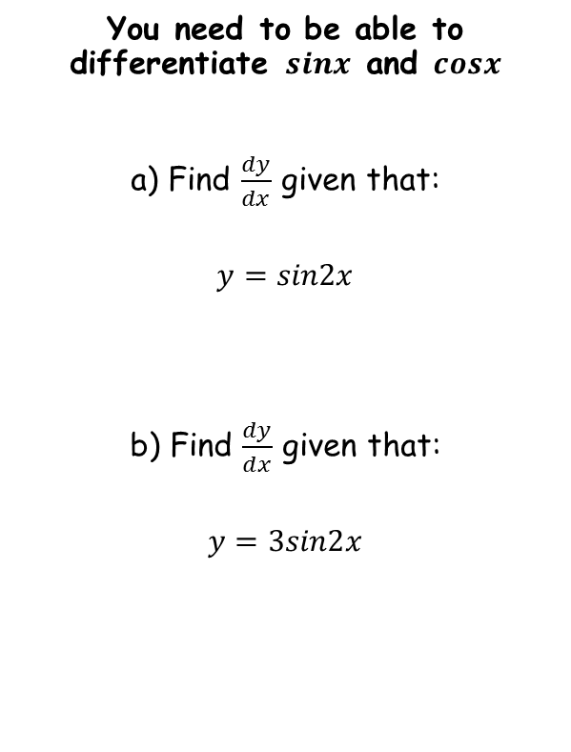






Differentiation
If: $f\left(x\right)=sinkx$
If: $f\left(x\right)=coskx$
Then: $f^{′}\left(x\right)=kcoskx$
Then: $f^{′}\left(x\right)=−ksinkx$
You need to be able to differentiate $sinx$ and $cosx$
a) Find $\frac{dy}{dx}$ given that:
$$y=sin2x$$
b) Find $\frac{dy}{dx}$ given that:
$$y=3sin2x$$
$$y=sin2x$$
Follow the pattern you have learned!
$$\frac{dy}{dx}=2cos2x$$
$$y=3sin2x$$
The constant will multiply the differentiated term
$$\frac{dy}{dx}=3×\left(2cos2x \right)$$
$$\frac{dy}{dx}=6cos2x$$
Simplify
9A

Slide 13





Differentiation
If: $f\left(x\right)=sinkx$
If: $f\left(x\right)=coskx$
Then: $f^{′}\left(x\right)=kcoskx$
Then: $f^{′}\left(x\right)=−ksinkx$
You need to be able to differentiate $sinx$ and $cosx$
Find $\frac{dy}{dx}$ given that:
$$y=3cosx+2sin4x$$
$$y=3cosx+2sin4x$$
Differentiate each term separately
$$\frac{dy}{dx}=$$
$$−3sinx$$
$$+ 8cos4x$$
Be careful – when differentiating cos, the answer becomes negative!
Remember that a constant will cause the differentiated term to be multiplied by it!
9A

Slide 14





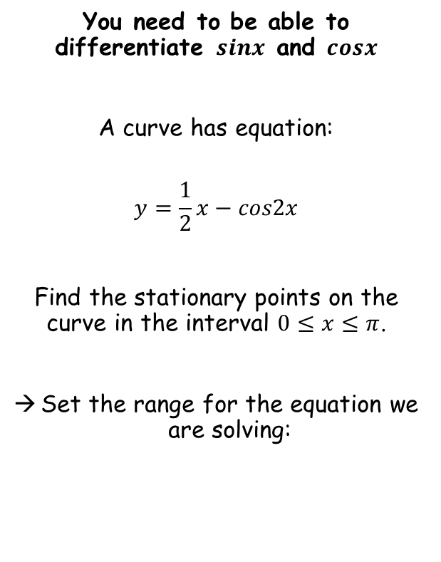





Differentiation
If: $f\left(x\right)=sinkx$
If: $f\left(x\right)=coskx$
Then: $f^{′}\left(x\right)=kcoskx$
Then: $f^{′}\left(x\right)=−ksinkx$
$$y=\frac{1}{2}x−cos2x$$
You need to be able to differentiate $sinx$ and $cosx$
A curve has equation:
$$y=\frac{1}{2}x−cos2x$$
Find the stationary points on the curve in the interval $0≤x≤π$.
Set the range for the equation we are solving:
Differentiate each separately – be careful with the negatives!
$$\frac{dy}{dx}=$$
$$\frac{1}{2}$$
$$+ 2sin2x$$
The stationary points will be where $\frac{dy}{dx}=0$
$$0=\frac{1}{2}+2sin2x$$
Subtract $−\frac{1}{2}$
$$−\frac{1}{2}=2sin2x$$
Divide by 2
$$−\frac{1}{4}=sin2x$$
Inverse sine
$$−0.253=2x$$
$$0≤2x≤2π$$
We need to find all values in the range we are working with…
9A

Slide 15


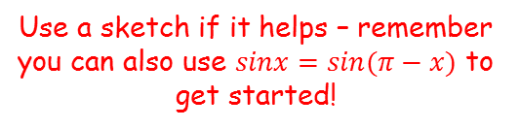





Differentiation
If: $f\left(x\right)=sinkx$
If: $f\left(x\right)=coskx$
Then: $f^{′}\left(x\right)=kcoskx$
Then: $f^{′}\left(x\right)=−ksinkx$
Use a sketch if it helps – remember you can also use $sinx=sin⁡(π−x)$ to get started!
You need to be able to differentiate $sinx$ and $cosx$
A curve has equation:
$$y=\frac{1}{2}x−cos2x$$
Find the stationary points on the curve in the interval $0≤x≤π$.
Set the range for the equation we are solving:
$$2x=−0.253$$
y
$$−0.253$$
$$3.394$$
$$6.030$$
x
$$−\frac{1}{4}$$
$$y = sinx$$
$$2x=3.394$$
$$, 6.030$$
Divide all by 2
$$x=1.70$$
$$, 3.02$$
$$0≤2x≤2π$$
9A

Slide 16









Differentiation
If: $f\left(x\right)=sinkx$
If: $f\left(x\right)=coskx$
Then: $f^{′}\left(x\right)=kcoskx$
Then: $f^{′}\left(x\right)=−ksinkx$
You need to be able to differentiate $sinx$ and $cosx$
A curve has equation:
$$y=\frac{1}{2}x−cos2x$$
Find the stationary points on the curve in the interval $0≤x≤π$.
Set the range for the equation we are solving:
$$x=1.70$$
$$, 3.02$$
$$y=\frac{1}{2}x−cos2x$$
$$x=1.70$$
$$x=3.02$$
$$y=\frac{1}{2}(1.70)−cos2(1.70)$$
$$y=\frac{1}{2}(3.02)−cos2(3.02)$$
$$y=1.82$$
$$y=0.539$$
So the coordinates of the stationary points are:
(1.70, 1.82) and (3.02, 0.539)
$$0≤2x≤2π$$
9A

Slide 17
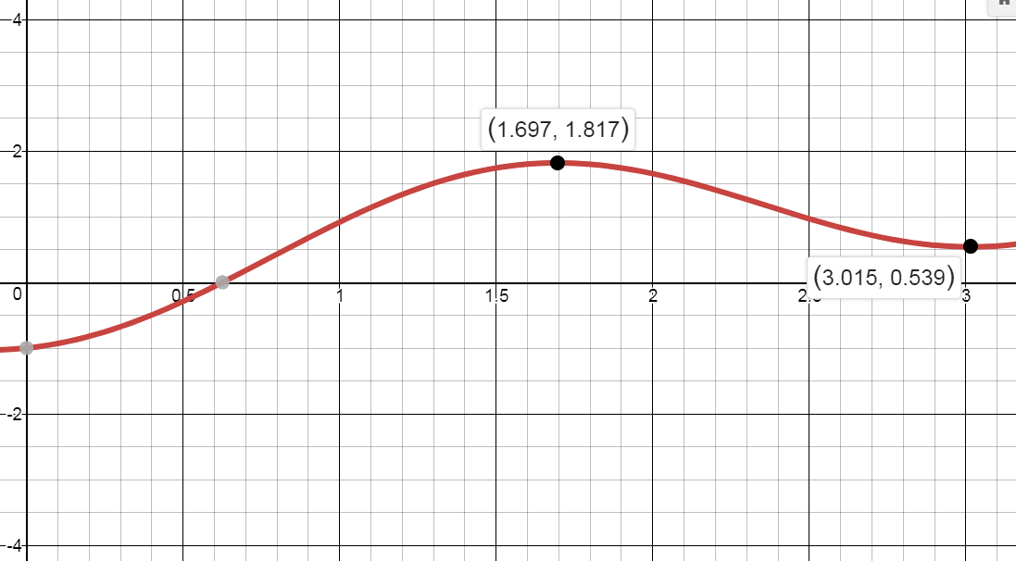

Differentiation
If: $f\left(x\right)=sinkx$
If: $f\left(x\right)=coskx$
Then: $f^{′}\left(x\right)=kcoskx$
Then: $f^{′}\left(x\right)=−ksinkx$
You need to be able to differentiate $sinx$ and $cosx$
A curve has equation:
$$y=\frac{1}{2}x−cos2x$$
Find the stationary points on the curve in the interval $0≤x≤π$.
Set the range for the equation we are solving:
$$y=\frac{1}{2}x−cos2x$$
$$0≤2x≤2π$$
(1.70, 1.82) and (3.02, 0.539)
9A

Slide 18
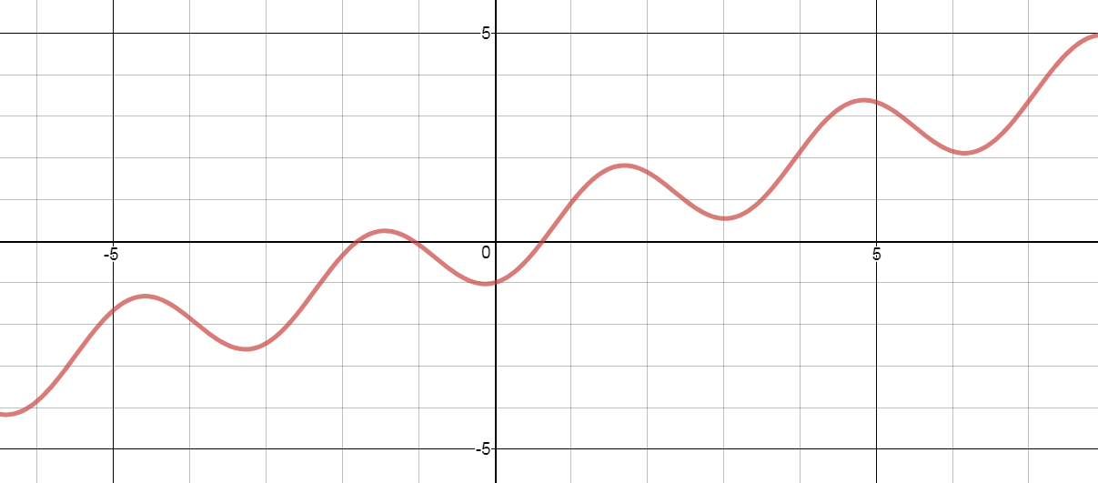

Differentiation
If: $f\left(x\right)=sinkx$
If: $f\left(x\right)=coskx$
Then: $f^{′}\left(x\right)=kcoskx$
Then: $f^{′}\left(x\right)=−ksinkx$
You need to be able to differentiate $sinx$ and $cosx$
$$y=\frac{1}{2}x−cos2x$$
9A

Slide 19
Teachings for
Exercise 9B

Slide 20
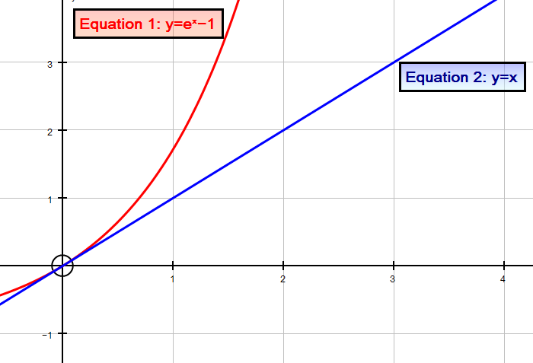
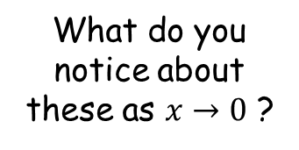


Differentiation
Let’s start by looking at two graphs on a set of axes
$$y=e^{x}−1$$
$$y=x$$
What do you notice about these as $x→0$ ?
9B

Slide 21
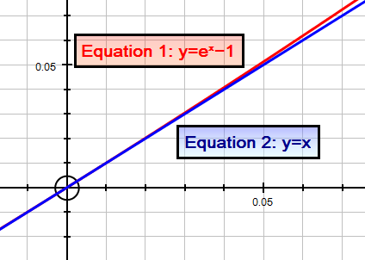
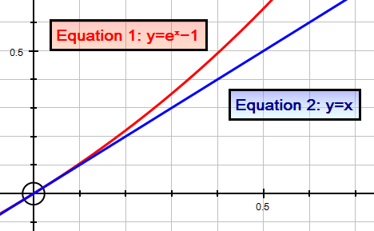
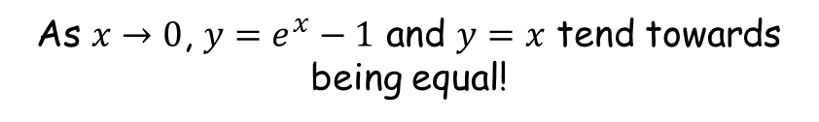
Differentiation
Let’s start by looking at two graphs on a set of axes
$$y=e^{x}−1$$
$$y=x$$
What do you notice about these as $x→0$ ?
Let’s zoom in further…
As $x→0$, $y=e^{x}−1$ and $y=x$ tend towards being equal!
9B

Slide 22
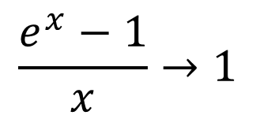

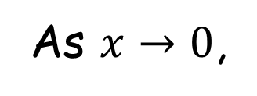
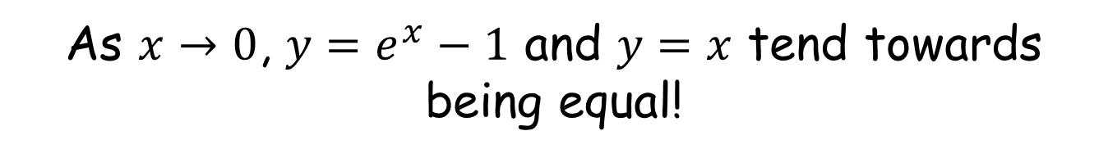
Differentiation
As $x→0$, $y=e^{x}−1$ and $y=x$ tend towards being equal!
As $x→0$,
$$e^{x}−1→x$$
Divide both sides by x
$$\frac{e^{x}−1}{x}→1$$
As $x→0$, $\frac{e^{x}−1}{x}→$1
9B

Slide 23
Differentiation
As $x→0$, $\frac{e^{x}−1}{x}→$1
$$y=e^{x}$$
From first principles
$$\frac{dy}{dx}=$$
$$\lim_{δx→0}{\frac{e^{x+δx}−e^{x}}{δx}}$$
Note: Using $δx$ (‘a small change in x’) is the same as using $h$…
The added powers come from multiplying 2 $e$ terms
$$\frac{dy}{dx}=$$
$$\lim_{δx→0}{\frac{e^{x}e^{δx}−e^{x}}{δx}}$$
Factorise the numerator
$$\frac{dy}{dx}=$$
$$\lim_{δx→0}{\frac{e^{x}\left(e^{δx}−1\right)}{δx}}$$
As $δx→0$, $\frac{e^{δx}−1}{δx}→$1
$$\frac{dy}{dx}=$$
$$e^{x}$$
9B

Slide 24
Differentiation
If: $y=e^{x}$
If: $y=e^{f(x)}$
Then: $\frac{dy}{dx}=e^{x}$
Then: $\frac{dy}{dx}={f′(x)e}^{f(x)}$
You will see a proof of this result later in the chapter!
9B

Slide 25
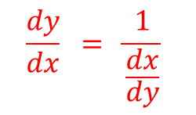

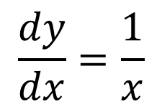

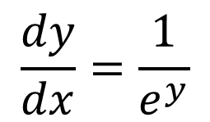



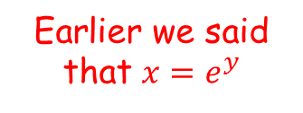

Differentiation
If: $y=e^{x}$
If: $y=e^{f(x)}$
Then: $\frac{dy}{dx}=e^{x}$
Then: $\frac{dy}{dx}={f′(x)e}^{f(x)}$
If: $y=lnx$
Then: $\frac{dy}{dx}=\frac{1}{x}$
Let:
$$y=lnx$$
Inverse Logarithm
$$x=e^{y}$$
$$\frac{dx}{dy}=e^{y}$$
Differentiate
$$\frac{dy}{dx} = \frac{1}{\frac{dx}{dy}}$$
$$\frac{dy}{dx}=\frac{1}{e^{y}}$$
Earlier we said that $x=e^{y}$
$$\frac{dy}{dx}=\frac{1}{x}$$
9B

Slide 26
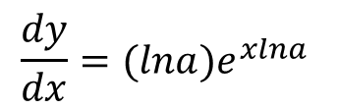

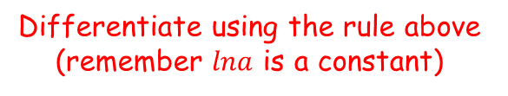
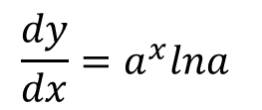


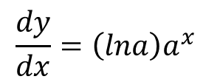

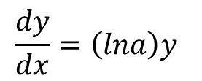
Differentiation
If: $y=e^{x}$
If: $y=e^{f(x)}$
Then: $\frac{dy}{dx}=e^{x}$
Then: $\frac{dy}{dx}={f′(x)e}^{f(x)}$
If: $y=lnx$
Then: $\frac{dy}{dx}=\frac{1}{x}$
$$y=a^{x}$$
Take natural logs of both sides
$$lny={lna}^{x}$$
Use the power law
$$lny=xlna$$
Rewrite using inverse logs
$$y=e^{xlna }$$
Differentiate using the rule above (remember $lna$ is a constant)
$$\frac{dy}{dx}={(lna)e}^{xlna }$$
$$\frac{dy}{dx}={\left(lna\right)y}^{ }$$
We can replace $e^{x}lna$ using a previous step
We can then replace $y$ using a previous step
$$\frac{dy}{dx}={\left(lna\right)a^{x}}^{ }$$
Rewrite
$$\frac{dy}{dx}={a^{x}lna}^{ }$$
9B

Slide 27
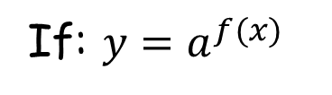
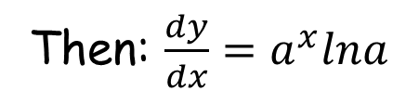

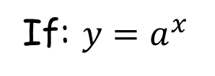



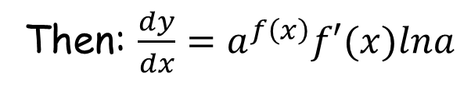
Differentiation
If: $y=e^{x}$
If: $y=a^{f(x)}$
Then: $\frac{dy}{dx}=a^{f\left(x\right)}f^{′}(x)lna$
If: $y=e^{f(x)}$
Then: $\frac{dy}{dx}=e^{x}$
Then: $\frac{dy}{dx}={f′(x)e}^{f(x)}$
If: $y=a^{x}$
If: $y=lnx$
Then: $\frac{dy}{dx}=a^{x}lna$
Then: $\frac{dy}{dx}=\frac{1}{x}$
If: $y=a^{x}$
If: $y=a^{f(x)}$
Then: $\frac{dy}{dx}=a^{x}lna$
Then: $\frac{dy}{dx}=a^{f\left(x\right)}f′(x)lna$
You will see a proof of this result later in the chapter!
9B

Slide 28





Differentiation
If: $y=e^{x}$
If: $y=a^{f(x)}$
Then: $\frac{dy}{dx}=a^{f\left(x\right)}f^{′}(x)lna$
If: $y=e^{f(x)}$
Then: $\frac{dy}{dx}=e^{x}$
Then: $\frac{dy}{dx}={f′(x)e}^{f(x)}$
If: $y=a^{x}$
If: $y=lnx$
Then: $\frac{dy}{dx}=a^{x}lna$
Then: $\frac{dy}{dx}=\frac{1}{x}$
You need to be able to differentiate the exponential and natural logarithm functions
Find $\frac{dy}{dx}$ given that:
$$y=e^{3x}+2^{3x}$$
$$y=e^{3x}+2^{3x}$$
Differentiate each term separately using the laws above…
$$\frac{dy}{dx}=$$
$$3e^{3x}$$
$${+ 2}^{3x}3ln2$$
9B

Slide 29








Differentiation
If: $y=e^{x}$
If: $y=a^{f(x)}$
Then: $\frac{dy}{dx}=a^{f\left(x\right)}f^{′}(x)lna$
If: $y=e^{f(x)}$
Then: $\frac{dy}{dx}=e^{x}$
Then: $\frac{dy}{dx}={f′(x)e}^{f(x)}$
If: $y=a^{x}$
If: $y=lnx$
Then: $\frac{dy}{dx}=a^{x}lna$
Then: $\frac{dy}{dx}=\frac{1}{x}$
You need to be able to differentiate the exponential and natural logarithm functions
Find $\frac{dy}{dx}$ given that:
$$y=ln\left(x^{3}\right)+ln7x$$
$$y=ln\left(x^{3}\right)+ln7x$$
Use the power law
$$y=3lnx+ln7x$$
Use the addition law
$$y=3lnx+ln7+lnx$$
Collect like terms
$$y=4lnx+ln7$$
Differentiate each term using the laws above
→ Remember that $ln7$ is just a number, so will ‘disappear’
$$\frac{dy}{dx}=$$
$$\frac{4}{x}$$
9B

Slide 30








Differentiation
If: $y=e^{x}$
If: $y=a^{f(x)}$
Then: $\frac{dy}{dx}=a^{f\left(x\right)}f^{′}(x)lna$
If: $y=e^{f(x)}$
Then: $\frac{dy}{dx}=e^{x}$
Then: $\frac{dy}{dx}={f′(x)e}^{f(x)}$
If: $y=a^{x}$
If: $y=lnx$
Then: $\frac{dy}{dx}=a^{x}lna$
Then: $\frac{dy}{dx}=\frac{1}{x}$
You need to be able to differentiate the exponential and natural logarithm functions
Find $\frac{dy}{dx}$ given that:
$$y=\frac{2−3e^{7x}}{{4e}^{3x}}$$
$$y=\frac{2−3e^{7x}}{{4e}^{3x}}$$
Separate into two fractions
$$y=\frac{2}{{4e}^{3x}}−\frac{3e^{7x}}{{4e}^{3x}}$$
Simplify/rewrite for differentiation
$$y=\frac{1}{2}e^{−3x}$$
$$− \frac{3}{4}e^{4x}$$
Differentiate each term using the laws above
$$\frac{dy}{dx}=$$
$$−\frac{3}{2}e^{−3x}$$
$$− 3e^{4x}$$
9B

Slide 31
Teachings for
Exercise 9C

Slide 32


Differentiation
$$\frac{dy}{dx}=\frac{dy}{du}×\frac{du}{dx}$$
$$\frac{dy}{dx}=\frac{dy}{du}×\frac{du}{dx}$$
You need to be able to differentiate using the chain rule
The chain rule is a way of writing a differential as the product of two different differentials
This will allow you to differentiate increasingly complex functions, and will also be used to prove some of the results you have seen so far…
This is true since the $du$ terms would cancel out…
9C

Slide 33








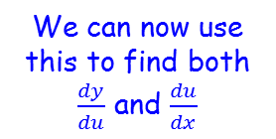



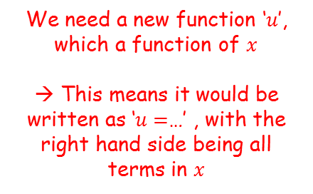






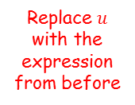
Differentiation
$$\frac{dy}{dx}=\frac{dy}{du}×\frac{du}{dx}$$
We can now use this to find both $\frac{dy}{du}$ and $\frac{du}{dx}$
$$y={\left(3x^{4}+x\right)}^{5}$$
You need to be able to differentiate using the chain rule
Given that $y={\left(3x^{4}+x\right)}^{5}$, find $\frac{dy}{dx}$ using the chain rule.
Let $u={3x}^{4}+x$
We can write $y$ as a function of $u$
We have $u$ as a function of $x$
$$y=u^{5}$$
$$u=3x^{4}+x$$
$$\frac{dy}{du}=5u^{4}$$
Differentiate
Differentiate
$$\frac{dy}{dx}=\frac{dy}{du}×\frac{du}{dx}$$
$$\frac{du}{dx}=12x^{3}+1$$
Now replace these in the chain rule…
$$\frac{dy}{dx}=\frac{dy}{du}×\frac{du}{dx}$$
Replace each part with the expressions we found
The function we create using $u$, must then be used to eliminate all the $x$ terms in our current function
→ If it does not, then we cannot find $\frac{dy}{du}$
We need a new function ‘$u$’, which a function of $x$
→ This means it would be written as ‘$u=$…’ , with the right hand side being all terms in $x$
$$\frac{dy}{dx}=$$
$${5u}^{4}$$
$$×(12x^{3}+1)$$
The terms can be written together
$$\frac{dy}{dx}={5u}^{4}({12x}^{3}+1)$$
Replace $u$ with the expression from before
$$\frac{dy}{dx}={5\left({3x}^{4}+x \right)}^{4}({12x}^{3}+1)$$
9C

Slide 34
















Differentiation
$$\frac{dy}{dx}=\frac{dy}{du}×\frac{du}{dx}$$
$$y=\sin^{4}x$$
$$y={(sinx)}^{4}$$
You need to be able to differentiate using the chain rule
Given that $y=\sin^{4}x$, find $\frac{dy}{dx}$
Let $u=sinx$
We can write $y$ as a function of $u$
We have $u$ as a function of $x$
$$y=u^{4}$$
$$u=sinx$$
$$\frac{dy}{du}=4u^{3}$$
Differentiate
$$\frac{du}{dx}=cosx$$
Differentiate
Now replace these in the chain rule…
$$\frac{dy}{dx}=\frac{dy}{du}×\frac{du}{dx}$$
Replace each part with the expressions we found
$$\frac{dy}{dx}=$$
$${4u}^{3}$$
$$×cosx$$
The second term can be written in a bracket
$$\frac{dy}{dx}={4u}^{3}(cosx)$$
Replace $u$ with the expression from before
$$\frac{dy}{dx}={4\left(sinx\right)}^{3}(cosx)$$
Simplify if possible
$$\frac{dy}{dx}={4sin}^{3}xcosx$$
9C

Slide 35






Differentiation
$$\frac{dy}{dx}=\frac{dy}{du}×\frac{du}{dx}$$
You need to be able to differentiate using the chain rule
As a general rule, using the alternative notation for functions…
If $y={\left(f(x)\right)}^{n}$
If $y=f(g\left(x\right))$
Then $\frac{dy}{dx}={n\left(f(x)\right)}^{n−1}f′(x)$
Then $\frac{dy}{dx}=f^{′}\left(g\left(x\right)\right)g′(x)$
Differentiate the bracketed part using the ‘normal’ pattern
Then multiply by the derivative of the bracketed part
Differentiate the entire $g(x)$term as a whole
Then multiply by the derivative of $g(x)$
9C

Slide 36
















Differentiation
$$\frac{dy}{dx}=\frac{dy}{du}×\frac{du}{dx}$$
If $y={\left(f(x)\right)}^{n}$
Then $\frac{dy}{dx}={n\left(f(x)\right)}^{n−1}f′(x)$
If $y=f(g\left(x\right))$
Then $\frac{dy}{dx}=f^{′}\left(g\left(x\right)\right)g′(x)$
$$y={\left({5x}^{2}+1\right)}^{\frac{1}{2}}$$
You need to be able to differentiate using the chain rule
Given that $y=\sqrt{{5x}^{2}+1}$, find the gradient of the curve at $\left(4,9\right)$.
→ Start by writing the function in a differentiatable form:
Differentiate using the rule above
$$\frac{dy}{dx}=$$
$${\frac{1}{2}\left({5x}^{2}+1\right)}^{−\frac{1}{2}}$$
$$(10x)$$
Simplify
$$\frac{dy}{dx}=$$
$${5x\left({5x}^{2}+1\right)}^{−\frac{1}{2}}$$
To find the gradient at the coordinate indicated, substitute in the x-value
$$y={\left({5x}^{2}+1\right)}^{\frac{1}{2}}$$
$$\frac{dy}{dx}={5x\left({5x}^{2}+1\right)}^{−\frac{1}{2}}$$
Sub in $x=4$
$$\frac{dy}{dx}={5(4)\left({5(4)}^{2}+1\right)}^{−\frac{1}{2}}$$
Simplify
$$\frac{dy}{dx}=\frac{20}{9}$$
9C

Slide 37





Differentiation
$$\frac{dy}{dx}=\frac{dy}{du}×\frac{du}{dx}$$
If $y={\left(f(x)\right)}^{n}$
Then $\frac{dy}{dx}={n\left(f(x)\right)}^{n−1}f′(x)$
If $y=f(g\left(x\right))$
Then $\frac{dy}{dx}=f^{′}\left(g\left(x\right)\right)g′(x)$
$$\frac{dy}{dx}=\frac{1}{\frac{dx}{dy}}$$
You need to be able to differentiate using the chain rule
There is one final rule that you can use (which you saw in the previous section)
$$\frac{dy}{dx}×\frac{dx}{dy}=1$$
Divide both sides by $\frac{dx}{dy}$
$$\frac{dy}{dx}=\frac{1}{\frac{dx}{dy}}$$
Sometimes it is easier to differentiate $x$ in terms of $y$ instead
→ Note that this will give you the gradient function, but in terms of the y-coordinate instead of the x-coordinate!
9C

Slide 38






Differentiation
$$\frac{dy}{dx}=\frac{dy}{du}×\frac{du}{dx}$$
If $y={\left(f(x)\right)}^{n}$
Then $\frac{dy}{dx}={n\left(f(x)\right)}^{n−1}f′(x)$
If $y=f(g\left(x\right))$
Then $\frac{dy}{dx}=f^{′}\left(g\left(x\right)\right)g′(x)$
$$\frac{dy}{dx}=\frac{1}{\frac{dx}{dy}}$$
You need to be able to differentiate using the chain rule
Find the value of $\frac{dy}{dx}$ at the point $(2,1)$ on the curve with equation $y^{3}+y=x$
$$x=y^{3}+y$$
Differentiate using normal rules
$$\frac{dx}{dy}={3y}^{2}+1$$
‘Invert’ both sides
$$\frac{dy}{dx}=\frac{1}{{3y}^{2}+1 }$$
Sub in the y-coordinate
$$\frac{dy}{dx}=\frac{1}{{3(1)}^{2}+1 }$$
Calculate
$$\frac{dy}{dx}=\frac{1}{4}$$
9C

Slide 39














Differentiation
We can use the chain rule to prove some of the rules you have seen so far…
$$y={\left(f(x)\right)}^{n}$$
Proof of:
Let $u=f(x)$
$$u=f(x)$$
$$y=u^{n}$$
If $y={\left(f(x)\right)}^{n}$
Differentiate
Differentiate
Then $\frac{dy}{dx}={n\left(f(x)\right)}^{n−1}f′(x)$
$$\frac{du}{dx}=f′(x)$$
$$\frac{dy}{du}={nu}^{n−1}$$
$$\frac{dy}{dx}=\frac{dy}{du}×\frac{du}{dx}$$
Replace each differential
$$\frac{dy}{dx}=$$
$${nu}^{n−1}$$
$$f′(x)$$
Replace u
$$\frac{dy}{dx}=$$
$${n\left(f(x)\right)}^{n−1}$$
$$f′(x)$$
9C

Slide 40
















Differentiation
Proof of:
$$y=e^{f(x)}$$
If $y=e^{f(x)}$
Then $\frac{dy}{dx}=e^{f(x)}f′(x)$
Let $u=f(x)$
$$u=f(x)$$
$$y=e^{u}$$
Differentiate
Differentiate (we know this result from before)
$$\frac{du}{dx}=f′(x)$$
$$\frac{dy}{du}=e^{u}$$
$$\frac{dy}{dx}=\frac{dy}{du}×\frac{du}{dx}$$
Sub in values
$$\frac{dy}{dx}=$$
$$e^{u}$$
$$f′(x)$$
$$u=f(x)$$
$$\frac{dy}{dx}=$$
$$e^{f(x)}$$
$$f′(x)$$
9C

Slide 41










Differentiation
Proof of:
$$y=sin⁡f\left(x\right)$$
If $y=sinf(x)$
Then $\frac{dy}{dx}=f^{′}\left(x\right)cosf(x)$
Let $u=f(x)$
$$u=f(x)$$
$$y=sinu$$
Differentiate
Differentiate (we know this result from before)
$$\frac{du}{dx}=f′(x)$$
$$\frac{dy}{du}=cosu$$
$$\frac{dy}{dx}=\frac{dy}{du}×\frac{du}{dx}$$
Sub in values
$$\frac{dy}{dx}=$$
$$cosu$$
$$f′(x)$$
$$u=f(x)$$
$$\frac{dy}{dx}=$$
$$cosf(x)$$
$$f′(x)$$
9C

Slide 42











Differentiation
Proof of:
$$y=cos⁡f\left(x\right)$$
If $y=cosf(x)$
Then $\frac{dy}{dx}=−f^{′}\left(x\right)sinf(x)$
Let $u=f(x)$
$$u=f(x)$$
$$y=cosu$$
Differentiate
Differentiate (we know this result from before)
$$\frac{du}{dx}=f′(x)$$
$$\frac{dy}{du}=−sinu$$
$$\frac{dy}{dx}=\frac{dy}{du}×\frac{du}{dx}$$
Sub in values
$$\frac{dy}{dx}=$$
$$−sinu$$
$$f′(x)$$
$$u=f(x)$$
$$\frac{dy}{dx}=$$
$$−sinf(x)$$
$$f′(x)$$
9C

Slide 43
Teachings for
Exercise 9D

Slide 44







Differentiation
The product rule is used when we have 2 functions multiplied together. For example:
Don’t confuse this with the chain rule, where we have a function of a function
You also should hopefully remember this!
$$y=f\left(x\right)g(x)$$
$$y=uv$$
(where $u$ and $v$ are both functions of $x$)
$$y=f\left[g(x)\right]$$
If:
$$y=f(x)$$
$$f′(x)=\lim_{δx→0}{\frac{f\left(x+δx\right)−f(x)}{δx}}$$
$$\frac{dy}{dx}=\lim_{δx→0}{\frac{f\left(x+δx\right)−f(x)}{δx}}$$
Then:
9D

Slide 45


















Differentiation
$$y=f(x)$$
$$f′(x)=\lim_{δx→0}{\frac{f\left(x+δx\right)−f(x)}{δx}}$$
The two functions are multiplied together. So are any changes to them.
$$f′(x)=\lim_{δx→0}{\frac{f\left(x+δx\right)−f(x)}{δx}}$$
$$(fg)′(x)=\lim_{δx→0}{\frac{f\left(x+δx\right)g(x+δx)−f\left(x\right)g(x)}{δx}}$$
Subtract and add
$$f\left(x+δx\right)g\left(x\right)$$
$$(fg)′(x)=\lim_{δx→0}{\frac{f\left(x+δx\right)g\left(x+δx\right)−f\left(x+δx\right)g\left(x\right)+f\left(x+δx\right)g(x)−f\left(x\right)g(x)}{δx}}$$
$$f\left(x\right)g(x)$$
Write as 2 fractions
→ Represents the two multiplied functions
$$\lim_{δx→0}{\frac{f\left(x+δx\right)g\left(x+δx\right)−f\left(x+δx\right)g\left(x\right)}{δx}}$$
$$+ \frac{f\left(x+δx\right)g(x)−f\left(x\right)g(x)}{δx}$$
$$(fg)′(x)=$$
Factorise using square brackets
$$(fg)′(x)$$
$$(fg)′(x)=$$
$$\lim_{δx→0}{\frac{f\left(x+δx\right)\left[g\left(x+δx\right)−g\left(x\right)\right]}{δx}}$$
$$+ \frac{g(x)\left[f\left(x+δx\right)−f(x)\right]}{δx}$$
→ Represents the differential of the two multiplied functions
Some of these are differentials!
$$(fg)′(x)=$$
$$\lim_{δx→0}{f\left(x+δx\right)g′(x) }$$
$$+ g\left(x\right)f′(x)$$
As $δx$ tends towards 0, $f\left(x+δx\right)=f(x)$
$$(fg)′(x)=$$
$$f\left(x\right)g′(x)$$
$$+ g\left(x\right)f′(x)$$
9D

Slide 46





Differentiation
If: $y=f\left(x\right)g(x)$
If: $y=uv$
$$\frac{dy}{dx}=f\left(x\right)g′(x)+g\left(x\right)f′(x)$$
$$\frac{dy}{dx}=u\frac{dv}{dx}+v\frac{du}{dx}$$
($u$ and $v$ are both functions of $x$)
You can use either of these notations!
→ You do not get given this on exams…
9D

Slide 47






















Differentiation
If: $y=f\left(x\right)g(x)$
If: $y=uv$
$$\frac{dy}{dx}=f\left(x\right)g′(x)+g\left(x\right)f′(x)$$
$$\frac{dy}{dx}=u\frac{dv}{dx}+v\frac{du}{dx}$$
$$u=x^{2}$$
$$v=\sqrt{3x−1}$$
Rewrite as a power
You need to be able to use the product rule to differentiate functions which are multiplied together
Given that $f\left(x\right)=x^{2}\sqrt{3x−1}$, find $f′(x)$.
Differentiate
$$\frac{du}{dx}=2x$$
$$v={\left(3x−1\right)}^{\frac{1}{2}}$$
Differentiate using the chain rule
$$\frac{dv}{dx}=\frac{1}{2}{\left(3x−1\right)}^{−\frac{1}{2}}$$
$$\left(3\right)$$
Simplify
$$\frac{dv}{dx}=\frac{3}{2}{\left(3x−1\right)}^{−\frac{1}{2}}$$
Now we can replace all terms in the product rule…
You need to be able to recognize that this is two separate functions multiplied together
A good starting point is to write the functions out separately (as $u$ and $v$), and then differentiate both
This will give you all the information you need to then use the product rule…
$$\frac{dy}{dx}=u\frac{dv}{dx}+v\frac{du}{dx}$$
Sub in expressions from above
$$\frac{dy}{dx}=$$
$$\left(\frac{3}{2}{\left(3x−1\right)}^{−\frac{1}{2}}\right)$$
$${\left(3x−1\right)}^{\frac{1}{2}}$$
$$\left(x^{2}\right)$$
$$+$$
$$(2x)$$
Simplify
$$\frac{dy}{dx}=$$
$$\frac{3x^{2}}{2}{\left(3x−1\right)}^{−\frac{1}{2}}$$
$${+ 2x\left(3x−1\right)}^{\frac{1}{2}}$$
We can do some rearranging here (it would be good for you to practice this as it can help simplify expressions!
9D

Slide 48
















Differentiation
If: $y=f\left(x\right)g(x)$
If: $y=uv$
$$\frac{dy}{dx}=f\left(x\right)g′(x)+g\left(x\right)f′(x)$$
$$\frac{dy}{dx}=u\frac{dv}{dx}+v\frac{du}{dx}$$
You need to be able to use the product rule to differentiate functions which are multiplied together
Given that $f\left(x\right)=x^{2}\sqrt{3x−1}$, find $f′(x)$.
$$\frac{dy}{dx}=\frac{3x^{2}}{2}{\left(3x−1\right)}^{−\frac{1}{2}}{+ 2x\left(3x−1\right)}^{\frac{1}{2}}$$
Write each term as a multiplication
$$\frac{dy}{dx}=$$
$$\frac{3x^{2}}{2}×\frac{1}{\sqrt{3x−1}}$$
$$+ 2x×\sqrt{3x−1}$$
Combine each pair of multiplied terms
$$\frac{dy}{dx}=$$
$$\frac{3x^{2}}{2\sqrt{3x−1}}$$
$$+ 2x\sqrt{3x−1}$$
Multiply the right hand term by $\frac{2\sqrt{3x−1}}{2\sqrt{3x−1}}$
We are going to write this as a single fraction with a common denominator
$$\frac{dy}{dx}=$$
$$\frac{3x^{2}}{2\sqrt{3x−1}}$$
$$+ \frac{4x\sqrt{3x−1}\sqrt{3x−1}}{2\sqrt{3x−1}}$$
Combine terms – the two square roots will cancel out
$$\frac{dy}{dx}=$$
$$\frac{3x^{2}+4x(3x−1)}{2\sqrt{3x−1}}$$
Expand and simplify the numerator
$$\frac{dy}{dx}=$$
$$\frac{{15x}^{2}−4x}{2\sqrt{3x−1}}$$
Factorise the numerator
$$\frac{dy}{dx}=$$
$$\frac{x(15x−4)}{2\sqrt{3x−1}}$$
9D

Slide 49





















Differentiation
If: $y=f\left(x\right)g(x)$
If: $y=uv$
$$\frac{dy}{dx}=f\left(x\right)g′(x)+g\left(x\right)f′(x)$$
$$\frac{dy}{dx}=u\frac{dv}{dx}+v\frac{du}{dx}$$
$$u=e^{4x}$$
$$v=\sin^{2}3x$$
Rewrite as a power
You need to be able to use the product rule to differentiate functions which are multiplied together
Given that $y=e^{4x}\sin^{2}3x$, show that $\frac{dy}{dx}=e^{4x}sin3x\left(Acos3x+Bsin3x\right)$, where $A$ and $B$ are constants to be found.
Differentiate
$$\frac{du}{dx}={4e}^{4x}$$
$$v={\left(sin3x\right)}^{2}$$
Differentiate using the chain rule
$$\frac{dv}{dx}=2{\left(sin3x\right)}^{1}$$
$$\left(3cos3x\right)$$
Simplify
$$\frac{dv}{dx}=6sin3xcos3x$$
Now we can replace all terms in the product rule…
$$\frac{dy}{dx}=u\frac{dv}{dx}+v\frac{du}{dx}$$
Sub in expressions from above
Compare what we have with what we are aiming for – notice that $e^{4x}sin3x$ has been factorised out?
$$\frac{dy}{dx}=$$
$$\left(e^{4x}\right)$$
$$\left(6sin3xcos3x \right)$$
$$+$$
$${\left(sin3x\right)}^{2}$$
$$({4e}^{4x})$$
Simplify
$$\frac{dy}{dx}=$$
$$+ {4e}^{4x}{\left(sin3x\right)}^{2}$$
$$6e^{4x}sin3xcos3x$$
Factorise out the $e^{4x}sin3x$ part
$$\frac{dy}{dx}=$$
$$(6cos3x+4sin3x)$$
$$e^{4x}sin3x$$
9D

Slide 50
Teachings for
Exercise 9E

Slide 51



Differentiation
The quotient rule is used when we have one function divided by another. For example:
$$y=\frac{f(x)}{g(x)}$$
$$y=\frac{u}{v}$$
(where $u$ and $v$ are both functions of $x$)
9E

Slide 52


















Differentiation
$$y=f(x)$$
$$f′(x)=\lim_{δx→0}{\frac{f\left(x+δx\right)−f(x)}{δx}}$$
The two functions are divided together. So are any changes to them.
$$f′(x)=\lim_{δx→0}{\frac{f\left(x+δx\right)−f(x)}{δx}}$$
$$\left(\frac{f}{g}\right)′(x)=\lim_{δx→0}{\frac{\frac{f\left(x+δx\right)}{g\left(x+δx\right)}−\frac{f(x)}{g(x)}}{δx}}$$
Multiply all terms by $g\left(x\right)g(x+δx)$
$$\frac{f(x)}{g(x)}$$
$$\left(\frac{f}{g}\right)′(x)=\lim_{δx→0}{\frac{\frac{f\left(x+δx\right)g(x)g\left(x+δx\right)}{g\left(x+δx\right)}−\frac{f(x)g(x)g\left(x+δx\right)}{g(x)}}{g(x)g\left(x+δx\right)δx}}$$
Simplify fractions on the numerator
→ Represents the two divided functions
$$\left(\frac{f}{g}\right)′(x)=\lim_{δx→0}{\frac{f\left(x+δx\right)g\left(x\right)−f\left(x\right)g\left(x+δx\right)}{g(x)g\left(x+δx\right)δx}}$$
$$\left(\frac{f}{g}\right)′(x)$$
Subtract and add $f\left(x\right)g(x)$
$$\left(\frac{f}{g}\right)′(x)=\lim_{δx→0}{\frac{f\left(x+δx\right)g\left(x\right)−f\left(x\right)g\left(x\right)+f\left(x\right)g\left(x\right)−f\left(x\right)g\left(x+δx\right)}{g(x)g\left(x+δx\right)δx}}$$
(terms swapped around, and swapped sign)
Write as 2 separate fractions, the first subtract the second
→ Represents the differential of $f$ divided by $g$
$$\left(\frac{f}{g}\right)′(x)=$$
$$\lim_{δx→0}{\frac{f\left(x+δx\right)g\left(x\right)−f\left(x\right)g\left(x\right)}{g(x)g\left(x+δx\right)δx} }$$
$$− \frac{f\left(x\right)g\left(x+δx\right)−f\left(x\right)g\left(x\right)}{g(x)g\left(x+δx\right)δx}$$
Factorise the numerators
$$\left(\frac{f}{g}\right)′(x)=$$
$$\lim_{δx→0}{\frac{g\left(x\right)\left[f\left(x+δx\right)−f(x)\right]}{g(x)g\left(x+δx\right)δx}}$$
$$− \frac{f\left(x\right)\left[g\left(x+δx\right)−g(x)\right]}{g(x)g\left(x+δx\right)δx}$$
9E

Slide 53













Differentiation
$$y=f(x)$$
$$\left(\frac{f}{g}\right)′(x)=$$
$$\lim_{δx→0}{\frac{g\left(x\right)\left[f\left(x+δx\right)−f(x)\right]}{g(x)g\left(x+δx\right)δx}}$$
$$− \frac{f\left(x\right)\left[g\left(x+δx\right)−g(x)\right]}{g(x)g\left(x+δx\right)δx}$$
Some of these are differentials
$$f′(x)=\lim_{δx→0}{\frac{f\left(x+δx\right)−f(x)}{δx}}$$
$$\left(\frac{f}{g}\right)′(x)=$$
$$\lim_{δx→0}{\frac{g\left(x\right)f′(x)}{g(x)g\left(x+δx\right)}}$$
$$− \frac{f\left(x\right)g′(x)}{g(x)g\left(x+δx\right)}$$
Write as a single fraction
$$\left(\frac{f}{g}\right)′(x)=$$
$$\lim_{δx→0}{\frac{g\left(x\right)f^{′}\left(x\right)−f\left(x\right)g′(x)}{g(x)g\left(x+δx\right)}}$$
$$\frac{f(x)}{g(x)}$$
As $δx$ tends towards 0, $g\left(x+δx\right)=g(x)$
$$\left(\frac{f}{g}\right)′(x)=$$
$$\frac{g\left(x\right)f^{′}\left(x\right)−f\left(x\right)g′(x)}{g(x)g\left(x\right)}$$
→ Represents the two divided functions
Rewrite the denominator
$$\left(\frac{f}{g}\right)′(x)$$
$$\left(\frac{f}{g}\right)′(x)=$$
$$\frac{g\left(x\right)f^{′}\left(x\right)−f\left(x\right)g′(x)}{{\left[g(x)\right]}^{2}}$$
→ Represents the differential of $f$ divided by $g$
9E

Slide 54





Differentiation
The quotient rule is as follows:
If: $y=\frac{u}{v}$
If: $y=\frac{f(x)}{g(x)}$
$$\frac{dy}{dx}=\frac{v\frac{du}{dx}−u\frac{dv}{dx}}{v^{2}}$$
$$\frac{dy}{dx}=\frac{g\left(x\right)f^{′}\left(x\right)−f\left(x\right)g′(x)}{{\left[g(x)\right]}^{2}}$$
($u$ and $v$ are both functions of $x$)
9E

Slide 55

Differentiation
This is what you get given in the formula booklet!
9E

Slide 56

















Differentiation
If: $y=\frac{u}{v}$
If: $y=\frac{f(x)}{g(x)}$
$$\frac{dy}{dx}=\frac{v\frac{du}{dx}−u\frac{dv}{dx}}{v^{2}}$$
$$\frac{dy}{dx}=\frac{g\left(x\right)f^{′}\left(x\right)−f\left(x\right)g′(x)}{{\left[g(x)\right]}^{2}}$$
$$u=x$$
$$v=2x+5$$
You need to be able to differentiate functions using the quotient rule
Given that $y=\frac{x}{2x+5}$, find $\frac{dy}{dx}.$
Differentiate
Differentiate
$$\frac{du}{dx}=1$$
$$\frac{dv}{dx}=2$$
Now we can replace all terms in the quotient rule…
$$\frac{dy}{dx}=\frac{v\frac{du}{dx}−u\frac{dv}{dx}}{v^{2}}$$
As with the product rule, a good start is to summarise $u$ and $v$, and find their derivatives
The numerator should be $u$, and the denominator should be $v$
Sub in expressions from above
$$\frac{dy}{dx}=$$
$$− \left(x\right)$$
$$\left(2x+5\right)$$
$$\left(2\right)$$
$$\left(1\right)$$
$${(2x+5)}^{2}$$
Simplify
$$\frac{dy}{dx}=\frac{5}{{(2x+5)}^{2}}$$
9E

Slide 57















Differentiation
If: $y=\frac{u}{v}$
If: $y=\frac{f(x)}{g(x)}$
$$\frac{dy}{dx}=\frac{v\frac{du}{dx}−u\frac{dv}{dx}}{v^{2}}$$
$$\frac{dy}{dx}=\frac{g\left(x\right)f^{′}\left(x\right)−f\left(x\right)g′(x)}{{\left[g(x)\right]}^{2}}$$
$$u=sinx$$
$$v=e^{2x}$$
You need to be able to differentiate functions using the quotient rule
A curve $C$ has equation $y=\frac{sinx}{e^{2x}}, 0<x<π$.
The curve has a stationary point at $P$. Find the coordinates of $P$, to 3 significant figures.
Differentiate
Differentiate
$$\frac{du}{dx}=cosx$$
$$\frac{dv}{dx}=2e^{2x}$$
Now we can replace all terms in the quotient rule…
$$\frac{dy}{dx}=\frac{v\frac{du}{dx}−u\frac{dv}{dx}}{v^{2}}$$
Sub in expressions from above
$$\frac{dy}{dx}=$$
$$(e^{2x})$$
$$(cosx)$$
$$− (sinx)$$
$$({2e}^{2x})$$
$${\left(e^{2x}\right)}^{2}$$
Expand brackets
$$\frac{dy}{dx}=\frac{e^{2x}cosx−2e^{2x}sinx}{e^{4x}}$$
Divide all by $e^{2x}$
$$\frac{dy}{dx}=\frac{cosx−2sinx}{e^{2x}}$$
Now we have the expression for $\frac{dy}{dx}$, we need to set it equal to 0 to calculate the stationary point
9E

Slide 58











Differentiation
If: $y=\frac{u}{v}$
If: $y=\frac{f(x)}{g(x)}$
$$\frac{dy}{dx}=\frac{v\frac{du}{dx}−u\frac{dv}{dx}}{v^{2}}$$
$$\frac{dy}{dx}=\frac{g\left(x\right)f^{′}\left(x\right)−f\left(x\right)g′(x)}{{\left[g(x)\right]}^{2}}$$
You need to be able to differentiate functions using the quotient rule
A curve $C$ has equation $y=\frac{sinx}{e^{2x}}, 0<x<π$.
The curve has a stationary point at $P$. Find the coordinates of $P$, to 3 significant figures.
$$\frac{dy}{dx}=\frac{cosx−2sinx}{e^{2x}}$$
Set equal to 0
$$0=\frac{cosx−2sinx}{e^{2x}}$$
Multiply by $e^{2x}$
$$0=cosx−2sinx$$
Add $2sinx$
$$2sinx=cosx$$
Divide by $cosx$ (which cannot be 0, as then $sinx$ would also have to be 0, which is not possible)
$$2tanx=1$$
$$tanx=\frac{1}{2}$$
Divide by 2
Inverse $tan$
$$x=0.464$$
Check for other values within the range (in this case this is the only one)
9E

Slide 59





Differentiation
If: $y=\frac{u}{v}$
If: $y=\frac{f(x)}{g(x)}$
$$\frac{dy}{dx}=\frac{v\frac{du}{dx}−u\frac{dv}{dx}}{v^{2}}$$
$$\frac{dy}{dx}=\frac{g\left(x\right)f^{′}\left(x\right)−f\left(x\right)g′(x)}{{\left[g(x)\right]}^{2}}$$
You need to be able to differentiate functions using the quotient rule
A curve $C$ has equation $y=\frac{sinx}{e^{2x}}, 0<x<π$.
The curve has a stationary point at $P$. Find the coordinates of $P$, to 3 significant figures.
$$y=\frac{sinx}{e^{2x}}$$
Sub in the exact value of $x$
$$y=\frac{sin⁡(0.464)}{e^{2(0.464)}}$$
Calculate
$$y=0.177$$
So the coordinates of P are (0.464, 0.177)
$$x=0.464$$
9E

Slide 60
Teachings for
Exercise 9F

Slide 61














Differentiation
If: $y=uv$
If: $y=\frac{u}{v}$
$$\frac{dy}{dx}=u\frac{dv}{dx}+v\frac{du}{dx}$$
$$\frac{dy}{dx}=\frac{v\frac{du}{dx}−u\frac{dv}{dx}}{v^{2}}$$
If: $y=tanx$, then $\frac{dy}{dx}=\sec^{2}x$
$$u=sinx$$
$$v=cosx$$
You need to be able to apply to the results you have learnt to the remaining trigonometric functions
Given that $y=tanx$, find $\frac{dy}{dx}$.
Differentiate
Differentiate
$$\frac{du}{dx}=cosx$$
$$\frac{dv}{dx}=−sinx$$
Now we can replace all terms in the quotient rule…
$$\frac{dy}{dx}=\frac{v\frac{du}{dx}−u\frac{dv}{dx}}{v^{2}}$$
We can rewrite $y=tanx$ as $y=\frac{sinx}{cosx}$, and then use the quotient rule…
Sub in values
$$\frac{dy}{dx}=\frac{\left(cosx\right)\left(cosx\right)−(sinx)(−sinx)}{{(cosx)}^{2}}$$
Expand brackets on the numerator
$$\frac{dy}{dx}=\frac{\cos^{2}x+\sin^{2}x}{\cos^{2}x}$$
The top can be replaced since $\cos^{2}x+\sin^{2}x≡1$
$$\frac{dy}{dx}=\frac{1}{\cos^{2}x}$$
Rewrite
$$\frac{dy}{dx}=\sec^{2}x$$
9F

Slide 62






Differentiation
If: $y=uv$
If: $y=\frac{u}{v}$
$$\frac{dy}{dx}=u\frac{dv}{dx}+v\frac{du}{dx}$$
$$\frac{dy}{dx}=\frac{v\frac{du}{dx}−u\frac{dv}{dx}}{v^{2}}$$
If: $y=tanx$, then $\frac{dy}{dx}=\sec^{2}x$
If: $y=tanf(x)$, then $\frac{dy}{dx}=f′(x)\sec^{2}f(x)$
$$y=tan⁡f\left(x\right)$$
But what about if tan was of a function of x?
Let $u=f(x)$
$$u=f(x)$$
$$y=tanu$$
Differentiate
Differentiate (we know this result from before)
$$\frac{du}{dx}=f′(x)$$
$$\frac{dy}{du}=\sec^{2}u$$
$$\frac{dy}{dx}=\frac{dy}{du}×\frac{du}{dx}$$
Sub in values
$$\frac{dy}{dx}=$$
$$\sec^{2}u$$
$$f′(x)$$
$$u=f(x)$$
$$\frac{dy}{dx}=$$
$$\sec^{2}f(x)$$
$$f′(x)$$

Slide 63










Differentiation
If: $y=uv$
If: $y=cosecx$, then $\frac{dy}{dx}=−cosecxcotx$
If: $y=\frac{u}{v}$
$$\frac{dy}{dx}=u\frac{dv}{dx}+v\frac{du}{dx}$$
$$\frac{dy}{dx}=\frac{v\frac{du}{dx}−u\frac{dv}{dx}}{v^{2}}$$
$$y=\frac{1}{sinx}$$
You need to be able to apply to the results you have learnt to the remaining trigonometric functions
Given that $y=cosecx$, find $\frac{dy}{dx}$.
Write as a power
$$y={(sinx)}^{−1}$$
Differentiate using the chain rule
$$\frac{dy}{dx}={−(sinx)}^{−2}$$
$$(cosx)$$
Rewrite as fractions
$$\frac{dy}{dx}=−\frac{1}{\sin^{2}x}×cosx$$
We can rewrite $y=cosecx$ as $y=\frac{1}{sinx}$, and then use the chain rule
Separate the sin terms
$$\frac{dy}{dx}=−\frac{1}{sinx}×\frac{cosx}{sinx}$$
Rewrite both
$$\frac{dy}{dx}=−cosecxcotx$$
9F

Slide 64







Differentiation
If: $y=uv$
If: $y=cosecx$, then $\frac{dy}{dx}=−cosecxcotx$
If: $y=cosecf(x)$, then $\frac{dy}{dx}=−f′(x)cosecf(x)cotf(x)$
If: $y=\frac{u}{v}$
$$\frac{dy}{dx}=u\frac{dv}{dx}+v\frac{du}{dx}$$
$$\frac{dy}{dx}=\frac{v\frac{du}{dx}−u\frac{dv}{dx}}{v^{2}}$$
$$y=cosec⁡f\left(x\right)$$
But what about if cosec was of a function of x?
Let $u=f(x)$
$$u=f(x)$$
$$y=cosecu$$
Differentiate (we know this result from before)
$$\frac{du}{dx}=f′(x)$$
Differentiate
$$\frac{dy}{du}=−cosecucotu$$
$$\frac{dy}{dx}=\frac{dy}{du}×\frac{du}{dx}$$
Sub in values
$$\frac{dy}{dx}=$$
$$−cosecucotu$$
$$f′(x)$$
$$u=f(x)$$
$$\frac{dy}{dx}=$$
$$−cosecf(x)cotf(x)$$
$$f′(x)$$

Slide 65










Differentiation
If: $y=uv$
If: $y=\frac{u}{v}$
$$\frac{dy}{dx}=u\frac{dv}{dx}+v\frac{du}{dx}$$
$$\frac{dy}{dx}=\frac{v\frac{du}{dx}−u\frac{dv}{dx}}{v^{2}}$$
If: $y=secx$, then $\frac{dy}{dx}=secxtanx$
$$y=\frac{1}{cosx}$$
You need to be able to apply to the results you have learnt to the remaining trigonometric functions
Given that $y=secx$, find $\frac{dy}{dx}$.
Write as a power
$$y={(cosx)}^{−1}$$
Differentiate using the chain rule
$$\frac{dy}{dx}={−(cosx)}^{−2}$$
$$(−sinx)$$
Rewrite as fractions
$$\frac{dy}{dx}=\frac{1}{\cos^{2}x}×sinx$$
We can rewrite $y=secx$ as $y=\frac{1}{cosx}$, and then use the chain rule
Separate the cos terms
$$\frac{dy}{dx}=\frac{1}{cosx}×\frac{sinx}{cosx}$$
Rewrite both
$$\frac{dy}{dx}=secxtanx$$
9F

Slide 66









Differentiation
If: $y=uv$
If: $y=\frac{u}{v}$
$$\frac{dy}{dx}=u\frac{dv}{dx}+v\frac{du}{dx}$$
$$\frac{dy}{dx}=\frac{v\frac{du}{dx}−u\frac{dv}{dx}}{v^{2}}$$
If: $y=secx$, then $\frac{dy}{dx}=secxtanx$
If: $y=secf(x)$, then $\frac{dy}{dx}=f′(x)secf(x)tanf(x)$
$$y=sec⁡f\left(x\right)$$
But what about if sec was of a function of x?
Let $u=f(x)$
$$u=f(x)$$
$$y=secu$$
Differentiate (we know this result from before)
$$\frac{du}{dx}=f′(x)$$
Differentiate
$$\frac{dy}{du}=secutanu$$
$$\frac{dy}{dx}=\frac{dy}{du}×\frac{du}{dx}$$
Sub in values
$$\frac{dy}{dx}=$$
$$secutanu$$
$$f′(x)$$
$$u=f(x)$$
$$\frac{dy}{dx}=$$
$$secf\left(x\right)tanf(x)$$
$$f′(x)$$

Slide 67












Differentiation
If: $y=uv$
If: $y=cotx$, then $\frac{dy}{dx}=−{cosec}^{2}x$
If: $y=\frac{u}{v}$
$$\frac{dy}{dx}=u\frac{dv}{dx}+v\frac{du}{dx}$$
$$\frac{dy}{dx}=\frac{v\frac{du}{dx}−u\frac{dv}{dx}}{v^{2}}$$
$$y=\frac{1}{tanx}$$
You need to be able to apply to the results you have learnt to the remaining trigonometric functions
Given that $y=cotx$, find $\frac{dy}{dx}$.
Write as a power
$$y={(tanx)}^{−1}$$
Differentiate using the chain rule
$$\frac{dy}{dx}={−(tanx)}^{−2}$$
$$(\sec^{2}x)$$
$$\frac{dy}{dx}=−{\left(\frac{sinx}{cosx}\right)}^{−2}×\frac{1}{\cos^{2}x}$$
Rewrite as fractions
We can rewrite $y=cotx$ as $y=\frac{1}{tanx}$, and then use the chain rule
$$\frac{dy}{dx}=−\frac{\cos^{2}x}{\sin^{2}x}×\frac{1}{\cos^{2}x}$$
Rewrite the first term
The $\cos^{2}x$ terms will cancel out
$$\frac{dy}{dx}=−\frac{1}{\sin^{2}x}$$
Rewrite
$$\frac{dy}{dx}=−{cosec}^{2}x$$
9F

Slide 68









Differentiation
If: $y=uv$
If: $y=cotx$, then $\frac{dy}{dx}=−{cosec}^{2}x$
If: $y=cotf(x)$, then $\frac{dy}{dx}=−f′(x){cosec}^{2}f(x)$
If: $y=\frac{u}{v}$
$$\frac{dy}{dx}=u\frac{dv}{dx}+v\frac{du}{dx}$$
$$\frac{dy}{dx}=\frac{v\frac{du}{dx}−u\frac{dv}{dx}}{v^{2}}$$
$$y=cotf\left(x\right)$$
But what about if cot was of a function of x?
Let $u=f(x)$
$$u=f(x)$$
$$y=cotu$$
Differentiate (we know this result from before)
$$\frac{du}{dx}=f′(x)$$
Differentiate
$$\frac{dy}{du}={−cosec}^{2}u$$
$$\frac{dy}{dx}=\frac{dy}{du}×\frac{du}{dx}$$
Sub in values
$$\frac{dy}{dx}=$$
$$f′(x)$$
$${−cosec}^{2}u$$
$$u=f(x)$$
$$\frac{dy}{dx}=$$
$${−cosec}^{2}f(x)$$
$$f′(x)$$

Slide 69
Differentiation
If: $y=uv$
If: $y=\frac{u}{v}$
$$\frac{dy}{dx}=u\frac{dv}{dx}+v\frac{du}{dx}$$
$$\frac{dy}{dx}=\frac{v\frac{du}{dx}−u\frac{dv}{dx}}{v^{2}}$$
You need to be able to apply to the results you have learnt to the remaining trigonometric functions
You need to know the derivatives of sine and cosine, but the rest you are given in the formula booklet!
9F

Slide 70









Differentiation
If: $y=uv$
If: $y=tanf(x)$, then $\frac{dy}{dx}=f′(x)\sec^{2}f(x)$
If: $y=\frac{u}{v}$
$$\frac{dy}{dx}=u\frac{dv}{dx}+v\frac{du}{dx}$$
$$\frac{dy}{dx}=\frac{v\frac{du}{dx}−u\frac{dv}{dx}}{v^{2}}$$
$$u=x$$
$$v=tan2x$$
You need to be able to apply to the results you have learnt to the remaining trigonometric functions
Differentiate:
$$y=xtan2x$$
Differentiate
Differentiate
$$\frac{du}{dx}=1$$
$$\frac{dv}{dx}=2\sec^{2}2x$$
Now we can replace all terms in the product rule…
$$\frac{dy}{dx}=u\frac{dv}{dx}+v\frac{du}{dx}$$
Sub in expressions from above
You need to use the product rule here!
$$\frac{dy}{dx}=\left(x\right)\left({2sec}^{2}2x\right)+(tan2x)(1)$$
Simplify
$$\frac{dy}{dx}=2x\sec^{2}2x+tan2x$$
9F

Slide 71






Differentiation
If: $y=uv$
If: $y=tanf(x)$, then $\frac{dy}{dx}=f′(x)\sec^{2}f(x)$
If: $y=\frac{u}{v}$
$$\frac{dy}{dx}=u\frac{dv}{dx}+v\frac{du}{dx}$$
$$\frac{dy}{dx}=\frac{v\frac{du}{dx}−u\frac{dv}{dx}}{v^{2}}$$
$$y=\tan^{4}x$$
You need to be able to apply to the results you have learnt to the remaining trigonometric functions
Differentiate:
$$y=\tan^{4}x$$
Write as a power
$$y={(tanx)}^{4}$$
Differentiate using the chain rule
$$\frac{dy}{dx}={4(tanx)}^{3}$$
$$\left(\sec^{2}x\right)$$
Simplify
$$\frac{dy}{dx}={4tan}^{3}x\sec^{2}x$$
You need to use the chain rule here!
9F

Slide 72












Differentiation
If: $y=uv$
If: $y=cosecf(x)$, then $\frac{dy}{dx}=−f′(x)cosecf(x)cotf(x)$
If: $y=\frac{u}{v}$
$$\frac{dy}{dx}=u\frac{dv}{dx}+v\frac{du}{dx}$$
$$\frac{dy}{dx}=\frac{v\frac{du}{dx}−u\frac{dv}{dx}}{v^{2}}$$
$$u=cosec2x$$
$$v=x^{2}$$
You need to be able to apply to the results you have learnt to the remaining trigonometric functions
Differentiate:
$$y=\frac{cosec2x}{x^{2}}$$
Differentiate
Differentiate
$$\frac{du}{dx}=−2cosec2xcot2x$$
$$\frac{dv}{dx}=2x$$
Now we can replace all terms in the quotient rule…
$$\frac{dy}{dx}=\frac{v\frac{du}{dx}−u\frac{dv}{dx}}{v^{2}}$$
Sub in values using the expressions above
$$\frac{dy}{dx}=\frac{\left(x^{2}\right)\left(−2cosec2xcot2x\right)−(cosec2x)(2x)}{{\left(x^{2}\right)}^{2}}$$
You need to use the quotient rule here!
Expand bracket on the numerator
$$\frac{dy}{dx}=\frac{−2x^{2}cosec2xcot2x−2xcosec2x}{x^{4}}$$
Divide all by $x$
$$\frac{dy}{dx}=\frac{−2xcosec2xcot2x−2cosec2x}{x^{3}}$$
Factorise $−2cosec2x$ on the numerator
$$\frac{dy}{dx}=\frac{−2cosec2x(xcot2x+1)}{x^{3}}$$
9F

Slide 73







Differentiation
If: $y=uv$
If: $y=secx$, then $\frac{dy}{dx}=secxtanx$
If: $y=\frac{u}{v}$
$$\frac{dy}{dx}=u\frac{dv}{dx}+v\frac{du}{dx}$$
$$\frac{dy}{dx}=\frac{v\frac{du}{dx}−u\frac{dv}{dx}}{v^{2}}$$
You need to be able to apply to the results you have learnt to the remaining trigonometric functions
Differentiate:
$$y=\sec^{3}x$$
$$y=\sec^{3}x$$
Rewrite
$$y={(secx)}^{3}$$
Differentiate using the chain rule
$$\frac{dy}{dx}={3(secx)}^{2}$$
$$(secxtanx)$$
$$\frac{dy}{dx}=3\sec^{3}tanx$$
Simplify
You need to use the chain rule here!
9F

Slide 74














Differentiation
If: $y=uv$
If: $y=\frac{u}{v}$
$$\frac{dy}{dx}=u\frac{dv}{dx}+v\frac{du}{dx}$$
$$\frac{dy}{dx}=\frac{v\frac{du}{dx}−u\frac{dv}{dx}}{v^{2}}$$
$$y=arcsinx$$
Sin of both sides
You need to be able to apply to the results you have learnt to the remaining trigonometric functions
Show that if $y=arcsinx,$ then $\frac{dy}{dx}=\frac{1}{\sqrt{1−x^{2}}}$
$$siny=x$$
Rewrite
$$x=siny$$
Differentiate using known patterns
$$\frac{dx}{dy}=cosy$$
Invert
$$\frac{dy}{dx}=\frac{1}{cosy}$$
Since $cosy=\sqrt{1−x^{2}}$
We are now going to consider an identity we learnt a while ago…
$$\frac{dy}{dx}=\frac{1}{\sqrt{1−x^{2}}}$$
$$\sin^{2}y+\cos^{2}y≡1$$
Subtract $\sin^{2}y$
$$\cos^{2}y≡1−\sin^{2}y$$
Since $siny=x$, $\sin^{2}y=x^{2}$
$$\cos^{2}y=1−x^{2}$$
Square root both sides
$$cosy=\sqrt{1−x^{2}}$$
9F

Slide 75

Differentiation
If: $y=uv$
If: $y=\frac{u}{v}$
$$\frac{dy}{dx}=u\frac{dv}{dx}+v\frac{du}{dx}$$
$$\frac{dy}{dx}=\frac{v\frac{du}{dx}−u\frac{dv}{dx}}{v^{2}}$$
You need to be able to apply to the results you have learnt to the remaining trigonometric functions
These are given in the formula booklet, although they are in the Further Maths section!
9F

Slide 76






















Differentiation
$$y=arcsinx$$
$$y=arccosx$$
$$y=arctanx$$
$$\frac{dy}{dx}=\frac{1}{\sqrt{1−x^{2}}}$$
$$\frac{dy}{dx}=−\frac{1}{\sqrt{1−x^{2}}}$$
$$\frac{dy}{dx}=\frac{1}{1+x^{2}}$$
$$y=arcsinx^{2}$$
You need to be able to apply to the results you have learnt to the remaining trigonometric functions
Given $y=arcsinx^{2}$, find $\frac{dy}{dx}$.
Let $u=x^{2}$
We can write $y$ as a function of $u$
We have $u$ as a function of $x$
$$y=arcsinu$$
Differentiate using the pattern above
$$u=x^{2}$$
$$\frac{dy}{du}=\frac{1}{\sqrt{1−u^{2}}}$$
$$\frac{du}{dx}=2x$$
Differentiate
You need to use the chain rule here!
Now replace these in the chain rule…
$$\frac{dy}{dx}=\frac{dy}{du}×\frac{du}{dx}$$
Replace each part with the expressions we found
$$\frac{dy}{dx}=$$
$$\frac{1}{\sqrt{1−u^{2}}}$$
$$×2x$$
Combine terms
$$\frac{dy}{dx}=\frac{2x}{\sqrt{1−u^{2}}}$$
Replace $u$ with the expression from before
$$\frac{dy}{dx}=\frac{2x}{\sqrt{1−x^{4}}}$$
9F

Slide 77






Differentiation
$$y=arcsinx$$
$$y=arccosx$$
$$y=arctanx$$
$$\frac{dy}{dx}=\frac{1}{\sqrt{1−x^{2}}}$$
$$\frac{dy}{dx}=−\frac{1}{\sqrt{1−x^{2}}}$$
$$\frac{dy}{dx}=\frac{1}{1+x^{2}}$$
$$y=arctan\left(\frac{1−x}{1+x}\right)$$
You need to be able to apply to the results you have learnt to the remaining trigonometric functions
Given $y=arctan\left(\frac{1−x}{1+x}\right)$, find $\frac{dy}{dx}$.
$$u=\left(\frac{1−x}{1+x}\right)$$
Let
We can write $y$ as a function of $u$
We have $u$ as a function of $x$
$$y=arctanu$$
$$u=\left(\frac{1−x}{1+x}\right)$$
Differentiate (we will need to use the quotient rule…
You need to use the chain rule and the quotient rule here!
Differentiate using the pattern above
$$\frac{dy}{du}=\frac{1}{1+u^{2}}$$
9F

Slide 78









Differentiation
$$y=arcsinx$$
$$y=arccosx$$
$$y=arctanx$$
$$\frac{dy}{dx}=\frac{1}{\sqrt{1−x^{2}}}$$
$$\frac{dy}{dx}=−\frac{1}{\sqrt{1−x^{2}}}$$
$$\frac{dy}{dx}=\frac{1}{1+x^{2}}$$
$$u=\left(\frac{1−x}{1+x}\right)$$
You need to be able to apply to the results you have learnt to the remaining trigonometric functions
Given $y=arctan\left(\frac{1−x}{1+x}\right)$, find $\frac{dy}{dx}$.
Using the quotient rule (I will use the $f(x)$and $g(x)$ notation, since the letter $u$ is already being used!)
$$f\left(x\right)=1−x$$
$$g\left(x\right)=1+x$$
Differentiate
Differentiate
$$f^{′}(x)=−1$$
$$g^{′}(x)=1$$
You need to use the chain rule and the quotient rule here!
→ Sub into the quotient rule…
$$\frac{du}{dx}=\frac{g\left(x\right)f^{′}\left(x\right)−f\left(x\right)g′(x)}{{(g\left(x\right))}^{2}}$$
Sub in expressions from above
$$\frac{du}{dx}=\frac{\left(1+x\right)\left(−1\right)−(1−x)(1)}{{(1+x)}^{2}}$$
Expand brackets
$$\frac{du}{dx}=\frac{−1−x−1+x}{{(1+x)}^{2}}$$
Simplify numerator
$$\frac{du}{dx}=\frac{−2}{{(1+x)}^{2}}$$
9F

Slide 79

Differentiation
$$y=arcsinx$$
$$y=arccosx$$
$$y=arctanx$$
$$\frac{dy}{dx}=\frac{1}{\sqrt{1−x^{2}}}$$
$$\frac{dy}{dx}=−\frac{1}{\sqrt{1−x^{2}}}$$
$$\frac{dy}{dx}=\frac{1}{1+x^{2}}$$
$$y=arctan\left(\frac{1−x}{1+x}\right)$$
You need to be able to apply to the results you have learnt to the remaining trigonometric functions
Given $y=arctan\left(\frac{1−x}{1+x}\right)$, find $\frac{dy}{dx}$.
$$u=\left(\frac{1−x}{1+x}\right)$$
Let
We can write $y$ as a function of $u$
We have $u$ as a function of $x$
$$y=arctanu$$
$$u=\left(\frac{1−x}{1+x}\right)$$
Differentiate (we will need to use the quotient rule…
You need to use the chain rule and the quotient rule here!
Differentiate using the pattern above
$$\frac{dy}{du}=\frac{1}{1+u^{2}}$$
$$\frac{du}{dx}=\frac{−2}{{(1+x)}^{2}}$$
Now we can substitute these into the chain rule…
9F

Slide 80










Differentiation
$$y=arcsinx$$
$$y=arccosx$$
$$y=arctanx$$
$$\frac{dy}{dx}=\frac{1}{\sqrt{1−x^{2}}}$$
$$\frac{dy}{dx}=−\frac{1}{\sqrt{1−x^{2}}}$$
$$\frac{dy}{dx}=\frac{1}{1+x^{2}}$$
$$\frac{dy}{dx}=\frac{dy}{du}×\frac{du}{dx}$$
You need to be able to apply to the results you have learnt to the remaining trigonometric functions
Given $y=arctan\left(\frac{1−x}{1+x}\right)$, find $\frac{dy}{dx}$.
Replace each part with the expressions we found
$$\frac{dy}{dx}=$$
$$\frac{1}{1+u^{2}}$$
$$×\frac{−2}{{(1+x)}^{2}}$$
Combine into a single fraction
$$\frac{dy}{dx}=$$
$$\frac{−2}{\left(1+u^{2}\right){(1+x)}^{2}}$$
Replace $u$ with the expression in $x$
$$\frac{dy}{dx}=\frac{−2}{\left(1+{\left(\frac{1−x}{1+x}\right)}^{2}\right){(1+x)}^{2}}$$
You need to use the chain rule and the quotient rule here!
Square numerator and denominator
$$\frac{dy}{dx}=\frac{−2}{\left(1+\frac{{\left(1−x\right)}^{2}}{{\left(1+x\right)}^{2}}\right){(1+x)}^{2}}$$
$$u=\left(\frac{1−x}{1+x}\right)$$
Expand the larger bracket
$$\frac{dy}{dx}=\frac{−2}{{(1+x)}^{2}+{\left(1−x\right)}^{2}}$$
$$\frac{dy}{du}=\frac{1}{1+u^{2}}$$
$$\frac{du}{dx}=\frac{−2}{{(1+x)}^{2}}$$
Expand both squared brackets
$$\frac{dy}{dx}=\frac{−2}{1+2x+x^{2}+1−2x+x^{2}}$$
Group up terms and then simplify
$$\frac{dy}{dx}=\frac{−2}{2+2x^{2}}$$
$$=\frac{−1}{1+x^{2}}$$
9F

Slide 81
Teachings for
Exercise 9G

Slide 82

Differentiation
You need to be able to differentiate functions which are given parametrically
If $x$ and $y$ are given as functions of $t$, then:
$$\frac{dy}{dx}=\frac{\frac{dy}{dt}}{\frac{dx}{dt}}$$
You can see from the division above, that the $t$-terms on the right side will cancel out, leaving $\frac{dy}{dx}$
You will then get a gradient function in terms of the parameter $t$ (instead of $x$ or $y$)
9G

Slide 83











Differentiation
$$\frac{dy}{dx}=\frac{\frac{dy}{dt}}{\frac{dx}{dt}}$$
You need to be able to differentiate functions which are given parametrically
Find the gradient at the point $P$ where $t=2$, on the curve given parametrically by:
$x=t^{3}+t$, $y=t^{2}+1$, $t∈ℝ$
$$x=t^{3}+t$$
$$y=t^{2}+1$$
Differentiate
Differentiate
$$\frac{dx}{dt}={3t}^{2}+1$$
$$\frac{dy}{dt}=2t$$
Now you can substitute these into the formula from above…
$$\frac{dy}{dx}=\frac{\frac{dy}{dt}}{\frac{dx}{dt}}$$
Sub in values
$$\frac{dy}{dx}=\frac{2t }{{3t}^{2}+1 }$$
Sub in $t=2$
$$\frac{dy}{dx}=\frac{2(2) }{{3(2)}^{2}+1 }$$
Calculate
$$\frac{dy}{dx}=13$$
9G

Slide 84












Differentiation
$$\frac{dy}{dx}=\frac{\frac{dy}{dt}}{\frac{dx}{dt}}$$
You need to be able to differentiate functions which are given parametrically
Find the equation of the normal at the point $P$, where $θ=\frac{π}{6}$, to the curve with parametric equations $x=3sinθ$ and $y=5cosθ$.
First, we need to find the gradient of the curve at the given point, where $θ=\frac{π}{6}$
$$x=3sinθ$$
$$y=5cosθ$$
Differentiate
Differentiate
$$\frac{dx}{dθ}=3cosθ$$
$$\frac{dy}{dθ}=−5sinθ$$
Now you can substitute these into the formula from above (using $θ$ instead of $t$)
$$\frac{dy}{dx}=\frac{\frac{dy}{dθ }}{\frac{dx}{dθ }}$$
Sub in values
$$\frac{dy}{dx}=\frac{−5sinθ }{3cosθ }$$
$$m=\frac{3\sqrt{3}}{5}$$
Sub in $θ=\frac{π}{6}$
$$\frac{dy}{dx}=\frac{−5sin\left(\frac{π}{6}\right)}{3cos\left(\frac{π}{6}\right)}$$
Gradient of the normal
Calculate
$$\frac{dy}{dx}=\frac{−5}{3\sqrt{3}}$$
9G

Slide 85









Differentiation
$$\frac{dy}{dx}=\frac{\frac{dy}{dt}}{\frac{dx}{dt}}$$
You need to be able to differentiate functions which are given parametrically
Find the equation of the normal at the point $P$, where $θ=\frac{π}{6}$, to the curve with parametric equations $x=3sinθ$ and $y=5cosθ$.
First, we need to find the gradient of the curve at the given point, where $θ=\frac{π}{6}$
→ Now, we need to find the coordinate at the given point, by substituting $\frac{π}{6}$ into the equations for $x$ and $y$…
$$x=3sinθ$$
$$y=5cosθ$$
Sub in $\frac{π}{6}$
Sub in $\frac{π}{6}$
$$x=3sin\left(\frac{π}{6}\right)$$
$$y=5cos\left(\frac{π}{6}\right)$$
Calculate
$$y=\frac{5\sqrt{3}}{2}$$
Calculate
$$x=\frac{3}{2}$$
$$m=\frac{3\sqrt{3}}{5}$$
$$\left(\frac{3}{2},\frac{5\sqrt{3}}{2}\right)$$
9G

Slide 86









Differentiation
$$\frac{dy}{dx}=\frac{\frac{dy}{dt}}{\frac{dx}{dt}}$$
You need to be able to differentiate functions which are given parametrically
Find the equation of the normal at the point $P$, where $θ=\frac{π}{6}$, to the curve with parametric equations $x=3sinθ$ and $y=5cosθ$.
Finally we can use a relationship learnt in Year 12…
$$y−y_{1}=m\left(x−x_{1}\right)$$
Sub in the gradient and coordinate
$$y−\frac{5\sqrt{3}}{2}=\frac{3\sqrt{3}}{5}\left(x−\frac{3}{2}\right)$$
Expand bracket
$$y−\frac{5\sqrt{3}}{2}=\frac{3x\sqrt{3}}{5}−\frac{9\sqrt{3}}{10}$$
Make the fractions have the same denominator
$$m=\frac{3\sqrt{3}}{5}$$
$$\left(\frac{3}{2},\frac{5\sqrt{3}}{2}\right)$$
$$y−\frac{25\sqrt{3}}{10}=\frac{6x\sqrt{3}}{10}−\frac{9\sqrt{3}}{10}$$
Multiply every term by 10
$$10y−25\sqrt{3}=6x\sqrt{3}−9\sqrt{3}$$
Add $25\sqrt{3}$ to both sides
$$10y=6x\sqrt{3}+16\sqrt{3}$$
Divide by 2
$$5y=3x\sqrt{3}+8\sqrt{3}$$
9G

Slide 87
Teachings for
Exercise 9H

Slide 88










Differentiation
You need to be able to differentiate functions implicitly, without needing to rearrange them
We are going to start by revisiting and clarifying some of the notation that is used for differentiation, as well as seeing the way things might be written in this section…
$$y=x^{2}$$
Follow the usual pattern for differentiation
$$\frac{dy}{dx}=2x$$
In reality, there is an extra step in this process
→ It is important that you understand this step as it will help you understand the process of implicit differentiation more clearly
$$y=x^{2}$$
A small change in $y$ divided by a small change in $x$, will be the same as a small change in $x^{2}$ divided by a small change in $x$
$$\frac{d}{dx}(y)$$
$$\frac{d(y)}{dx}=$$
$$\frac{d{(x)}^{2}}{dx}$$
We can work out the right side (essentially, we can only follow the pattern if the term we differentiate is the same as the term we are differentiating ‘with respect to’
→ The left side we leave as it is
Note that the left side can also be written as…
$$\frac{dy}{dx}=$$
$$2x$$
So really, if we are differentiating with respect to $x$, we can only ‘work out’ the $x$-terms
9H

Slide 89
















Differentiation
You need to be able to differentiate functions implicitly, without needing to rearrange them
Differentiate the following equation implicitly:
$$y^{3}=3x^{2}$$
Using implicit differentiation, you do not need to rearrange anything first…
$$y^{3}=3x^{2}$$
Differentiate both sides with respect to $x$
$$\frac{d}{dx}(y^{3})=$$
$$\frac{d}{dx}({3x}^{2})$$
The right side we can work out since the terms are in $x$, and we differentiated with respect to $x$
$$\frac{d}{dx}(y^{3})=$$
$$6x$$
On the left side, we can rewrite (effectively using the chain rule)
$$\frac{d}{dy}(y^{3})$$
$$×\frac{dy}{dx}$$
$$=6x$$
Now since the differential is with respect to $y$, we can follow the standard pattern…
$${3y}^{2}\frac{dy}{dx}=6x$$
Divide both sides by ${3y}^{2}$
$$\frac{dy}{dx}=\frac{6x}{{3y}^{2}}$$
So we have a formula for the gradient of the curve, but in this case it is in terms of both $x$ and $y$
→ Sometimes a single coordinate is not enough to determine the gradient…
9H

Slide 90




Differentiation
You need to be able to differentiate functions implicitly, without needing to rearrange them
As a general rule, to differentiate a $y$ term with respect to $x$, you should differentiate $y$ as normal, and multiply it by $\frac{dy}{dx}$
$$\frac{d}{dx}f(y)$$
Differentiate the $y$ term
Multiply by $\frac{dy}{dx}$
$$=f′(y)\frac{dy}{dx}$$
9H

Slide 91






Differentiation
$$\frac{d}{dx}f(y)$$
$$=f′(y)\frac{dy}{dx}$$
You need to be able to differentiate functions implicitly, without needing to rearrange them
Below is a sketch of the circle with equation $x^{2}+y^{2}=25$, $−5≤x≤5$, $−5≤y≤5$.
Find the gradient of the curve where $x=4$
$$y$$
5
Notice that when $x=4$, there are two possible gradients
→ These points have different $y$-coordinates, so that means that the gradient function must also contain a term in $y$…
3
-5
4
5
$$x$$
-3
-5
9H

Slide 92








Differentiation
$$\frac{d}{dx}f(y)$$
$$=f′(y)\frac{dy}{dx}$$
You need to be able to differentiate functions implicitly, without needing to rearrange them
Below is a sketch of the circle with equation $x^{2}+y^{2}=25$, $−5≤x≤5$, $−5≤y≤5$.
Find the gradient of the curve where $x=4$
$$x^{2}+y^{2}=25$$
Differentiate each term with respect to $x$
$$2x+2y\frac{dy}{dx}=0$$
Subtract $2x$
$$2y\frac{dy}{dx}=−2x$$
Divide by $2y$
$$\frac{dy}{dx}=−\frac{2x }{2y}$$
Simplify
$$y$$
$$\frac{dy}{dx}=−\frac{x }{y}$$
5
3
-5
4
5
$$x$$
-3
-5
9H

Slide 93






Differentiation
$$\frac{d}{dx}f(y)$$
$$=f′(y)\frac{dy}{dx}$$
$$\frac{dy}{dx}=−\frac{x }{y}$$
You need to be able to differentiate functions implicitly, without needing to rearrange them
Below is a sketch of the circle with equation $x^{2}+y^{2}=25$, $−5≤x≤5$, $−5≤y≤5$.
Find the gradient of the curve where $x=4$
The ‘higher’ coordinate is (4,3)
The ‘lower’ coordinate is (4,-3)
$$\frac{dy}{dx}=−\frac{4}{3}$$
$$\frac{dy}{dx}=−\frac{4}{−3}$$
$$\frac{dy}{dx}=\frac{4}{3}$$
$$y$$
5
$$Gradient=−\frac{4}{3}$$
3
-5
4
5
$$x$$
$$Gradient=\frac{4}{3}$$
-3
-5
9H

Slide 94









Differentiation
$$\frac{d}{dx}f(y)$$
$$=f′(y)\frac{dy}{dx}$$
$$x^{3}+x+y^{3}+3y=6$$
You need to be able to differentiate functions implicitly, without needing to rearrange them
Find $\frac{dy}{dx}$ in terms of $x$ and $y$ when:
$$x^{3}+x+y^{3}+3y=6$$
Differentiate each term with respect to $x$
$$3x^{2}+1+{3y}^{2}\frac{dy}{dx}+3\frac{dy}{dx}=0$$
Subtract 1 and subtract ${3x}^{2}$
$${3y}^{2}\frac{dy}{dx}+3\frac{dy}{dx}=−1−{3x}^{2}$$
Factorise left side
$$\frac{dy}{dx}\left({3y}^{2}+3\right)=−1−{3x}^{2}$$
Divide by ${3y}^{2}+3$
$$\frac{dy}{dx}=\frac{−1−{3x}^{2}}{{3y}^{2}+3}$$
9H

Slide 95
















Differentiation
$$\frac{d}{dx}f(y)$$
If: $y=uv$
$$\frac{dy}{dx}=u\frac{dv}{dx}+v\frac{du}{dx}$$
$$=f′(y)\frac{dy}{dx}$$
If: $y=\frac{u}{v}$
$$\frac{dy}{dx}=\frac{v\frac{du}{dx}−u\frac{dv}{dx}}{v^{2}}$$
$${4xy}^{2}+\frac{{6x}^{2}}{y}=10$$
You need to be able to differentiate functions implicitly, without needing to rearrange them
Given that ${4xy}^{2}+\frac{{6x}^{2}}{y}=10$, find the value of $\frac{dy}{dx}$ at the point (1,1)
Use the product rule for this term
$$u=4x$$
Differentiate (with respect to $x$)
$$v=y^{2}$$
Differentiate (with respect to $x$)
$$\frac{du}{dx}=4$$
$$\frac{dv}{dx}=2y\frac{dy}{dx}$$
In this question you have two functions multiplied in the first term, and a division of functions in the second term
This means that you will need to apply your knowledge of the product and quotient rules as well!
Substitute these expressions into the product rule
$$\frac{dy}{dx}=u\frac{dv}{dx}+v\frac{du}{dx}$$
Sub in expressions
$$\frac{dy}{dx}=(4x)\left(2y\frac{dy}{dx}\right) +(y^{2})(4)$$
Simplify
$$\frac{dy}{dx}=8xy\frac{dy}{dx}+4y^{2}$$
$$8xy\frac{dy}{dx}+4y^{2}$$
9H

Slide 96










Differentiation
$$\frac{d}{dx}f(y)$$
If: $y=uv$
$$\frac{dy}{dx}=u\frac{dv}{dx}+v\frac{du}{dx}$$
$$=f′(y)\frac{dy}{dx}$$
If: $y=\frac{u}{v}$
$$\frac{dy}{dx}=\frac{v\frac{du}{dx}−u\frac{dv}{dx}}{v^{2}}$$
$${4xy}^{2}+\frac{{6x}^{2}}{y}=10$$
You need to be able to differentiate functions implicitly, without needing to rearrange them
Given that ${4xy}^{2}+\frac{{6x}^{2}}{y}=10$, find the value of $\frac{dy}{dx}$ at the point (1,1)
Use the quotient rule for this term
$$u={6x}^{2}$$
Differentiate (with respect to $x$)
$$v=y$$
Differentiate (with respect to $x$)
$$\frac{du}{dx}=12x$$
$$\frac{dv}{dx}=1\frac{dy}{dx}$$
Substitute these expressions into the quotient rule
In this question you have two functions multiplied in the first term, and a division of functions in the second term
This means that you will need to apply your knowledge of the product and quotient rules as well!
$$\frac{dy}{dx}=\frac{v\frac{du}{dx}−u\frac{dv}{dx}}{v^{2}}$$
Sub in expressions
$$\frac{dy}{dx}=\frac{(y)(12x)−({6x}^{2})\left(1\frac{dy}{dx}\right) }{{\left(y\right)}^{2}}$$
Simplify terms
$$\frac{12xy−{6x}^{2}\frac{dy}{dx}}{y^{2}}$$
$$\frac{dy}{dx}=\frac{12xy−{6x}^{2}\frac{dy}{dx}}{y^{2}}$$
$$8xy\frac{dy}{dx}+4y^{2}$$
9H

Slide 97







Differentiation
$$\frac{d}{dx}f(y)$$
If: $y=uv$
$$\frac{dy}{dx}=u\frac{dv}{dx}+v\frac{du}{dx}$$
$$=f′(y)\frac{dy}{dx}$$
If: $y=\frac{u}{v}$
$$\frac{dy}{dx}=\frac{v\frac{du}{dx}−u\frac{dv}{dx}}{v^{2}}$$
$${4xy}^{2}+\frac{{6x}^{2}}{y}=10$$
You need to be able to differentiate functions implicitly, without needing to rearrange them
Given that ${4xy}^{2}+\frac{{6x}^{2}}{y}=10$, find the value of $\frac{dy}{dx}$ at the point (1,1)
Differentiate with respect to $x$, using the results we just obtained
$$8xy\frac{dy}{dx}+4y^{2}+\frac{12xy−{6x}^{2}\frac{dy}{dx}}{y^{2}}=0$$
Rather than rearranging, you can actually sub in the $x$ and $y$ values now!
$$8(1)(1)\frac{dy}{dx}+4{(1)}^{2}+\frac{12(1)(1)−{6(1)}^{2}\frac{dy}{dx}}{{(1)}^{2}}=0$$
Simplify
$$8\frac{dy}{dx}+4+12−6\frac{dy}{dx}=0$$
Collect like terms
$$2\frac{dy}{dx}+16=0$$
Subtract 16, divide by 2
$$\frac{dy}{dx}=−8$$
9H

Slide 98








Differentiation
$$\frac{d}{dx}f(y)$$
If: $y=uv$
$$\frac{dy}{dx}=u\frac{dv}{dx}+v\frac{du}{dx}$$
$$=f′(y)\frac{dy}{dx}$$
If: $y=\frac{u}{v}$
$$\frac{dy}{dx}=\frac{v\frac{du}{dx}−u\frac{dv}{dx}}{v^{2}}$$
$$u=e^{2x}$$
Differentiate (with respect to $x$)
$$v=lny$$
Differentiate (with respect to $x$)
You need to be able to differentiate functions implicitly, without needing to rearrange them
Find the value of $\frac{dy}{dx}$ at the point (1,1), when:
$$e^{2x}lny=x+y+2$$
$$\frac{du}{dx}={2e}^{2x}$$
$$\frac{dv}{dx}=\frac{1}{y}\frac{dy}{dx}$$
Substitute these expressions into the product rule
$$\frac{dy}{dx}=u\frac{dv}{dx}+v\frac{du}{dx}$$
Sub in expressions
$$\frac{dy}{dx}=(e^{2x})\left(\frac{1}{y}\frac{dy}{dx}\right) +(\text{lny})({2e}^{2x})$$
$$\frac{dy}{dx}=\frac{e^{2x}}{y}\frac{dy}{dx}+{2e}^{2x}lny$$
Simplify
Use the product rule to differentiate the left side
$$\frac{e^{2x}}{y}\frac{dy}{dx}+{2e}^{2x}lny$$
9H

Slide 99










Differentiation
$$\frac{d}{dx}f(y)$$
If: $y=uv$
$$\frac{dy}{dx}=u\frac{dv}{dx}+v\frac{du}{dx}$$
$$=f′(y)\frac{dy}{dx}$$
If: $y=\frac{u}{v}$
$$\frac{dy}{dx}=\frac{v\frac{du}{dx}−u\frac{dv}{dx}}{v^{2}}$$
You need to be able to differentiate functions implicitly, without needing to rearrange them
Find the value of $\frac{dy}{dx}$ at the point (1,1), when:
$$e^{2x}lny=x+y+2$$
$$e^{2x}lny=x+y+2$$
Differentiate each term with respect to $x$, using the expression we found
$$\frac{e^{2x}}{y}\frac{dy}{dx}+{2e}^{2x}lny=1+\frac{dy}{dx}$$
Sub in values now, rather than rearranging first
$$\frac{e^{2(1)}}{(1)}\frac{dy}{dx}+{2e}^{2(1)}ln⁡(1)=1+\frac{dy}{dx}$$
Calculate/simplify terms ($ln1=0$)
$$e^{2}\frac{dy}{dx}=1+\frac{dy}{dx}$$
Subtract $\frac{dy}{dx}$
$$e^{2}\frac{dy}{dx}−\frac{dy}{dx}=1$$
Use the product rule to differentiate the left side
Factorise left side
$$\frac{dy}{dx}\left(e^{2}−1\right)=1$$
$$\frac{e^{2x}}{y}\frac{dy}{dx}+{2e}^{2x}lny$$
Divide by the bracket
$$\frac{dy}{dx}=\frac{1}{e^{2}−1}$$
9H

Slide 100
Teachings for
Exercise 9I

Slide 101
Differentiation
You need to be able to answer questions based on concave and convex functions
You might have heard of the terms ‘convex’ and ‘concave’ in science…
Convex
Concave
In Maths, curves can be described as concave, convex, or in some cases both!
9I

Slide 102
Differentiation
You need to be able to answer questions based on concave and convex functions
Convex function
“A function where the line segment joining two points is above the function”
Concave function
“A function where the line segment joining two points is below the function”
Some functions can contain both convex and concave sections…
Concave section
Convex section
Convex – the line segment is above the curve
Concave – the line segment is below the curve
9I

Slide 103

Differentiation
You need to be able to answer questions based on concave and convex functions
For a convex function, the gradient is increasing
The rate of change of the gradient is positive (as in, the value is increasing)
The rate of change of the gradient is given by the differential of the gradient function
Convex function
“A function where the line segment joining two points is above the function”
Convex – the line segment is above the curve
For a convex function, $\frac{d^{2}y}{{dx}^{2}}≥0$ for all values of x in the interval being considered
9I

Slide 104

Differentiation
You need to be able to answer questions based on concave and convex functions
For a concave function, the gradient is decreasing
The rate of change of the gradient is negative (as in, the value is decreasing)
The rate of change of the gradient is given by the differential of the gradient function
Concave function
“A function where the line segment joining two points is below the function”
For a concave function, $\frac{d^{2}y}{{dx}^{2}}≤0$ for all values of x in the interval being considered
Concave – the line segment is below the curve
9I

Slide 105












Differentiation
Convex – line segment is above the curve
Concave – line segment is below the curve
For a convex function, $\frac{d^{2}y}{{dx}^{2}}≥0$ for all values of $x$ in the interval being considered
For a concave function, $\frac{d^{2}y}{{dx}^{2}}≤0$ for all values of $x$ in the interval being considered
You need to be able to answer questions based on concave and convex functions
Find the interval on which the function $f\left(x\right)=x^{3}+4x+3$ is concave.
$$f\left(x\right)=x^{3}+4x+3$$
Differentiate with respect to $x$
$$f′\left(x\right)={3x}^{2}+4$$
Differentiate again with respect to $x$
$$f′′\left(x\right)=6x$$
For the function to be concave, $\frac{d^{2}y}{{dx}^{2}}≤0$
$$6x≤0$$
Divide by 6
$$x≤0$$
So this function is concave between any values of $x$ that are less than or equal to 0…
9I

Slide 106





Differentiation
Convex – line segment is above the curve
Concave – line segment is below the curve
For a convex function, $\frac{d^{2}y}{{dx}^{2}}≥0$ for all values of $x$ in the interval being considered
For a concave function, $\frac{d^{2}y}{{dx}^{2}}≤0$ for all values of $x$ in the interval being considered
$y=x^{3}+4x+3$
You need to be able to answer questions based on concave and convex functions
Find the interval on which the function $f\left(x\right)=x^{3}+4x+3$ is concave.
$$x≤0$$
$$x≤0$$
So this function is concave between any values of $x$ that are less than or equal to 0…
Concave – the line segment is below the curve
9I

Slide 107









Differentiation
Convex – line segment is above the curve
Concave – line segment is below the curve
For a convex function, $\frac{d^{2}y}{{dx}^{2}}≥0$ for all values of $x$ in the interval being considered
For a concave function, $\frac{d^{2}y}{{dx}^{2}}≤0$ for all values of $x$ in the interval being considered
You need to be able to answer questions based on concave and convex functions
Show that the function $f\left(x\right)=e^{2x}+x^{2}$ is convex for all real values of $x$.
$$f\left(x\right)=e^{2x}+x^{2}$$
Differentiate with respect to $x$
$$f′\left(x\right)={2e}^{2x}+2x$$
Differentiate again with respect to $x$
$$f′′\left(x\right)={4e}^{2x}+2$$
Now start your explanation, starting from known facts..
$e^{2x}>0$ for all real values of x
So if this function is always convex, you need to show that the second differential is always greater than 0…
Multiply by 4
$4e^{2x}>0$ for all real values of x
Add 2
$4e^{2x}+2>2$ for all real values of x
Therefore, since $f^{′′}\left(x\right)>0$ for all values of $x$, the function will be convex for all values of $x$
9I

Slide 108


Differentiation
Convex – line segment is above the curve
Concave – line segment is below the curve
For a convex function, $\frac{d^{2}y}{{dx}^{2}}≥0$ for all values of $x$ in the interval being considered
For a concave function, $\frac{d^{2}y}{{dx}^{2}}≤0$ for all values of $x$ in the interval being considered
$y=e^{2x}+x^{2}$
You need to be able to answer questions based on concave and convex functions
Show that the function $f\left(x\right)=e^{2x}+x^{2}$ is convex for all real values of $x$.
Concave – the line segment is above the curve
So if this function is always convex, you need to show that the second differential is always greater than 0…
9I

Slide 109

Differentiation
Convex – line segment is above the curve
Concave – line segment is below the curve
For a convex function, $\frac{d^{2}y}{{dx}^{2}}≥0$ for all values of $x$ in the interval being considered
For a concave function, $\frac{d^{2}y}{{dx}^{2}}≤0$ for all values of $x$ in the interval being considered
You need to be able to answer questions based on concave and convex functions
The point at which a curve changes from being concave to convex is known as a point of inflection.
As we move along this curve, it changes from concave to convex…
There must be an exact point where this change happens
This is known as a point of inflection
$$y=f(x)$$
At a point of inflection, the curve changes from concave to convex
→ Therefore, the sign of the second differential must change
9I

Slide 110










Differentiation
Convex – line segment is above the curve
Point of inflection – position where the second differential changes sign
Concave – line segment is below the curve
For a convex function, $\frac{d^{2}y}{{dx}^{2}}≥0$ for all values of $x$ in the interval being considered
For a concave function, $\frac{d^{2}y}{{dx}^{2}}≤0$ for all values of $x$ in the interval being considered
You need to be able to answer questions based on concave and convex functions
The curve $C$ has equation $y=x^{3}−{2x}^{2}−4x+5$
Show that C is concave on the interval $\left[−2,0\right]$ and convex on the interval $\left[1,3\right]$
Find the coordinates of the point of inflection
$$y=x^{3}−{2x}^{2}−4x+5$$
Differentiate with respect to $x$
$$\frac{dy}{dx}={3x}^{2}−4x−4$$
Differentiate again with respect to $x$
$$\frac{d^{2}y}{dx^{2}}=6x−4$$
Now you should consider the first interval given…
$$6x−4$$
If $x=−2$
If $x=0$
$$=−16$$
$$=−4$$
→ Since the function is linear, $\frac{d^{2}y}{{dx}^{2}}≤0$ for all $−2≤x≤0$
9I

Slide 111




Differentiation
Convex – line segment is above the curve
Point of inflection – position where the second differential changes sign
Concave – line segment is below the curve
For a convex function, $\frac{d^{2}y}{{dx}^{2}}≥0$ for all values of $x$ in the interval being considered
For a concave function, $\frac{d^{2}y}{{dx}^{2}}≤0$ for all values of $x$ in the interval being considered
You need to be able to answer questions based on concave and convex functions
The curve $C$ has equation $y=x^{3}−{2x}^{2}−4x+5$
Show that C is concave on the interval $\left[−2,0\right]$ and convex on the interval $\left[1,3\right]$
Find the coordinates of the point of inflection
$$y=x^{3}−{2x}^{2}−4x+5$$
Differentiate with respect to $x$
$$\frac{dy}{dx}={3x}^{2}−4x−4$$
Differentiate again with respect to $x$
$$\frac{d^{2}y}{dx^{2}}=6x−4$$
Now you should consider the second interval given…
$$6x−4$$
If $x=1$
If $x=3$
$$=2$$
$$=14$$
→ Since the function is linear, $\frac{d^{2}y}{{dx}^{2}}≥0$ for all $1≤x≤3$
9I

Slide 112






Differentiation
Convex – line segment is above the curve
Point of inflection – position where the second differential changes sign
Concave – line segment is below the curve
For a convex function, $\frac{d^{2}y}{{dx}^{2}}≥0$ for all values of $x$ in the interval being considered
For a concave function, $\frac{d^{2}y}{{dx}^{2}}≤0$ for all values of $x$ in the interval being considered
You need to be able to answer questions based on concave and convex functions
The curve $C$ has equation $y=x^{3}−{2x}^{2}−4x+5$
Show that C is concave on the interval $\left[−2,0\right]$ and convex on the interval $\left[1,3\right]$
Find the coordinates of the point of inflection
$$y=x^{3}−{2x}^{2}−4x+5$$
Differentiate with respect to $x$
$$\frac{dy}{dx}={3x}^{2}−4x−4$$
Differentiate again with respect to $x$
$$\frac{d^{2}y}{dx^{2}}=6x−4$$
To find the coordinates of the point of inflection, set the second differential equal to 0 (since this point is where the sign of the second differential changes, it make sense that the point itself must give a value of 0)
$$6x−4=0$$
Add 4
$$6x=4$$
$$\left(\frac{2}{3},\frac{47}{27}\right)$$
$$x=\frac{2}{3}$$
Divide by 6
Use the original equation to find the value of $y$
$$y=\frac{47}{27}$$
9I

Slide 113








Differentiation
Convex – line segment is above the curve
Point of inflection – position where the second differential changes sign
Concave – line segment is below the curve
For a convex function, $\frac{d^{2}y}{{dx}^{2}}≥0$ for all values of $x$ in the interval being considered
For a concave function, $\frac{d^{2}y}{{dx}^{2}}≤0$ for all values of $x$ in the interval being considered
You need to be able to answer questions based on concave and convex functions
The curve $C$ has equation $y=x^{3}−{2x}^{2}−4x+5$
Show that C is concave on the interval $\left[−2,0\right]$ and convex on the interval $\left[1,3\right]$
Find the coordinates of the point of inflection
You should verify that $\frac{d^{2}y}{{dx}^{2}}$ changes sign across the point we found
→ Choose values of $x$ either side of $\frac{2}{3}$ and substitute them in
$$\frac{d^{2}y}{dx^{2}}=6x−4$$
If $x=0.6$
If $x=\frac{2}{3}$
If $x=0.7$
$$\frac{d^{2}y}{dx^{2}}=−0.4$$
$$\frac{d^{2}y}{dx^{2}}=0$$
$$\frac{d^{2}y}{dx^{2}}=0.2$$
$$\left(\frac{2}{3},\frac{47}{27}\right)$$
Change of sign
9I

Slide 114



Differentiation
Convex – line segment is above the curve
Point of inflection – position where the second differential changes sign
Concave – line segment is below the curve
For a convex function, $\frac{d^{2}y}{{dx}^{2}}≥0$ for all values of $x$ in the interval being considered
For a concave function, $\frac{d^{2}y}{{dx}^{2}}≤0$ for all values of $x$ in the interval being considered
You need to be able to answer questions based on concave and convex functions
The curve $C$ has equation $y=x^{3}−{2x}^{2}−4x+5$
Show that C is concave on the interval $\left[−2,0\right]$ and convex on the interval $\left[1,3\right]$
Find the coordinates of the point of inflection
$$y=x^{3}−{2x}^{2}−4x+5$$
$$\left(\frac{2}{3},\frac{47}{27}\right)$$
$$\left(\frac{2}{3},\frac{47}{27}\right)$$
Note that a point of inflection is not necessarily a stationary point!
9I

Slide 115
Teachings for
Exercise 9J

Slide 116




Differentiation
The rate of change of the radius with respect to time is 5
ie) Every unit of time (lets assume seconds for now), the radius increases by 5cm (so the circle is expanding)
You need to be able to use the chain rule to connect together rates of change, and apply them to practical contexts
Given that the area of a circle $A {cm}^{2}$ is related to its radius $r cm$ by the formula $A=πr^{2}$, and that the rate of change of its radius in ${cm s}^{−1}$ is given by $\frac{dr}{dt}=5$, find $\frac{dA}{dt}$ when $r=3$
$$\frac{dr}{dt}=5$$
$$\frac{dA}{dt}$$
The rate of change of the Area with respect to time
$$r=3$$
The radius is 3cm
→ Let’s start by unpicking what some of this information means…
So we are being asked:
‘Find the rate at which the Area is increasing at the moment the radius is 3cm, given that the radius is increasing at 5cm per second’
9J

Slide 117






Differentiation
You need to be able to use the chain rule to connect together rates of change, and apply them to practical contexts
Given that the area of a circle $A {cm}^{2}$ is related to its radius $r cm$ by the formula $A=πr^{2}$, and that the rate of change of its radius in ${cm s}^{−1}$ is given by $\frac{dr}{dt}=5$, find $\frac{dA}{dt}$ when $r=3$
→ Use the chain rule, starting with the differential we are trying to find (in this case, $\frac{dA}{dt}$)
$$\frac{dA}{dt}=$$
$$\frac{dr}{dt}$$
$$\frac{dA}{dr}$$
$$×$$
Include the differential we have already (in this case, $\frac{dr}{dt}$)
Now you need to think what differential to multiply by, so that the two sides are equivalent
We will need to have a $dA$ on the numerator
We will need to cancel the $dr$ on the numerator, which can be done by having a $dr$ on the denominator
So we need to find an expression for $\frac{dA}{dr}$ - can we do that from the information given?
So we are being asked:
‘Find the rate at which the Area is increasing at the moment the radius is 3cm, given that the radius is increasing at 5cm per second’
9J

Slide 118























Differentiation
$$\frac{dA}{dt}=$$
$$\frac{dr}{dt}$$
$$\frac{dA}{dr}$$
$$×$$
You need to be able to use the chain rule to connect together rates of change, and apply them to practical contexts
Given that the area of a circle $A {cm}^{2}$ is related to its radius $r cm$ by the formula $A=πr^{2}$, and that the rate of change of its radius in ${cm s}^{−1}$ is given by $\frac{dr}{dt}=5$, find $\frac{dA}{dt}$ when $r=3$
We have an equation linking $A$ and $r$ already!
$$A=πr^{2}$$
Differentiate with respect to $r$
$$\frac{dA}{dr}=2πr$$
Substitute these into the equation we formed…
$$\frac{dA}{dt}=$$
$$\frac{dr}{dt}$$
$$\frac{dA}{dr}$$
$$×$$
We now know both $\frac{dr}{dt}$ and $\frac{dA}{dr}$
So we are being asked:
‘Find the rate at which the Area is increasing at the moment the radius is 3cm, given that the radius is increasing at 5cm per second’
$$\frac{dA}{dt}=$$
$$5$$
$$×$$
$$2πr$$
We are also told the value of $r$
$$\frac{dA}{dt}=$$
$$5$$
$$×$$
$$2π(3)$$
→ So at the moment given, the area is increasing at $30{π cm}^{2}$ per second
Calculate
$$\frac{dA}{dt}=30π$$
9J

Slide 119









Differentiation
You need to be able to use the chain rule to connect together rates of change, and apply them to practical contexts
The volume of a hemisphere $V {cm}^{3}$ is related to its radius $r cm$ by the formula $V=\frac{2}{3}{πr}^{3}$, and the total surface area $S {cm}^{2}$ is given by the formula $S=3{πr}^{2}$. Given that the rate of increase of volume, in ${cm}^{3} s^{−1}$, $\frac{dV}{dt}=6$, find the rate of increase of the surface area, $\frac{dS}{dt}$.
→ Use the chain rule, starting with the differential we are trying to find (in this case, $\frac{dS}{dt}$)
$$\frac{dS}{dt}=$$
$$\frac{dV}{dt}$$
$$\frac{dS}{dr}$$
$$\frac{dr}{dV}$$
$$×$$
$$×$$
Include the differential we have already (in this case, $\frac{dV}{dt}$)
We need to have a $dS$ on the numerator. Since we have $S={3πr}^{2}$, we can use it to find $\frac{dS}{dr}$
We now need to cancel the $dV$ on the numerator and the $dr$ on the denominator
We can do this in one go by including $\frac{dr}{dV}$ in the chain
We can find this by first finding $\frac{dV}{dr}$…
9J

Slide 120















Differentiation
$$\frac{dS}{dt}=$$
$$\frac{dV}{dt}$$
$$\frac{dS}{dr}$$
$$\frac{dr}{dV}$$
You need to be able to use the chain rule to connect together rates of change, and apply them to practical contexts
The volume of a hemisphere $V {cm}^{3}$ is related to its radius $r cm$ by the formula $V=\frac{2}{3}{πr}^{3}$, and the total surface area $S {cm}^{2}$ is given by the formula $S=3{πr}^{2}$. Given that the rate of increase of volume, in ${cm}^{3} s^{−1}$, $\frac{dV}{dt}=6$, find the rate of increase of the surface area, $\frac{dS}{dt}$.
$$×$$
$$×$$
We need to find the two differentials so we can substitute them in…
$$S=3{πr}^{2}$$
$$V=\frac{2}{3}{πr}^{3}$$
Differentiate with respect to $r$
Differentiate with respect to $r$
$$\frac{dS}{dr}=6πr$$
$$\frac{dV}{dr}=2πr^{2}$$
$$\frac{dr}{dV}=\frac{1}{2πr^{2}}$$
‘Invert’
$$\frac{dS}{dr}=6πr$$
$$\frac{dr}{dV}=\frac{1}{2πr^{2}}$$
9J

Slide 121
















Differentiation
You need to be able to use the chain rule to connect together rates of change, and apply them to practical contexts
The volume of a hemisphere $V {cm}^{3}$ is related to its radius $r cm$ by the formula $V=\frac{2}{3}{πr}^{3}$, and the total surface area $S {cm}^{2}$ is given by the formula $S=3{πr}^{2}$. Given that the rate of increase of volume, in ${cm}^{3} s^{−1}$, $\frac{dV}{dt}=6$, find the rate of increase of the surface area, $\frac{dS}{dt}$.
$$\frac{dS}{dt}=$$
$$\frac{dV}{dt}$$
$$\frac{dS}{dr}$$
$$\frac{dr}{dV}$$
$$×$$
$$×$$
Sub in the differentials we calculated
$$\frac{dS}{dt}=$$
$$\frac{1}{{2πr}^{2}}$$
$$6$$
$$×$$
$$6πr$$
$$×$$
Write as a single fraction
$$\frac{dS}{dt}=$$
$$\frac{36πr}{{2πr}^{2}}$$
Simplify
$$\frac{dS}{dt}=$$
$$\frac{18}{r}$$
$$\frac{dS}{dr}=6πr$$
$$\frac{dr}{dV}=\frac{1}{2πr^{2}}$$
So given the conditions, the rate of increase of the surface area over time is equal to 18 divided by the hemisphere’s radius at that point in time…
9J

Slide 122






Differentiation
You need to be able to use the chain rule to connect together rates of change, and apply them to practical contexts
In the decay of radioactive particles, the rate at which particles decay is proportional to the number of particles remaining. Write down a differential equation for the rate of change of the number of particles.
A differential equation is an equation that can be used to calculate a rate of change over time (essentially, what you have just been doing!)
Let the rate of decay over time be $\frac{dN}{dt}$
The letter $k$ is often used to represent a constant of proportion
Let $N$ be the number of particles
$$\frac{dN}{dt}=$$
$$−k$$
$$N$$
…the number of particles remaining
The rate of change of particles…
…is proportional to…
(decreasing, so needs to be negative)
9J

Slide 123







Differentiation
Let the temperature of the body be $θ$
You need to be able to use the chain rule to connect together rates of change, and apply them to practical contexts
Newton’s law of cooling states that the rate of loss of temperature of a body is proportional to the excess temperature of the body compared to its surroundings. Write an equation that expresses this law.
Let the rate of change of the temperature over time be $\frac{dθ}{dt}$
The letter $k$ is often used to represent a constant of proportion
Let $θ_{0}$ be the temperature of the surroundings
$$\frac{dθ}{dt}=$$
$$−k$$
$$(θ−θ_{0})$$
…the difference between the termperature of the body and its surroundings
The rate of change of temperature…
…is proportional to…
(decreasing, so needs to be negative)
9J

Slide 124



Differentiation
You need to be able to use the chain rule to connect together rates of change, and apply them to practical contexts
The head of a snowman of radius $R cm$ loses volume by evaporation at a rate proportional to its surface area. Assuming that the head is spherical, that the volume of a sphere is given by $V=\frac{4}{3}πR^{3} {cm}^{3}$ and that the surface area is $A=4πR^{2} {cm}^{2}$, write down a differential equation for the rate of change of radius of the snowman’s head.
The first sentence tells us that $\frac{dV}{dt}=−kA$
(the rate of loss of volume is proportional to the head’s surface area)
We are being asked to find a differential equation starting with $\frac{dR}{dt}$
9J

Slide 125






Differentiation
→ Use the chain rule, starting with the differential we are trying to find (in this case, $\frac{dR}{dt}$)
You need to be able to use the chain rule to connect together rates of change, and apply them to practical contexts
The head of a snowman of radius $R cm$ loses volume by evaporation at a rate proportional to its surface area. Assuming that the head is spherical, that the volume of a sphere is given by $V=\frac{4}{3}πR^{3} {cm}^{3}$ and that the surface area is $A=4πR^{2} {cm}^{2}$, write down a differential equation for the rate of change of radius of the snowman’s head.
$$\frac{dR}{dt}=$$
$$\frac{dV}{dt}$$
$$\frac{dR}{dV}$$
$$×$$
Include the differential we have already (in this case, $\frac{dV}{dt}$)
We need to have a $dR$ on the numerator, as we need to cancel the $dV$ part…
We can do this in one go by including $\frac{dR}{dV}$ in the chain
We can find this by first finding $\frac{dV}{dR}$…
$$\frac{dV}{dt}=−kA$$
9J

Slide 126






















Differentiation
$$\frac{dR}{dt}=$$
$$\frac{dV}{dt}$$
$$×$$
$$\frac{dR}{dV}$$
You need to be able to use the chain rule to connect together rates of change, and apply them to practical contexts
The head of a snowman of radius $R cm$ loses volume by evaporation at a rate proportional to its surface area. Assuming that the head is spherical, that the volume of a sphere is given by $V=\frac{4}{3}πR^{3} {cm}^{3}$ and that the surface area is $A=4πR^{2} {cm}^{2}$, write down a differential equation for the rate of change of radius of the snowman’s head.
We need to find an expression for $\frac{dR}{dV}$
$$V=\frac{4}{3}πR^{3}$$
Differentiate with respect to $R$
$$\frac{dV}{dR}=4πR^{2}$$
‘Invert’
$$\frac{dR}{dV}=\frac{1}{4πR^{2}}$$
$$\frac{dR}{dt}=$$
$$\frac{dV}{dt}$$
$$×$$
$$\frac{dR}{dV}$$
Replace using the expressions we have
$$\frac{dR}{dt}=$$
$$−kA$$
$$×$$
$$\frac{1}{4πR^{2}}$$
We can now replace $A$
$$\frac{dV}{dt}=−kA$$
$$\frac{dR}{dt}=$$
$$\frac{1}{4πR^{2}}$$
$$−k(4πR^{2})$$
$$×$$
Simplify
$$\frac{dR}{dt}=−k$$
9J

Slide 127

Differentiation
You need to be able to use the chain rule to connect together rates of change, and apply them to practical contexts
The head of a snowman of radius $R cm$ loses volume by evaporation at a rate proportional to its surface area. Assuming that the head is spherical, that the volume of a sphere is given by $V=\frac{4}{3}πR^{3} {cm}^{3}$ and that the surface area is $A=4πR^{2} {cm}^{2}$, write down a differential equation for the rate of change of radius of the snowman’s head.
$$\frac{dR}{dt}=−k$$
This is telling us that, given the conditions, the radius of the snowman’s head will decrease at a constant rate over time
9J

