Slide 1
Before we start today, lets put the proteins to bed!
You have 5 minutes to collect a piece of plain paper and create a poster containing as many facts as possible about proteins. No looking anything up
Now lets swap or steal – move round 3 places. With a purple pen add some facts to the poster in front of you and steal some facts for yourself.
Go back to your poster and improve it.
Do that again, moving 6 places. Cross out anything on the poster that is incorrect. Swap and steal again.

Slide 2
Did you include:
1,2,3,4 structure
Bonds
Diagram
Different types – globular, fibrous and examples
Examples in the body
Ribosomes – why?
Enzymes, examples of
Effect of temp, pH
Now it’s perfect!

Slide 3
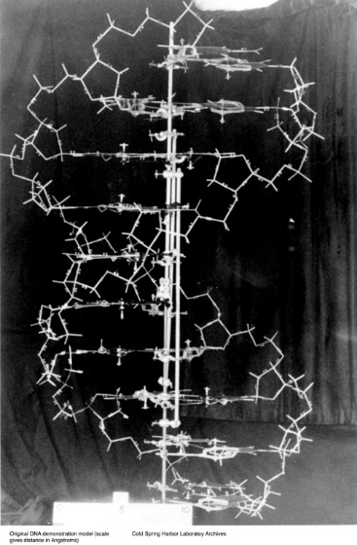
What is the structure of DNA?
(DNA is NOT a protein!!)
By the end of the lesson you should be able to:
Recall the structure of a mononucleotide
Recall the structure of DNA
Understand base pairing and the nature of the double helix

Slide 4
Home work
Complete and perfect your DNA fact sheet.
Research and write notes on who discovered DNA and summarise, in no more than 10 lines, how they did it.
Next lesson you will be making an edible model of DNA. Divide yourselves into pairs and decide what type and how many sweets you will need to make your model. Make sure you bring them to the lesson.

Slide 5
TASK:
Read the analogy explaining how a cell is controlled by genes. Write your own explanation for what happens in cells to develop different characteristics.
Inside a factory there is a boss in an office with a big instruction book.
The instruction book never leaves the office.
Messengers go into the office and receive messages from one section of the instruction book.
The messengers take the messages to parts of the factory.
These messages tell the workers in the factory to make certain products.
Each part of the factory makes something different.
A different factory has a different instruction book, and so makes different end products.

Slide 6
DNA what can you remember from last year?
Now start a DNA fact sheet
Answer these questions to improve your sheet:
What does DNA stand for?
What is it made from?
What does it look like?
What does it do?
What type of bonds does it contain?

Slide 7
Answers
Factory = Cell
Office = Nucleus
Boss = DNA
Instruction book = genes
Messengers = mRNA
Different part of factory = cytoplasm
Workers in the factory = ribosomes
Products = proteins

Slide 8
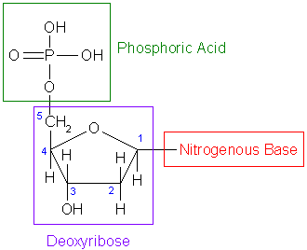
Nucleotides
DNA is an example of a group of molecules called nucleic acids. It is made of monomers called mononucleotides.
A phosphate group
A pentose (5 carbon) sugar called deoxyribose
An organic nitrogenous base, either thymine, adenine, guanine or cytosine

Slide 9
How do nucleotides join together?
The sugar and the phosphate join to form ‘a sugar phosphate backbone’. They are joined in a condensation reaction forming a phosphodiester bond
A polynucleotide chain is formed
C to G has 3 H bonds
A to T has 2 H bonds
A second polynucleotide chain runs antiparallel with the first and is joined via hydrogen bonding between the bases. This forms a ladder like structure
Think G – three and T two!
Approximately every 10 base pairs the “ladder” twists, this gives DNA its characteristic double helix shape
What do you notice about the sugar groups in each chain?

Slide 10
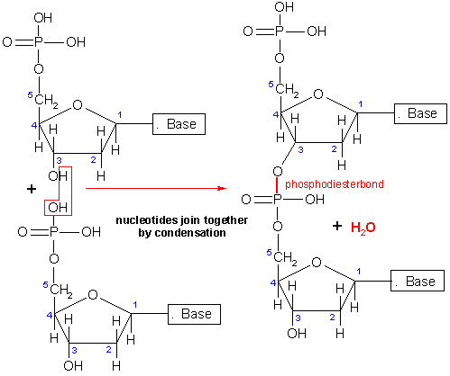

Slide 11
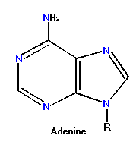
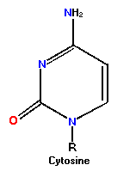
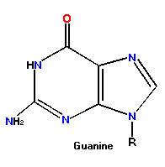
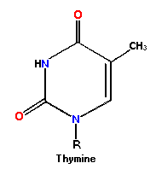
The Bases
There are 4 bases found in DNA. They can be divided into 2 groups
Think U's here!
Think Y's here
Purines
Pyrimidines
Purines are double ring structures
Pyrimidines are single ring structures
In DNA Adenine always bonds with Thymine and Cytosine always bonds with Guanine. This is called complementary base pairing.

Slide 12
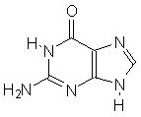
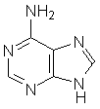

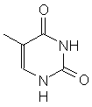

Base pairing
DNA shows complementary base pairing
A = T (apples in the tree)
C G (cars in the garage)
A, G are purines
C, T, U are pyrimidines (think Y's!)
Guanine
Adenine
Cytosine
Thymine
Uracil

Slide 13
Key Terms
Use your text book & your notes to help you match key words to their definitions
The basic building blocks of macromolecules such as DNA & RNA
Made from a double ring structure consisting of a 6 & a 5 sided ring e.g. adenine and guanine
Complementary base pairs with thymine
The name of the sugar found in DNA
The type of bond that links nucleotides together
The type of bond that links base pairs together
The two polynucleotide chains in DNA run _________ to one another
Complementary base pairs with guanine
The DNA ‘ladder’ is twisted to form a _______ ____
An example of a nucleic acid (other than DNA)
Nucleotides
Purine
Adenine
Deoxyribose
Phosphodiester
Hydrogen bonds
Antiparallel
Cytosine
Double Helix
RNA or AMP

