Slide 1
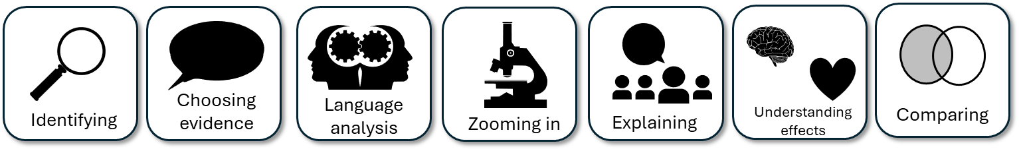
AQA English Language Paper 2 Q4: Comparing Texts
In the previous lesson we focused on comparing the two texts and exploring the different feelings and experiences of travelling on a train.
What differences were there in the feelings and experiences between the two writer’s journeys?
How can we compare the differences between the two texts?
Why is it so crucial to switch focus between the two sources in our Q4 answers? Provide examples.
Source A
Source B

Slide 2
Learning outcomes
To describe how contrast connectives, linking sentences and cherry-picking evidence can improve our Q4 answers
To explain how student answers can better meet the requirements of the mark scheme
To evaluate the effectiveness of our improved Q4 answers

Slide 3
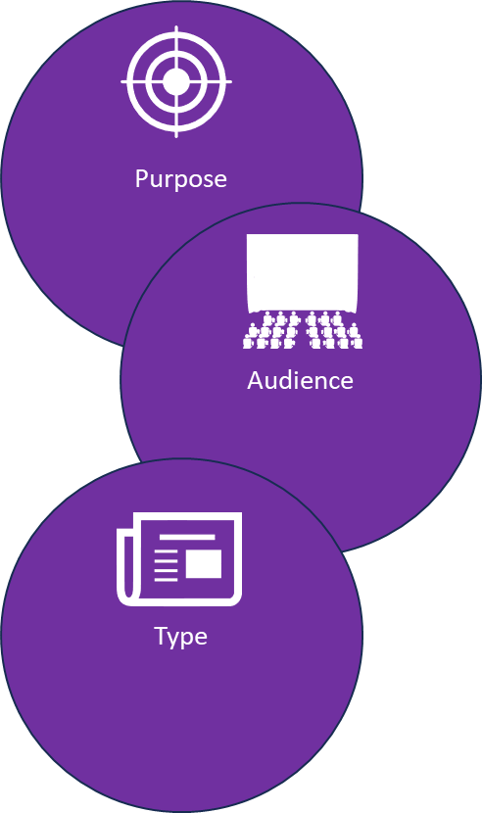
Let’s recap our ideas for this Q4 task
Source A:
Purpose: To describe, to explain, to entertain
Audience: Readers with an interest in travel from the 1930s.
Type: An extract from a travel book.
Source B:
Purpose: To describe, to explain, to entertain
Audience: Kemble’s friend from the late Victorian period.
Type: A letter written to a friend.
Tone: Disappointed, frustrated, angry, panic-stricken, confused, relieved.
Tone: Jovial, joyful, happy, excited.
Language techniques: Personification, metaphors, adjectives, adverbs.
Language techniques: Personification, metaphors, adjectives.
Why do they use these techniques? The use of personification brings the train to life and makes us feel as if the train is in conflict with the writer, given the crash and the amount of problems it has caused him.
Why do they use these techniques? The use of personification describes the train as if it is powerful and wild, but also it helps to convey the writer’s sense of joy and freedom that the new train technology provides her with.

Slide 4
We can use contrast connectives to help us show clear comparisons in our Q4 answers
In comparison,
In contrast,
However,
Despite this,
Conversely,
On the other hand,
Nevertheless,
Whereas
Source A:
Purpose: To describe, to explain, to entertain
Audience: Readers with an interest in travel from the 1930s.
Type: An extract from a travel book.
Source B:
Purpose: To describe, to explain, to entertain
Audience: Kemble’s friend from the late Victorian period.
Type: A letter written to a friend.
The perspectives are very different in both sources given their different audiences. Source A is written for readers interested in travel. In contrast, the audience for Source B is one friend writing to another. This means that the writer’s tone in Source A is humorous and droll, whereas the tone in Source B is jovial and friendly.

Slide 5
It’s really important that we use linking sentences in Q4
In Source A, the writer has grown distasteful of his train journey and now looks forward to the “end of term” or concluding his journey. In contrast, the writer of Source B finds her train journey captivating and exhilarating: “wonderful beast”, “a child might manage it” and “snorting little animal”.
Discuss: Why is this an effective comparison?
To get 16/16:
Compares ideas and perspectives in a perceptive way:
• analyses how writers’ methods are used
• selects a range of judicious supporting detail from both texts
• shows a detailed and perceptive understanding of the different ideas and
perspectives in both texts.

Slide 6
Look back at your answer to Q4 from the previous lesson
In comparison,
In contrast,
However,
Despite this,
Conversely,
On the other hand,
Nevertheless,
Whereas
Find at least one example where you could add in a contrast connective to help improve your comparisons between the two texts.
Go back over your answer and add in contrast connectives and linking sentences to make your comparisons clear.

Slide 7
We must also explore the writers’ methods in Q4
In Source A, the writer has grown distasteful of his train journey and now looks forward to the “end of term” or concluding his journey. In the very first paragraph alone he lists all the aspects of the journey he has hated so far, including the “rancid peat” bread, the “equally earthy tea” and “days entirely blank of action”. The hyperbolic adjectives of “rancid”, “earthy” and “blank” really amplify how much he dislikes his journey.
In contrast, the writer of Source B finds her train journey captivating and exhilarating: “wonderful beast”, “a child might manage it” and “snorting little animal”. The writer personifies the train as a “beast” and a “little animal”, but uses the adjectives “wonderful” and “snorting” to convey that it is friendly and harmless to people, to the point where “even a child might manage it” (perhaps hyperbole on the writer’s part).
Discuss: Why is this an effective comparison?
To get 16/16:
Compares ideas and perspectives in a perceptive way:
• analyses how writers’ methods are used
• selects a range of judicious supporting detail from both texts
• shows a detailed and perceptive understanding of the different ideas and
perspectives in both texts.

Slide 8
Look back at your answer to Q4 from the previous lesson
This time, focus on where you have analysed the writers’ methods.
Highlight or circle any sections where you have analysed the writers’ methods.
Find any examples where you could add analysis of the writers’ methods. Add these in now.
Language techniques: Personification, metaphors, adjectives, adverbs.
Language techniques: Personification, metaphors, adjectives.
Why do they use these techniques? The use of personification brings the train to life and makes us feel as if the train is in conflict with the writer, given the crash and the amount of problems it has caused him.
Why do they use these techniques? The use of personification describes the train as if it is powerful and wild, but also it helps to convey the writer’s sense of joy and freedom that the new train technology provides her with.

Slide 9

Cherry-picking evidence is a great skill to have!
Rather than just using one longer quotation from the text you are analysing, you can look out for patterns that emerge with the use of language, for instance: how the writer uses adjectives throughout a text, or how one person or object is described and the techniques that are used for this description.

Slide 10
Can you see the differences between these two answers?
In contrast, the writer of Source B finds her train journey captivating and exhilarating: “wonderful beast”. The adjective “wonderful” conveys that the machine is friendly.
In contrast, the writer of Source B finds her train journey captivating and exhilarating: “wonderful beast”, “a child might manage it” and “snorting little animal”. The writer personifies the train as a “beast” and a “little animal”, but uses the adjectives “wonderful” and “snorting” to convey that it is friendly and harmless to people, to the point where “even a child might manage it” (perhaps hyperbole on the writer’s part).
Discuss: How has ‘cherry-picking’ helped to improve the student’s answer?

Slide 11
Last lesson we wrote our own Q4 answers
Drafting and redrafting is an important activity in English because it helps you to become a more effective English analyst.
Using your learning from today and the success criteria, rewrite your answer.
Your answer for Q4
Compared the thoughts and feelings of the writers
Included examples to support ideas
Compared the methods (language) used to convey their thoughts and feelings
Bonus criteria:
Included contrast connectives and linking sentences
Included cherry-picked evidence

Slide 12
We will now peer assess our new answers
Swap your answers with another student.
Your answer for Q4 |  | What could they add or change to improve their answer?
Compared the thoughts and feelings of the writers
Included examples to support ideas
Compared the methods (language) used to convey their thoughts and feelings
Bonus criteria:
Included contrast connectives and linking sentences
Included cherry-picked evidence

Slide 13
Your answer for Q4 |  | What could they add or change to improve their answer?
Compared the thoughts and feelings of the writers
Included examples to support ideas
Compared the methods (language) used to convey their thoughts and feelings
Bonus criteria:
Included contrast connectives and linking sentences
Included cherry-picked evidence
Notes:
To print out for students

Slide 14

Plenary: The Hand of Progress
Draw around your hand in your exercise book.
On each finger, write down one thing you’ve learnt from today’s lesson.
To describe how contrast connectives, linking sentences and cherry-picking evidence can improve our Q4 answers
To explain how student answers can better meet the requirements of the mark scheme
To evaluate the effectiveness of our improved Q4 answers

