Slide 1
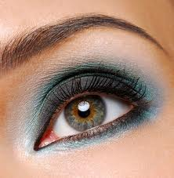
NNNNNNNNNNN
M
Notes:
ENZYME

Slide 2
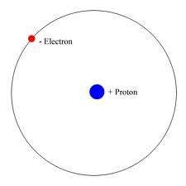

Notes:
HYDROGEN BOND

Slide 3
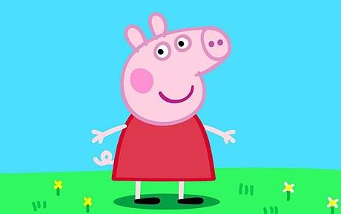

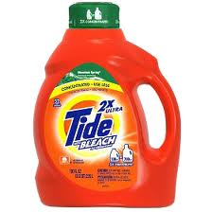
- PA
Notes:
PEPTIDE BOND

Slide 4
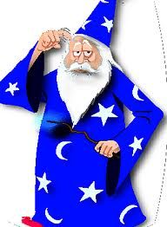

-LIN
Notes:
POLYMER

Slide 5
Globular and fibrous proteins
By the end of the lesson, you should be able to:
Describe the structure and function of globular proteins
Describe the properties and functions of fibrous proteins (no details of structure required)
Understand the roles of ionic, hydrogen and disulphide bonds in the structure of globular proteins

Slide 6
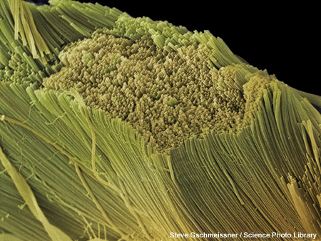
This is just a quick listen to introduction. You will be writing detailed notes when you complete the task
Fibrous proteins
Fibrous proteins are formed from parallel polypeptide chains held together by cross-links. These form long, rope-like fibres, with high tensile strength and are generally insoluble in water.
collagen – the main component of connective tissue such as ligaments, tendons, cartilage.
keratin – the main component of hard structures such as hair, nails, claws and hooves.
silk – forms spiders’ webs and silkworms’ cocoons.
elastin – gives strength and elasticity to the skin and other tissues and organs in the body
Notes:
Photo credit: Steve Gschmeissner / Science Photo Library
Scanning electron micrograph (SEM) of collagen bundles from the delicate connective tissue endoneurium. Endoneurium wraps around and between individual nerve fibres (axons), providing support and filling space between the nerve fibres. Endoneurium consists of collagen and elastin fibres and is found throughout the peripheral nervous system. Magnification not known.
Teacher notes
Collagen is the most abundant protein in the body, comprising about 25% of all protein.

Slide 7
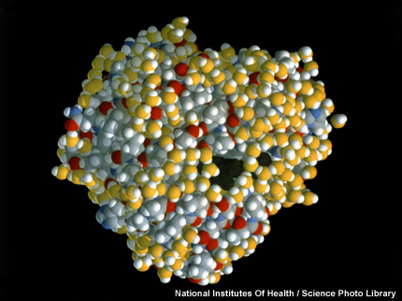
Globular proteins
Globular proteins usually have a spherical shape caused by tightly folded polypeptide chains.
The chains are usually folded so that hydrophobic groups are on the inside, while the hydrophilic groups are on the outside. This makes many globular proteins soluble in water.
transport proteins – such as haemoglobin, myoglobin and those embedded in membranes.
enzymes – such as lipase and DNA polymerase.
hormones – such as oestrogen and insulin.
Notes:
Photo credit: National Institutes Of Health / Science Photo Library
Molecular graphic of the oxygen-carrying protein myoglobin. Myoglobin consists of a chain of amino acids folded into a globin molecule, which is similar to the four globin subunits in haemoglobin. Coloured spheres here represent atoms in the chain. The dark region in the centre is the haem group, which contains a single iron atom to which a molecule of oxygen can form a temporary bond. Myoglobin is found in muscle tissue, where it stores additional oxygen for use during strenuous exercise.

Slide 8
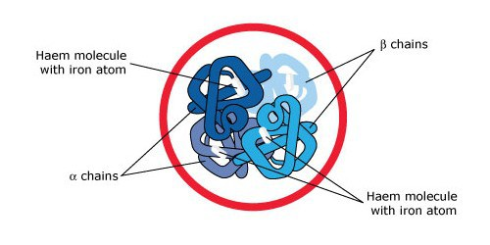
Haemoglobin is a protein made up of 4 polypeptide chains; two alpha and two beta chains.
Each polypeptide chain has a prosthetic group, which is a non-polypeptide structure needed for the activity of the protein.
These prosthetic groups are called haem groups, and each contains a Fe²⁺ ion.
Is a globular protein, which is round and compact.
Job is to carry oxygen around the body.
There are hydrophilic side chains on the outside, making it soluble in water, so is easily transported around the body. Haemoglobin also has hydrophobic side chains on the inside.
Haemoglobin is an example of a conjugated protein. It has a globular structure and contains a prosthetic group

Slide 9
Produce a poster comparing globular and fibrous proteins.
You must highlight the similarities and differences between each protein type.
Your posters should include:
1. Fibrous proteins:
The properties and functions of fibrous proteins including keratin, elastin and collagen
2. Globular proteins:
The structure and functions of globular proteins including haemoglobin, insulin and a named enzyme. (Catalase is a good choice here!).
A detailed description of the levels of organisation (primary, secondary, tertiary etc) and the bonding involved
The function of each protein
The solubility of each protein
Any other relevant information
Extra practice questions in your folder if you finish quickly

Slide 10
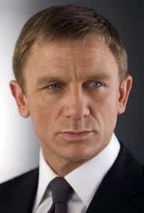
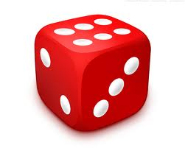
S²⁻
Notes:
DISULPHIDE BOND

Slide 11
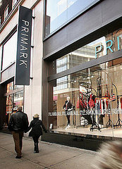
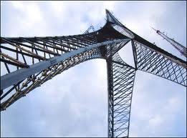
-k +y
Notes:
PRIMARY STRUCTURE

Slide 12
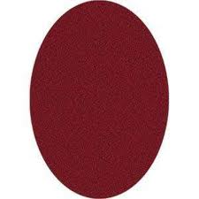


C
T
Notes:
COVALENT BOND

Slide 13
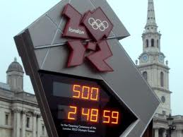
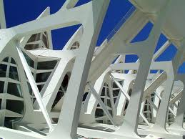
+ary
Notes:
SECONDARY STRUCTURE

Slide 14
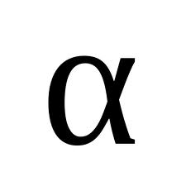
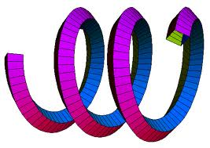
Notes:
ALPHA HELIX

Slide 15
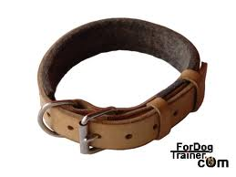
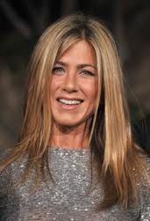
Notes:
COLLAGEN

Slide 16
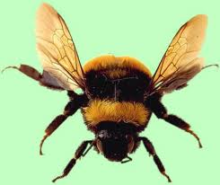
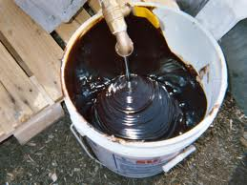
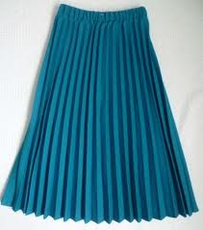

Notes:
BETA PLEATED SHEET

Slide 17
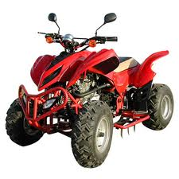
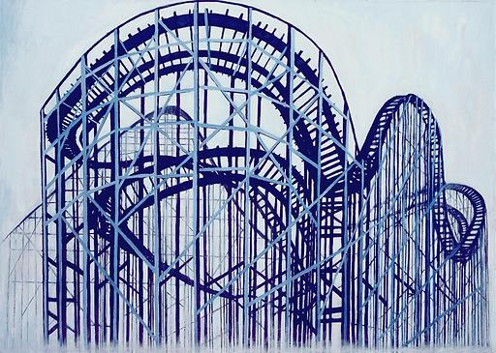

-d
+ary
Notes:
QUATERNARY STRUCTURE

