Slide 1
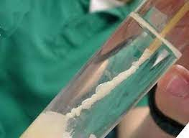
DNA extraction
What could this be used for?
DNA analyses for crime scenes, paternity cases and genealogy,
including PCR, electrophoresis, sequencing, fingerprinting and cloning.

Slide 2
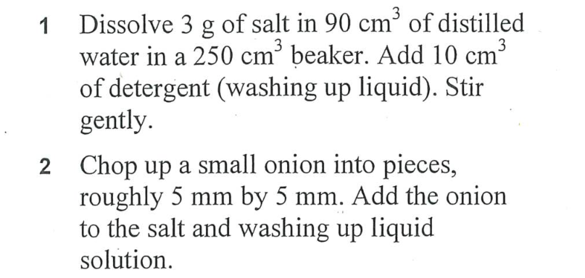
Complete steps 1, 2 and 3 from the method as quickly as possible as there is a 15-minute wait time.

Slide 3
DNA recap quiz:
Name the 4 different bases found in DNA
What shape is the DNA polymer?
What is the entire genetic information of an organism?
How many chromosomes are there in a human skin cell?
What does the DNA backbone consist of?
How many bases code for a specific amino acid?
Which repeating unit makes up DNA?
Where does protein synthesis take place?
What could cause a change in the structure of a protein?
Which base does cytosine always pair up with ?

Slide 4
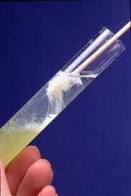
Now complete your DNA extraction, by carefully following the steps on the method sheet.
CH – explain this statement
If you put all the DNA molecules in your body end to end, the DNA would reach from the Earth to the Sun and back over 600 times
Answer questions 1-5 on the work sheet

