Slide 1



AQA English Language Paper 2 – Q4: Comparing Texts
Last lesson we began to compare the two sources and explore their different purposes, audience, types, tones and language.
Let’s refocus on the use of tone again.
Which of these emojis best represents Source A and Source B?
How is the tone of Source A different to Source B?
Why is it important to consider the tones of the sources when comparing texts? Provide examples.
A
B
C

Slide 2
Source A has a few different tones. The early part of the text is one of frustration and disappointment: “no more days entirely blank of action”. We know the writer did not enjoy his trip and he is looking forward to it ending.
However, during the crash there is a clear sense of panic and confusion: “This is the end of the world, I thought” because he has no control over what is happening and is worried he may.
Finally, he has a sense of relief after the crash is over and says it would be harder to imagine “a nicer sort of railway accident” given no one was hurt.
He then has a cynical tone with some relief that he has survived and returns to being critical of the train: “We had not liked her. Now she was down and out.”

Slide 3
Source B is very different in tone because the writer has enjoyed her trip and is clearly keen to tell her friend all about it: “but only a large sheet can contain my raptures about my railroad journey.”
Throughout her journey she uses personification, metaphors and adjectives to convey her sense of joy towards her journey: “The reins of this wonderful beast are a small steel handle”. Referring to the train as a “wonderful beast” highlights her sense of wonder and awe at the machine, and this sense of joy continues throughout: “I felt as if no fairy tale was ever half so wonderful as what I saw”.

Slide 4
Learning outcomes
To describe the thoughts and feelings of the writers in the two sources
To explain how the thoughts and feelings of the writers are different to each other and make comparisons
To evaluate the effectiveness of our Q4 drafts based on success criteria

Slide 5
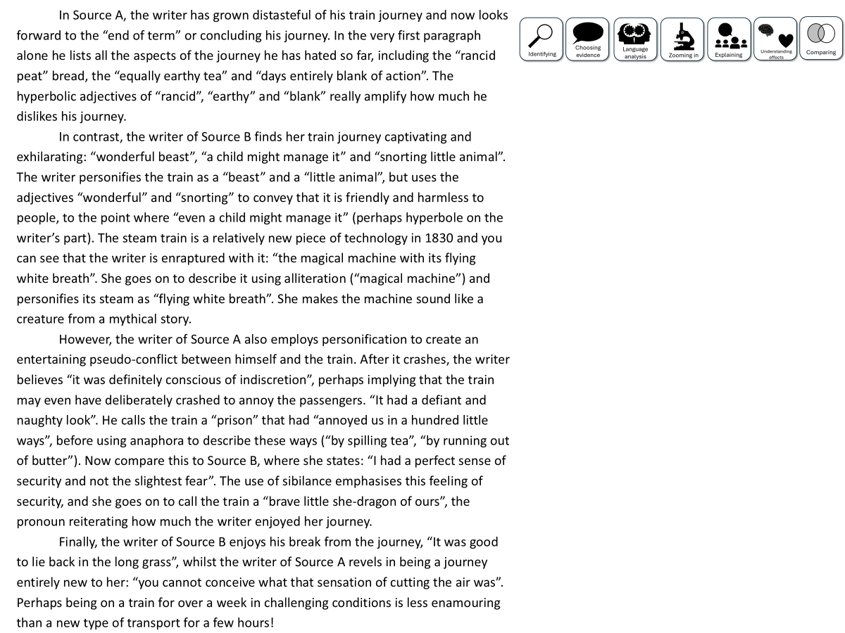

You have been given a good answer for Q4
Go through the answer and find good examples of how the student has compared the two texts. You could do this through arrows, annotations or highlighting.
Bonus Challenge: Find examples of language analysis.

Slide 6
In Source A, the writer has grown distasteful of his train journey and now looks forward to the “end of term” or concluding his journey. In the very first paragraph alone he lists all the aspects of the journey he has hated so far, including the “rancid peat” bread, the “equally earthy tea” and “days entirely blank of action”. The hyperbolic adjectives of “rancid”, “earthy” and “blank” really amplify how much he dislikes his journey.
In contrast, the writer of Source B finds her train journey captivating and exhilarating: “wonderful beast”, “a child might manage it” and “snorting little animal”. The writer personifies the train as a “beast” and a “little animal”, but uses the adjectives “wonderful” and “snorting” to convey that it is friendly and harmless to people, to the point where “even a child might manage it” (perhaps hyperbole on the writer’s part). The steam train is a relatively new piece of technology in 1830 and you can see that the writer is enraptured with it: “the magical machine with its flying white breath”. She goes on to describe it using alliteration (“magical machine”) and personifies its steam as “flying white breath”. She makes the machine sound like a creature from a mythical story.
However, the writer of Source A also employs personification to create an entertaining pseudo-conflict between himself and the train. After it crashes, the writer believes “it was definitely conscious of indiscretion”, perhaps implying that the train may even have deliberately crashed to annoy the passengers. “It had a defiant and naughty look”. He calls the train a “prison” that had “annoyed us in a hundred little ways”, before using anaphora to describe these ways (“by spilling tea”, “by running out of butter”). Now compare this to Source B, where she states: “I had a perfect sense of security and not the slightest fear”. The use of sibilance emphasises this feeling of security, and she goes on to call the train a “brave little she-dragon of ours”, the pronoun reiterating how much the writer enjoyed her journey.
Finally, the writer of Source B enjoys his break from the journey, “It was good to lie back in the long grass”, whilst the writer of Source A revels in being a journey entirely new to her: “you cannot conceive what that sensation of cutting the air was”. Perhaps being on a train for over a week in challenging conditions is less enamouring than a new type of transport for a few hours!

Slide 7
Let’s look at a good answer for Q4:
In Source A, the writer has grown distasteful of his train journey and now looks forward to the “end of term” or concluding his journey. In the very first paragraph alone he lists all the aspects of the journey he has hated so far, including the “rancid peat” bread, the “equally earthy tea” and “days entirely blank of action”. The hyperbolic adjectives of “rancid”, “earthy” and “blank” really amplify how much he dislikes his journey.
In contrast, the writer of Source B finds her train journey captivating and exhilarating: “wonderful beast”, “a child might manage it” and “snorting little animal”. The writer personifies the train as a “beast” and a “little animal”, but uses the adjectives “wonderful” and “snorting” to convey that it is friendly and harmless to people, to the point where “even a child might manage it” (perhaps hyperbole on the writer’s part). The steam train is a relatively new piece of technology in 1830 and you can see that the writer is enraptured with it: “the magical machine with its flying white breath”. She goes on to describe it using alliteration (“magical machine”) and personifies its steam as “flying white breath”. She makes the machine sound like a creature from a mythical story.
However, the writer of Source A also employs personification to create an entertaining pseudo-conflict between himself and the train. After it crashes, the writer believes “it was definitely conscious of indiscretion”, perhaps implying that the train may even have deliberately crashed to annoy the passengers. “It had a defiant and naughty look”. He calls the train a “prison” that had “annoyed us in a hundred little ways”, before using anaphora to describe these ways (“by spilling tea”, “by running out of butter”). Now compare this to Source B, where she states: “I had a perfect sense of security and not the slightest fear”. The use of sibilance emphasises this feeling of security, and she goes on to call the train a “brave little she-dragon of ours”, the pronoun reiterating how much the writer enjoyed her journey.
Finally, the writer of Source B enjoys his break from the journey, “It was good to lie back in the long grass”, whilst the writer of Source A revels in being a journey entirely new to her: “you cannot conceive what that sensation of cutting the air was”. Perhaps being on a train for over a week in challenging conditions is less enamouring than a new type of transport for a few hours!
Read through this answer and think about:
How the student has included:
Comparisons about how the perspectives are different in Source A and B
Quotations to support comparisons
Explanations about the methods both writers use to convey their different feelings and perspectives

Slide 8
Can you see how the student has mixed together quotations, comparisons about the writers’ perspectives and explanations about their methods used?
In Source A, the writer has grown distasteful of his train journey and now looks forward to the “end of term” or concluding his journey. In the very first paragraph alone he lists all the aspects of the journey he has hated so far, including the “rancid peat” bread, the “equally earthy tea” and “days entirely blank of action”. The hyperbolic adjectives of “rancid”, “earthy” and “blank” really amplify how much he dislikes his journey.
In contrast, the writer of Source B finds her train journey captivating and exhilarating: “wonderful beast”, “a child might manage it” and “snorting little animal”. The writer personifies the train as a “beast” and a “little animal”, but uses the adjectives “wonderful” and “snorting” to convey that it is friendly and harmless to people, to the point where “even a child might manage it” (perhaps hyperbole on the writer’s part). The steam train is a relatively new piece of technology in 1830 and you can see that the writer is enraptured with it: “the magical machine with its flying white breath”. She goes on to describe it using alliteration (“magical machine”) and personifies its steam as “flying white breath”. She makes the machine sound like a creature from a mythical story.
However, the writer of Source A also employs personification to create an entertaining pseudo-conflict between himself and the train. After it crashes, the writer believes “it was definitely conscious of indiscretion”, perhaps implying that the train may even have deliberately crashed to annoy the passengers. “It had a defiant and naughty look”. He calls the train a “prison” that had “annoyed us in a hundred little ways”, before using anaphora to describe these ways (“by spilling tea”, “by running out of butter”). Now compare this to Source B, where she states: “I had a perfect sense of security and not the slightest fear”. The use of sibilance emphasises this feeling of security, and she goes on to call the train a “brave little she-dragon of ours”, the pronoun reiterating how much the writer enjoyed her journey.
Finally, the writer of Source B enjoys his break from the journey, “It was good to lie back in the long grass”, whilst the writer of Source A revels in being a journey entirely new to her: “you cannot conceive what that sensation of cutting the air was”. Perhaps being on a train for over a week in challenging conditions is less enamouring than a new type of transport for a few hours!
Read through this answer and think about:
How the student has included:
Comparisons about how the perspectives are different in Source A and B
Quotations to support comparisons
Explanations about the methods both writers use to convey their different feelings and perspectives

Slide 9

There are many skills needed to answer Q4, but you need to use them all to answer Q4 effectively and try to hit the top marks.
One of the most challenging skills is comparing. You have to compare the two texts in order to get a good mark, so we will spend some time today focusing on this skill.

Slide 10
Let’s focus on one part of the student’s answer
However, the writer of Source A also employs personification to create an entertaining pseudo-conflict between himself and the train. After it crashes, the writer believes “it was definitely conscious of indiscretion”, perhaps implying that the train may even have deliberately crashed to annoy the passengers. “It had a defiant and naughty look”. He calls the train a “prison” that had “annoyed us in a hundred little ways”, before using anaphora to describe these ways (“by spilling tea”, “by running out of butter”). Now compare this to Source B, where she states: “I had a perfect sense of security and not the slightest fear”. The use of sibilance emphasises this feeling of security, and she goes on to call the train a “brave little she-dragon of ours”, the pronoun reiterating how much the writer enjoyed her journey.
Now compare this to Source B, where she states: “I had a perfect sense of security and not the slightest fear”. The use of sibilance emphasises this feeling of security, and she goes on to call the train a “brave little she-dragon of ours”, the pronoun reiterating how much the writer enjoyed her journey.
The student makes sure they make direct comparisons between the two sources. Source A shows the writer’s distaste for the journey, but Source B highlights the writer’s immense joy for the journey.

Slide 11
Let’s look at the mark scheme for Q4
AO3: Compare writers’ ideas and perspectives, as well as how these are conveyed,
across two or more texts.
To get 16/16:
Compares ideas and perspectives in a perceptive way:
• analyses how writers’ methods are used
• selects a range of judicious supporting detail from both texts
• shows a detailed and perceptive understanding of the different ideas and
perspectives in both texts.
Student’s answer
Compared the thoughts and feelings of the writers
Included examples to support ideas
Compared the methods (language) used to convey their thoughts and feelings
This is what we need to focus on next

Slide 12
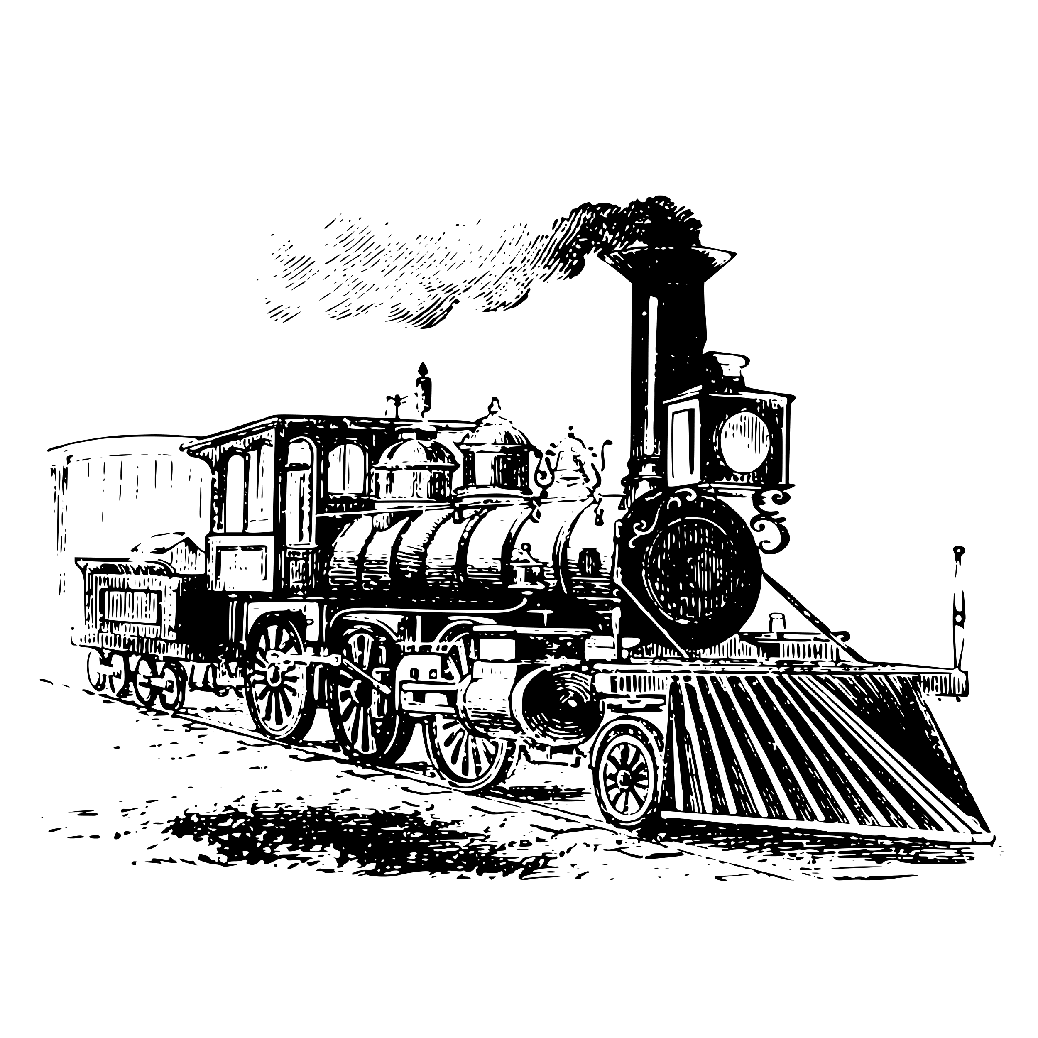

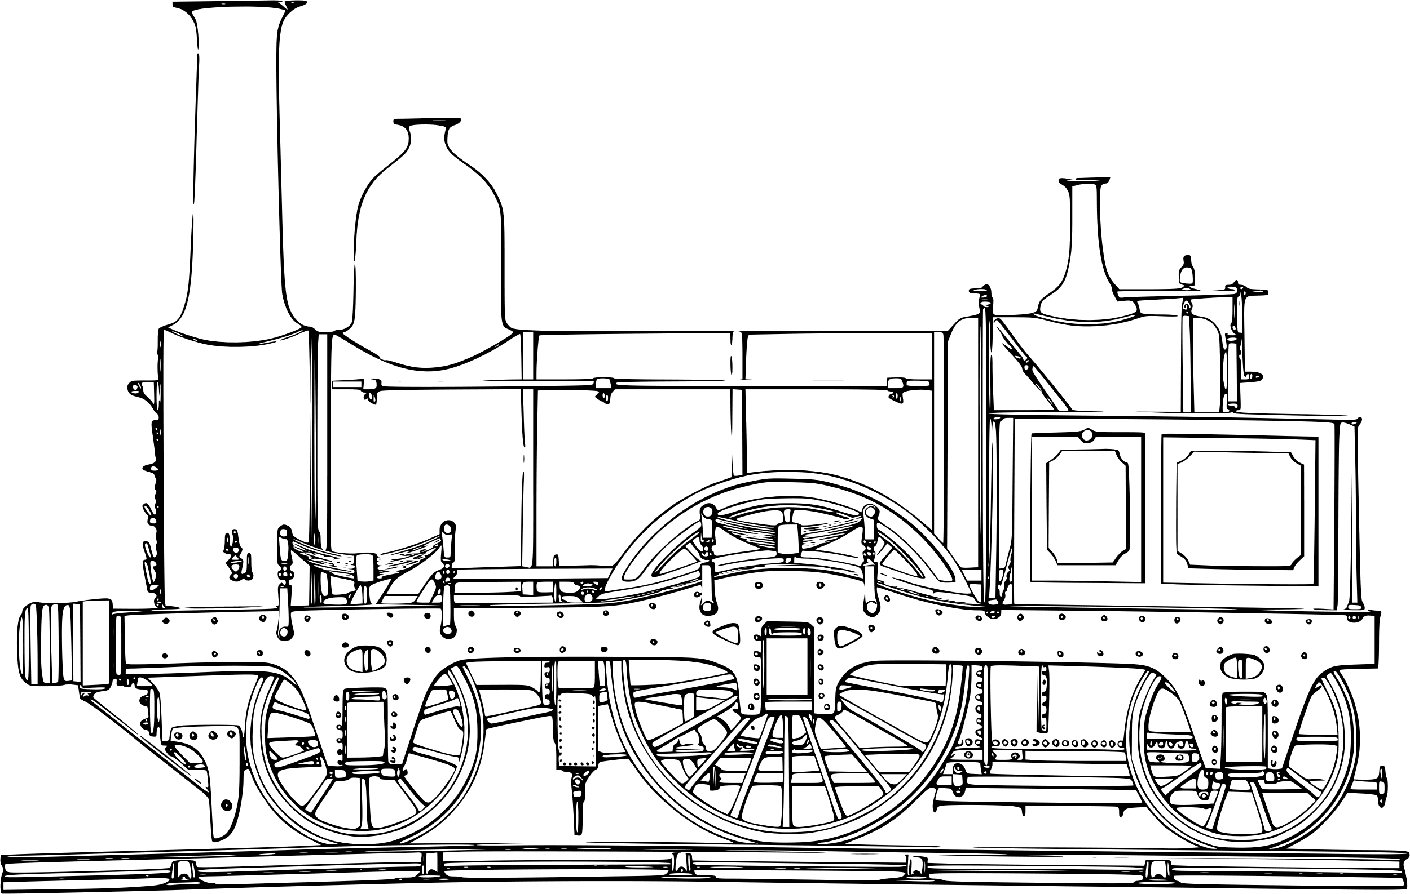

Q4) Comparison
20 minutes to answer!
Q4) For this question, you need to refer to the whole of Source A, together with Source B.
The task asks you to compare how the writers convey their different experiences and feelings about travelling on a train.
In your answer, you could:
• compare their different thoughts and feelings and perspectives
• compare the methods they use to convey their thoughts and feelings and perspectives
• support your response with references to both texts.[16 marks]
Exam tip
This is the comparison question, so you must compare the two texts and how they convey their thoughts and feelings.
Compare the writers’ thoughts and feelings
Compare the use of language techniques to convey their thoughts and feelings
Include quotes or examples to support your comparison
Explain the effects of their methods on their readers

Slide 13
Plenary: We will now peer assess our own answers
Swap your answers with another student.
1) What skills did the student use well in their answer?
Example: They include examples from both sources to support their ideas.
2) What skills could the student improve on in their answer?
Example: They need to compare how the thoughts and feelings in one source are different to the other about the train journeys.

