Slide 1
Algebraic Methods

Slide 2
Prior Knowledge Check
Simplify:
a) ${3x}^{2}×{5x}^{5}$ b) $\frac{5x^{3}y^{2}}{{15x}^{2}y^{3}}$
2) Factorise:
a) $x^{2}−2x−24$
b) ${3x}^{2}−17x+20$
3) Use long division to calculate:
197541 ÷ 9
56168 ÷ 34
4) Find the equation of the lines that pass through these points:
a) (-1,4) and (5,-14)
b) (2,-6) and (8,-3)
5) Complete the square for these expressions:
a) $x^{2}−2x−20$
b) ${2x}^{2}+4x+15$
$$\frac{x}{3y}$$
$${15x}^{7}$$
$$y=1−3x$$
$$y=\frac{1}{2}x−7$$
$$(x−6)(x+4)$$
$$(3x−5)(x−4)$$
$${\left(x−1\right)}^{2}−21$$
$$21949$$
$${2\left(x+1\right)}^{2}+13$$
$$1652$$

Slide 3
Teachings for
Exercise 7A

Slide 4
Algebraic Methods
You can simplify algebraic fractions by using division
Sometimes you need to look for common factors to each term
→ In this case, every term, top and bottom, contains an x
→ You can therefore ‘cancel’ an x from each part
Divide all by x
Don’t need to divide by 1!
7A

Slide 5
Algebraic Methods
You can simplify algebraic fractions by using division
→ This equation has been put into brackets
→ You can cancel out brackets which are on the top and bottom
Divide by (2x – 1)
Don’t need to divide by 1!
7A

Slide 6
Algebraic Methods
You can simplify algebraic fractions by using division
→ Sometimes you will have to factorise one of the equations first
→ Once this is done, you can cancel out brackets as before
Two numbers that multiply to give +12 and add to give +7
Cancel the (x + 3)s
7A

Slide 7
Algebraic Methods
You can simplify algebraic fractions by using division
→ Sometimes you will have to factorise both of the equations first
→ Once this is done, you can cancel out brackets as before
Two numbers that multiply to give +5 and add to give +6
Two numbers that multiply to give -10 and add to give +3
Divide by (x + 5)
7A

Slide 8
Algebraic Methods
You can simplify algebraic fractions by using division
→ Sometimes you will have to factorise one of the equations first
→ Once this is done, you can cancel out brackets as before
Two numbers that multiply to give +12 and add to give +11, when one is doubled
Divide by the (x + 4)
7A

Slide 9
Teachings for
Exercise 7B

Slide 10
Algebraic Methods
You can use algebraic long division to divide a polynomial by $\left(x±p\right)$, where $p$ is a constant.
A polynomial is a finite expression with positive, integer indices
Example of Polynomials could include $2x+4$, $4xy^{2}+3x−9$, $100$
Examples of non-polynomials would include $\sqrt{x}$, $6x^{2}$, $\frac{4}{x}$
You need to be able to divide polynomials – this can be used in factorization…
7B

Slide 11
Algebraic Methods
You can use algebraic long division to divide a polynomial by $\left(x±p\right)$, where $p$ is a constant.
First though, we will look at numerical long division, and what the process actually means…
1) Divide 819 by 7
→ So 7 divides into 819 exactly 117 times, with no remainder
1
1
7
First, ‘How many 700s in 800’
1
We now take away ‘1 x 700’ from what we started with
Second, ‘How many 70s in 119’
1
We now take away ‘1 x 70’ from what we had (119)
Finally, ‘How many 7s in 49’
7
We now take away ‘7 x 7’ from what we had (49)
7
8
1
9
7
0
0
1
1
9
7
0
4
9
4
9
0
7B

Slide 12
Algebraic Methods
1
0
8
2
You can use algebraic long division to divide a polynomial by $\left(x±p\right)$, where $p$ is a constant.
First though, we will look at numerical long division, and what the process actually means…
1) Divide 9746 by 9
→ So 9 divides into 9746 exactly 1082 times, with 8 remainder
9
9
7
4
6
9
0
0
0
7
4
6
Finally, ‘How many 9s in 26’
2
We now take away ‘2 x 9’ from what we had left (26)
First, ‘How many 9000s in 9000’
1
We now take away ‘1 x 9000’ from what we started with
Second, ‘How many 900s in 746’
0
We now take away ‘0 x 900’ from what we had left (746)
Third, ‘How many 90s in 746’
8
We now take away ‘8 x 90’ from what we had left (746)
0
7
4
6
7
2
0
2
6
1
8
8
7B

Slide 13
Algebraic Methods
You can use algebraic long division to divide a polynomial by $\left(x±p\right)$, where $p$ is a constant.
We are now going to look at some algebraic examples..
1) Divide x³ + 2x² – 17x + 6 by (x – 3)
So the answer is x² + 5x – 2, and there is no remainder
This means that (x – 3) is a factor of the original equation
x²
+
5x
-
2
x - 3
x³ + 2x² – 17x + 6
x³ – 3x²
5x² - 17x + 6
5x² - 15x
Third, Divide -2x by x
-2
We then subtract -2(x – 3) from what we have left
First, Divide x³ by x
x²
We then subtract x²(x – 3) from what we started with
Second, Divide 5x² by x
5x
We then subtract 5x(x – 3) from what we have left
- 2x + 6
- 2x + 6
0
Therefore:
$$\left(x−3\right)\left(x^{2}+5x−2\right)=x^{3}+2x^{2}−17x+6$$
7B

Slide 14
Algebraic Methods
2x³
-
x²
You can use algebraic long division to divide a polynomial by $\left(x±p\right)$, where $p$ is a constant.
Given that $f\left(x\right)={4x}^{4}−17x^{2}+4$, write $f\left(x\right)$ in the form:
$f\left(x\right)=(2x+1)({ax}^{3}+{bx}^{2}+cx+d)$
→ So we need to find out what multiplies by $(2x+1)$ to give the original equation
→ Divide by $(2x+1)$
-
8x
+ 4
2x + 1
4x⁴ + 0x³ - 17x² + 0x + 4
4x⁴ + 2x³
-2x³ - 17x² + 0x + 4
Follow the same processes as previously!
→ You must include terms with a 0 coefficient as well!
-2x³ - x²
- 16x² + 0x + 4
- 16x² - 8x
8x + 4
8x + 4
0
$$f\left(x\right)=(2x+1)({2x}^{3}−x^{2}−8x+4)$$
7B

Slide 15
Algebraic Methods
You can use algebraic long division to divide a polynomial by $\left(x±p\right)$, where $p$ is a constant.
Find the remainder when ${2x}^{3}−{5x}^{2}−16x+10$ is divided by $(x−4)$
2x²
+
3x
-
4
x - 4
2x³ - 5x² – 16x + 10
2x³ – 8x²
3x² – 16x + 10
First, divide 2x³ by x
= 2x²
Then, work out 2x²(x – 4) and subtract from what you started with
Second, divide 3x² by x
= 3x
Then, work out 3x(x – 4) and subtract from what you have left
Third, divide -4x by x
= -4
Then, work out -4(x – 4) and subtract from what you have left
3x² – 12x
-4x + 10
-4x + 16
-6
7B

Slide 16
Algebraic Methods
Interesting Algebraic long division result…
Rewrite $\frac{x^{2}−6x+4}{x+1}$ using algebraic long division…
Imagine writing the original division as an equation of a graph…
Also write the ‘whole’ part (quotient) as an equation of a graph…
Let’s see what these look like on a set of axes…
$$x$$
$$− 7$$
$$x+1$$
$$x^{2}−6x+4$$
$$x^{2}+x$$
$$−7x+4$$
$$−7x−7$$
$$11$$
$$y=\frac{x^{2}−6x+4}{x+1}$$
$$=x−7 remainder 11$$
$$y=x−7$$
7B

Slide 17
Algebraic Methods
$$y=\frac{x^{2}−6x+4}{x+1}$$
It is the (oblique) asymptote to the curve!
$$y=x−7$$
7B

Slide 18
Algebraic Methods
Interesting Algebraic long division result…
Rewrite $\frac{{2x}^{3}−{5x}^{2}−16x+10}{x−4}$
We actually worked this one out earlier…
Consider both graphs as before…
$$={2x}^{2}−3x−4 remainder −6$$
$$y=\frac{{2x}^{3}−{5x}^{2}−16x+10}{x−4}$$
$$y={2x}^{2}−3x−4$$
7B

Slide 19
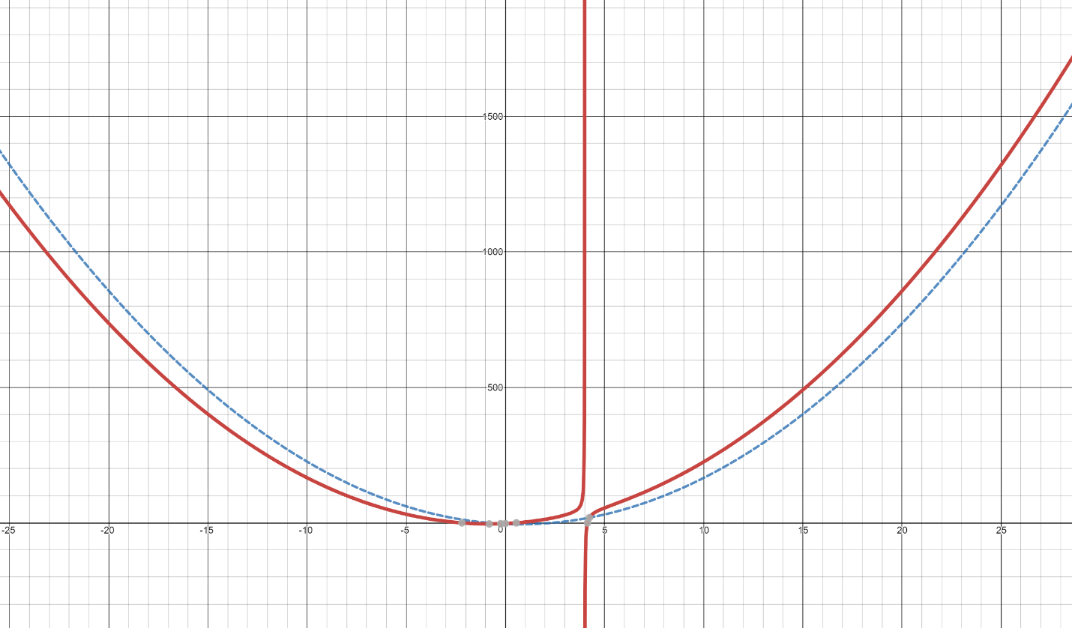
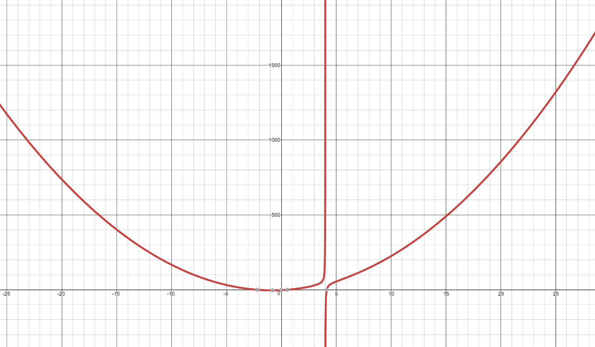
Algebraic Methods
$$y=\frac{{2x}^{3}−{5x}^{2}−16x+10}{x−4}$$
It is the (parabolic) asymptote to the curve!
$$y={2x}^{2}−3x−4$$
7B

Slide 20
Teachings for
Exercise 7C

Slide 21
Algebraic Methods
The factor theorem is a quick way of finding simple linear factors of a polynomial
Factorise and solve the following:
$$x^{2}−9x+20=0$$
$$x^{2}−9x+20=0$$
Factorise
$$(x−4)(x−5)=0$$
Solve
$x=4$ or $x=5$
→ Remember that what we are doing is finding the values that make the original equation equal 0
Another (less reliable) way to factorise is to try subbing in values
If a value gives an answer 0, you then know one of the brackets
$$x^{2}+6x−16=0$$
Sub in 1
Sub in 2
$${(1)}^{2}+6(1)−16=0$$
$${(2)}^{2}+6(2)−16=0$$
$$−9=0$$
$$0=0$$
Because 2 gives an answer of 0, we know that one of the brackets must be $\left(x−2\right)$
7C

Slide 22
Algebraic Methods
The factor theorem is a quick way of finding simple linear factors of a polynomial
The factor theorem states that, if $f(x)$is a polynomial:
If $f\left(p\right)=0$, then $\left(x−p\right)$ is a factor of $f(x)$
If $(x−p)$ is a factor of $f(x)$, then $f\left(p\right)=0$
If $f\left(3\right)=0$, then $\left(x−3\right)$ is a factor of $f(x)$
If $f\left(−1\right)=0$, then $\left(x+1\right)$ is a factor of $f(x)$
If $(x−5)$ is a factor of $f(x)$, then $f\left(5\right)=0$
If $(x+4)$ is a factor of $f(x)$, then $f\left(−4\right)=0$
7C

Slide 23
Algebraic Methods
The factor theorem is a quick way of finding simple linear factors of a polynomial
Show that $(x−2)$ is a factor of $x^{3}+x^{2}−4x−4$ by:
Algebraic division
The factor theorem
x²
+
3x
+
2
x - 2
x³ + x² – 4x - 4
x³ – 2x²
3x² - 4x - 4
3x² - 6x
2x - 4
2x - 4
0
The remainder is 0, so $(x−2)$ is a factor!
7C

Slide 24
Algebraic Methods
The factor theorem is a quick way of finding simple linear factors of a polynomial
Show that $(x−2)$ is a factor of $x^{3}+x^{2}−4x−4$ by:
Algebraic division
The factor theorem
$$x^{3}+x^{2}−4x−4$$
Sub in x = 2
$${(2)}^{3}+{(2)}^{2}−4(2)−4$$
Calculate
$$=0$$
The answer is 0, so $(x−2)$ is a factor!
7C

Slide 25
Algebraic Methods
The factor theorem is a quick way of finding simple linear factors of a polynomial
a) Fully factorise ${2x}^{3}+x^{2}−18x−9$
b) Hence, sketch the graph of $y={2x}^{3}+x^{2}−18x−9$
2x³ + x² – 18x - 9
Substitute in values of x to find a factor
x = 1
2 + 1 – 18 - 9
= -24
x = 2
16 + 4 – 36 - 9
= -25
x = 3
54 + 9 – 54 - 9
= 0
So (x – 3) is a factor
7C

Slide 26
Algebraic Methods
The factor theorem is a quick way of finding simple linear factors of a polynomial
a) Fully factorise ${2x}^{3}+x^{2}−18x−9$
b) Hence, sketch the graph of $y={2x}^{3}+x^{2}−18x−9$
→ Now we know (x – 3) is a factor, divide by it to find the quotient
The quotient (the answer once division has taken place) is 2x² + 7x + 3
2x²
+
7x
+
3
x - 3
2x³ + x² – 18x - 9
2x³ – 6x²
7x² – 18x - 9
7x² – 21x
3x - 9
3x - 9
0
7C

Slide 27
Algebraic Methods
The factor theorem is a quick way of finding simple linear factors of a polynomial
a) Fully factorise ${2x}^{3}+x^{2}−18x−9$
b) Hence, sketch the graph of $y={2x}^{3}+x^{2}−18x−9$
(x – 3)(2x² + 7x + 3)
You can also factorise the quotient
$$=(x−3)(2x+1)(x+3)$$
2 numbers that multiply to give +3, and add to give +7 when one has doubled…
(x – 3)(2x + 1)(x + 3)
This is now fully factorised!
7C

Slide 28
Algebraic Methods
The factor theorem is a quick way of finding simple linear factors of a polynomial
a) Fully factorise ${2x}^{3}+x^{2}−18x−9$
b) Hence, sketch the graph of $y={2x}^{3}+x^{2}−18x−9$
→ Roots at 3, -3 and -¹/₂
→ y-intercept at -9
$$−\frac{1}{2}$$
$$=(x−3)(2x+1)(x+3)$$
$$−3$$
$$3$$
$$−9$$
$$y=(x−3)(2x+1)(x+3)$$
7C

Slide 29
Algebraic Methods
The factor theorem is a quick way of finding simple linear factors of a polynomial
Given that (x + 1) is a factor of 4x⁴ – 3x² + a, find the value of a.
4x⁴ – 3x² + a
If (x + 1) is a factor, then subbing -1 will make the equation = 0
0 =
4(-1 ) ⁴ – 3(-1)² + a
Work out each term
0 =
4 – 3 + a
Solve the equation to find the value of a
0 =
1 + a
-1 =
a
7C

Slide 30
Teachings for
Exercise 7D

Slide 31
Algebraic Methods
A proof is a logical and structured argument to show that a mathematical statement is always true (or not true)
A proof will follow this general pattern:
You need to be able to prove mathematical statements clearly
→ One way is by deduction
Statement: Prove that the product of two odd numbers is odd”
Demonstration: 5 x 7 = 35, which is odd
Proof:
$p$ and $q$ are integers, so $2p+1$ and $2q+1$ are odd numbers
Known facts/ theorems
$$(2p+1)(2q+1)$$
Multiply out
$$=4pq+2p+2q+1$$
Factorise partially
Clearly shown logical steps
$$=2(2pq+p+q)+1$$
→ Since p and q are integers, $2pq+p+q$ is also an integer.
Statement of proof
→ Therefore, $2(2pq+p+q)+1$ is once more than an even number
→ Consequently, the product of two numbers is an odd number
7D

Slide 32
Algebraic Methods
Prove that:
A proof is a logical and structured argument to show that a mathematical statement is always true (or not true)
You might have to prove identities
An identity has a ‘triple’ equal sign, and means that both sides are always equal (for any value of x)
Do not try to solve it like an equation. Instead, start with one side and show it is equal to the other
$$\left(3x+2\right)\left(x−5\right)\left(x+7\right)≡{3x}^{3}+{8x}^{2}−101x−70$$
Start with the left hand side (LHS)
$$\left(3x+2\right)\left(x−5\right)\left(x+7\right)$$
Expand one bracket
$$=\left(3x+2\right)(x^{2}+2x−35)$$
Expand again
$$={3x}^{3}+{6x}^{2}−105x+2x^{2}+4x−70$$
Group like terms
$$={3x}^{3}+{8x}^{2}−101x−70$$
This equals the right hand side
$$=RHS$$
7D

Slide 33
Algebraic Methods
A proof is a logical and structured argument to show that a mathematical statement is always true (or not true)
Prove that if $(x−p)$ is a factor of $f(x)$ then $f\left(p\right)=0$
If $(x−p)$ is a factor of $f(x)$ then:
Think about what $(x−p)$being a factor means…
$$f\left(x\right)=(x−p)×g(x)$$
We want to show what happens with $f(p)$ → Let $x=p$
$$f\left(p\right)=(p−p)×g(p)$$
$$(p−p)=0$$
$$f\left(p\right)=0×g(p)$$
This equals 0
$$f\left(p\right)=0$$
7D

Slide 34
Algebraic Methods
A proof is a logical and structured argument to show that a mathematical statement is always true (or not true)
Prove that $A(1,1)$, $B\left(3,3\right)$ and $C(4,2)$ are the vertices of a right-angled triangle.
You need to show that two of the lines are perpendicular – this will give us the right-angle
You also need to show that the points are no collinear ie) they are all different lines
For example, if two lines have the same gradient, they could be the same line!
$$B(3,3)$$
$$C(4,2)$$
$$A(1,1)$$
Gradient of Line AB
Gradient of Line AC
Gradient of Line BC
$$\frac{y_{2}−y_{1}}{x_{2}−x_{1}}$$
$$\frac{y_{2}−y_{1}}{x_{2}−x_{1}}$$
$$\frac{y_{2}−y_{1}}{x_{2}−x_{1}}$$
$$\frac{3−1}{3−1}$$
$$\frac{2−1}{4−1}$$
$$\frac{3−2}{3−4}$$
$$=1$$
$$=\frac{1}{3}$$
$$=−1$$
Gradient of AB x Gradient of BC = -1 so they are perpendicular
→ All gradients are different so the lines are not collinear
7D

Slide 35
Algebraic Methods
A proof is a logical and structured argument to show that a mathematical statement is always true (or not true)
The equation $kx^{2}+3kx+2=0$, where k is a constant, has no real roots. Prove that k satisfies the inequality $0≤k<\frac{8}{9}$.
Remember to state what relationships you are using…
${kx}^{2}+3kx+2=0$ has no real roots
→ Therefore $b^{2}−4ac<0$
$$b^{2}−4ac<0$$
Sub in values
$${(3k)}^{2}−4(k)(2)<0$$
Simplify
$${9k}^{2}−8k<0$$
Factorise
$$k(9k−8)<0$$
$$y={9k}^{2}−8k$$
At this point a sketch can help show the answer!
→ We want the part below the x-axis, therefore:
$$0$$
$$\frac{8}{9}$$
$$0<k<\frac{8}{9}$$
7D

Slide 36
Algebraic Methods
$$y={9k}^{2}−8k$$
A proof is a logical and structured argument to show that a mathematical statement is always true (or not true)
The equation $kx^{2}+3kx+2=0$, where k is a constant, has no real roots. Prove that k satisfies the inequality $0≤k<\frac{8}{9}$.
Remember to state what relationships you are using…
Be careful though, is the above inequality actually what we need to prove?
$$0$$
$$\frac{8}{9}$$
Based on the quadratic equation graph, $k=0$ would give us a root, and we therefore should not include it (since we are told the original equation has no real roots)
→ What happens when we substitute 0 into the original equation though?
$$0<k<\frac{8}{9}$$
$$0≤k<\frac{8}{9}$$
$$kx^{2}+3kx+2=0$$
$$(0)x^{2}+3(0)x+2=0$$
$$2=0$$
So we do not get a root for $k=0$, and therefore it should be included in our answer
7D

Slide 37
Teachings for
Exercise 7E

Slide 38
Algebraic Methods
For odd numbers → $2p+1$
A mathematical statement can be proved via exhaustion.
The method of exhaustion involves breaking a situation down into smaller cases, and then proving each of them separately
This method is better when there are a limited number of cases
“Prove that all square numbers are either a multiple of 4, or 1 more than a multiple of 4”
→ A square number is generated by either multiplying an odd number by itself, or an even number by itself…
$${\left(2p+1\right)}^{2}$$
Squared means the bracket times itself…
$$=(2p+1)(2p+1)$$
Multiply out
$$={4p}^{2}+4p+1$$
Factorise 4 out for part of it
$$={4(p}^{2}+p)+1$$
So a square number generated from an odd number will always be one more than a multiple of 4
For even numbers → $2p$
$${\left(2p\right)}^{2}$$
Multiply by itself
$$=(2p)(2p)$$
Calculate
$$={4p}^{2}$$
Factorise the 4 out
$$={4(p}^{2})$$
So a square number generated from an even number will always be a multiple of 4
→ Since all integers are odd or even, the statement has been proved for all cases
7E

Slide 39
Algebraic Methods
A mathematical statement can be proved via exhaustion.
Prove that the following statement is not true:
“The sum of two consecutive prime numbers is always even”
You can prove a statement is not true by ‘counter-example’. In that case, you find a single example where the statement does not work
2 + 3 = 5 would be a counter-example here…
7E

Slide 40
Algebraic Methods
A mathematical statement can be proved via exhaustion.
Prove that for all positive values of x and y:
$$\frac{x}{y}+\frac{y}{x}≥2$$
Remember that a proof like this needs to start from known facts, not from what you are proving itself
Sometimes you should do some ‘jottings’ or workings first, and then write up the proof properly afterwards…
‘Jottings’
$$\frac{x}{y}+\frac{y}{x}≥2$$
Convert fractions so the denominators are equal
$$\frac{x^{2}}{xy}+\frac{y^{2}}{xy}≥2$$
Multiply by xy (we know this is positive so the inequality sign will not flip)
$$x^{2}+y^{2}≥2xy$$
Subtract 2xy
$$x^{2}+y^{2}−2xy≥0$$
This can be factorized (doing lots of practice questions helps spot this kind of pattern!)
$${\left(x−y\right)}^{2}≥0$$
We know this statement to be true since any value squared will be equal to or greater than 0
→ To do our proof, we should start from this known statement
7E

Slide 41
Algebraic Methods
A mathematical statement can be proved via exhaustion.
Prove that for all positive values of x and y:
$$\frac{x}{y}+\frac{y}{x}≥2$$
Remember that a proof like this needs to start from known facts, not from what you are proving itself
Sometimes you should do some ‘jottings’ or workings first, and then write up the proof properly afterwards…
Proof
Consider ${\left(x−y\right)}^{2}$
We know the statement will give an answer greater than or equal to 0
$${\left(x−y\right)}^{2}≥0$$
Expand the bracket
$$x^{2}+y^{2}−2xy≥0$$
Divide both sides by xy (this is valid as we know they are both positive)
$$\frac{x^{2}+y^{2}−2xy}{xy}≥0$$
Simplify
$$\frac{x}{y}+\frac{y}{x}−2≥0$$
Add 2
$$\frac{x}{y}+\frac{y}{x}≥2$$
We have therefore proved the statement, starting from a known fact!
7E

