Slide 1
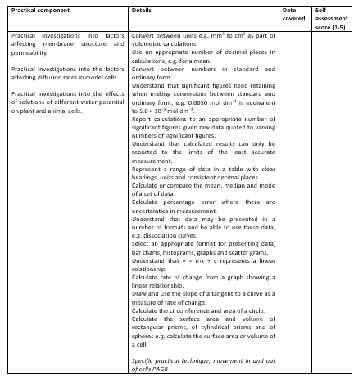
Learning Outcomes
Why does the colour leak out of cooked beetroot?
Investigate water potential of cells

Slide 2
Please note…
Records
As evidence for the Practical Endorsement:
Students should not need to re‐draft their work but rather keep all their notes as a continuing record of practical activity.
Students should:
  record the volumes used to make the serial dilution
  complete an appropriate results table with IV and DV in the correct places and all results recorded correctly
  draw a graph of percentage change in mass against concentration of sucrose solution (mol dm⁻³)
  In preparation for the indirect assessment of practical skills in the written examinations, and to help students develop their understanding of the underlying biological theory, students should answer the extension questions and ensure that their data are recorded appropriately, for example the correct format of tables, graphs, units and significant figures.
  All work should be clearly dated.

Slide 3
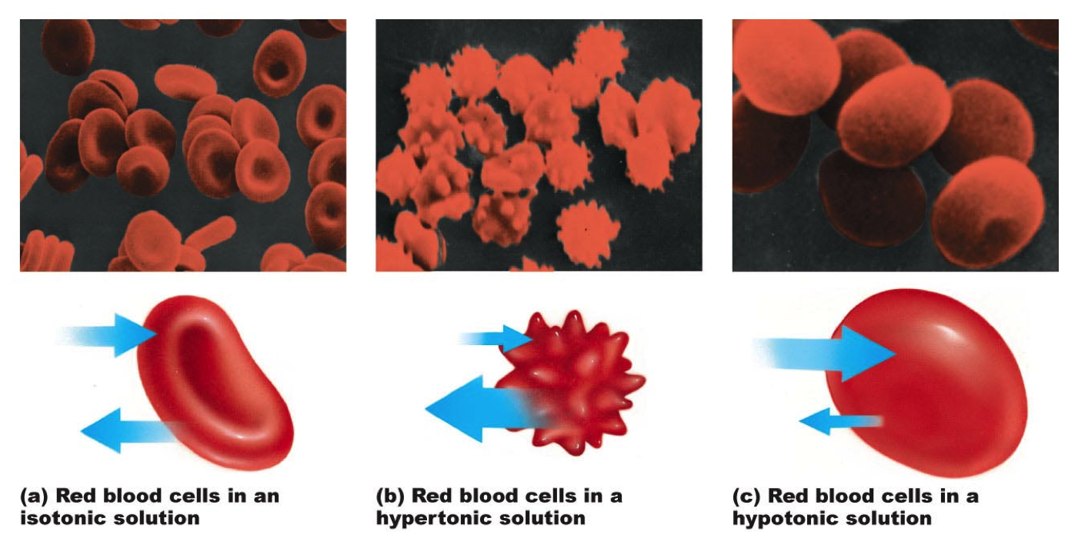
RECAP WITH PARTNER USING THE WORDS: WATER POTENTIAL / SHAPE OF CELL / HYPERTONIC HYPOTONIC

Slide 4
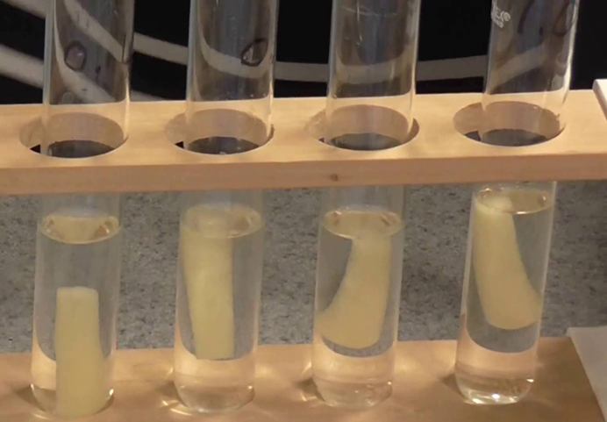
Serial dilution: You need to make the correct concentrations from 0.8mol dm⁻³

Slide 5

Creating your serial dilution
You have:
1mol dm⁻³
0.8mol dm⁻³
Water
Take 20cm³ of your stock 0.8mol and pour into the 20cm³ of distilled water
40cm³
20cm³
20cm³
20cm³
0.8mol dm⁻³
Each beaker must have 20cm³ of water

Slide 6
Serial dilution
You need to write the volumes transferred on you PAG sheet
You have:
1mol dm⁻³
0.8mol dm⁻³
Water
Take 20cm³ of your stock 0.8mol and pour into the 20cm³ of water
Repeat with another 20cm³
40cm³
20cm³
20cm³
20cm³
0.8mol dm⁻³
0.4mol dm⁻³
Each beaker must have 20cm³ of water
You need to write the volumes transferred on you PAG sheet

Slide 7
Serial dilution
You have:
1mol dm⁻³
0.8mol dm⁻³
Water
Take 20cm³ of your stock 0.8mol and pour into the 20cm³ of water
Repeat with another 20cm³
Repeat with another 20cm³
40cm³
20cm³
20cm³
20cm³
0.8mol dm⁻³
0.4mol dm⁻³
0.2mol dm⁻³
Each beaker must have 20cm³ of water

Slide 8
Serial dilution
You have:
1mol dm⁻³
0.8mol dm⁻³
Water
Take 20cm³ of your stock 0.8mol and pour into the 20cm³ of water
Repeat with another 20cm³
Repeat with another 20cm³
40cm³
20cm³
20cm³
20cm³
0.8mol dm⁻³
0.4mol dm⁻³
0.2mol dm⁻³
0.1mol dm⁻³
Each beaker must have 20cm³ of water
Remove 20cm³

Slide 9
Serial dilution
You have:
1mol dm⁻³
0.8mol dm⁻³
Water
Take 20cm³ of your stock 0.8mol and pour into the 20cm³ of water
Repeat with another 20cm³
Repeat with another 20cm³
20cm³
20cm³
20cm³
20cm³
0.8mol dm⁻³
0.4mol dm⁻³
0.2mol dm⁻³
0.1mol dm⁻³
Each beaker must have 20cm³ of water
Remove 20cm³
You also need 20cm³ of the 1mol dm⁻³ and 20cm³ of water

Slide 10
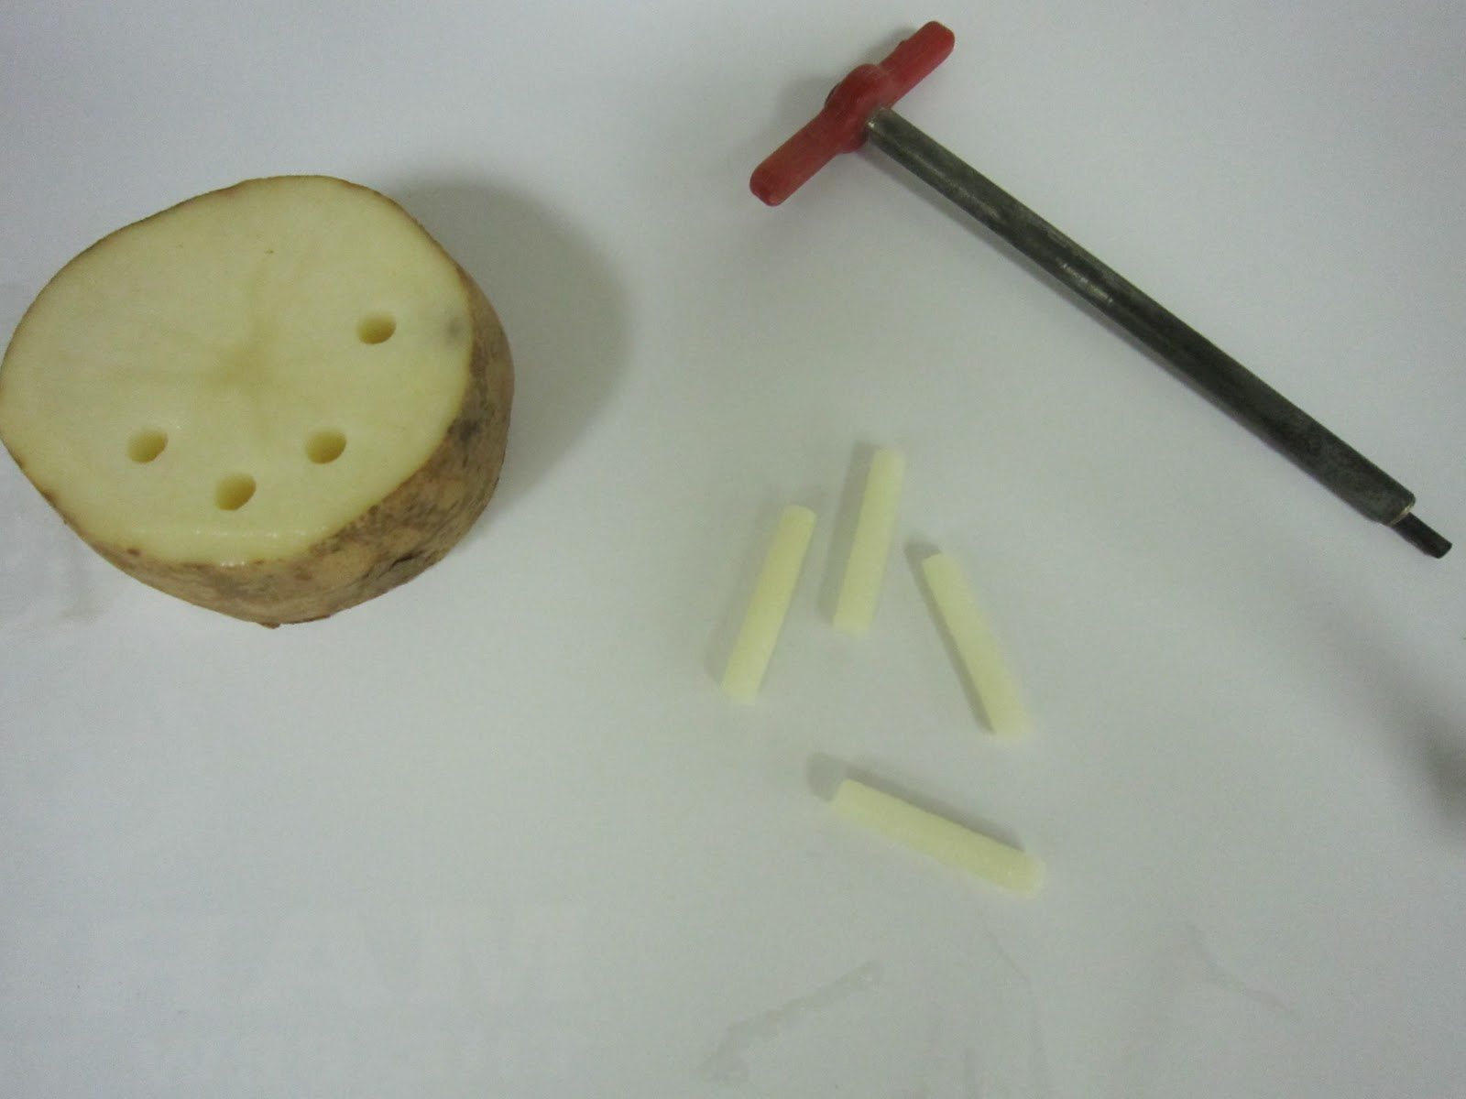
Serial dilution recap
All potatoes must be placed into each solution at the same time and removed at the same time!
Take photos as you go
You have 1M and 0.8M sucrose solution.
You must set up 6 test tubes each containing 20cm³:
1 = water
2 = 1M
3 = 0.8M
4 = 0.4M
5 = 0.2M
6 = 0.1M
Put 20cm³ of distilled water in 3 beakers.
Carefully measure 40cm³ of 0.8M into a fourth beaker.
Can you remember what happens next? If you feel confident go ahead, if you don’t ask!
Fill in the volumes on the method sheet.
Now begin your potato prep
Next complete the method up to step 7. Make sure you label your test tube racks so that you can recognize your investigation.
What should I consider with the potatoes?

Slide 11
Table – you need to draw this
Solution (M) | Potato starting mass (g) | Potato end mass (g) | Percentage change in mass
0
0.1
0.2
0.4
0.8
1
Why do we calculate the % change in mass?

Slide 12
Calculating % change in mass
Original mass of potato 1.7g. It is left in a concentrated sugar solution for 24 hours. Its new mass is 0.4g.
Calculate the % change in mass 2s.f (2 marks)
0.4 – 1.7 = -1.3g
-1.3 ÷ 1.7 x 100 = -76%
final mass – original mass = change in mass (may be negative or positive)
Change in mass ÷ original mass x 100 = % change in mass
A plant cells initial mass is 3.3g. Its new mass is 4.4g. Calculate the % change in mass 2s.f (2 marks)
4.4 – 3.3 = 1.1g
1.1 ÷ 3.3 x 100 = 33%

Slide 13
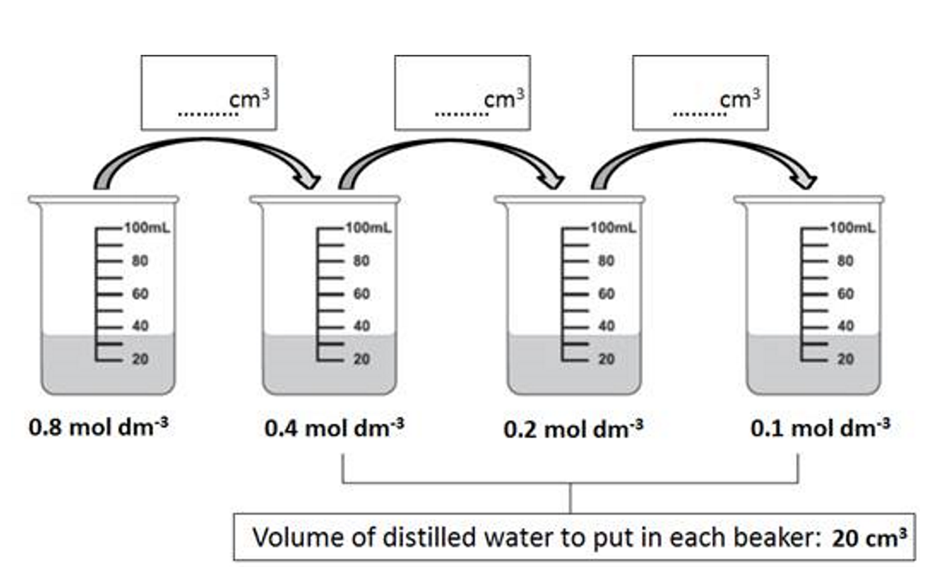
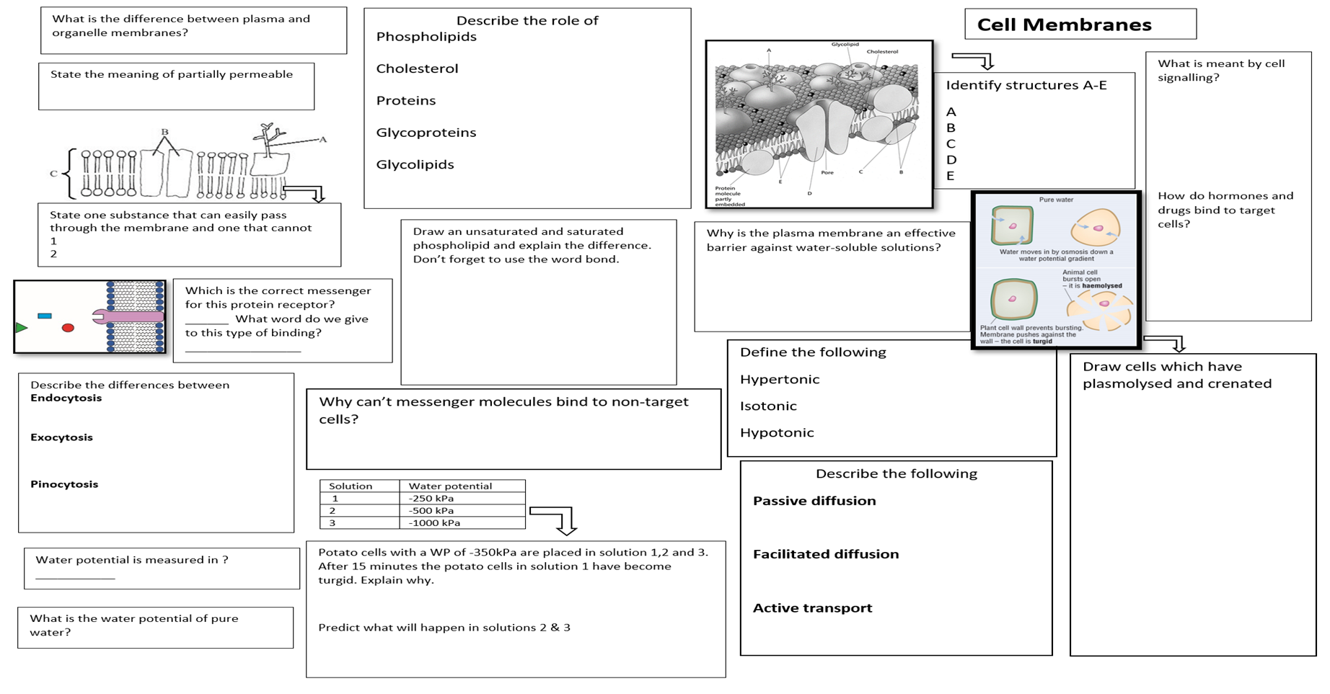
Complete any extension questions you can
When you finish today complete the “Knowledge organiser” found in the biological molecules section
Complete additional questions from previous lessons
Knowledge organiser

Slide 14
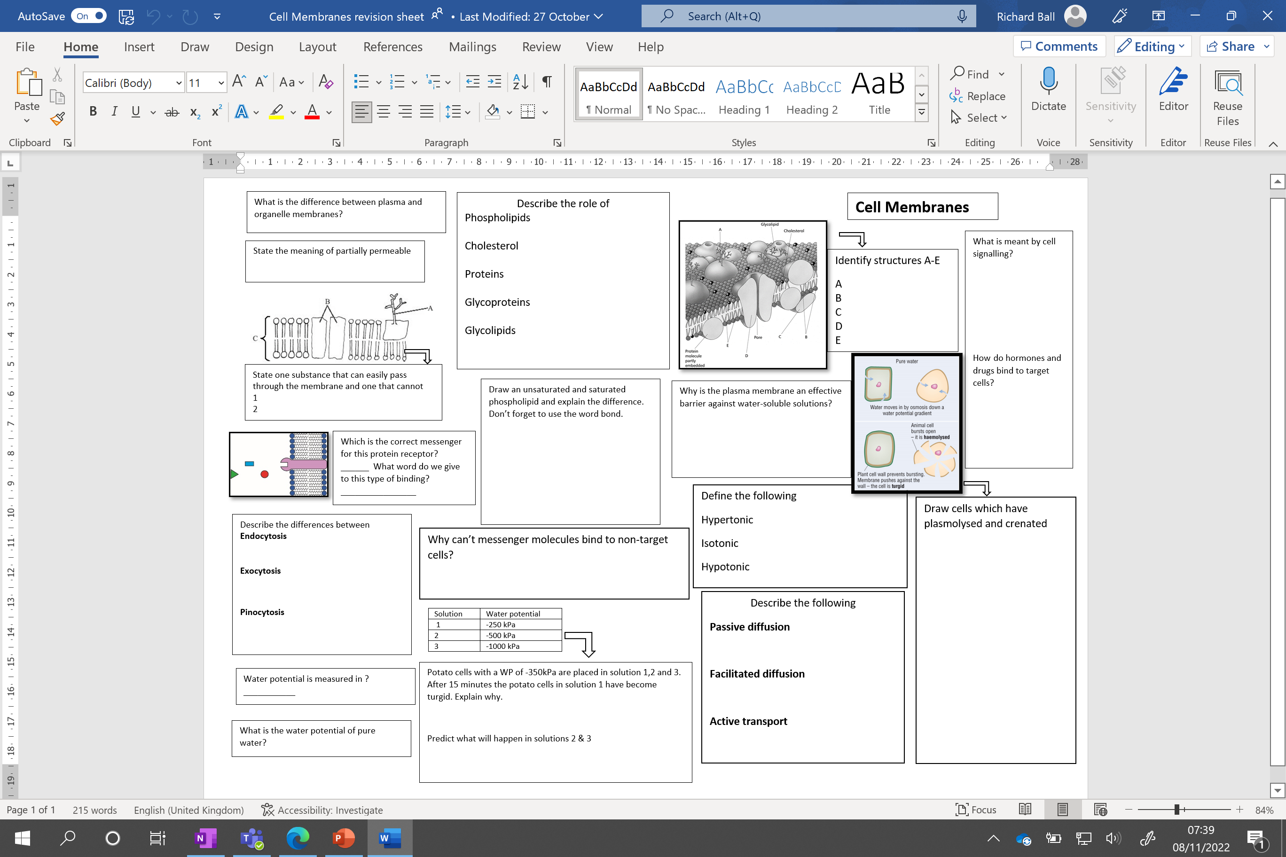

Slide 15
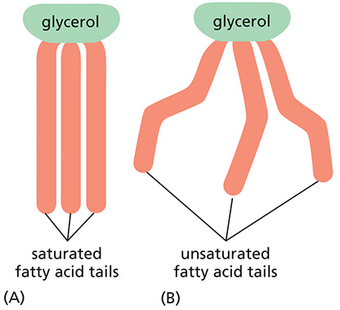
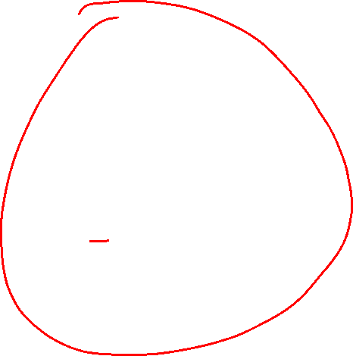
Saturated Vs unsaturated phospholipids

Slide 16
Learning Outcomes
Why does the colour leak out of cooked beetroot?
Investigate water potential of cells

Slide 17
Potato PAG (continued)
Tuesday, 22 July 2025

Slide 18
Learning Outcomes
Why does the colour leak out of cooked beetroot?
Investigate water potential of cells

Slide 19
Potato PAG continued
Complete PAG steps 9-11
Finish write up including extension questions
Check your Beetroot PAG and Potato PAG are completely finished ready for marking today
There is an “additional revision materials” folder found in the Potato PAG folder. Use these in the remaining time to prepare for your test on Friday.

Slide 20
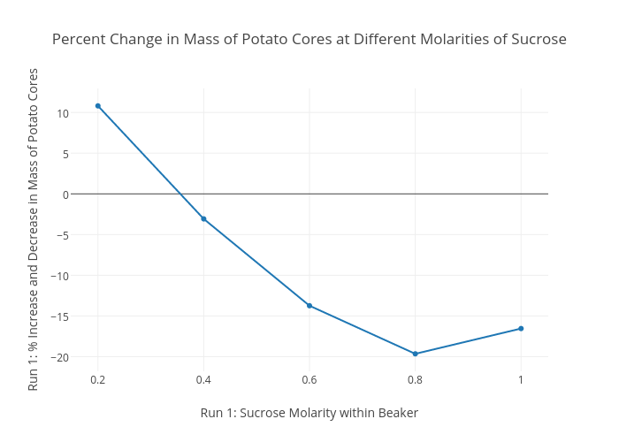
Example graph – yours may well not look like this – it doesn’t matter!

Slide 21
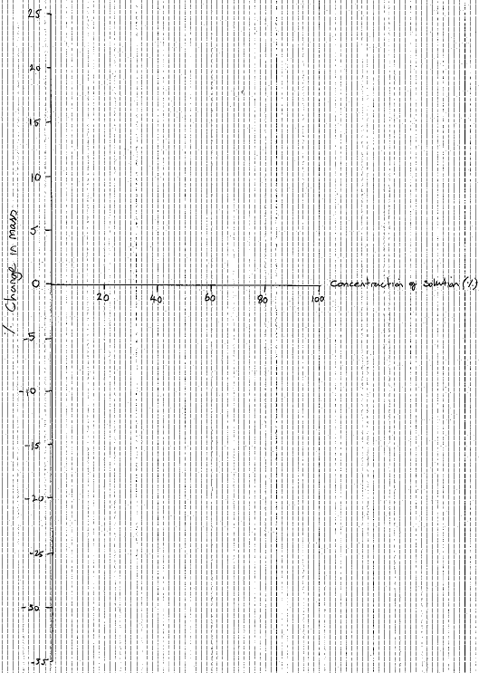

Slide 22
Extension questions
Why was it important to dry the chips and in the same way each time?
What was the purpose of placing the bungs in the tubes?
Why did you compare the percentage change in mass rather than simply the change in mass of each chip?
What are the limitations of this practical activity? What improvements could be made?

Slide 23
Extension questions
Why was it important to dry the chips and in the same way each time?
So that the mass of water on the outside of the chips does not affect the weighing of the chips.
What was the purpose of placing the bungs in the tubes?
Prevents evaporation of water.
Why did you compare the percentage change in mass rather than simply the change in mass of each chip?
To allow for variations in size of the chips, even though attempts were made to cut them to the same size.
What are the limitations of this practical activity? What improvements could be made?
Students’ ideas e.g. different parts of the potato may have different water potentials.

Slide 24
Risk | Hazard | Control
Sharp cutting tools | Chance of cutting hand | Cut towards the white tile

Slide 25
Buzzer quiz:
Which part of the membrane is involved in cell signaling?
Draw and label a phospholipid.
Which model describes the plasma membrane?
Which process removes hormones out of the cell?
Which units are used for water potential.
If a cell is in an hypertonic solution what will happen to it?
Which membrane component is needed for facilitated diffusion?
Name the membrane that surrounds the vacuole.
What is the role of cholesterol in the membrane?
If your cells are dehydrated how is this resolved?

Slide 26
Quick 10 Quiz
Name 3 bonds that secure the tertiary structure of a protein
Which 2 types of fibres are found in cellulose?
Name 2 places I would find chitin.
Which polymer is in the cell wall of prokaryotes?
What is a squamous ciliated epithelial cell?
Which stains are used to view:
  DNA, b) cytoplasm, c) lipids, d) cell walls
7. Name 3 organelles without membranes
8. What is water temperature a measure of?
9. Name 2 steroid hormones that are derived from cholesterol.
10. What is formed when glycogen is hydrolised?

Slide 27
Answers
Ionic, hydrogen, di-sulphide bridges
Microfibrils, macrofibrils
Exoskeletons of insects and crustaceans, cell wall of fungi
Peptidoglycan
A flattened (square shape) cell with cilia that lines the trachea
  a)acetic orcein b) eosin c) Sudan d) iodine
Centrioles, ribosomes, cytoskeleton, cell walls
Kinetic energy of water molecules
Testosterone, oestrogen
Alpha glucose molecules

