Slide 1
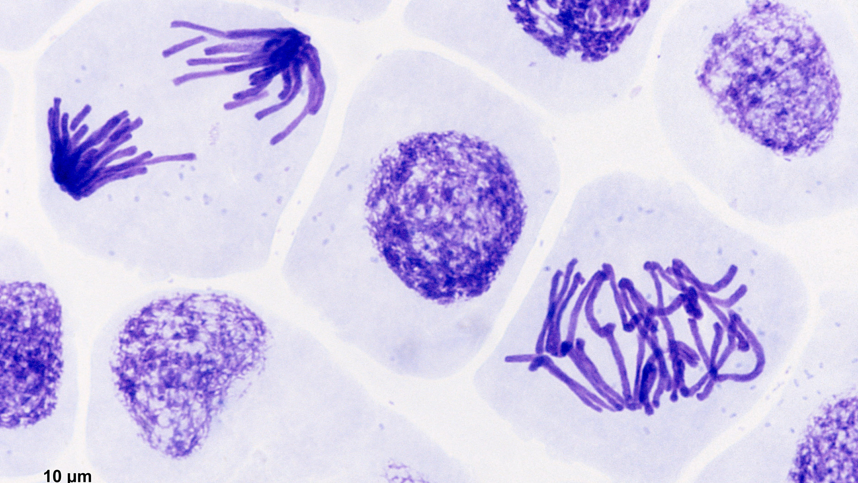
Root Tip Squash
Observing Mitosis

Slide 2
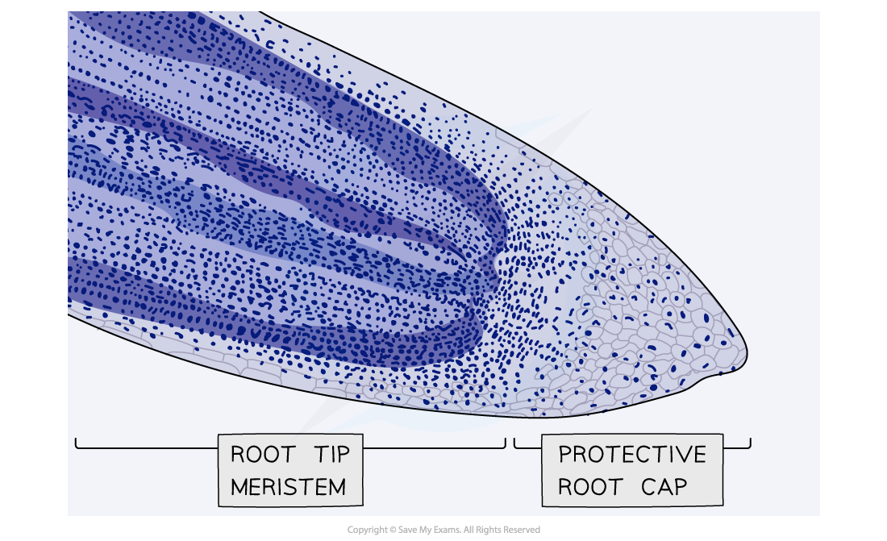
Observing Mitosis in garlic root tips
Complete step one to warm HCl
Garlic roots have actively dividing cells in the meristematic region near their tips.
Each cell has only eight chromosomes so it is relatively easy to see the chromosomes once they have condensed.
In order to see the chromosomes inside the cells, the cells must be separated and spread out into a layer that is ideally just one cell thick.
Plant cells are glued together by a middle lamella of pectins.
Heating in hydrochloric acid will break down these pectins, allowing the cells to be separated.
In this practical we will be staining the DNA using toluidine blue. An alternative stain is acetic orcein.

Slide 3

The procedure
Notes:
https://www.youtube.com/watch?v=56zjXZWMd7w&t=242s
https://www.saps.org.uk/teaching-resources/resources/1358/a-level-set-practicals-microscopy-of-root-tip-mitosis/

Slide 4
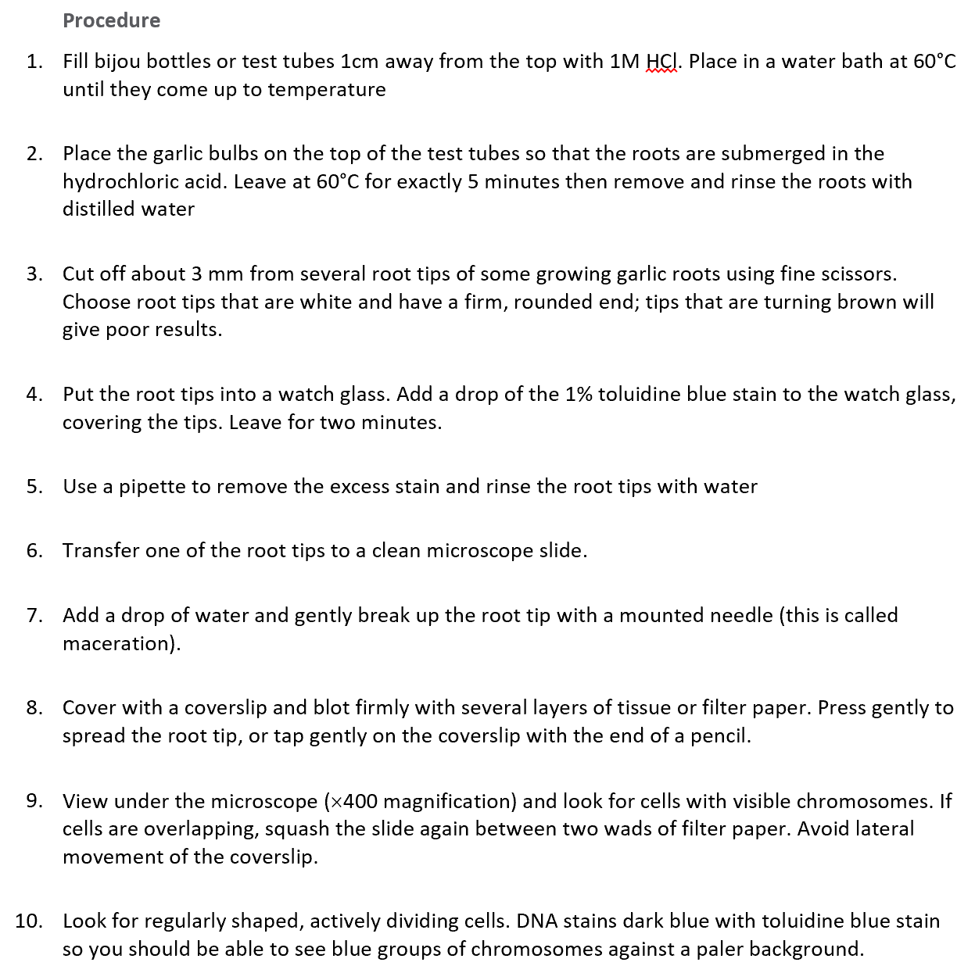
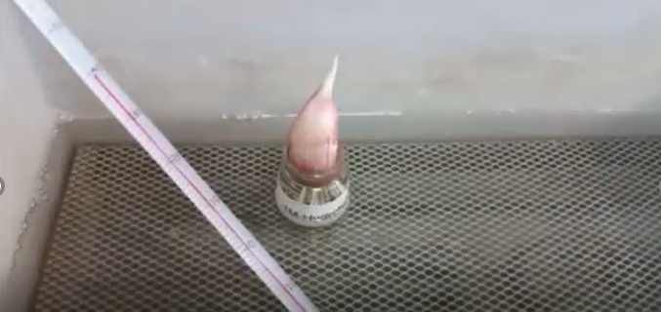
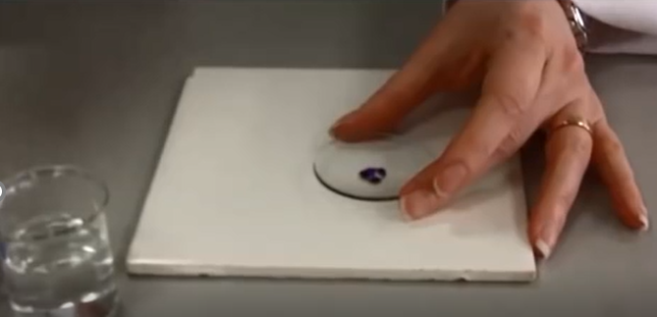
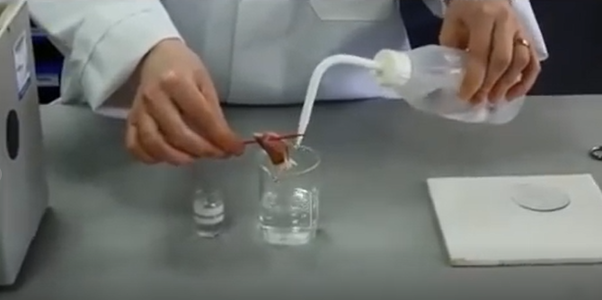
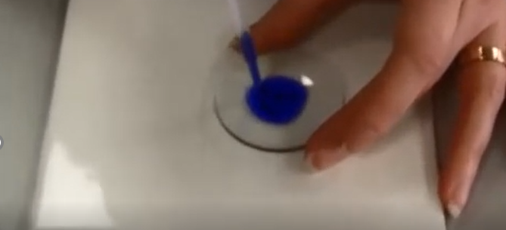
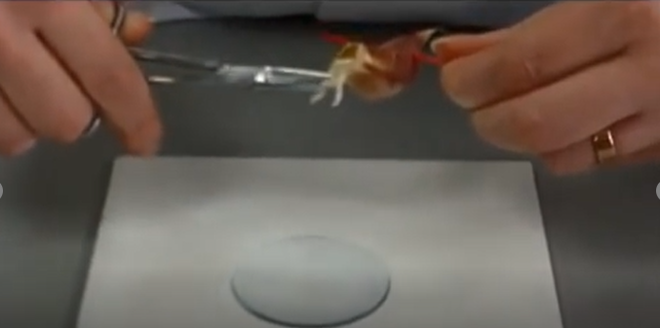
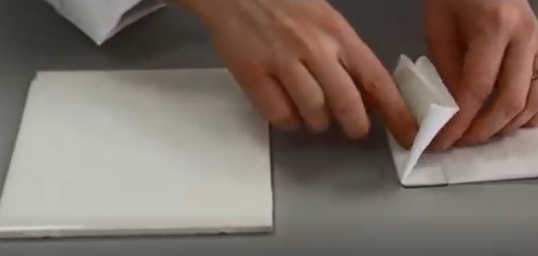

Slide 5
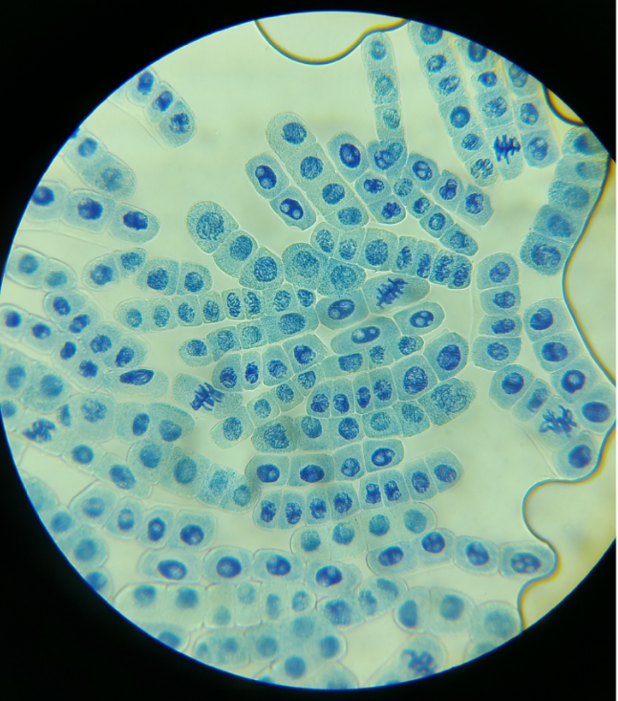
Identify cells in the following stages of mitosis: interphase, prophase, metaphase, anaphase and telophase.
Identify one cell to illustrate each stage. Annotate to describe what is happening.
Example Results:
Notes:
https://www.studocu.com/en-gb/document/kings-college-london/business-management/saps-root-tip-mitosis-for-a-level-set-practicals-teacher-notes/8192760

Slide 6
2 Count the number of cells in the area visible under the microscope when viewed at ×400 (the field of view). Count the number of cells in each stage of mitosis. Record your results in an appropriate table.
Stage of Mitosis | Number of Cells | Percentage of cells in the stage
(Interphase)
Prophase
Metaphase
Anaphase
Telophase
Notes:
https://www.studocu.com/en-gb/document/kings-college-london/business-management/saps-root-tip-mitosis-for-a-level-set-practicals-teacher-notes/8192760

Slide 7
3 Calculate the percentage of the cells in each stage of mitosis. Rank these values from highest to lowest. Given that your preparation freezes the process of mitosis at one point of time, what do these values suggest to you about the length of time a cell spends in each stage of mitosis? Explain how you arrive at your conclusion.
The longer a stage of mitosis lasts, the more likely a cell is to be in that stage at a particular moment in time.
Notes:
https://www.studocu.com/en-gb/document/kings-college-london/business-management/saps-root-tip-mitosis-for-a-level-set-practicals-teacher-notes/8192760

Slide 8

Why is mitotic index useful in cancer diagnosis?
4 If a group of cells is dividing rapidly, a high proportion of the cells will be undergoing mitosis. A group of cells that is not dividing will have all cells in interphase of the cell cycle. The amount of cell division occurring in a tissue can be quantified using the mitotic index. Using the formula below, calculate the mitotic index for your root tip. If you have time, compare this value with the mitotic index of an area of cells away from the tip and comment on your findings.
The mitotic index near the tip will be higher than that further along the root because of the higher rate of division in the apical meristem.
The mitotic index is useful in studies of cell division in many different types of tissues, for example in examining tumour growth in cancer patients. A very low index indicates uncontrolled cell division which could be malign.

