Slide 1

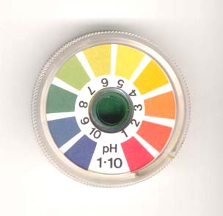
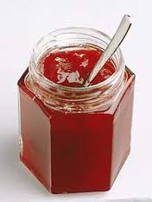
- j
Notes:
AMINO (JAM – IN – O WITHOUT A J) ACID
1

Slide 2
Links to the specification
The general structure of an amino acid
The synthesis and breakdown of dipeptides and polypeptides, by the formation and breakage of peptide bonds
The levels of protein structure

Slide 3
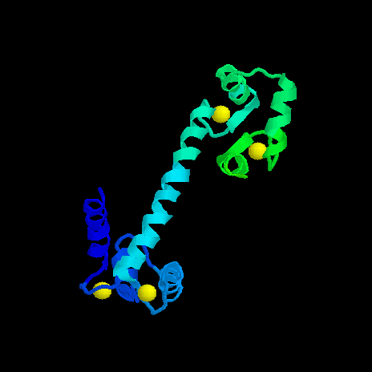
What are Proteins?
Proteins are organic molecules made of carbon, hydrogen, oxygen and nitrogen. They sometimes also contain sulphur and may form complexes with other molecules.
Proteins are made of small units called amino acids. These link together by peptide bonds to form chains of polypeptides.

Slide 4
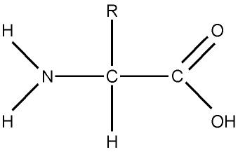
Amino Acids
There are twenty different amino acids, but they all have the general formula NH₂.RCH.COOH
They all have an amino group
(basic)
They all have a carboxyl group
(acidic)
The ‘R’ group differs between amino acids. It is always bonded to a C-H

Slide 5
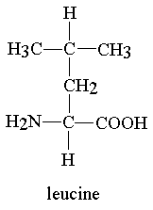
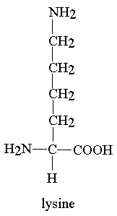
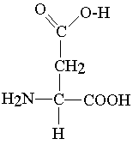
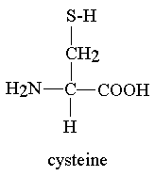
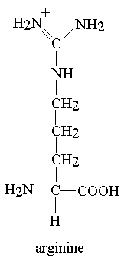
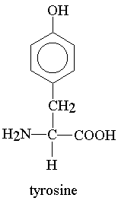
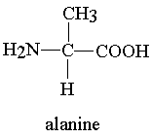
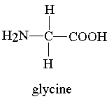
Identify the amino, carboxyl and ‘R’ groups on the following amino acids, use a key and highlight your sheet:
Amino acids have hydrophilic and hydrophobic parts. Which part is which and why?
Amino group and carboxyl group are polar, R group is non-polar

Slide 6
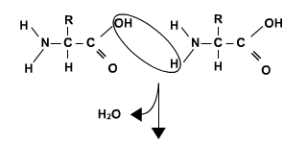
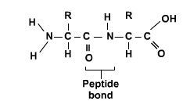
Peptide Bonds:
How do amino acids join together?
Two amino acids link together to form a dipeptide. When more amino acids are linked together, a polypeptide is formed. This is catalysed by peptidyl transferase in the ribosomes.
Use the information given to try and draw out 2 amino acids linked by a peptide bond
This reaction produces water? What type of reaction is it?
animation

Slide 7
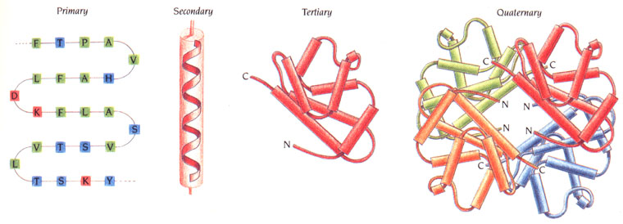
Protein Structure
http://www.youtube.com/watch?v=lijQ3a8yUYQ
http://www.youtube.com/watch?v=eor6EK_JP40&feature=fvwrel
Now find out:
a) what the primary, secondary, tertiary and quaternary structures of proteins are
b) For each of the above, what type of bonding is involved in creating and maintaining the structures
Present this information in a table.

Slide 8
Level of Structure | Description | Bonding involved
Primary | Specific sequence of amino acids forming a polypeptide chain | Peptide bonding
Secondary | Shape the polypeptide folds into; an alpha helix or beta pleated sheet (non-specific) | O H and N interact forming Hydrogen bonding
Tertiary | Caused by interactions between R groups which leads to bending and twisting of the secondary structure into a specific 3D shape | Disulphide (between sulphurs on R groups) Hydrogen and ionic bonds Hydrophillic and hydrophobic interactions
Quaternary | Combinations of 2 or more subunits of different polypeptide chains and associated non-protein groups | As above

Slide 9
Homework
Complete snab activity sheet 2.6

Slide 10
(d) Proteins are polymers of amino acids joined by peptide bonds formed between the: (1)
A R groups
B R group and the amino group
C R group and the carboxyl group
D carboxyl group and the amino group
(e) The three-dimensional structure of a protein is held together by:
(1)
A peptide, hydrogen and ionic bonds
B hydrogen, ester and ionic bonds
C disulphide bridges and ester bonds
D disulphide bridges, hydrogen and ionic bonds
2. Alpha keratin, a protein found in sheep's wool, is primarily composed of alpha-helices. Explain why alpha keratin has a more regular structure than the quaternary protein haemoglobin. (3)

