Slide 1
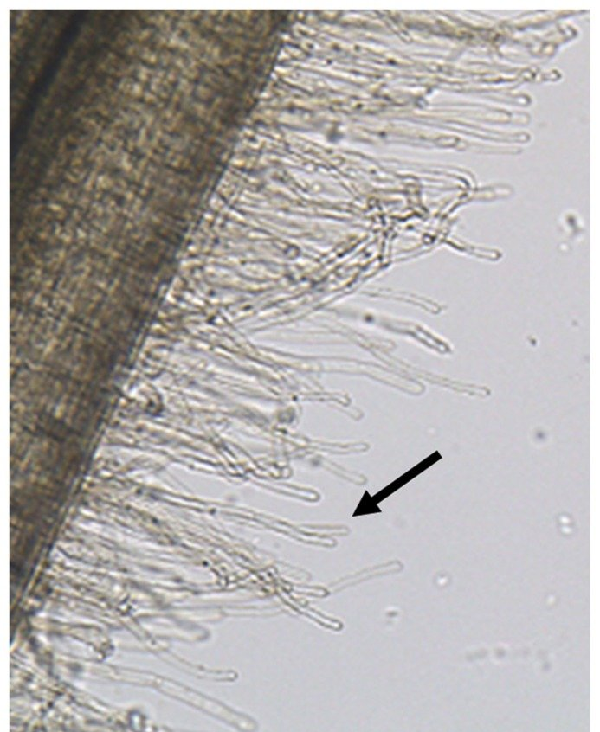
How to attempt method questions
Please open the PAG1.2 PPt and attempt the question below on the PPt
Explain how you would attempt to measure the average size of a root hair in a prepared temporary mount of root cells (5)

Slide 2

MS
Calibrate eyepiece graticule using stage micrometer (at each magnification)
Get root hair cells in focus using coarse/fine focussing knobs
Measure the length of a root hair cell using the graticule
Complete multiple times for multiple root hair cells
Use data to calculate an average (mean) length of a root hair cell

Slide 3
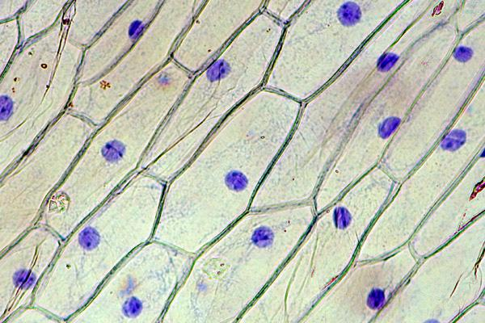
Assessment question
Describe how to use a micrometer and graticule to determine how many times bigger a drawing is than an actual cell in a blood smear. (4)

Slide 4
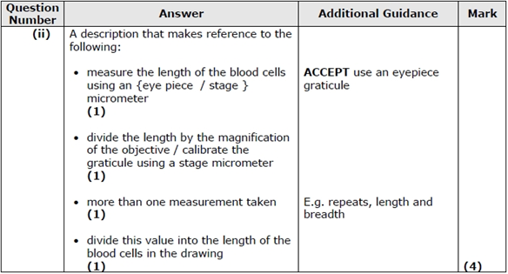

Slide 5
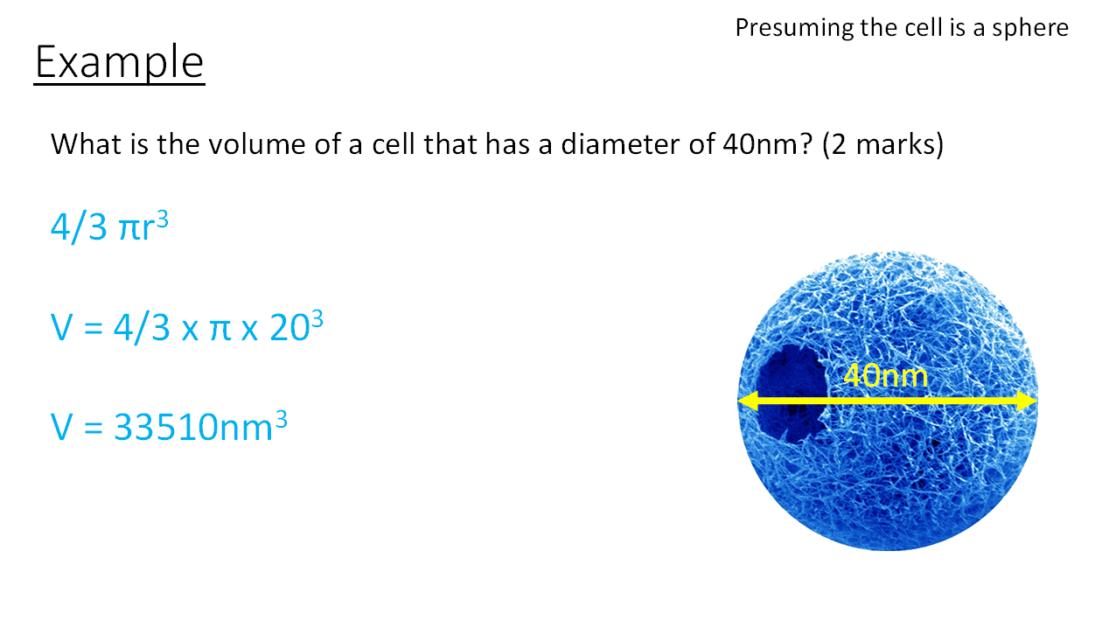

Slide 6


Slide 7
To calibrate a light microscope using an eyepiece graticule and stage micrometre. Producing a table (showing calculations) for each magnification x40, x100, x400

Slide 8
Example table – first one together
Eyepiece magnification | Objective lens magnification | Total magnification | 1 e.p.u (um)
x10 | x4 | x40
Show calculations for each calibration below your table

Slide 9
Example table
Eyepiece magnification | Objective lens magnification | Total magnification | 1 e.p.u (um)
x10 | x4 | x40 | 25
X10 | x10 | x100 | 10
x10 | x40 | x400 | 2.5
Show calculations for each calibration below your table

Slide 10
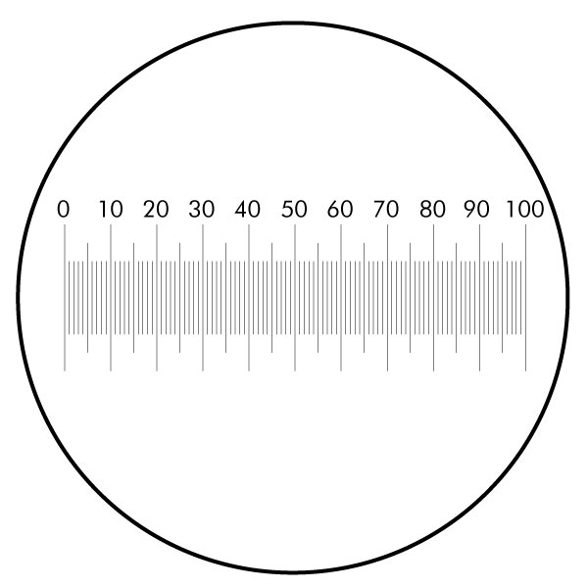
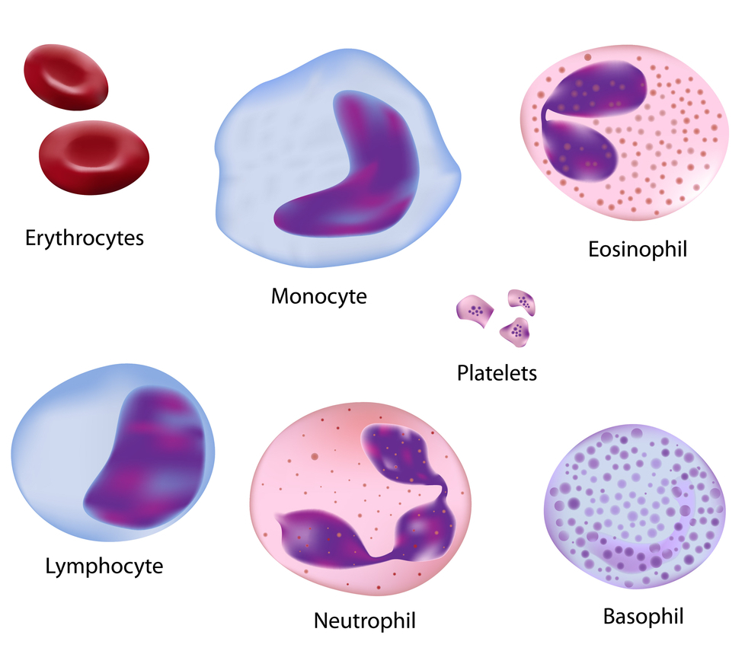
Determine the size of the cell using your calibration at 400x in um.

Slide 11
Take the stage micrometer away and use your values to determine actual sizes of cells
At x400 1 e.p.u is equal to 2.5um
So the cell is 19 e.p.u across
To calculate the actual size of the cell
19 x 2.5 = 47.5um

Slide 12
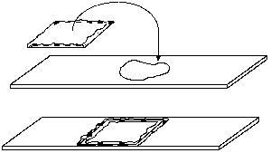
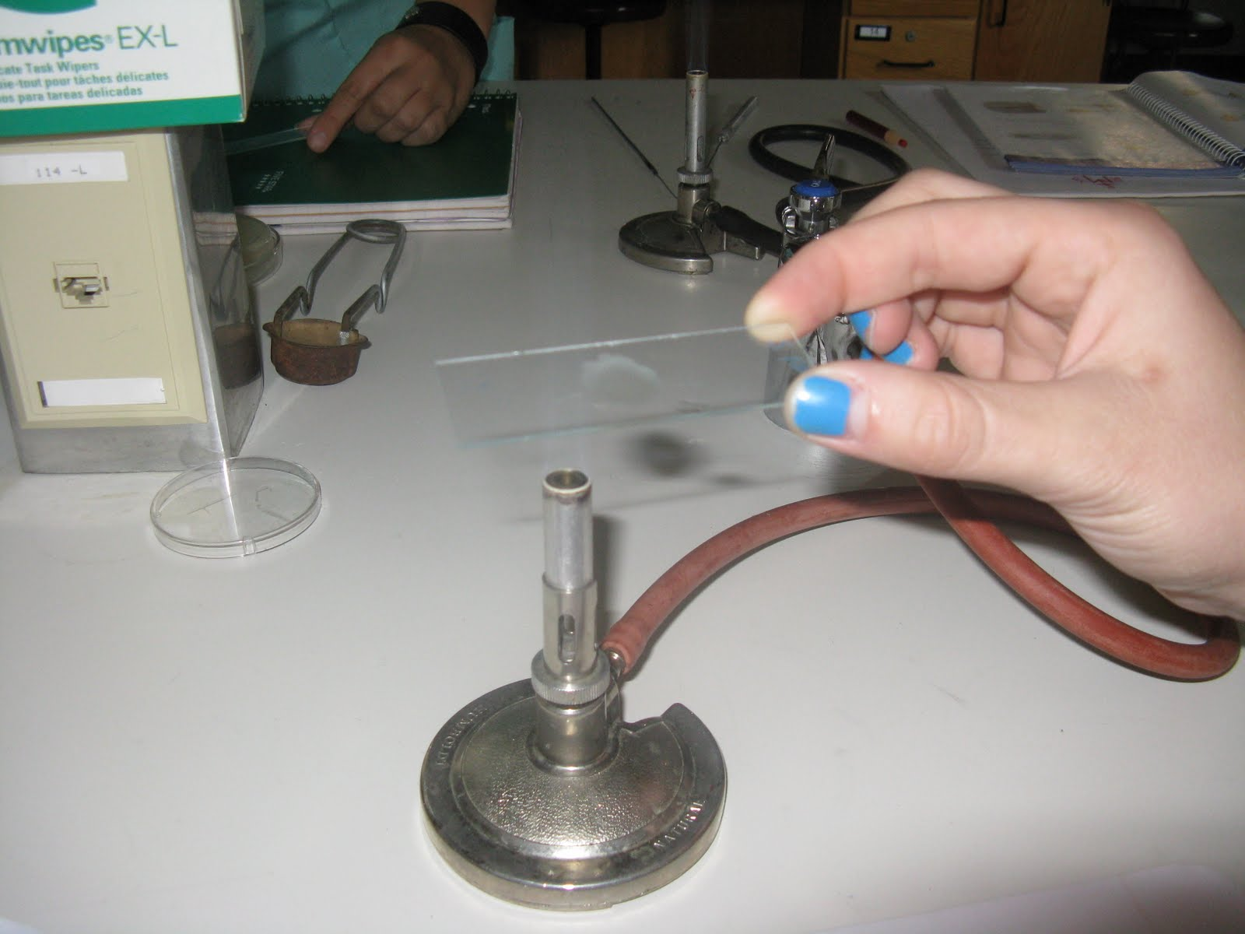
Preparing a slide
Wet-mounting is the technique you will have used for preparing a slide already.
Water is dropped on to a slide and the specimen is placed on to the slide
The second method of preparing specimens for light microscopy is fixation.
Fixation is often achieved either by heating (heat fixing) or chemically treating the specimen.
In addition to attaching the specimen to the slide, fixation also kills microorganisms in the specimen, stopping their movement and metabolism while preserving the integrity of their cellular components for observation.

Slide 13
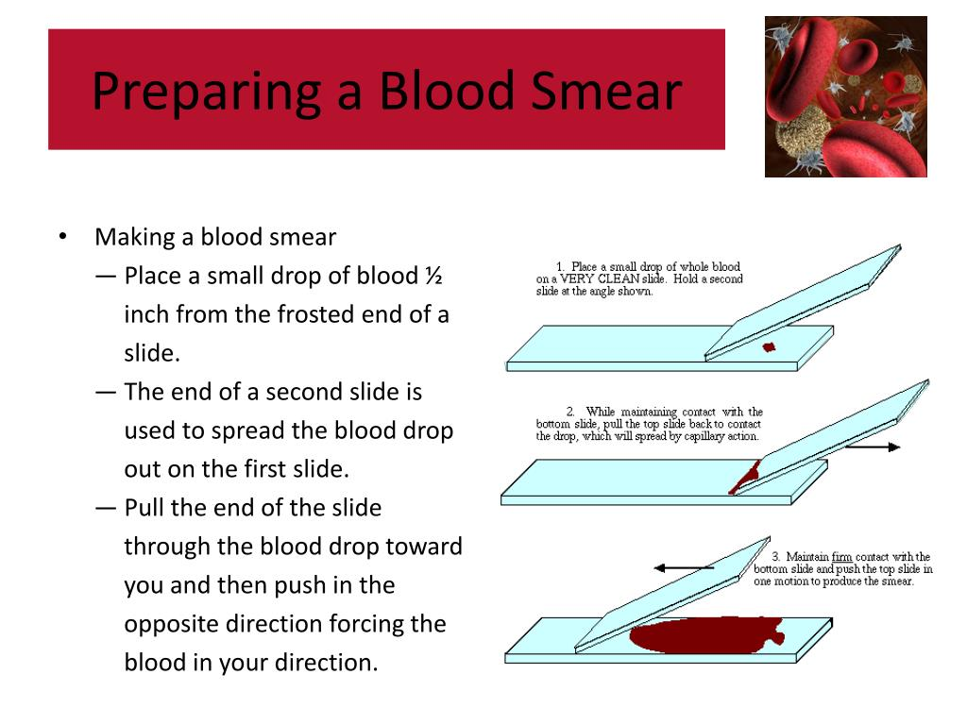

Slide 14
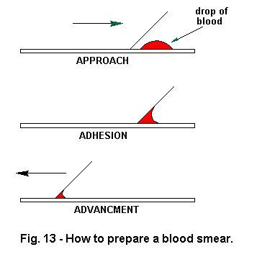
We have done this for you!

Slide 15
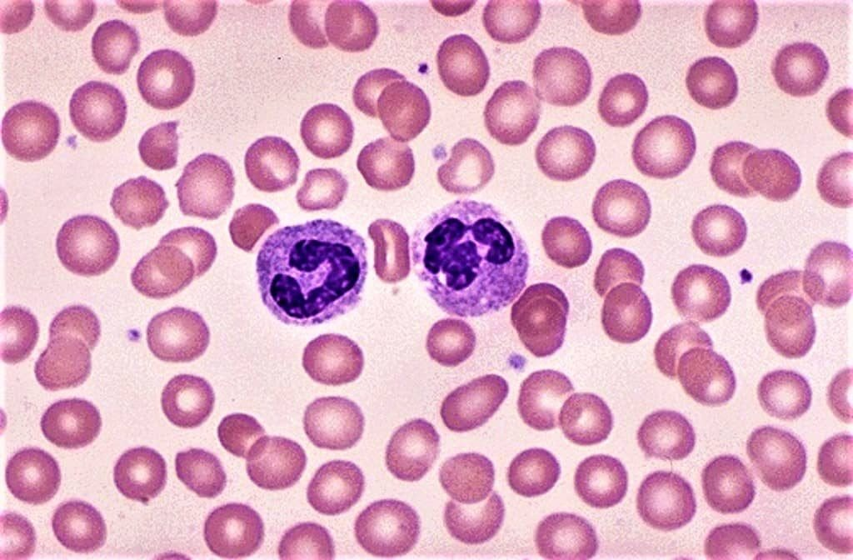
Leishman Stain is a stain for blood smears which was devised by the British surgeon W. B. Leishman (1865–1926).
It consists of a mixture of eosin (an acidic stain), and Methylene blue (a basic stain) in Methyl alcohol and is usually diluted and buffered during the staining procedure.
It stains the different components of blood in a range of shades between red and blue.

Slide 16

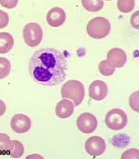
PAG 1.2
The examination and drawing of blood cells observed in blood smears

Slide 17
PAG rules
All work must be dated.
You must have successfully completed each practical task by the end of year 13, there will be several opportunities to meet each objective, it does not matter if you don’t pass them all at the beginning.
Carefully follow the instructions in the PAG sheets to make sure you complete each criteria.
Answer the ‘extension’ questions on every PAG.
Anything incomplete will be returned to be improved.

Slide 18
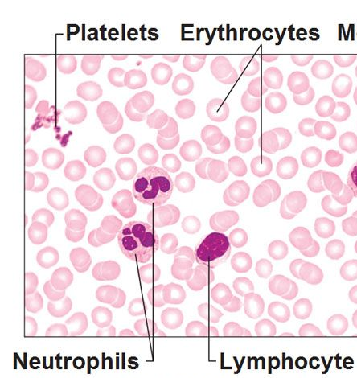
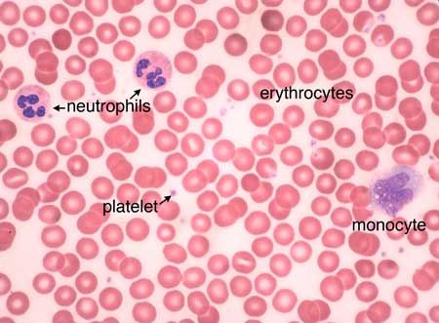

Slide 19
Erythrocytes (red blood cells) – red
Thrombocytes (platelets) – purple grains (so small they will be difficult to see even at high power)
Lymphocytes – very dark nuclei (purple or dark blue) and light blue cytoplasm
Neutrophils – dark purple nuclei, pale pink cytoplasm
Eosinophils – blue nuclei, pale pink cytoplasm, red granules within the cytoplasm (these cells are rare and you will probably not see any examples in your sample)
Basophils – dark blue nuclei, very dark granules in the cytoplasm (these cells are rare and you will probably not see any examples in your sample)

Slide 20
Drawing a diagram
ON PLAIN PAPER AND UPLOADED
Sharp pencil.
No shading or colour
Date, magnification, title (with biological name if appropriate), scale bar.
Horizontal label lines drawn with a ruler.
Labels with biological annotations regarding function
No sketching. Drawing lines are clear and continuous.
Diagram is an accurate representation of what you have seen.

Slide 21
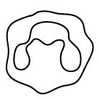
TEXT MUST BE JUSTIFIED
25um
Name and description
Scale
80mm = 25um
Name and description
Name and description
Magnification : X400

Slide 22
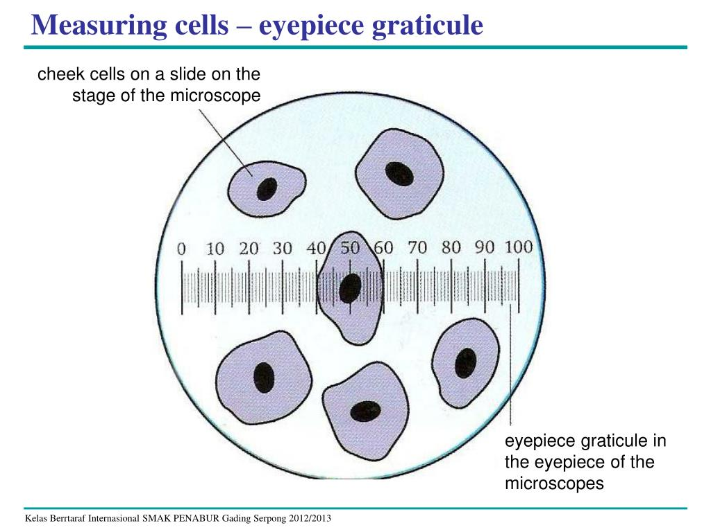
Producing a scale bar
Look through eyepiece and record number of e.g.u the length of the cell is.
Example
Width of cell is 1 e.p.u
You calculated that 1 e.p.u at x400 is equal to 25um
Draw your cell in lab book (any reasonable size)
Measure cells width you drew
Example
If the cell you drew was 80mm across
Scale bar 80mm = 25um
25um

Slide 23
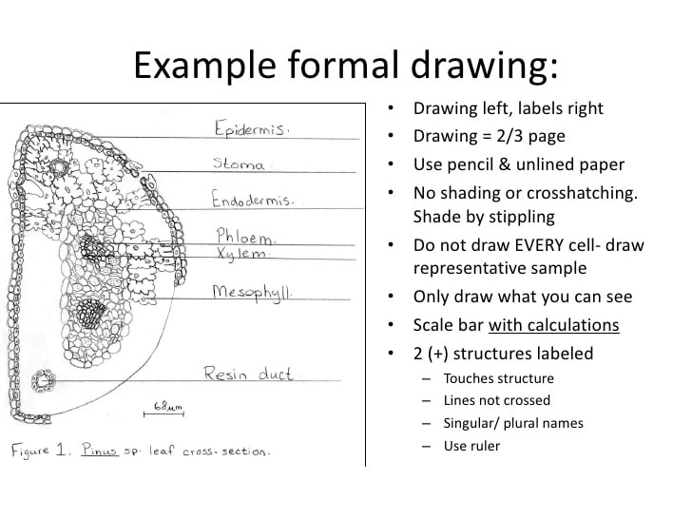

Slide 24
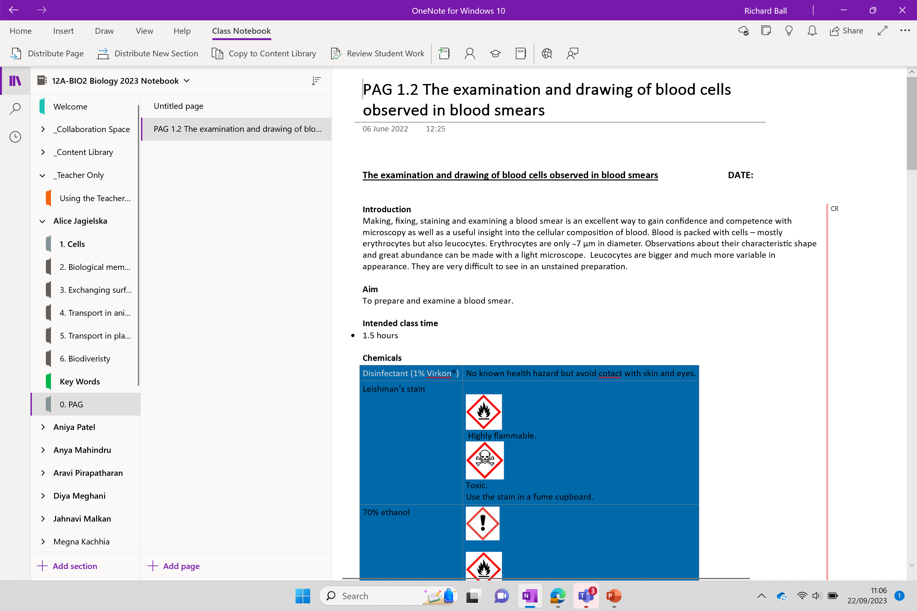
OPEN THE PAG 1.2 IN YOU 0.PAG SECTION

Slide 25
PAG 1.2 – Microscopy (to be completed in PAG team)
Complete the calibration table to calculate the value for 1epg unit at each magnification, with calculations below table
Place your blood smear under the highest magnification
To produce a scientific drawing of a Neutrophil (WBC) and Erythrocyte (RBC) cell at x400 magnification. This must include an accurate scale bar. Drawings should be on plain paper with x400 magnification written below. Take up half a page and have an accurate scale bar (See drawing a diagram and producing a scale bar in notebook)
Answer all PAG questions. You can use your device to research any answers you are unsure of.
When you finish, attempt the additional questions at the end of next lesson. End of unit test: Friday 29th (cells unit)

Slide 27
Extension question answers below

Slide 28
Q1.
Yes, students could use their own blood.
Their proposed precautions should include measures to ensure that the puncture wound from which they extract their own blood does not become infected
(pre- and post-swabbing with ethanol, covering with a sterile dressing) and measures to ensure that nobody else is contaminated with their blood (students work only with their own blood, all materials disposed of in bleach, good general hygiene e.g. handwashing).

Slide 29
Q2.
Serial dilution Definition
what is the volume of the drop they added to the slide?,
how can they work out what fraction of that volume they are seeing in any one field of view?,
what is the nature of the ‘wedge’ of blood they have created by smearing (how much thicker is the start than the end)?
5 billion (5 x 109 ) erythrocytes per cm3 is probably close to the truth.
Serial dilution, as the name suggests, is a series of sequential dilutions that are performed to convert a dense solution into a more usable concentration..
In biology, serial dilution is often associated with reducing the concentration of cells in a culture to simplify the operation.

Slide 30
Q3.
If the calculated diameter is 7 µm the volume of a spherical cell would be 180 µm³
4/3 π r³
4/3 x 3.14 x 3.5² = 180um³

Slide 31
Q4.
Erythrocytes – carry and deliver oxygen (from lungs to tissues) and carbon dioxide (from tissues to lungs)
Thrombocytes – blood clotting
Lymphocytes – specific immunity
Neutrophils – non-specific immunity (phagocytosis of pathogens)
Eosinophils – inflammation and response to parasites
Basophils – inflammatory response.

Slide 32
Homework
Complete PAG
Table + calculations
Scientific drawing with labels, and scale bar
Extension questions (Just note areas of uncertainty for Q2 – don’t spend too long on this one!)
Revise for test on Friday. Revision PPt and mark scheme in resource folder

Slide 33
Answers to Extension Questions
Could you use a sample of your own blood for this practical? What precautions would you need to take if you did?
Yes, students could use their own blood. Their proposed precautions should include measures to ensure that the puncture wound from which they extract their own blood does not become infected (pre- and post-swabbing with ethanol, covering with a sterile dressing) and measures to ensure that nobody else is contaminated with their blood (students work only with their own blood, all materials disposed of in bleach, good general hygiene e.g. handwashing).
Make an estimate of the concentration of erythrocytes in this sample of blood. What facts do you need to produce this estimate? How accurately can you gauge each of these things? What do you judge to be the uncertainty in this estimate? How would you go about making a more accurate measurement and what additional apparatus would you need?
The way students deal with the uncertainty here is as interesting as the actual ‘right’ answer. They are being asked to pile estimates on top of estimates to get to a number – what is the volume of the drop they added to the slide?, how can they work out what fraction of that volume they are seeing in any one field of view?, what is the nature of the ‘wedge’ of blood they have created by smearing (how much thicker is the start than the end)? 5 billion (5 x 10⁹) erythrocytes per cm³ is probably close to the truth. A haemocytometer would of course be the ideal way to get an accurate measurement and this in turn brings in the concept of serial dilution (students should realise from this practical that the concentration is going to be too high to easily count the cells in ‘neat’ blood – so dilution or smearing is required).

Slide 34
3. Using your calculation of the diameter of a typical erythrocyte, and assuming these cells are spherical, what is the volume of a typical erythrocyte? Given what you know about the shape of erythrocytes do you think this is likely to be an over-estimate or an under-estimate?
Check the student’s calculation of diameter to allow ‘error carried forward’.
If the calculated diameter is 7 µm the volume of a spherical cell would be 180 µm³ or 1.8 x 10⁻¹⁶ m³.
Given their biconcave shape the true volume of erythrocytes will be considerably lower.
4. What are the functions of the various different cell types you have identified in the sample?
Erythrocytes – carry and deliver oxygen (from lungs to tissues) and carbon dioxide (from tissues to lungs)
Thrombocytes – blood clotting
Lymphocytes – specific immunity
Neutrophils – non-specific immunity (phagocytosis of pathogens)
Eosinophils – inflammation and response to parasites
Basophils – inflammatory response.

