Slide 1
True or False?
Examine lines 3 to 8 are the outputs True of False
1 2 3 4 5 6 7 8 | a=2 b=3 print(a==b) print(a<=b) print(a<b) print(a>b) print(a>=b) print(a!=b)
Operator | Meaning
> | Greater than
< | Less than
<= | Less than or equal to
>= | Greater than or equal to
== | Equal to (the same as)
!= | Not equal to

Slide 2
Relational and Boolean operators

Slide 3
Learning objectives
Use relational operators
Use Boolean operators to combine expressions

Slide 4
Relational Operators
We often need to compare one value with another determine whether it is smaller, larger or the same size. For this, we use relational operators.
Logical operators return only one of two values: True (1) or False (0)
Operator | Meaning
> | Greater than
< | Less than
<= | Less than or equal to
>= | Greater than or equal to
== | Equal to (the same as)
!= | Not equal to

Slide 5
Run, Investigate and Modify
1 2 3 4 5 6 7 8 | a=2 b=3 print(a==b) print(a<=b) print(a<b) print(a>b) print(a>=b) print(a!=b)
Write up the code and run.
Does it output what you expected?
Change the value of the variables a and b to both be 5.
Swap the values of a and b, so that a=3 and b=2
What happens now when you run the code?

Slide 6
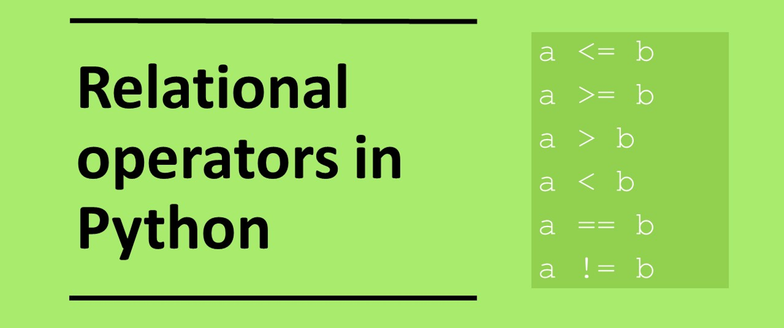

Slide 7
Relational operators
Write in the boxes whether the answer is true or false.
A | B | A<B | A<=B | A>B | A>=B | A==B | A!=B
7 | 6
8 | 10
12 | 12

Slide 8
Relational operators
Write in the boxes whether the answer is true or false.
A | B | A<B | A<=B | A>B | A>=B | A==B | A!=B
7 | 6 | False | False | True | True | False | True
8 | 10 | True | True | False | False | False | True
12 | 12 | False | True | False | True | True | False

Slide 9
Relational operators on strings
Relational operators can be applied to strings and compared based on their alphabetic position or more strictly their ASCII value
animal = “aardvark” < “zebra”
print(animal)
>> True
“aardvark” come before “zebra” alphabetically therefore it has a lower value so the expression is true
"A" < "a“
>> True
The ASCII value for “A” is 65 and the value for “a” is 97
“catalogue" < “catfish“
>> True

Slide 10
Relational operators on strings: True or False
Write in the boxes whether the answer is true or false.
“a” < “b”
“Platypus” < “Komodo”
a = “mouse” b = “frog” a > b
password=“abc123” password==“abc123”
“Ukraine” > “ukraine”

Slide 11
Relational operators on strings: True or False
Write in the boxes whether the answer is true or false.
“a” < “b” | True
“Platypus” < “Komodo” | False
a = “mouse” b = “frog” a > b | True
password=“abc123” password==“abc123” | True
“Ukraine” > “ukraine” | False

Slide 12
Boolean operators
As with relational operators Boolean operators return only one of two values: true (1) or false (0).
Boolean operators are often used in conjunction with relational operators.
Operator | Meaning
AND | Used for combining pairs of expressions. Returns true when both expressions are true otherwise returns false
OR | Used for combining pairs of expressions. Returns true when either of the expressions are true
NOT | Returns true when an expression is false, otherwise returns false. ie reverses the outcome of an expression.
XOR | Exclusive OR. Returns true only when one of the inputs is true.

Slide 13
Boolean operators
Expression 1 | Expression 2 | AND
True | True | True
True | False | False
False | True | False
False | False | False
Expression 1 | Expression 2 | OR
True | True | True
True | False | True
False | True | True
False | False | False
Expression | NOT
True | False
False | True
Expression 1 | Expression 2 | XOR
True | True | False
True | False | True
False | True | True
False | False | False

Slide 14
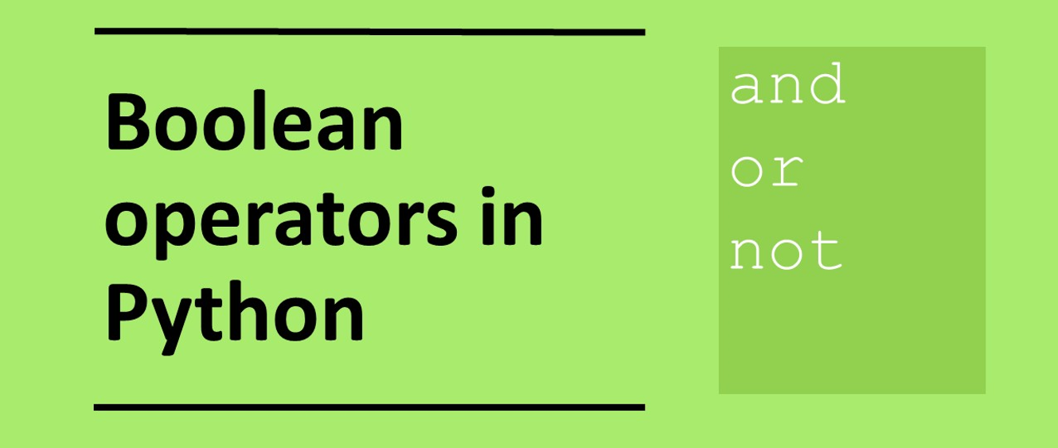

Slide 15
Worked example 1
print((9 > 6) and (2<=1))
Because the operator is and both the expressions must be true for the overall expression to be true
Expression 1 is True
Expression 2 is False
Expression 1 | Expression 2 | AND | XOR | OR
True | True | True | False | True
True | False | False | True | True
False | True | False | True | True
False | False | False | False | False
Expression | NOT
True | False
False | True

Slide 16
Worked example 2
print(not(9 > 6)))
The expression 9>6 is True but the not operator is applied it, so this reverses the output to False
Expression is True
Expression 1 | Expression 2 | AND | XOR | OR
True | True | True | False | True
True | False | False | True | True
False | True | False | True | True
False | False | False | False | False
Expression | NOT
True | False
False | True

Slide 17
Are the outputs True or False?
1 2 3 4 5 6 7 8 | a = 7 > 6 b = 2 < 3 print(a and b) print((9 == 6) and (9 < 10)) print((9 == 6) or (9 < 10)) print((7 <= 8) or (2 < 3)) print(not (2>=3)) print(not(3>2)) x = 7 < 6 y = 9 < 3 print(not(x or y)) print((12 // 3) < (7 % 2))
9 10 11 12 | print((9 % 3) <= (3 // 6)) # ^ means XOR print((7 <= 8) ^ (2 < 3)) print((9 == 6) ^ (9 < 10)) “bananas” > “biscuits”
Expression | NOT
True | False
False | True
Expression 1 | Expression 2 | AND | XOR | OR
True | True | True | False | True
True | False | False | True | True
False | True | False | True | True
False | False | False | False | False

Slide 18
Answers: Are the outputs True or False?
1 2 3 4 5 6 7 8 | a = 7 > 6 b = 2 < 3 print(a and b) print((9 == 6) and (9 < 10)) print((9 == 6) or (9 < 10)) print((7 <= 8) or (2 < 3)) print(not (2>=3)) print(not(3>2)) x = 7 < 6 y = 9 < 3 print(not(x or y)) print((12 // 3) < (7 % 2))
True False True True True False True False
9 10 11 12 | print((9 % 3) <= (3 // 6)) # ^ means XOR print((7 <= 8) ^ (2 < 3)) print((9 == 6) ^ (9 < 10)) “bananas” > “biscuits”
True False True False

Slide 19
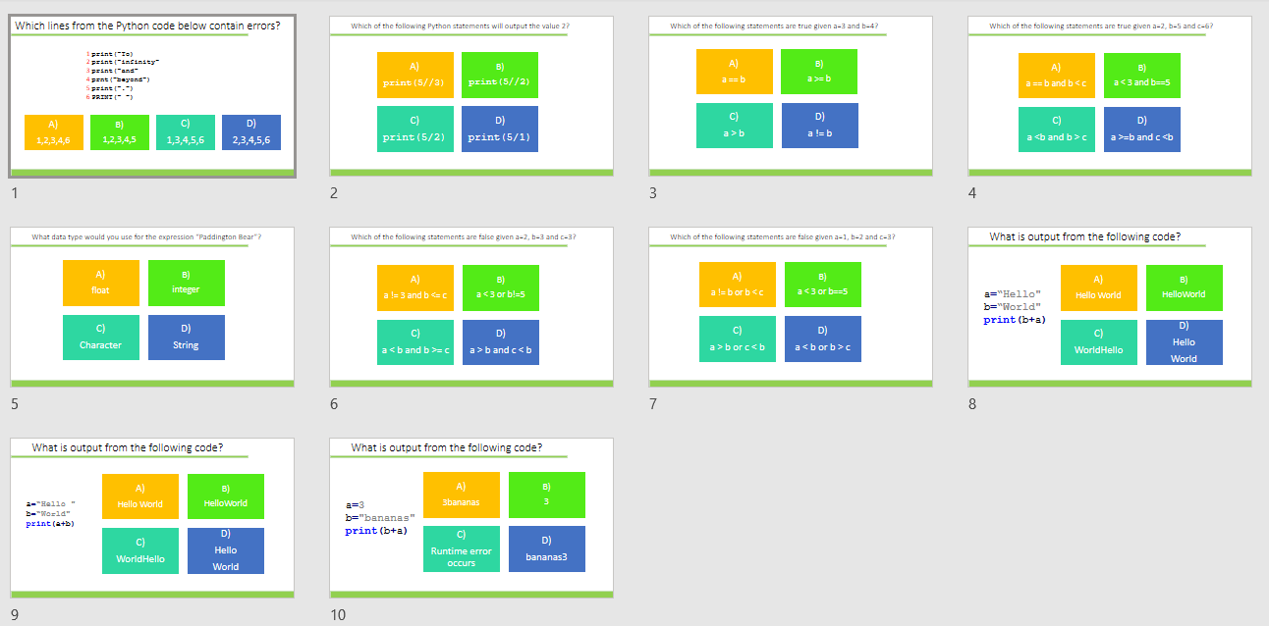
Plenary / Homework
Complete task:
Python programming: Boolean and relational operators, output: GCSE
Alternatively use:
diagnostic-questions-python-set2.pptx

