Slide 1



AQA English Language Paper 2 – Q4: Comparing Texts
Purpose
Q4 of Paper 2 is all about comparing the two sources.
In order to help us do this, let’s think about purpose, audience and type.
What are the purposes of Source A and Source B?
How are the audiences similar or different for the two sources?
Why might the type or form of the sources affect how the readers understand the texts? Provide examples.
Audience
Type
Purpose: What the writer is trying to achieve when writing their text (for example: writing to inform).
Audience: Who the writer is writing to with their text.
Type: The format of the text (speech, leaflet, article, letter and so on).

Slide 2
Learning outcomes
To describe the purposes, audiences and types for both sources
To explain how the tones of both sources are similar or different
To evaluate how the use of language is different in each text and why they affect the thoughts and feelings of the reader

Slide 3
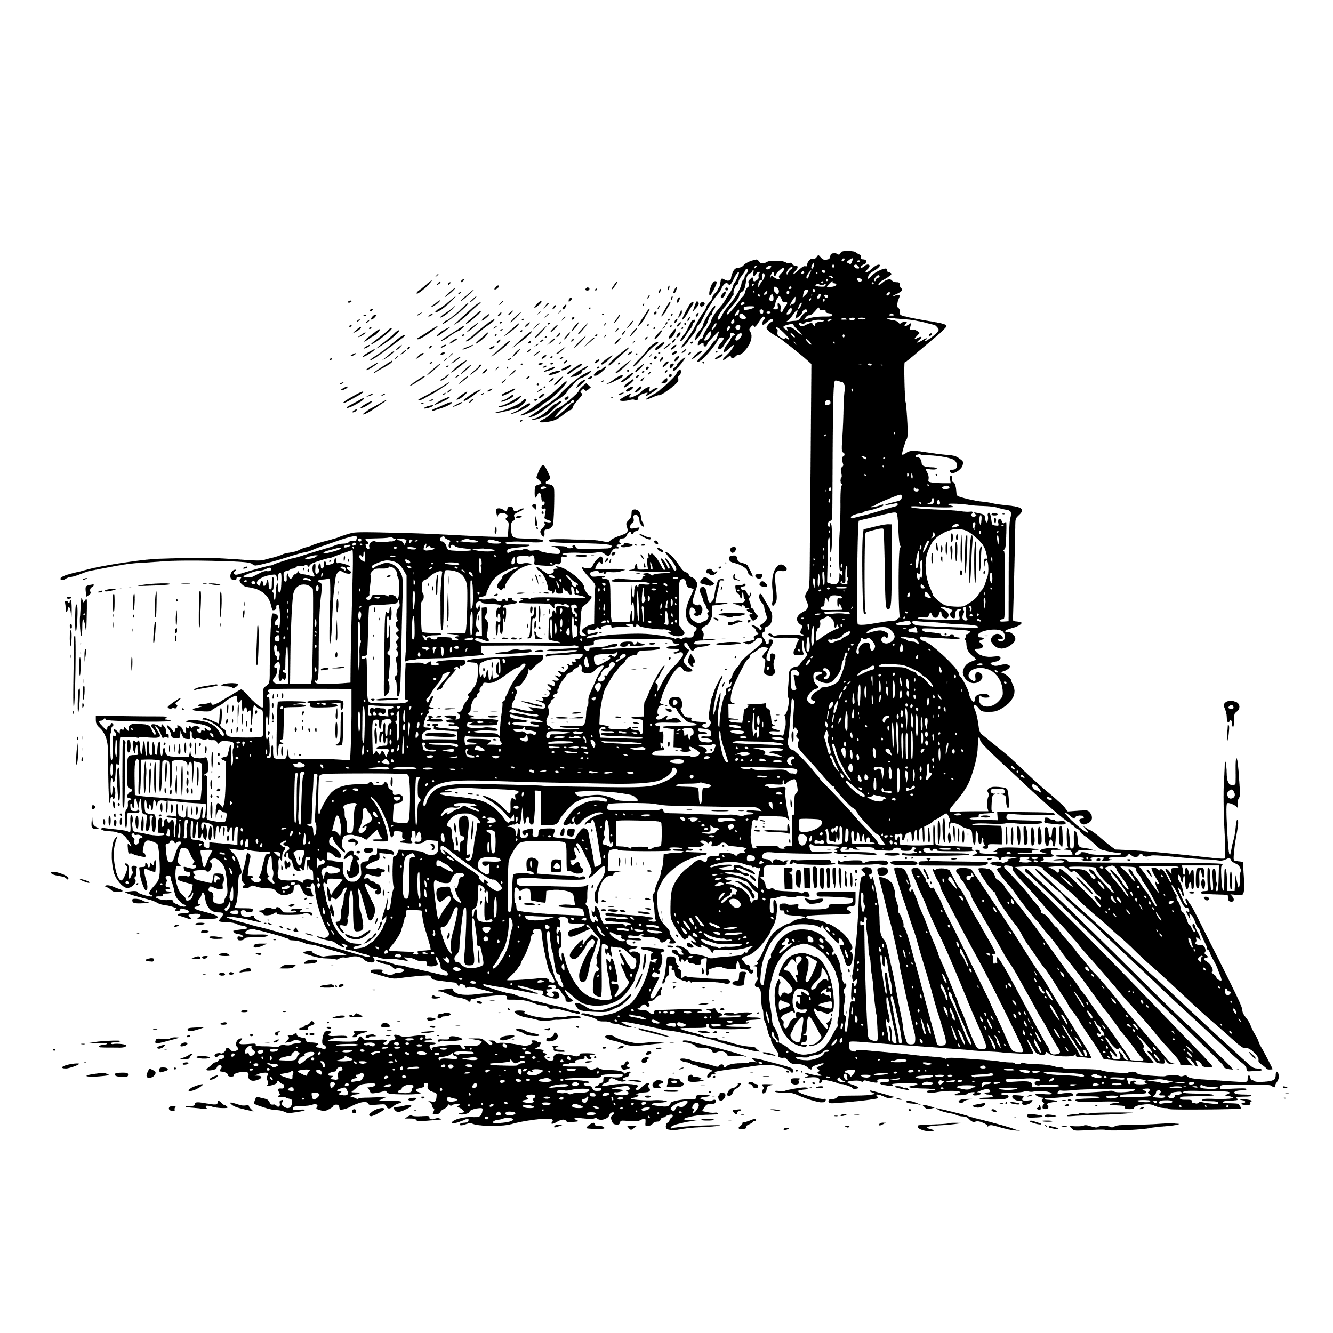
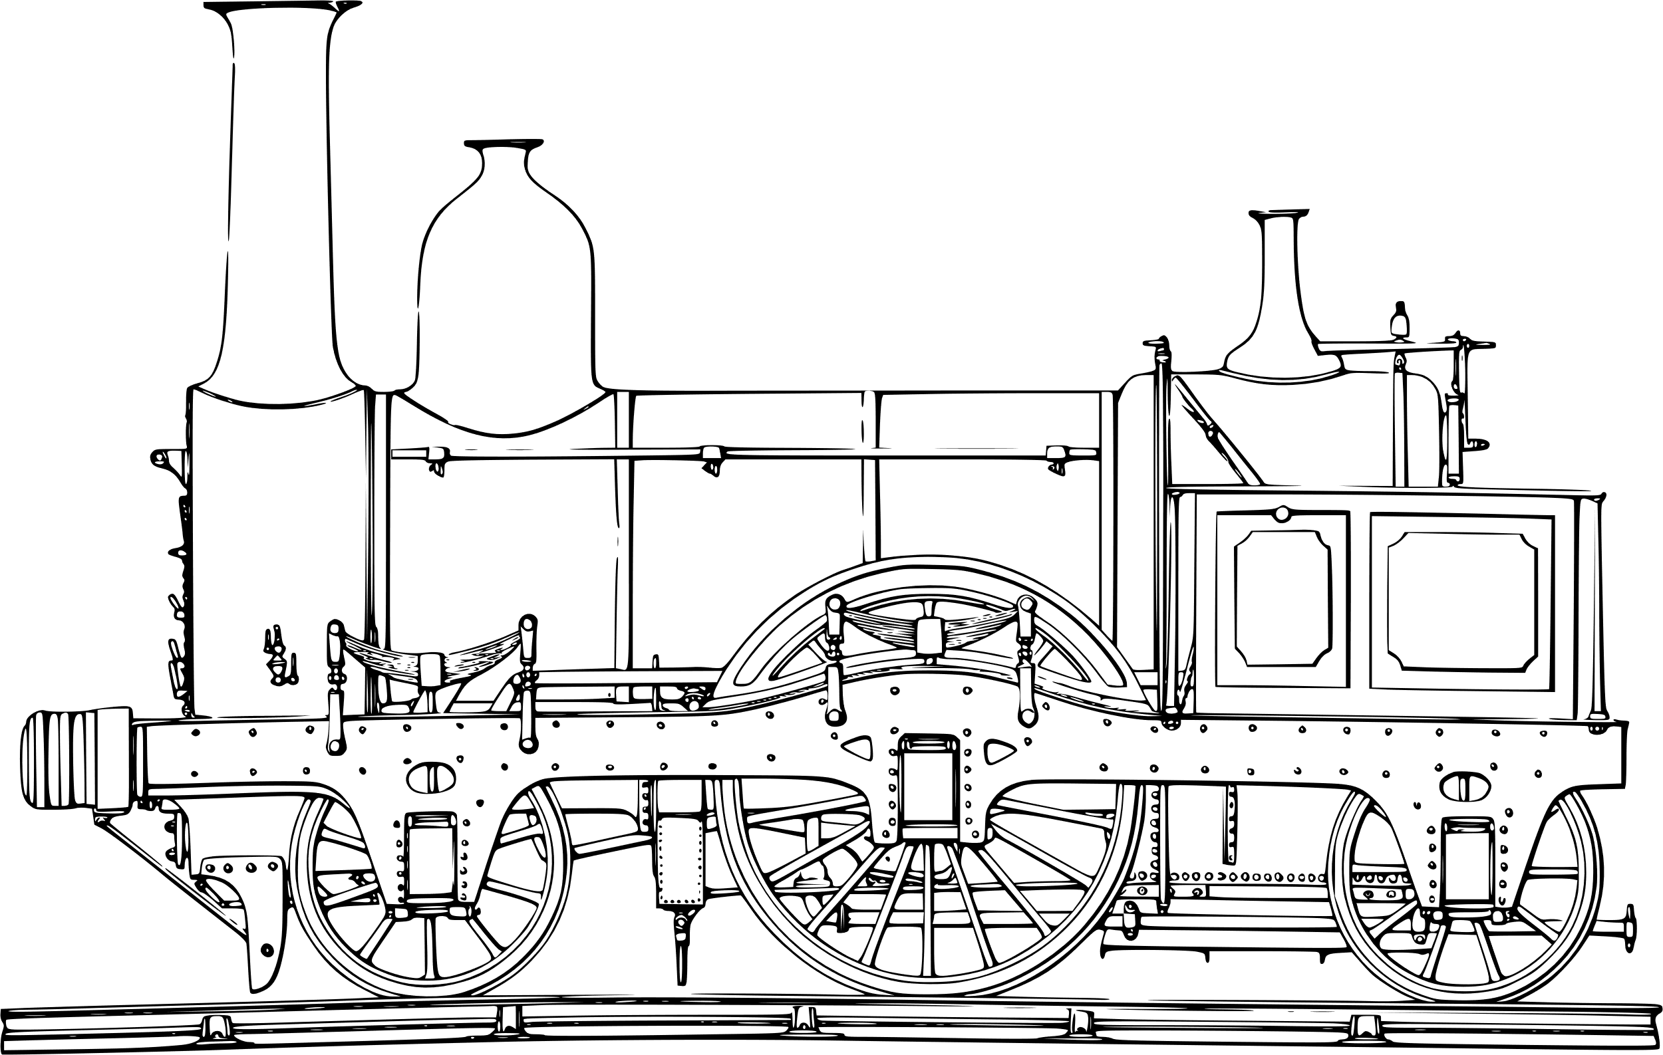
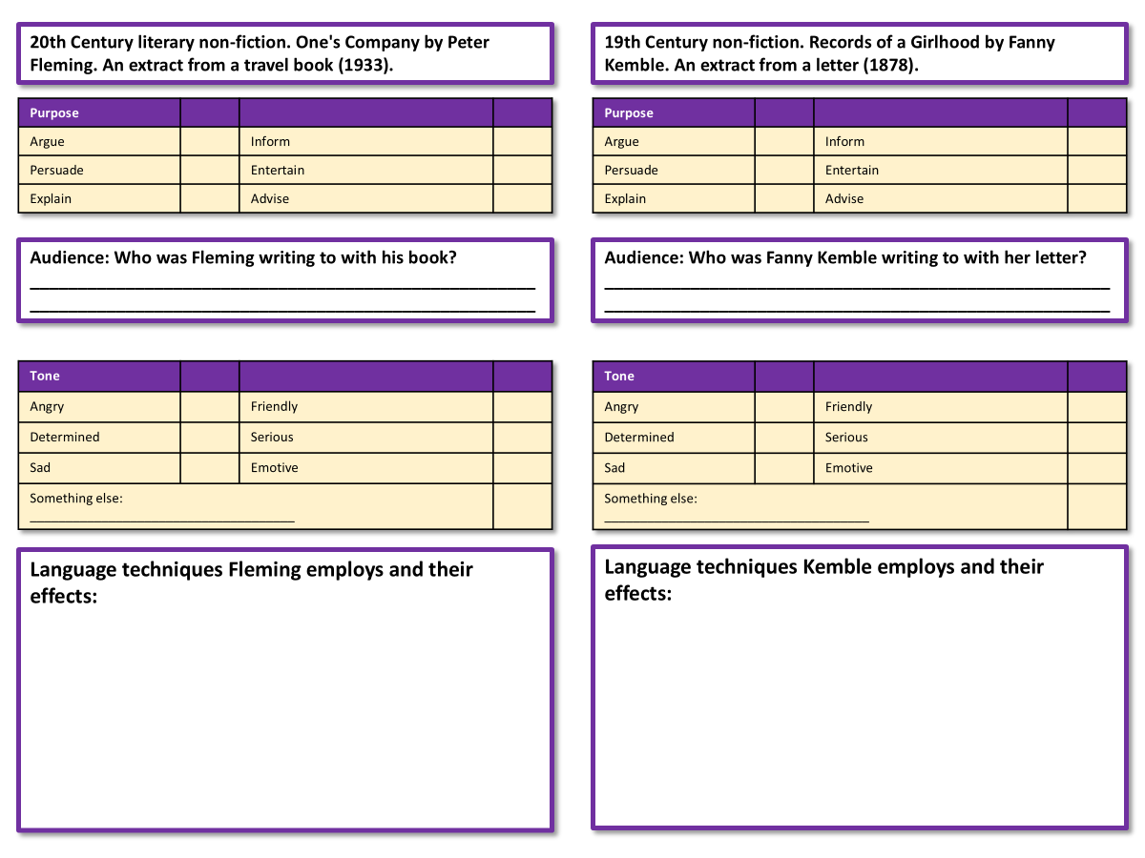
We’re going to compare the two sources now
Complete your worksheet for both sources.
Bonus Challenge: Use analytical verbs when making your notes on the language techniques used in both sources.
Notes:
For further biographical information: https://malala.org/malalas-story
By DFID - UK Department for International Development - Malala Yousafzai: Education for girls, CC BY 2.0, https://commons.wikimedia.org/w/index.php?curid=44613645

Slide 4
20th Century literary non-fiction. One's Company by Peter Fleming. An extract from a travel book (1933).
19th Century non-fiction. Records of a Girlhood by Fanny Kemble. An extract from a letter (1878).
Purpose
Argue |  | Inform
Persuade |  | Entertain
Explain |  | Advise
Purpose
Argue |  | Inform
Persuade |  | Entertain
Explain |  | Advise
Audience: Who was Fleming writing to with his book?
_____________________________________________________
_____________________________________________________
Audience: Who was Fanny Kemble writing to with her letter?
_____________________________________________________
_____________________________________________________
Tone
Angry |  | Friendly
Determined |  | Serious
Sad |  | Emotive
Something else: _____________________________________
Tone
Angry |  | Friendly
Determined |  | Serious
Sad |  | Emotive
Something else: _____________________________________
Language techniques Fleming employs and their effects:
Language techniques Kemble employs and their effects:

Slide 5



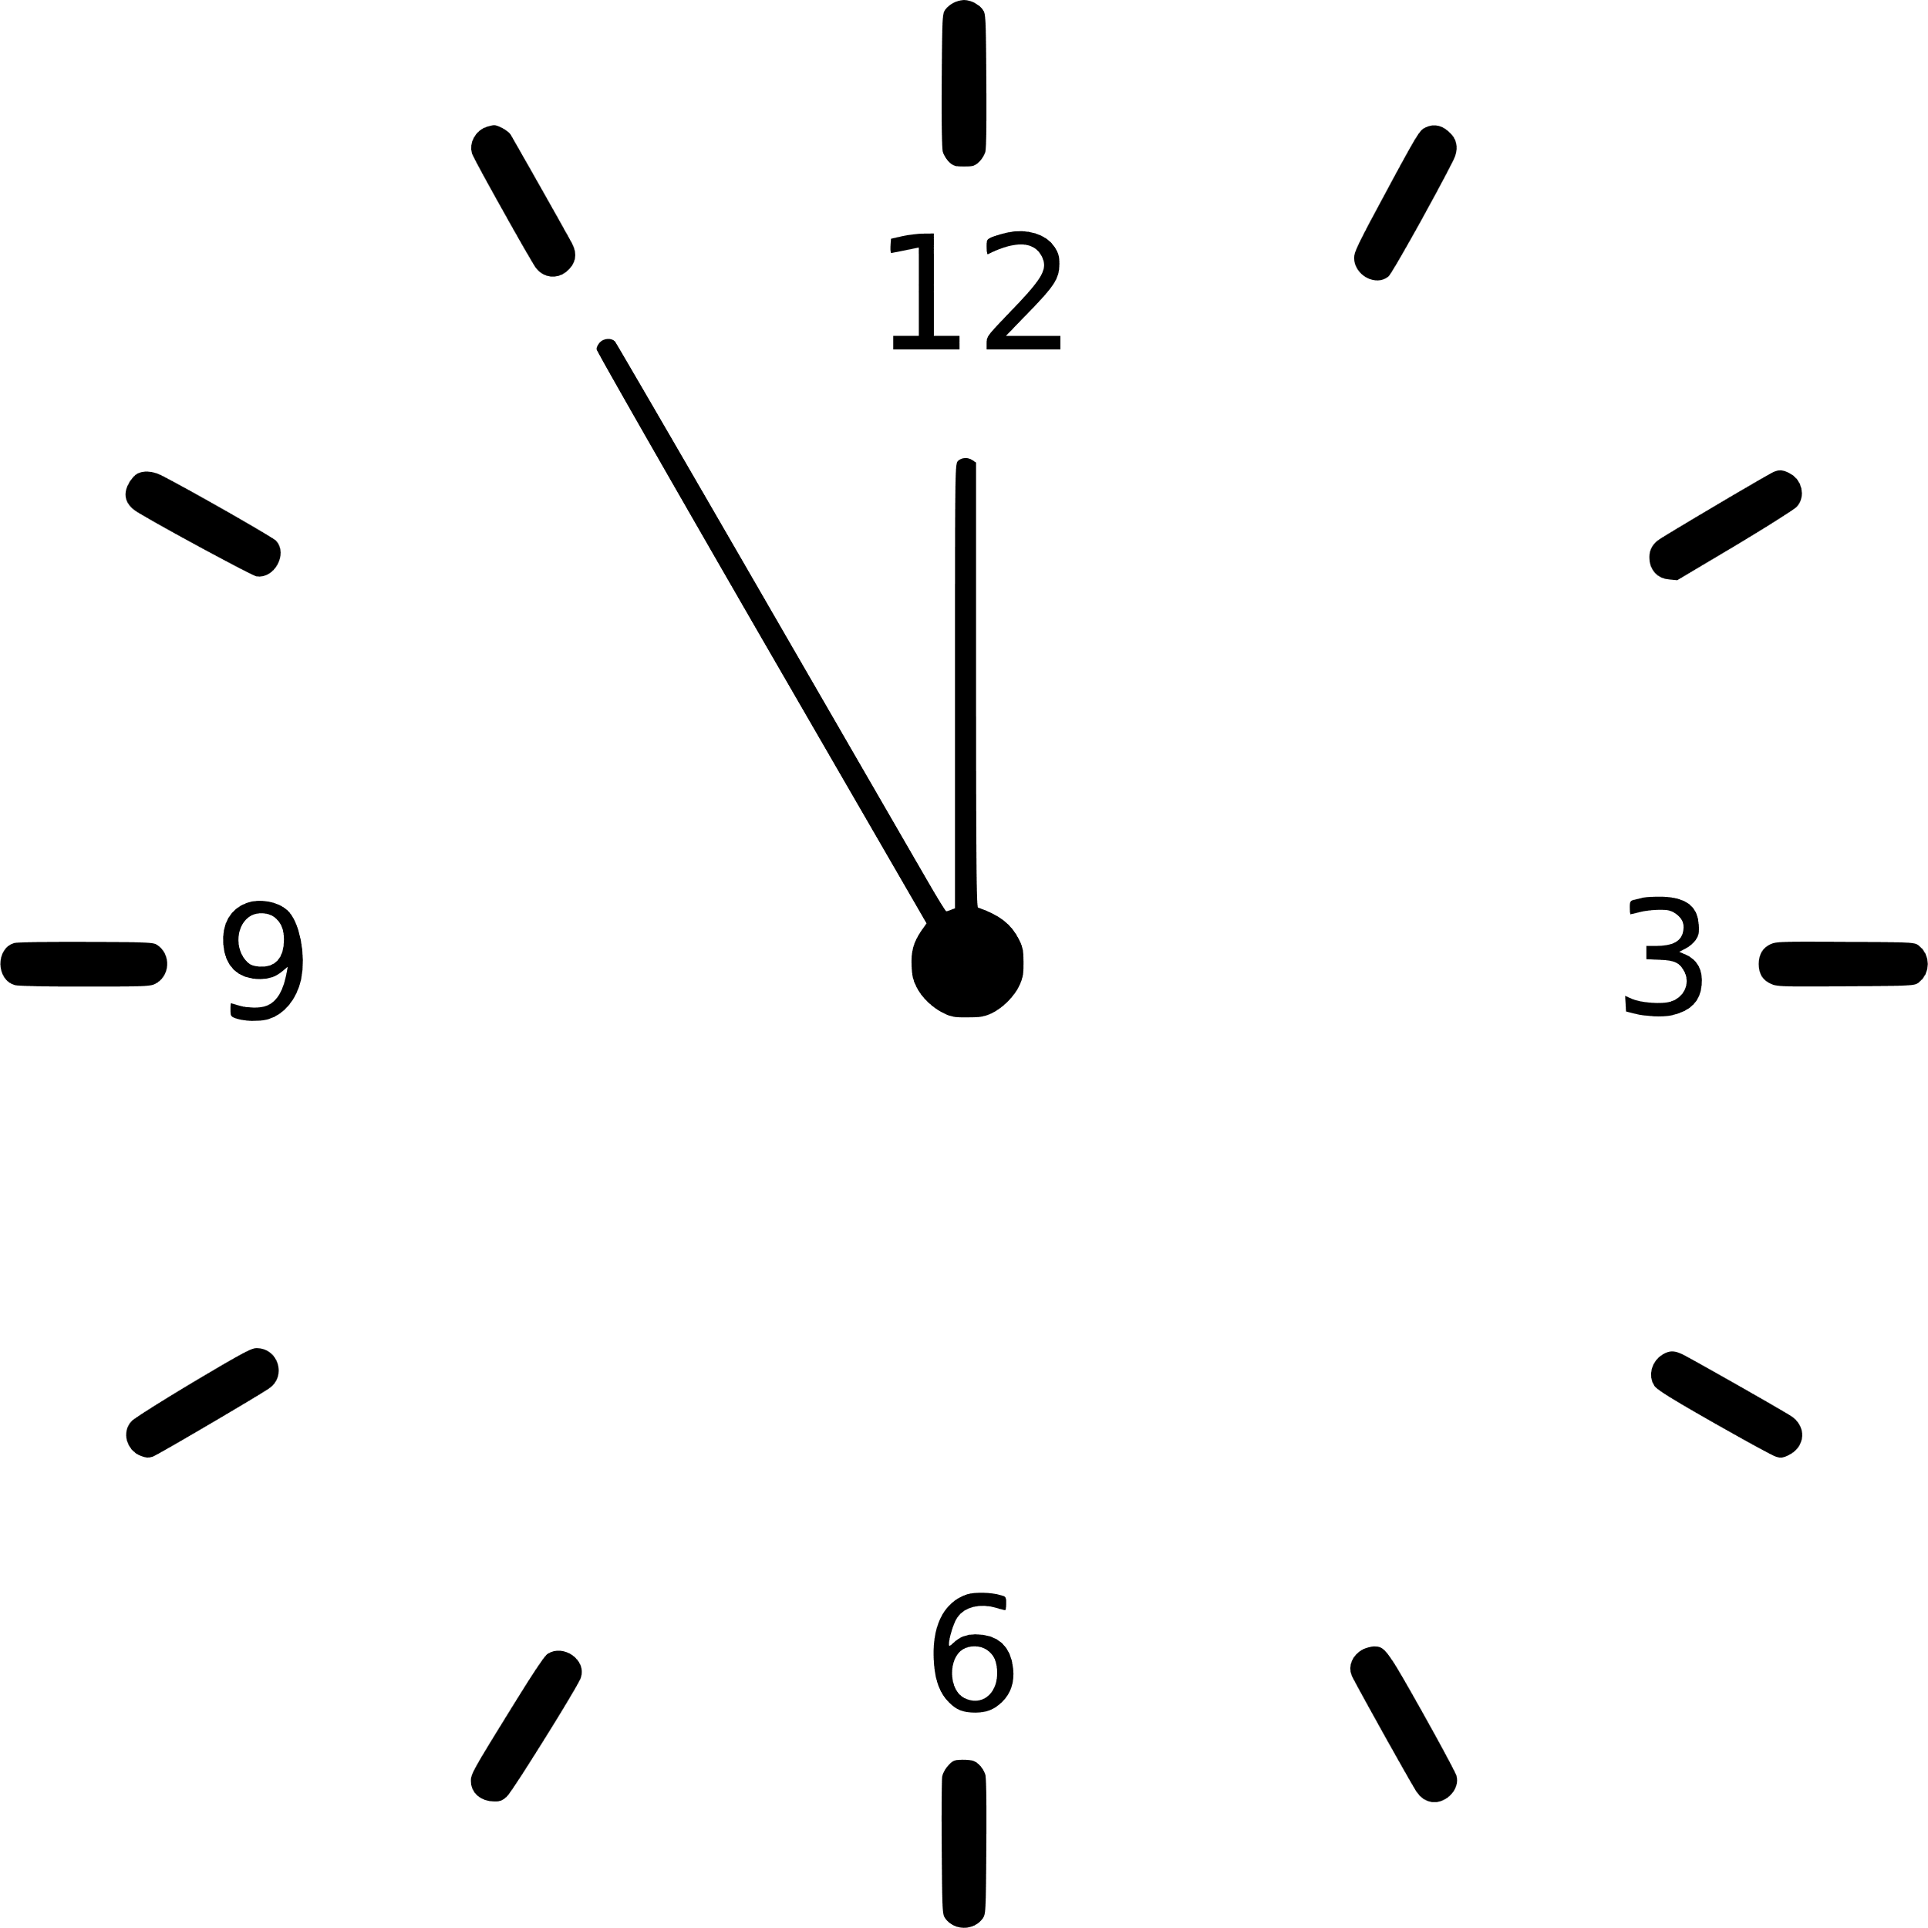

Source A
Who wrote it?
Peter Fleming, a writer from the 1930s, so almost a century before our time.
Who were they communicating their ideas to?
This is an extract from a travel book, so Fleming describes his journeys and travel experiences to his readers, who are likely interested in travel and train journeys as that is why they would have purchased the travel book. They may also have some experience in travel themselves.
Why did they write it?
It seems Fleming wanted to explain what travelling on a new long-distance train was like, as well as offering his opinions on what he enjoyed and what he disliked, plus entertain his readers with humour.
What were they trying to tell their audience?
The purpose of the book is to explain how Fleming found the journey and why he both disliked and liked it. He tries to entertain his readers with humorous language, including the use of personification, hyperbole, adjectives and adverbs that offer a droll and dry sense of humour.
When did they write it?
It was published in 1933, so the technology he was writing about was new and exciting to readers.
How do they tell their audience about their ideas?
Fleming describes his thoughts and feelings in detail, including his criticisms and his panic and confusion, plus relief, with the crash. He is mostly negative about the experience.

Slide 6
Source B
Who wrote it?
A writer called Fanny Kemble in 1878, so a long time before our own.
Who were they communicating their ideas to?
The letter was written to a friend, so we are on the outside looking in at a piece of text written for the writer’s friend. The tone is friendly and jovial, but also conveys her excitement on taking the train journey.
Why did they write it?
This is from a letter to a friend, so when written it would have had a friendly and relaxed tone. They want to explain to their friend their travel experiences and what this new train technology was like.
What were they trying to tell their audience?
The purpose of the letter is to describe and explain the writer’s thoughts and feelings on the journey on new train technology. Because she is writing to a friend, this affects the tone and mood of the writing. The writer is mostly positive about their experiences.
When did they write it?
It was published in 1878, and the letter may have been written before that, so this is during the late Victorian period where this technology was new and exciting.
How do they tell their audience about their ideas?
Kemble uses a range of language techniques including metaphors, adjectives, and lots of examples of personification (as is the case in Source A, but used for different reasons).

Slide 7
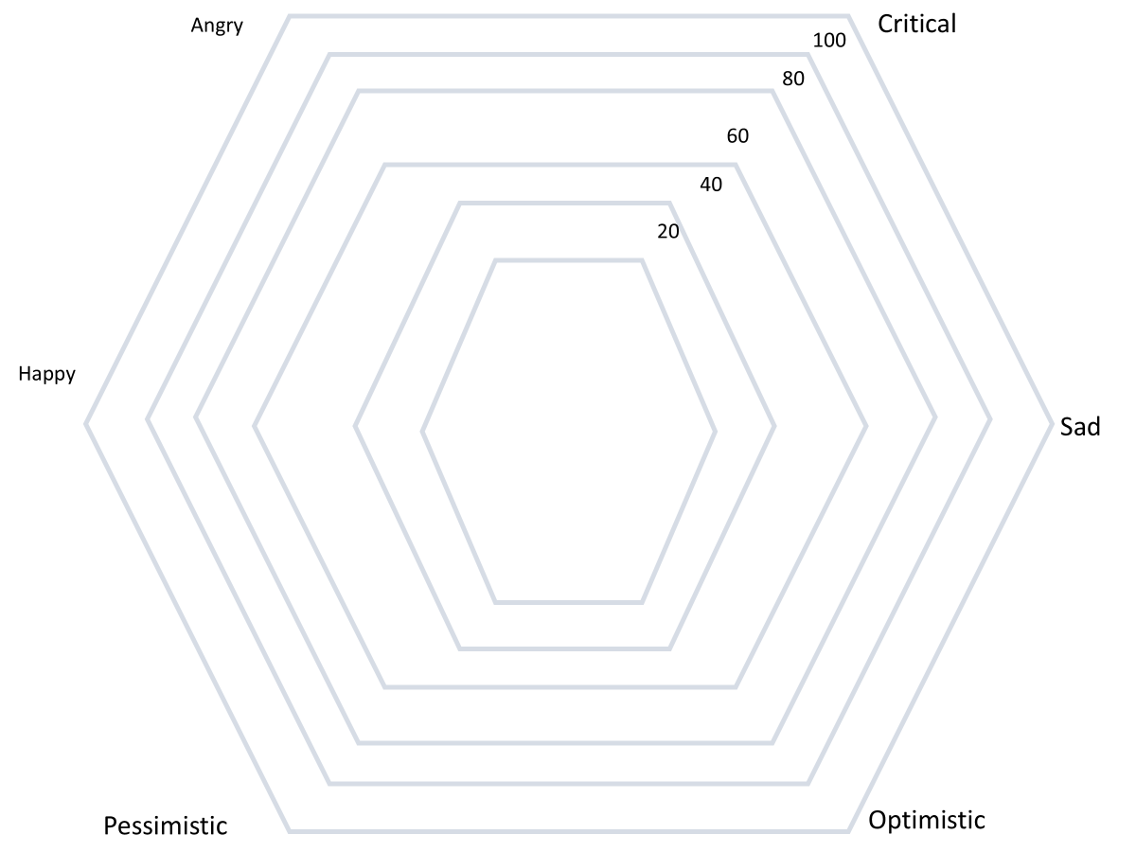
Tone: Radar Chart
It can be difficult to compare texts, but one way to make it easier is to use radar charts, like this one.
Create a radar chart for the Peter Fleming travel book extract like the one on the board. This is just an example, don’t try to copy the shape.
Add in an ‘x’ for each of the six tones listed.
Link up the x’s together.
x
x
x
x
x
x
Bonus Challenges:
What is the overriding tone of the Peter Fleming travel book extract?
How does the writer convey this tone to the reader? Provide specific examples.

Slide 8
Angry
Critical
100
80
60
40
20
Happy
Sad
Pessimistic
Optimistic

Slide 9
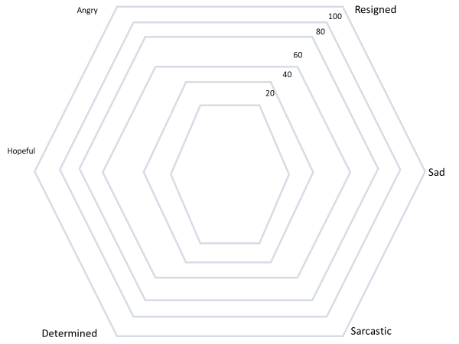
Tone: Radar Chart
Go back to your radar chart and add in the letter by Fanny Kemble.
x
x
x
x
Bonus Challenges:
What do you notice about the two texts you have analysed? How are they similar or different?
How are the writers able to convey different or similar tones?
x
x

Slide 10
Here is a Q6-style question which asks you to compare the two texts on the common theme of ‘football supporters’.
For this question, you need to refer to the whole of Source A, together with the whole of Source B.
Compare how the writers convey their different feelings and perspectives about their experiences of travelling on a train.
In your answer, you could:
• compare their different feelings and perspectives
• comment on the methods the writers use to convey their feelings and perspectives
• support your response with references to both texts.
[16 marks]
This is worth 16 marks – it involves a lot of skills.
What do you need to do to answer this question?
What elements need to be included in your answer?
Why is it so important to focus on the word ‘methods’?

Slide 11
You must compare the two texts. You cannot just write about both texts, you must discuss how their feelings and perspectives are different.
You must explore how the writers convey their ideas. In this case, we are looking at the travel book extract and the letter to a friend.
You must analyse the ideas in each text, but also the perspectives or viewpoints about their experiences of travelling on a train. How do both writers present these experiences?
For this question, you need to refer to the whole of Source A, together with the whole of Source B.
Compare how the writers convey their different feelings and perspectives about their experiences of travelling on a train.
In your answer, you could:
• compare their different feelings and perspectives
• comment on the methods the writers use to convey their feelings and perspectives
• support your response with references to both texts.
[16 marks]
The word ‘methods’ is so important because it is asking you to look at the language and techniques used by both writers to convey or get across their ideas and views. You cannot get 16 marks unless you explore HOW the writers get across their ideas and how they affect the readers.
Finally, you must include examples or quotations from both texts to back up your interpretations about the writers’ ideas and perspectives. Without using examples, you cannot get 16/16.

Slide 12
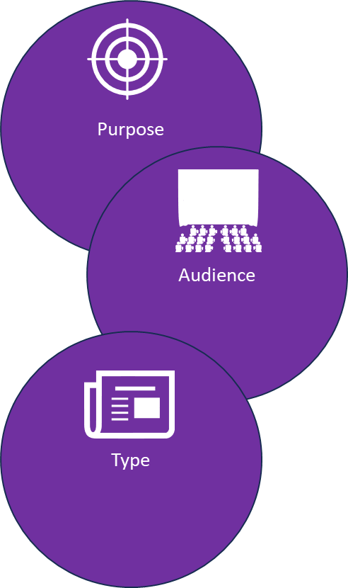
Let’s recap our ideas for this Q4 task
Source A:
Purpose: To describe, to explain, to entertain
Audience: Readers with an interest in travel from the 1930s.
Type: An extract from a travel book.
Source B:
Purpose: To describe, to explain, to entertain
Audience: Kemble’s friend from the late Victorian period.
Type: A letter written to a friend.
Tone: Disappointed, frustrated, angry, panic-stricken, confused, relieved.
Tone: Jovial, joyful, happy, excited.
Language techniques: Personification, metaphors, adjectives, adverbs.
Language techniques: Personification, metaphors, adjectives.
Why do they used these techniques? The use of personification brings the train to life and makes us feel as if the train is in conflict with the writer, given the crash and the amount of problems it has caused him.
Tone: The use of personification describes the train as if it is powerful and wild, but also it helps to convey the writer’s sense of joy and freedom that the new train technology provides her with.

Slide 13
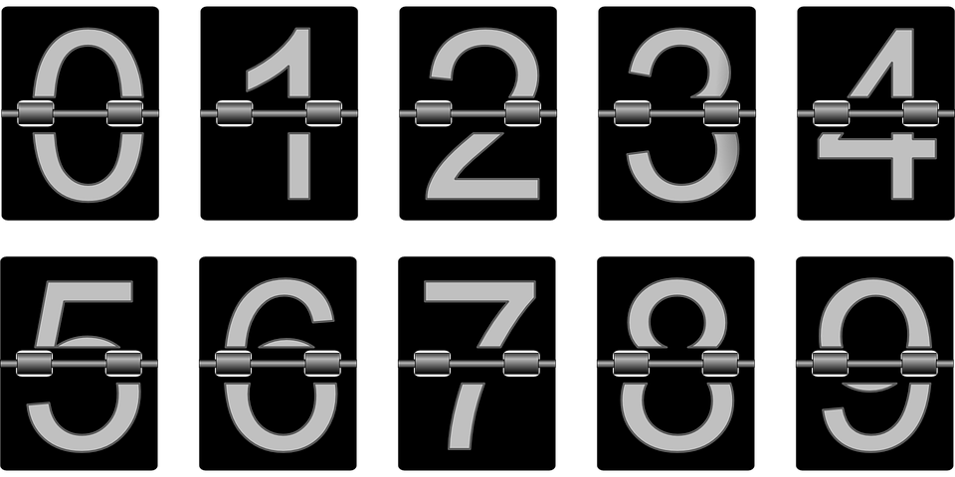
Plenary: Countdown
Q E S T A P V O U
In a pair, one person chooses nine random letters.
The other person then has to make a word that helps to describe their learning from today’s lesson!
You then switch around and swap roles.
To describe the purposes, audiences and types for both sources
To explain how the tones of both sources are similar or different
To evaluate how the use of language is different in each text and why they affect the thoughts and feelings of the reader

