Slide 1
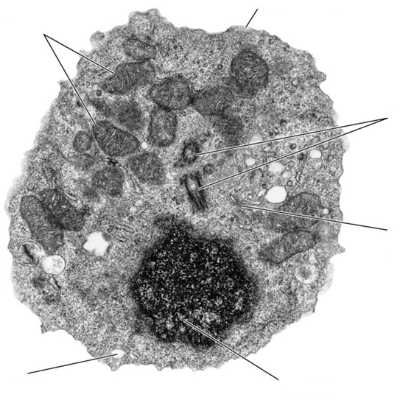
Knowledge retrieval questions
Q1. Label the electron micrograph for the eukaryotic cell below (6 marks)

Slide 2
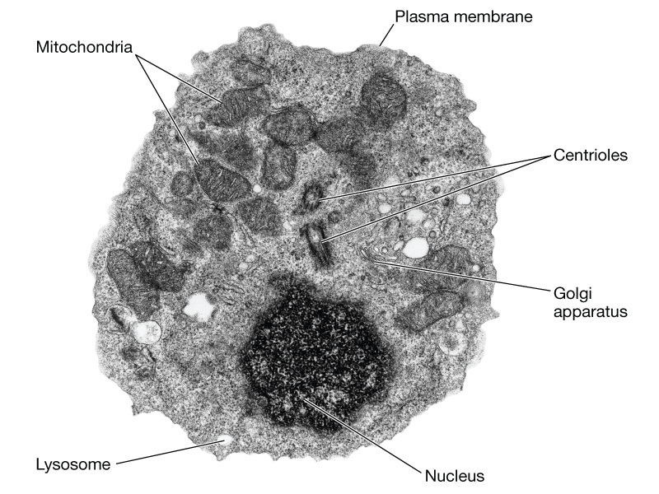
Knowledge retrieval questions
Date
Q1. Label the electron micrograph for the eukaryotic cell below (6 marks)

Slide 3
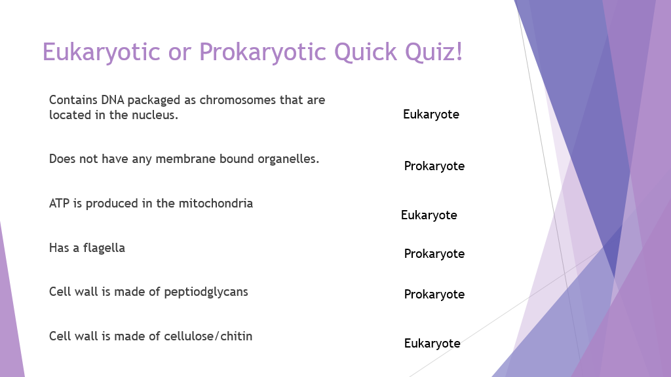

Slide 4
Notes:
Chitin – fungi

Slide 5
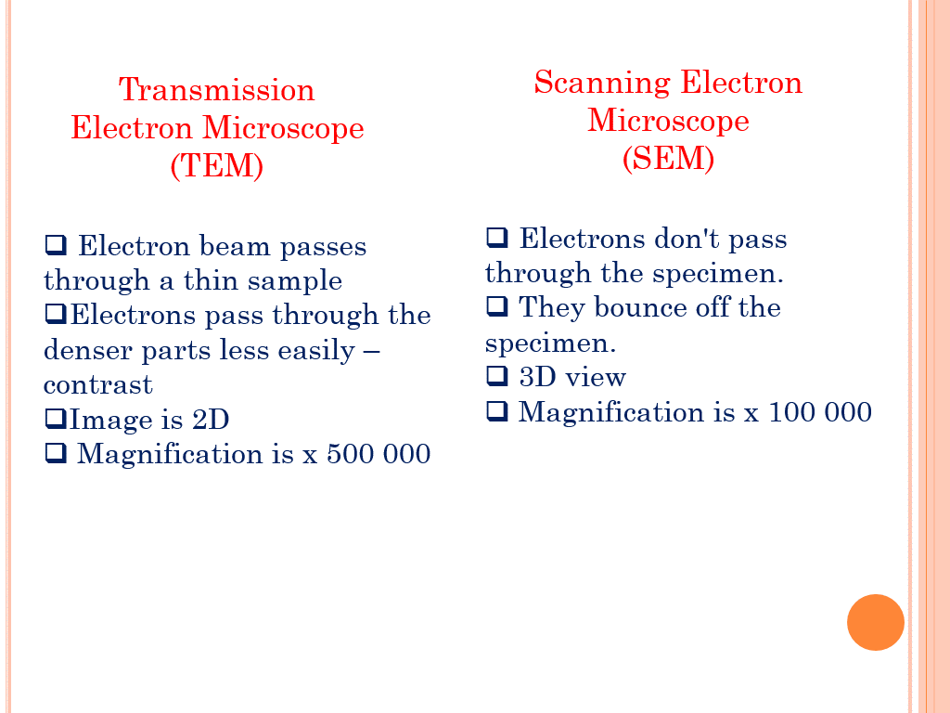
Do not copy
Electron Microscopy (TEM and SEM) - YouTube
Lots of detail not required, but still interesting!! Start at 0.7s

Slide 6
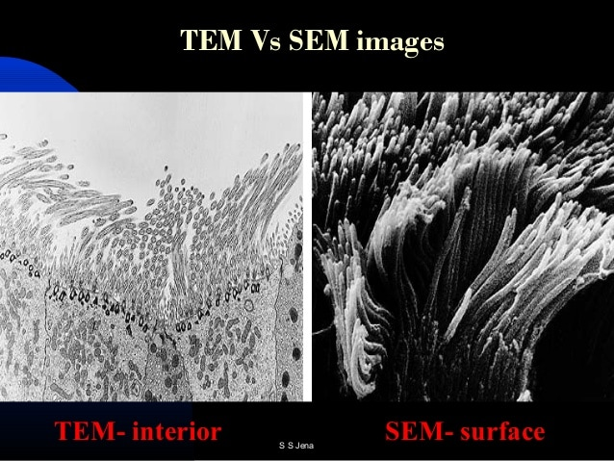

Slide 7
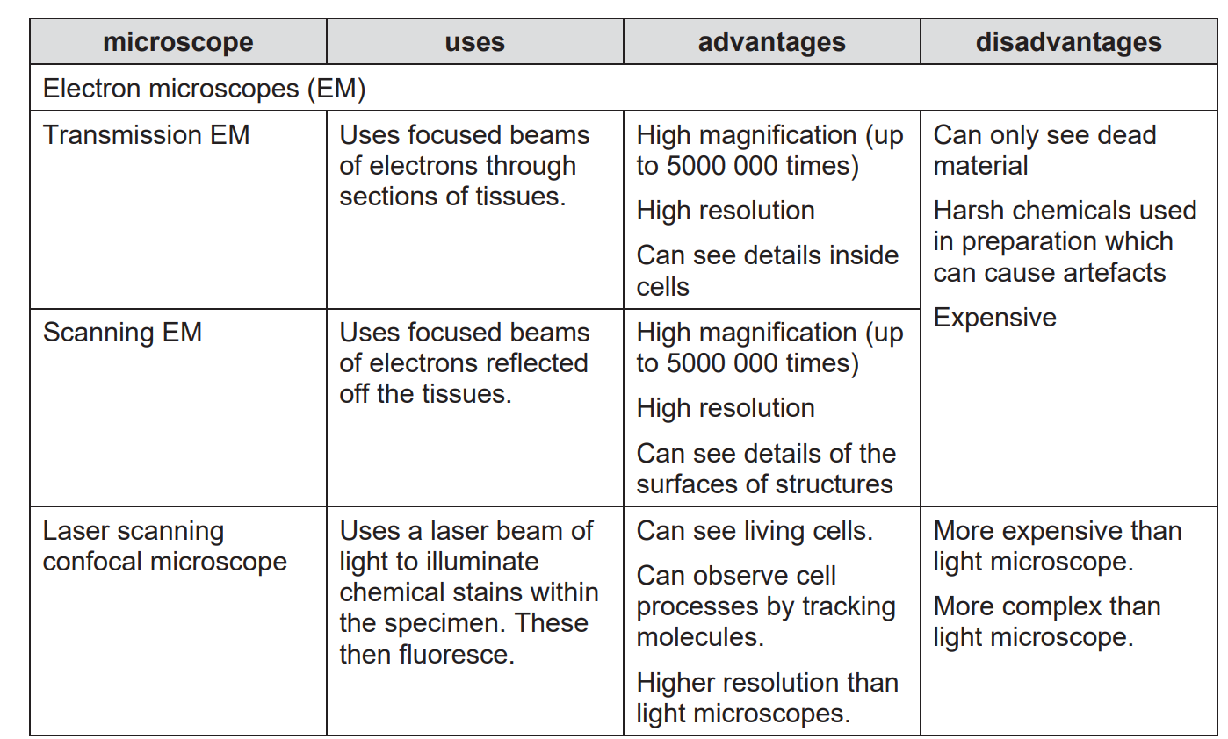

Slide 9
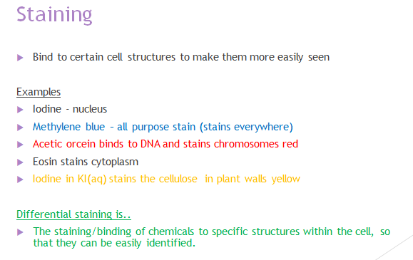
Bright pink (binds to salts)

Slide 11
Which of the following statements, A to D, about differential staining is not true?
A Differential staining can distinguish between different organelles.
B Differential staining can distinguish between types of cell.
C Differential staining can distinguish between types of organism.
D Differential staining is a common feature of electron microscopy.
Your answer ……… [1]
Cells are usually stained before viewing under a light microscope.
Explain why cells need to be stained [2]
To provide contrast
Making cells easily visible
Electron microscopy does not use differential staining because electrons would pass through any stain
Heavy metals are used during electron microscopy to observe biological tissue by absorbing/scattering electrons
D

Slide 12
Calibrating A Microscope

Slide 13
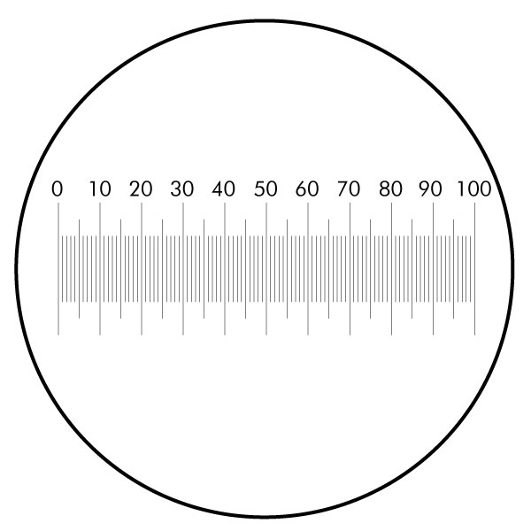
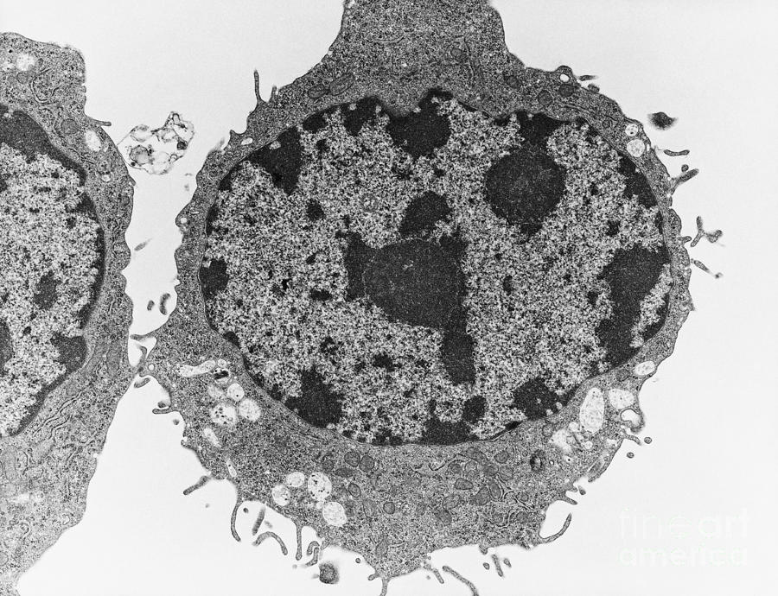
Has the actual size of the cell changed?
X40
X100
X400
No, the image size has changed. So how do you use the scale to determine the actual size at different magnifications?
Calibration!

Slide 14
Why is calibration important?
You need to be able to measure the image size of what you are looking at so that you can calculate the actual size of the object.
This is easy if it’s a printed photo, but not so easy looking down a microscope.
Obviously, the magnification will change the image size.
Equipment required to calculate the actual size:
Eye piece graticule - inside the eye piece lens (tiny ruler, arbitrary units)
Stage micrometer – A ruler mounted on a slide

Slide 15
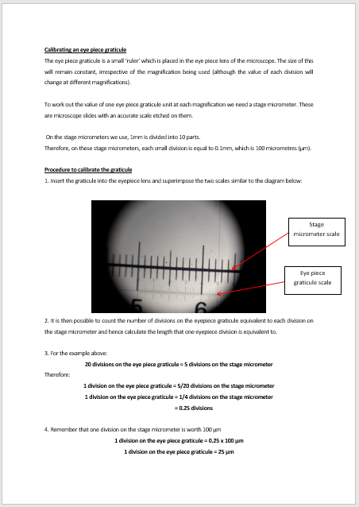

Slide 16
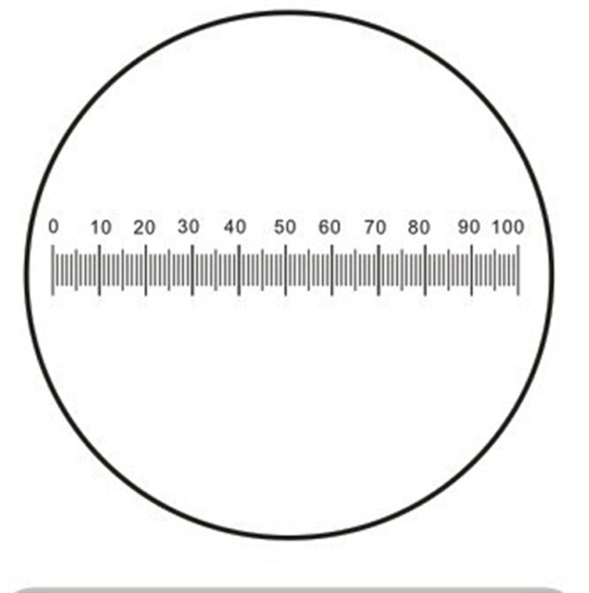
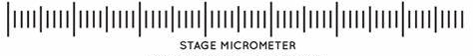
The eyepiece graticule is divided in 100 small units. They are arbitrary units (no value).
The stage micrometer is exactly 1cm / 10mm in length. It also has 100 small divisions each worth 0.1mm
CAREFULL!!
Not all stage micrometers are 10mm in length!! So this may vary in your exam.

Slide 17
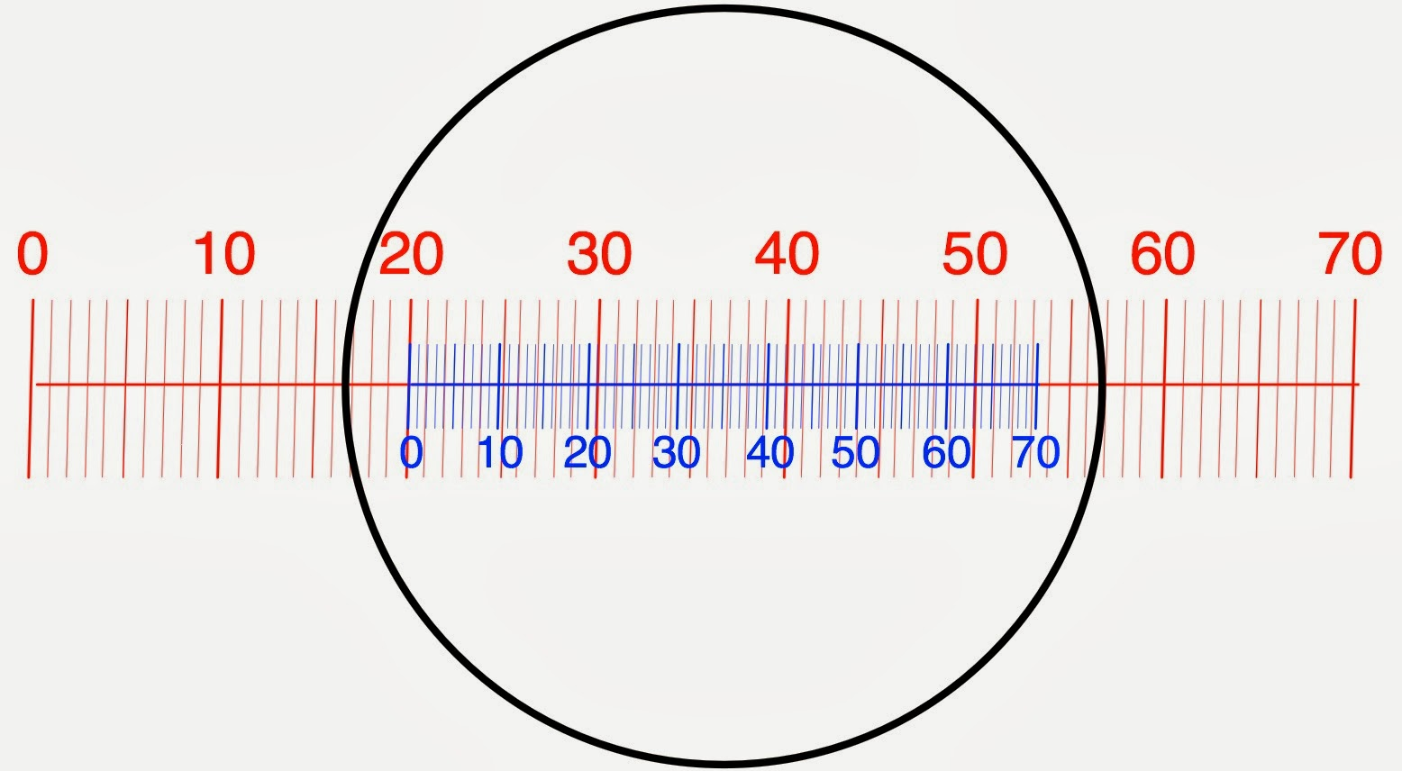
By aligning the stage micrometre with the eyepiece graticule we can determine the length of each small division on the eyepiece graticule
Pick two lines on the e.p.g that align with the stage micrometer
21 e.p.u = 1mm
Now calculate what 1 small division on the eyepiece graticule is
Stage micrometer / e.p.u
1 / 21 = 0.047mm
Turn into um
0.047 x 1000 = 47um
Each small division on the e.p.g is worth 47um
Now we can remove the micrometer and use the e.p.g to measure our samples!!!
Stage micrometer
Eyepiece graticule
Stage micrometer 10mm total width
Each small division = 0.1mm
Notes:
1mm on the stage micrometer is equal to 21 division on the eyepiece graticule ……….. So what is 1 e.p.g division worth 1/21

Slide 18
Has the actual size of the cell changed?
Now I know 1 e.p.u = 47um
In this example my cells actual size would be:
20 x 47 = 940um

Slide 19
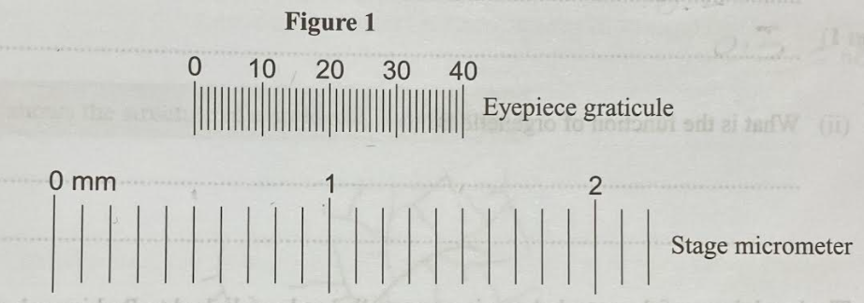
You try!
Total length 10mm
A student used an eyepiece graticule to calculate the size of some onions cells.
Figure 1 shows the students eyepiece graticule and stage micrometer.
The stage micrometer measures in millimetres.
Use figure 1 to calculate the size of one division on the students eyepiece graticule, in micrometers. Show working (2 marks)
The student increased the magnification. Explain why they needed to recalibrate the eyepiece graticule (1 mark)

Slide 20
You try!
Total length 10mm
A student used an eyepiece graticule to calculate the size of some onions cells.
Figure 1 shows the students eyepiece graticule and stage micrometer.
The stage micrometer measures in millimetres.
Use figure 1 to calculate the size of one division on the students eyepiece graticule, in micrometers. Show working (2 marks)
The student increased the magnification. Explain why they needed to recalibrate the eyepiece graticule (1 mark)
40 e.g.u = 1 mm 1 / 40 = 0.025mm 0.025 x 1000 = 25um
The stage micrometer will appear larger, so each division will be a smaller value

Slide 21
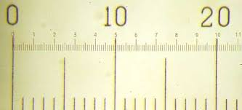
This means 10 small divisions not 10mm!!
e.g.u
Stage micrometer 10mm total length
Calculate the size of 1 division on the e.g.u in um (2 marks)

Slide 22
This means 10 small divisions not 10mm!!
e.g.u
Stage micrometer 10mm total length
Calculate the size of 1 division on the e.g.u in um (2 marks)
50 e.g.u = 1mm
1/50 = 0.02mm
0.02 x 1000 = 20um

Slide 23
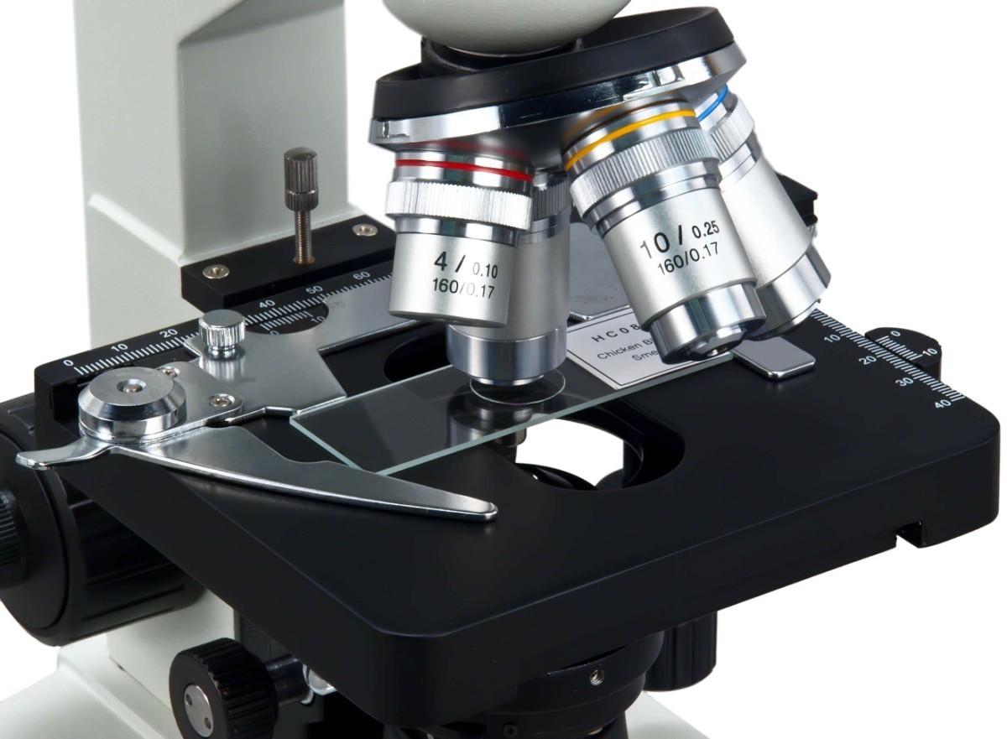
Lets go through it together!
Take an A-level light microscope

Slide 24
Instructions
Insert the eyepiece graticule into microscope
Use the x4 objective lens (total mag = x40)
Turn on the light and select the lowest objective lens
Check that the e.p.g is horizontal
Clip on the stage micrometer and use the focus/fine focus to bring it into sharp view
Rotate the eyepiece to remind yourself which scale is the eyepiece graticule and which is the stage micrometer
Ensure the eyepiece graticule is horizontal and manoeuvre the stage to align both scales up at 0 (easier for calculations)
You will only be using the eyepiece graticule when measuring objects, so now need to calculate the length of each division on the EG.
Can you calculate what 1 small unit on the e.p.g is worth at x40 magnification in um?

Slide 25
Calculating one unit on the eyepiece graticule
At x40 magnification
Remember there are 100 small divisions on the stage micrometer and each small division is 0.1mm in length if the total length of the micrometer is 10mm
Pick a line on the eyepiece graticule that is perfectly aligned to the stage micrometer
20 e.g.u = 0.5mm
To calculate 1 unit on the EG first divide: ……… ……………………………………………………………………………………………………………………………………………………………… …...length on micrometer / number on e.g.u
0.5 / 20 = 0.025mm
Convert into um (micrometers)
0.025 x 1000 = 25um
Each unit on the EG is worth 25um in length at x40 magnification
Next calculate the value of one small graticule divisions for x100 and x400 magnification
PUT THE MICROMETER BACK TO THE CENTRE OF THE EYE PIECE BEFORE YOU TURN UP THE MAGNIFICATION.
The higher the magnification the more difficult it is to align the two scales as the movement is so fine.

Slide 26
Recap questions
Q1. Which type of microscope uses focused beams project through tissue? (1 marks)
Q2. Which microscope can view living cells? (1 marks)
Q3. Give one advantage/disadvantage of using a transmitting or scanning microscope (2 marks)
Q4. What formula is used to predict the volume of a cell? Select one:
4/3 πr³ 3/2 πr³ 2 πr³ (1 marks)
Transmission EM
Laser scanning confocal microscope
Advantage: See inside cells / high magnification / high resolution
Disadvantage: Can only observe dead cells (harsh chemicals used) / expensive
4/3 πr³

Slide 27
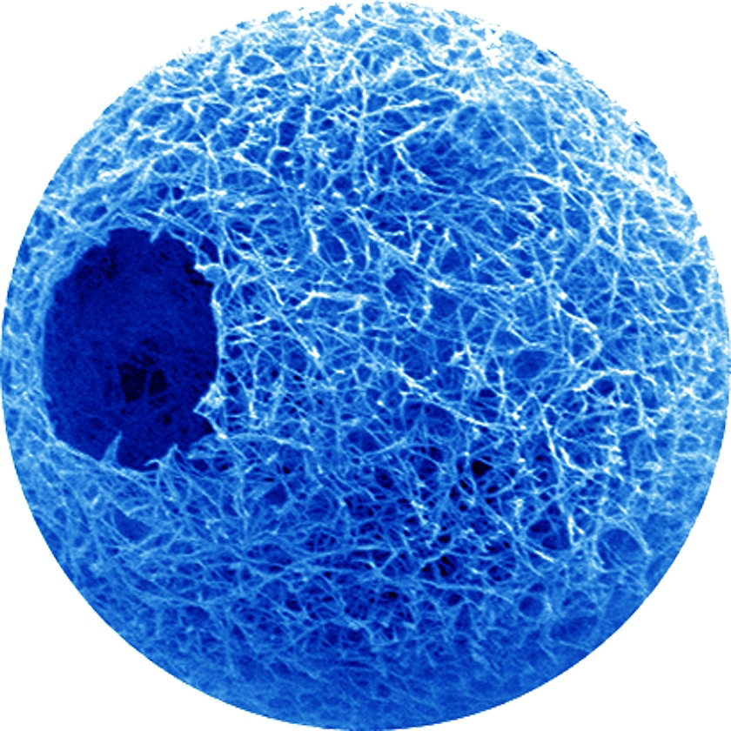
Try this
Presuming the cell is a sphere
What is the volume of a cell that has a diameter of 40nm? (2 marks)
4/3 πr³
V = 4/3 x π x 20³
V = 33510nm³
40nm

Slide 28
Task
Take the prepared slide
Using your value for each e.p.u at x40 magnification
Calculate the actual size of the following:
NEED BETTER SLIDES
Width = 7
NEED BETTER SLIDES
Width =

Slide 29

Watch this video to revise the calibration procedure

Slide 30
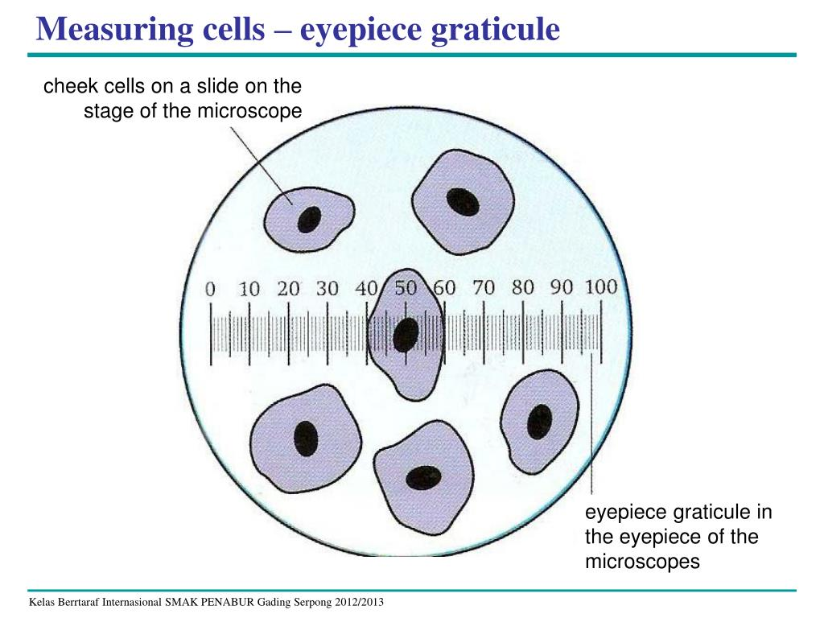
Magnification of ​ objective lens​ | Value of one ​ eyepiece division (µm)​
x4​ | 25​
x10​ | 10​
x40​ | 2.5​
x10
Calculate the size of the cell at x10 magnification
20 x 10 = 200um

Slide 34
PAG 1.2 – Microscopy (to be completed in lab book)
To calibrate a light microscope using an eyepiece graticule and stage micrometre. Producing a table (showing calculations) for each magnification x40, x100, x400
To produce a scientific drawing of a Neutrophil (WBC) and Erythrocyte (RBC) cell at x400 magnification. This must include an accurate scale bar.

Slide 35
Eyepiece magnification | Objective lens magnification | Total magnification | 0.1 e.p.u | 1 e.p.u
x10
X10
x10
Show calculations for each calibration below your table

Slide 36
Calculating one unit on the eyepiece graticule
At x40 magnification
Remember there are 100 small divisions on the stage micrometer and each small division is 0.1mm in length if the total length of the micrometer is 10mm
Pick a line on the eyepiece graticule that is perfectly aligned to the stage micrometer
20 e.g.u = 0.5mm
To calculate 1 unit on the EG first divide: ……… ……………………………………………………………………………………………………………………………………………………………… …...length on micrometer / number on e.g.u
0.5 / 20 = 0.025mm
Convert into um (micrometers)
0.025 x 1000 = 25um
Each unit on the EG is worth 25um in length at x40 magnification
Next calculate the value of one small graticule divisions for x100 and x400 magnification
PUT THE MICROMETER BACK TO THE CENTRE OF THE EYE PIECE BEFORE YOU TURN UP THE MAGNIFICATION.
The higher the magnification the more difficult it is to align the two scales as the movement is so fine.

Slide 37
Calculating one unit on the eyepiece graticule
At x100 magnification
50 e.g.u = 0.5mm
To calculate 1 e.p.g unit divide: ……… …………………………………………………………………………………………………………………………...length on micrometer / e.g.u
0.5 / 50 = 0.01mm
Convert into um (micrometers)
0.01 x 1000 = 10um
Each unit on the EG is worth 10um in length at x100 magnification

Slide 38
Calculating one unit on the eyepiece graticule
At x400 magnification
40 e.g.u = 0.1mm
To calculate 1 unit on the EG is first divide: ……… …………………………………………………………………………………………………………………………………………………………………...length on micrometer / e.g.u
0.1 / 40 = 0.002mm
Convert into um (micrometers)
0.002 x 1000 = 2.5um
Each small unit on the EG is worth 2.5um in length at x400 magnification

Slide 39
Magnification of eyepiece lens | Magnification of objective lens | Total magnification | Value of 0.1 eyepiece division (µm) | Value of 1 eyepiece division (µm)
x10 | x4 | x40 | 25 | 250
x10 | x10 | x100 | 10 | 100
x10 | x40 | x400 | 2.5 | 25

Slide 40
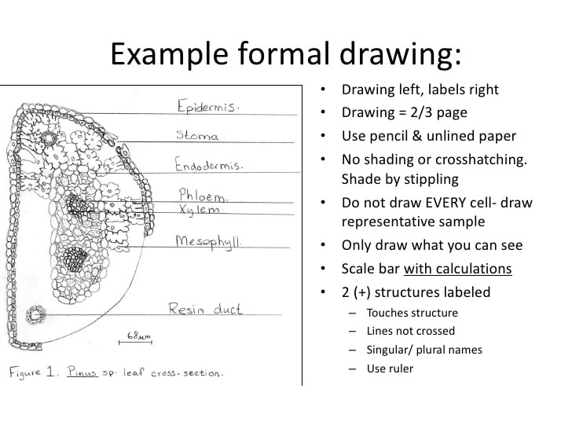

Slide 41
Producing a scale bar
Look through eyepiece and record number of e.g.u the length of the cell is.
Example
Width of cell is 1 e.p.u
You calculated that 1 e.p.u at x400 is equal to 25um
Draw your cell in lab book (half a page on blank paper)
Measure cells width you drew
Example
If the cell you drew was 80mm across
Scale bar 80mm = 25um
25um

