Slide 1
In pairs, predict what the following code is doing
1 2 3 4 5 6 7 8 | def calc(): print(“Enter the first number:”) number1 = float(input()) print(“Enter the second number:”) number2 = float(input()) total = number1 + number2 print (total) calc()

Slide 2
Procedures and Consolidation

Slide 3
Learning objectives
Use a procedure with no parameters
Consolidate previous learning including
  output
  input
  assignment
  datatypes
  casting

Slide 4
Copy the code and run. Does it do as you as expected?
1 2 3 4 5 6 7 8 | def calc(): print(“Enter the first number:”) number1 = float(input()) print(“Enter the second number:”) number2 = float(input()) total = number1 + number2 print (total) calc()
You can download a copy of the code from:
calc.py

Slide 5
Procedures
Procedures are useful if you want to run the same block of operations multiple times to perform some task. We define procedures in the following way:
def name_of_procdure():
statement_1
…
statement_n
name_of_procedure()

Slide 6
Procedures
def calc():
print(“Enter first number”)
number1 = float(input())
print(“Enter the second number:”)
number2 = float(input())
total = number1 + number2
print (total)
calc()
calc()
calc()
calc()
calc()
Name of procedure

Slide 7
Procedures
def calc():
print(“Enter first number”)
number1 = float(input())
print(“Enter the second number:”)
number2 = float(input())
total = number1 + number2
print (total)
calc()
calc()
calc()
calc()
calc()
Always have brackets and colon

Slide 8
Procedures
def calc():
print(“Enter first number”)
number1 = float(input())
print(“Enter the second number:”)
number2 = float(input())
total = number1 + number2
print (total)
calc()
calc()
calc()
calc()
calc()
def means define

Slide 9
Procedures
def calc():
print(“Enter first number”)
number1 = float(input())
print(“Enter the second number:”)
number2 = float(input())
total = number1 + number2
print (total)
calc()
calc()
calc()
calc()
calc()
Statements in the function are indented

Slide 10
Procedures
def calc():
print(“Enter first number”)
number1 = float(input())
print(“Enter the second number:”)
number2 = float(input())
total = number1 + number2
print (total)
calc()
calc()
calc()
calc()
calc()
Call procedure (no indent)
Procedure called 5 times

Slide 11
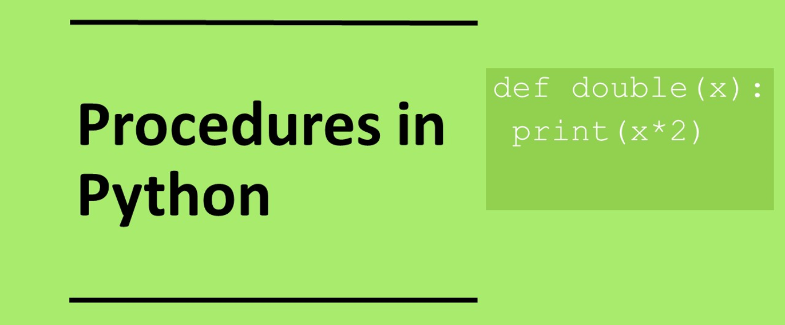

Slide 12
Investigate the code
1 2 3 4 5 6 7 8 | def calc(): print(“Enter the first number:”) number1 = float(input()) print(“Enter the second number:”) number2 = float(input()) total = number1 + number2 print (total) calc()
Add comments on to the code:
What is the name of the procedure?
What line is the casting on?
What casting is being used?
Why is casting being used?
Name 3 variables?
What lines is the output on?
What happens if you swap lines 3 and 5 around?
Overall what is the code doing?

Slide 13
Investigate the code
Add comments on to the code:
What is the name of the procedure? calc()
What lines are the casting on? 3 and 5
What casting is being used? Conversion from string to float
Why is casting being used? So that the input datatypes are floats and calculations can be performed on them
Name 3 variables? number1, number2, total
What lines is the output on? 7
What happens if you swap lines 3 and 5 around? No difference
Overall what is the code doing? Adding two numbers together
1 2 3 4 5 6 7 8 | def calc(): print(“Enter the first number:”) number1 = float(input()) print(“Enter the second number:”) number2 = float(input()) total = number1 + number2 print (total) calc()

Slide 14
Modify the code
1 2 3 4 5 6 7 8 | def calc(): print(“Enter the first number:”) number1 = float(input()) print(“Enter the second number:”) number2 = float(input()) total = number1 + number2 print (total) calc()
Modify the program to ask the user to input 3 numbers.
Multiply the three numbers together.
Get the program to perform to run the calc procedure 3 times

Slide 15
Modify the code: Example
1 2 3 4 5 6 7 8 9 10 | def calc(): print(“Enter the first number:”) number1 = float(input()) print(“Enter the second number:”) number2 = float(input()) print(“Enter the second number:”) number3 = float(input()) total = number1 * number2 * number3 print (total) calc()
Modify the program to ask the user to input 3 numbers.
Multiply the three numbers together.
Get the program to perform to run the calc procedure 3 times

Slide 16
Make 1: Square a number
Write a program that asks the user for a number. Get the program to output the square of that number. Use a procedure.
def square():
# square a number
number = float(input("Enter number to square: "))
# square=number*number
square=number**2
print(square)
square()

Slide 17
Code discussion
Upload your code to the collaboration space (OneNote/www.padlet.com)
In pairs, discuss your code with your neighbour
Share you thoughts with the class

Slide 18
Make 2: Name
Write a program that asks the user for their first name and the for their second name and prints out their whole name
Ask the user to enter their first name.
Ask the user to enter their second name.
Print out the user’s first name and second name

Slide 19
Make 2: Name example
def name():
print("What is you firstname?")
firstname=input()
print("What is you surname?")
surname=input()
fullname=firstname+" "+surname
print(fullname)
name()

Slide 20
Make 3
Write a program that asks the user for a length in centimeters. Get the program to output the length in inches. The conversion from centimeters to inches is 2.39.
def cm2inches():
# cms to inches
cm = float(input("Enter the length in centimetres: "))
inch = cm / 2.39
print (inch)
cm2inches()

Slide 21
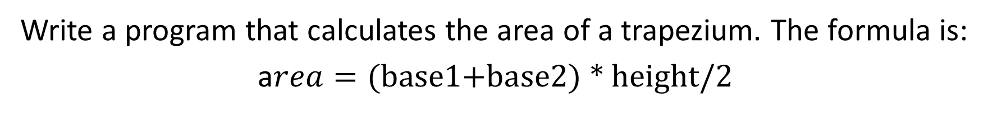
Make 4
Write a program that calculates the area of a trapezium. The formula is:
a$rea=\text{(}\text{base}\text{1+}\text{base}\text{2) ∗ }\text{height}\text{/2}$
def area_trap():
print("Enter base 1")
b1=float(input())
print("Enter base 2")
b2=float(input())
print("Enter height")
h=float(input())
a= (b1+b2)* h / 2
print("trapezium area:", a)
area_trap()

Slide 22

Extension 1
Write a program converts from temperature from Fahrenheit to Celsius
$$Calcius=\frac{9 (Fahrenheit+32) }{5}$$
def temp_conversion():
# Temperature conversion
f = float(input("Enter temperature in Fahrenheit: "))
c = (9 * (f + 32)) / 5
print (c)
temp_conversion()

Slide 23
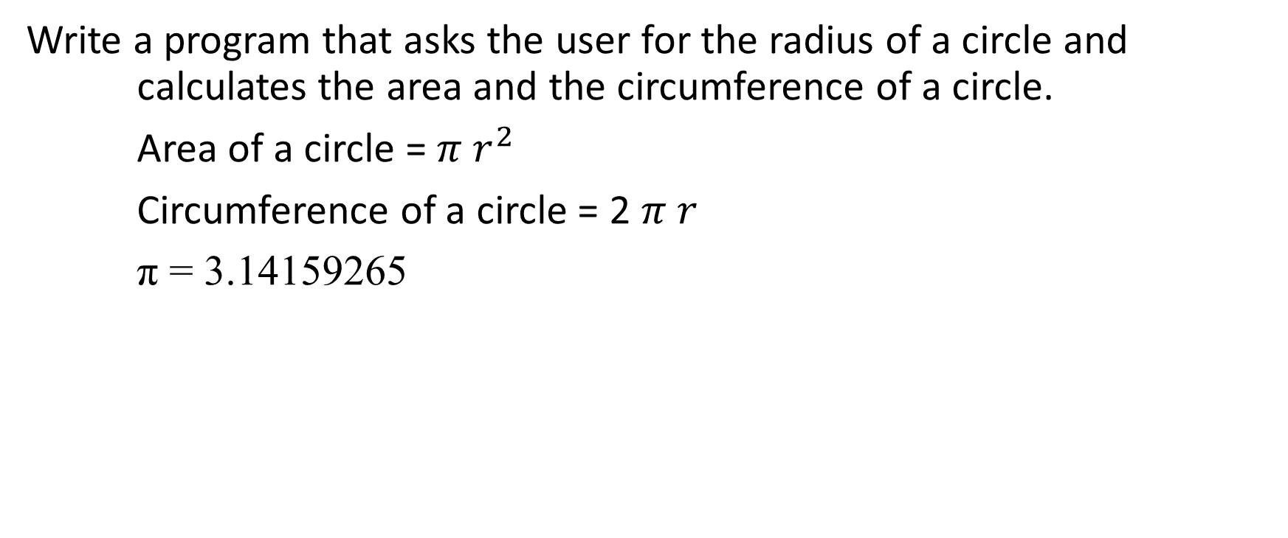
Extension 2
Write a program that asks the user for the radius of a circle and calculates the area and the circumference of a circle.
Area of a circle = $π r^{2}$
Circumference of a circle = 2 $π r$
π = 3.14159265
def circle_calc():
# Circle
pi=3.141
radius=float(input("Enter radius "))
area=pi * radius**2
circumference = 2 * pi * radius
print("area: ", area, "circumference: ", circumference)
circle_calc()

