Slide 1
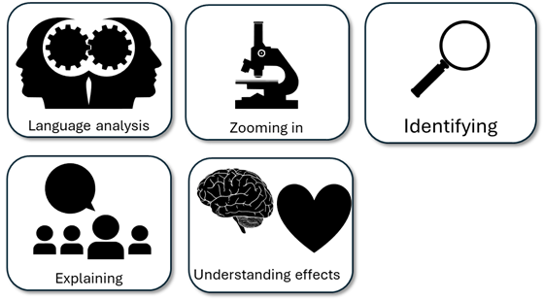
English Language Paper 2 – Q3: Improving Language Analyses
The man talks about his heavy suitcase falling off the rack, so that shows the crash is really bad for the man.
He also tells us that “my little world was tilted drunkenly” so that shows everything was different.
Read the student answer to Q3 above.
What skills did they use in their answer?
How could they improve this answer?
Why does this answer not address AO3 effectively? Provide examples.
AO2
Explain, comment on and analyse how writers use language to achieve effects and
influence readers, using relevant subject terminology to support their views

Slide 2
Learning outcomes
To describe ways of improving our Q3 answers
To explain how student answers can better meet the requirements of the mark scheme
To evaluate the effectiveness of our improved Q3 answers

Slide 3


AO2
Explain, comment on and analyse how writers use language to achieve effects and influence readers, using relevant subject terminology to support their views
This is the mark scheme that examiners use to mark Q3:
Shows perceptive and detailed understanding of language:
• Analyses the effects of the writer’s choices of language
• Selects a range of judicious textual detail
• Makes sophisticated and accurate use of subject terminology
Student’s answer
Analysed the effects of the language
Included quotes to support ideas
Included subject terminology to support ideas

Slide 4
The student did include quotes, but…
The man talks about his heavy suitcase falling off the rack, so that shows the crash is really bad for the man.
He also tells us that “my little world was tilted drunkenly” so that shows everything was different.
• Selects a range of judicious textual detail
Judicious means showing good judgement and sense.
… They didn’t explain the effects of language on the reader, and one good way to do this is by using a range of quotes that back up your interpretations.

Slide 5
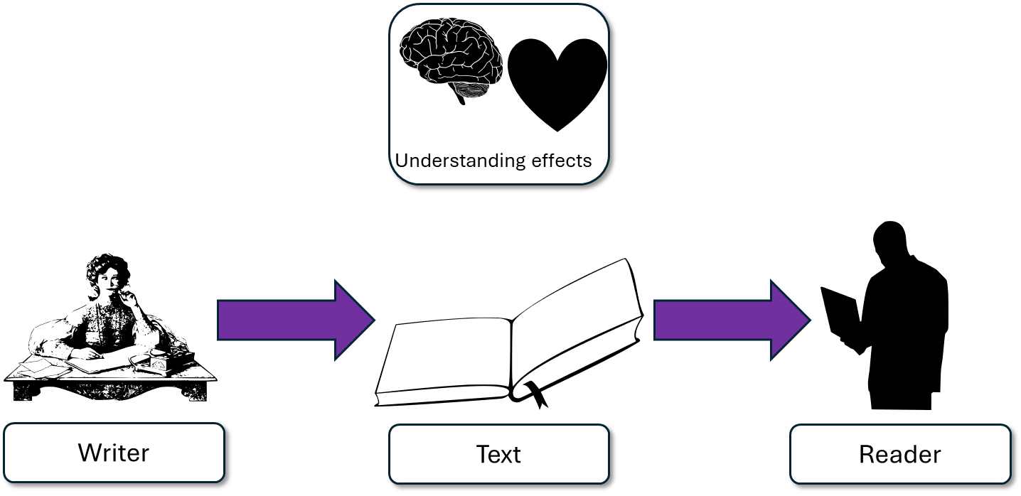
The writer is keen for us to understand the power of the crash and the confusion and panic it causes him. By telling us that “my heaviest suitcase was cannonaded down”, the superlative heaviest (coupled with hyperbole) conveys the destruction caused, but also the verb ‘cannonaded down’ is a military image that amplifies the sense of conflict between the writer and the train. It is as if the train is actively trying to hurt and attack the writer during the crash.
This student’s answer uses the same quote but look at how they’ve zoomed in on that quote and explained the effects on the reader.
The suitcase does fall, but rather than just making the journey ‘bad’, the student explains how two of the techniques used combine to create a sense of panic and confusion for the reader, but also that the language helps us feel that the train is deliberately attacking the man, which alters the mood and tone of the writing.

Slide 6
“I want to convey how confusing and terrifying the crash was for me.
“Wow, it feels like the train is using the objects around the writer to attack him!”
“my heaviest suitcase was cannonaded down”

Slide 7
Let’s help this student to improve part of their answer
He also tells us that “my little world was tilted drunkenly” so that shows everything was different.
“my little world was tilted drunkenly”
Student’s answer
Analysed the effects of the language
Included quotes to support ideas
Included subject terminology to support ideas
Using your understanding of the Q3 mark scheme, transform this into a more effective answer.

Slide 8
Let’s look at another student’s answer
Similarly, the writer explains “my little world was tilted drunkenly”. The use of the adjective little implies that writer is overpowered by the train crash, but also the verb ‘titled’ and adverb ‘drunkenly’ work together to amplify the sudden change in mood and how the writer’s world has been physically transformed, given that the train is behaving in a drunken manner.
Moreover, the use of personification continues throughout the extract as the writer says: “it was definitely conscious of indiscretion.” The writer tells us that the train is aware of the problems it has caused, which again reiterates the conflict between the writer and the train because of the previous issues he has described.
This student’s answer includes a range of evidence or quotes from the text that all help to support their idea: that the train is battling against the writer. Using evidence from different parts of the extract can help to convince the examiner that you’re using evidence judiciously.

Slide 9
We should also include some language devices…
Similarly, the writer explains “my little world was tilted drunkenly”. The use of the adjective little implies that writer is overpowered by the train crash, but also the verb ‘titled’ and adverb ‘drunkenly’ work together to amplify the sudden change in mood and how the writer’s world has been physically transformed, given that the train is behaving in a drunken manner.
Moreover, the use of personification continues throughout the extract as the writer says: “it was definitely conscious of indiscretion.” The writer tells us that the train is aware of the problems it has caused, which again reiterates the conflict between the writer and the train because of the previous issues he has described.
Similarly, the writer explains “my little world was tilted drunkenly”. Little implies that writer is overpowered by the train crash, but also ‘titled’ and ‘drunkenly’ work together to amplify the sudden change in mood and how the writer’s world has been physically transformed, given that the train is behaving in a drunken manner.
Moreover, this throughout the extract as the writer says: “it was definitely conscious of indiscretion.” The writer tells us that the train is aware of the problems it has caused, which again reiterates the conflict between the writer and the train because of the previous issues he has described.
Student 1
Student 2
Discuss: What has the Student 1 included that Student 2 has not?

Slide 10
You must explain your interpretations
Remember that it is crucial that you include explanations as to why the quotes and devices have effects on the reader.
How do those quotes make the reader think and feel?

Slide 11
Last lesson we wrote our own Q3 answers
Drafting and redrafting is an important activity in English because it helps you to become a more effective English analyst.
Using your learning from today and the success criteria, rewrite your answer.
Your answer for Q3
Analysed the effects of the language
Included quotes to support ideas
Included subject terminology (devices) to support ideas
Bonus criteria:
Included analytical verbs
Used a range of quotes to support your ideas

Slide 12



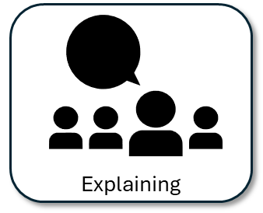
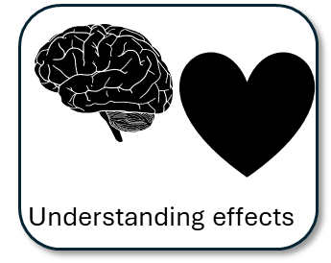
We will now peer assess our new answers
Swap your answers with another student.
Student’s Q3 answer |  | What could they add or change to improve their answer?
Analysed the effects of the language
Included quotes to support ideas
Included subject terminology (devices) to support ideas
Bonus criteria:
Included analytical verbs
Used a range of quotes to support your ideas

Slide 13
Student’s Q3 answer: |  | What could they add or change to improve their answer?
Analysed the effects of the language
Included quotes to support ideas
Included subject terminology (devices) to support ideas
Bonus criteria:
Included analytical verbs
Used a range of quotes to support your ideas
Notes:
To print out for students

Slide 14
Let’s recap Paper 1 Section A so far
Close your exercise books and cover up your notes.
What skills do you need to show for Q1? (4 marks)
What skills do you need to show for Q2? (8 marks)
What skills do you need to show for Q3? (12 marks)

Slide 15

Q1 Recap
Q1: You are given a short extract from the text.
You are given eight statements. Four of them are true, four are false.
Shade in the circles next for the four true statements.
Do not shade in more than four circles.
Identifying

Slide 16
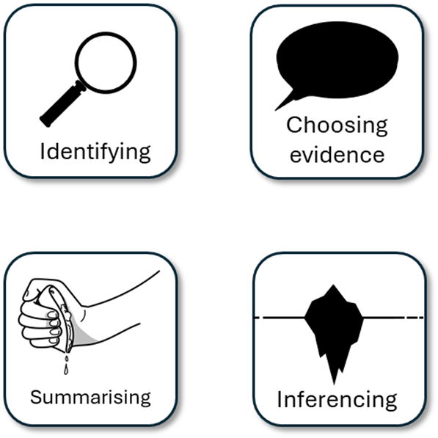
Q2 Recap
Q2: You are asked to write a summary about a key focus. In this example, it is the differences between the two trains.
You must include examples or quotes from both texts.
You must include inferences (this suggests…) about both texts.
You must only write about the information relevant to the focus given to you in Q2.
You could include connectives.

Slide 17
Q3 Recap
This is the language analysis question.
It is worth 12 marks, so you will need to mark a good range of points to hit the top mark.
You will be asked to analyse the use of language in a small part of the source to explain how the writer uses language to describe something (in this case, the train crash).
You must include clear points that answer the task.
You must include quotes or examples to support your points.
You must analyse how the use of language affects the reader’s thoughts and feelings.
You should include specific language techniques to highlight your use of terminology.

Slide 18

Plenary: One Word
Reduce everything you have learnt from today’s lesson down to just one word, e.g. Analysis.
Now, the person next to you is going to explain why you chose that word.
To describe ways of improving our Q3 answers
To explain how student answers can better meet the requirements of the mark scheme
To evaluate the effectiveness of our improved Q3 answers

