Slide 1
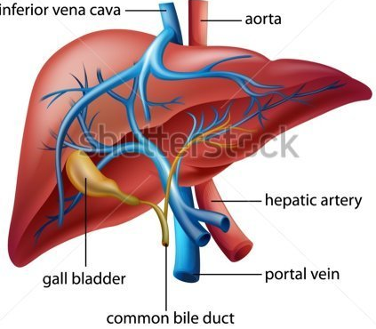
Knowledge retrieval starter
Hepatic artery
Oxygenated blood from the heart comes from the aorta, through the hepatic artery and into liver.
Supplies oxygen for aerobic respiration
Liver cells very (metabolically) active, have large number of mitochondria in their cells
Portal vein
Deoxygenated blood from digestive system enters liver here.
Contains products (biomolecules) from digestion
These substances will be in different concentrations and of different toxicity
These substances need to be removed from the blood
Central vein
Blood leaving liver
Re-joins vena cava
Bile duct
Bile secreted from liver travels along this and is stored in gall bladder

Slide 2
Req
Liver to blend and mix with hydrogen peroxide
Microscopes and liver cell slides

Slide 3
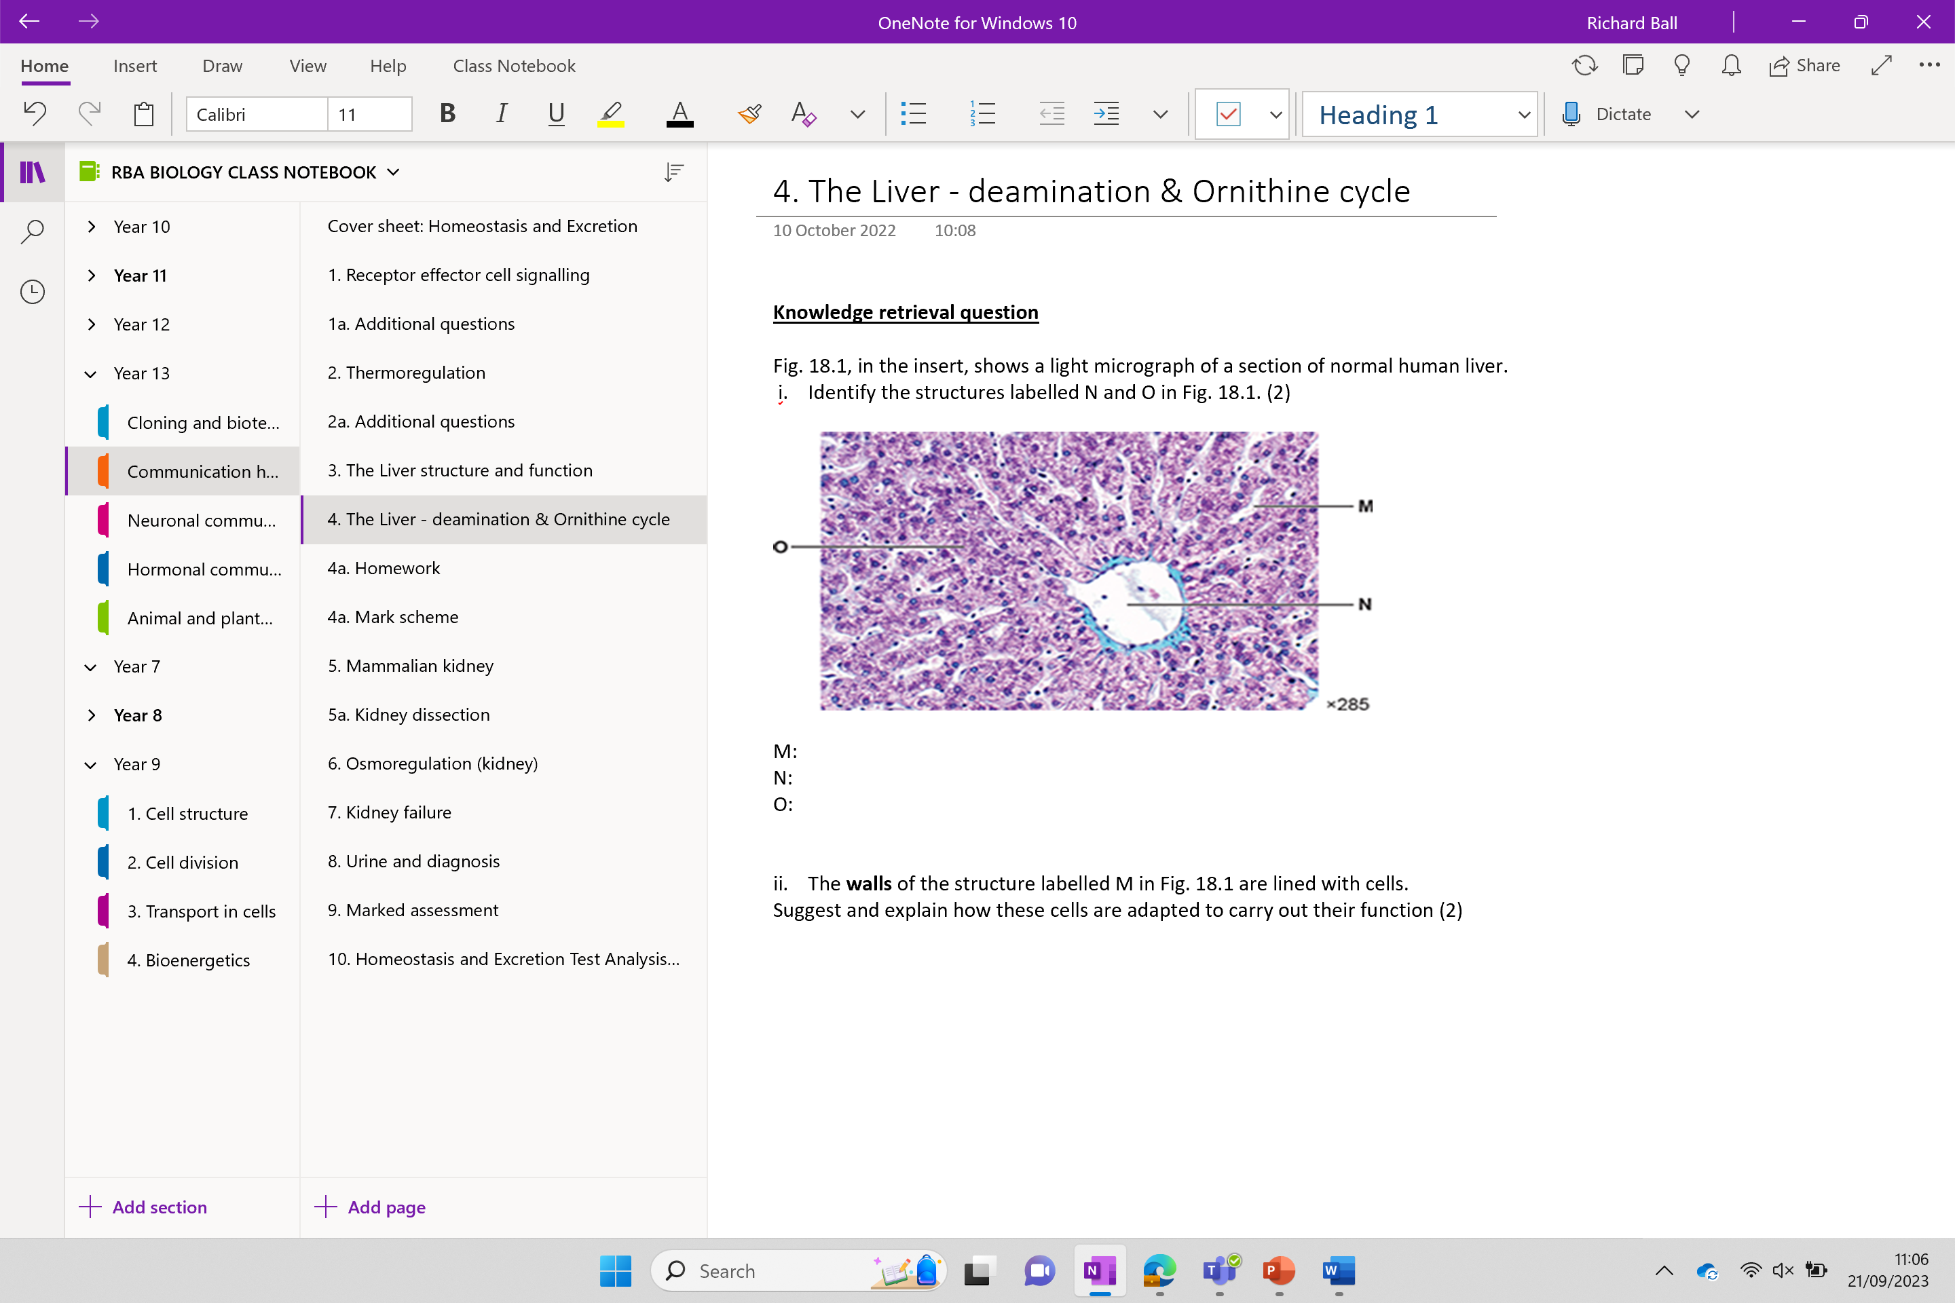

Slide 4
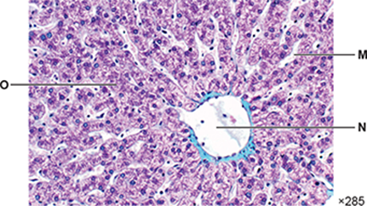
Knowledge retrieval question
Fig. 18.1, in the insert, shows a light micrograph of a section of normal human liver.
i. Identify the structures labelled N and O in Fig. 18.1. (2)
M:
N:
O:
ii. The walls of the structure labelled M in Fig. 18.1 are lined with cells.
Suggest and explain how these cells are adapted to carry out their function (2)
thin / flat, cells ✓
short diffusion distance ✓
OR
fenestrated ✓
increases permeability ✓
Sinusoid
Central vein
Hepatocyte cells

Slide 5
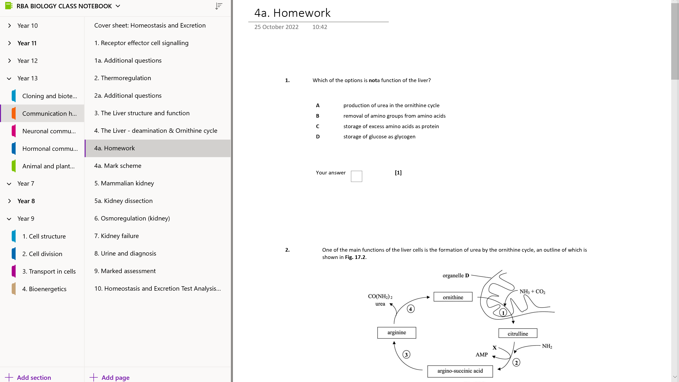
Homework – due next lesson

Slide 6
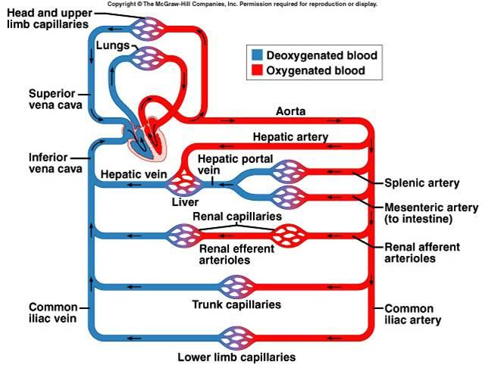

Slide 7
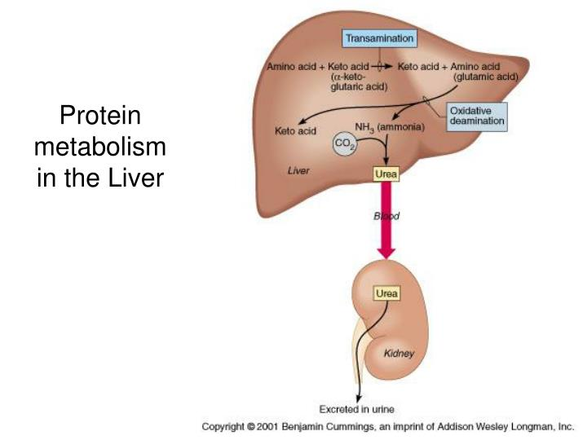

Slide 8
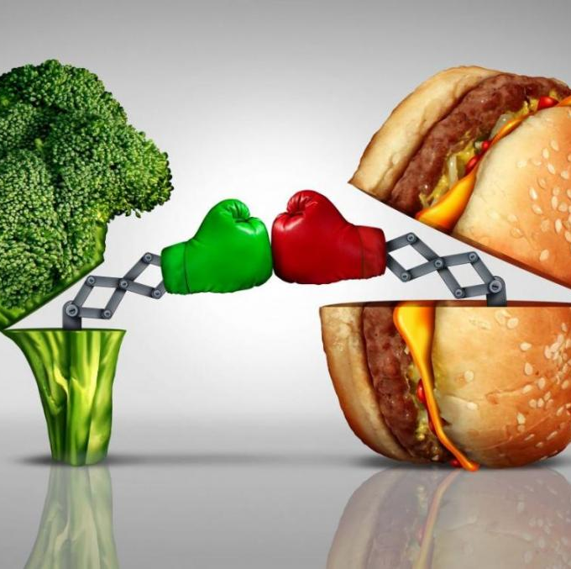
Transamination

Slide 9
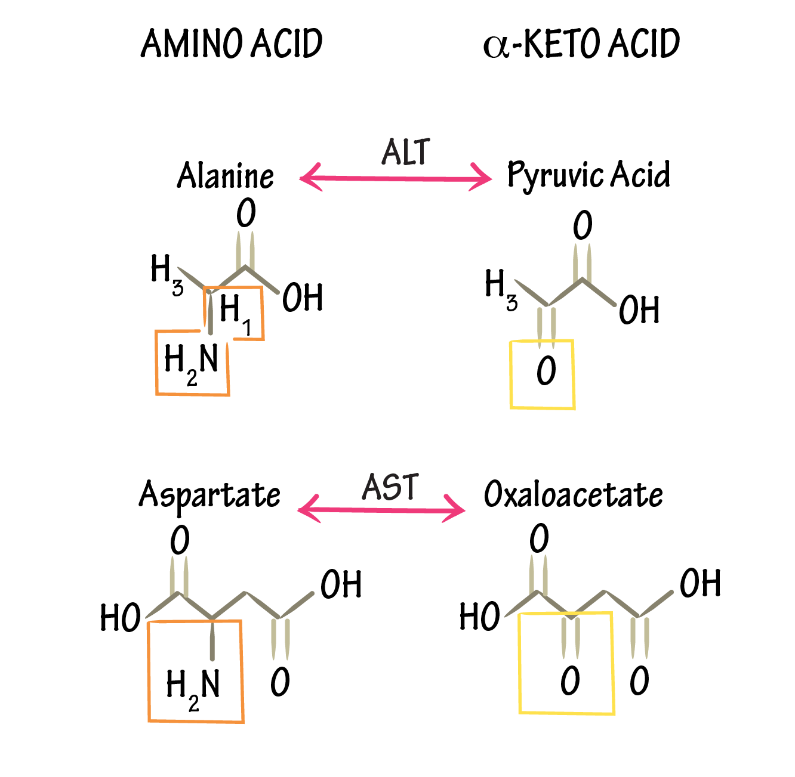
Transamination
The conversion of one amino acid into another within the hepatocyte cells.
Why is this so important?
A humans diet may not always contain the required balance of amino acids

Slide 10
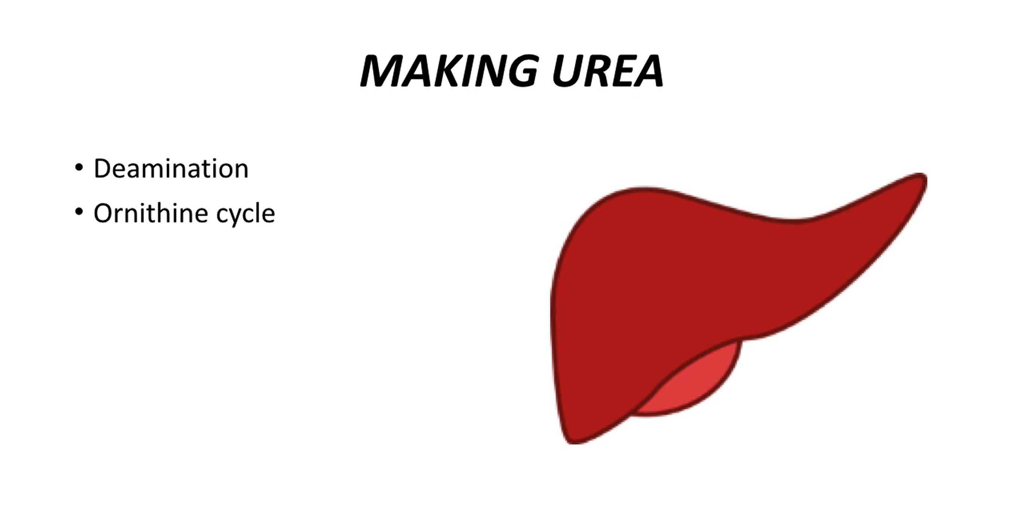
A two-step process

Slide 11

Protein
Notes:
Unable to store protein

Slide 12
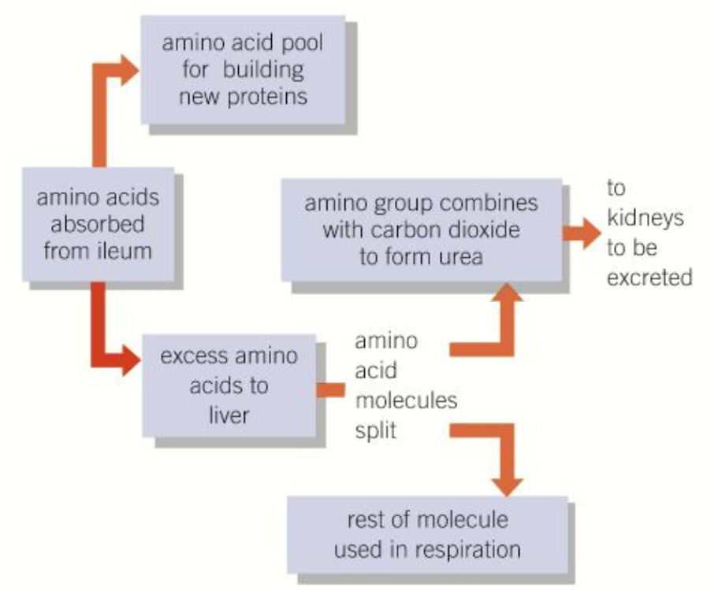
Deamination
Deamination process
The removal of an amine group from a molecule.
The body is unable to store proteins or amino acids, so must find a way to use or remove them
Remaining amino acids can also be converted into lipids for storage
Excess amino acids → deamination (produces toxic ammonia) → ammonia combines with CO₂ to form urea
Notes:
Without deamination any excess protein would be excreted and wasted – so the hypatocytes are really important for this reason
Ileum is the final part of the small intestine – absorb nutrients from digestion

Slide 13
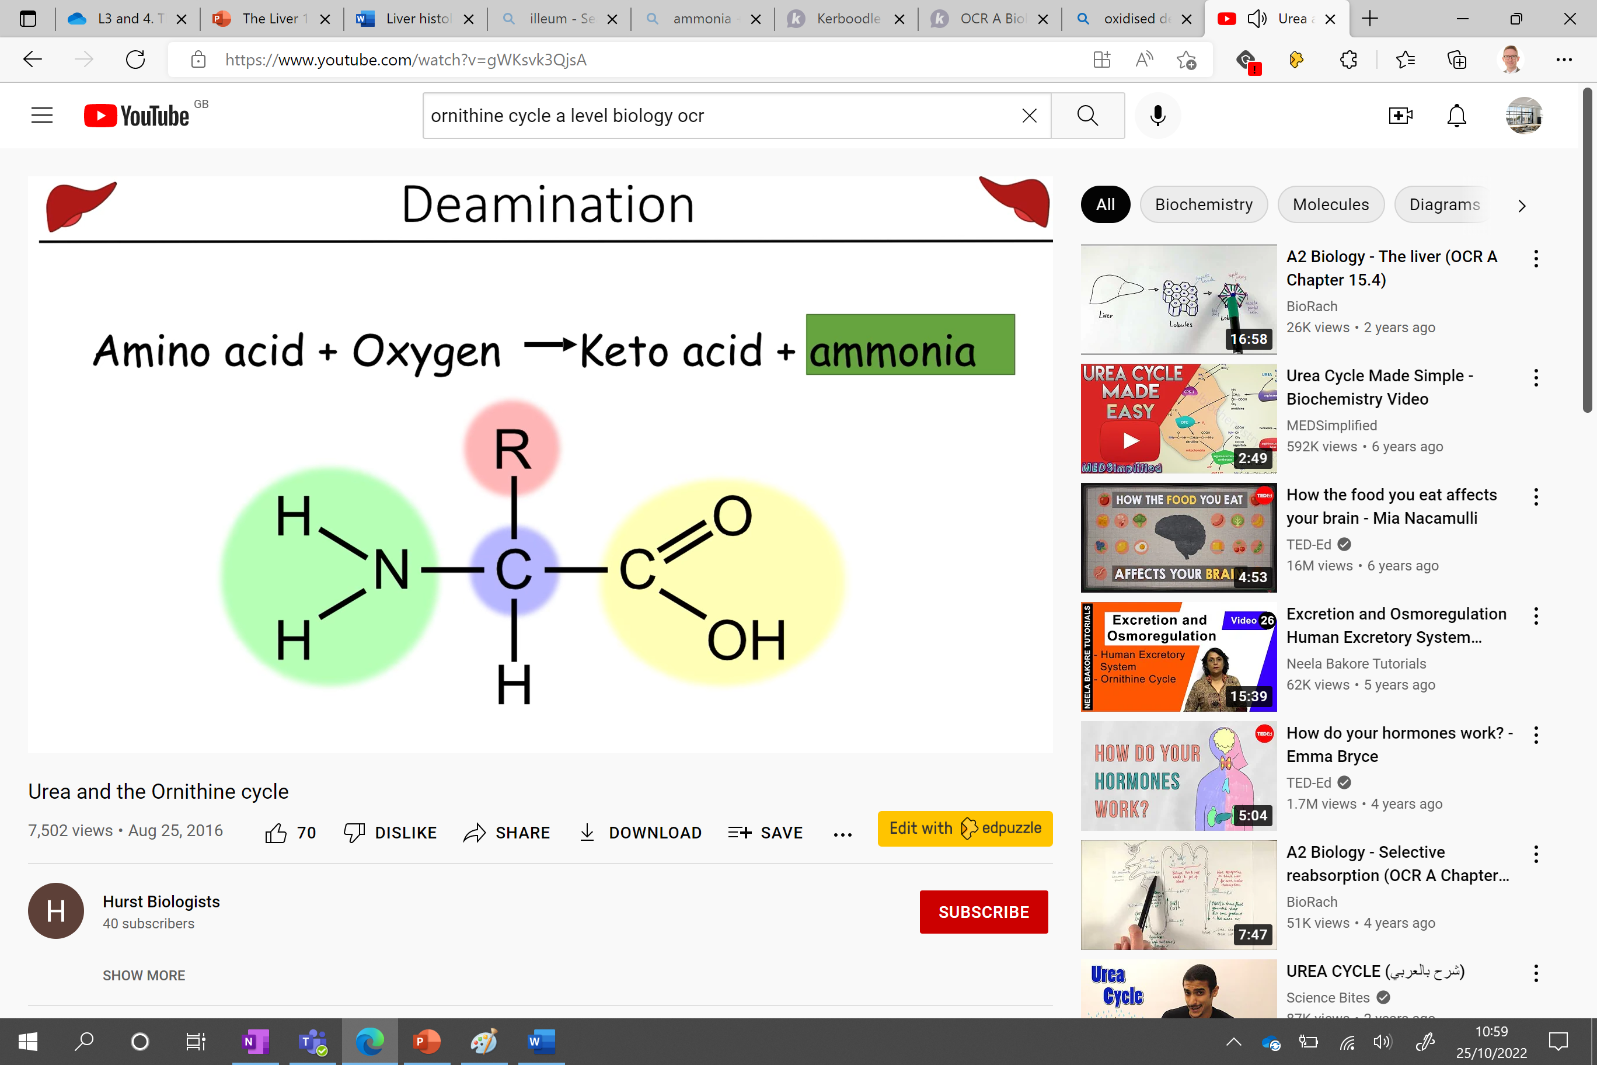
Process of oxidised deamination
Amino acid → ammonia → urea
The amino group is removed from the amino acid during deamination.
The ammonia is then fed into the ornithine cycle to create urea
Remain part of amino acid can be used a fuel (converted into glucose)
Notes:
Another hydrogen added to create NH3?

Slide 14
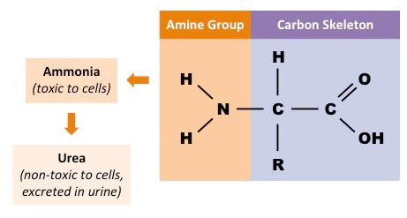
Ornithine cycle
Ammonia produced during deamination of proteins is converted into urea
Urea is more manageable and less toxic than ammonia
The is controlled by a number of enzymes in a process called the ornithine cycle
Here's how……..

Slide 15
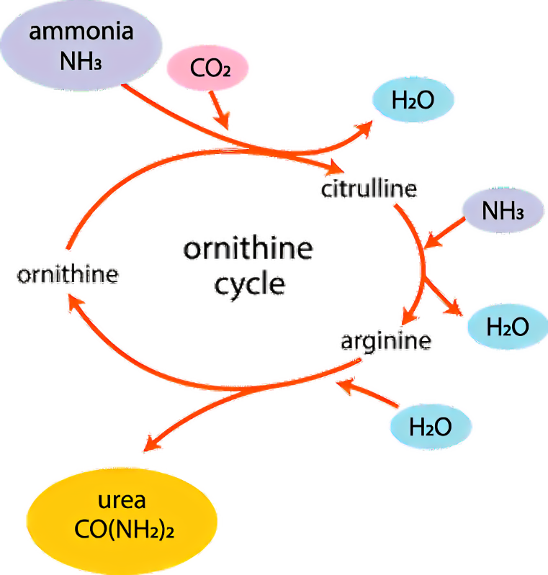
1) Ammonia and CO₂ combined with ornithine to produce citrulline. Water is also produced.
What type of reaction is this?
Condensation
*ornithine, citrulline and arginine are all amino acids
2) Ammonia is then added to citrulline to form arginine
3) Arginine is hydrolysed to produce urea which is removed, reforming ornithine which is fed back into the cycle

Slide 16
1) Ammonia and CO₂ combined with ornithine to produce citrulline. Water is also produced.
What type of reaction is this?
Condensation
*ornithine, citrulline and arginine are all amino acids
2) Ammonia is then added to citrulline to form arginine
3) Arginine is hydrolysed to produce urea which is removed, reforming ornithine which is fed back into the cycle

Slide 17
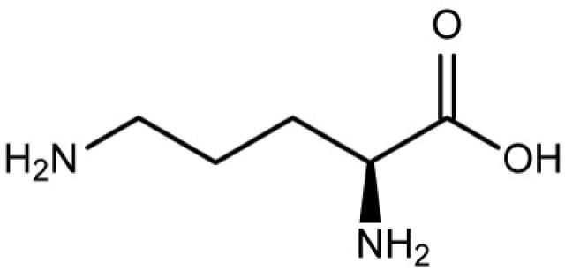
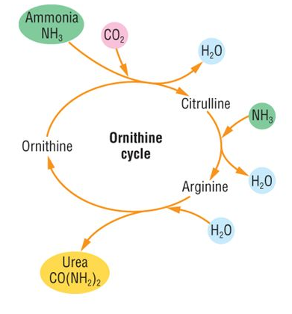
Ornithine cycle
https://www.youtube.com/watch?v=gWKsvk3QjsA
Ornithine
Write a word and chemical equation to summarise this cycle
carbon dioxide + ammonia → urea + water
……….. + ………… → CO(NH₂)₂ + ………….

Slide 18
Ornithine cycle
https://www.youtube.com/watch?v=gWKsvk3QjsA
Ornithine
Write a word and chemical equation to summarise this cycle
carbon dioxide + ammonia → urea + water
CO₂ + 2NH₃ → CO(NH₂)₂ + H₂O

Slide 19
How do we create a toxic environment in our body?
Drugs
Alcohol
Metabolic pathways

Slide 20
Detoxification
Here are two examples you may be asked about:
How are the following broke down?
Hydrogen peroxide
A by-product of various metabolic pathways (immune response)
Hepatocytes contain the enzyme catalase
This splits hydrogen peroxide into water and oxygen.
Ethanol
Broken down by the enzyme alcohol dehydrogenase, also found in hepatocyte cells.
The ethanol breaks down into ethanal
Ethanal is then converted into ethanoate.
Ethanoate can be used to build fatty acids or used in cellular respiration
Many other metabolic pathways produce potentially poisonous substances.
We also consume a wide variety of toxins like alcohol and other drugs.
The liver is the site where these substances are detoxified and made harmless.
Notes:
Hydrogen perioxide produced by natural killer cells during immune responses

Slide 21
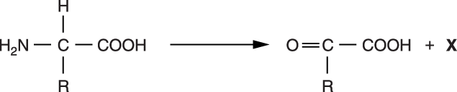
Most excess amino acids are metabolised in the liver, resulting in products that are relatively harmless to the body.
The figure outlines the first step in the metabolism of amino acids in the liver.
The figure shows the first step in the metabolism of amino acids in the liver. The next step involves a series of reactions known as the _ _ _ _ _ _ _ _ _ _ _ _ _ _ _ _ _ _ _ _ _ _ _ _ _ cycle. The toxic product X enters the cycle together with _ _ _ _ _ _ _ _ _ _ _ _ _ _ _ _ _ _ _ _ _ _ _ _ _ , resulting in the formation of the final nitrogenous product _ _ _ _ _ _ _ _ _ _ _ _ _ _ _ _ _ .
The nitrogenous product is transported to the _ _ _ _ _ _ _ _ _ _ _ _ _ _ _ _ _ _ _ _ _ _ _ _ _ and then via the ureter to the _ _ _ _ _ _ _ _ _ _ _ _ _ _ _ _ _ _ where it is stored as _ _ _ _ _ _ _ _ _ _ before leaving the body.
ornithine
carbon dioxide
urea
Kidneys / nephron / glomerulus
bladder
urine

Slide 22
Tb

Slide 23
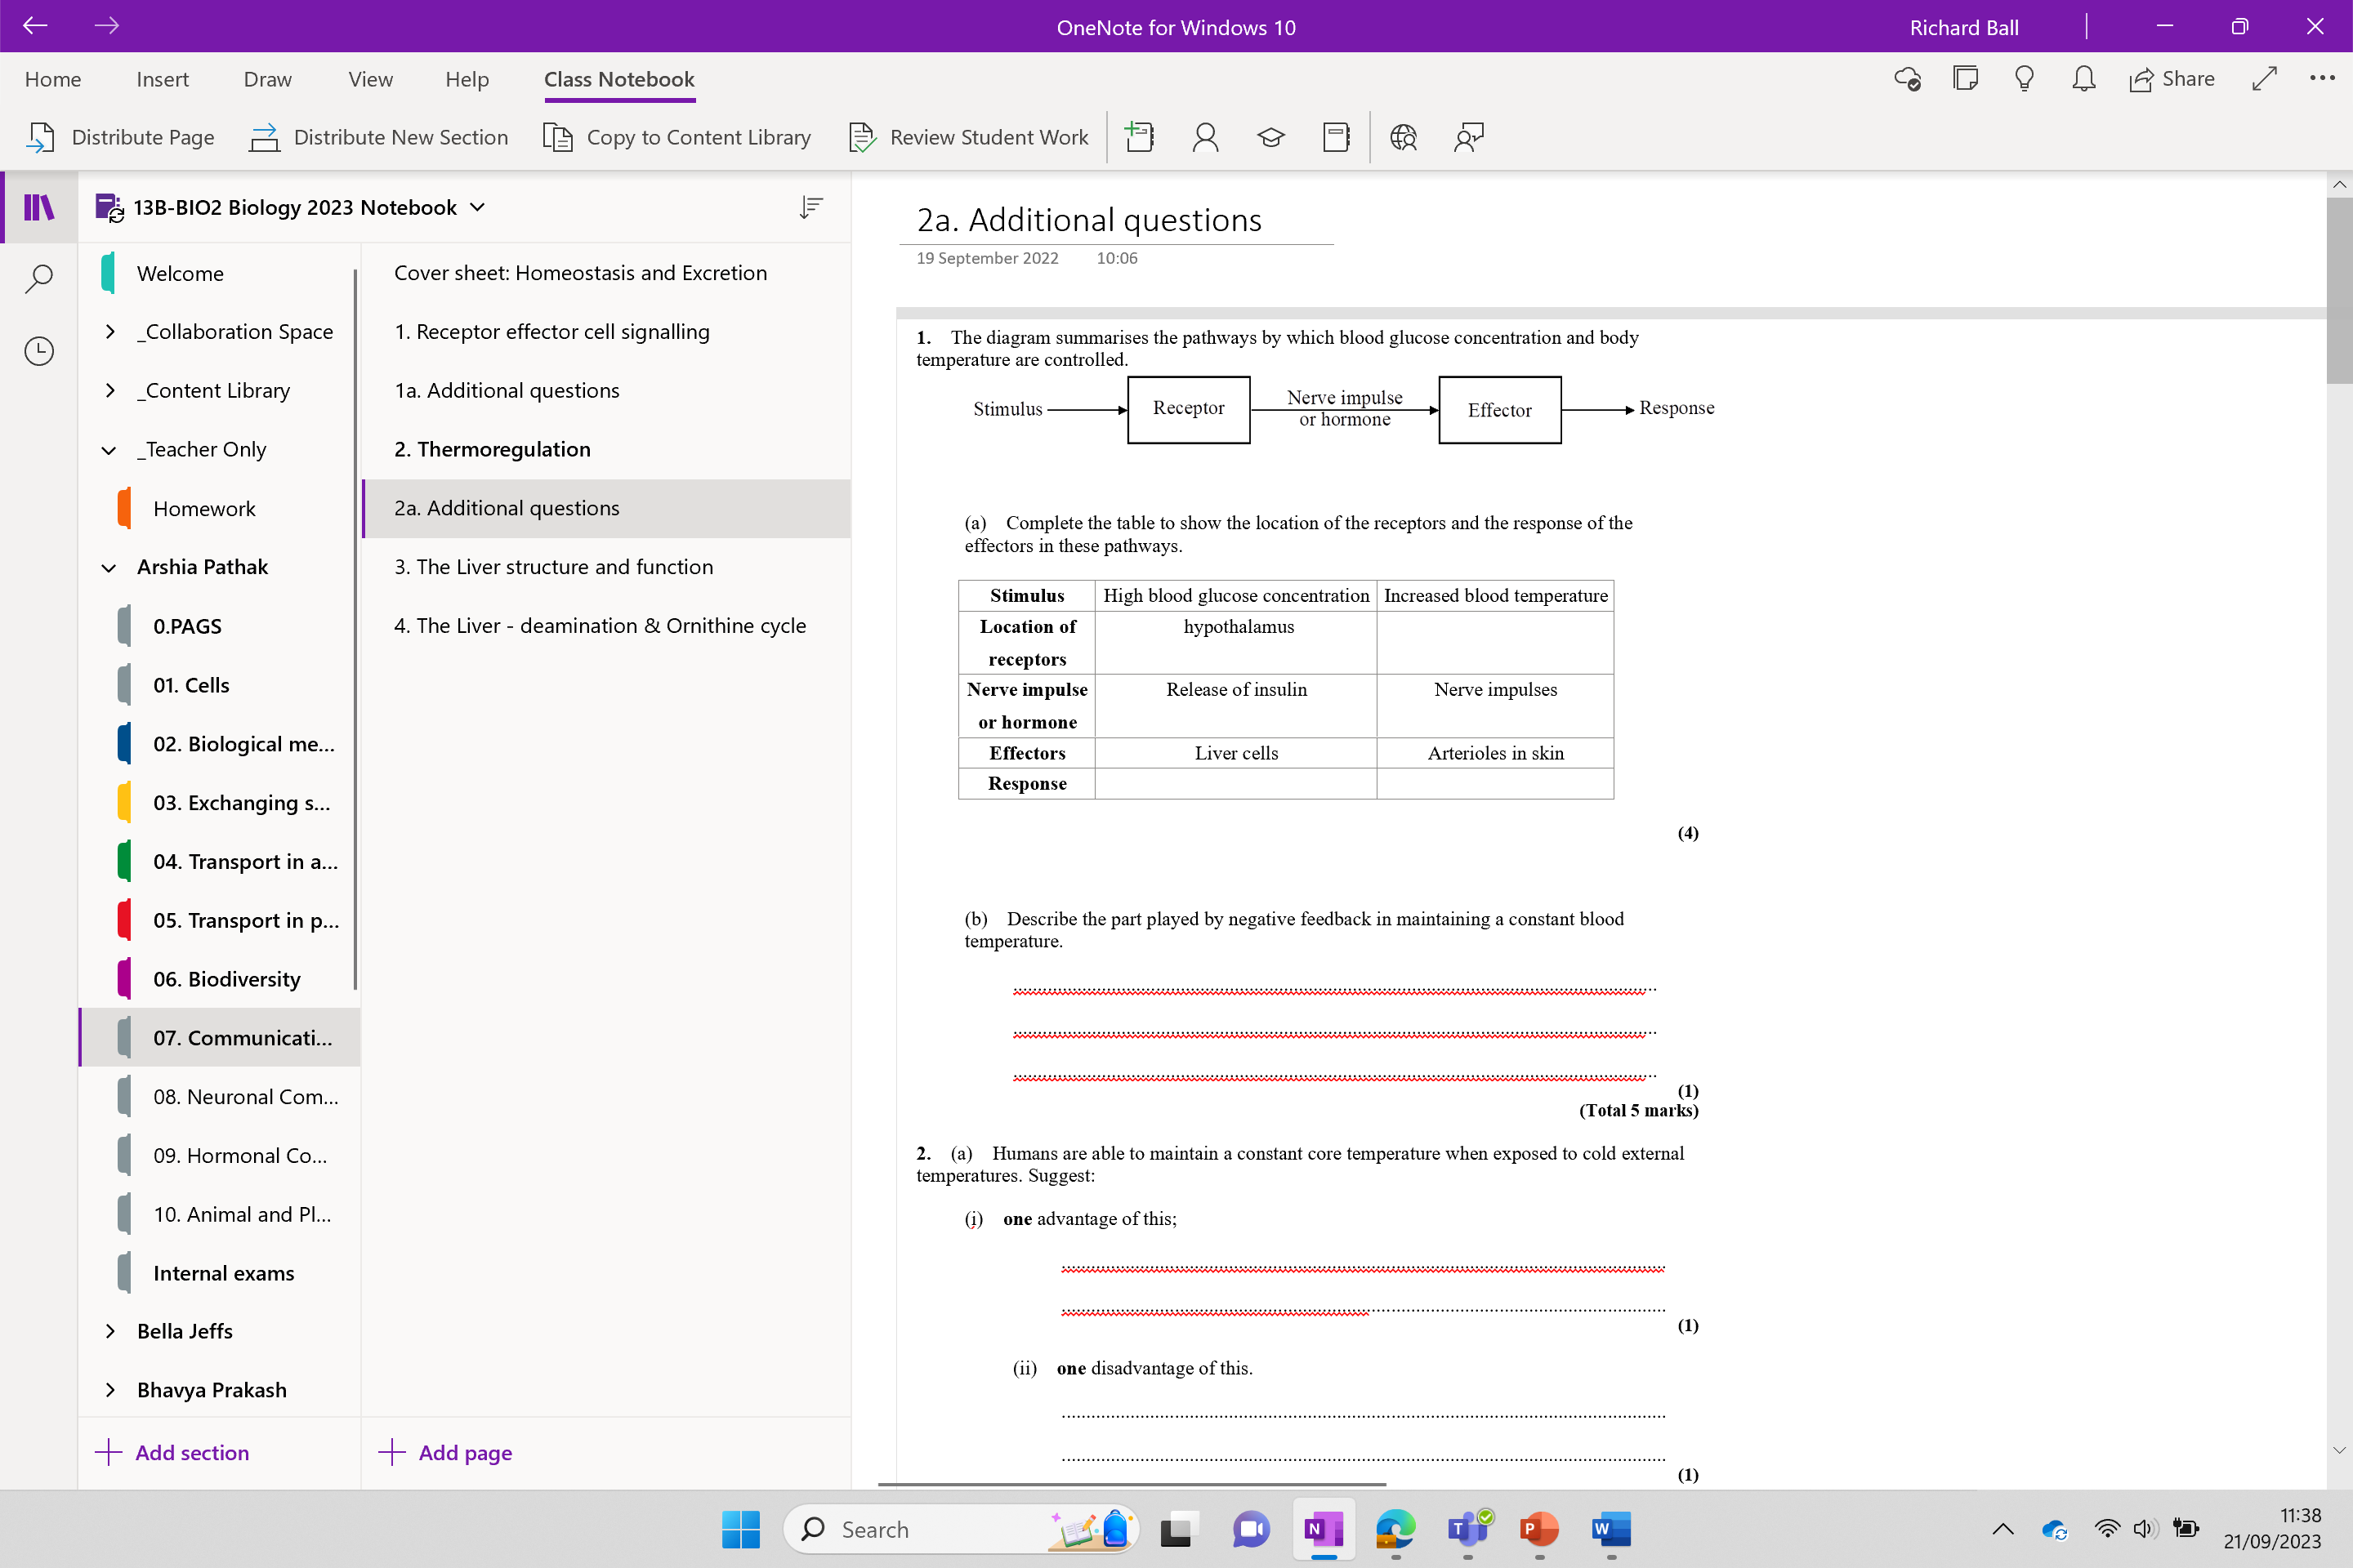
Additional questions

Slide 24
Homework – due next lesson

