Slide 1
Challenge: Try now…………..
A zygote (a fertilised egg cell) is totipotent. After about five days a hollow ball of cells forms – the blastocyst . The cells of the blastocyst are pluripotent. Explain what is meant by the terms totipotent and pluripotent. 2 marks
Totipotent ...............................................................................................................
.................................................................................................................................
................................................................................................................................
Puripotent ...............................................................................................................
.................................................................................................................................
(Answers later!)

Slide 2
Stem cells – how do we get from one to many?
Your spec says:
Describe how cells of multicellular organisms are specialised for particular functions, including erythrocytes, neutrophils, squamous and ciliated epithelial cells, sperm cells, palisade cells, root hair cells and guard cells
Understand the features and differentiation of stem cells, including stem cells as a renewing source of undifferentiated cells.
Describe the production of erythrocytes and neutrophils derived from stem cells in bone marrow
Describe the potential uses of stem cells in research and medicine, including the repair of damaged tissues, the treatment of neurological conditions such as Alzheimer’s and Parkinson’s, and research into developmental biology

Slide 3
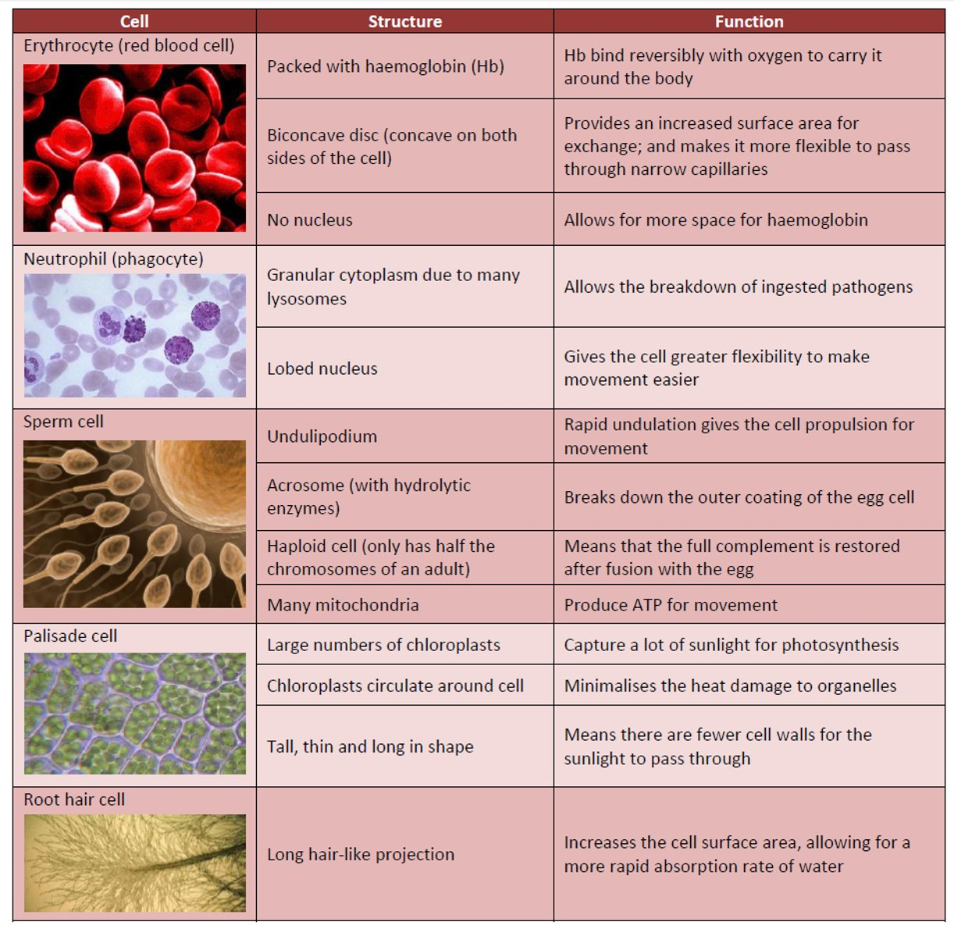
How many specialised cells can you name? What structures do they have which allows them to function effectively?

Slide 4

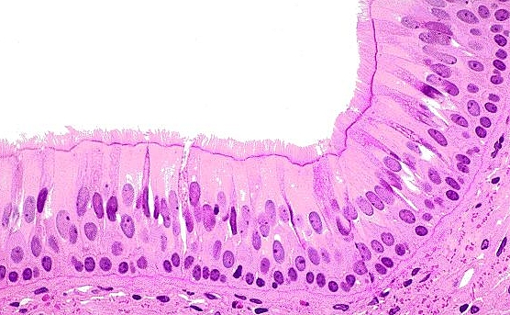
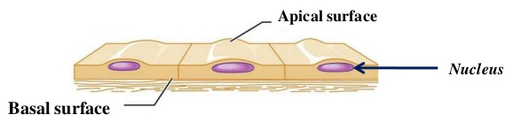
Epithelial cells make up the epithelium (lines the tissue), and endothelium in arteries, veins and capillaries.
Found in:
airways (alveoli)
blood vessels (capillaries)
digestive tract (intestines). Not microvilli!
Ciliated epithelial cells
have cilia
e.g bronchioles, in the oviduct
Squamous epithelial cells
flat in shape
e.g cheeks, blood vessels and alveoli

Slide 5
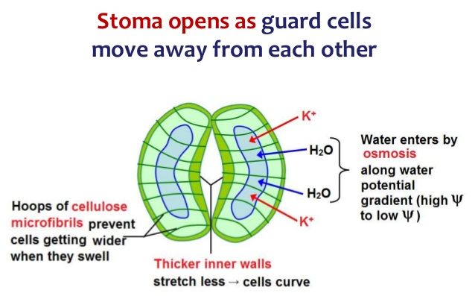
A* thinking:
The guard cells swell because of osmosis. Why does it change shape to open the stomata rather than swell evenly?
Guard cells in plants
Contain chloroplasts…
Light dependent stage of photosynthesis only.
Doesn’t produce sugars but ATP instead.
ATP used to pump K⁺ into cell, lowering ψ. Water follows into cells, via osmosis. Swelling of cells cause stoma to open.
Must have lots of protein carriers for active transport.

Slide 6
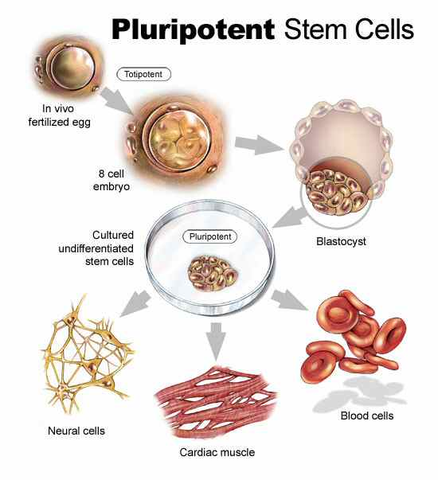
Where do all these specialised cells come from?
Annotate your diagram to define the new key words.
Totipotent – all cell types including extraembryonic, e.g. zygote and spores
Pluripotent – all cell types that make up the embryo.
Multipotent – adult stem cells of more than one type, can only differentiate into a few specialised cells that are closely related.
Add bone marrow, label this and neural cells as multipotent.​
Cardiac muscle and red blood cells are specialised cells, they cannot differentiate any further.

Slide 7
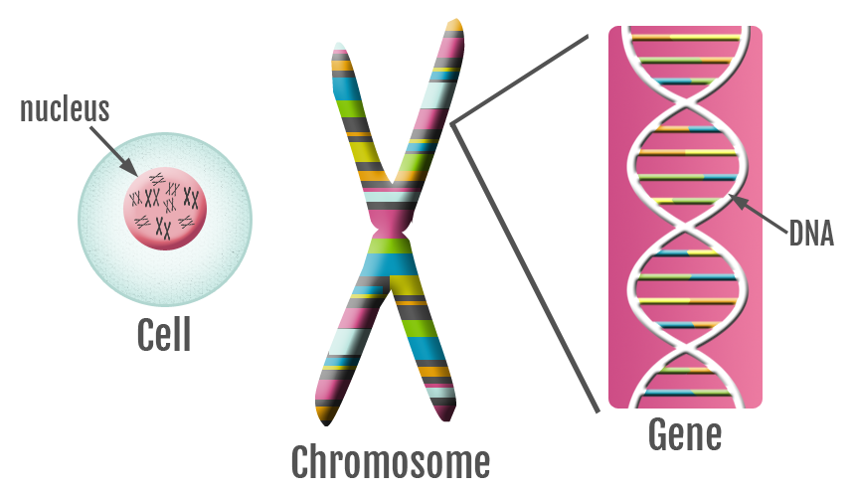
Pluripotent to specialised.
Differentiation – how does it happen?
Every cell contains a copy of the full genetic information.
Only some of the genes are expressed (cellular control year 13 topic)
Active mRNA is produced
Proteins are synthesised
Those proteins determine the specific structure/function of the cell

Slide 8
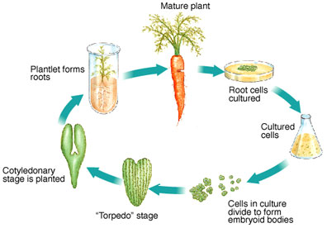
What is the difference between animal and plant totipotent cells?
What is this process called?

Slide 9
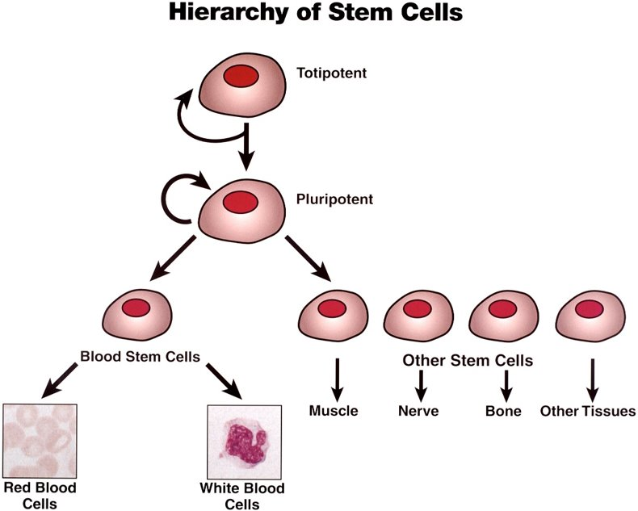
Specialisation of blood cells
Use your knowledge to draw your own family tree for red blood cells (erythrocytes) and white blood cells (neutrophils)

Slide 10
Where do we find these amazing cells?
Pluripotent cells from “spare embryos” discarded during ivf treatment.
Multipotent cells from the umbilical cord blood
Adult multipotent cells from bone marrow etc. (very recent science is suggesting that multipotent cells can be stimulated to become pluripotent)
The meristem (growth plate) of roots and shoots
Lab-grown mini-organs help model disease, test new drugs | Science | AAAS
(extra reading)

Slide 11
The potential use of stem cells in research:
New cardiac muscle cells can be grown to replace those damaged after a heart attack
1. Heart disease
2. Type 1 diabetes
3. Parkinson's disease
4. Alzheimers disease
5. Macular degeneration
6. Developmental biology
Pancreatic cells can be grown that release insulin
These two diseases cause death of brain cells. Stem cells could replace these
Causes blindness in the elderly. Research is looking into replacing these cells
The use of stem cells in the study of how multicellular organisms grow and where things go wrong

Slide 12
Now try again…………
) A zygote (a fertilised egg cell) is totipotent. After about five days a hollow ball of cells forms – the blastocyct . The cells of the blastocyst are pluripotent. Explain what is meant by the terms totipotent and pluripotent. 2 marks
Totipotent ...............................................................................................................
.................................................................................................................................
................................................................................................................................
Pluripotent ...............................................................................................................
.................................................................................................................................
Totipotent cells can give rise to a complete human / all cell types;
Pluripotent cells can only give some cell types; multipotent and differentiated cells. 2 marks

Slide 13
(e) Explain briefly how cells in the blastocyst can become specialised for particular functions. (3 marks)
Differential gene expression / only some genes expressed;
Active mRNA produced;
Proteins synthesised;
Proteins determine structure / function of cell; 3 marks

Slide 14
Answer the following questions:
1. Describe the major differences between embryonic stem cells and adult stem cells
2. Explain why therapies using adult stem cells are less controversial than therapies using embryonic stem cells.

Slide 15
Answers
1. ESC are pluripotent, they can differentiate into every type of cell when stimulated correctly. Their only source is an embryo.
ASC are multipotent, they differentiate into limited tissue cells. They are found in umbilical cord blood, skin tissue and bone marrow.
2. ASC are harvested from living adult consenting donors. Using ESC obviously causes the embryo to die.
Removal of ASC does not cause damage or death to the owner.

