Slide 1

PAG 4.1 The effect of substrate concentration on the rate of enzyme-controlled reactions

Slide 2
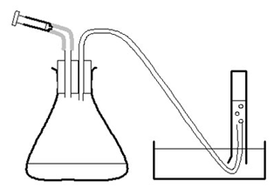
Investigating an enzyme-controlled reaction: catalase and hydrogen peroxide concentration
You need to carry out a serial dilution to prepare your different concentrations of hydrogen peroxide.
Start with 100ml of 20v hydrogen peroxide and dilute it so that you have 50ml of:
20v, 16v, 8v, 4v, 2v
Hint: to dilute from 20v to 16v, add 40cm³ distilled water to 160cm³ hydrogen peroxide

Slide 3
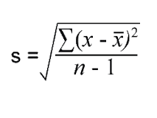
Standard deviation
This PAG asks you to calculate and record standard deviation.
Later in the course we will do this using a formula, but for now, what does SD mean?

Slide 4
Standard deviation measures the amount of variation or spread from the mean.
A low SD indicates that the data has a narrow range, the results are close together (precise), which could indicate greater reliability.
A high SD indicates a larger range of results, which could indicate lower reliability.
On your graph use SD bars to show the spread of the data around each mean value.

Slide 5
Graphs
You need to draw two graphs for this investigation.
1. Mean volume of oxygen (cm3) against time for each concentration
2. Concentration (vol.) against rate (cm3 min-1).

