Slide 1
Knowledge retrieval questions
Q1. What is the difference between an intrinsic (integral) and extrinsic (peripheral) protein, give examples of both? (4 marks)
Q2. Alcohol, caffeine and nicotine are all lipid-soluble molecules – they have an almost instant impact on the body. Explain why? (3 marks)
Q3. Membranes, particularly those in mitochondria are often highly folded. Suggest what advantage this folding provides (6 marks)
Intrinsic protein – embedded in both sides of the membrane
For example a channel or carrier protein
Extrinsic protein – embedded on one side of the cell membrane
For example a glycoprotein or enzymes
Lipid soluble molecules can pass through the membrane
Via diffusion
So diffuse quickly into the cells
Processes occur within or across the cell membrane of the mitochondria
The process (in mitochondria) are enzyme controlled
Folding give increased (larger) surface area
For more enzymes
Increased rate of reaction
Increased rate of ATP production
Notes:
cytochrome-c oxidase, the terminal enzyme of the mitochondrial respiratory chain

Slide 2
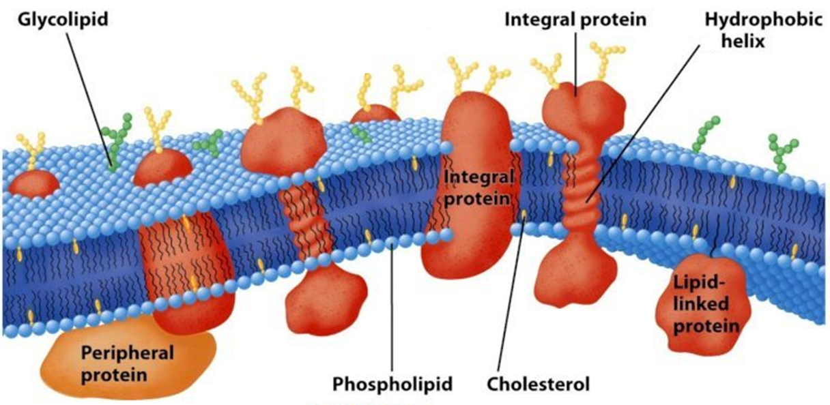
Label your diagram from memory
A
D
B
Glycoprotein
E
I
F
G
H

Slide 3
Label your diagram from memory

Slide 4
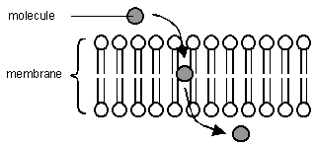
Lipid soluble molecules
Lipid soluble molecules are able to pass through the lipid bilayer.
Giving examples and explain how lipid soluble molecules pass easily through the membrane?
These small, non-polar fat soluble gasses/molecules can dissolve in the plasma membrane.
Examples include gas molecules such as oxygen (O₂) and carbon dioxide (CO₂)

Slide 5
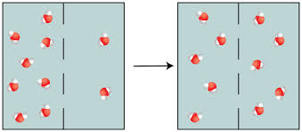
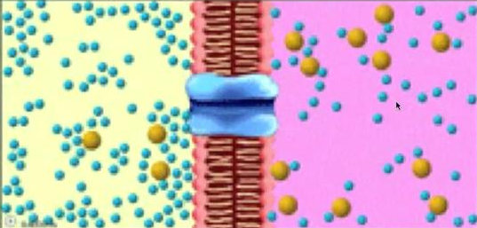
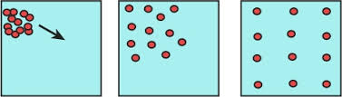
How many types of movement of molecules can you remember?
What are the main differences between them?

Slide 6
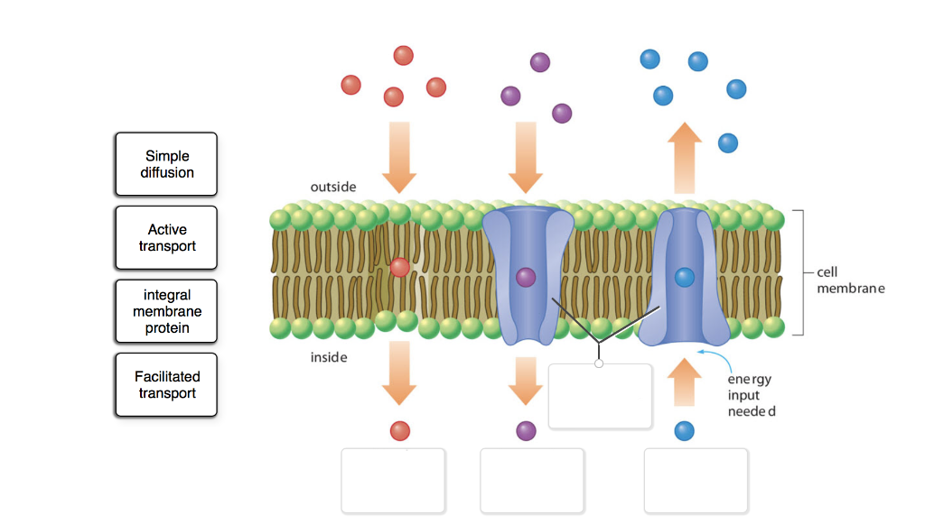
Give examples of molecules that travel across the membrane via each process
Integral membrane proteins
Simple
Diffusion H→L
O₂/CO₂/Water
Facilitated
Diffusion H → L
Ions / glucose / amino acids
Active transport L→H
glucose / ions

Slide 7
Past exam style question
How can a protein carrier assist with facilitated diffusion if it needs to change shape to allow molecules to cross the plasma membrane? (3 marks)
Hint: It does not use any ATP for this!
Kinetic energy in molecules (passing through the protein carrier )
force the protein carrier to change shape
without the need of metabolic ATP

Slide 8
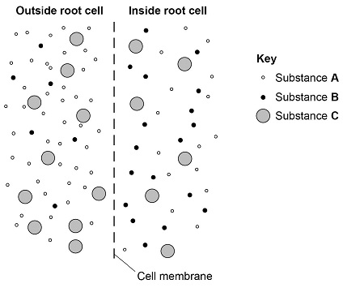
Discuss / answer the following questions:
What might substance A be and how does it cross the membrane?
What might substance B be and how does it cross the membrane?
What might substance C be and how does it cross the membrane?
What does hypertonic, hypotonic and isotonic to the cell mean?
What does water potential mean?

Slide 9
Discuss the following questions:
What might substance A be and how does it cross the membrane?
What might substance B be and how does it cross the membrane?
What might substance C be and how does it cross the membrane?
What does hypertonic, hypotonic and isotonic to the cell mean?
What does water potential mean?
Water - osmosis
Ions – active transport
Glucose – facilitated diffusion
Hypertonic to cell – lower water potential outside the cell
Hypotonic to cell – higher water potential outside the cells
Isotonic to cell – same water potential on both sides of membrane
The measure of the ability of water molecules to move freely in solution

Slide 10
Water potential
Water potential is the 'measure of the ability of water molecules to move freely in solution’.
All this means is, that in a solution of pure water where there is no solute, all of the water molecules are free to move, so the water potential is high. If a solute is added to the solution, it is attracted to the water molecules, so those water molecules can no longer move as freely, and the water potential is lower.
The highest possible water potential is in pure water (0% solute concentration), with a water potential of 0kPa (kilo-Pascals).
As solute is added this decreases, so a weak solution might have a water potential of -10kPa, and a strong solution might have a potential of -300kPa.
In osmosis, water molecules move down the water potential gradient, from a high water potential (0kPa) to a lower water potential (<0kPa)

Slide 11
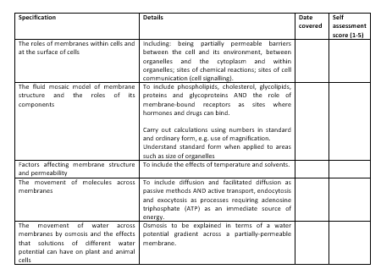
Learning Outcomes
Describe the movement of molecules across membranes.
  Understand what is meant by passive and active transport
  Explain how large molecules are transported into and out of cells.
  Understand the involvement of carrier and channel proteins in membrane transport.

Slide 12
INVESTIGATING TRANSPORT IN CELLS
THREE PRACTICALS
Complete the following practical to recap osmosis, diffusion and active transport.
Answer the experiment questions below each practical sheet
Experiment 1 changes
Pour iodine solution into the viskin tubing and clamp shut at both ends.
Place in a beaker of hot water and another in a beaker of cold water

Slide 13
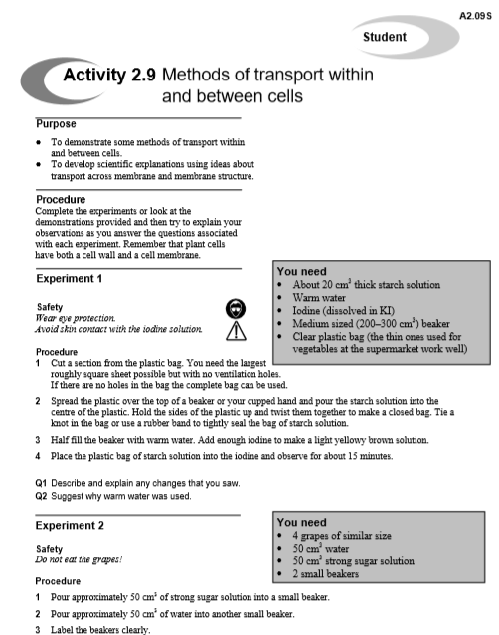
Task
Use snab sheet 2.9 complete experiments 1 & 3 – have fun!
Answer the questions in full sentences – have a try at explanations.
Prepare experiment 2 for tomorrows lesson
Home Learning:
Answer the relevant questions on the SNAB sheet

Slide 14
Learning Outcomes
Describe the movement of molecules across membranes.

