Slide 1
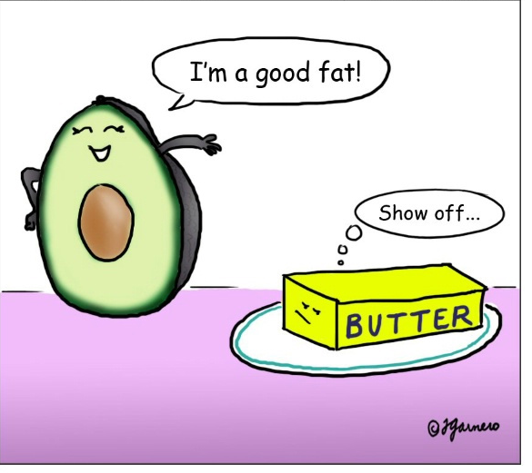
Lipids…..
Good or bad?
Discuss and note down your ideas

Slide 2
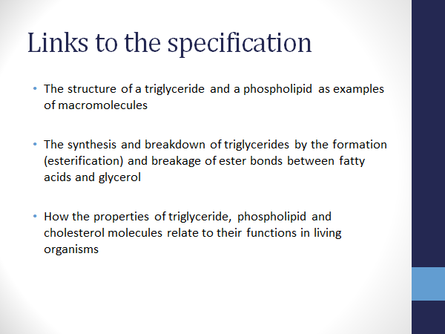

Slide 3
Task….
You are going to produce a “lipid fact sheet”
Listen to the power point and write brief notes all over your fact sheet then use your text book to help you extend and consolidate your learning.

Slide 4
Homework
Use annotated diagrams to explain the formation of a triglyceride (8 marks)

Slide 5
What is a lipid?
Lipids are organic compounds which means they contain:
They include: Fats, Oils & Waxes
Carbon, Hydrogen & Oxygen
You all know that oil and water doesn't mix so what does this tell you about the electron distribution of a lipid?
Made of glycerol (an alcohol) combined with 3 fatty acids. Fats are solid at room temperature & oils are liquids
Contain a variety of different alcohols other than glycerol
Lipids must be non-polar as they repel water, therefore there must be an even distribution of electrons around the nucleus

Slide 6
Triglycerides
O
H
HOOC
Fatty Acid 1
All lipids consist of an alcohol (usually glycerol) attached to 3 fatty acids. The hydroxyl groups on the fatty acids and the glycerol interact forming a bond. It's called an ester bond. The reaction, esterification, releases water & is therefore a condensation reaction.
glycerol
O
H
HOOC
Fatty Acid 2
O
H
HOOC
Fatty Acid 3
O
OC
Fatty Acid 1
glycerol
How many molecules of water need to be added to reverse this reaction and what is this called?
O
OC
Fatty Acid 2
O
OC
Fatty Acid 3
H
HO
+
H
HO
+
H
HO

Slide 7
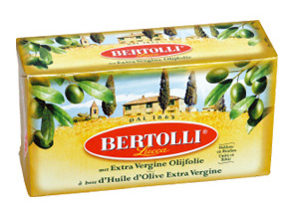
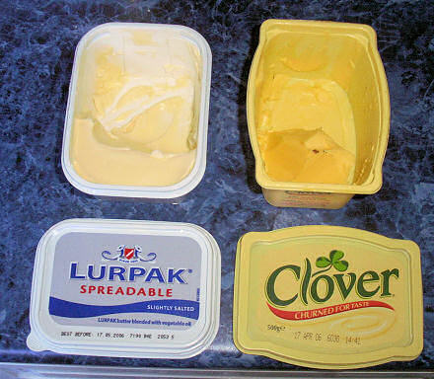
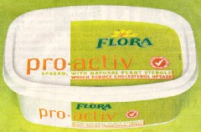
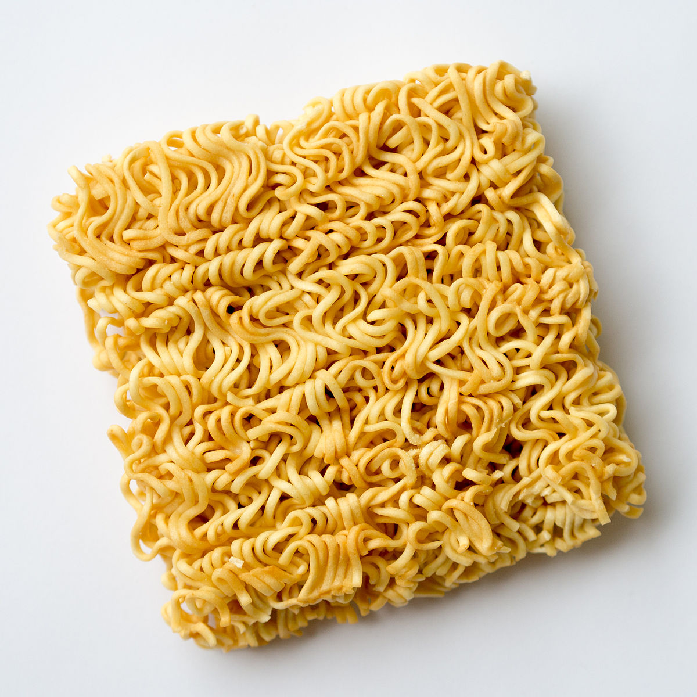
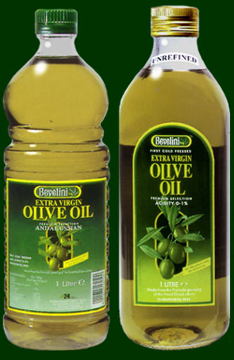
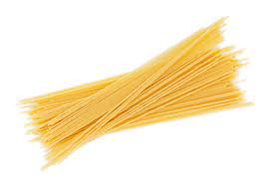
Double bond formed by dehydrogenation. Kink in chain created as bond restricts free rotation of atoms.
Fatty Acids
“Low in saturates, high in poly-unsaturates”
Fatty acids are hydrocarbon chains. The chains can be of varying different lengths, but they all contain a carboxyl (COOH) group.
If the hydrocarbon chain contains at least one double bond, then it is unsaturated. If there are no double bonds in the chain then it is said to be saturated.
Think spaghetti and noodles here :)
Hydrocarbon chains are either saturated (full) of hydrogen atoms, or have some missing, therefore can form double bonds instead.

Slide 8
Lipids – Melting point
Lipids with long chain fatty acids will have a higher melting point as it takes more energy to turn them into a liquid. They will therefore be solid at room temp.
Saturated fatty acids have a higher melting point than unsaturated F.A’s due to them having stronger inter molecular bonds. More double bonds further decrease melting point. So unsaturated F.A’s are usually _________ at room temp.
Liquid

Slide 9
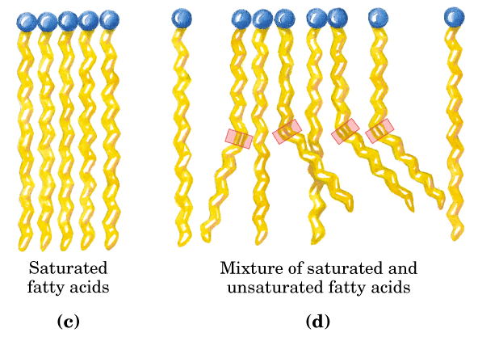
Why do double bonds affect melting point?
Because double bonds (unsaturated F.A’s) cause kinked F.A chains and so they can’t pack as tightly and have weaker intermolecular forces.
spaghetti
noodles

Slide 10
Fatty Acids
“Low in saturates, high in poly-unsaturates”
As most lipids contain glycerol, it is the fatty acids that determine the characteristics of different types of fat.
The fatty acid chains are hydrophobic – they repel water.
Unsaturated fats reduce cholesterol levels in the blood helping in the prevention of cardiovascular disease.

Slide 11
Phospholipids
Phospholipids are lipids in which one of the fatty acids has been replaced by a phosphate group.
O
OC
Fatty Acid 1
Long chain hydrocarbons – repel water (Hydrophobic)
glycerol
O
OC
Fatty Acid 2
Phosphate
Polar end of molecule attracts water - Hydrophilic
O
OC
The hydrophobic v hydrophilic parts of the phospholipid are important in the role of phospholipids in the cell membrane.

Slide 12
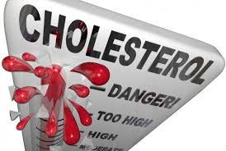
Cholesterol – good or bad?
Good:
Maintains the correct fluidity of cell membranes, not too fluid or stiff.
Involved in manufacture of steroid hormones and vitamin D
A component of bile
Bad:
Contributes to plaque formation in the arteries
Cholesterol :
25% diet, 75% made in the liver
A sterol, not made from glycerol or fatty acids
Hydrophobic

Slide 13

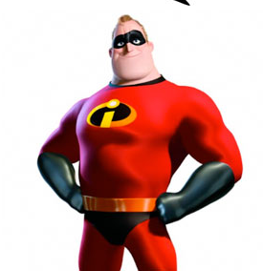
LDL’s and HDL’s
The 'density' part here refers to the density of proteins to lipids. HDL has higher protein density
Cholesterol is not soluble in the blood, it must be transported by a lipoprotein carrier:
Low density lipoproteins are the “bad guys”
They bind to the cell surface, blocking receptors and leaving other LDL’s in the blood stream
High density lipoproteins are the “good guys”
They transport cholesterol in the blood, taking it to the liver to be broken down

Slide 14
Copy and complete:
Add an illustration to help you remember which one is which
Property | LDL | HDL
What are they formed from?
What is their function?
What process are they associated with?
How much of these should we eat?
Saturated fats, protein, cholesterol
Unsaturated fats, protein, cholesterol
Bind and block cell receptors, leaving excess LDL’s in blood
Transport cholesterol in blood to be broken down in liver
Plaque deposits in atherosclerosis
Prevents atherosclerosis by reducing blood cholesterol
Higher levels (In moderation)
Low levels

Slide 15
Next….
Transfer all the facts onto your own sheet.
Use bright colours and pictures to help you remember facts.
Finish the carbs, lipids, proteins key word card sort.

