Slide 1

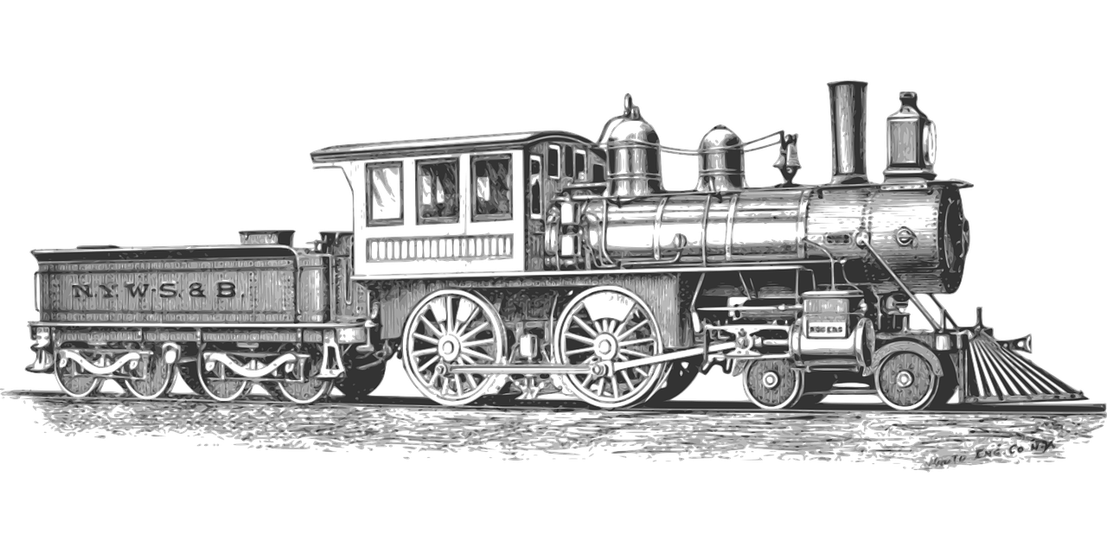

AQA English Language Paper 2 – Q3: Language Analysis
We previously explored Q1 (identification) and Q2 (summary skills) for Paper 2.
We will look at Q3 today which is all about language analysis.
Let’s explore Source A in more detail.
What are the purpose and audience of Source A?
How do the purpose and audience of the text affect the writer’s language?
Why should we always consider the purpose and audience of a non-fiction text when analysing it? Provide examples.
Purpose: What the writer is trying to achieve when writing their text (for example: writing to inform).
Audience: Who the writer is writing to with their text.

Slide 2
Learning outcomes
To describe the use of language in the extract
To explain how we can improve our language analysis in Q3
To apply our understanding of Q3 skills to our own answers

Slide 3

What does non-fiction mean?
Writing that is informative or factual and not fictional. Fictional writing describes imaginary people and events.
There are lots of different types or formats of non-fiction writing, including speeches, letters, leaflets, essays, reports, articles, reviews, adverts, diaries and so on.
There are lots of different purposes for non-fiction texts, such as writing to argue, writing to advise, writing to explain, writing to persuade, writing to inform and more.

Slide 4
The blurb at the top of each source gives you clues into its purpose, audience and type
The source is from a travel book, so instantly we know the audience will be people either interested in travel or experienced in travel. That means they will want lots of details and descriptions of the journey.
Source A is an extract from a travel book in which Peter Fleming describes his train journey on the Trans-Siberian Railway in 1933. The journey is over nine thousand kilometres and takes more than a week to complete.
We are told that the writer describes their train journey on a specific train called the Trans-Siberian Railway. We now have some understanding of the purpose. He will describe the train journey, but also explain to us about the train, how he thought and felt about the journey and train, and that he may be trying to entertain his readers about his experiences.
It’s also important to consider when the text was written. This one was written in 1933, meaning this type of fast travel over long distances would have still been new and exciting to people in the early 20th century. That’s important when you consider the writer’s style of language.

Slide 5
Q3 focuses on language analysis
It asks you to focus on specific lines. In this example, we are asked to explore lines 12 to 13.
Here is the question:
How does the writer use language to describe the train crash?

Slide 6
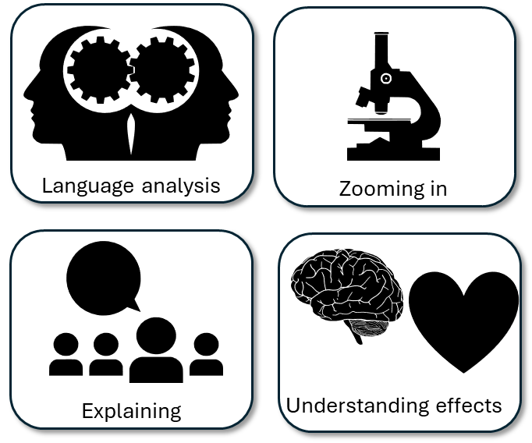

Re-read lines 12 to 23 of Source A
Around your train picture:
Write down examples of how the crash is described
How the writer has employed language techniques
Why this example affects how the reader understands the crash.
“snorting steam”
Use of sibilance and personification to make the reader understand the writer’s feelings about the crash, but also for us to feel a sense of pity for the train.

Slide 8
The extract begins with the idiom or adverbial phrase ‘All of a sudden’ to highlight the change in action and mood. The adjective ‘frightful’ and noun ‘jarring’, work together to alert us to the change in atmosphere.
The writer tells us that his heaviest suitcase falls from the rack, using the superlative ‘heaviest’ to indicate the power of the crash. The military image of ‘cannonaded down’ (which means to be attacked by artillery) highlights how the writer feels out of control and being attacked by the contents of the train during the crash.
All of a sudden there was a frightful jarring, followed by a crash. I sat up in my berth. From the rack above me my heaviest suitcase was cannonaded down, catching me with fearful force on either knee-cap. This is the end of the world, I thought, and in addition they have broken both my legs. My little world was tilted drunkenly. The window showed me nothing except a few fields. It was six o’clock. I began to dress. I felt very much annoyed. But I climbed out of the carriage into a refreshingly spectacular world and the annoyance passed.
The writer employs alliteration with ‘fearful force’ to continue the idea of him being attacked during the crash, as the suitcase feels on his knee-caps. He uses hyperbole when saying “this is the end of the world”, and a little humour in dryly claiming “they have broken both my legs”. He says his “little world was titled drunkenly”, personifying the world as being titled and using the adverb ‘drunkenly’ to give the sense that he has no control of what is happening.
He personifies the windows that ‘showed me nothing’, as if the train is actively working against him. He employs a variety of short sentences to highlight his confusion and frustration at what has happened but feels a sense of relief when he gets out of the carriage into “a refreshingly spectacular world”. The adjectives “refreshingly spectacular” may reveal his sense of relief and joy that he has survived the crash.

Slide 9
The writer continues to use personification to describe the train, saying it “sprawled foolishly”. Rather than creating a sense of fear now, the writer seems to feel pity for the train. He personifies the carriages using the pronoun “their” to aid in this conveyance of pity.
His use of the adjective ‘grotesque’ reveals how he feels about the sight of the carriages that are ‘disposed’. He uses personification to describe their ‘attitudes’. All of these techniques describe the change in atmosphere as one that has been transformed from fear and confusion to a mixture of joy and pity.
The Trans-Siberian Express train sprawled foolishly down the embankment. The mail van and the dining-car, which had been in front, lay on their sides at the bottom. Behind them the five sleeping cars, headed by my own, were disposed in attitudes which became less and less grotesque until you got to the last, which had remained, primly, on the rails. Fifty yards down the line, the engine, which had parted company with the train, was dug in, snorting steam, on top of the embankment. It had a defiant and naughty look; it was definitely conscious of indiscretion.
The personification continues as he says the engine had “parted company with the train”, as if it were once friends with the carriages. It was “snorting steam”, using sibilance to suggest the train is angry or annoyed at what has happened.
Finally, the writer uses personification to tell us that the train has a “defiant and naughty look”. He feels as if the train is perhaps too proud to show any sense of responsibility, even though it was “definitely conscious of indiscretion”. The personification helps us to find humour in a very dangerous and fearful situation.

Slide 10

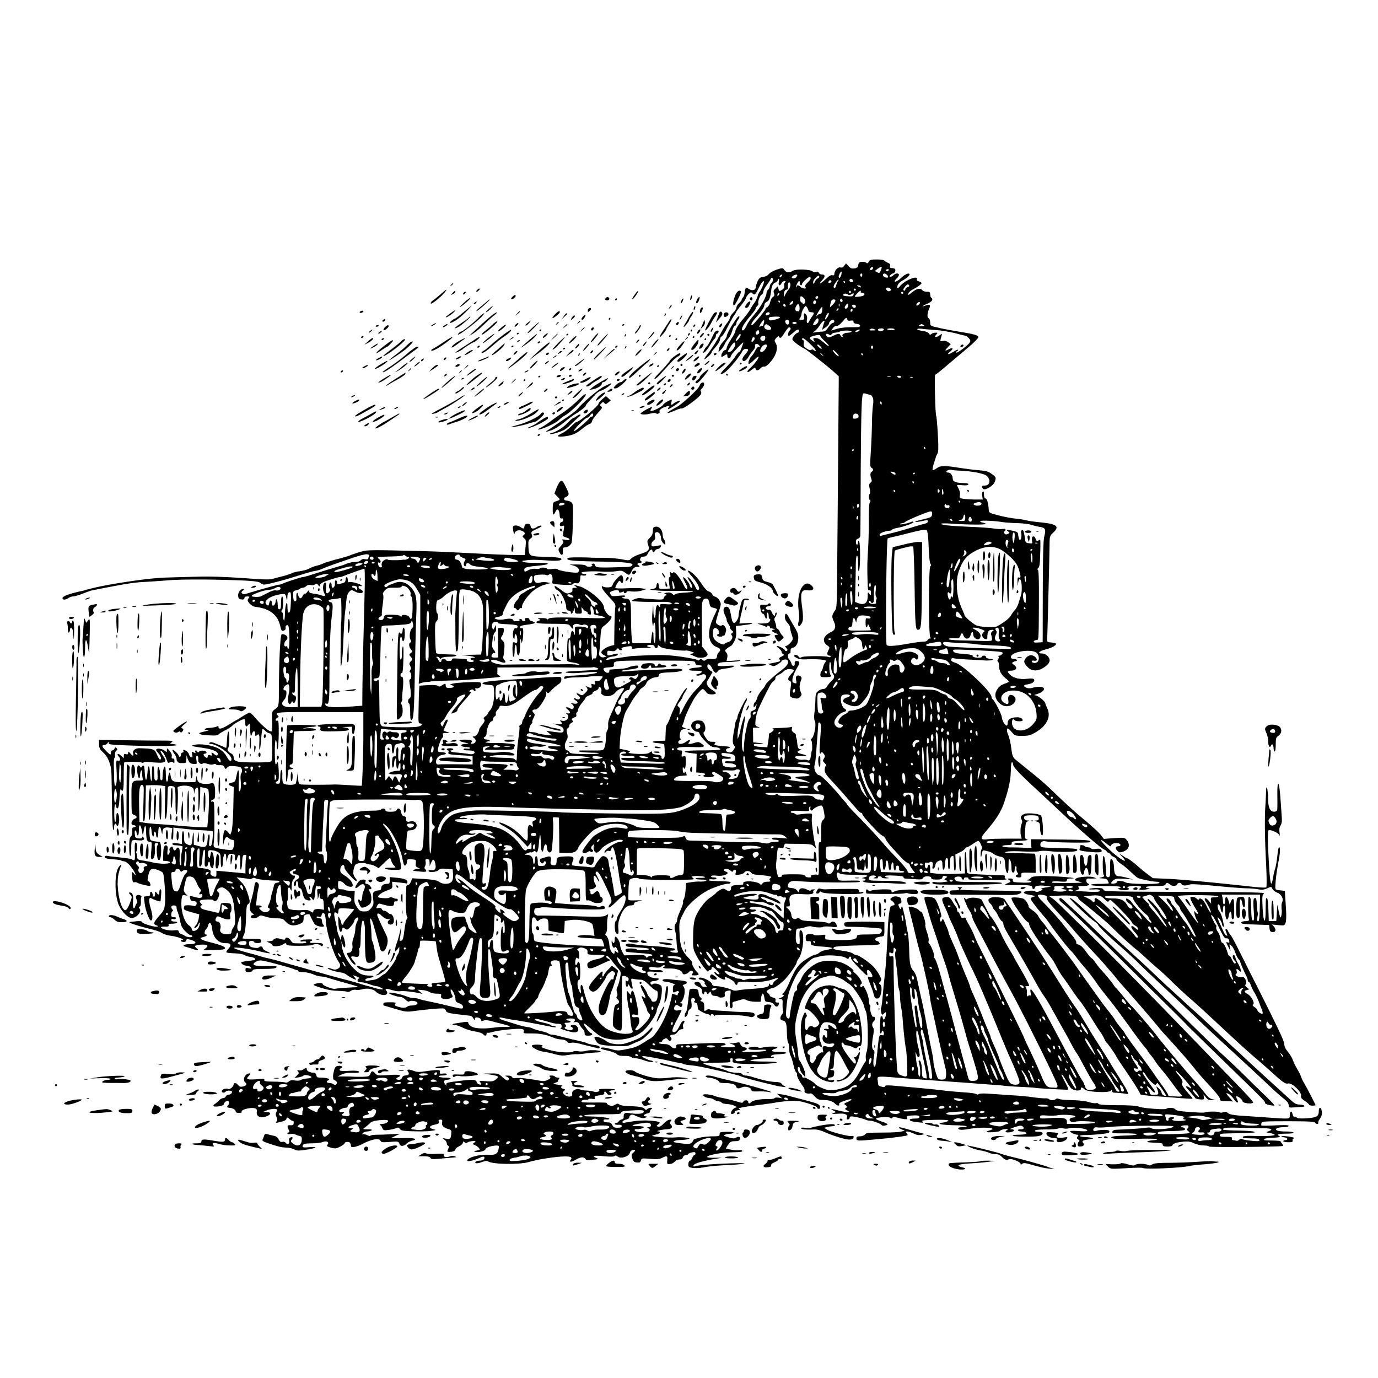


Q3) Language Analysis
15 minutes to answer!
Q3) You now need to refer only to Source A from lines 12 to 23.
The task asks you to explain how the writer uses language to describe train crash.
[12 marks]
Exam tip
Make your point clear.
Use a quotation to support your idea.
Explain what technique the writer uses
Analyse how that technique describe the train crash.
Zoom in on a particular word or phrase and explain its impact on the reader.
Link back to the question, e.g. Therefore the adjectives help to create a vivid description of the crash.
Plan and write out your answer to this question
Timed conditions: 15 minutes

Slide 11
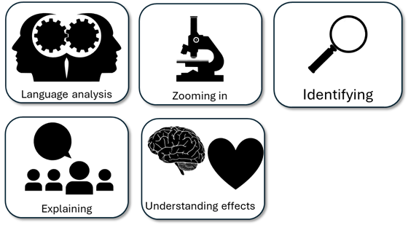
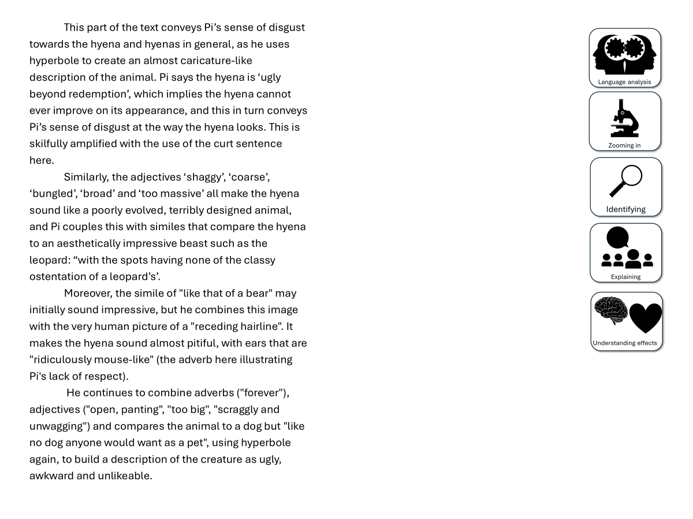
You have been given a good answer for Q3
Go through the answer and find one good example for each of the five skills shown. You could this through arrows, annotations or highlighting.
Bonus Challenge: The student has avoided using words like “shows” too often. What other analytical verbs have they used instead?

Slide 12
The writer uses personification across this extract to convey his sense of shock at the crash: “the window showed me nothing”, “sprawled foolishly down the embankment”, “lay on their sides at the bottom”, “it had a defiant and naughty look”. These examples work together to transform the train from a machine into a monster that conflicted with the narrator on its journey, and now it has crashed, it still defies him despite their journey pausing for now. This helps to convey the writer’s sense of frustration at the crash, but also puts across his entertaining battle with the train. As we know from earlier in the text, he doesn’t want to be on this journey anymore, and the idea of the train being “definitely conscious of its indiscretion” makes what could have been a tragedy into an amusing anecdote.
Additionally, the writer employs hyperbole to convey how he felt after the initial shock of the crash: “My little world was titled drunkenly” and “This is the end of the world, I thought”. The repetition of world amplifies how consuming the crash is to him, but also how its effects will be the end of “the world”. This combination of hyperbole and personification (“drunkenly”) illustrates how the journey has been radically transformed by the crash, but also how much it shocks the writer as well, which in turn engrosses the reader.

Slide 13
Let’s take a look at a good answer for Q3:
The writer uses personification across this extract to convey his sense of shock at the crash: “the window showed me nothing”, “sprawled foolishly down the embankment”, “lay on their sides at the bottom”, “it had a defiant and naughty look”. These examples work together to transform the train from a machine into a monster that conflicted with the narrator on its journey, and now it has crashed, it still defies him despite their journey pausing for now. This helps to convey the writer’s sense of frustration at the crash, but also puts across his entertaining battle with the train. As we know from earlier in the text, he doesn’t want to be on this journey anymore, and the idea of the train being “definitely conscious of its indiscretion” makes what could have been a tragedy into an amusing anecdote.
Additionally, the writer employs hyperbole to convey how he felt after the initial shock of the crash: “My little world was titled drunkenly” and “This is the end of the world, I thought”. The repetition of world amplifies how consuming the crash is to him, but also how its effects will be the end of “the world”. This combination of hyperbole and personification (“drunkenly”) illustrates how the journey has been radically transformed by the crash, but also how much it shocks the writer as well, which in turn engrosses the reader.
Read through this answer and think about:
How the student has included:
Explanations about how the writer describes the train crash
Quotations to support ideas
Techniques used
The effects of the techniques

Slide 14
Can you see how the student has mixed together quotations, explanations about how the writer describes the train journey and its effects on the reader?
The writer uses personification across this extract to convey his sense of shock at the crash: “the window showed me nothing”, “sprawled foolishly down the embankment”, “lay on their sides at the bottom”, “it had a defiant and naughty look”. These examples work together to transform the train from a machine into a monster that conflicted with the narrator on its journey, and now it has crashed, it still defies him despite their journey pausing for now. This helps to convey the writer’s sense of frustration at the crash, but also puts across his entertaining battle with the train. As we know from earlier in the text, he doesn’t want to be on this journey anymore, and the idea of the train being “definitely conscious of its indiscretion” makes what could have been a tragedy into an amusing anecdote.
Additionally, the writer employs hyperbole to convey how he felt after the initial shock of the crash: “My little world was titled drunkenly” and “This is the end of the world, I thought”. The repetition of world amplifies how consuming the crash is to him, but also how its effects will be the end of “the world”. This combination of hyperbole and personification (“drunkenly”) illustrates how the journey has been radically transformed by the crash, but also how much it shocks the writer as well, which in turn engrosses the reader.
Read through this answer and think about:
How the student has included:
Explanations about how the writer describes the train crash.
Quotations to support ideas
Techniques used
The effects of the techniques

Slide 15
Next lesson we will explore improving our answers for Q3

Slide 16

Plenary: 5 Steps To Success!
To describe the use of language in the extract
To explain how we can improve our language analysis in Q3
To apply our understanding of Q3 skills to our own answers
What have you learnt today?
What do you still need to work on?
Write down five steps you will take to ensure you answer Q3 effectively.

