Slide 1
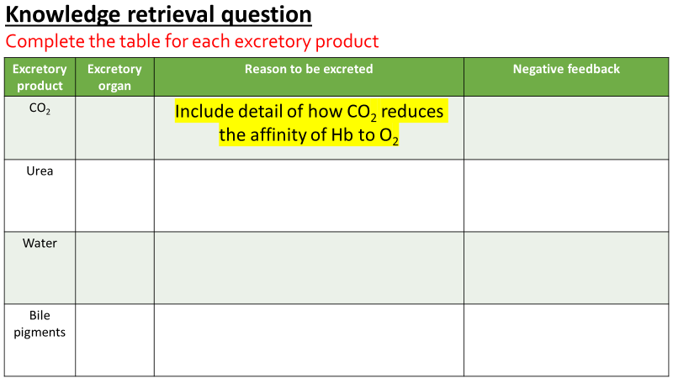
Tasks:
Complete PAG write up to include table, evaluation of results, extension questions
If you finish please begin the knowledge retrieval question on the “Liver 1” notebook page. Include as much detail as possible

Slide 2
Excretion as an example of homeostatic control
Describe the term excretion and its importance in maintaining metabolism and homeostasis, including reference to the importance of removing metabolic wastes, including carbon dioxide and nitrogenous waste, from the body.
Describe the structure and functions of the mammalian liver, including the gross structure and histology of the liver AND the roles of the liver in storage of glycogen, detoxification and the formation of urea (the ornithine cycle covered in outline only).
What is the difference between egestion and excretion?
egestion is the removal of undigested food from the rectum
excretion is the removal of metabolic waste products from the body. These metabolic waste products may become toxic if left to increase in concentration.

Slide 3
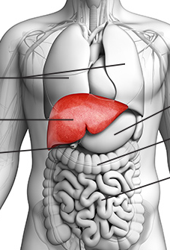
Excretion game…
Collect next question when you get the right answer!

Slide 4
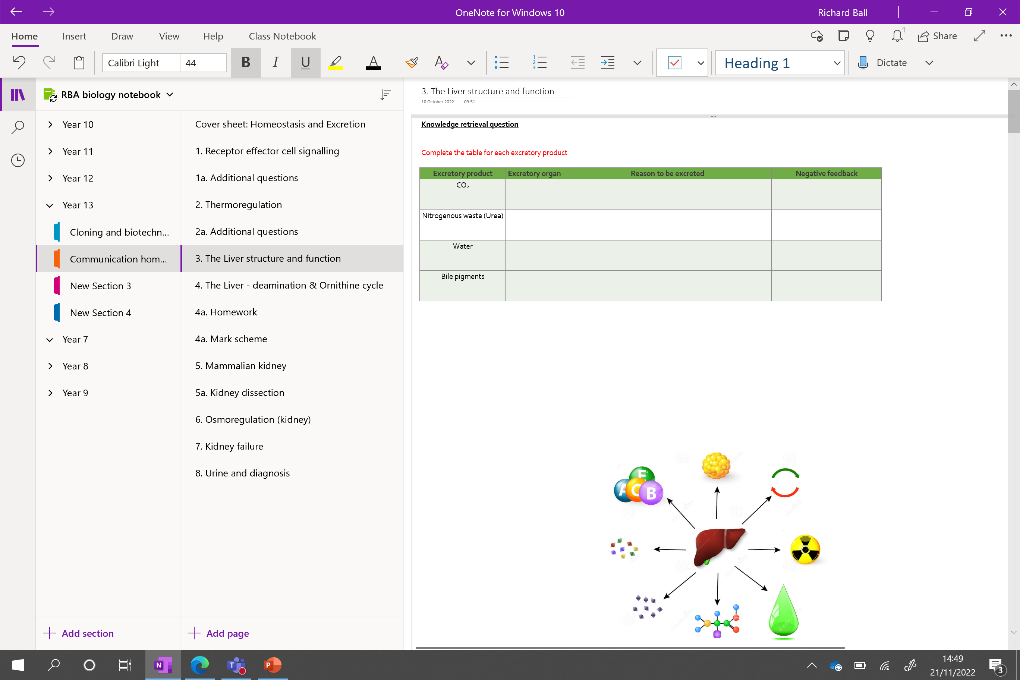

Slide 5
Knowledge retrieval question
Complete the table for each excretory product
Excretory product | Excretory organ | Reason to be excreted | Negative feedback
CO₂ |  | Include detail of how CO₂ reduces the affinity of Hb to O₂
Urea
Water
Bile pigments
Notes:
Urea is also removed in the sweat. The concentration of urea in your sweat is higher if you suffer from kidney disease – unable to process and remove it via urine

Slide 6
Excretory product | Excretory organ | Reason to be excreted | Negative feedback
CO₂ | Lungs | CO₂ with water to form carbonic acid (H₂CO₃) H⁺ dissociates, binds to HB in place of O₂, reducing affinity of Hb for O₂ HCO₃⁻ can combine with Hb (effect same as above) H⁺ also increases acidity, denaturing proteins | H⁺ detected by medulla oblongata (respiratory centre) in brain
Nitrogenous waste (Urea) | Kidneys, skin | Excess amino acids breakdown (liver) → Urea / ammonia / uric acid Alter pH (NH₃ and urea are basic) | pH detected by medulla oblongata (respiratory centre) in brain
Water | Kidneys, skin | Osmoregulation Maintain correct water potential of blood plasma, tissue fluid etc | Osmoreceptors present in hypothalamus Signal sent to pituitary gland, ADH released etc.
Bile pigments | Gall bladder(in the form of bile) | Formed from the breakdown of Hb from old red blood cells in the liver. Impairs the flow of bile from the liver to the small intestine (cholestasis) | Excess bile pigment
Notes:
Urea is also removed in the sweat. The concentration of urea in your sweat is higher if you suffer from kidney disease – unable to process and remove it via urine
Forms of nitrogenous waste
All mammals produce urea
Fish produce ammonia
Birds and insects produce uric acid C5H4N4O3
cholestasis - A condition which impairs the flow of bile from the liver to the small intestine by either slowing or stopping the flow.

Slide 7
Excretory product | Excretory organ | Reason to be excreted | Negative feedback
CO₂ | Lungs | CO₂ with water to form carbonic acid (H₂CO₃) H⁺ dissociates, binds to HB in place of O₂, reducing affinity of Hb for O₂ HCO₃⁻ can combine with Hb (effect same as above) H⁺ also increases acidity, denaturing proteins | H⁺ detected by medulla oblongata (respiratory centre) in brain Breathing rate increases
Nitrogenous waste (Urea) | Kidneys, skin | Excess amino acids breakdown (liver) → Urea / ammonia / uric acid Alter pH (NH₃ and urea are basic) | H⁺ detected by medulla oblongata (respiratory centre) in brain
Water | Kidneys, skin | Osmoregulation Maintain correct water potential of blood plasma, tissue fluid etc | Osmoreceptors present in hypothalamus Signal sent to pituitary gland, ADH released etc.
Bile pigments | Gall bladder(in the form of bile) | Formed from the breakdown of Hb from old red blood cells in the liver. Impairs the flow of bile from the liver to the small intestine (cholestasis) | Excess bile pigment
Notes:
Urea is also removed in the sweat. The concentration of urea in your sweat is higher if you suffer from kidney disease – unable to process and remove it via urine
Forms of nitrogenous waste
All mammals produce urea
Fish produce ammonia
Birds and insects produce uric acid C5H4N4O3
cholestasis - A condition which impairs the flow of bile from the liver to the small intestine by either slowing or stopping the flow.

Slide 8
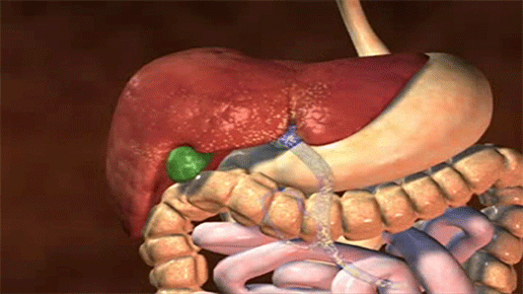
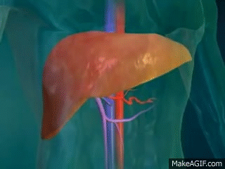
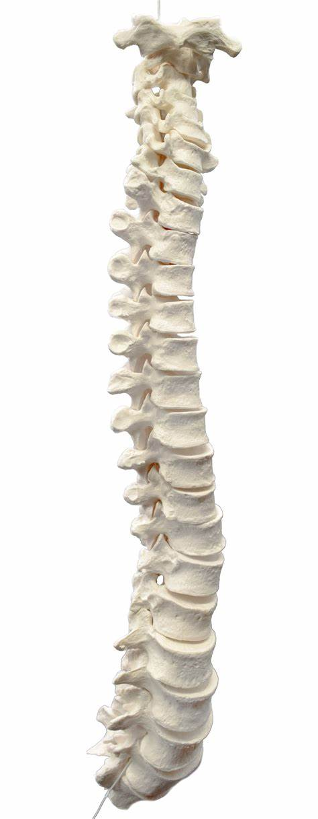


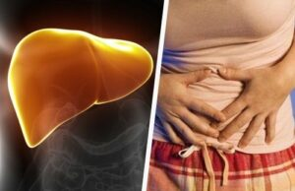
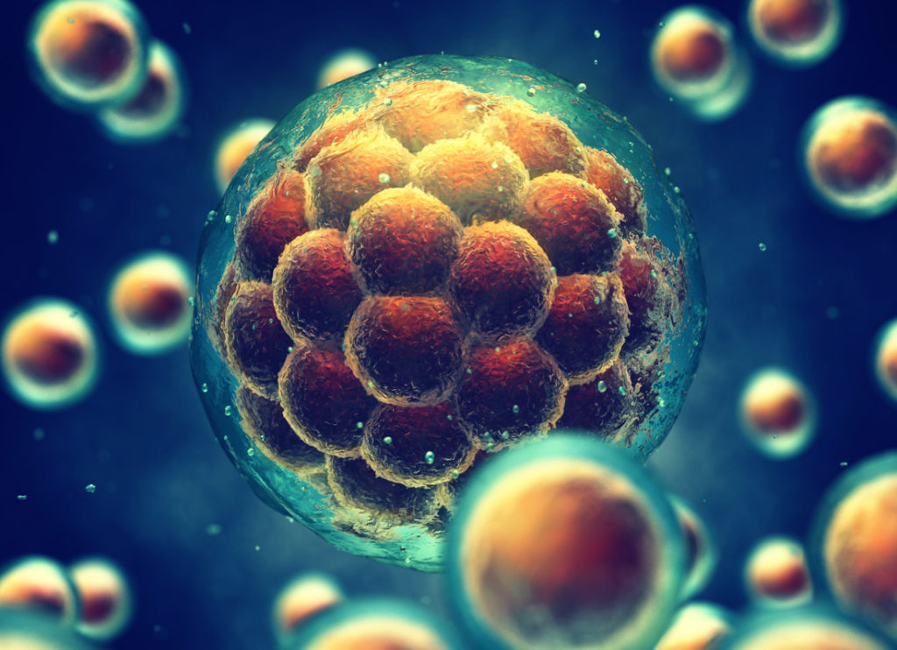

Hepar
Notes:
The liver plays a major role in the homeostasis
Liver facts:
Every vertebrate has a liver
Performs over 500 functions in the body (we know of)
The fastest regenerative organ – can regenerate half its mass in 30 days!!
Any given time it contains 10% of your blood
The main blood forming organ during embryonic development before the bone marrow takes over later
Hepar is the Greek term for liver, who believed it to be the location of all human emotion / your sole and would often target this during torture

Slide 9
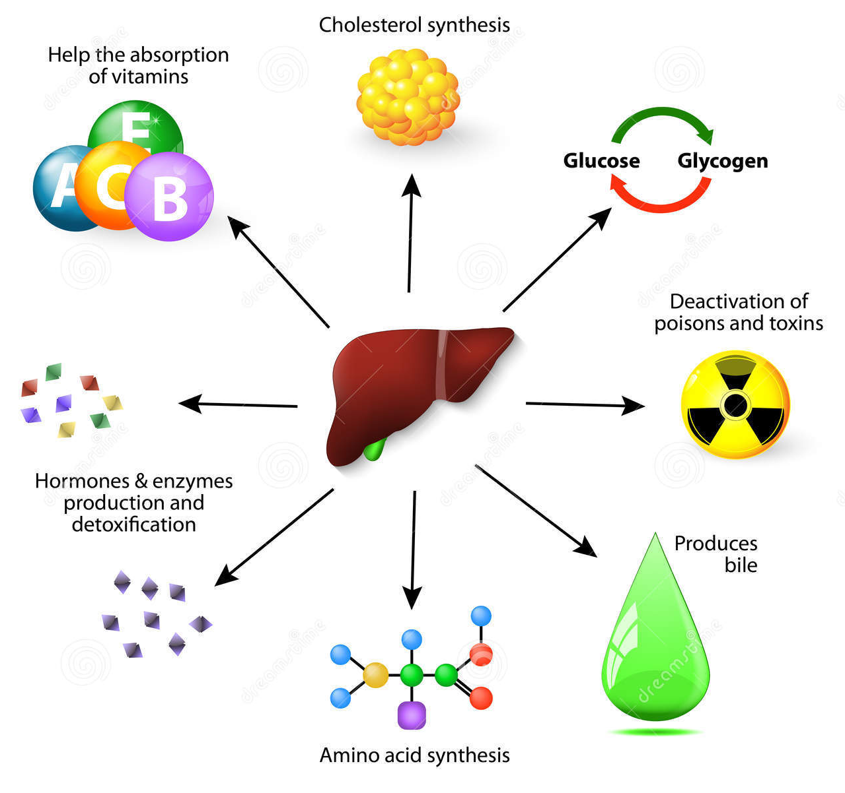
Use the images to annotate your diagram to show the functions of the liver
LDL / HDL
STORAGE
CHEMICAL MESSANGERS AND BIOLOGICAL CATALYSTS
EMULSIFY

Slide 10
Use the images to annotate your diagram to show the functions of the liver

Slide 11
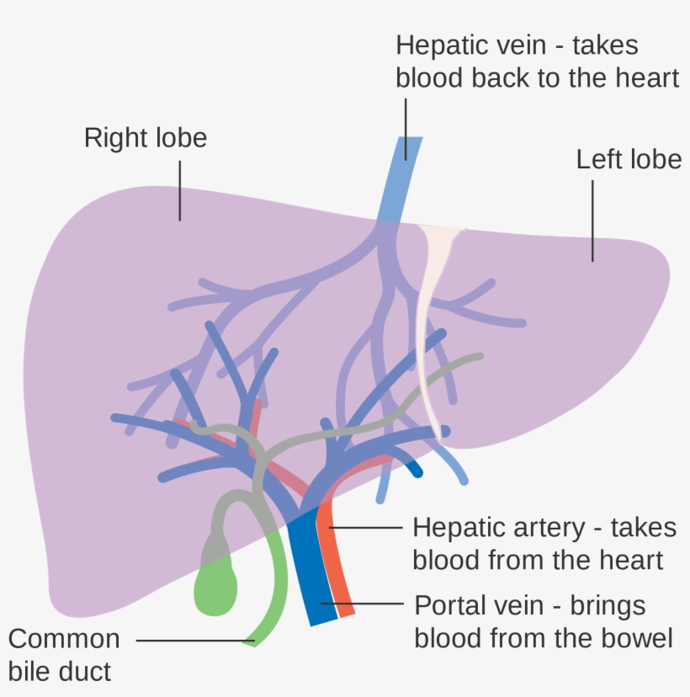
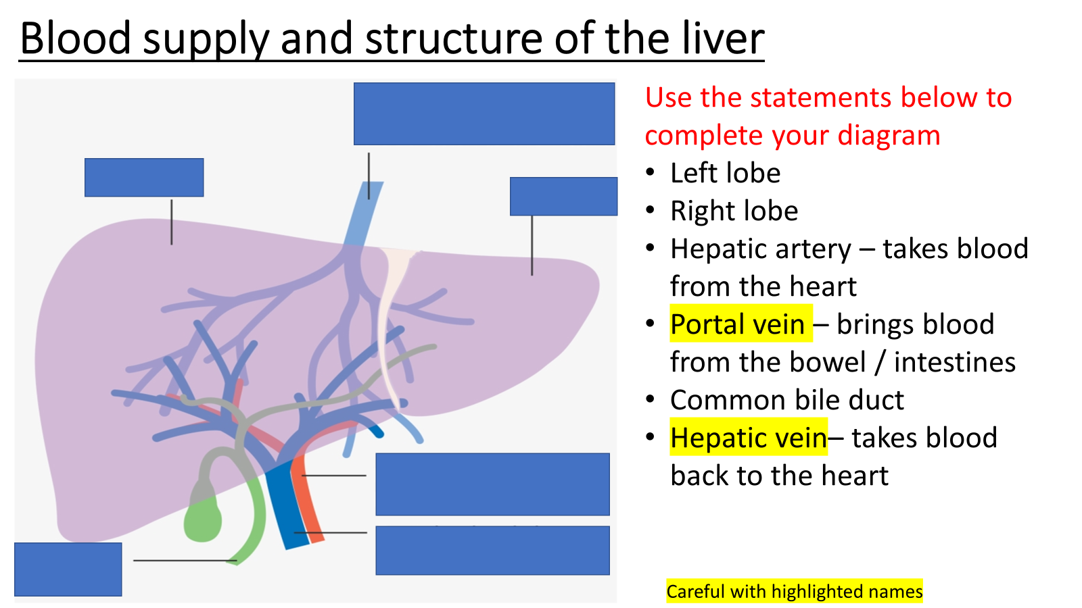
Blood supply and structure of the liver
Use the statements below to complete your diagram
Left lobe
Right lobe
Hepatic artery – takes blood from the heart
Portal vein – brings blood from the bowel / intestines
Common bile duct
Hepatic vein– takes blood back to the heart
Careful with highlighted names

Slide 12
Blood supply and structure of the liver
Use the statements below to complete your diagram
Left lobe
Right lobe
Hepatic artery – takes blood from the heart
Portal vein – brings blood from the bowel / intestines
Common bile duct
Hepatic vein – takes blood back to the heart
Careful with highlighted names

Slide 13
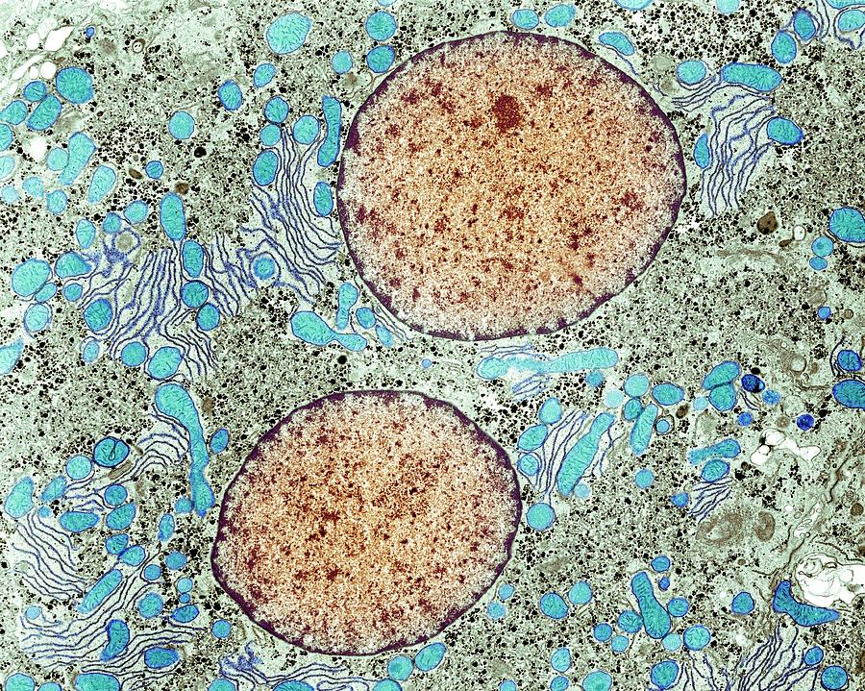
Liver cells / hepatocytes
The diagram shows and EM image of hepatocytes.
Which organelles are present?
Why do you think these are so prominent / numerous?

Slide 14
Liver cells / hepatocytes
Very large nuclei
Prominent Golgi apparatus
Many mitochondria
These indicate that the hepatocytes are very metabolically active
Blood from vessel supplying the liver is mixed in spaces called sinusoids which are surrounded by hepatocytes.

Slide 15
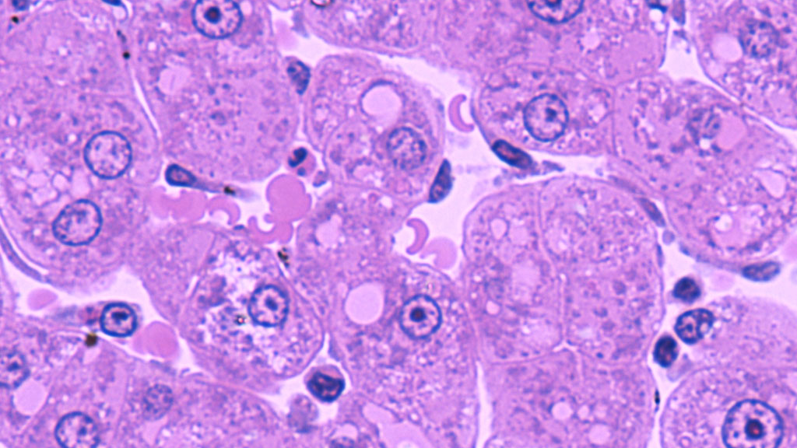
Sinusoids
Notes:
Organs such as the liver, spleen, and bone marrow
Similar to a fenestrated capillary, they serve as a location for mixing of the oxygen-rich blood from the hepatic artery and the nutrient-rich blood from the portal vein
contain blood vessel structures called sinusoids instead of capillaries

Slide 16
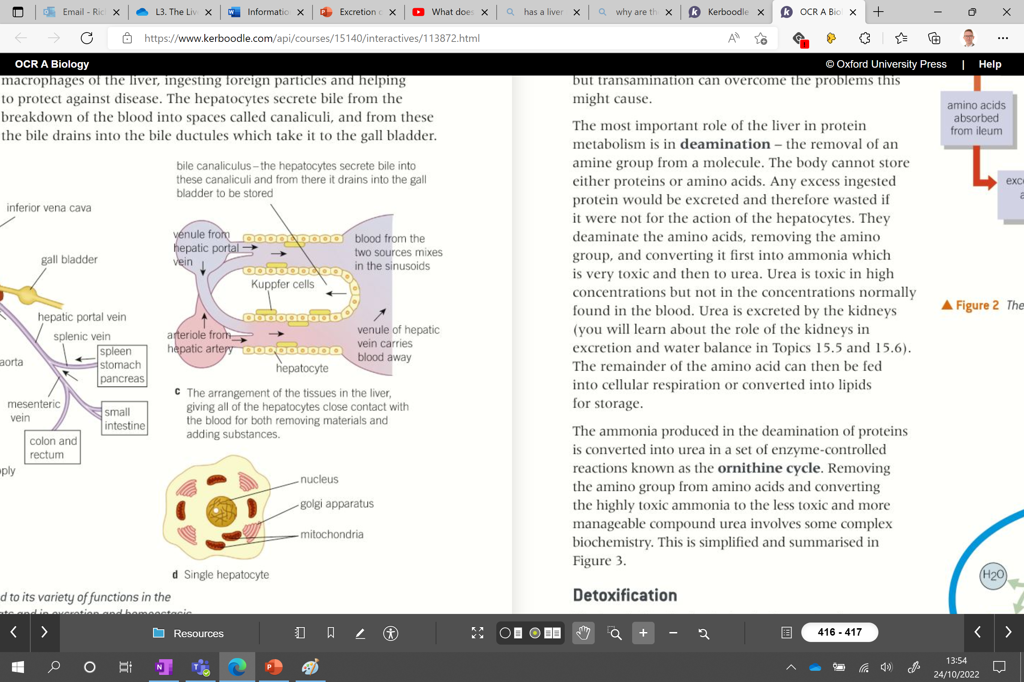
Sinusoids – blood mixes here
Mixing of blood provide sufficient oxygen to hepatocytes to function
One function of hepatocytes is producing bile which is sent into canaliculus
From here the bile is drained into the bile ducts and taken to the gall bladder.
Sinusoids also contain Kupffer cells – ingest foreign particles, protecting against disease.
Notes:
Can u lic a lie
Kupffer – one p – typo on diagram
The paper is concerned to problem of discovery of macrofage cells present in the liver sinusoid, which are recognized in the world medical literature as Kuppffer cells. On the other hand in Poland the name of professor Tadeusz Browicz is firmly connected with the cells resulting in eponymous Browicz cells. The authors are trying to determine who has priority in this respect; Karl Kupffer, a professor of anatomy in Koniggsberg, and then in München, or professor of pathological anatomy at Jagiellonian University, Tadeusz Browicz.

Slide 17
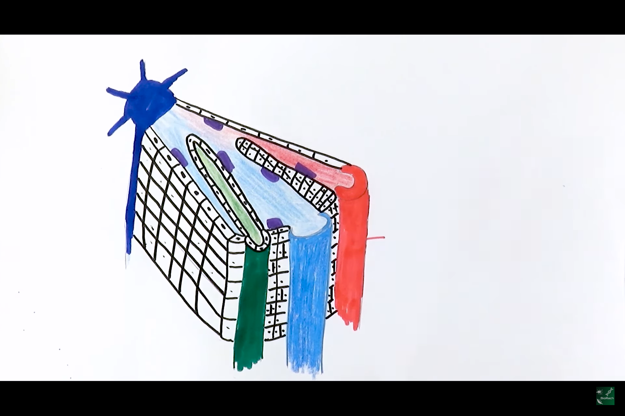
Kupffer cells – macrophages, ingesting foreign particles and helping to protect against disease
Central vein – feeds into hepatic vein
Hepatocytes
Sinusoid
If we had a diagram like this in an exam how could we decipher each part of the triad?
Canaliculus – surrounded by hepatocytes
Hepatic artery – small lumen, thick cell wall
Hepatic vein – large lumen, thin cell wall
Canaliculus
Hepatic artery – supplies oxygenated blood
Bile duct – drains bile to the gall bladder
Portal vein – supplies nutrient rich blood
Recap:
Add arrows
Function of bile

Slide 18
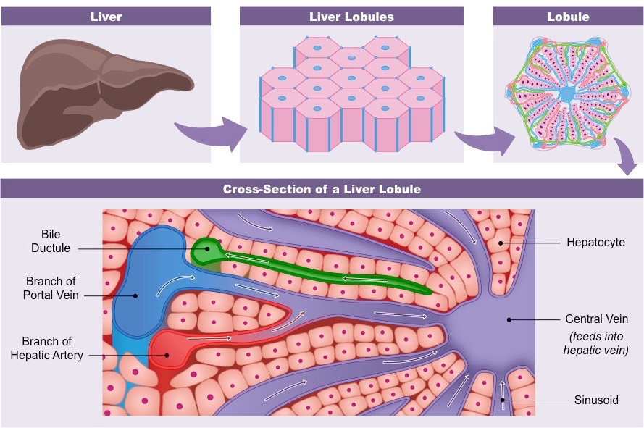

Slide 19
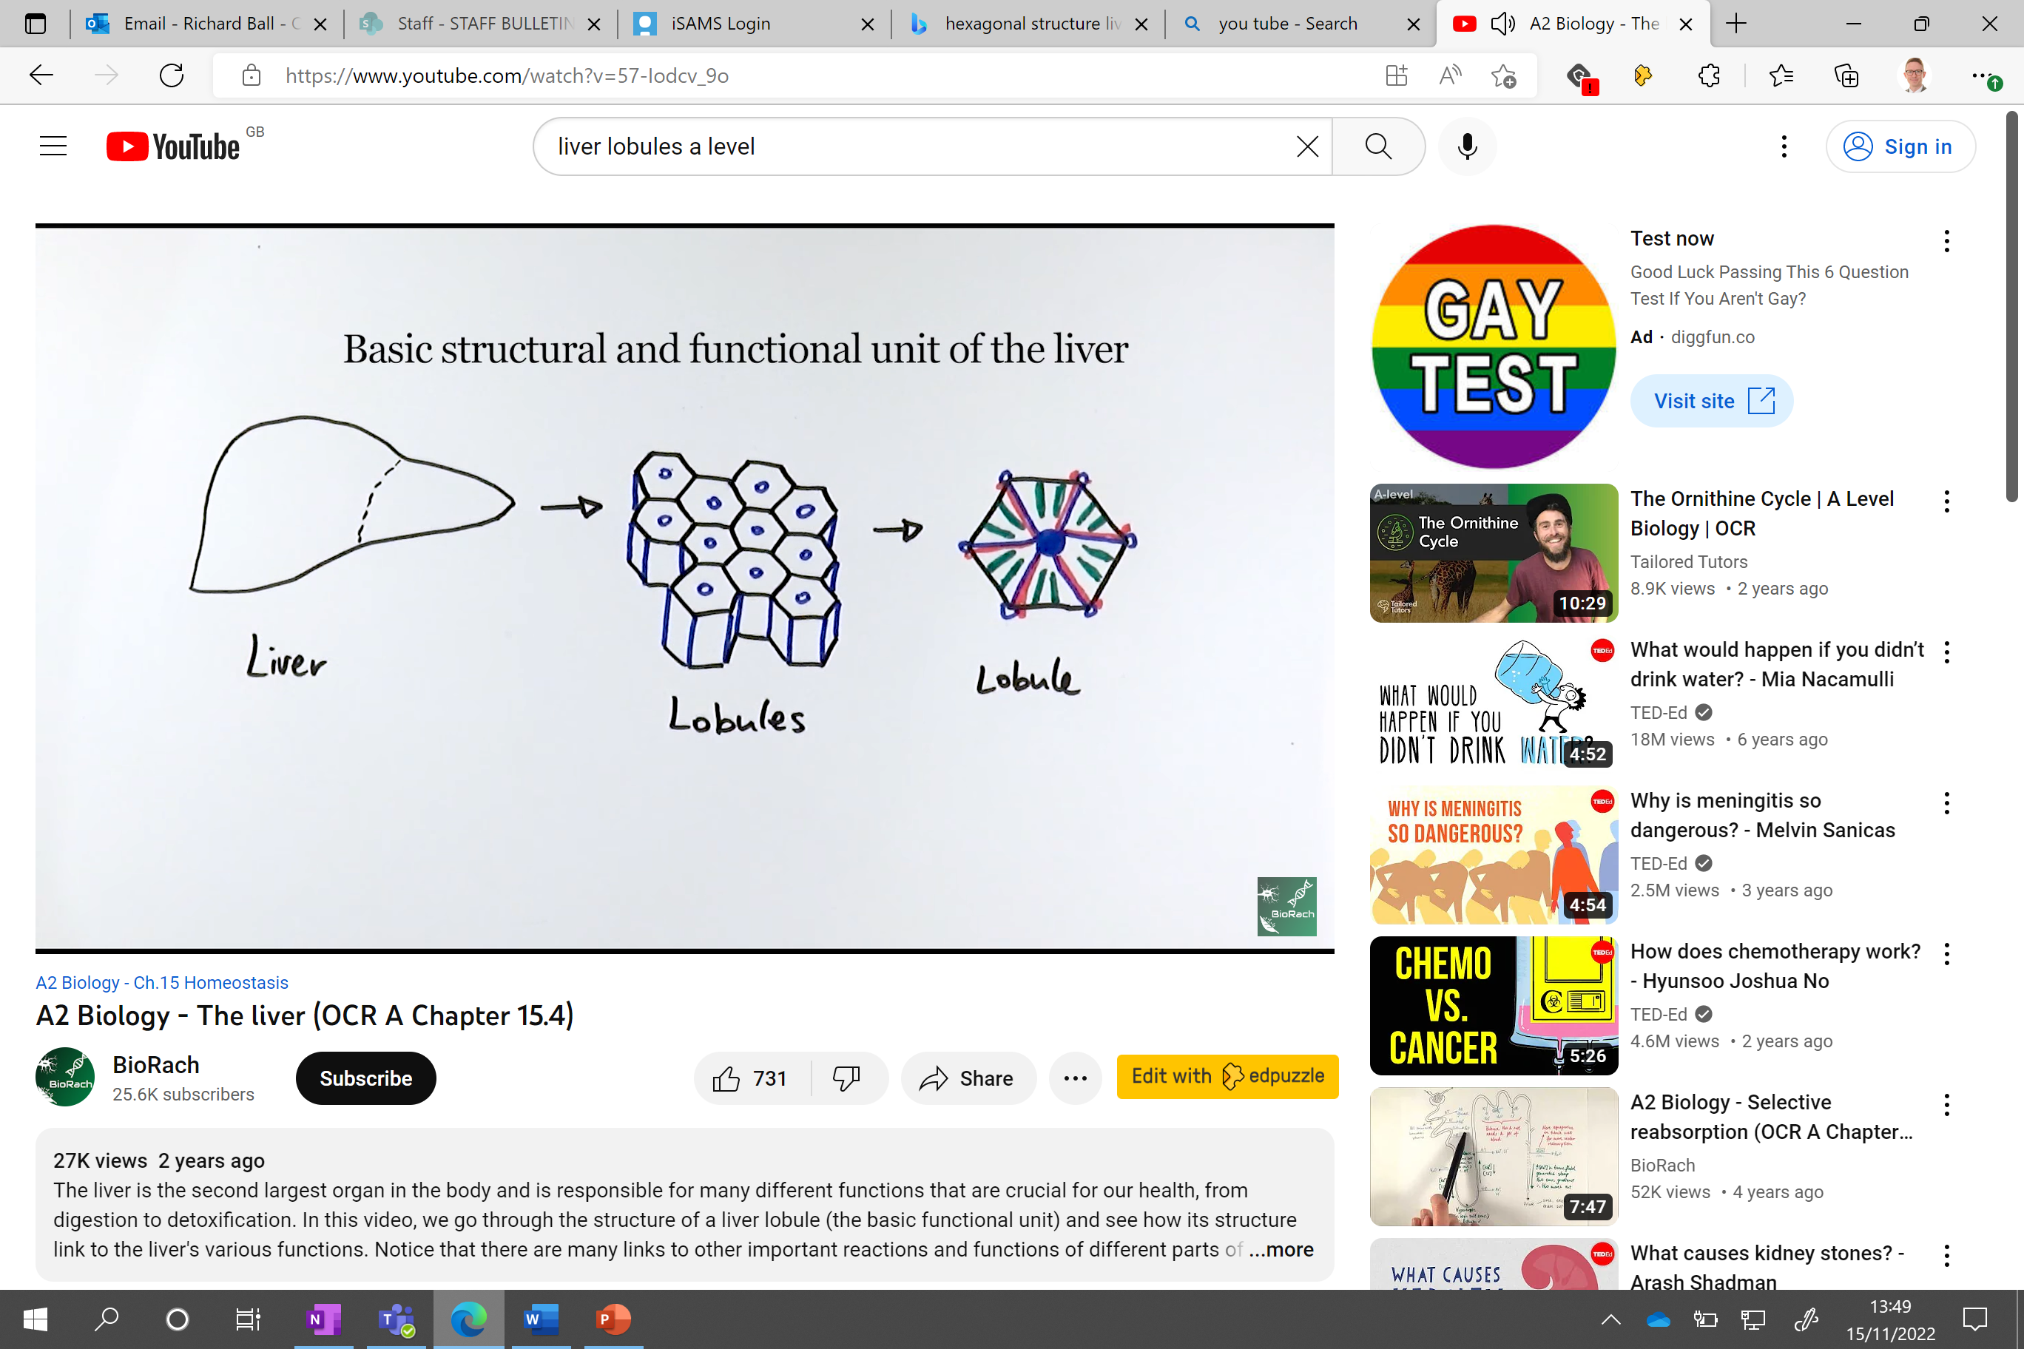

Slide 20
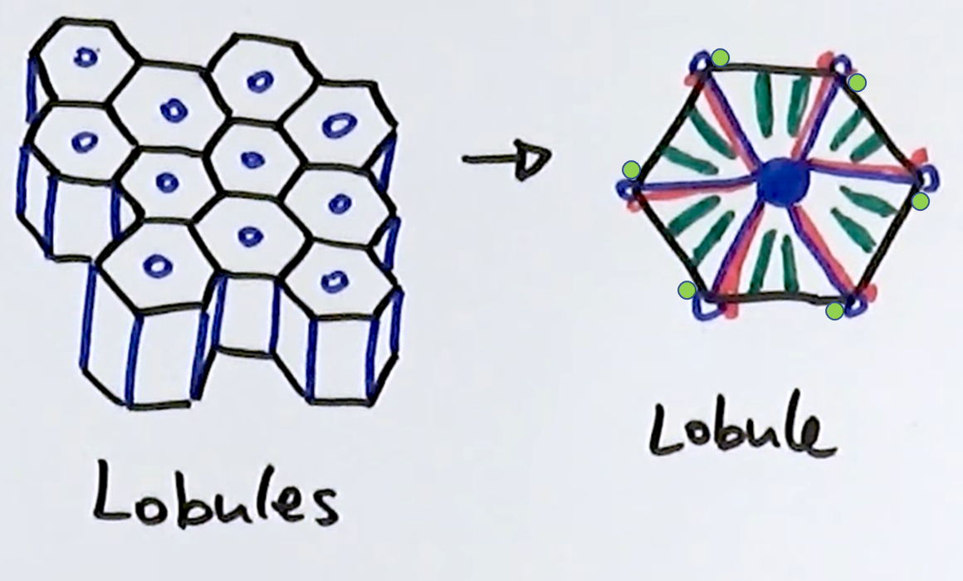
Central vein -
All blood will eventually drains from here
Hepatic artery – supplies oxygenated blood
Sinusoid
Portal vein – supplies nutrient rich blood
Bile duct – drains bile to the gall bladder
Canaliculus
Notes:
Hepatic vein – only blood vessel to connect two organs that isn’t coming from the heart

Slide 21
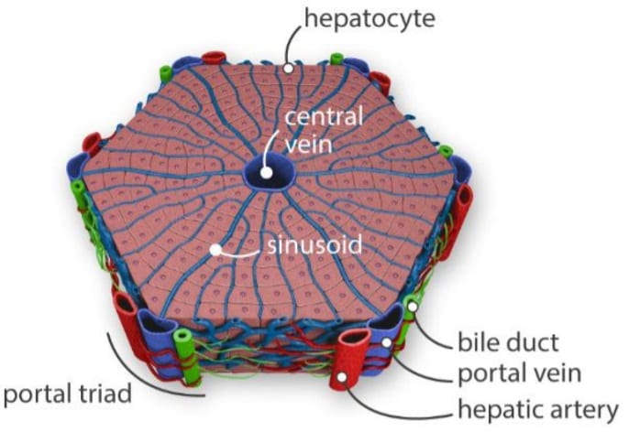
Liver lobules

Slide 22
Liver Structure and the Flow of Blood and Bile (Master's Project) - YouTube

Slide 23
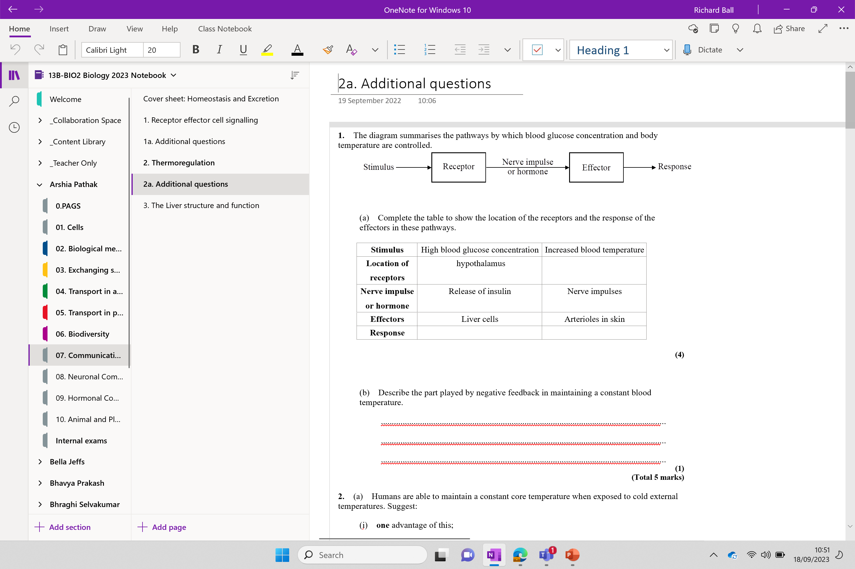
Try additional questions 2a / PAG final touches

Slide 24
Label the diagram with annotations

Slide 25
Kupffer cells – macrophages, ingesting foreign particles and helping to protect against disease
Hepatocytes
Central vein
Sinusoid
If we had a diagram like this in an exam how could we decipher each part of the triad?
Canaliculus – surrounded by hepatocytes
Hepatic artery – small lumen, thick cell wall
Hepatic vein – large lumen, thin cell wall
Canaliculus
Hepatic artery – supplies oxygenated blood
Bile duct – drains bile to the gall bladder
Portal vein – supplies nutrient rich blood
Recap:
Add arrows
Function of bile

Slide 26
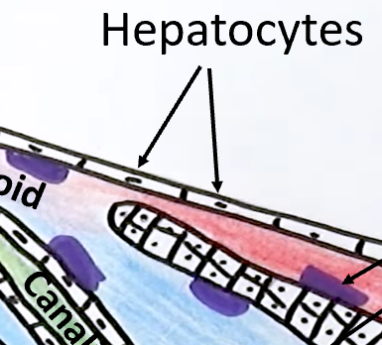
Hepatocyte functions

Slide 27
emulsify
neutralise
Produce bile to ……………. fats and ……………. stomach acid in the small intestine
They respond to insulin and glucagon. When insulin is secreted they convert ……………. into ………….. . When …………… is secreted they do the opposite. This helps regulate the ……………… concentration in the blood plasma.
glucose
glycogen
glucagon
glucose
Which vessel brings the glucose and which brings the hormone to the sinusoids?
Hepatic artery: Hormone portal vein: glucose
……………………………………………………………………………………….
amino acids
Deamination – breakdown of ………. ………… (more next lesson)
Detoxification (Alcohol, drugs).
Example: Alcohol ………………………. breakdown ethanol → ………….. → ethanoate, which is then converted into ………. ……….. (storage, respiration).
dehydrogenase
ethanal
fatty acids
Notes:
Pyruvate that is left over after deamination can be fed into cellular respiration – so can make up for a lack of glucose – however, not ideal as this is breaking down muscle mass

Slide 28
Produce bile to emulsify fats and neutralise stomach acid in the small intestine
They respond to insulin and glucagon. When insulin is secreted they convert glucose into glycogen. When glucagon is secreted they do the opposite. This helps regulate the glucose concentration in the blood plasma.
Which vessel brings the glucose and which brings the hormone to the sinusoids?
Hepatic artery: Hormone Portal vein: glucose
Deamination – breakdown of amino acids (more next lesson)
Detoxification (Alcohol, drugs).
Example: Alcohol dehydrogenase breakdown ethanol → ethanal → ethanoate, which is then converted into fatty acids (storage, respiration).
Notes:
Pyruvate that is left over after deamination can be fed into cellular respiration – so can make up for a lack of glucose – however, not ideal as this is breaking down muscle mass

Slide 29
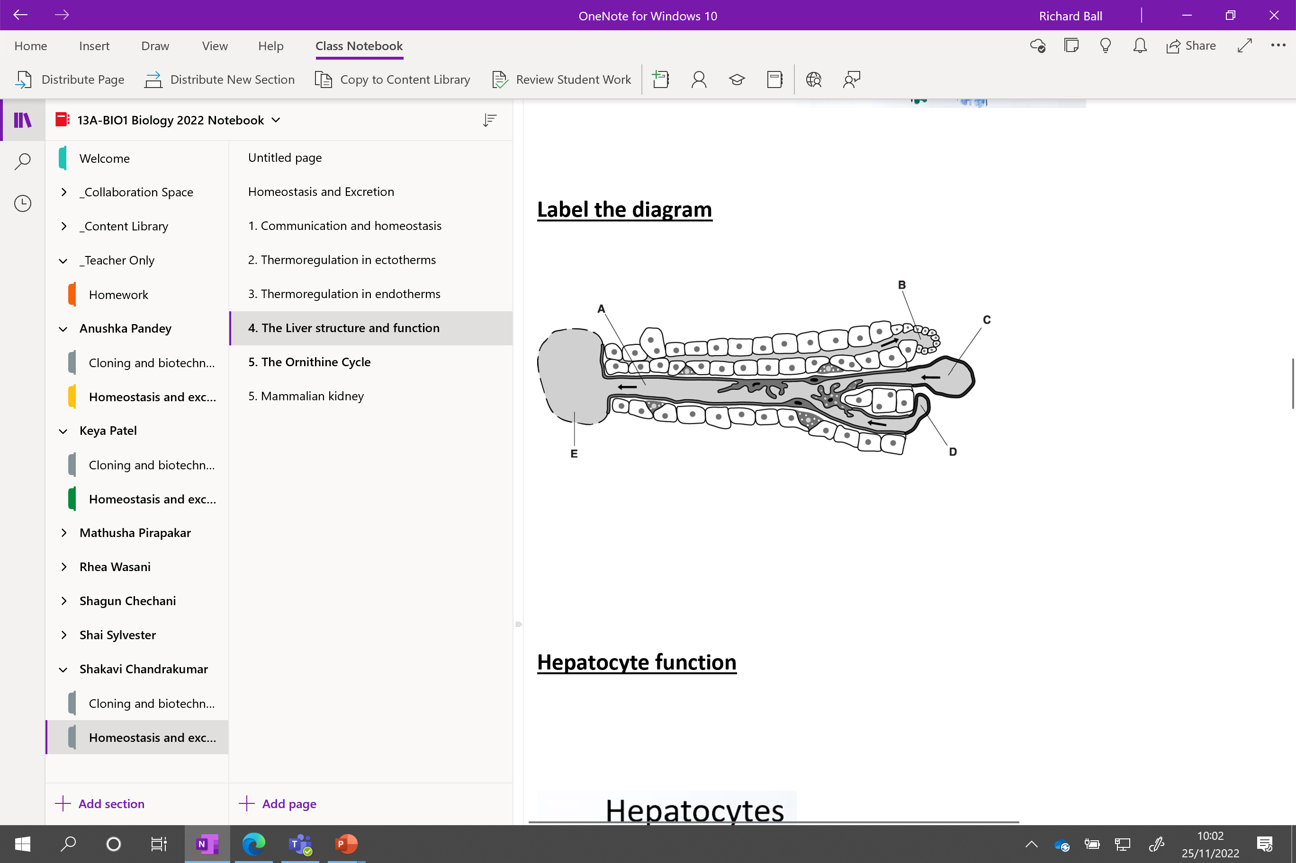

Slide 30
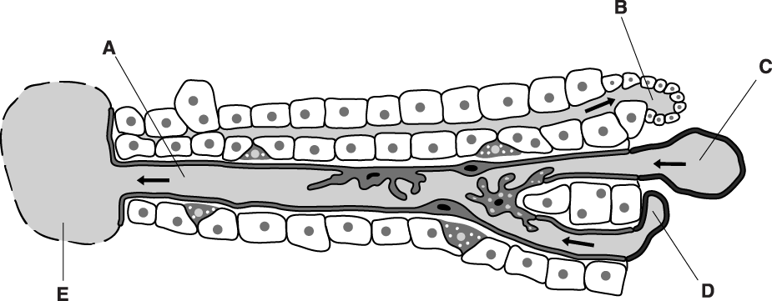
Label the diagram
A sinusoid
B bile duct
C portal vein
D hepatic artery / arteriole
E central, vein;
Notes:
Different levels of Kupffer cells – dots lysomes

Slide 31
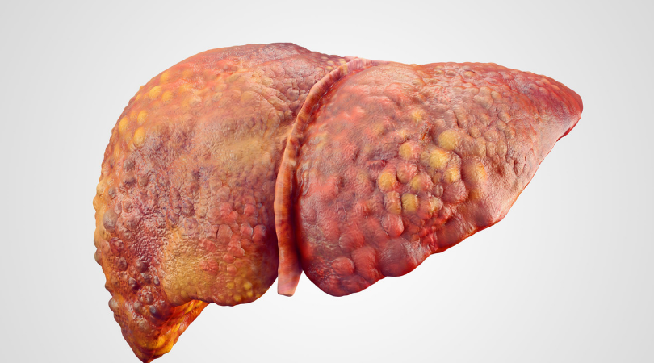
Cirrhosis of the liver
Most common cause is alcohol abuse
When this occurs the hepatocytes die and are replaced with fibrous/scarred tissue
The hepatocytes can no longer divide, causing the liver to shrink and lose its ability to deal with toxins

Slide 32
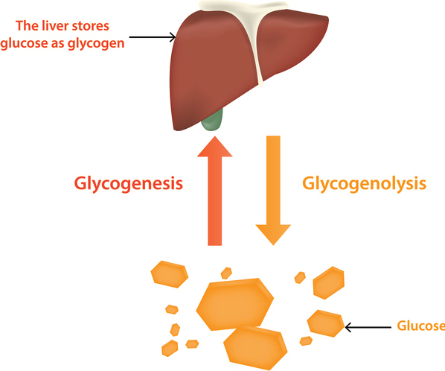
Notes:
Glycogen stored in hepatocyte cells

Slide 33
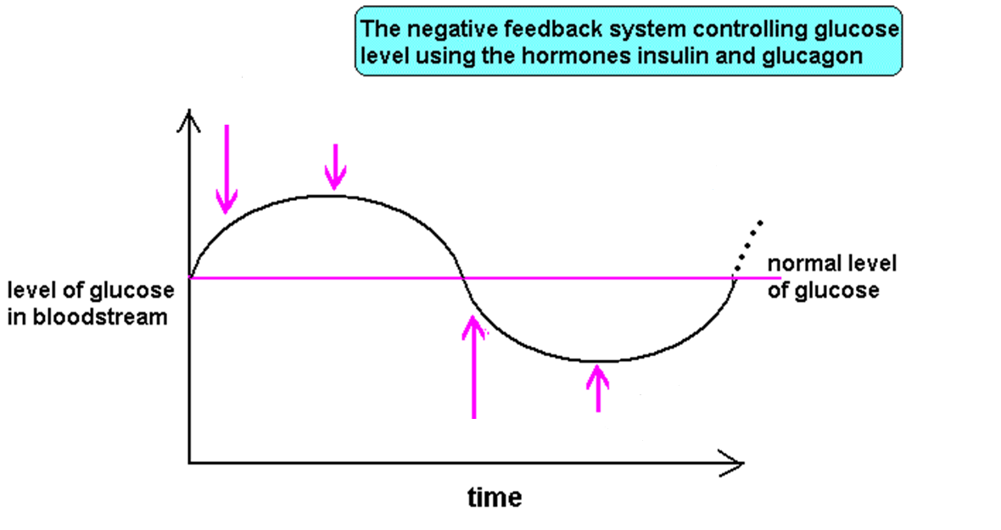
Carbohydrate metabolism in the liver

Slide 34
Carbohydrate metabolism in the liver
Annotate your diagram to explain how blood glucose concentration are controlled. Include hormones, organs and substances.
When blood glucose levels ……….. , insulin levels ……….. and stimulate hepatocytes to convert …………….. into carbohydrate …………….. .
When blood …………….. levels fall the hepatocytes convert glycogen back into glucose under the influence of the hormone …………….. .

Slide 35
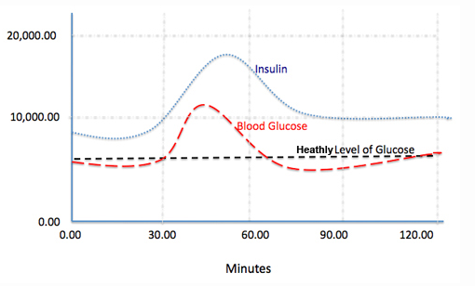
Carbohydrate metabolism in the liver
When blood glucose levels rise, insulin levels rise and stimulate hepatocytes to convert glucose into carbohydrate glycogen.
When blood glucose levels fall the hepatocytes convert glycogen back into glucose under the influence of the hormone glucagon.

Slide 36
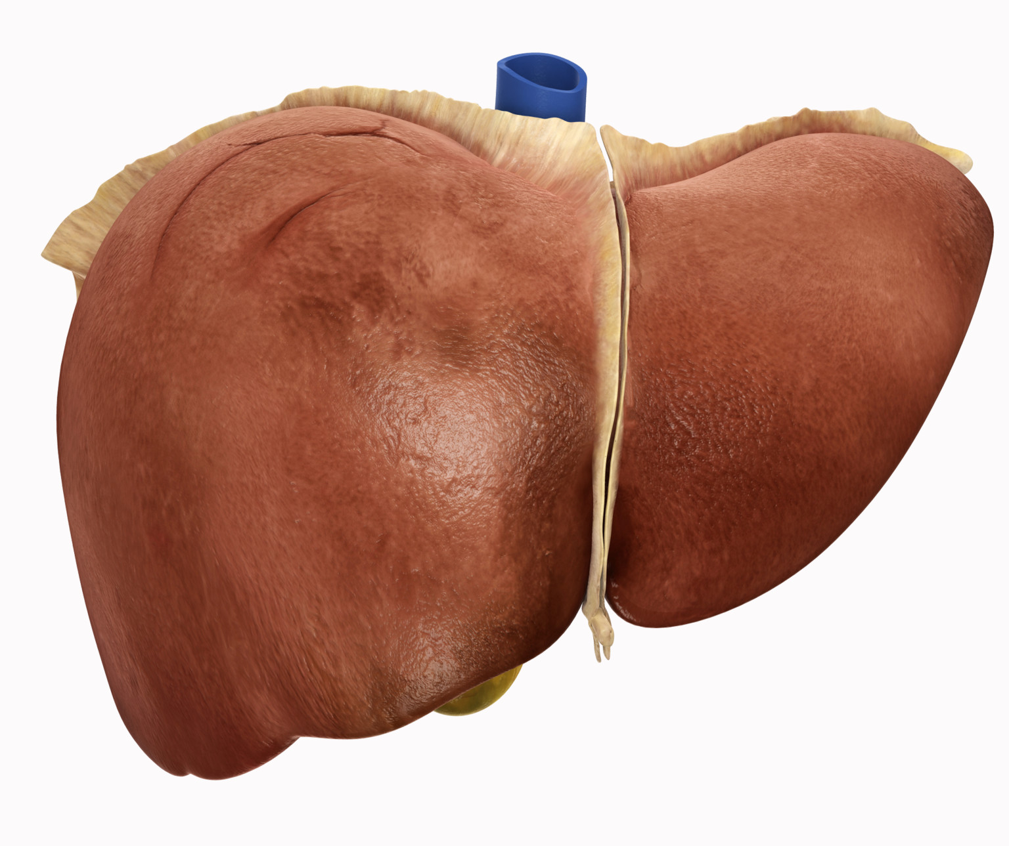
Liver also stores…
Liver breaks down red blood cells/haemoglobin and stores it as iron
Liver stored fat-soluble vitamins A, D and B12
Liver stores folic acids
Notes:
Bile is a physiological aqueous solution produced and secreted by the liver. It consists mainly of bile salts, phospholipids, cholesterol, conjugated bilirubin, electrolytes, and water

Slide 37
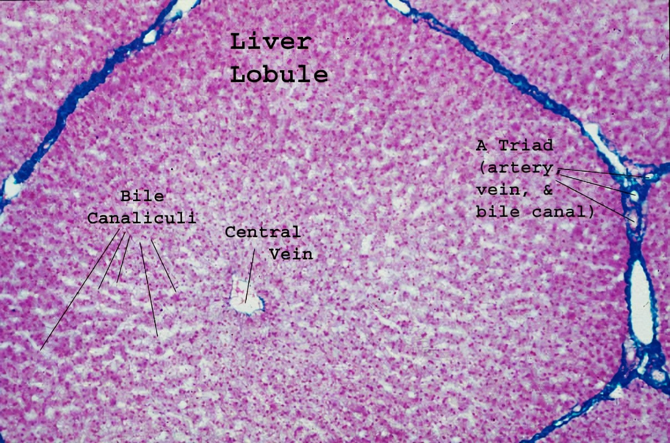

Slide 38
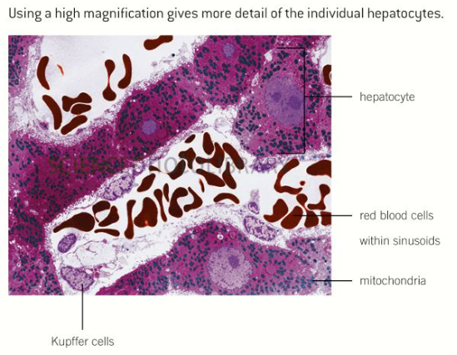

Slide 39
Liver histology
Take photo using camera through microscope
Upload image and label the following:
Central vein
Hepatic artery
Portal vein
Bile duct
Bile canicular
Sinusoids
Label this as the triad – difficult to decipher

Slide 40
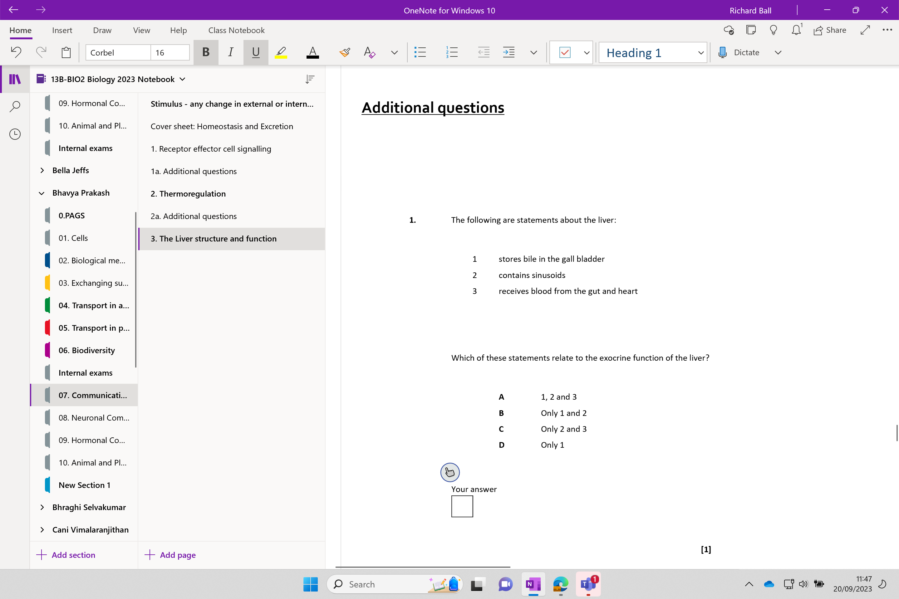
Try additional questions

Slide 41
