Slide 1
Sugar 2:
Molymod race
1st person to build an alpha glucose molecule……………….GO!
Quick 10 starter

Slide 2
Quick 10
1. What type of bond joins two monosaccharides?
2. What type of monosaccharide is ribose?
3. Name the two types of glucose.
4. Which reaction forms a disaccharide?
5. Why is water described as dipolar?
6. Why does ice float?
7. Name the attraction of water molecules to the side of a vessel.
8. How would I recognise beta glucose?
9. Name a disaccharide.
10. Name two polysaccharides.

Slide 3
Disaccharides and polysaccharides
2.1.12
f) the structure of starch (amylose and amylopectin), glycogen and cellulose molecules
g) how the structures and properties of glucose, starch, glycogen and cellulose molecules relate to their functions in living organisms

Slide 4
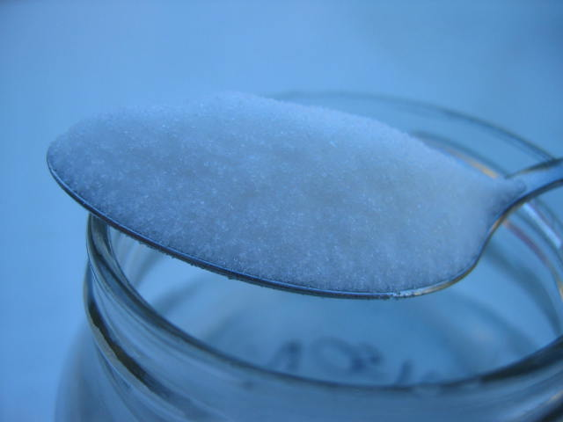
Disaccharides
Find out the missing information:
Disaccharide | Constituent monosaccharides | Type of glycosidic bond | Occurrence & Importance
Lactose | A-glucose & B-galactose | 1,4 | Sugar found only in milk, main energy source for mammal infants
Maltose | A-glucose & A-glucose | 1,4 | Formed during digestion & seed germination
Sucrose | A-glucose & fructose | 1,2 Do not need to know why. | Produced naturally by plants. Extracted and refined for dietary use.
Challenge – come up with a way to remember the disaccharide monomers

Slide 5
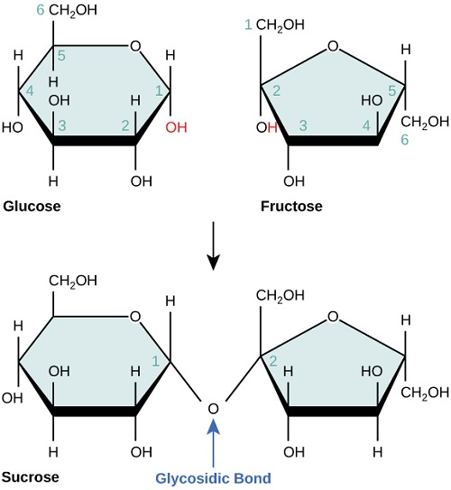
Extra information beyond the spec:
Carbon 1 alpha glucose.
Carbon 2 fructose
Fructose is also a hexose but only has 4 carbon atoms in the ring, this prevents bonding using carbon 4.
It is a non-reducing sugar as OH groups on the reducing ends are involved in the glycosidic bond.

Slide 6
Sucrose is soluble and does not cause tooth decay. Why then is sucrose so bad for your teeth?
A* thinking
Streptococcus mutans (harmless mouth bacteria) convert sucrose to a sticky extracellular polysaccharide which sticks the bacteria together and forms plaque. Bacteria then breakdown food and release lactic acid which dissolves enamel.

Slide 7
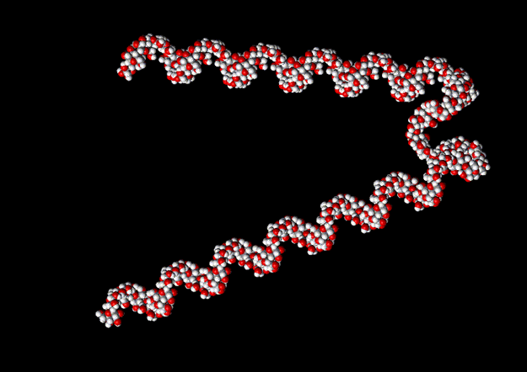
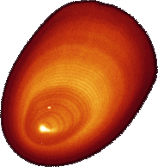
Polysaccharides – structure and function
Polysaccharide | Diagram of molecule | Structure of molecule | Type of Glycosidic Bond | Function of molecule
Starch (Amylose)
Starch (Amylopectin)
Glycogen
Cellulose
Complete the table as I introduce the molecules

Slide 8
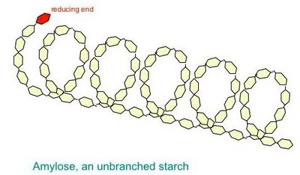
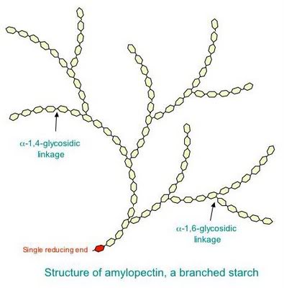
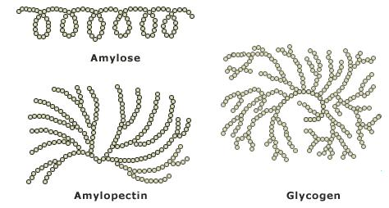
1-4 glycosidic, angle of bonds makes molecule twist into a helix.
Helix stabilised by H bonds.
The reducing end can donate electrons
Extremely branched, 1-4 and 1-6. Insoluble but quickly broken down as easy to remove monomers from ends of chains.

Slide 9
Polysaccharides – structure and function
Polysaccharide | Structure of molecule | Type of Glycosidic Bond | Function of molecule
Starch (Amylose)
Starch (Amylopectin)
Glycogen
Alpha glucose. Unbranched helix with H bonds, compact. OH groups on inside reducing solubility.
Energy storage in plants
Less soluble than glucose, very little osmotic affect, easily hydrolysed
Alpha Glycosidic 1-4
Alpha glucose
Tightly packed helix with H bonds and branches
Alpha
Glycosidic 1-4 with some 1-6
Storage in plants, quickly broken down at ends, insoluble
Alpha glucose
Smaller chains. very branched, compact molecule
Storage in animals. Quickly broken down for energy release in respiration as multiple branches make many free ends for glucose removal. Non soluble
Alpha 1-4 glycosidic with more 1-6 than amylopectin
Challenge:
Why is water so vital for us to survive when it is not required for respiration?

Slide 10
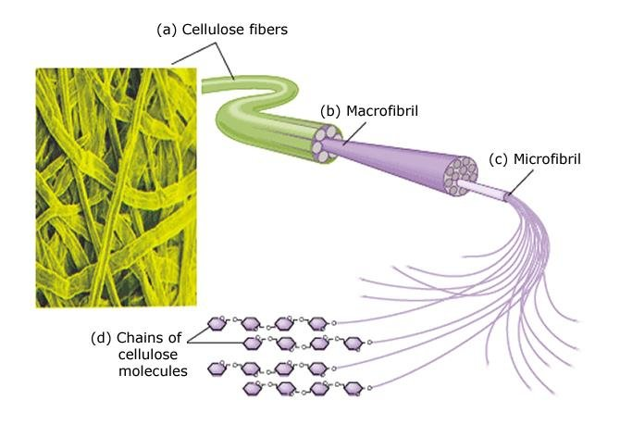
Cellulose
Macrofibrils embedded in pectins to form a mesh with gaps for transport of water and ions.

Slide 11
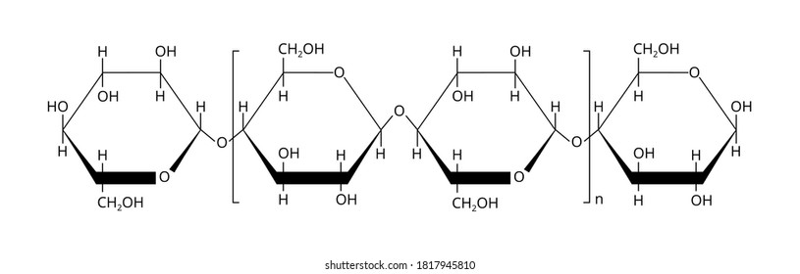
Cellulose
1. B-glucose
2. Condensation.
3. OH groups on 1 and 4 are too far away from each other to bond. Prevents the chain from coiling.
4. Enables H bonds to form between different chains giving the molecule additional strength.
1. Identify the monomers (hint – be careful here!)
2. Name the reaction that joins the monomers.
3. Why are alternate monomers inverted?
4. What is the benefit of the hydroxyl group on carbon 2 sticking out?

Slide 12
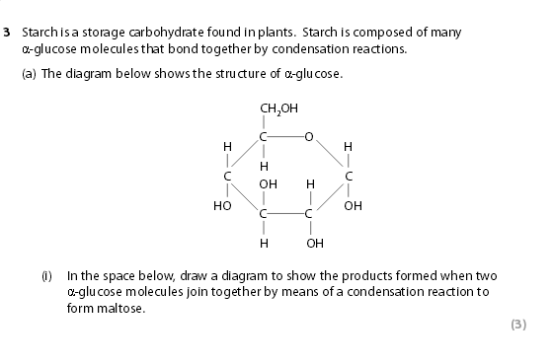
(ii) Name the bond that joins the two
(ii) Name the bond that joins the two
α
α
-glucose molecules together.
-glucose molecules together.
(ii) Name the bond that joins the two α-glucose molecules together.(1)
(b) Describe the structure of starch and explain why this structure makes it a suitable molecule for storing energy.(4)
(1)
(1)

Slide 13
0901
Question
Number
Answer
Mark
3(a)(i)
1.
Question
Answer
Mark
2.
3.
indication that water is formed ;
glycosidic bond correctly drawn ;
two glucose molecules correctly drawn ;
(3)
Number
3(a)(ii)
glycosidic (bond) ;
(1)
Question
Answer
Mark
Number
3(b)
1.
reference to amylose and amylopectin ;
2.
credit details of amylose e.g. straight chain, spiraled, 1-4
links ;
3.
credit details of {amylopectin / starch} e.g. branched, (1-4
3(b) 1.reference to amylose and amylopectin ;
2.credit details of amylose e.g. straight chain, spiraled, 1-4 links ;
3.credit details of {amylopectin / starch} e.g. branched, (1-4 and) 1-6 links ;
4.idea that it is easily hydrolysed ;
5.idea of compact structure ;
6.(leading to) more glucose in a smaller space (in a cell) ;
7.idea of being {insoluble / large} ;
8.(leading to ) it {not diffusing out of cells / having {little / no} osmotic effect} / eq ;
NB maximum of 3 marks for structural points (pts 1, 2, 3, 5 and 7)
and) 1-6 links ;
4.
idea that it is easily hydrolysed ;
5.
idea of compact structure ;
6.
(leading to) more glucose in a smaller space (in a cell) ;
7.
idea of being {insoluble / large} ;
8.
(leading to ) it {not diffusing out of cells / having {little / no}
osmotic effect} / eq ;
NB
maximum of 3 marks for structural points
(pts 1, 2, 3, 5 and 7)
6BI01_01

Slide 14
Challenge question:
There is another type of carbohydrate that is an essential part of our diet, but has no nutritional value. What is it and why does it have no value?
Cellulose (dietary fibre)
Chains of up to 10,000 glucose molecules
Straight chains
Indigestible by humans
Reduces chances of chd, diabetes and bowel cancer
Challenge:
Which animals can digest cellulose? Why?

