Slide 1
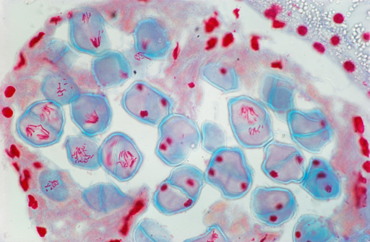
What’s going on here?
Notes:
Note to me:
Do this lesson with sugar paper. Make them draw and colour in chromosomes, model ind assort then chop up and restick for crossing over.
Draw out each stage physically moving chromosomes then answer exam q’s.

Slide 2
MEIOSIS
Also known as reduction division as it halves the genetic information in the daughter cells.
By the end of this lesson, you should be able to:
Describe and explain how unique haploid cells are formed by the process of meiosis and suggest the significance of this.
Explain how the diploid number is restored at fertilisation
What differences can you remember between mitosis and meiosis?
Start a table to note down your ideas. Continue adding as the lesson progresses.
Complete the meiosis key terms as much as you can.

Slide 3
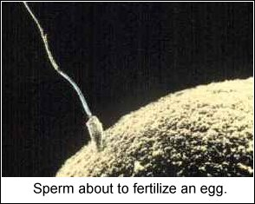
The nuclei of sperm and egg cells fuse together at fertilisation to form a zygote which divides by mitosis to form a ball of cells. The cells continue to divide and differentiate until an embryo is formed.
Half the genetic information comes from the mother and half from the father.
Keep this in mind!

Slide 4
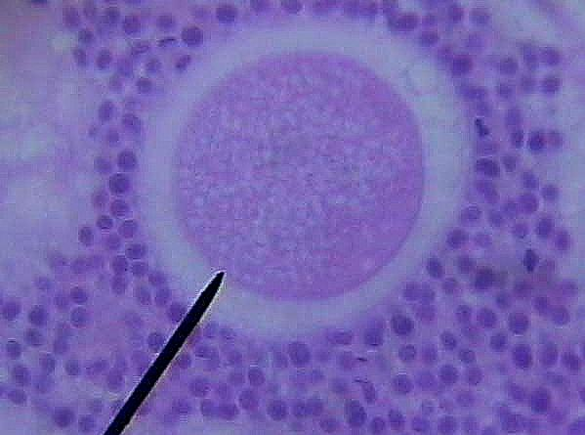
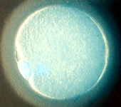
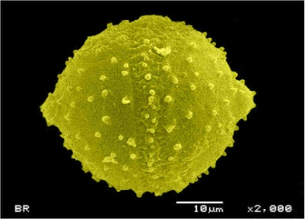
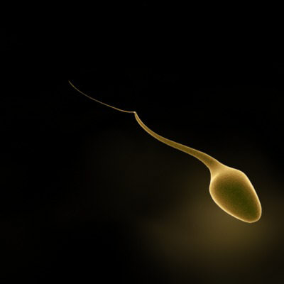
Use the key terms to define meiosis
Gametes (sex cells)
e.g. sperm, pollen, ovules and ova are formed by a type of cell division called meiosis.
Meiosis results in haploid cells. At fertilisation a diploid cell is formed.
A diploid cell contains 2 copies of each chromosome, one maternally derived and one paternally derived,
A haploid cell is one that only contains one copy of each chromosome.
Meiosis animation 1 cell to 4 cells - YouTube

Slide 5
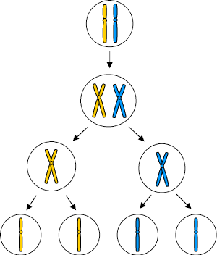
Meiosis in outline – discuss what this diagram shows
Occurs in sex organs
Testes and Ovaries
Parent cell: chromosome pair
What's wrong with this diagram?
Chromosomes copied
2nd division: produces 4 gamete cells with ½ the original no. of chromosomes
1st division: pairs split
Draw a pair of homologous chromosomes, ready to divide, one pink and one blue, and cut them out.
Produces haploid cells
Two haploid cells fuse at fertilisation to form a zygote

Slide 6
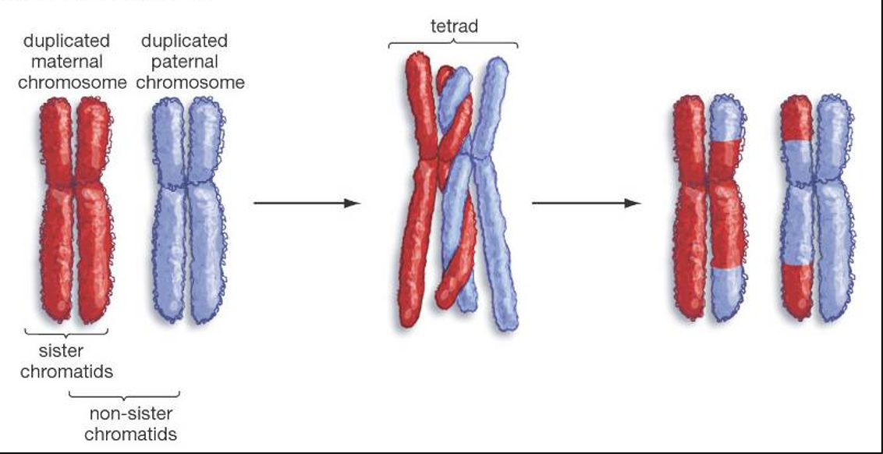
Why does meiosis lead to genetic variation?
1.Chiasmata & Crossing Over
When homologous pairs line up during prophase I, parts of the chromosomes may cross over. These points are called chiasmata. (singular chiasma)
It results in alleles being exchanged between the two inside chromatids.
These chromatids are called recombinants as they have a new combination of genes.
Randomly cut up the inner chromatids and swap the pieces over, then stick them back together.
Label the diagram with key terms and explain why this process is important in gamete formation.

Slide 7
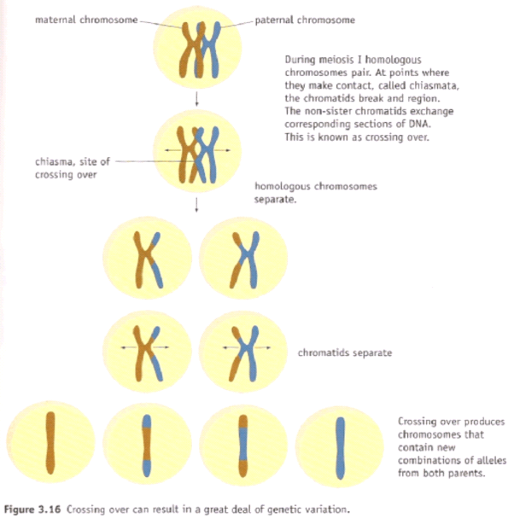
Now explain to your partner what this diagram shows
1. Crossing over

Slide 8
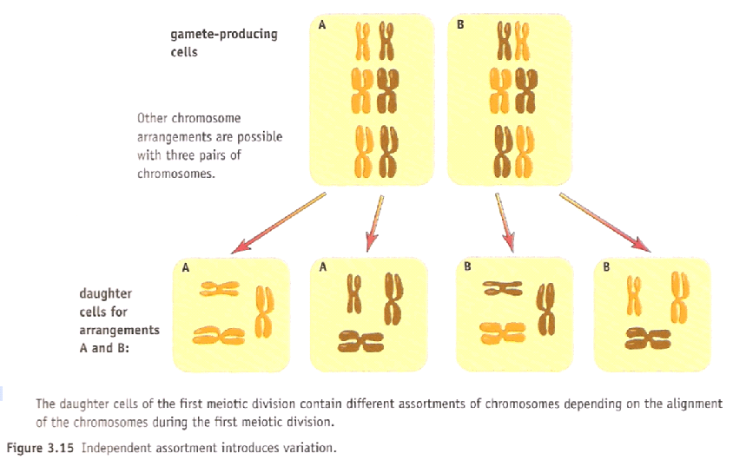
Why does meiosis lead to variation in the gametes?
2. Independent/ random assortment
Now bring your chromosomes to the middle desk and line up in homologous pairs on the equator.
How could this occur differently?
Give the possible combinations of chromosomes that could occur in the gametes of an organism with three homologous pairs XX, YY and ZZ
XYZ, XYZ, XYZ, XYZ, XYZ, XYZ, XYZ, XYZ

Slide 9
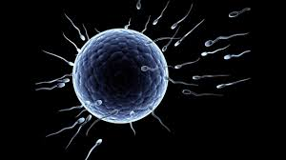
3. Fertilisation
Remember each gamete is unique, fusing of the sperm and egg produces a unique zygote
Variation =
1. Crossing over
2. Independent assortment
3. Fertilisation
Complete the meiosis key words sheet.

Slide 10
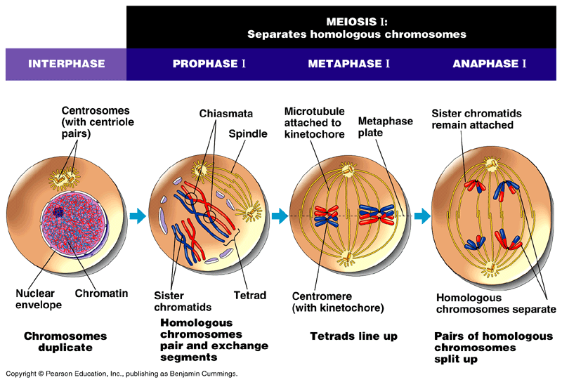
Extra terminology
Tetrads are pairs of chromosomes formed in meiosis I.
Bivalents are one side of this pair.
Kinetochore is the protein that attaches the centromere to the spindle

Slide 11
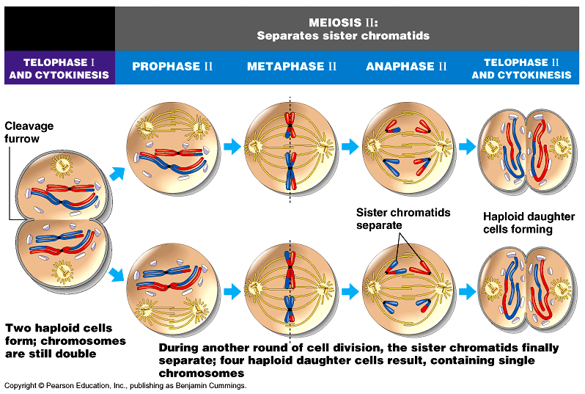
Join a different partner and model meiosis I and II using your two pairs of chromosomes, and a pair of scissors! Take a photo of each stage and up-load these to your worksheet

Slide 12
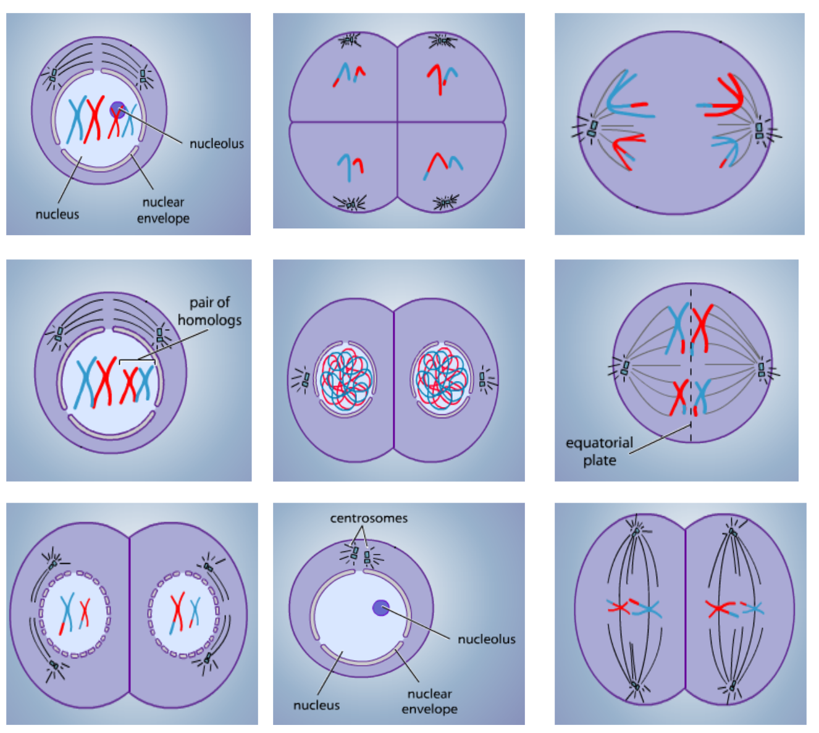
Stages to choose from:
Meiosis I
Interphase
Prophase I
Metaphase I
Anaphase I
Telopase I
Meiosis II
Prophase II
Metaphase II
(Anaphase II)
Telophase II
8
1, 4
6
3
5
7
9
Not shown
2

Slide 13
If the statement is correct place a tick (✓) in the appropriate box. If the statement is incorrect, place a cross (✗)in the appropriate box.
Statement | 1st Division of meiosis | 2nd Division of meiosis
Pairing of homologous chromosomes occurs | ✓ | ✗
Each chromosome consists of a pair of chromatids during prophase | ✓ | ✓
Crossing over occurs and chiasmata are formed | ✓ | ✗
Independent assortment of chromosomes occurs | ✓ | ✓

Slide 14
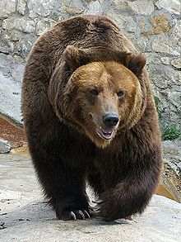
Cell division the bare essentials – check your comparison table
Meiosis
Mitosis
Involved in the production of gametes
2 stages of division 4 daughter cells
Produces haploid cells (½ the chromosome number)
Daughter cells are all different from each other and to parent cell – genetic variation
Occurs in germ cells to produce gametes
Daughter cells used for sexual reproduction
Common errors:
Meiosis is NOT sexual reproduction.
Meiosis occurs in germ cells NOT gametes

Slide 15
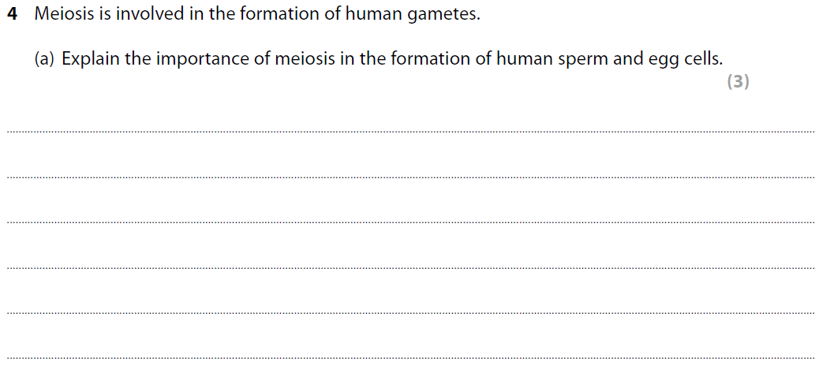
Meiosis exam question
It is a form of cell division that
1. halves the chromosome number / eq ;
2. so that at fertilisation the {full complement /
eq} of chromosomes is restored / eq ;
3. allows genetic variation (in gametes) / eq ;
4. through independent assortment / eq ;
5. through crossing over / eq ;

