Slide 1
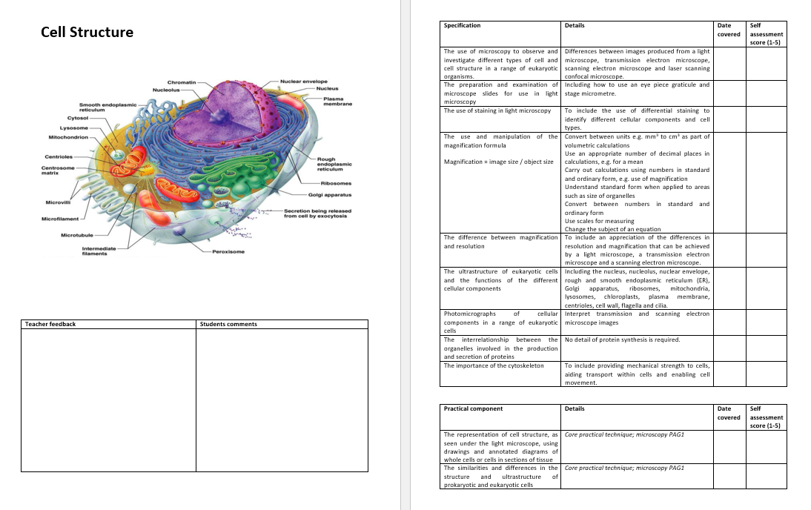
Learning Outcomes

Slide 2
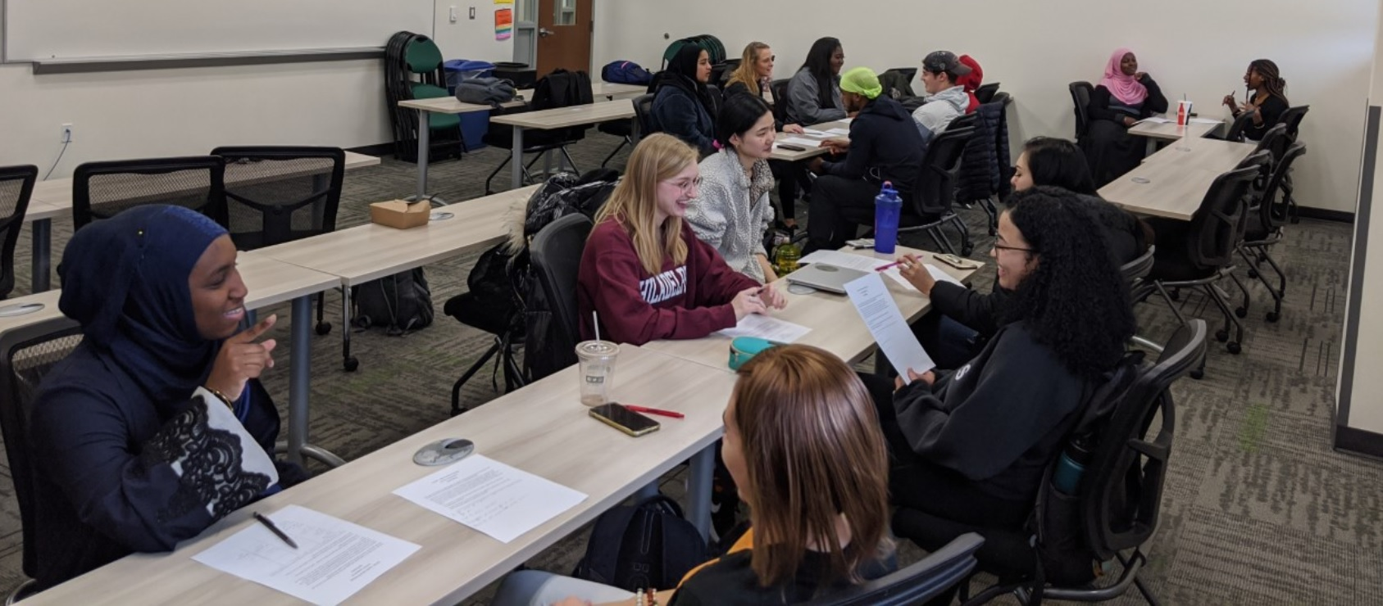
You will be speeding dating using your information on organelles
ITS ALL IN THE DETAIL!!

Slide 3
RIBOSOME

Slide 4
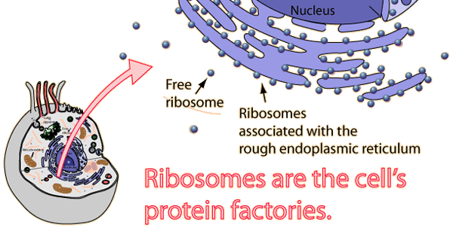
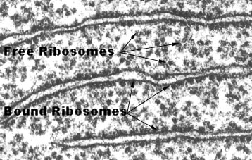
ribosomes
Doesn’t have a membrane Synthesised from ribosomal RNA in the nucleolus, into two sub units. Travels through nuclear pore and assembled in the cytoplasm. Some found free in cytoplasm, others bind to endoplasmic reticulum. | R.E.R bound ribosomes synthesise proteins to be exported from the cell. Free ribosomes make proteins to be used internally (inside cell).

Slide 5
Rough endoplasmic reticulum (RER)

Slide 6
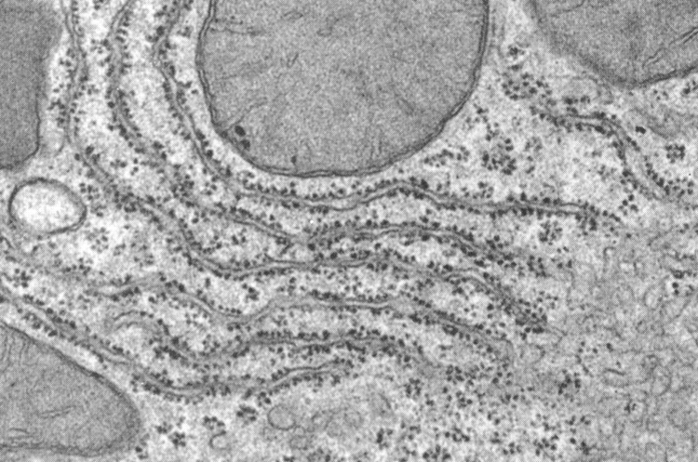
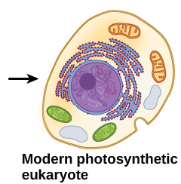
Enabled the nuclear envelope to form.
Limiting effects of jumping genes
Rough endoplasmic reticulum (R.ER)
System of membranes which is continuous with the nuclear membrane (envelope). Fluid filled cavities called cisternae. Coated with ribosomes. | Intracellular transport system, allowing transport of proteins out of the cell. Folds and packages proteins into vesicles Protein synthesis happens inside the ribosomes. The synthesised protein is actively transported (AT) into cisternae. Transported to golgi apparatus for modification and packaging. Proteins transported outside of the cell via exocytosis.

Slide 7
GOLGI APARATUS

Slide 8
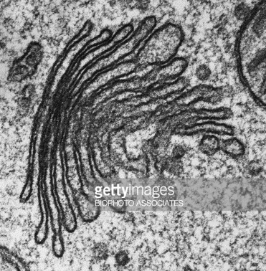
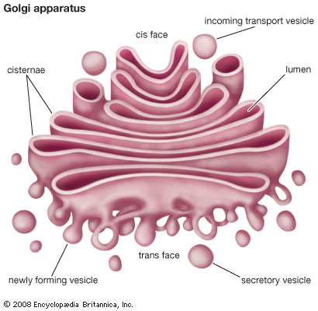
Part of the pathway linking protein production in R.ER to outside of the cell.
Golgi apparatus
Stack of membrane bound flattened sacs Secretory vesicles bring substances to and from the golgi aparatus | Proteins are modified here. Proteins are packaged into vesicles and then transported into the plasma membrane or outside of the cell (exocytosis).

Slide 9
LYSOSOME

Slide 10
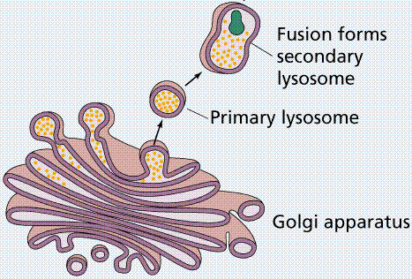
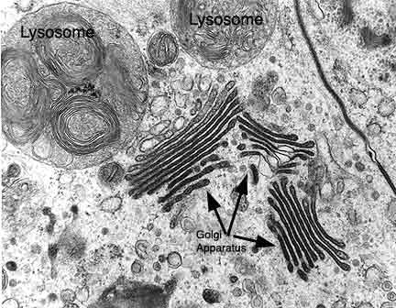
Lysosomes
Small vesicles, formed from Golgi apparatus Contain digestive/hydrolytic enzymes Lots are found in phagocytic cells (neutrophils and macrophages – type of WBC) | Powerful digestive enzymes are thus kept separate from rest of the cell. Lysosomes fuse/engulf old cellular organelles, foreign matter. Digested material can then be reused.
*Hydrolase is a class of enzyme that commonly perform as biochemical catalysts that use water to break a chemical bond

Slide 11
Smooth endoplasmic reticulum (SER)

Slide 12
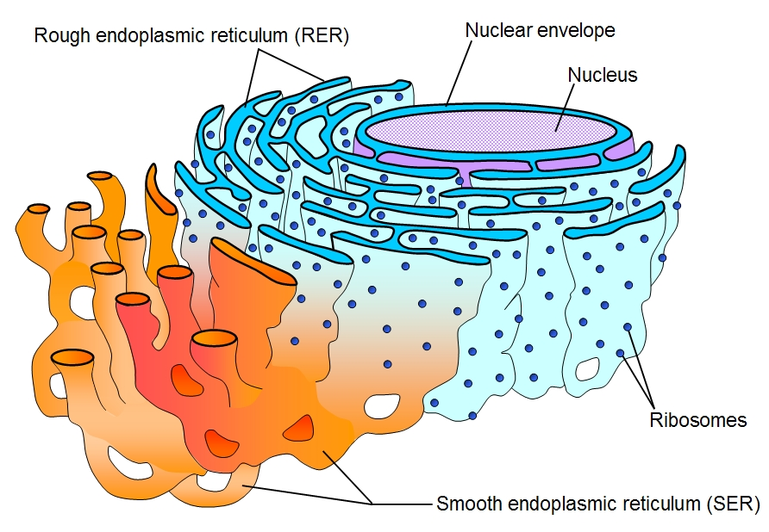
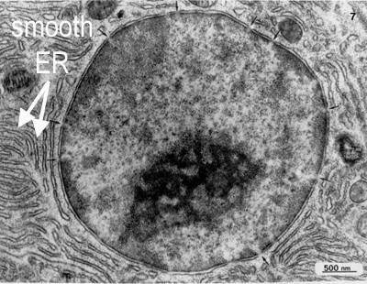
Smooth endoplasmic reticulum (SER)
System of membranes which is continuous with the nuclear membrane (envelope). Fluid filled cavities called cisternae. NO RIBOSOMES. | Responsible for the synthesis of essential lipids such as phospholipids and cholesterol. Responsible for the production and secretion of steroid hormones. It is also responsible for the metabolism of carbohydrates. Involved in absorption, synthesis and transport of substances from the gut.

Slide 13
MITOCHONDRIA

Slide 14
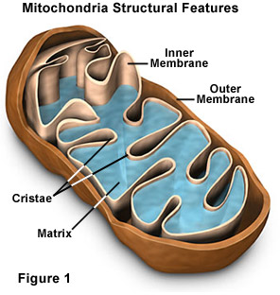
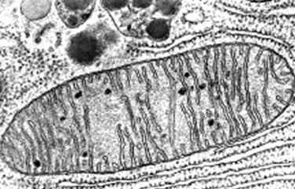
Loosened the energy constraints to allow cells to increase in size and become more complex.
Drove evolution of prokaryotic cells through into eukaryotes.
Mitochondria
Spherical, rod shaped or branched Surrounded by two membrane. Inner membrane folded into cristae. Filled with matrix (like cytoplasm but inside the mitochondria). | Site of aerobic respiration where ATP is produced. Are self replicating Have their own internal DNA, as well as genes found in the nuclear genome. More abundant in cells with high energy demands.

Slide 15
VACUOLE

Slide 16
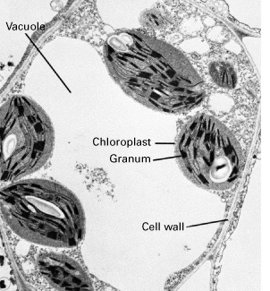
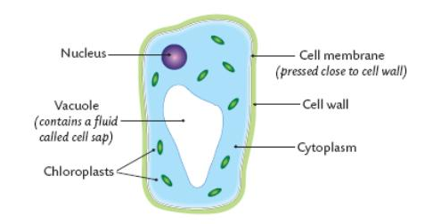
Vacuole
Surrounded by a membrane called a tonoplast. Contains fluid. | Only plant cells have large permanent vacuole. Filled with water and solutes Maintains cell stability Keeps plant cell turgid

Slide 17
CELL WALL

Slide 18
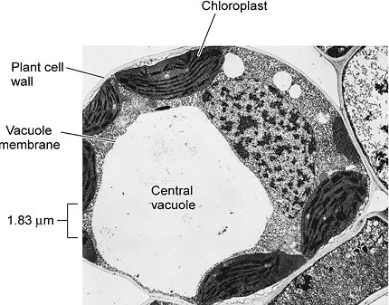
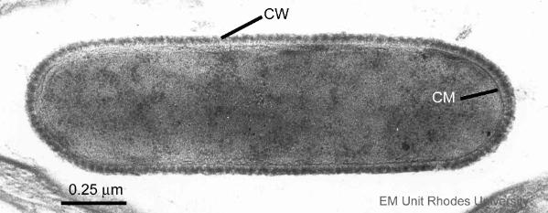
Cell wall
In plants is made of cellulose. In fungi is made of chitin In prokaryotes is made of peptidoglycan | Not found in animal cells. Is strong and prevents plant cell from bursting. Provides strength and support Maintains cell shape Is freely permeable

Slide 19
CENTRIOLES

Slide 20
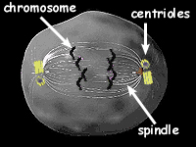
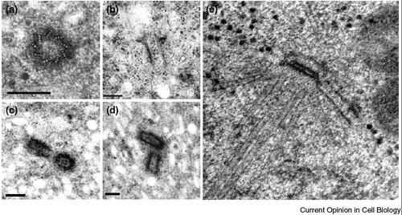
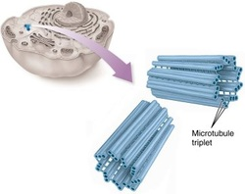
NOT FOUND IN PLANT CELLS!!
Centrioles
Consist of bundles of microtubules (small tubes) which are stuck together to give a fibre/rope like substance. | Before cell division, spindles come up of the ends which attach to chromosomes and pull them to opposite poles (ends) of the cell. Microtubules from centrioles sprout out from cell surface membrane to form cilia and undulipodia.

Slide 21
CYTOSKELETON

Slide 22
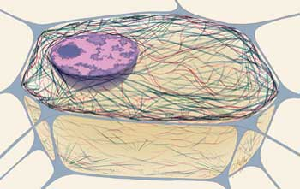
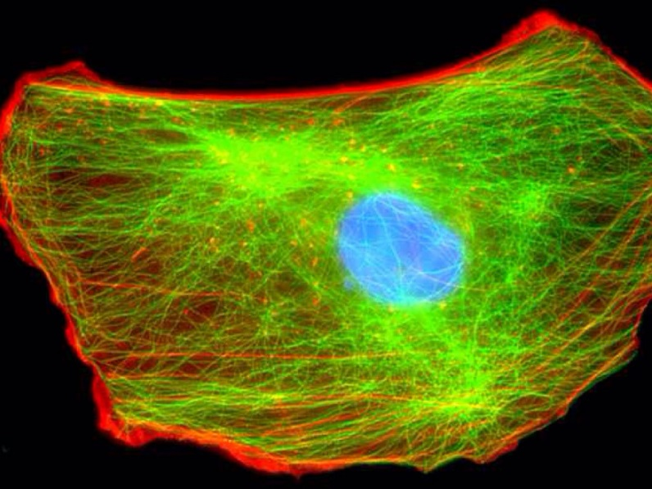
Cytoskeleton
Network of proteins criss-crossing through the cytoplasm. Made from three parts Microfilaments Microtubules intermediate fibres | Give support and mechanical strength, keeps cell shape stable. Exocytosis / endocytosis Allows cells to move. Act as tracks for organelles. Organelles attach and get moved to different parts of the cell (like a train line). Anchors the nucleus in the cytoplasm. Extends between some cells in some tissues and allows communication.

Slide 23
CILIA

Slide 24
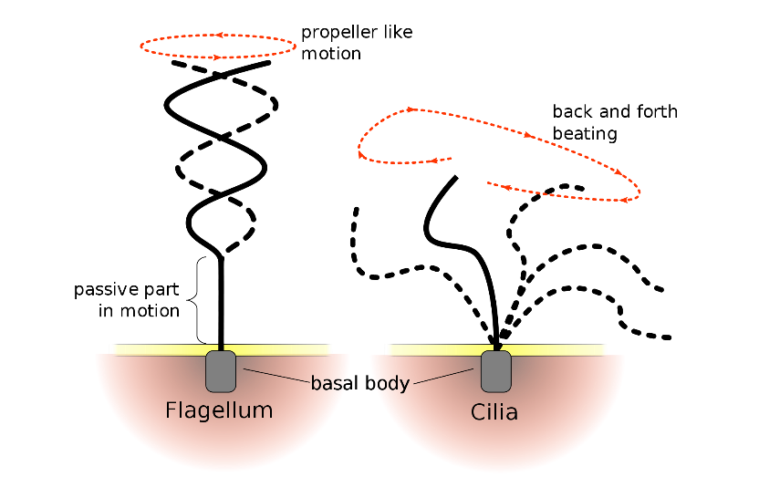
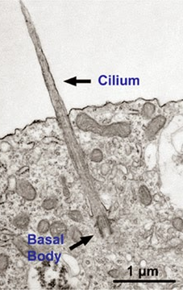
Cilia (undulipodia)
Protrusions from all cells, surrounded by cell surface membrane. Formed from centrioles Contain microtubules | E.g. cilia on epithelial cells Single cilia act as an antenna, detecting immediate surrounding environment. Spermatozoon (sperm cells) have an undulipodia (long cilium), enabling movement.

Slide 25
CHLOROPLAST

Slide 26
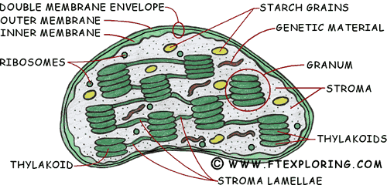
Led to the development of plant cells unique ability to synthesise own food (autotrophic)
Chloroplasts
Found in plant cells and some protoctists. Surrounded by double membrane Contain stacks of flattened stacks called thylakoids which contain chlorophyll. Fluid filled matrix is called stroma. Contain their own DNA and starch grains. | Site of photosynthesis. 1st stage of photosynthesis (light dependent stage) happens in thylakoid stack membranes, 2nd stage of photosynthesis (light independent stage – fixation of carbon) happens in stroma.

Slide 27
Please open your assignment on organelles from last lesson
2/3 minutes to revise the functions
Notes:
Chloroplast – thylakoids layers = granum
Centrioles – contain microtubules = these sprout out during cell division when attaching to the chloroplast / also from cilia undulipodia
Cytoskeleton – contain microtubules, microfilaments and intermediate fibres – structure, support and transport

Slide 28
You will be speeding dating using your information on organelles
ITS ALL IN THE DETAIL!!
Notes:
Chloroplast – thylakoids layers = granum
Centrioles – contain microtubules = these sprout out during cell division when attaching to the chloroplast / also from cilia undulipodia
Cytoskeleton – contain microtubules, microfilaments and intermediate fibres – structure, support and transport

Slide 29
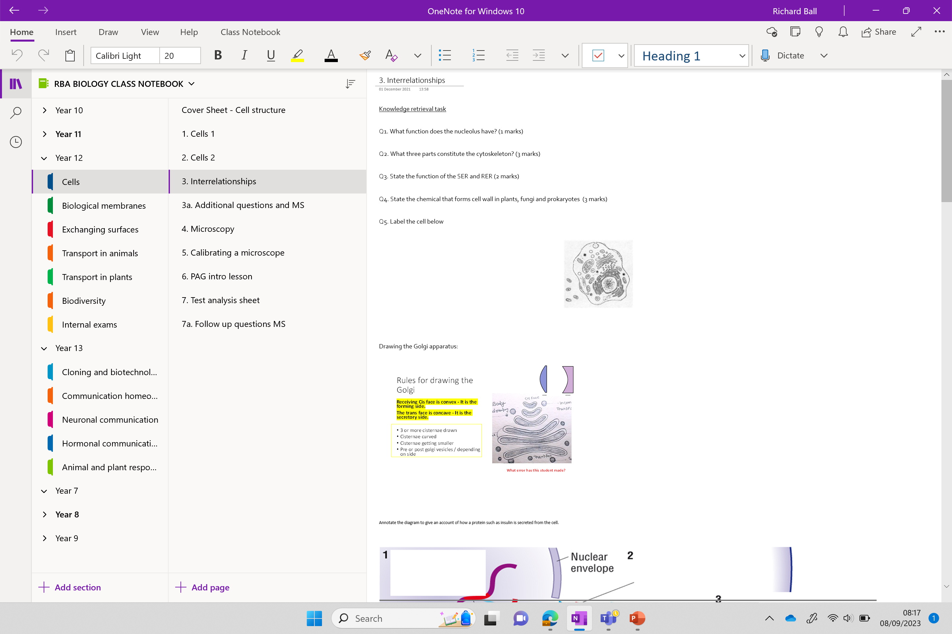

Slide 30
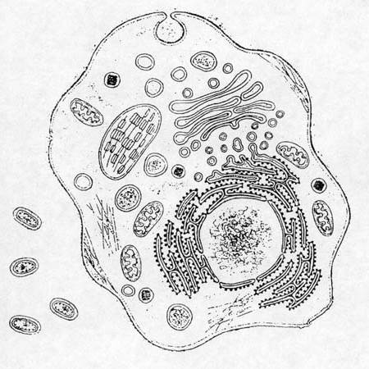
Knowledge retrieval questions
Q1. What function does the nucleolus have? (1 marks)
Q2. What three parts constitute the cytoskeleton? (3 marks)
Q3. State the function of the SER and RER (2 marks)
Q4. State the chemical that forms cell wall in plants, fungi and prokaryotes (3 marks)
Q5. Label the cell
Producing ribosomes
Microfilaments / microtubules / intermediate fibres
Smooth endoplasmic reticulum – synthesis and storage of lipids and carbohydrates / secrete steroid hormones
Rough endoplasmic reticulum – synthesis and transport of proteins
plants = cellulose / Fungi = chitin / prokaryotes = peptidoglycan

Slide 31
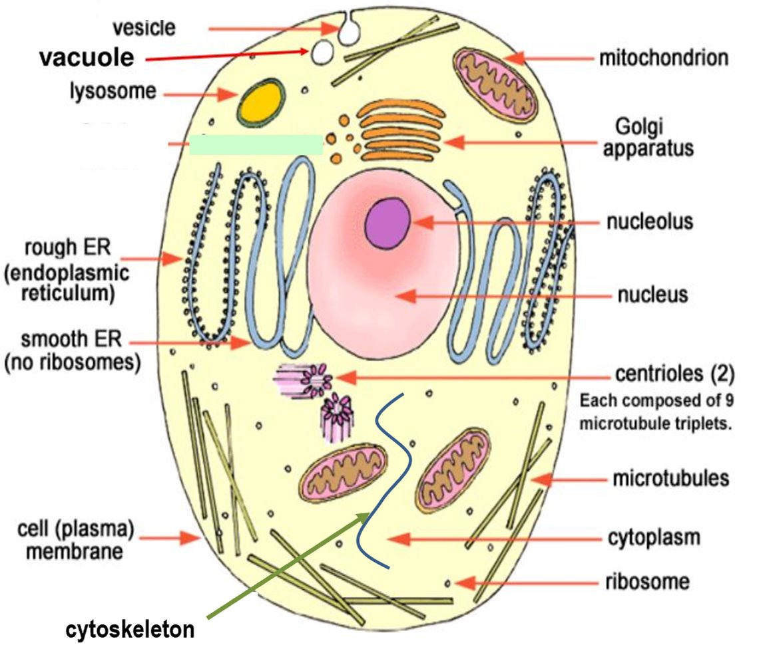

Slide 32
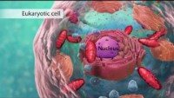

Slide 33
Biology: Cell Structure I Nucleus Medical Media - YouTube

Slide 34
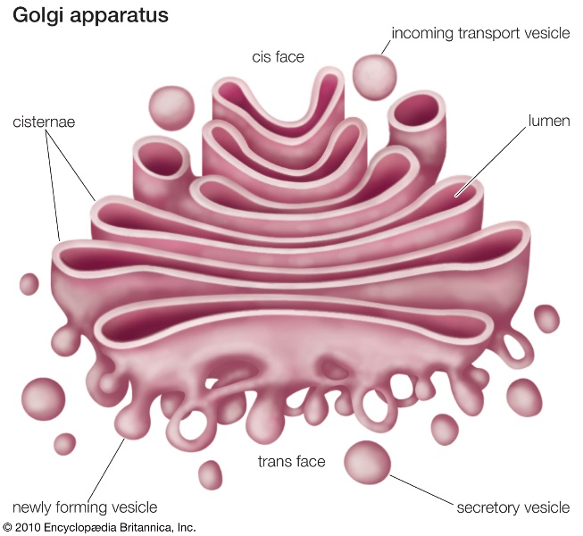
Interrelationships in complex cells

Slide 35
You may be asked to draw the Golgi apparatus – there are some rules!

Slide 36
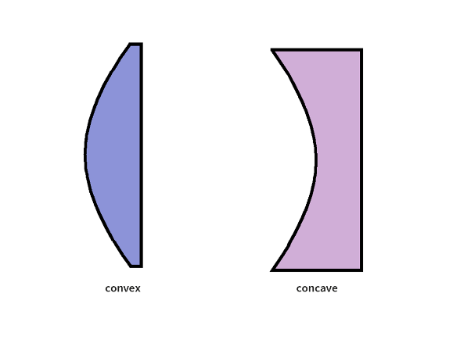
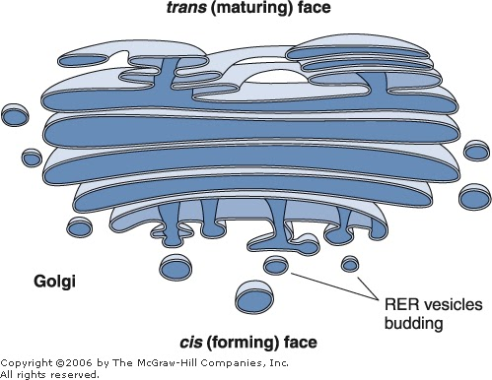
Rules for drawing the Golgi
Receiving Cis (forming) face is convex - It is the forming side.
The Trans (maturing) face is concave - It is the secretory side.
3 or more cisternae drawn
Cisternae curved
Cisternae getting smaller
Pre or post Golgi vesicles / depending on side
Trans Face
CIS Face

Slide 37
How are proteins made and transported?

Slide 38
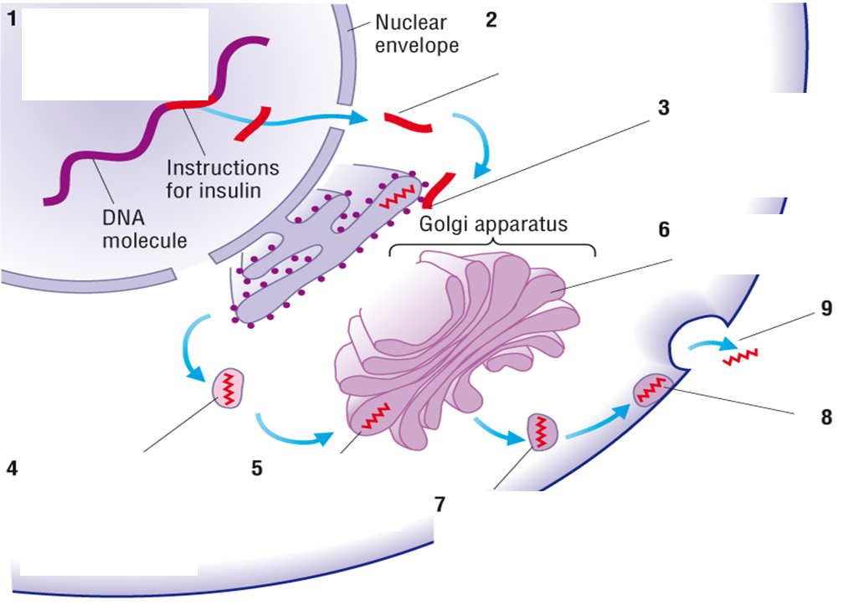
Protein trafficking (production)

Slide 39


Slide 40

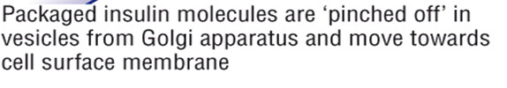
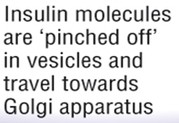

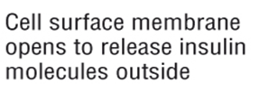
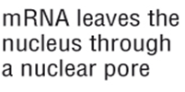
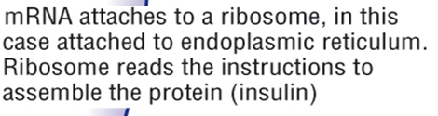
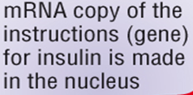

Place the statement in the correct order around your diagram. You then have 4/5 minutes to revise the order.

Slide 41
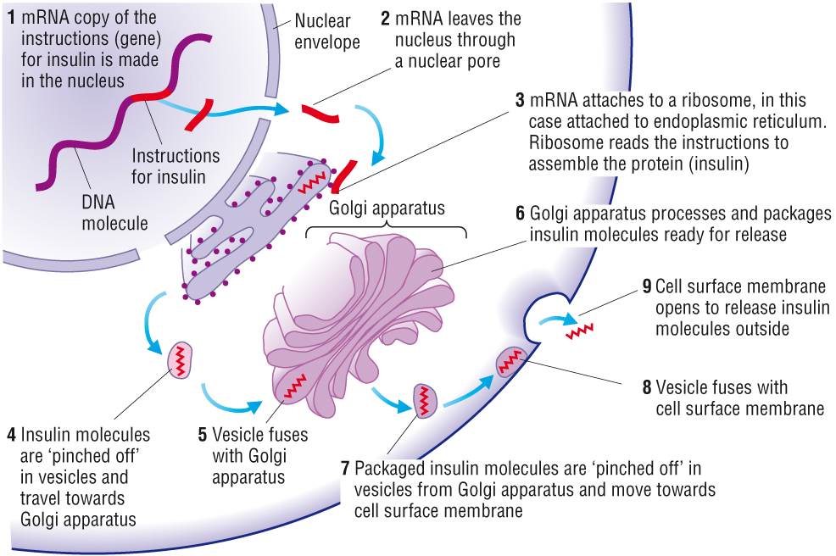
Exocytosis

Slide 43
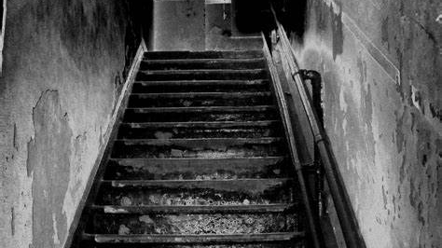
STEPS OF DOOM

Slide 44
The mRNA passes through the nucleus pore and attaches to the RER
The ribosome then synthesise for the protein
The protein is pinched off in vesicles and transported to the Golgi apparatus, where they fuse to the cis face.
They are then processed and packaged in the Golgi apparatus
Packaged proteins are then pinched off in vesicles from the trans face
They are transported via secretory vesicles to the cell-surface membrane (where they fuse) and are then released via exocytosis
*some proteins remain in the cell for internal use e.g in lysosomes

Slide 45
Learning Outcomes

Slide 46
The Cytoskeleton
https://www.youtube.com/watch?v=tO-W8mvBa78

Slide 47
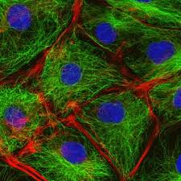
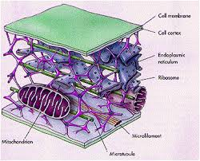
The cytoskeleton
Interlinking filaments and tubules providing:
Shape and support to the cell, anchor organelles (Intermediate filaments)
Movement of organelles within the cell, e.g. secretory vesicles moving to the plasma membrane to release contents out of the cell (microtubules)
Used for cell division (microfilaments)

Slide 48
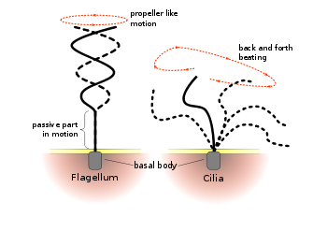
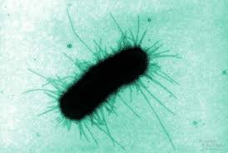
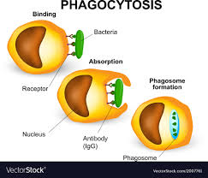
Movement of the cells
The flagellum has a rotary action which allows movement.
The cilia have a beating action e.g. ciliated epithelial cells in the trachea
Pili are involved in cell attachment, to each other and to surfaces
The cytoplasm is able to extend around a pathogen enabling the cell to engulf and destroy it.

Slide 49
Complete the exam style questions
Q1. The Golgi apparatus of a goblet cell is involved in receiving protein, modifying it and then packaging the modified protein into vesicles.
(i) In the space below, draw a diagram of a Golgi apparatus. Add an arrow to your drawing to show the direction of movement of the protein material as it moves through the Golgi apparatus.(3)
(ii) Proteins in a cell can be made radioactive by supplying the cell with radioactive amino acids. The movement of the radioactive protein within the cell can be traced over time.
In an investigation, it was found that the quantity of radioactivity in the protein that entered the Golgi apparatus was less than that supplied to the cell.
Suggest three reasons for this difference. (3)
Q2. Plant and animal cells have different structural features.
i)Name two features of plant cells that are not features of animal cells.[2]
1.
2.
ii)Name one structure present in animal cells that is not present in plant cells.[1]
iii) The cytoskeleton in cells consists of microtubules and microfilaments.
Describe the roles of the cytoskeleton [3]

Slide 50
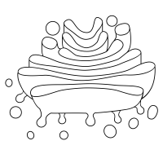
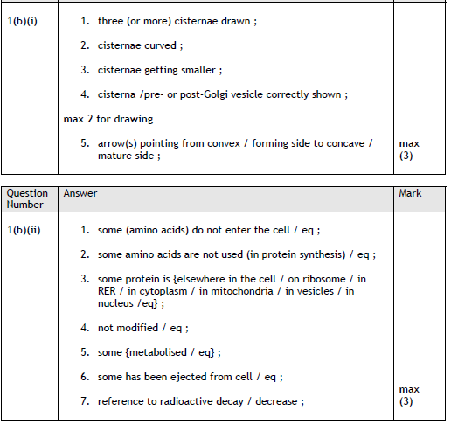
Mark Scheme:
Trans face / mature side
Cis face / forming side

Slide 51
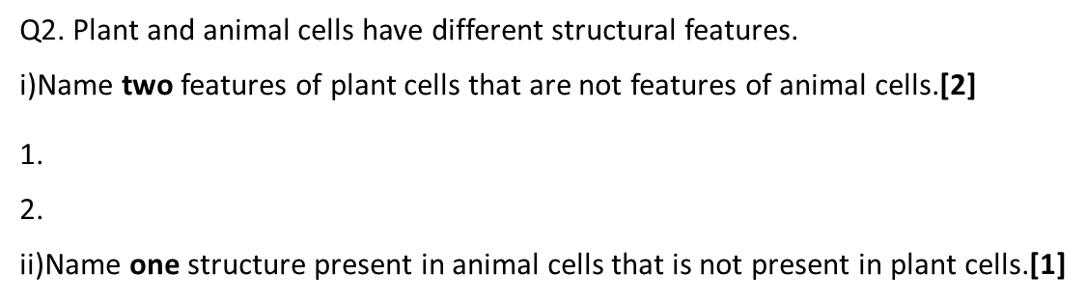
Answers
Q2.
Cell wall / cellulose / chloroplast / starch grain / permanent vacuole / tonoplast
II) Centriole / lysosome / cilia / flagella
iii)
(whole) cell, support / stability / scaffolding / maintain shape ;
changing shape of cell
phagocytosis / endocytosis / exocytosis /
muscle contraction ;
(named) organelles, moved / held in place ;
movement of, chromosomes / chromatids / (m)RNA ;
movement of, cilia / flagella / undulipodia OR use
of cilia / flagellum / undulipodium to move cell ;

