Slide 1
What’s the opposite?
COMPETITIVE
NON-COMPETITIVE
REVERSIBLE
IRREVERSIBLE
STIMULATION
INHIBITION

Slide 2
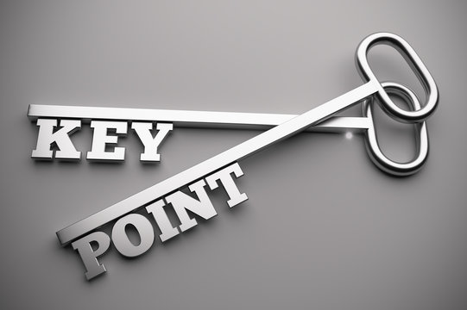
INHIBITORS: KEY POINT
Enzyme inhibitors reduce the rate of enzyme-controlled reactions by preventing the formation of enzyme-substrate complexes
Inhibitors that are able to prevent the formation of an enzyme-substrate complex by fitting into the enzyme’s active site to form an enzyme-inhibitor complex, are known as competitive inhibitors

Slide 3
Based on the fact below, identify what can be deduced about the shape of a competitive inhibitor [1 mark]
Competitive inhibitors fit into the enzyme’s active site to prevent the formation of enzyme-substrate complexes
Complete the passage below which describes the effect of competitive inhibitors on reactions [4 marks]
A competitive inhibitor competes directly with the ___________ molecule for the enzyme’s active site and an ___________-____________ complex, that is catalytically inactive, will be formed if the competitive inhibitor occupies the active site. The enzyme-inhibitor complexes reduce the rate of formation of enzyme substrate complexes and of _________ molecule formation and therefore reduce the rate of the __________-____________ reaction.
The collisions between enzymes and competitive inhibitors are random, just like the collisions between enzymes and substrates

Slide 4
Based on the fact below, identify what can be deduced about the shape of a competitive inhibitor [1 mark]
Competitive inhibitors fit into the enzyme’s active site to prevent the formation of enzyme-substrate complexes
The inhibitor has a similar shape to the enzyme’s substrate molecule
Complete the passage below which describes the effect of competitive inhibitors on reactions [4 marks]
A competitive inhibitor competes directly with the _substrate_ molecule for the enzyme’s active site and an _enzyme_-_inhibitor_ complex, that is catalytically inactive, will be formed if the competitive inhibitor occupies the active site. The enzyme-inhibitor complexes reduce the rate of formation of enzyme substrate complexes and of _product_ molecule formation and therefore reduce the rate of the _enzyme_-_controlled_ reaction.
The collisions between enzymes and competitive inhibitors are random, just like the collisions between enzymes and substrates

Slide 5
INHIBITORS: KEY POINT
An increase in the relative concentration of competitive inhibitor molecules will mean that more inhibitors collide with active sites and the effect of inhibition will be greater
Most of the enzyme inhibition by competitive inhibitors is reversible, meaning that the competitive inhibitor detaches and leaves the active site once the formation of the ESC has been inhibited

Slide 6
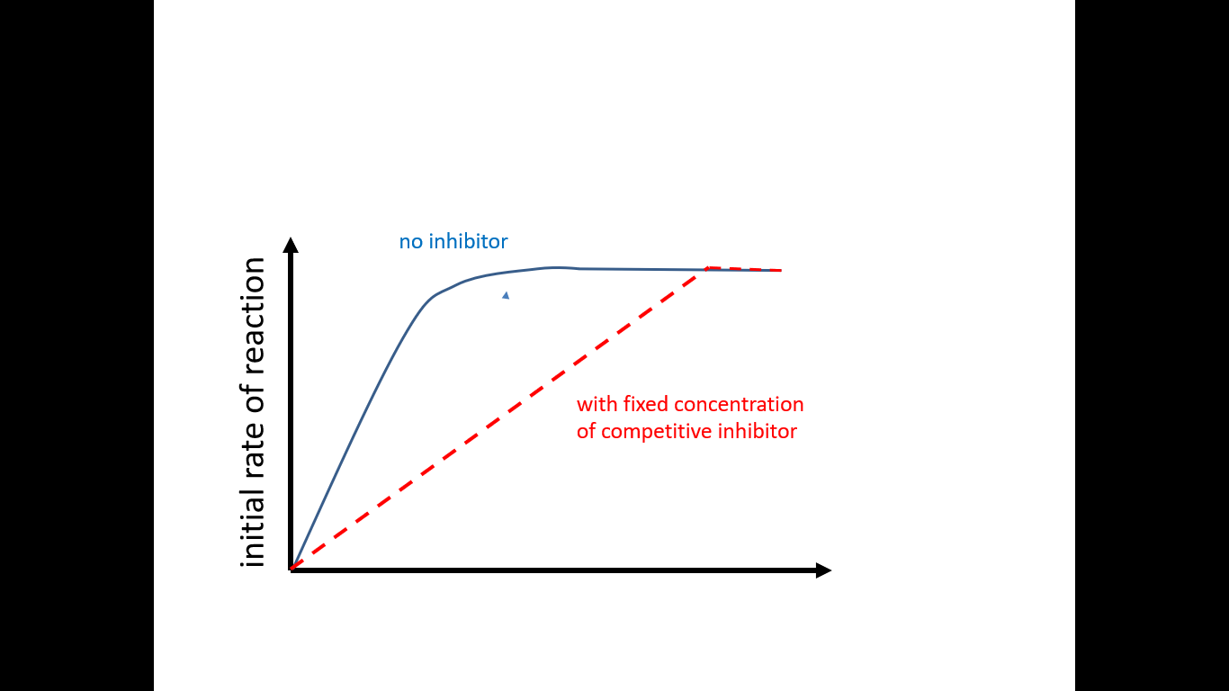
Suggest how the effect of reversible competitive inhibition could be reduced [1 mark]
Increasing the substrate concentration allows the uninhibited maximum rate of reaction to be attained
HINT
Make sure that you study the graph as the answer is the factor which is missing from the x-axis label

Slide 7
Herd immunity and substrate concentration
You may have heard or read about herd immunity in 2020 as some people believe that the UK government considered this as an option in response to the COVID-19 pandemic. The fundamental idea behind this form of immunity is that the greater the proportion of immune individuals in a community, the smaller the probability that non-immune individuals will come into contact with an infectious individual.
A similar idea can be used to explain why increasing the substrate concentration will reduce the effect of reversible competitive inhibition because there is a greater likelihood of an enzyme molecule colliding with a substrate molecule than with an inhibitor molecule

Slide 8
INHIBITORS: KEY POINT
An increase in substrate concentration will reduce the effect of reversible competitive inhibition as the enzyme molecule is more likely to collide with the substrate molecule than to collide with the inhibitor molecule

Slide 9
Understanding check
Some other types of inhibitors are non-competitive
Verbalise your answers to a partner
Identify one structural and one functional difference between a competitive and a non-competitive inhibitor (2 marks)
Non-competitive inhibitors do not have to be a similar shape to the substrate molecule as they do not compete for the enzyme’s active site.

Slide 10
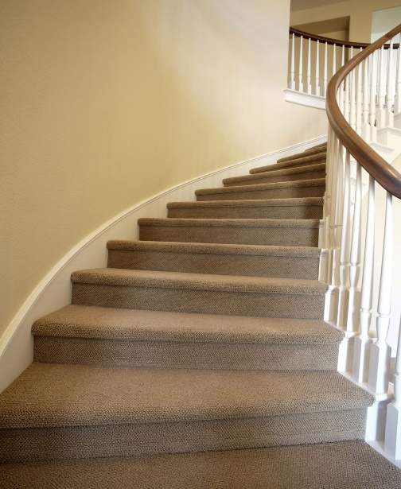
ALLOSTERIC (SITE)
Just SAY WHAT YOU SEE to get this 1 word
Meaning of the prefix hypo
Short version of the name Richard
Chemical symbol for aluminium

Slide 11
INHIBITORS: KEY POINT
Non-competitive inhibitors bind to the enzyme in a region away from the active site, which is known as the allosteric site

Slide 12
1 TO THINK ABOUT
You have 5 minutes to discuss as a class
The binding of a non-competitive inhibitor to the enzyme at the allosteric site changes the shape of the active site, meaning that it is no longer complementary to the substrate molecule and this prevents enzyme-substrate complexes from forming
By keeping today’s 1st KEY POINT at the forefront of your discussions, combine all of your brain power to come up with a plausible explanation for how it’s possible for a non-competitive inhibitor to function as an inhibitor when it doesn’t bind to the active site

Slide 13
Prior knowledge check
The binding of the non-competitive inhibitor to the enzyme at the allosteric site changes the shape of the active site, meaning that it is no longer complementary to the substrate molecule and this prevents enzyme-substrate complexes from forming
Verbalise your answers to a partner
Identify the protein structure that is disrupted by the binding of the non-competitive inhibitor (1 mark)

Slide 14
INHIBITORS: KEY POINT
A non-competitive inhibitor binds to an enzyme at the allosteric site and disrupts the tertiary structure. This changes the shape of the active site so that it is no longer complementary to the substrate and prevents the formation of an ESC
An increase in the relative concentration of non-competitive inhibitor molecules will mean that the effect of inhibition will be greater

Slide 15
Describe and explain how increasing the relative concentration of non-competitive inhibitors affects the rate of an enzyme-controlled reaction [2 marks]
Increasing the relative concentration of non-competitive inhibitors reduces the rate of an enzyme-controlled reaction. This is because as more inhibitors attach to the allosteric sites of the enzymes, more active sites are changed and more enzyme-substrate complexes are prevented from forming.

Slide 16
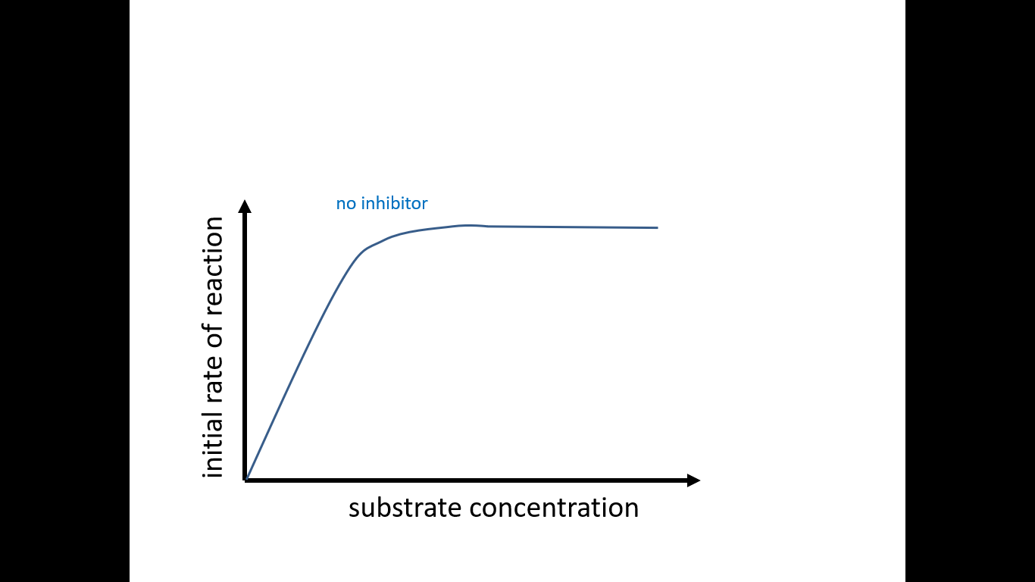
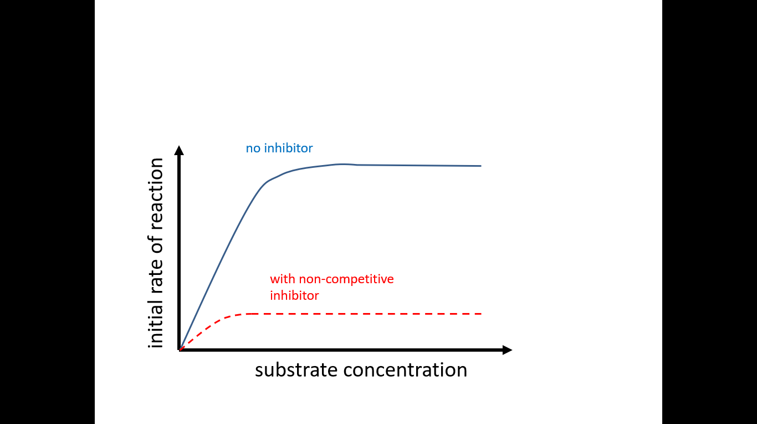
This graph shows the effect of an increase in substrate concentration on the rate of an enzyme-controlled reaction when there are no non-competitive inhibitors present
Add a second line to show how the presence of a fixed concentration of non-competitive inhibitors affects the rate of reaction as substrate concentration increases. You should briefly explain any differences to the graph in question 3 [3 marks]
As non-competitive inhibitors change the shape of the active site, increasing the substrate concentration will not allow the uninhibited maximum rate of reaction to be attained like it did with competitive inhibitors

Slide 17
A changed lock and a visit to the key cutters
To try to understand why increasing the substrate concentration does not have the effect that was observed with competitive inhibitors, let’s consider this simple analogy.
A girl has decided that she no longer wants to be with her boyfriend so breaks up with him over the phone and rather than going through the emotional distress of meeting up with him to get the keys to her flat back, she gets the lock changed instead. The ex-boyfriend is unaware of this and goes to the key-cutting shop and gets multiple copies of the key made. Of course, when he tries to unlock the door to the flat, neither the original key or any of the 20 copies that he got made will work.

Slide 18
Understanding check (just for FUN)
Verbalise your answers to a partner
Identify the biological action represented by the following parts of the story (3 marks)
Section of the story | Biological action
The girl gets the lock changed
Multiple copies of the key are cut at the shop
Neither the original key or the any of the copies will unlock the door
Non-competitive inhibitor binds and changes the shape of the active site
Increasing the substrate concentration
Substrate and active site are not complementary so cannot form enzyme-substrate complexes

Slide 19
This might just prove useful……
Make sure that you note that although increasing the substrate concentration doesn’t allow the uninhibited maximum rate of reaction to be attained, it does allow the new, lower rate of reaction to be attained

Slide 20
IRREVERSIBLE
The action of some competitive and non-competitive inhibitors is described as irreversible as the inhibitor does not dissociate from the enzyme following inhibition of the formation of the ESC.
One particular example is diisopropyl fluorophosphate which has been used in ophthalmology in the treatment of glaucoma as it is an irreversible anti-cholinesterase

Slide 21
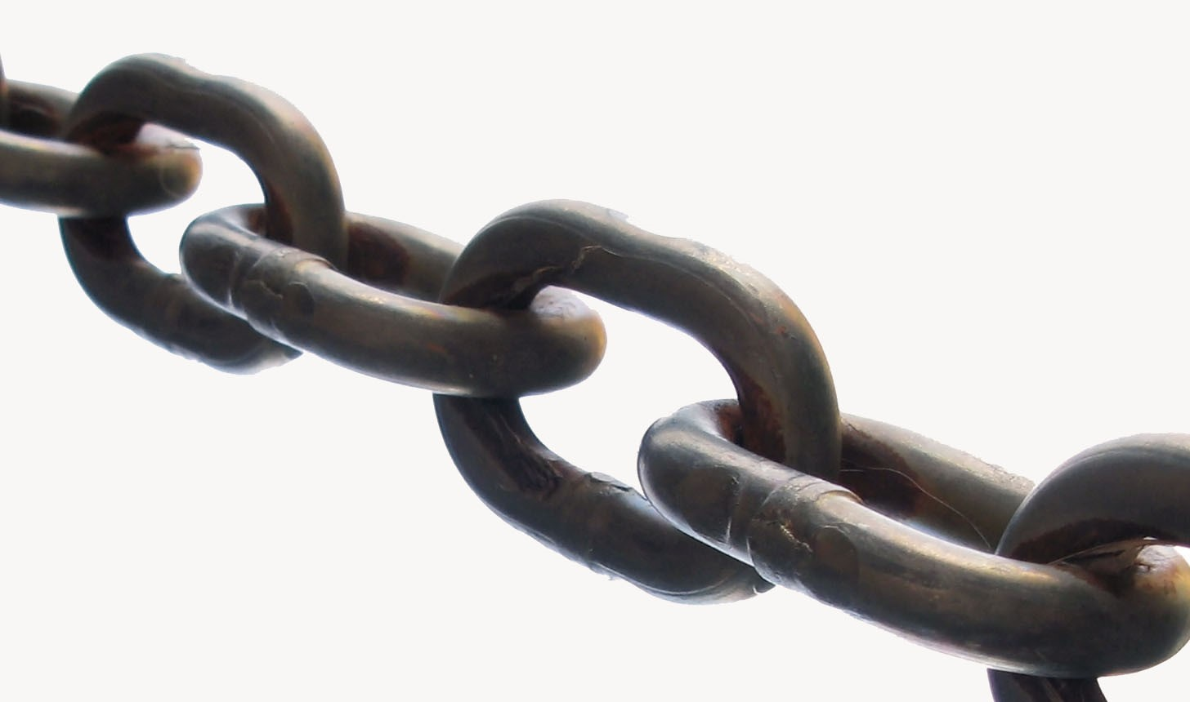
In topic 15, you will learn about the conduction of impulses along neurones and the communication between the end of one neurone and the start of the next via a synapse. Chemicals called neurotransmitters diffuse across synapses and bind to receptors on the post-synaptic membrane and acetylcholine is the neurotransmitter involved at a cholinergic synapse. Once the binding of the acetylcholine has resulted in the initiation of an action potential in the post-synaptic neurone, the acetylcholine is broken down into choline and acetate by acetylcholinesterase and this allows the synapse to recover in preparation for the next impulse. However, inhibition of this enzyme by drugs like diisopropyl fluorophosphate means that acetylcholine remains in the receptor for longer and this can be used in medical treatments but it also utilised in insecticides.
TO THE
LINK
FUTURE

Slide 22
Understanding check
The diagram on the right shows a substrate, succinate, and its two associated inhibitors, malonate and oxaloacetate.
Write your answer
State whether malonate and oxaloacetate are competitive or non-competitive inhibitors and explain your decision
(3 marks)

Slide 23
Malonate and oxaloacetate are both competitive inhibitors.
These inhibitors have a similar structure to the substrate and this means that they are able to compete with succinate for the active site in order to prevent the formation of an ESC

Slide 24
INHIBITORS: KEY POINT
End product inhibition is a form of negative feedback by which metabolic pathways can be controlled

Slide 25
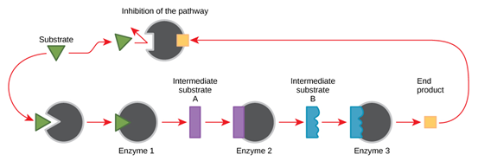
End product inhibition
In end-product inhibition:
The final product in a series of reactions inhibits an enzyme from an earlier step in the sequence
The product binds to an allosteric site and temporarily inactivates the enzyme (via non-competitive inhibition)
As the enzyme can no longer function, the reaction sequence is halted and the rate of product formation is decreased

Slide 26
6. Explain why end product inhibition is an example of negative feedback (2 marks)
If product levels build up, the product inhibits the reaction pathway and hence decreases the rate of further product formation
If product levels drop, the reaction pathway will proceed unhindered and the rate of product formation will increase

Slide 27
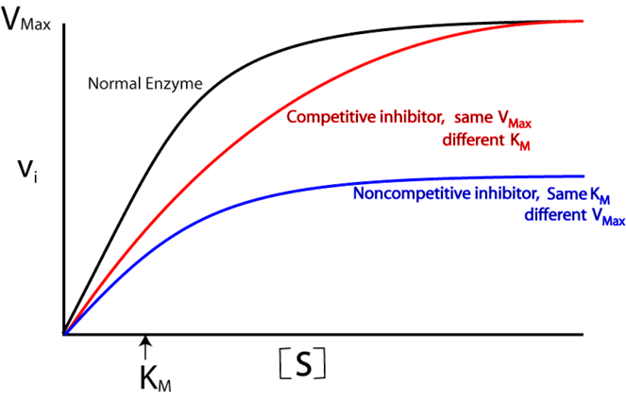
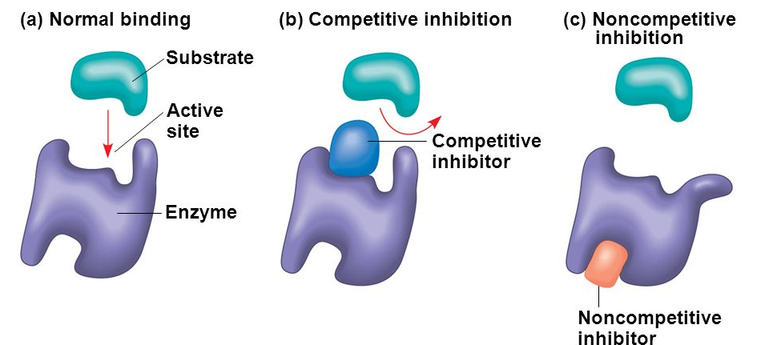
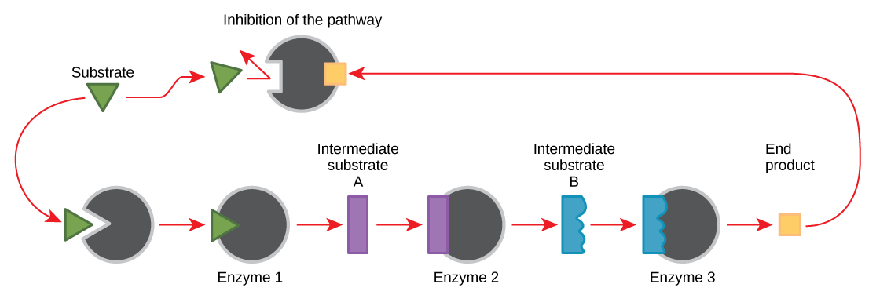
Summary

Slide 28
Stages | Order
The inhibitor binds with this site causing a reaction to occur which alters the enzymes tertiary structure
If the inhibitor is reversible it can dissociate with the enzyme allowing the tertiary structure to be reinstated
The inhibitor enters the enzyme’s environment
This part is called the allosteric site
The shape of the inhibitor is different from the shape of the substrate
The substrate can no longer fit into the active site
The shape of the inhibitor does match with a different site on the enzyme
Non- Competitive inhibitor
Competitive inhibitor
Stages | Order
The inhibitor binds with the enzymes active site preventing a substrate from binding
If the amount of inhibitor were to increase this would slow the rate further
Due to kinetic energy all of the molecules (inhibitor, enzyme and substrate) are moving around
The inhibitor enters the enzymes environment
Sometimes an inhibitor collides with an active site before a substrate
Other enzyme active sites are still available allowing a reaction to occur but at a slower rate

Slide 29
Stages | Order
The inhibitor binds with this site causing a reaction to occur which alters the enzymes tertiary structure | 5
If the inhibitor is reversible it can dissociate with the enzyme allowing the tertiary structure to be reinstated | 7
The inhibitor enters the enzyme’s environment | 1
This part is called the allosteric site | 4
The shape of the inhibitor is different from the shape of the substrate | 2
The substrate can no longer fit into the active site | 6
The shape of the inhibitor does match with a different site on the enzyme | 3
Non- Competitive inhibitor
Competitive inhibitor
Stages | Order
The inhibitor binds with the enzymes active site preventing a substrate from binding | 4
If the amount of inhibitor were to increase this would slow the rate further | 6
Due to kinetic energy all of the molecules (inhibitor, enzyme and substrate) are moving around | 2
The inhibitor enters the enzymes environment | 1
Sometimes an inhibitor collides with an active site before a substrate | 3
Other enzyme active sites are still available allowing a reaction to occur but at a slower rate | 5

