Slide 1
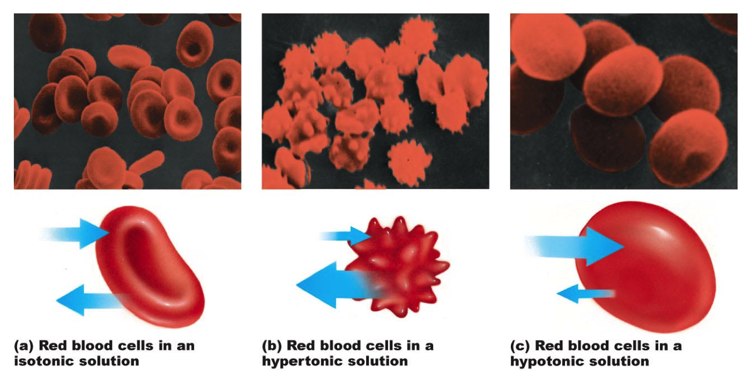
RECAP WITH PARTNER USING THE WORDS: WATER POTENTIAL / SHAPE OF CELL / HYPERTONIC HYPOTONIC

Slide 2
Please copy your PAG 1.2 Microscope PAG from the YR12BIOKS5 notebook
Into the PAG section in you 12B notebook
All PAGS will be completed in our usual Team in future

Slide 3
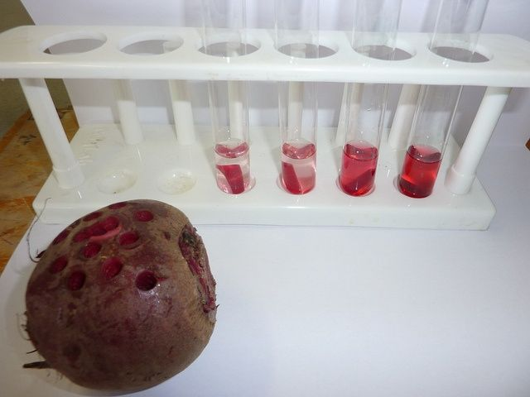
PAG 3
Investigate membrane structure, including the effect of alcohol concentration or temperature on membrane permeability.

Slide 4
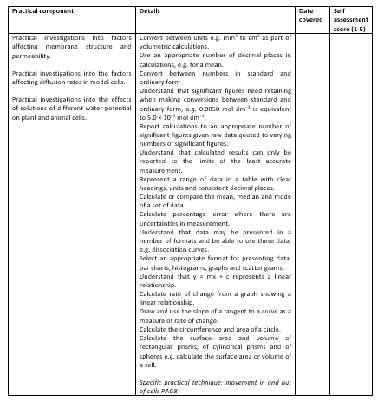
Learning Outcomes
Why does the colour leak out of cooked beetroot?
Describe how membrane structure can be investigated practically and safely carry out procedure
Explain the reasons for different steps in an experimental procedure
Apply knowledge and understanding of the experimental procedure to consider whether it will provide valid results

Slide 5
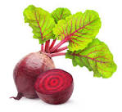
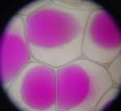
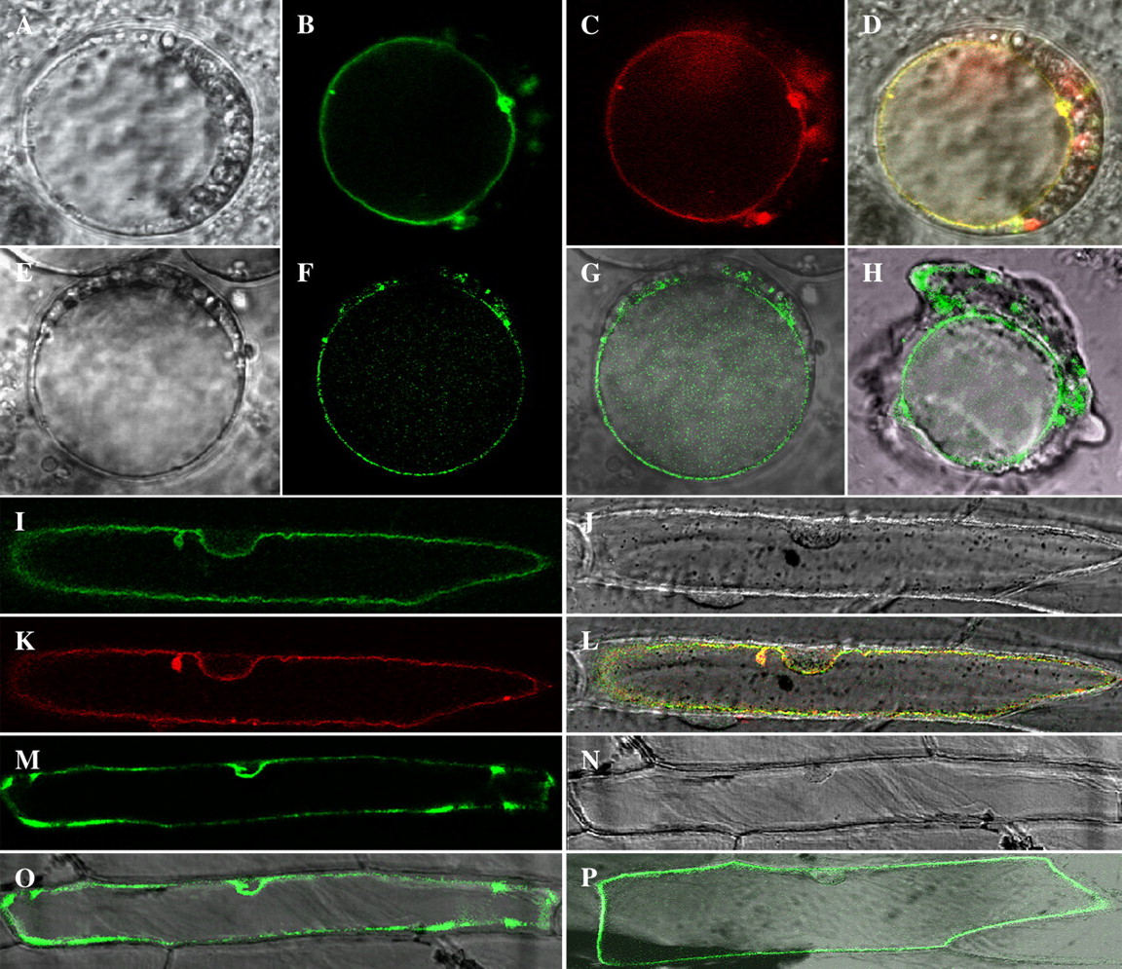
Beetroot contains a dark red pigment known as betalains.
Betalin is found in the vacuole of beetroot cell
To leave the beetroot, how many cell membranes must the pigment cross?
Two – tonoplast (vacuole membrane) and cell surface membrane (plasma membrane)

Slide 6
First…
Procedure
Take the six test tubes and label each with one of the temperatures from 20°C to 60°C.
Add 10 cm³ distilled water to each tube using the syringe.
Place the correctly labelled test tube in its corresponding water bath for 5 minutes to allow the water to equilibrate to the correct temperature. Record the actual temperature with the thermometer. Leave the tubes in the water baths.
Cut the beetroot cylinder to give six 5 mm cylinders using the knife and ruler on the white tile.
Rinse the cylinders under a running tap and pat dry using paper towel.
Add one 5 mm beetroot cylinder to a tube in each temperature and leave for 15 minutes.
Remove the tubes from the water bath, carefully swirl once and use the forceps to remove the cylinders. Throw the cylinders into a waste receptacle.
One tube at a time, carefully pour the remaining liquid into a cuvette.
Use the colorimeter to measure the absorption for each temperature and record this information in a suitably designed table. The absorption is measured in arbitrary units (AU).
Plot a graph of temperature against absorption and draw an appropriate line.
Read through steps 1-6 of the method
Complete these as quickly as possible so that the beetroot can be left to wash.
Use this format to write a risk assessment. Include at least 3 hazards
Demonstrate how to use a colorimeter we will use a green filter as we only want to measure the (absorbance, blue/green filter)
5:20 and green
Hazard | Risk | Precaution

Slide 7
Results table
This will be your X axis on the graph!
These are the results you will plot on your graph!
Water bath temperature (^{O}C) | Actual temperature in the water bath the test tube was in (^{O}C) | Absorbance of light (Au)
30
40
50
60
70

Slide 8
Tasks
DATE YOUR WORK
Complete the risk assessment on your PAG
Complete your results table on your PAG
Complete practical to collect your results (TAKE PHOTOS AS YOU GO!)
Use 440 wavelength on the colorimeter
Complete the graph (on graph paper) and upload (curved line of Best fit)
Analyse to explain the graph – 5 marks (calculate increases between values to support your answer)
8. Write a conclusion for the experiment. Are the results as you expected? Link in your biological theories here!
9. Complete the extension questions in your lab book
Notes:
Frosted side left and right – 440 wavelength

Slide 9
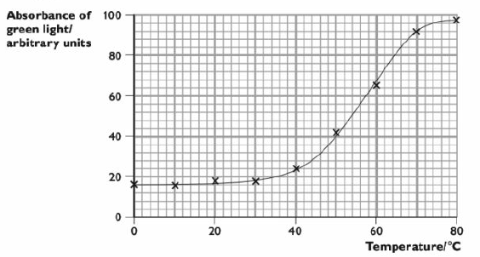
The greater the absorbance, the more red pigment had leaked out of the beetroot cells. The graph above shows her results.

Slide 10
(a) With reference to the graph, describe the effect of temperature on the absorbance of light in the colorimeter (3 marks)
(b) With reference to the structure of cell membranes, explain the effects you have described in (a) (4 marks)

Slide 11
(a) The general trend is that the higher the temperature, the greater the absorbance. Between 0 and 30°C, the absorbance increases very slightly from about 16 to 18 arbitrary units. Above 40°C it increases much more steeply, levelling off at about 70°C . The maximum absorbance is 98 arbitrary units.
*A good answer. However, although the candidate has quoted some figures from the graph, he or she has not manipulated them in any way - for example, he or she could have calculated the increase in absorbance between 0 and 30°C.3/3
(b) As temperature increases, the phospholipids and protein molecules in the membrane move about faster and with more energy. This leaves gaps in the membrane, so the beetroot pigment molecules can get through and escape from the cell. The protein molecules start to lose their shape at high temperatures because their hydrogen bonds break (denture) so the protein pores get wider which increases permeability.

Slide 12
Learning Outcomes
Why does the colour leak out of cooked beetroot?
Describe how membrane structure can be investigated practically and safely carry out procedure
Explain the reasons for different steps in an experimental procedure
Apply knowledge and understanding of the experimental procedure to consider whether it will provide valid results

Slide 13
Affect of alcohol on plasma membrane permeability
Ethanol is a non-polar solvent so it is able to dissolve non-polar substances such as lipids. This means that if you place a cell in ethanol, its membrane will become permeable and allow substances to leak into and out of the cell. As the ethanol concentration increases, membrane permeability will increase.
Exam styles questions in folder if required

