Slide 1




English Language Paper 2 – Q2: Improving Summaries
One train has five carriages. The other train has benches for people to sit on. One train crashes and the other one doesn’t.
Choosing evidence
Identifying
Summarising
Inferencing
Read the student answer to Q2 above.
What skills did they use in their answer?
How could they improve this answer?
Why does this answer not address AO2 effectively? Provide examples.
AO1
Identify and interpret explicit and implicit information and ideas
Select and synthesise evidence from different texts

Slide 2
Learning outcomes
To describe ways of improving our Q2 answers
To explain how student answers can better meet the requirements of the mark scheme
To evaluate the effectiveness of our improved Q2 answers

Slide 3
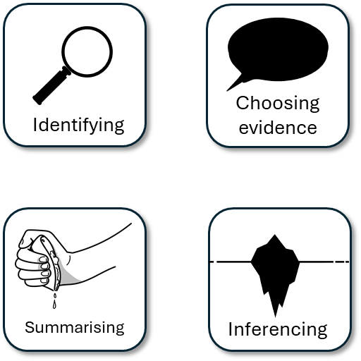


AO1
Identify and interpret explicit and implicit information and ideas
Select and synthesise evidence from different texts
This is the mark scheme that examiners use to mark Q2:
Shows perceptive or detailed synthesis and interpretation of both texts:
• makes perceptive inferences from both texts
• selects judicious references/use of textual detail relevant to the focus of the question
• statements show perceptive differences between texts.
Student’s answer
Made inferences from both texts
Included quotes or examples to support inferences and summary
Showed perceptive differences between texts

Slide 4
The student did include examples, but…
One train has five carriages. The other train has benches for people to sit on. One train crashes and the other one doesn’t.
• makes perceptive inferences from both texts
Perceptive means to notice details or things that others may not
… They didn’t make inferences, just listed facts about the two trains. The differences they found were obvious rather than perceptive.

Slide 5
The train in Source A has its windows shut for the majority of its journey owning to dust: “Her windows we might not open on account of the dust”, which suggests the journey would be unpleasant if the windows were opened. In Source B, the train is entirely open air and “and with my bonnet off, drank the air before me.” This implies that it was a pleasant experience for the writer.
This student’s answer uses similar examples but they have also made inferences. The writer doesn’t tell us that the windows were shut for most of the journey, but we infer that because he tells us the windows would not be opened because of the dust.
Similarly, this student explains that the writer’s description of the windows and the dust suggests the journey would have been unpleasant if opened, whilst in Source B the writer implies that the open air journey was pleasant for them.
Student’s answer
Made inferences from both texts
Included quotes or examples to support inferences and summary
Showed perceptive differences between texts

Slide 6

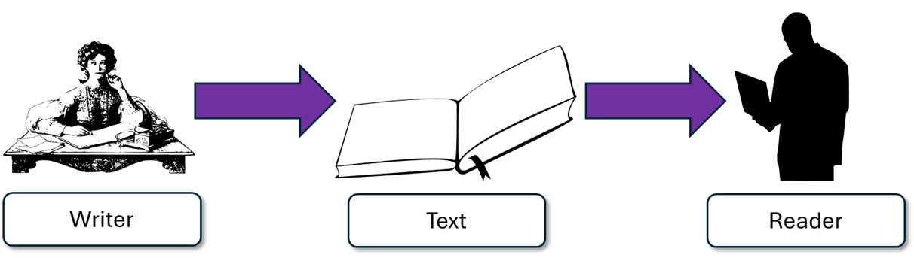
Source B: I want to convey how much I enjoyed the journey.
Although the writer doesn’t directly say they enjoyed the journey, they suggest it was pleasant because they took their bonnet off and “drank” the air, which implies that they couldn’t get enough of it.
“and with my bonnet off, drank the air before me.”

Slide 7
Let’s help this student to improve part of their answer
One train has five carriages. The other train has benches for people to sit on. One train crashes and the other one doesn’t.
Using your understanding of the Q2 mark scheme, transform this into a more effective answer.
Student’s answer
Made inferences from both texts
Included quotes or examples to support inferences and summary
Showed perceptive differences between texts

Slide 8
Let’s look at an upgraded answer
In Source A the train is designed for transporting many people, given the need for multiple sleeping carriages, as well as for long distances as passengers need rooms for sleep.
In contrast, in Source B the train is a rudimentary machine that holds only 16 people, and the facilities are limited to benches to sit on, with journeys lasting less than a day.
This student’s answer includes examples from the text that all help to support their inferences: that the Source A train carries many people and provides rooms for people to sleep, suggesting they are long journeys, whilst in Source B there are only benches to sit on and the journeys last for a short period.

Slide 9
We should also include connectives to help structure our summaries
In contrast, in Source B the train is a rudimentary machine that holds only 16 people, and the facilities are limited to benches to sit on, with journeys lasting less than a day.
In Source B the train is a rudimentary machine that holds only 16 people, and the facilities are limited to benches to sit on, with journeys lasting less than a day.
Student 1
Student 2
Discuss: What has the Student 1 included that Student 2 has not?

Slide 10
We should also include connectives to help structure our summaries
In contrast, in Source B the train is a rudimentary machine that holds only 16 people, and the facilities are limited to benches to sit on, with journeys lasting less than a day.
In Source B the train is a rudimentary machine that holds only 16 people, and the facilities are limited to benches to sit on, with journeys lasting less than a day.
Student 1
Student 2
It is a small addition, but using some connectives can help improve our summaries.

Slide 11
You must include inferences in your summary (Q2)
Remember that it is crucial that you include inferences in your summary, or you will not be able to achieve a high mark or meet the AO1 requirements for Q2.
Always think about what the writer is suggesting and picture an iceberg in your head for Q2.

Slide 12
Last lesson we wrote our own Q2 answers
Drafting and redrafting is an important activity in English because it helps you to become a more effective English analyst.
Using your learning from today and the success criteria, rewrite your answer.
Your answer for Q2
Made inferences from both texts
Included quotes or examples to support inferences and summary
Showed perceptive differences between texts
Bonus criteria:
Included connectives in your summary

Slide 13
We will now peer assess our new answers
Swap your answers with another student.
Your answer for Q2 |  | What could they add or change to improve their answer?
Made inferences from both texts
Included quotes or examples to support inferences and summary
Showed perceptive differences between texts
Bonus criteria:
Included connectives in your summary

Slide 14
Your answer for Q2 |  | What could they add or change to improve their answer?
Made inferences from both texts
Included quotes or examples to support inferences and summary
Showed perceptive differences between texts
Bonus criteria:
Included connectives in your summary
Notes:
To print out for students

Slide 15
Let’s recap Paper 2 Section A so far
Close your exercise books and cover up your notes.
What skills do you need to show for Q1? (4 marks)
What skills do you need to show for Q2? (8 marks)

Slide 16
Q1 Recap
Q1: You are given a short extract from the text.
You are given eight statements. Four of them are true, four are false.
Shade in the circles next for the four true statements.
Do not shade in more than four circles.
Identifying

Slide 17
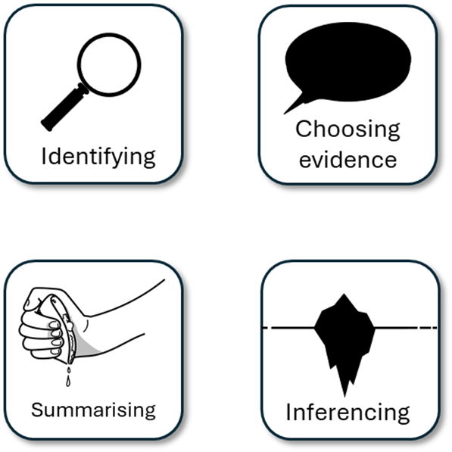
Q2 Recap
Q2: You are asked to write a summary about a key focus. In this example, it is the differences between the two trains.
You must include examples or quotes from both texts.
You must include inferences (this suggests…) about both texts.
You must only write about the information relevant to the focus given to you in Q2.
You could include connectives.

Slide 18


Plenary: Smileys
Describe what you have learnt today using smileys.
Be prepared to share your ideas.
To describe ways of improving our Q2 answers
To explain how student answers can better meet the requirements of the mark scheme
To evaluate the effectiveness of our improved Q2 answers

